Slide 1
INFOSYS SPRINGBOARD VIRTUAL INTERNSHIP 7.0
Supply Chain Visibility System with
Optimization Analytics
An individual completion report presented as an end-to-end Power BI business intelligence solution — a governed, seven-page interactive dashboard suite delivering real-time visibility into retail sales, profitability, shipping, and returns.
PREPARED BY
Pendyala Venkata Bharath
Team B, Batch-01 • Individual Milestone-4 Completion Submission
Infosys Springboard Virtual Internship 7.0 | Mentor: Ms. Nityasree

Slide 2
Project Objective
PROJECT OBJECTIVE
Establish a single, centralized source of truth for order, sales, and shipping data across procurement, inventory, and distribution.
PROJECT MODULES (7-PAGE DASHBOARD SUITE)
1
1. Executive Dashboard
Governance theory: one governed data model behind every visual removes the inconsistent-figures risk of scattered spreadsheets.
Total Sales (2.30M), Total Profit (286.41K), Total Orders, and Profit Margin (12.47%). Card visuals surface headline KPIs instantly.
2. Supply Chain Insights
Track key performance indicators such as lead time, on-time delivery rate, profit margin, and unit-level profitability.
Return Rate (5.91%) and Ship-Mode donut. Exposes the classic logistics cost-vs-service trade-off across carriers.
2
3. Product & Pricing Analysis
Normalized ratios (margin, rate) allow fair comparison across regions and time periods regardless of absolute scale.
Ranked waterfall of Profit by Sub-Category flags Tables/Furniture as loss-makers, guiding pricing correction.
4. Customer & Regional Insights
3
Identify regions, categories, discount bands, and shipping modes that contribute most to delays and losses.
Segment mix, Average Order Value, and Sales by State apply Pareto geography to purchasing power analysis.
5. Business Performance Monitoring
Pareto-style ranking surfaces the small subset of drivers responsible for most of the cost or delay.
Loss-by-Product ranking and Sum of Profit by Returned quantify exactly where margin is being destroyed.
6. Order & Unit Economics
4
Support faster, evidence-based decisions with a complete seven-page suite spanning executive, operational, and unit-economics views.
Profit and Sales per Unit normalize revenue by item sold — revealing per-unit strength hidden inside category totals.
7. Discount & Profitability Diagnostics
Cross-filtering turns static charts into a connected exploration tool for non-technical stakeholders.
Scatter of Discount vs. Profit plus Profitable/Loss-Making flags convert the suite into an order-level health check.
Supply Chain Visibility System with Optimization Analytics • Pendyala Venkata Bharath
2

Slide 3
Project Execution Milestones
01
Milestone 1 – Data Acquisition & Cleaning
02
Milestone 2 – Data Modeling
Sourced the Retail Supply Chain Sales Dataset from Kaggle and studied it field by field across five field groups (order, customer, product, performance, logistics). Removed duplicate order and shipment records, handled missing shipping/delivery dates, standardized data types and casing, and renamed fields for clarity. Theory: correctly parsed order/ship dates and de-duplication are prerequisites for every downstream KPI.
Built a star-style model with the order dataset as the central fact table and a supporting Calendar Table for time-intelligence. Defined a reusable nine-measure DAX library and delivered the first two-page dashboard: 2.30M in sales, 5,009 orders, 12.47% margin. Theory: keeping dates in their own table decouples time-intelligence from the fact table.
03
Milestone 3 – Development
04
Milestone 4 – Review & Optimization
Expanded the report to a five-page analytical suite, adding Product & Pricing Analysis, Customer & Regional Insights, and Business Performance Monitoring — all reusing the existing data model and measure library so formatting, colours, and cross-filtering stayed identical across every page.
Added nine new DAX measures and two pages — Order & Unit Economics and Discount & Profitability Diagnostics — introducing Profitable/Loss-Making order flags and Discount/Profitability bands. Validated every slicer and drill-through end-to-end and finalized the suite for stakeholder handover.
Supply Chain Visibility System with Optimization Analytics • Pendyala Venkata Bharath
3

Slide 4
Challenges & Resolutions
CHALLENGES
RESOLUTIONS
1
The raw Discount column is continuous, so the team had to agree on a clear cut-off before orders could be grouped into No-Discount / High-Discount bands.
1
Benchmarked the cut-off against the average discount already reported in Milestone 3, giving a defensible, data-grounded threshold for the Discount Band.
2
Profit per Unit and Sales per Unit risked being misread as per-order figures rather than per-unit benchmarks across the new Order & Unit Economics page.
2
Used clear card titles and matching labels across every page so unit-level and order-level metrics could never be confused by a reader.
3
Profitability Band totals (High/Medium/Low) had to reconcile exactly with the Total Profit already reported in Milestone 3 — any DAX slip would silently misstate the numbers.
3
Carefully checked the DAX logic so High/Medium/Low Profit Band totals summed back exactly to the Total Profit figure already validated in Milestone 3.
4
Region, Segment, and Ship Mode values in the raw CSV occasionally differed only in casing or spacing, risking split, near-duplicate groups on charts.
4
Standardized text formatting for every categorical column during preprocessing, before the data was loaded into the model.
5
Keeping two brand-new pages on-brand with Pages 1–5 while coordinating a six-person team within a compressed six-week schedule.
5
Reused the existing measure library and visual formatting for every new page, and split work along milestone phase boundaries with GitHub/GitLab version control.
Supply Chain Visibility System with Optimization Analytics • Pendyala Venkata Bharath
4

Slide 5
Future Enhancements & Key Insights
FUTURE ENHANCEMENTS
KEY INSIGHTS
Introduce a scheduled data refresh so the dashboard stays current automatically, rather than relying on a static CSV snapshot.
2.30M
108K
Total Sales across 5,009 orders (12.47% margin) — the baseline every efficiency ratio is judged against.
West-region profit leads East (92K), South (47K), Central (40K) — a benchmark for replicating practices.
Explore row-level security so regional managers see a filtered view of the same report without needing separate files.
79.26%
21
Build a discount-depth what-if parameter to simulate the profit impact of a proposed policy change before applying it.
Profitable Order Rate — but 20.40% of orders currently lose money, a concrete margin-recovery target.
Profit per unit for Technology — ~4x Office Supplies, ~10x Furniture, confirming strength beyond volume.
Add drill-through paths from region to state and category to sub-category directly on the Executive Dashboard.
237.68
59.77%
Profit per unit from Copiers, an order of magnitude above every other sub-category on the dashboard.
Of orders ship via Standard Class at 42 days average — the single biggest lever on delivery speed.
Segment loss-making orders into discount-driven vs. structurally-thin-margin groups, since each needs a different fix.
5.91%
Furniture
Return Rate; returned orders carry just 0.02M profit vs. 0.26M for kept orders.
Combines the deepest average discount with the weakest category profit — the clearest policy target.
Supply Chain Visibility System with Optimization Analytics • Pendyala Venkata Bharath
5

Slide 6
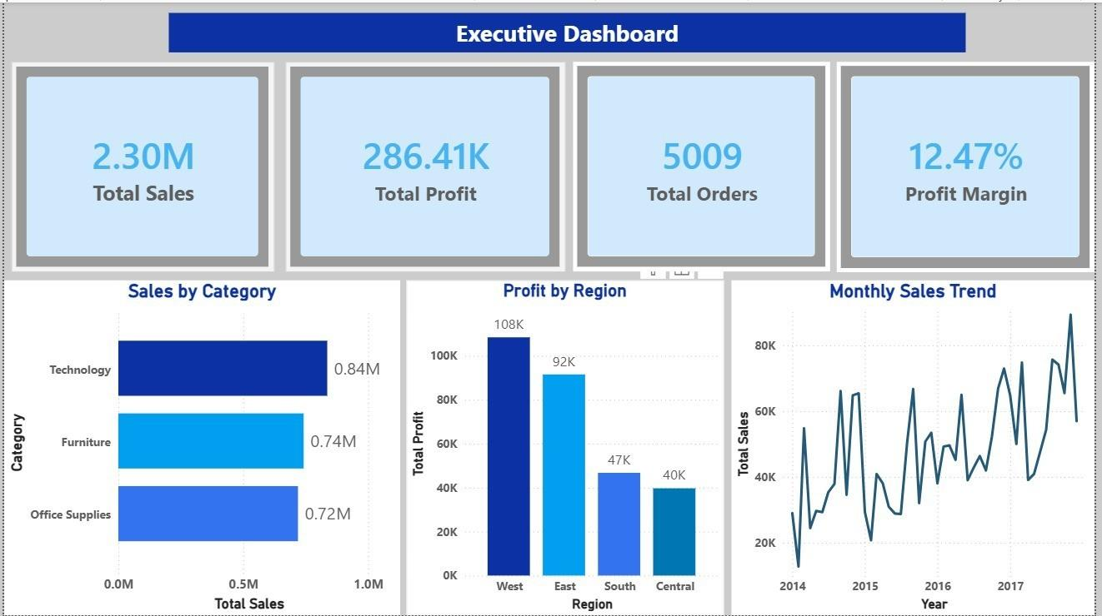
MILESTONE-2 · HEADLINE KPIS
Dashboard Page 1 — Executive Dashboard
KEY INSIGHTS
Total Sales reach 2.30M across 5,009 orders, with Total Profit of 286.41K and a blended Profit Margin of 12.47% — the baseline every other ratio on the suite is judged against.
Technology leads Sales by Category at 0.84M, ahead of Furniture (0.74M) and Office Supplies (0.72M) — a Pareto-style view that informs inventory prioritization.
West region leads Profit by Region at 108K, ahead of East (92K), South (47K), and Central (40K) — the operating practices behind this are worth studying and replicating.
Monthly Sales Trend spans 2014–2017 and exposes a clear upward growth trajectory alongside month-over-month seasonality.
Figure 3 · Power BI Desktop screenshot, exported from the working report file
Supply Chain Visibility System with Optimization Analytics • Pendyala Venkata Bharath
6

Slide 7
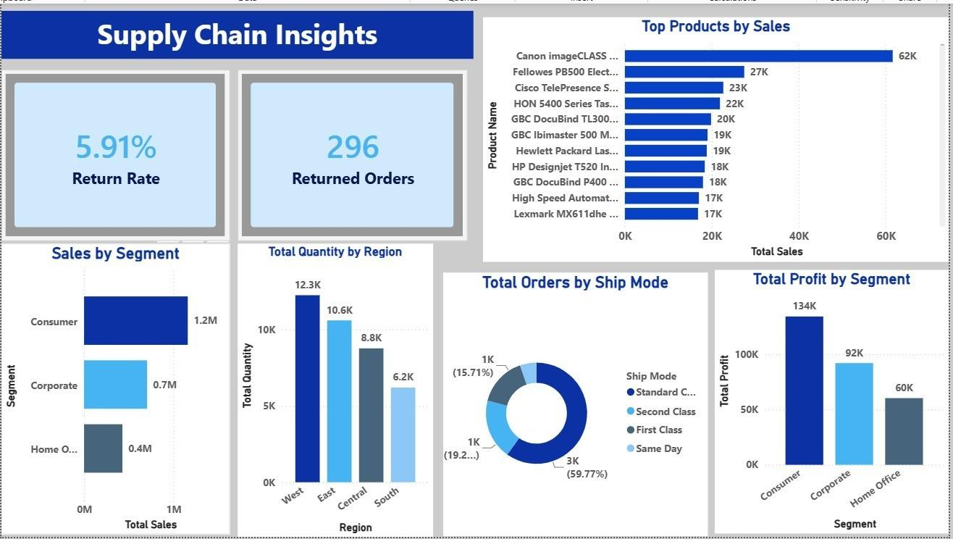
MILESTONE-2 · RETURNS & LOGISTICS
Dashboard Page 2 — Supply Chain Insights
KEY INSIGHTS
Return Rate sits at a healthy 5.91% across 296 returned orders out of 5,009 total — a clear baseline to track in future reporting periods.
Consumer segment dominates Sales by Segment at 1.2M, ahead of Corporate (0.7M) and Home Office (0.4M), and also leads Total Profit by Segment at 134K.
Standard Class dominates shipping at 59.77% of all orders on the Ship Mode donut — dwarfing Second Class (15.71%), First Class, and Same Day combined.
Canon imageCLASS line tops Top Products by Sales at 62K, heading a ranked list used for merchandising and stock decisions.
Figure 4 · Power BI Desktop screenshot, exported from the working report file
Supply Chain Visibility System with Optimization Analytics • Pendyala Venkata Bharath
7

Slide 8
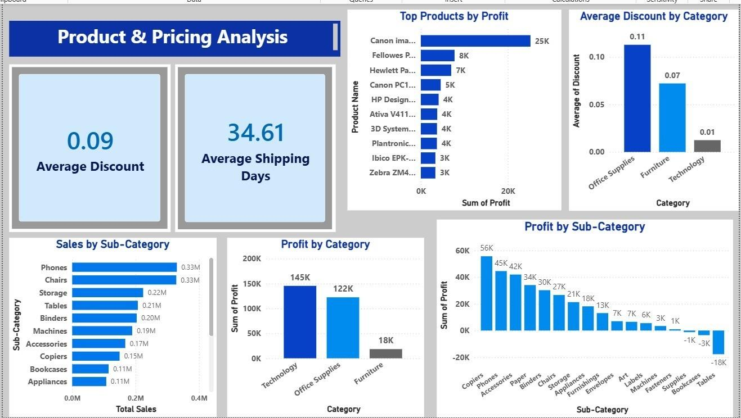
MILESTONE-3 · PRICING DIAGNOSTICS
Dashboard Page 3 — Product & Pricing Analysis
KEY INSIGHTS
Average Discount runs at 0.09 with Average Shipping Days at 34.61 — two headline pricing and service-level KPIs tracked together.
Office Supplies is discounted most heavily at 0.11 average discount, followed by Furniture (0.07); Technology is discounted least at 0.01.
Technology and Office Supplies stay strongly profitable at 145K and 122K profit respectively, while Furniture trails at a comparatively weak 18K.
Tables is the single biggest loss-maker at -18K on the ranked Profit by Sub-Category waterfall — the most actionable view for pricing correction.
Figure 5 · Power BI Desktop screenshot, exported from the working report file
Supply Chain Visibility System with Optimization Analytics • Pendyala Venkata Bharath
8

Slide 9
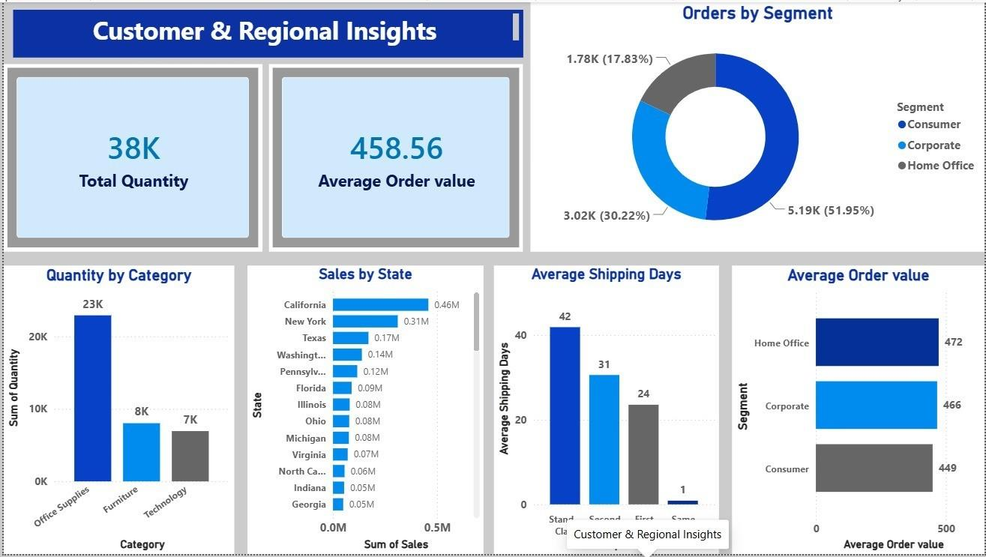
MILESTONE-3 · CUSTOMER & GEOGRAPHY
Dashboard Page 4 — Customer & Regional Insights
KEY INSIGHTS
Total Quantity reaches 38K units with an Average Order Value of 458.56 — revealing whether upsell and cross-sell activity increases basket size.
Consumer accounts for 51.95% of orders on the segment donut, ahead of Corporate (30.22%) and Home Office (17.83%).
California (0.46M) and New York (0.31M) anchor Sales by State, applying the Pareto principle geographically across the retail footprint.
Same Day ships in ~1 day vs. 42 for Standard Class and Home Office carries the highest Average Order Value by Segment at 472.
Figure 6 · Power BI Desktop screenshot, exported from the working report file
Supply Chain Visibility System with Optimization Analytics • Pendyala Venkata Bharath
9

Slide 10
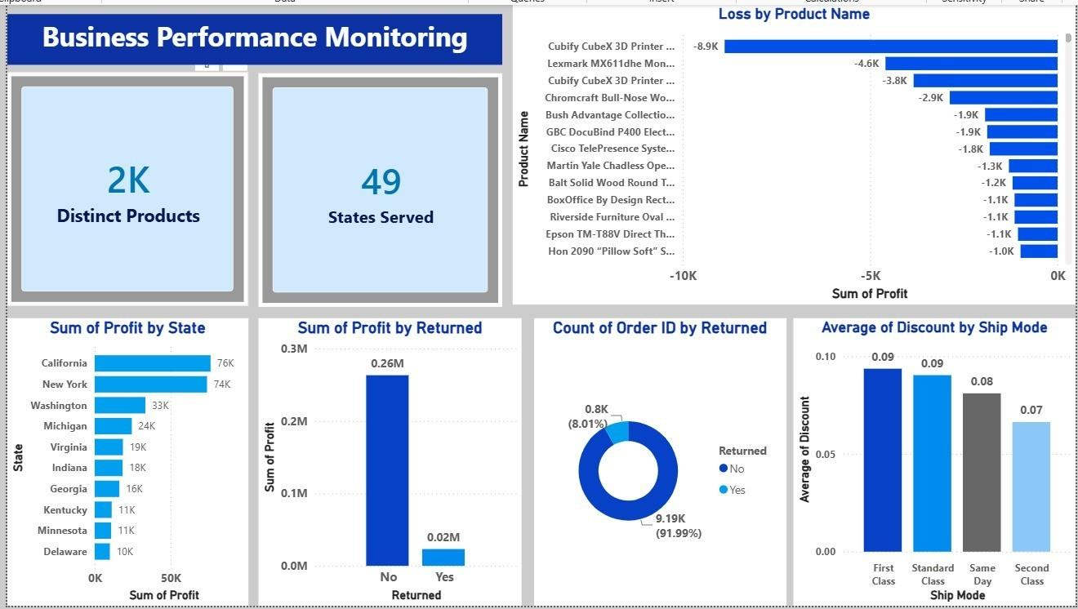
MILESTONE-3 · PRODUCT & RETURN RISK
Dashboard Page 5 — Business Performance Monitoring
KEY INSIGHTS
Distinct Products span 2K SKUs served across 49 States — headline KPIs reflecting the breadth and reach of the product catalogue.
Cubify CubeX 3D Printer is the top loss-maker at -8.9K on the Loss by Product Name ranking, the clearest single product-level red flag on the dashboard.
California (76K) and New York (74K) lead Sum of Profit by State, reinforcing the same geographic strength seen on the regional insights page.
Returned orders carry only 0.02M in profit versus 0.26M for kept orders — returns are concentrated in low-margin transactions, not spread evenly.
Figure 7 · Power BI Desktop screenshot, exported from the working report file
Supply Chain Visibility System with Optimization Analytics • Pendyala Venkata Bharath
10

Slide 11
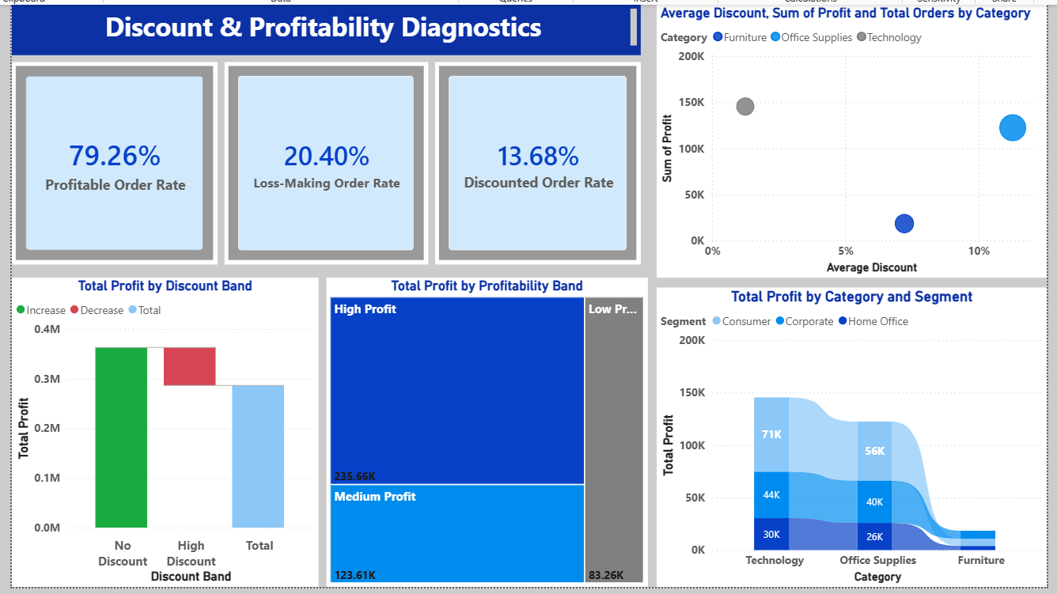
MILESTONE-4 · ORDER-LEVEL HEALTH CHECK
Dashboard Page 6 — Discount & Profitability Diagnostics
KEY INSIGHTS
Profitable Order Rate stands at 79.26% against a Loss-Making Order Rate of 20.40% — one order in five is currently unprofitable.
Discounted Order Rate is just 13.68% meaning discounting alone does not explain every loss-making order — some lose money even undiscounted.
Technology sits low-discount / high-profit while Furniture sits higher-discount / lower-profit on the scatter view by category.
Technology–Consumer (71K) and Office Supplies–Consumer (56K) are the two largest profit combinations on the category-and-segment ribbon chart.
Figure 8 · Power BI Desktop screenshot, exported from the working report file
Supply Chain Visibility System with Optimization Analytics • Pendyala Venkata Bharath
11

Slide 12
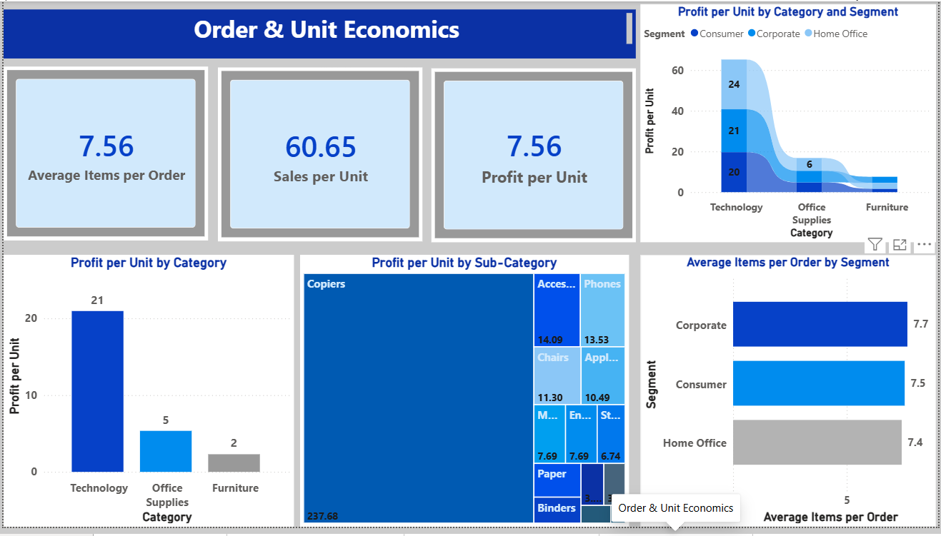
MILESTONE-4 · UNIT-LEVEL PROFITABILITY
Dashboard Page 7 — Order & Unit Economics
KEY INSIGHTS
Average Items per Order is 7.56 with Sales per Unit at 60.65 and Profit per Unit at 7.56 — normalizing revenue by item rather than by order.
Technology leads Profit per Unit at 21 roughly 4x Office Supplies (5) and 10x Furniture (2) — confirming its strength holds beyond raw volume.
Copiers stand out at 237.68 profit per unit an order of magnitude above every other sub-category — the clearest candidate for continued stock priority.
Basket sizes stay similar across segments Corporate (7.7), Consumer (7.5), Home Office (7.4) — revenue differences come from price and mix, not basket size.
Figure 9 · Power BI Desktop screenshot, exported from the working report file
Supply Chain Visibility System with Optimization Analytics • Pendyala Venkata Bharath
12

Slide 13
Conclusion
Supply Chain Visibility & Optimization — across four connected milestones I transformed a raw, scattered Kaggle CSV export into a governed, seven-page interactive Power BI dashboard suite, giving supply chain and sales stakeholders one trustworthy source of truth for decision-making.
TECHNICAL SKILLS
SOFT SKILLS
•
Power BI Desktop, Power Query & Star-Schema Data Modeling
Problem Solving
Communication
Teamwork
Presentation
•
DAX Measure Design — sums, ratios & FILTER/COUNTROWS order-level logic
•
Data Cleaning & Cross-Filtered / Drill-Through Dashboard Design
KEY LEARNINGS
•
Visual-Type Selection Matched to the Business Question
Analytical: a strong regional or category total is never trustworthy until checked at the next level of granularity — the discipline that surfaced West-region variation by state.
•
Version Control & Team Workflow via GitHub, GitLab, Microsoft Teams
Domain: understanding what “ship mode” and “discount band” mean in a retail operation made it easy to judge whether a visual answered a real business question.
Documentation: writing KPI theory alongside the build — not after — caught measure-definition inconsistencies early.
Supply Chain Visibility System with Optimization Analytics • Pendyala Venkata Bharath
13

Slide 14
Acknowledgements & References
ACKNOWLEDGEMENTS
REFERENCES
Infosys Springboard Team
Retail Supply Chain Sales Dataset
For organizing a structured, industry-aligned virtual internship programme with a milestone-based framework.
Sourced via Kaggle — the public order, customer, product, and logistics data used throughout the project.
Ms. Nityasree, Mentor
Microsoft Power BI Documentation
For consistent guidance, valuable feedback, and continuous encouragement throughout every milestone review.
Official documentation and community resources referenced for DAX syntax and dashboard design patterns.
Team B — Manoj, Narayana, P. Shreesha, Prajwal & Priyanshi
Infosys Springboard Training Materials
For strong collaboration, accountability, and shared commitment across the six-week build.
Virtual Internship 7.0 course modules, milestone guidelines, and mentor review notes.
Kaggle & the Power BI Community
For the public dataset and documentation resources that made hands-on, real-world practice possible.
Supply Chain Visibility System with Optimization Analytics • Pendyala Venkata Bharath
14

Slide 15
THANK YOU
Supply Chain Visibility System with Optimization Analytics • Pendyala Venkata Bharath
Infosys Springboard Virtual Internship 7.0 | Mentor: Ms. Nityasree

