Slide 1
Agenda
To concisely explain FIS’s investment philosophy and processes
To set out where we believe that FIS can add value
To answer your queries about FIS

Slide 2
Investment Philosophy
FIS’s investment philosophy has three key elements:
Growth
Business Momentum
Consistency

Slide 3
Investment Philosophy - Growth
Belief
The key long-term driver of a company’s stock price is normally the growth in its EPS
Evidence
Empiric observation - the growth/value debate
Behavioural influences - loss aversion
Our Philosophy
We seek to invest in companies which we expect to sustain growth that is above average

Slide 4
Investment Philosophy - Business Momentum
Belief
Market participants are generally slow to incorporate new information into their expectations
Evidence
Earnings revisions and surprises are serially correlated and predictive
Behavioural influences - anchoring
Our Philosophy
We seek to invest in stocks where the outlook for the business is improving

Slide 5
Investment Philosophy - Consistency
Belief
Stocks with relatively consistent earnings are likely to outperform in times of economic distress
Market participants can be over-optimistic in their EPS expectations for stocks with high earnings variability
Evidence
The Asian experience
Behavioural influences
Our Philosophy
We seek to invest in stocks which we expect to show above average consistency in the progression of EPS

Slide 6
Investment Philosophy - Summary
Clearly defined views on how markets work and a consistent view across global equity teams creates a solid platform for the investment process
Constant revalidation of philosophy
A philosophy well suited to a low inflation environment where pricing power is scarce

Slide 7
Investment Process - Key Elements
Consistent process across regional equity teams
Database analysis to focus primary research
Disciplined and coherent stock rating system
Decision making structure allows strong debate with focused accountability
Risk analysis

Slide 8
Database Analysis
Historic and prospective earnings
growth
Earnings estimate revisions and surprises
Focuses detailed research
Database
Analysis
Market
Awareness
Stocks Selected for
Detailed Analysis
Research and
Analysis
Stock Decisions
Risk Analysis
Portfolios
Review Group
Performance
Review

Slide 9
Company Research - Growth
Database
Analysis
Market
Awareness
Industry outlook
Strength of company’s competitive
position
How will EPS growth be sustained
above average
Management assessment
Will market expectations
be exceeded?
Stocks Selected for
Detailed Analysis
Research and
Analysis
Stock Decisions
Risk Analysis
Portfolios
Review Group
Performance
Review

Slide 10
Company Research - Business Momentum
Database
Analysis
Market
Awareness
How is the structure of the industry changing?
Is the return on invested capital
stable or rising?
Is the company seeing relative positive revisions to EPS?
Stocks Selected for
Detailed Analysis
Research and
Analysis
Stock Decisions
Risk Analysis
Portfolios
Review Group
Performance
Review

Slide 11
Company Research - Consistency
Database
Analysis
Market
Awareness
Forward looking
Economic sensitivity
Does company have pricing power?
Visibility of earnings
Stocks Selected for
Detailed Analysis
Research and
Analysis
Stock Decisions
Risk Analysis
Portfolios
Review Group
Performance
Review

Slide 12
Output from Research
Database
Analysis
Market
Awareness
Stored on our CoRes stock database
Disciplined and coherent framework for the analysis of stocks
Focus on style fit and the balance of risk to market expectations
Stocks Selected for
Detailed Analysis
Research and
Analysis
Stock Decisions
Risk Analysis
Portfolios
Review Group
Performance
Review

Slide 13
Buy and Sell Decisions
Database
Analysis
Market
Awareness
Decisions driven primarily by
change in future profit expectations
Changes in prospects for key markets/products
Changes in management/strategy
Changes in the macroeconomic environment
Substantial earnings estimate revisions or surprises
Stocks Selected for
Detailed Analysis
Research and
Analysis
Stock Decisions
Risk Analysis
Portfolios
Review Group
Performance
Review

Slide 14
Buy and Sell Decisions - Role of Valuation
Database
Analysis
Market
Awareness
Not normally the main driver of decisions
Valuation is a key indicator of long-term market expectations
Valuation of growth stocks related to bond yields
Stocks Selected for
Detailed Analysis
Research and
Analysis
Stock Decisions
Risk Analysis
Portfolios
Review Group
Performance
Review

Slide 15
UK Equity - Portfolio Construction
Database
Analysis
Market
Awareness
Bottom up approach
Two large cap model portfolios
Required 90% minimum overlap with relevant model
Pooled vehicle normally used for smaller companies
Stocks Selected for
Detailed Analysis
Research and
Analysis
Stock Decisions
Risk Analysis
Portfolios
Review Group
Performance
Review

Slide 16
Equities - Risk Analysis
Database
Analysis
Market
Awareness
Tracking Error - BARRA
Stock risk
Sector risk
Style risk
Internal stock categories
Stocks Selected for
Detailed Analysis
Research and
Analysis
Stock Decisions
Risk Analysis
Portfolios
Review Group
Performance
Review

Slide 17
UK Equities - Portfolio Controls
Database
Analysis
Market
Awareness
Stock load difference
  above 2%, desk head approval
  above 4%, CIO approval
Sector load difference
  above 5%, desk head approval
  above 10%, CIO approval
Stocks Selected for
Detailed Analysis
Research and
Analysis
Stock Decisions
Risk Analysis
Portfolios
Review Group
Performance
Review

Slide 18
Performance Monitoring and Review
Database
Analysis
Market
Awareness
Focus on longer-term performance history
Understanding nature of past performance
Use of BARRA performance attribution
Quarterly Review Groups
Stocks Selected for
Detailed Analysis
Research and
Analysis
Stock Decisions
Risk Analysis
Portfolios
Review Group
Performance Review

Slide 19
Appendices

Slide 20
Pan European Research
Steve Artingstall Pharmaceuticals
Chemicals
Jacqui Bosher Transport
Banks
Restaurants, pubs & brewers
Debbie Clarke Health
Packaging
Liz Feinstein Food products
Investment companies
Forestry & paper
Autos
Steel & other metals
Nick Hawken Insurance
Life assurance
Engineering
Jamie Hooper Banks
Leisure, entertainment & hotels
Garry Leon Oil & gas
Electronic & electrical
Gas distribution
Water
Marc Inzani Business support services
Tobacco
Personal care & household products
Speciality & other financial
Extractive industries
Property
Household goods & textiles
Russell Martin Telecomms
Electricity
Diversified industrials
David Moss General retailers
Insurance
Life Assurance
Beverages
Food & drug retailers
Ian Peart Distributors
Aerospace & Defence
Meena Shah Media
Construction & building materials

Slide 21
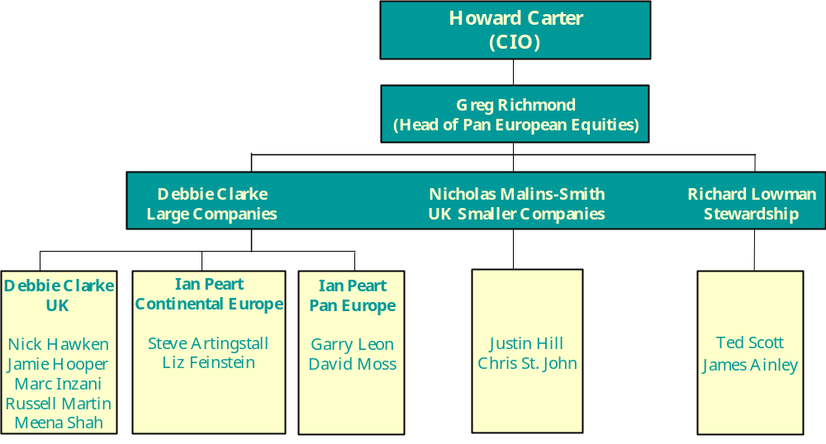
Pan European Portfolio Management

Slide 22
Friends Ivory
& Sime plc
Investment Philosophy
and Process
October 1999
15 Old Bailey
London
EC4M 7EF
Tel: 0171 506 1100
Fax: 0171 236 2060
Friends Ivory & Sime plc is a member of the Friends Provident Group and is regulated by IMRO.
All sources Friends Ivory & Sime plc unless otherwise stated.

