Slide 1

Reinforcement Learning: Training Deep Q Networks for Game Environments
Pranav Vishal Deshmukh (230102073)
Mir Maiti (230102057)
Chandan Das (230102021)

Slide 2
Flow of presentation
Introduction
What is Reinforcement Learning
Q-Learning and Deep Q Networks
Description of RL Environment
Methodology
Key challenges in Reinforcement Learning
Metric Plots and Code Snippets
Conclusions and Future Work

Slide 3
ABSTRACT
This course project presents the development of a reinforcement learning agent for playing the Cartpole and the Lunar Landing Game using Reinforcement Learning(RL). The agent is trained using Deep Q-Networks (DQN), which efficiently combines Neural Networks with Q-learning (A famous reinforcement learning strategies). Experimental results show that the agent learns to perform significantly well. It can also achieve scores comparable to the human-level expertise. We discuss model architecture, hyperparameter tuning, and the reward system that enables the agent’s learning process. Our results demonstrate the viability of Reinforcement Learning approaches in learning gaming strategies.

Slide 4
Introduction
Reinforcement Learning in Games
Role of Deep Learning in Q-Learning
Description of Environments for training the agents

Slide 5
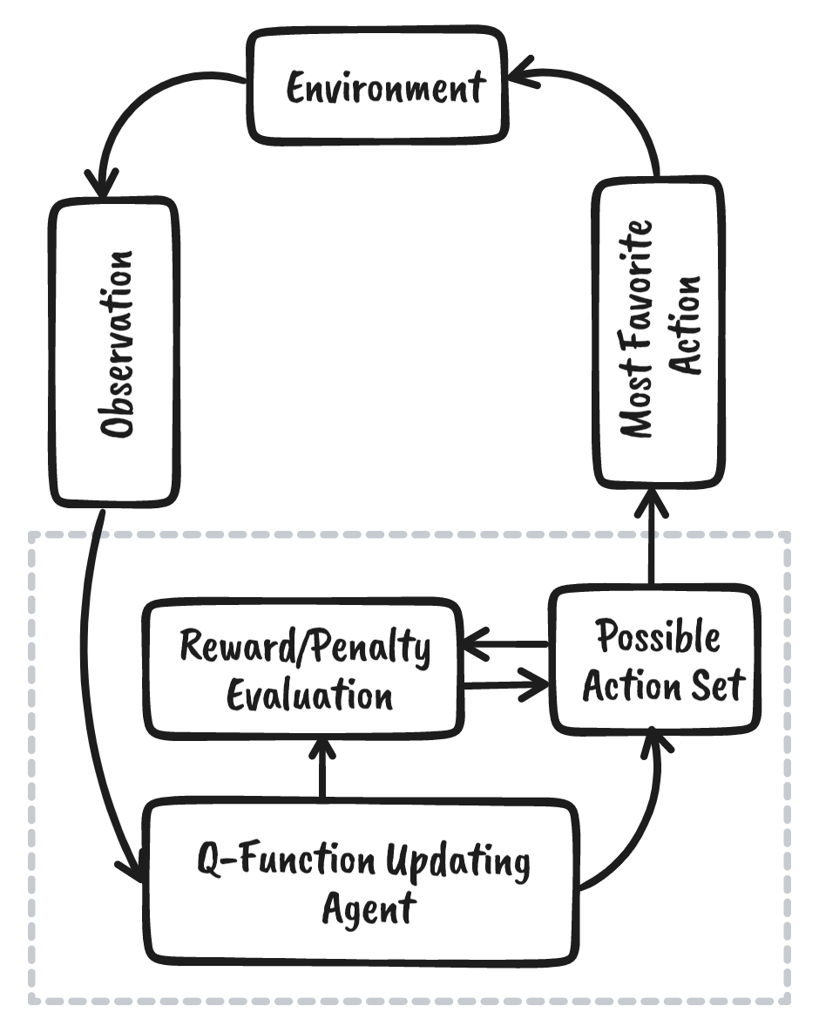
Reinforcement learning
Reinforcement learning (RL) is a branch of machine
learning focused on training agents to make sequential
decisions by interacting with an environment to
maximize cumulative rewards. This branch focuses on trial and error much like how we as humans learn from our environment rather than giving fixed set of instructions such as in the case of supervised learning. This paradigm has found success in gaming, robotics(robots can learn by interaction with environment as we cannot train them on all possible real scenarios), and autonomous systems, where agents learn optimal policies without explicit supervision. Games have proven to be a highly effective benchmark for testing RL algorithms, providing structured yet challenging environments where an agent’s ability to learn and adapt can be rigorously evaluated

Slide 6

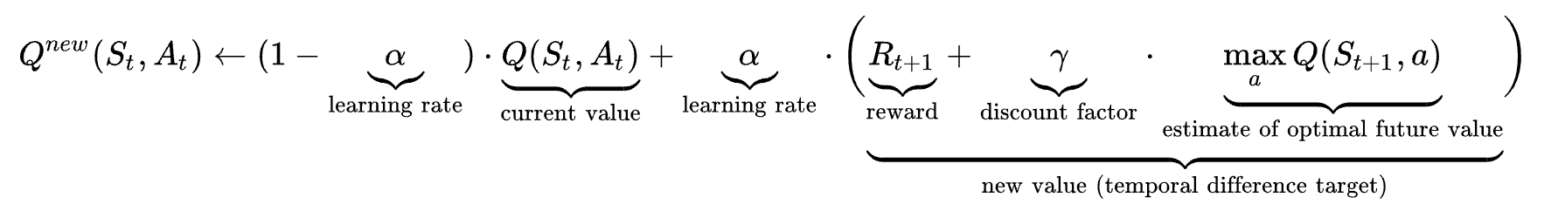
Q-Learning Algorithm
Learning rate
The learning rate or step size determines to what extent newly acquired information overrides old information. A factor of 0 makes the agent learn nothing (exclusively exploiting prior knowledge), while a factor of 1 makes the agent consider only the most recent information (ignoring prior knowledge to explore possibilities).
Discount Factor
The discount factor, denoted as gamma, determines how much importance an agent places on future rewards. If gamma is set to 0, the agent becomes "myopic" or short-sighted, only valuing immediate rewards, rt​. As gamma approaches 1, the agent increasingly prioritizes long-term rewards, aiming to maximize future gains.
Initial Conditions
Since Q-learning is an iterative algorithm, it implicitly assumes an initial condition before the first update occurs. High initial values, known as "optimistic initial conditions," can promote exploration: regardless of the selected action, the update rule will reduce its value, increasing the probability of choosing other actions. The first reward can be used to reset the initial conditions. According to this approach, the first time an action is taken, the reward is used to set the Q value, enabling immediate learning when rewards are fixed and deterministic.

Slide 7
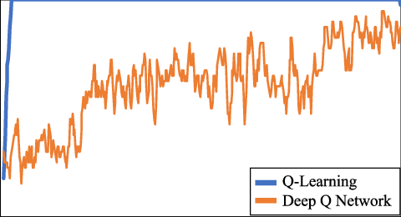
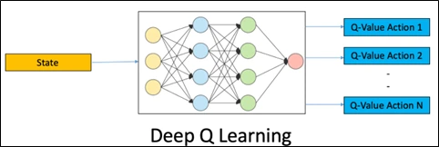
DEEP Learning in Q – Learning Algorithms
A DQN, or Deep Q-Network, approximates a state-value function in a Q-Learning framework with a neural network. In the Atari Games case, they take in several frames of the game as an input and output state values for each action as an output.

Slide 8
Description of the game environments
Cart Pole and Lunar Lander
The Cart Pole environment, a classic reinforcement learning challenge, requires an agent to balance a pole on
a moving cart by learning control strategies. Although relatively simple compared to full Atari games, Cart Pole
offers insightful challenges for evaluating the learning performance of RL models, as it requires balancing immediate and delayed rewards, maintaining stability, and optimizing control in a dynamic environment.
The Lunar Lander problem in OpenAI’s Gym is a classic reinforcement learning (RL) task where the objective is to land a lunar module smoothly on a landing pad. This problem is more complex than Cart Pole and is a good
candidate for advanced algorithms like Deep Q-Networks(DQN)
Cart Pole: Objectives & Rewards
Objective: Keep the pole balanced on the cart for as long as possible.
Rewards:
+1 for each time step the pole remains upright.
Episode ends if the pole falls or the cart moves out of bounds.
Goal: Maximize total reward by balancing the pole over a longer duration.
Lunar Lander: Objectives & Rewards
Objective: Safely land the spacecraft between the landing flags.
Rewards:
Positive reward for landing successfully.
Negative reward for crashing or using excessive fuel.
Shaped rewards for moving closer to the landing pad and reducing speed.
Goal: Maximize total reward by executing a smooth, controlled landing.

Slide 9
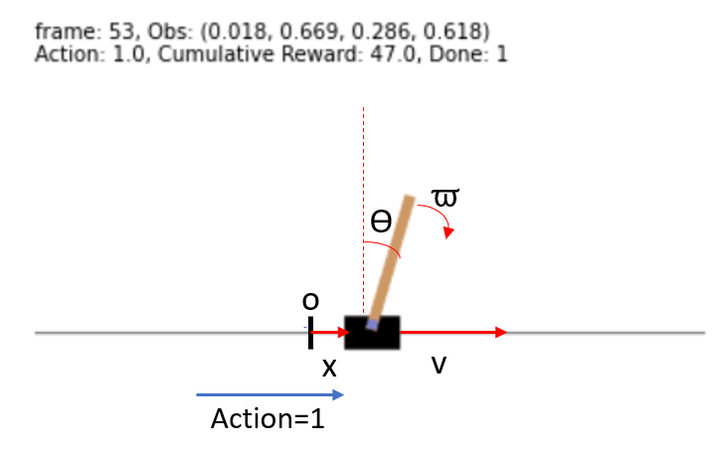
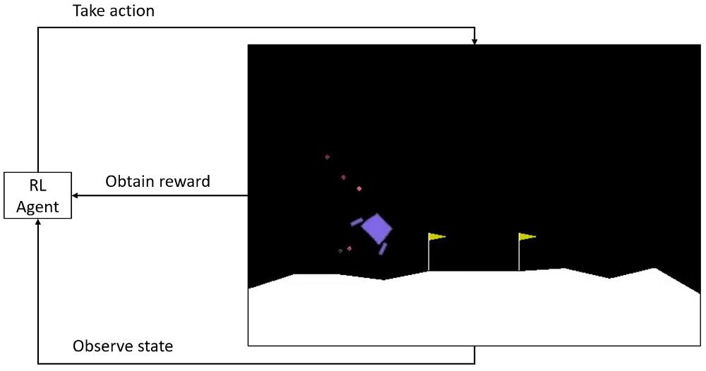
Cart Pole and Lunar Lander

Slide 10

Methodology
Implementing the DQN network in the respective environments
Defining the DQN Components
Experience Replay Buffer:
Stores experiences (state, action, reward, next_state, done)
Facilitates learning from past experiences and reduces correlations by sampling random mini-batches.
Q-Network:
A neural network that takes the current state as input and outputs Q-values for each possible action.
Target Network:
A separate network updated periodically to the Q-network's weights.
Helps stabilize training by reducing oscillations.
Action Selection Policy (Epsilon-Greedy):
Encourages exploration by choosing random actions with a decaying probability epsilon(ϵ).
Gradually shifts focus to exploiting learned strategies over time.

Slide 11
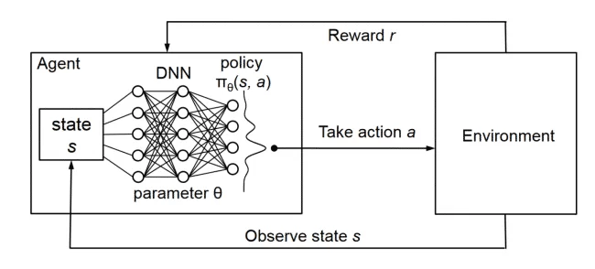
Implementing the DQN Model
Initialize Environment & Hyperparameters
Key Parameters: Learning rate, discount factor, epsilon decay, batch size, episodes.
Replay Memory
Stores experiences (state, action, reward, next_state, done) to sample batches and break correlation between consecutive experiences.
DQN Neural Network
Architecture: 3-layer fully connected network.
Input: State of the environment.
Output: Predicted Q-values for each action.
Experience Replay Buffer
Implementation: Deque stores a fixed number of experiences, older ones are removed.
Epsilon-Greedy Strategy
Selects actions with epsilon-greedy approach: random action with probability epsilon, otherwise action with highest Q-value.
DQN Training Loop
Process:
Store experience.
Sample mini-batch.
Compute Q-targets: Q_Target = reward + gamma * max(Q_Next) * (1 - done).
Backpropagate loss: MSE between Q-values and Q-targets.
Target Network Update
Periodic update: Copy Q-network weights to target network every few episodes.

Slide 12

CHALLENGES FACED BY US
Training Time increases by a lot as the game complexity increases, even with the use of GPU’s
When changing Hyper parameters, model scores were fluctuating to a great extent.

Slide 13
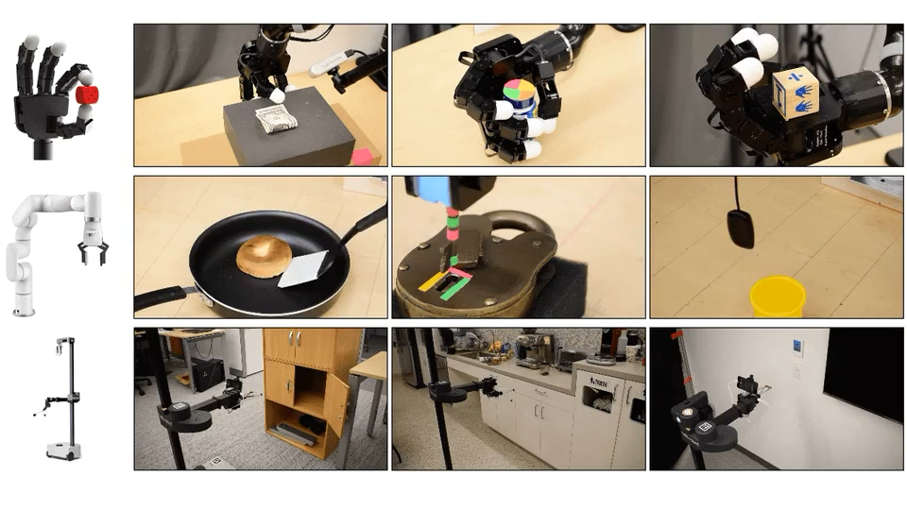
Key challenges in reinforcement learning
Balancing Exploration vs. Exploitation
Exploration: The agent must try new actions to discover which yield the best long-term rewards.
Exploitation: The agent uses the knowledge it has already gained to maximize its immediate reward.
Challenge: Finding the right balance is crucial. Too much exploration may delay optimal performance, while too much exploitation may prevent discovering better strategies.
Sensitivity to Hyperparameter Tuning
Learning Rate: Controls how much the model adjusts with each update. Too high can lead to instability, while too low slows down learning.
Discount Factor (gamma(γ)): Determines the importance of future rewards. Maladjustment can make the agent too short-sighted or overly concerned with distant outcomes.
Exploration Decay (Epsilon Decay in Epsilon-Greedy): Controls how quickly the agent shifts from exploration to exploitation. Incorrect decay rates can either slow down learning or prevent the agent from sufficiently exploring the environment.
Challenge: Hyperparameters must be carefully fine-tuned to achieve stable and efficient learning, often through extensive experimentation.
Imitation from One Minute of Demonstrations

Slide 14
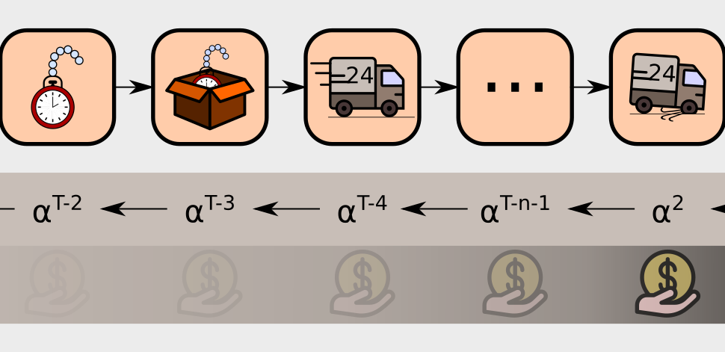
Sparse and delayed rewards
Handling Sparse or Delayed Rewards
Sparse Rewards: In many RL environments, rewards are not given at every step, making it hard for the agent to learn effective strategies.
Delayed Rewards: Some rewards are only given after a series of actions, which complicates the credit assignment problem (determining which actions led to the reward).
Example: In Lunar Lander, rewards may be sparse, with the most significant feedback occurring only upon landing or crashing.

Slide 15
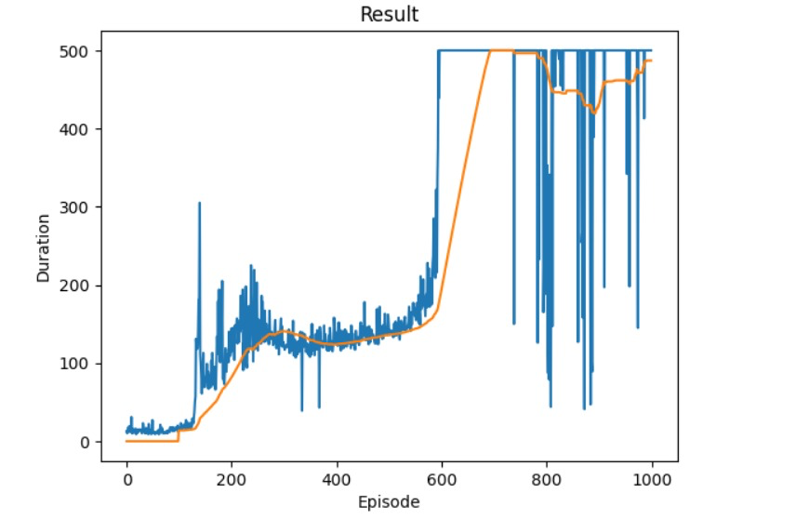
Metric Plots
Cartpole

Slide 16
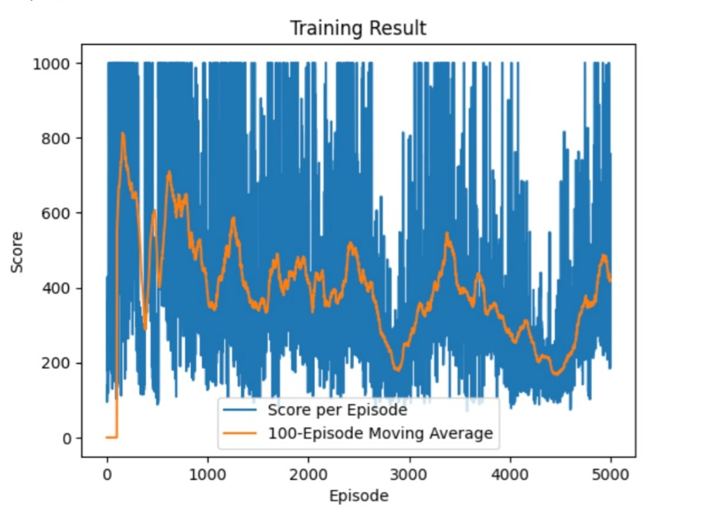
Metric plots
LUNAR LANDER

Slide 17


CONCLUSIONS AND FUTURE WORK

Slide 18
These results demonstrate the effectiveness of DQN based approaches in environments with discrete action spaces. The techniques developed here could be extended to robotic control tasks, where balancing stability or safe navigation is critical, or adapted to scenarios where smooth landings are required, such as drone or spacecraft descent.
Future work could explore the use of prioritized experience replay to focus the agent’s learning on transitions with higher impact, potentially accelerating training in environments like Lunar Lander. Additionally, applying PPO(Proximal policy optimization) or SAC(Soft Actor Critic) could yield further improvements in the stability and handling of continuous actions, making these methods promising candidates for more complex control tasks.

Slide 19
Thank you

