Slide 1
CmadBlog
Praveen Vedha & Aswin Kuppusami
Cisco modern Application Development program
Sunday, March 05, 2017

Slide 2
Features
Microservices approach (User and Blog app)
Continuous Integration and Continuous deployment
Feature rich user interface
Create and View Blog posts, comment on them
Interact with other users on a live Chat window
Maintain a favorite list of posts
Browse and Search posts by category, text and tag
MD5 Token based user sessions
Integration with cisco applications

Slide 3
Technology
Oracle DB integration with JPA and OJDBC (Blog app microservice)
Mongo DB integration (user microservice)
HTML5, JS, CSS3, Jquery/AJAX, Angular JS front-end
Java based controller with REST APIs, using JAX-RS
Testing with Postman, HTML UI and Junit
MVC Design Pattern & Separate objects for system (DAO) and user (DTO)
Github, Maven for repository and library management
Apache Tomcat, Sonarqube and Jfrog Artifactory integrated.
Deployed in a docker container inside a google compute engine.
Continuous integration and deployment using Jenkins.
Google cloud platform for the application and Amazon web services for the database.
Integration with cisco applications (spark and jabber plugins)

Slide 4
Software Architecture
HTML5 | JavaScript | CSS3 | JQuery | Angular JS | Ajax
JAX/RS
REST
Authentication Layer
J A V A
Business Layer
(JPA) Persistence Layer
JPA
JDBC
Oracle DB
Mongo DB

Slide 5
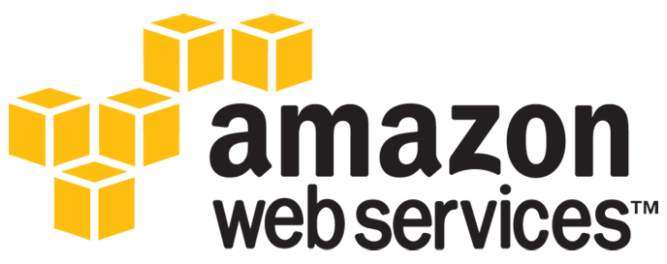
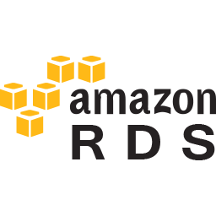



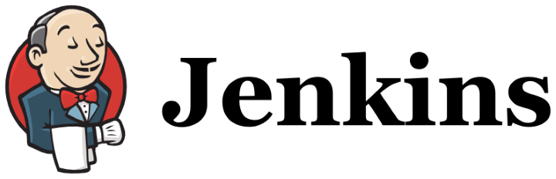
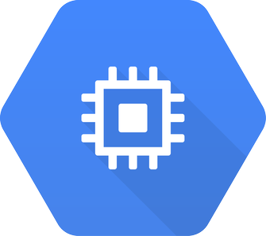


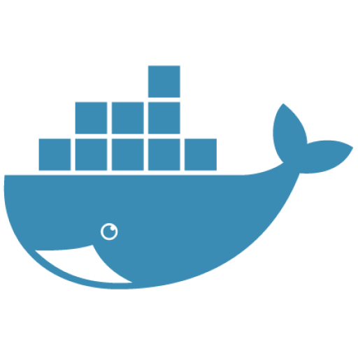

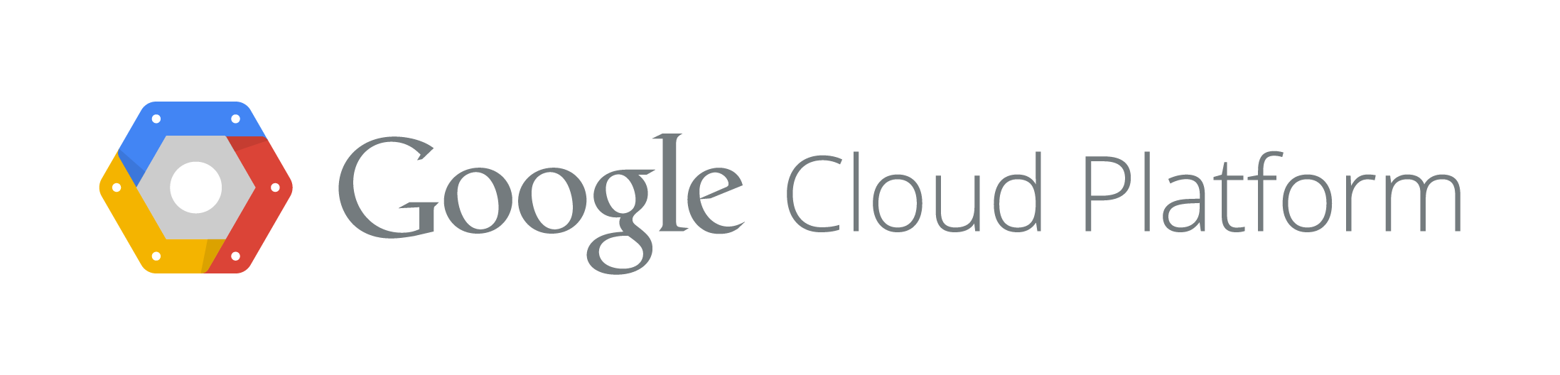
Architecture

Slide 6
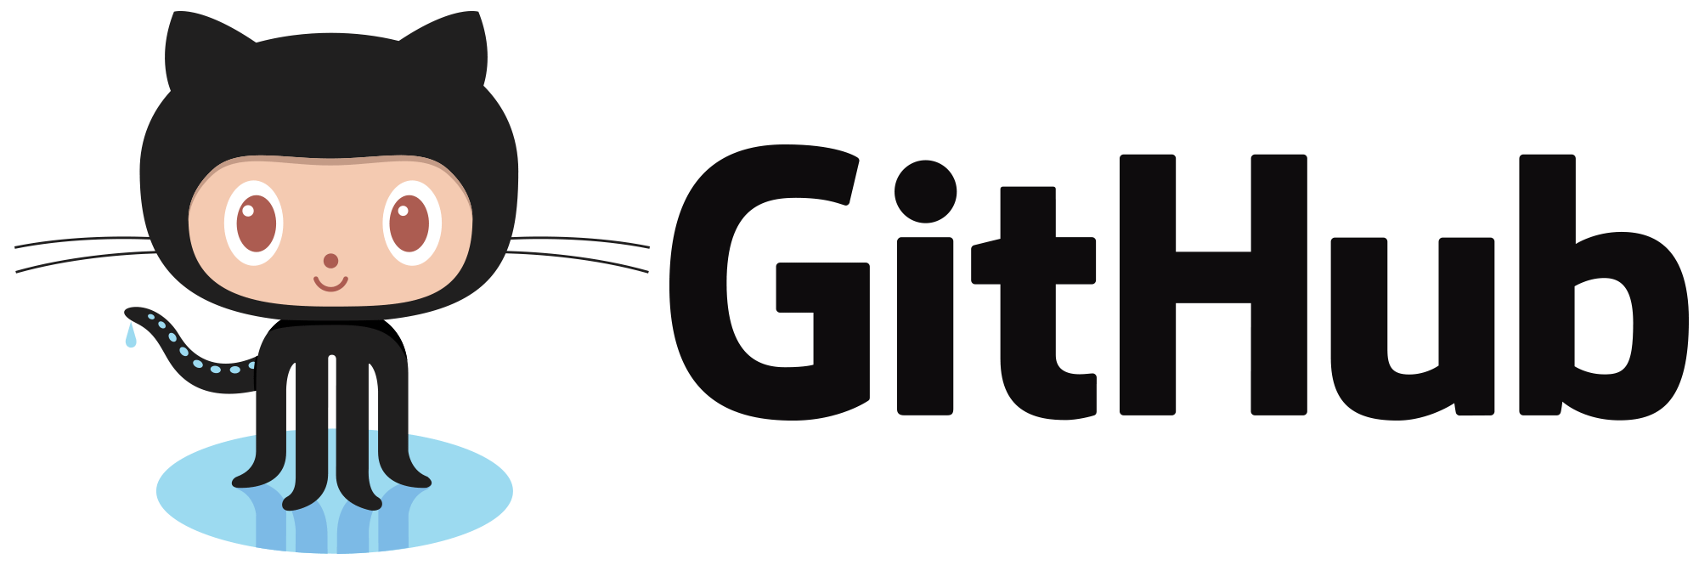

Deployment
User Service
Blog Service

