Slide 1


STAT – 515 FINAL PROJECT HEALTH PREDICTION MODELING AND ANALYSIS
Group 5
Puneeth Velivela
Hemanth Reddy Kurapati

Slide 2
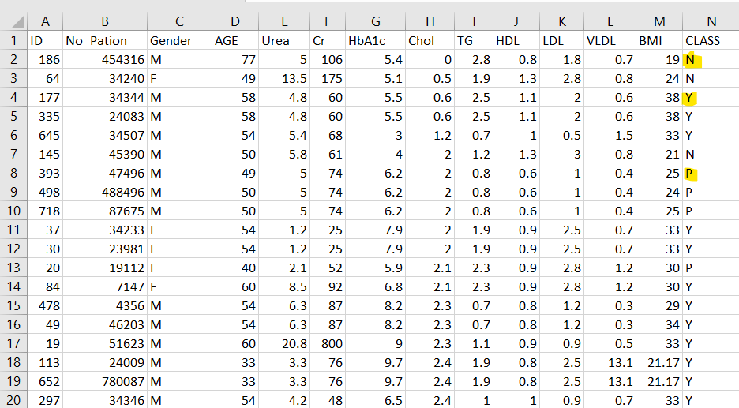

Dataset

Slide 3
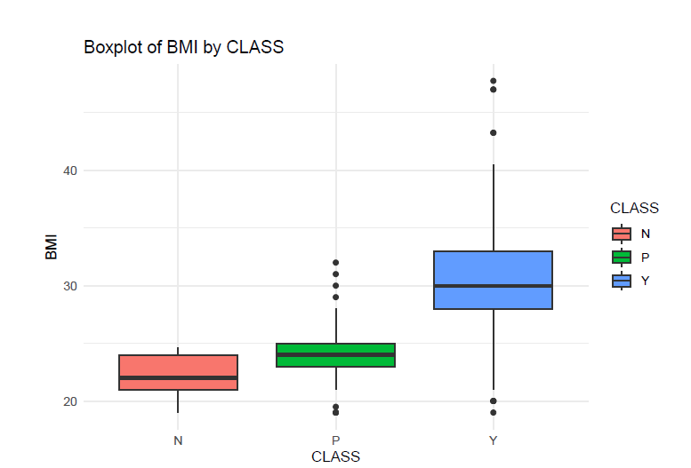
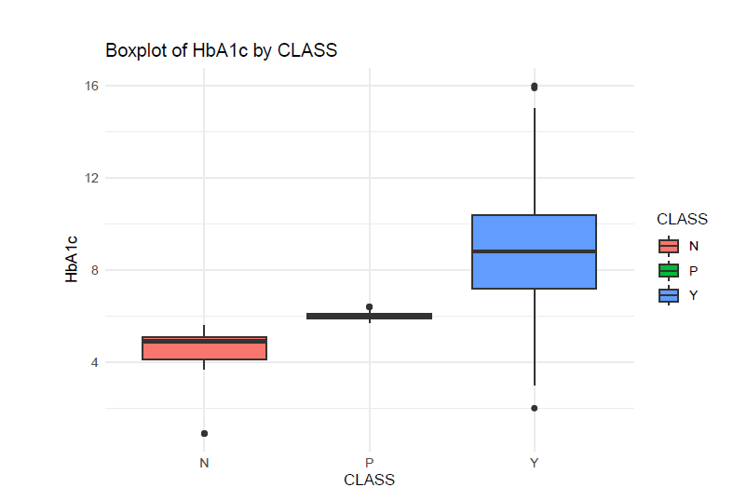
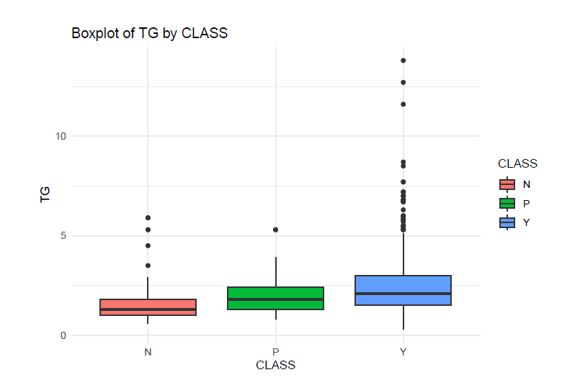

VISUALIZATIONS

Slide 4
Research Question 1
a) How do various factors contribute to the likelihood of patients being diagnosed with diabetes, as indicated by the 'CLASS' variable?
b) Identify and analyze the most influential features identified by the decision tree model. Assess the comparative effectiveness of a decision tree model against logistic regression in determining the presence or absence of a medical condition.

Slide 5

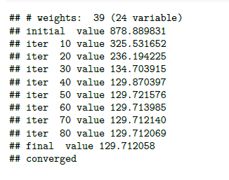
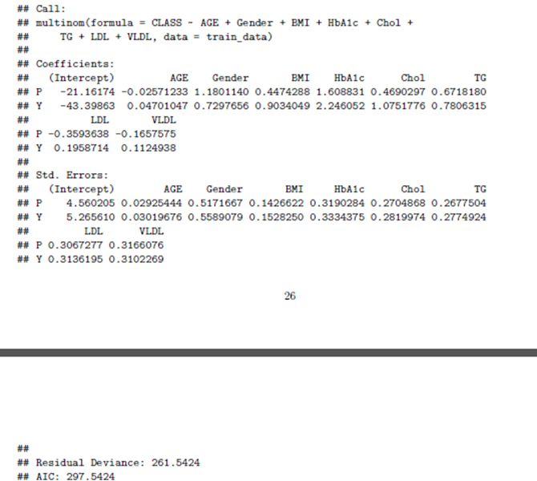
Multinomial Logistic Regression
WITH FULL VARIABLE MODEL

Slide 6
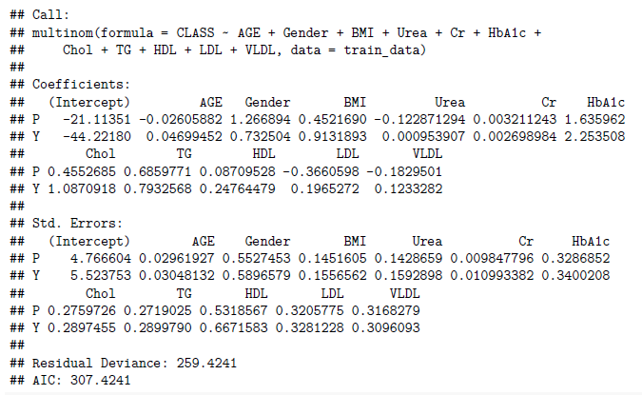
Multinomial Logistic Regression
WITH BEST SUBSET SELECTION

Slide 7
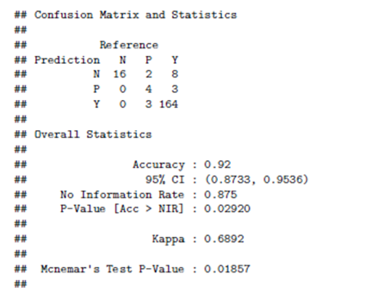
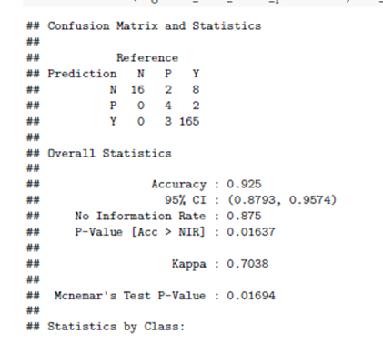
Comparing Accuracy of the predicted models
Full model prediction
Best Subset model prediction

Slide 8
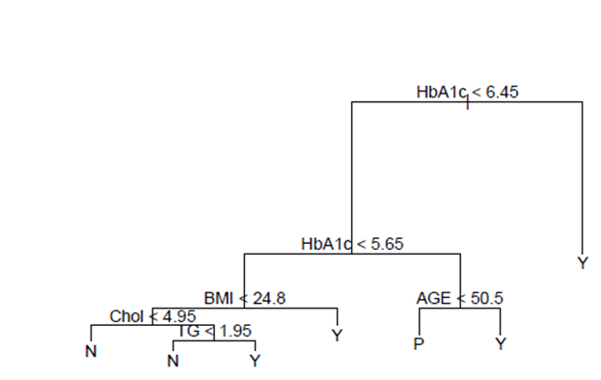
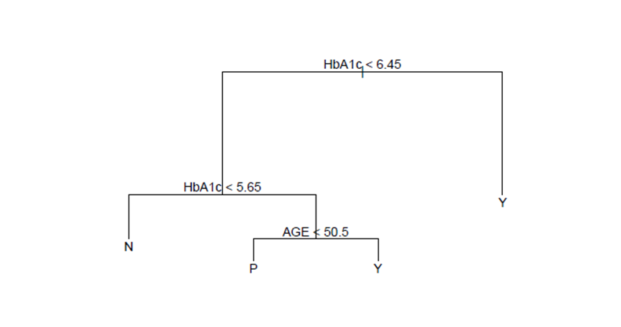
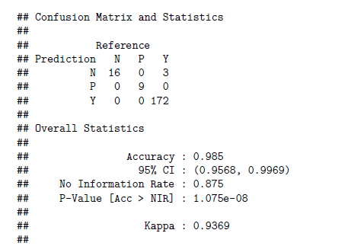
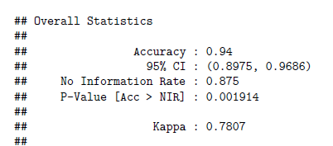
Tree Models
Unpruned Model
Pruned Model

Slide 9
Logistic Regression vs Tree models
Logistic
Tree
Full Model: 92%
Subset selection model: 92.5%
Unpruned: 98.5%
Pruned to branches: 94%

Slide 10
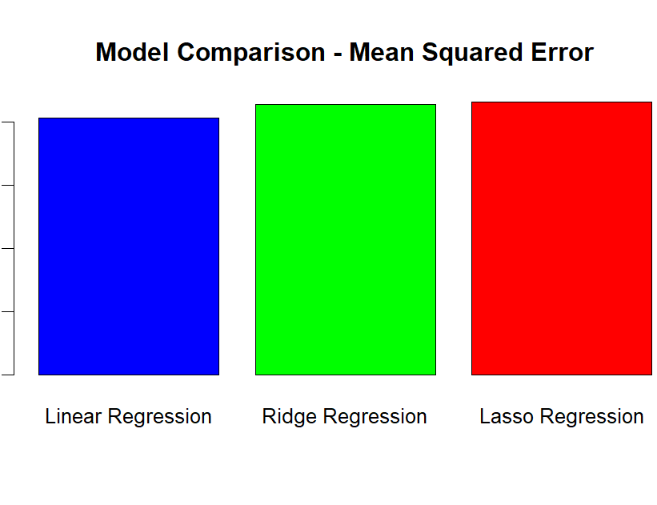
Research Question 2
What is the relationship between hbA1c levels and various factors, and how well can hbA1c be predicted using regression models? Additionally, can hierarchical clustering provide insights into the patterns of correlation among hbA1c and other variables.
From this, we are finding out what is the relationship between hbA1c and other factors.

Slide 11
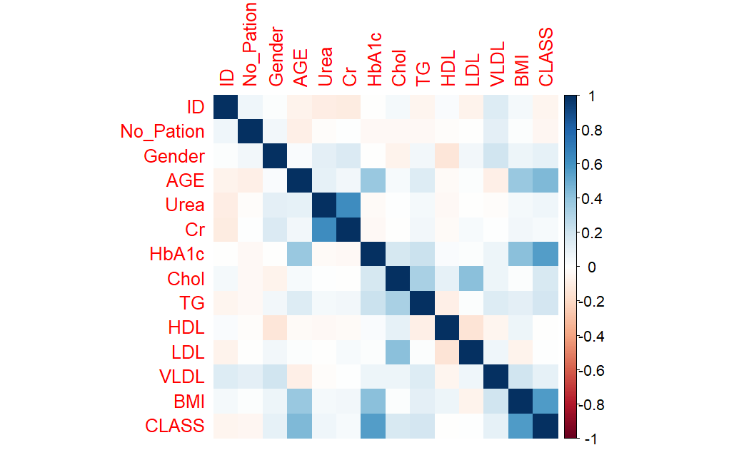
Now, from the correlation matrix, we will find out which factors has direct relations with each other.

Slide 12
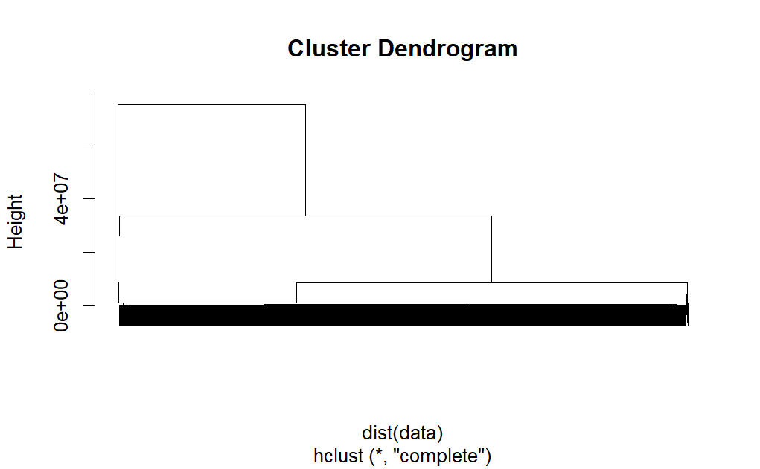
-> Now, we will find whether hierarchical clustering can provide insights into correlation patterns.

Slide 13
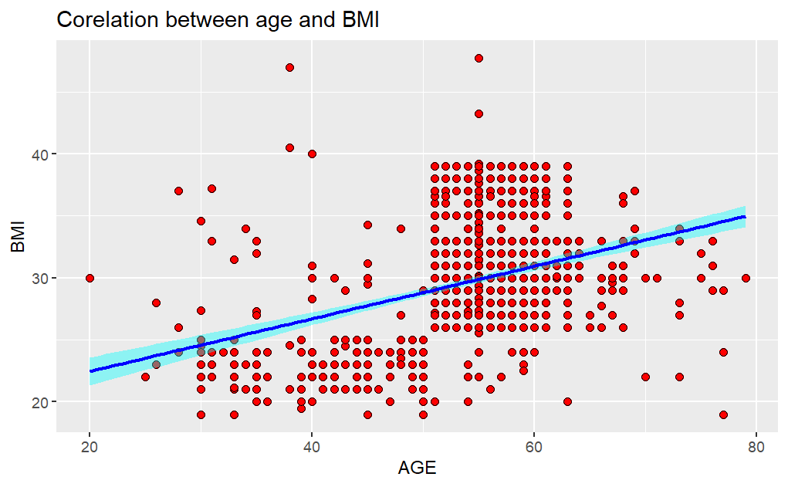
Research question 3
H0: There is no relationship between AGE and BMI versus the alternative hypothesis
Ha: There is some relationship between AGE and BMI
Test: Trying to find out the correlation between AGE and BMI and plot the relation.

Slide 14
Thank YOU

