Slide 1
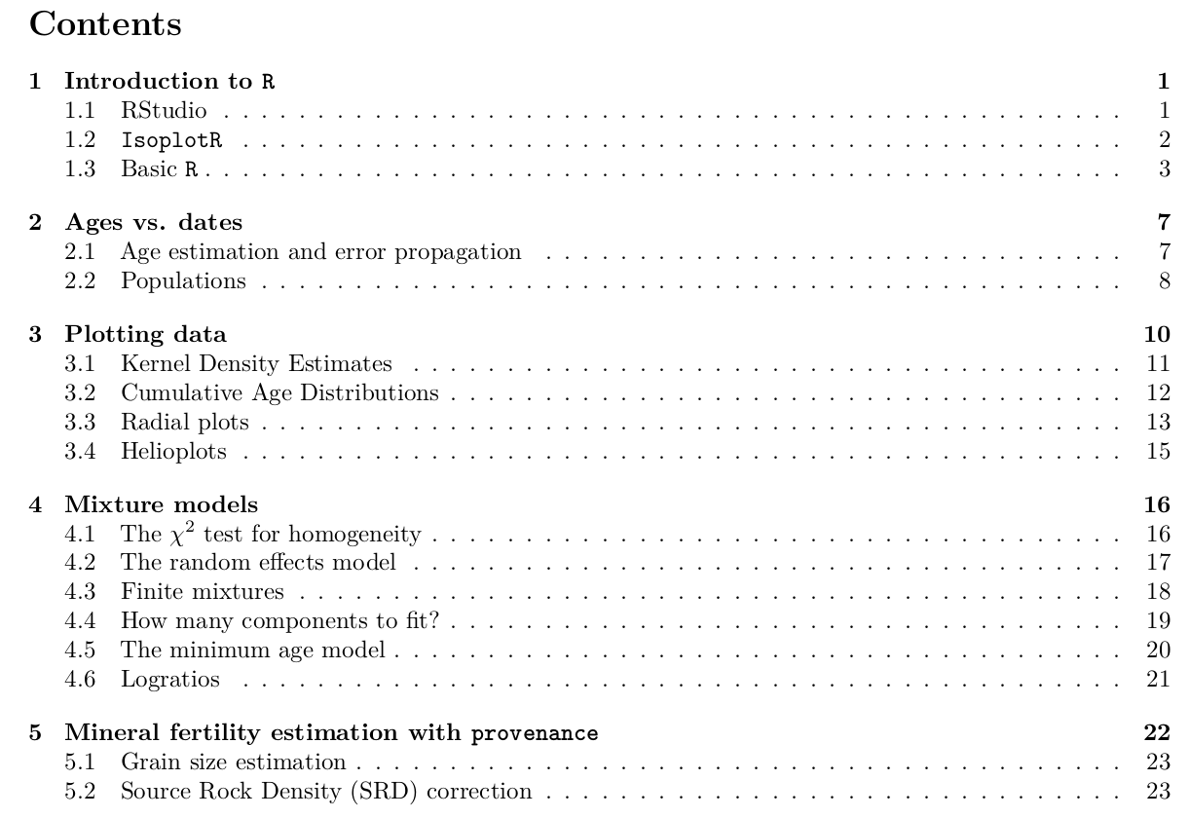

Slide 2






Slide 3

Pooled date

Slide 4



Ages:
FT dates:
U-Th-He
dates:

Slide 5
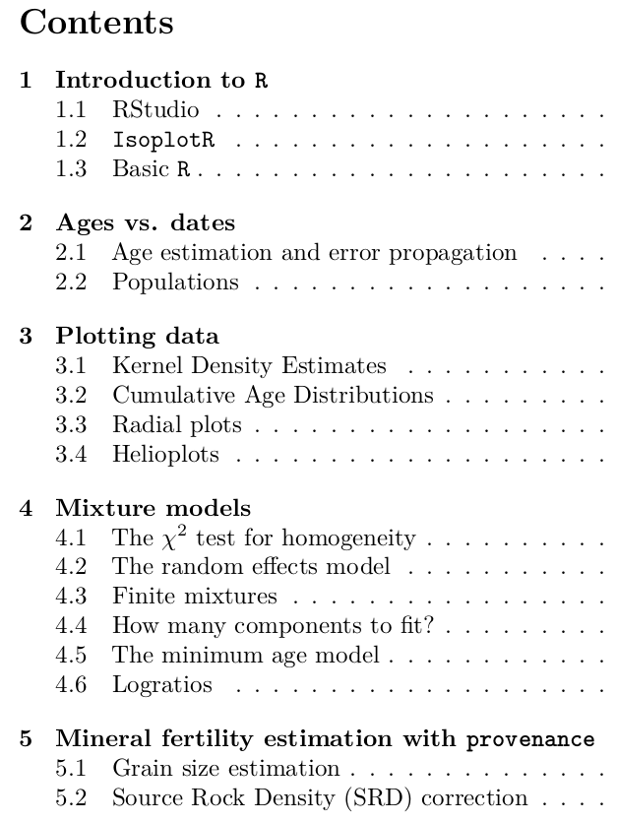
Ages:
FT dates:
U-Th-He
dates:

Slide 6

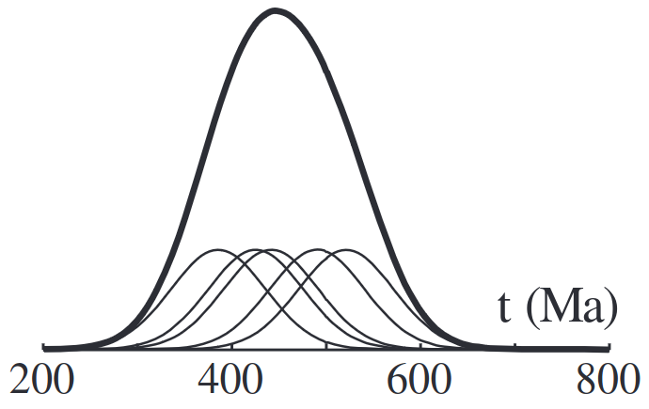

Slide 7
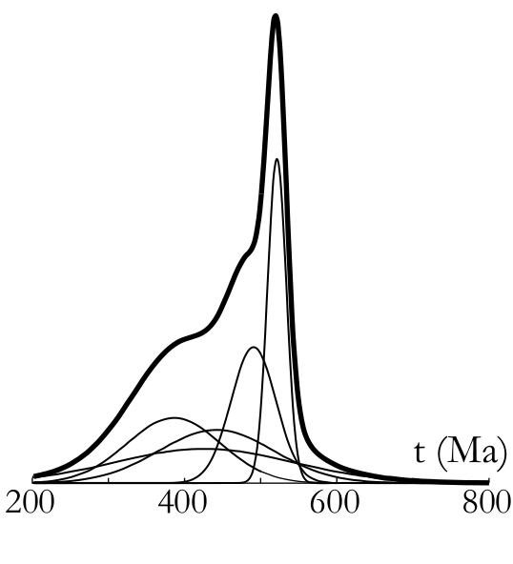
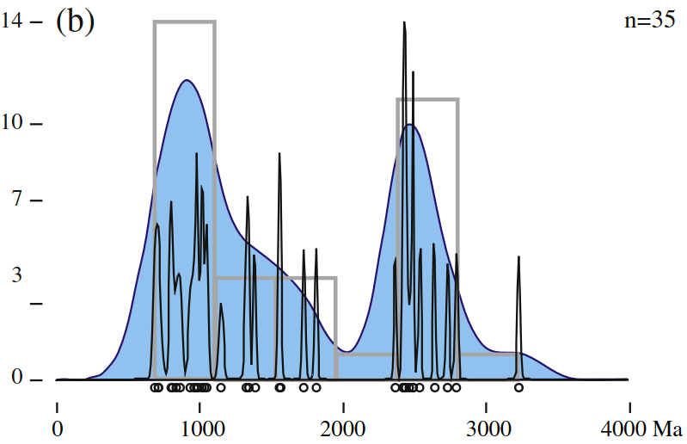

PDP(x)

Slide 8
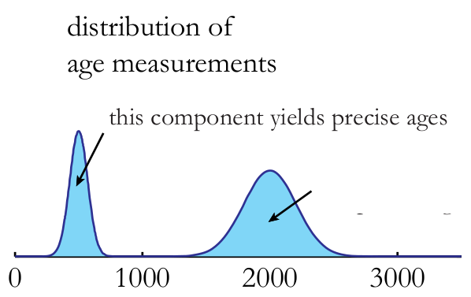
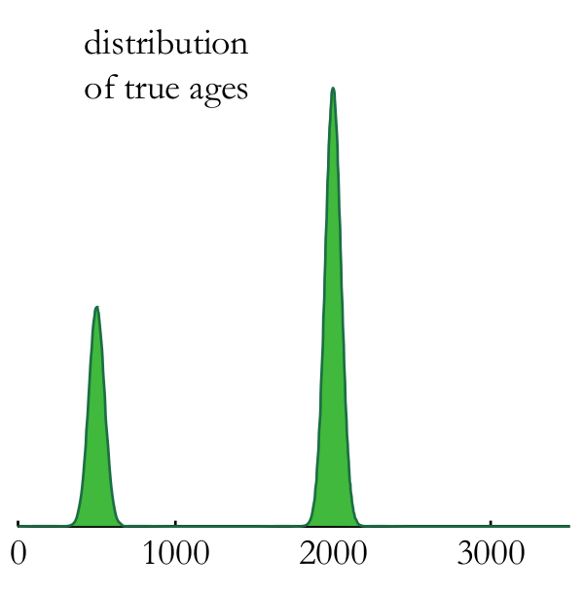


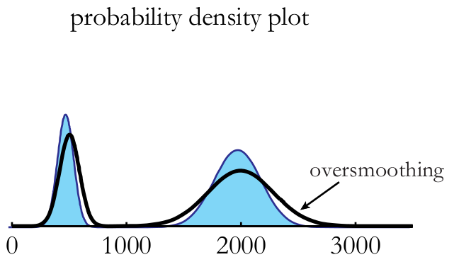



Slide 9
Ages:
FT dates:
U-Th-He
dates:

Slide 10

FT dates:

Slide 11

FT dates:

Slide 12
Ages:
FT dates:
U-Th-He
dates:

Slide 13

U-Th-He
dates:

Slide 14


Slide 15


FT dates:

Slide 16

U-Th-He
dates:

Slide 17
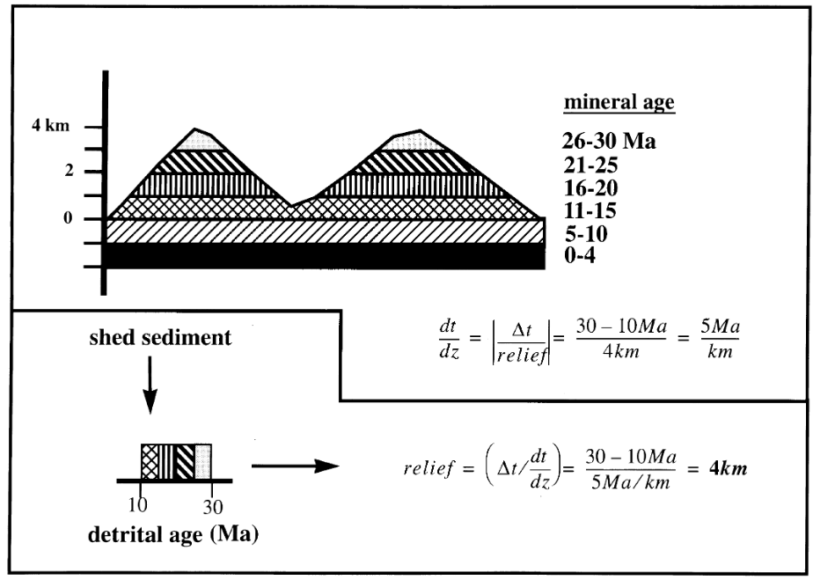
Stock &
Montgomery
(1996)

Slide 18
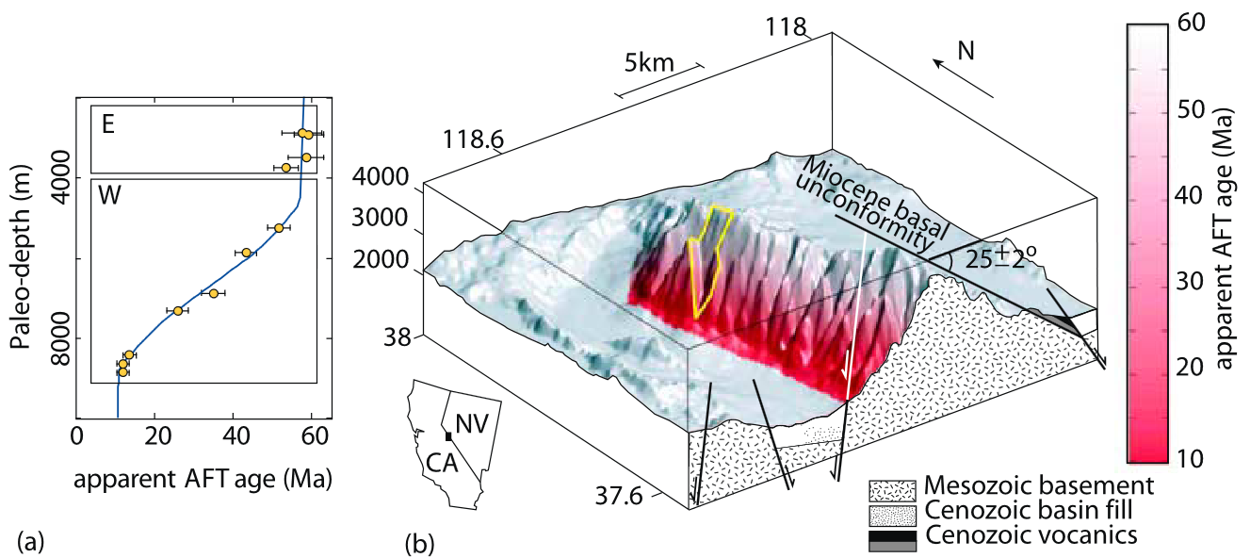
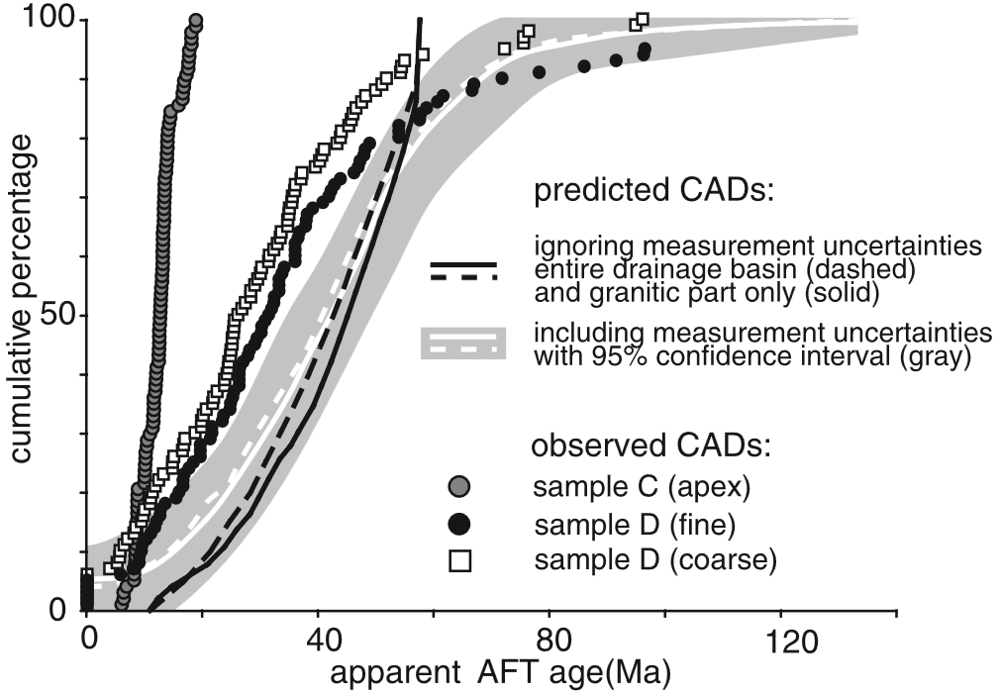
Vermeesch (2007)

Slide 19


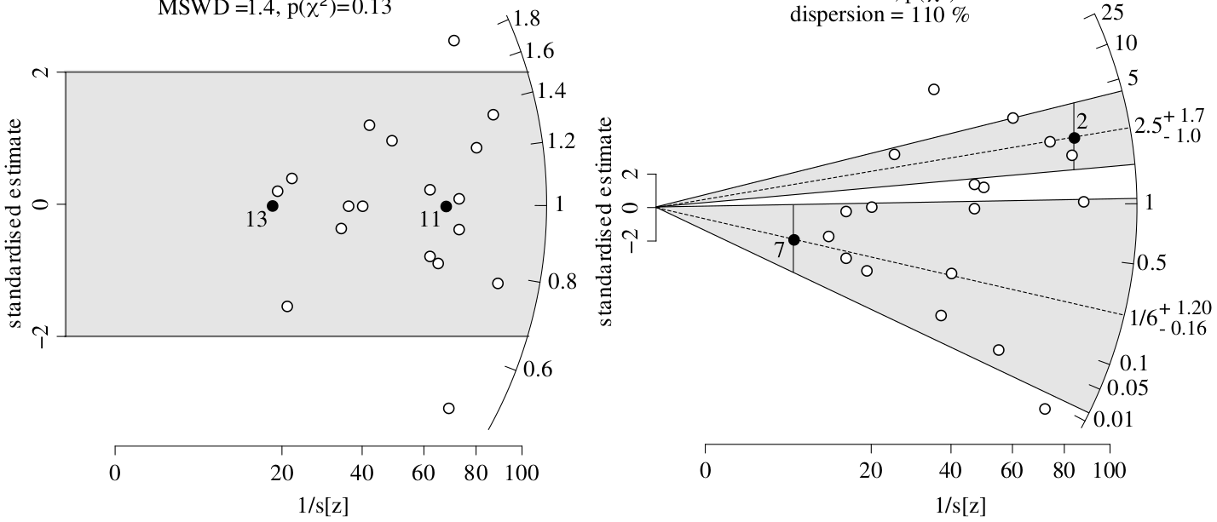

Slide 20

FT dates:

Slide 21

U-Th-He
dates:

Slide 22


Slide 23

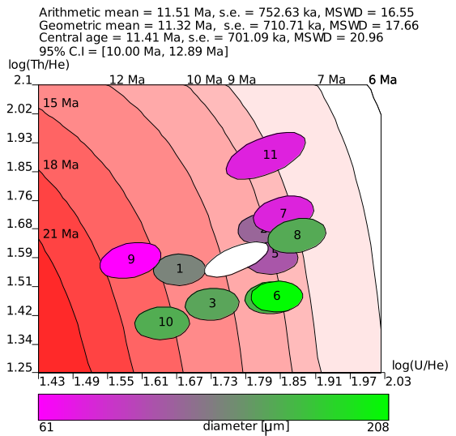
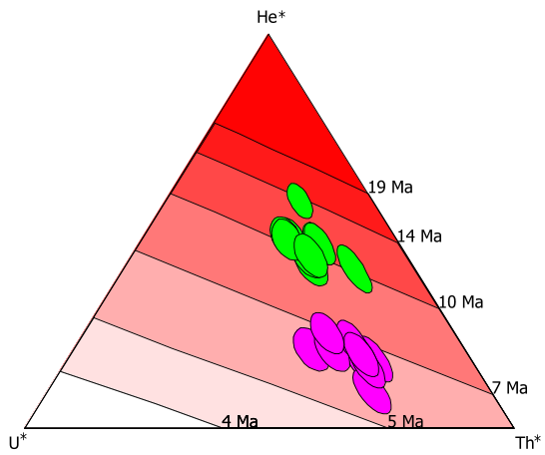

Slide 24


U-Th-He
dates:

Slide 25
Ages:
FT dates:
U-Th-He
dates:

Slide 26
Ages:
FT dates:
U-Th-He
dates:

Slide 27



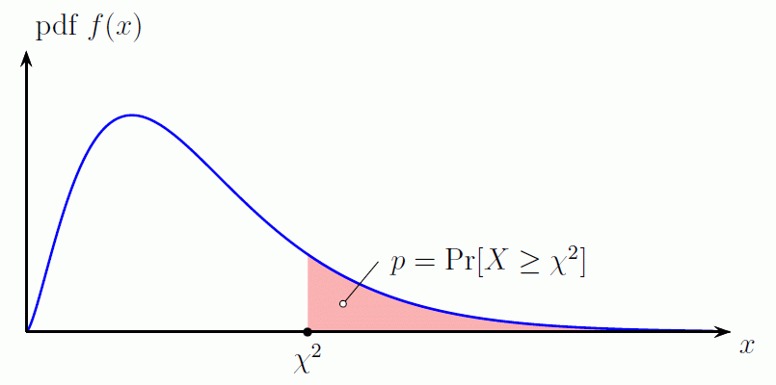


Slide 28
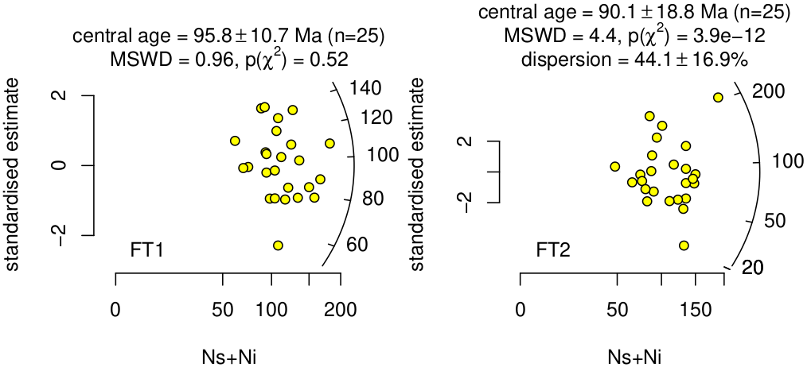


Ages:
P<0.05 → MSWD>

Slide 29

Ages:

Slide 30
Ages:
FT dates:
U-Th-He
dates:

Slide 31




Ages:
Central age
dispersion

Slide 32
Central age
dispersion

Slide 34
Ages:
FT dates:
U-Th-He
dates:

Slide 35
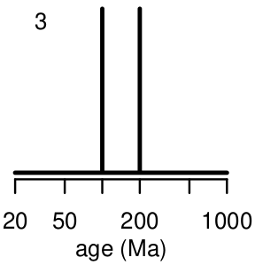
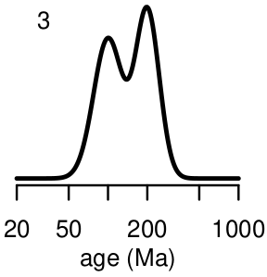
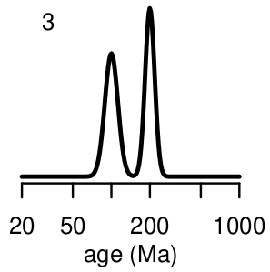
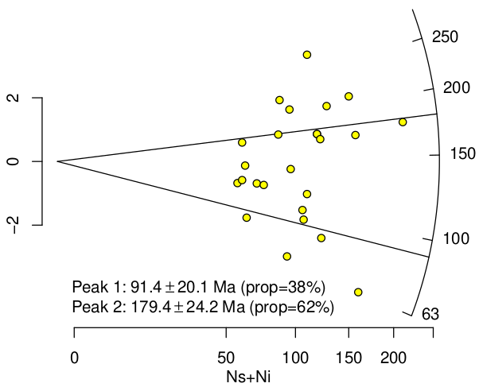
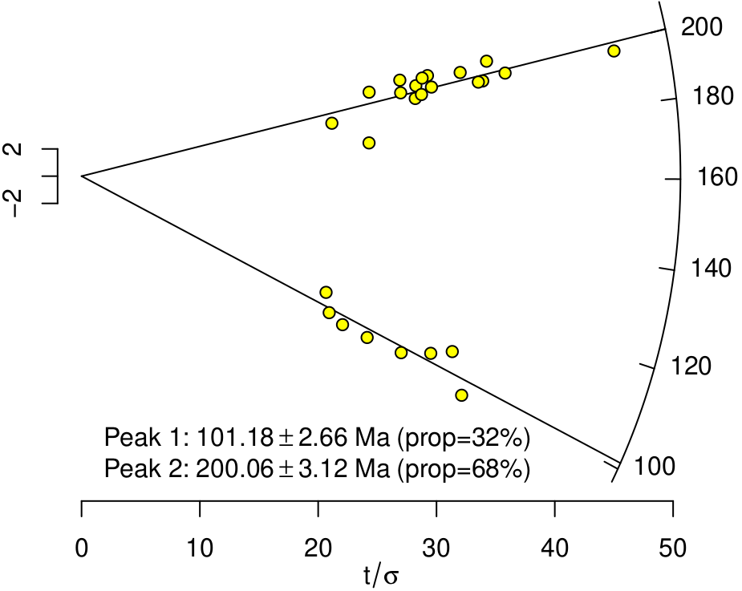
Ages:
FT dates:
U-Th-He dates:

Slide 36

Ages:

Slide 37

Ages:

Slide 38

Ages:
Fission tracks
U-Th-He

Slide 39
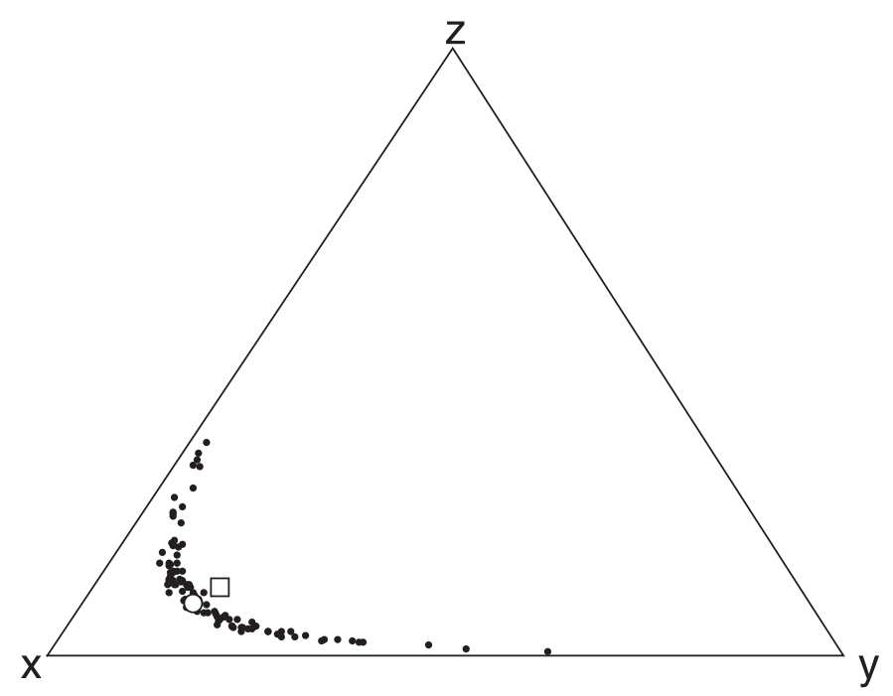
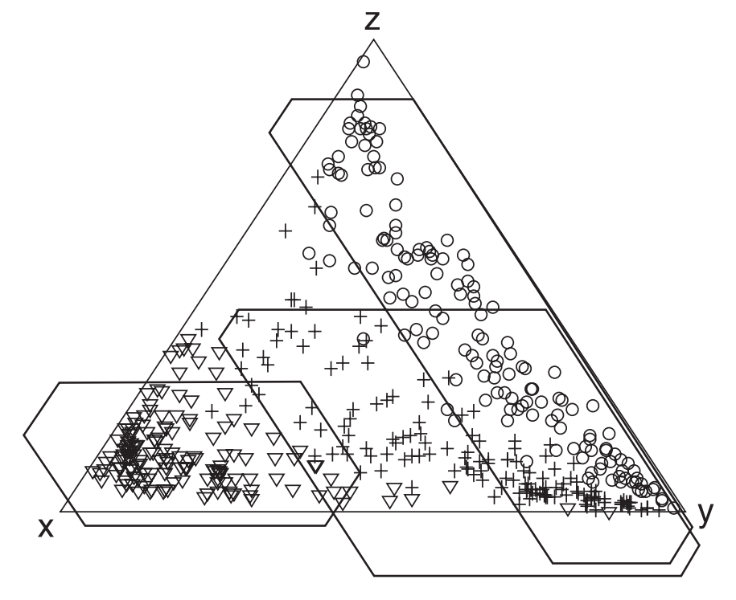

Slide 40
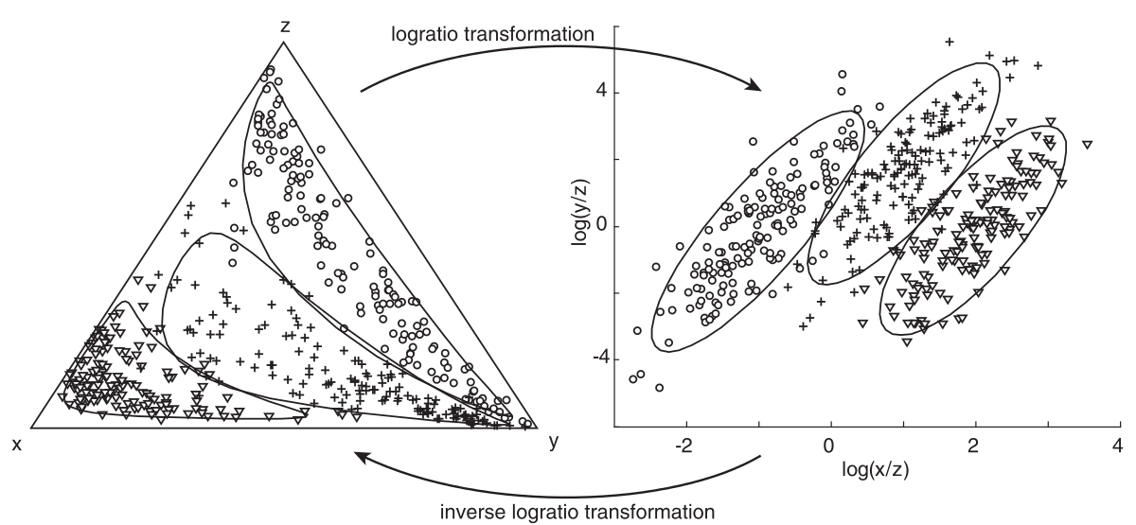

Slide 41
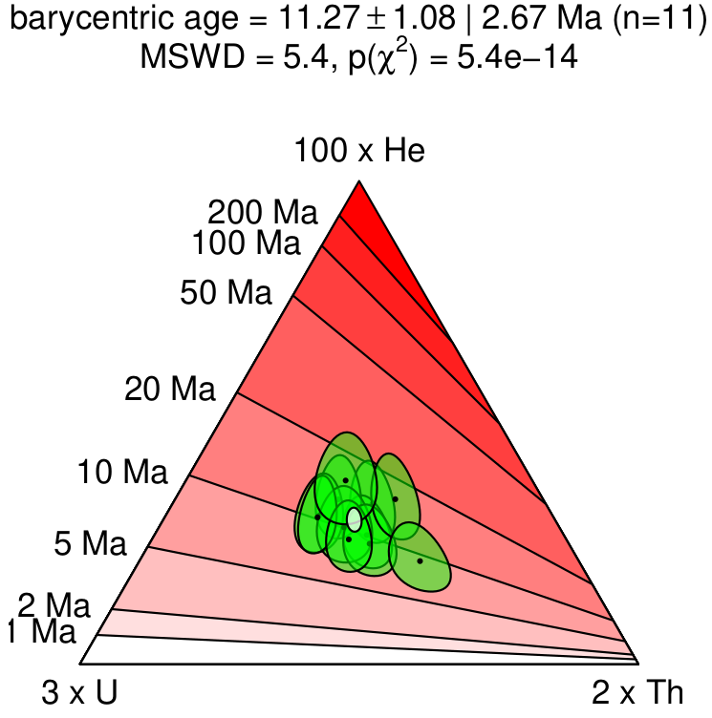
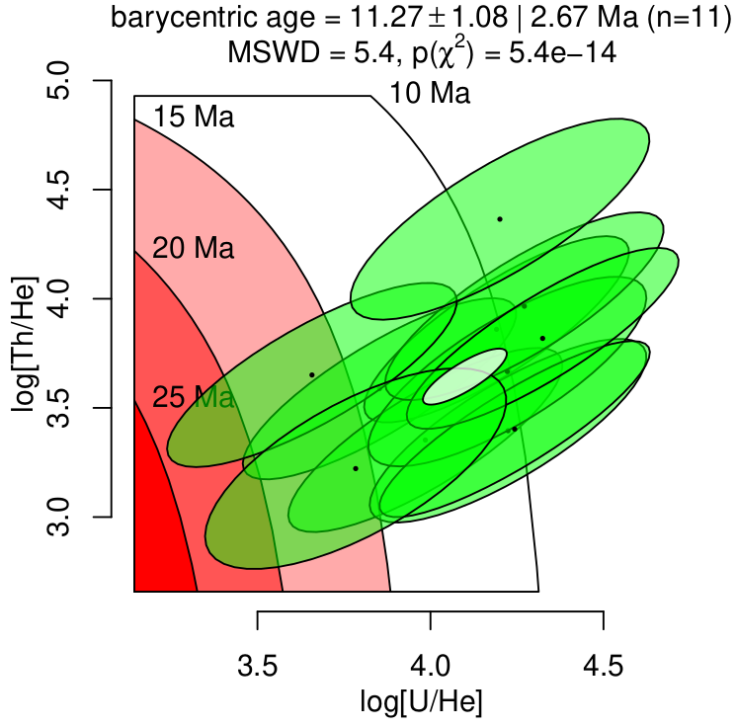

Slide 42
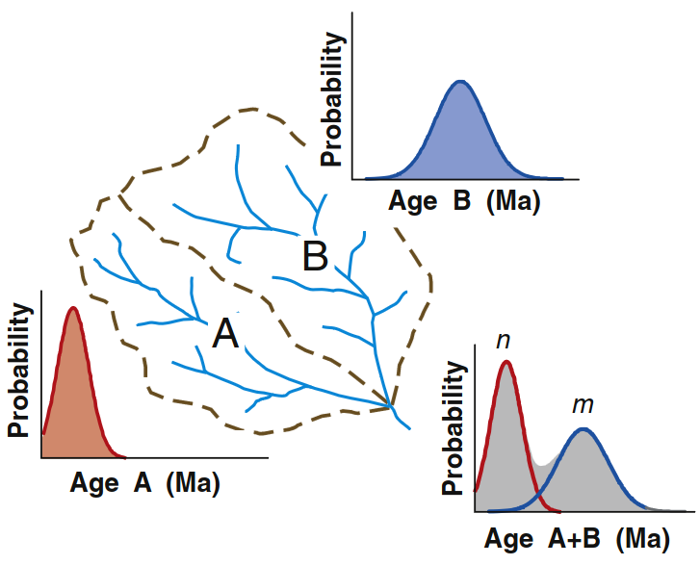
Malusa et al. (2016)

Slide 43
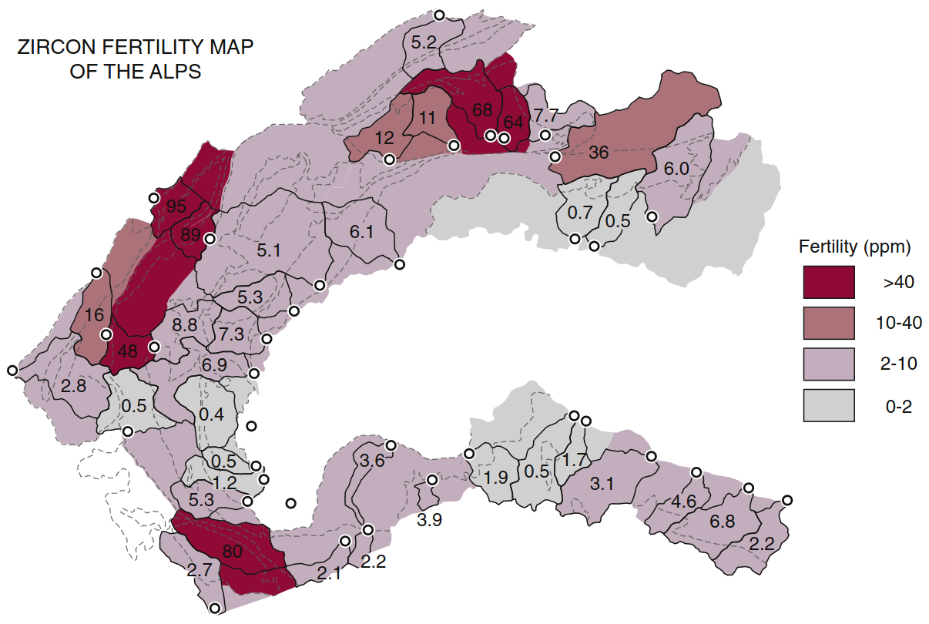
Malusa et al. (2016)

Slide 44

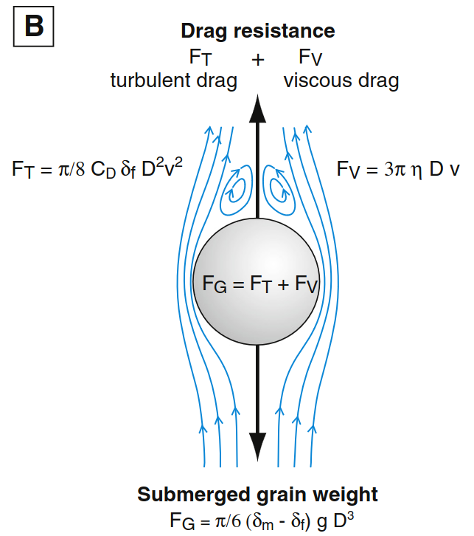
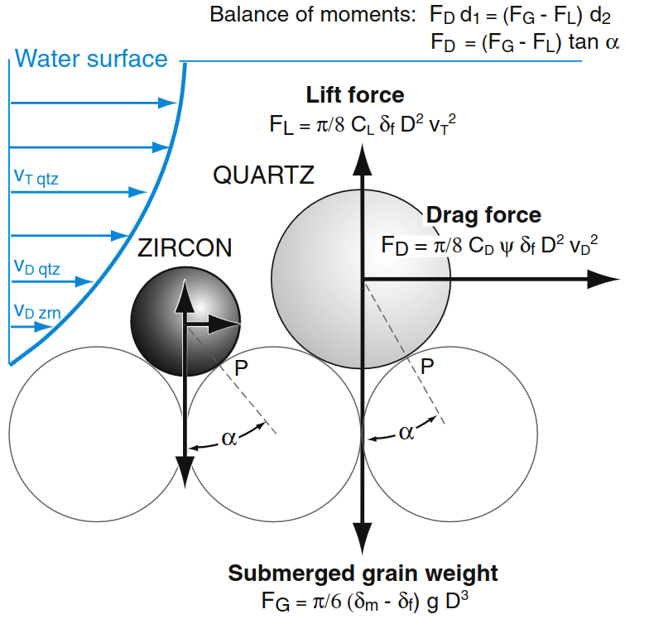
Malusa et al. (2016)
Garzanti et al. (2008,2009)

Slide 45
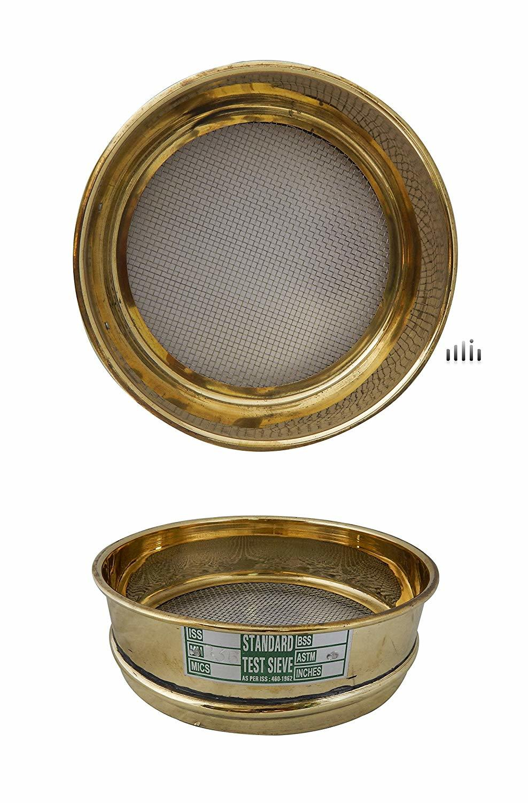
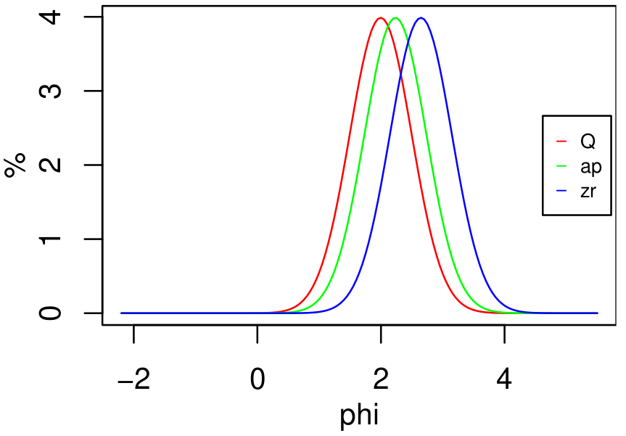

Slide 46
