Slide 1
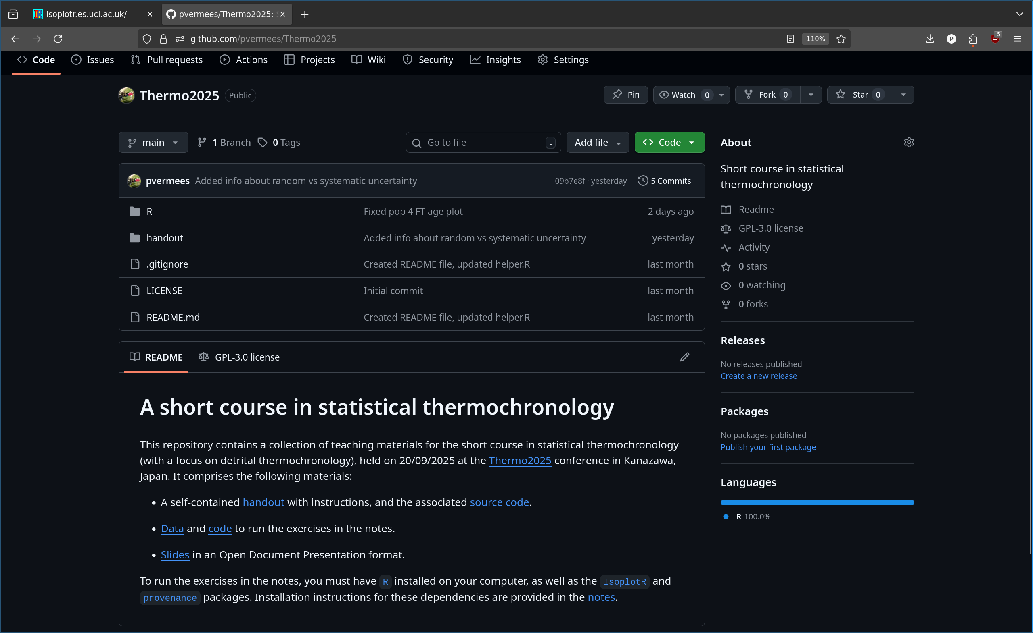
This is a shortened version of the Thermo2025 short course
https://github.com/pvermees/Thermo2025

Slide 2
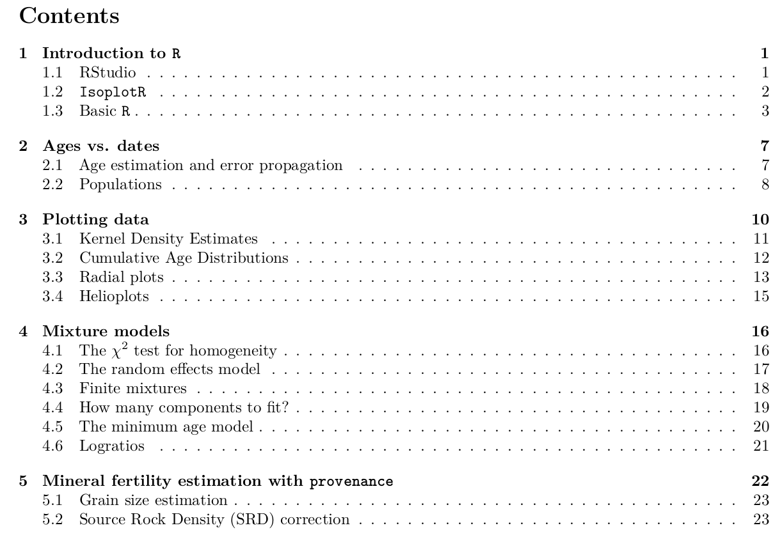

Slide 3
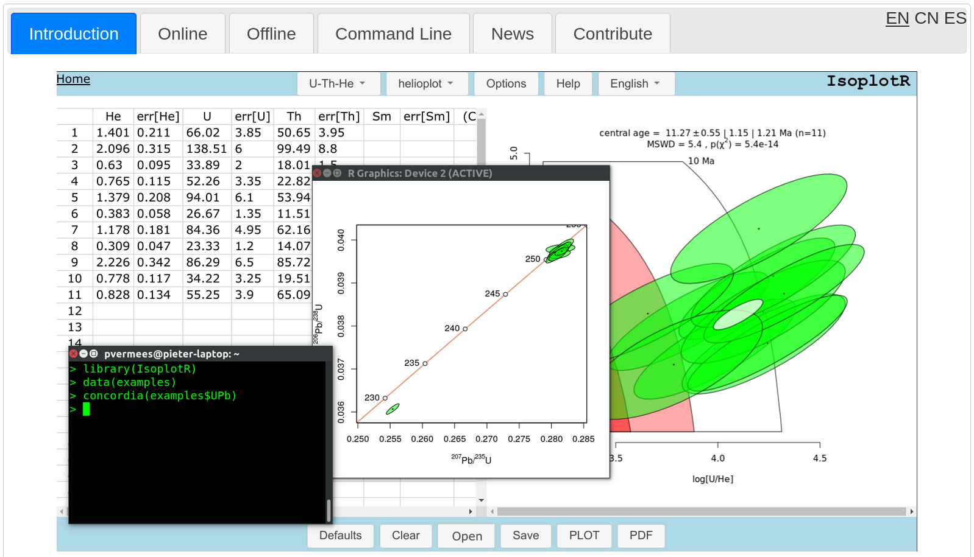
We won’t do any programming, but use IsoplotR’s GUI
https://isoplotr.es.ucl.ac.uk

Slide 4

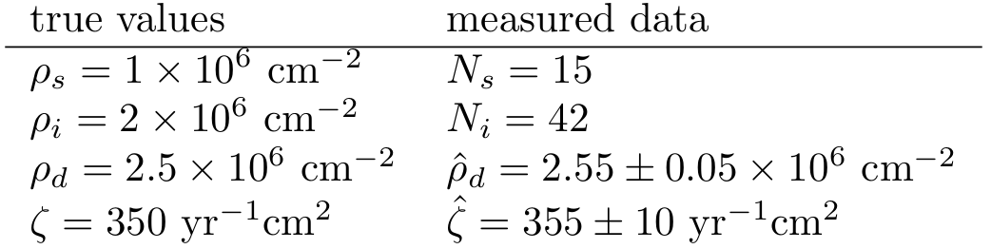
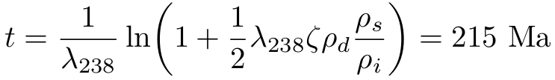
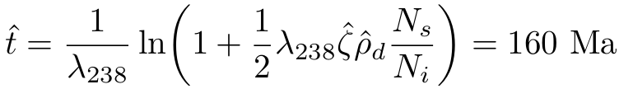
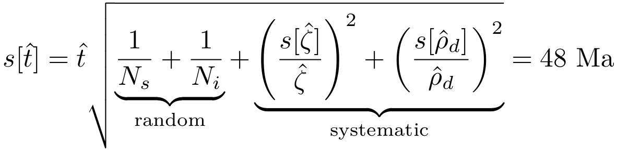

Slide 5
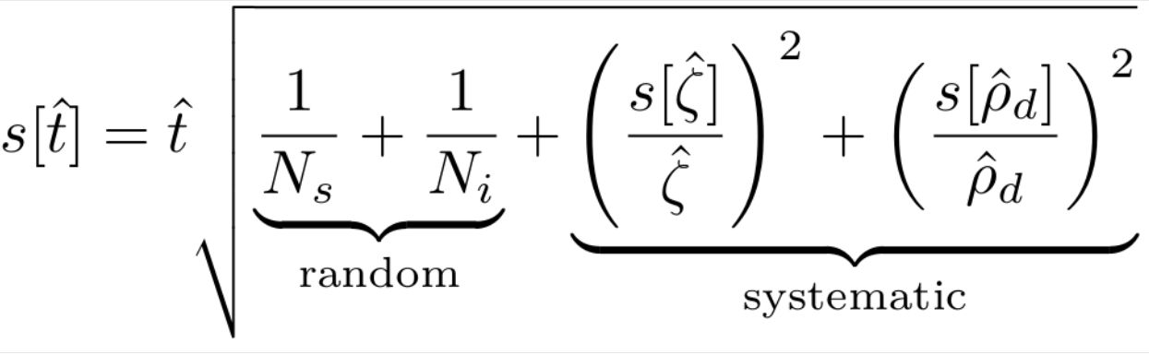
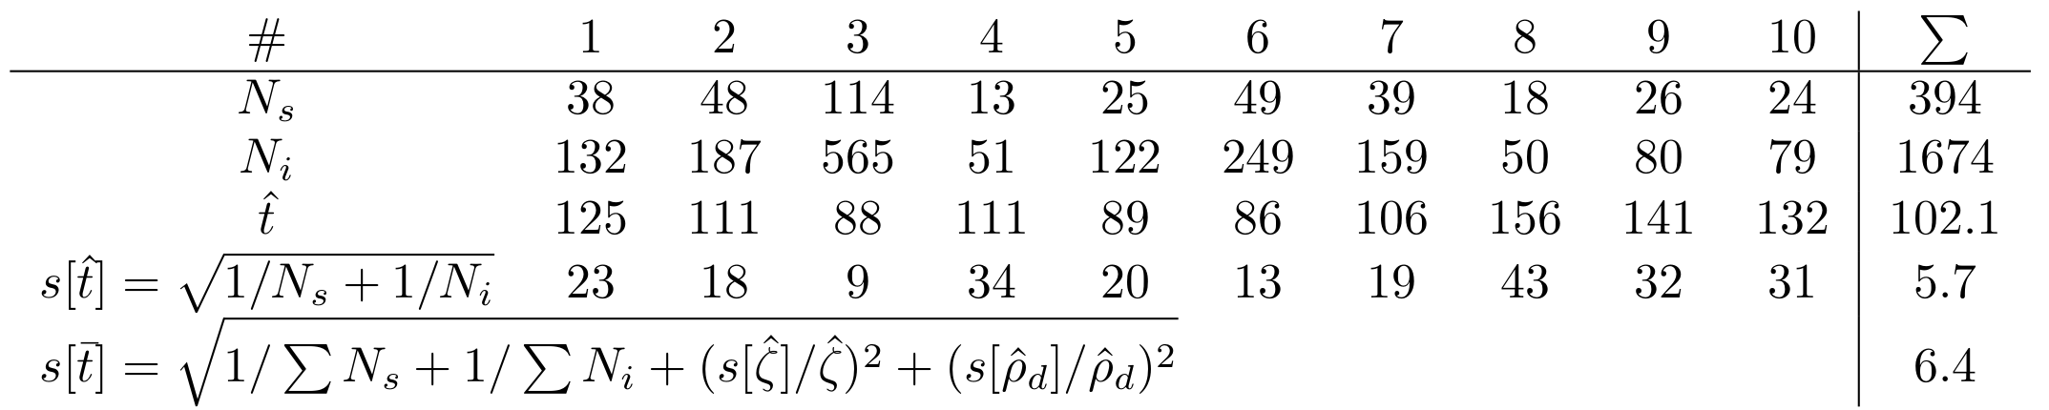
Pooled date

Slide 6
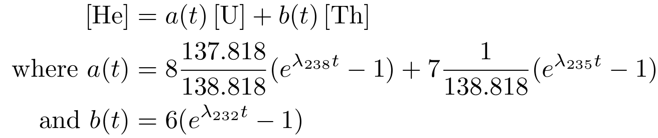
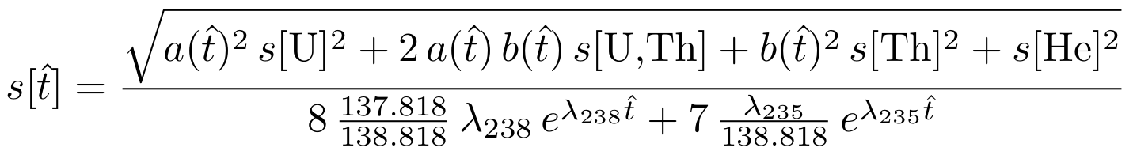

Slide 7
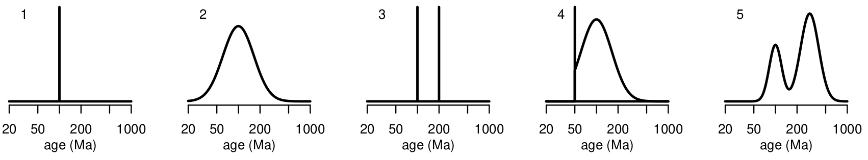
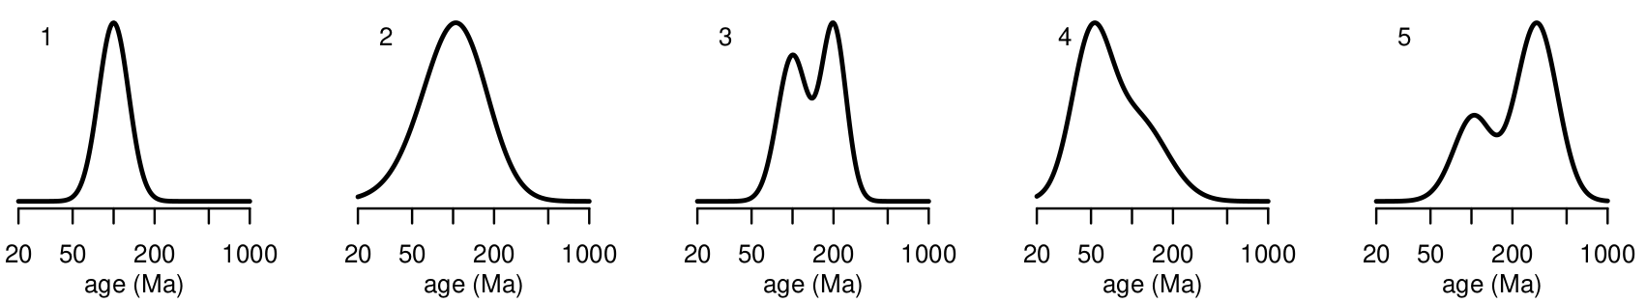
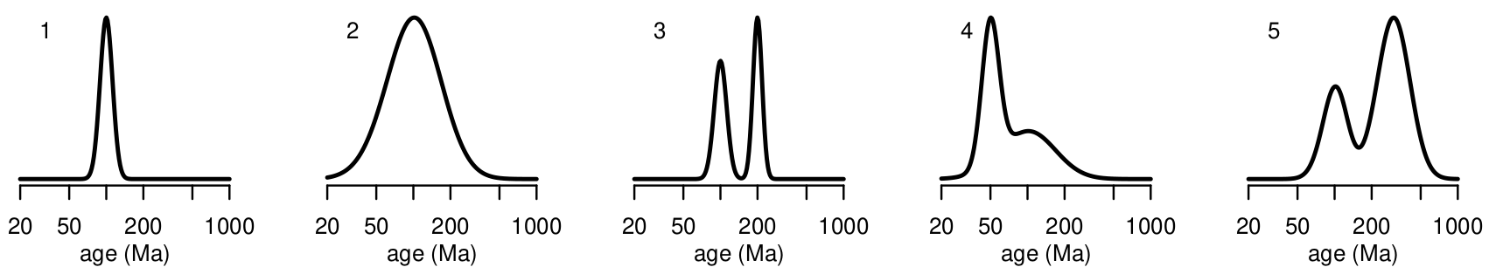
Dates are always more scattered than ages
Ages:
FT dates:
U-Th-He
dates:

Slide 8
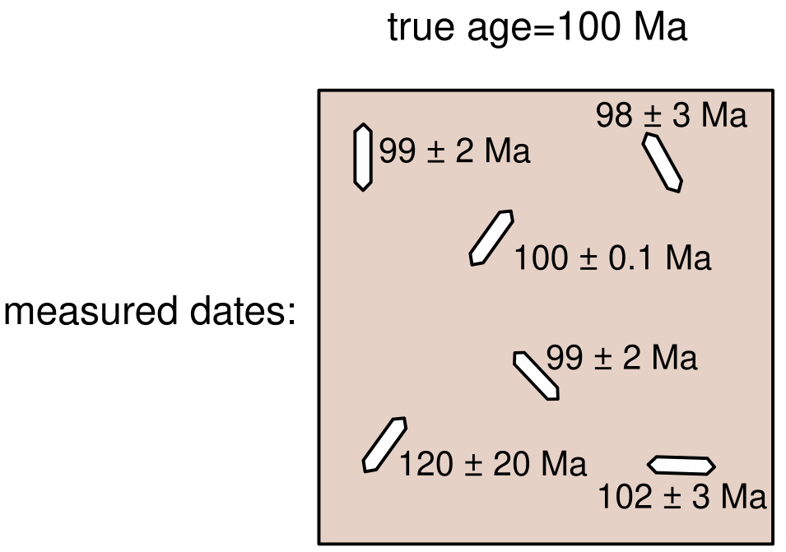

Slide 9
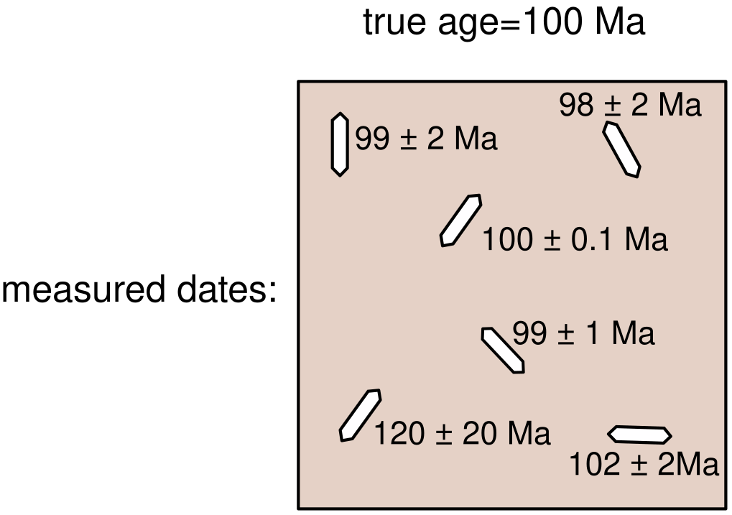
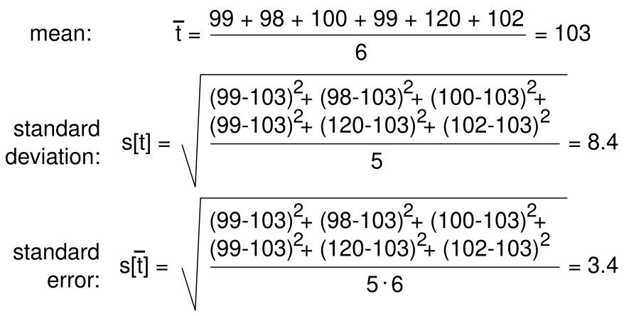

Slide 10
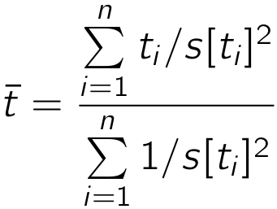
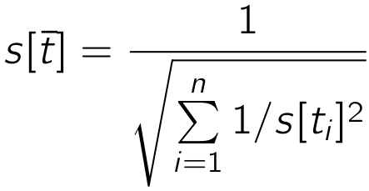
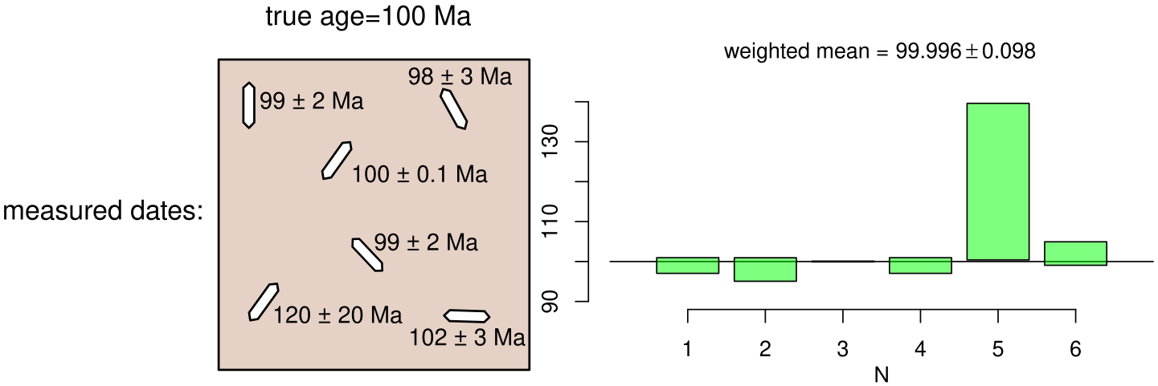

Slide 11
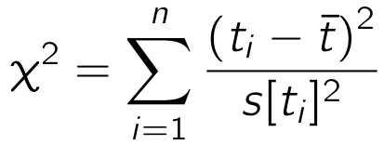
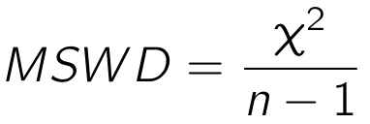



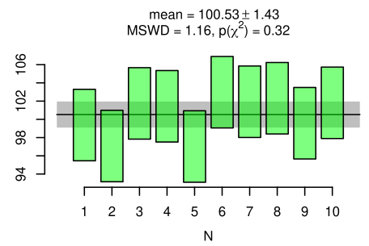
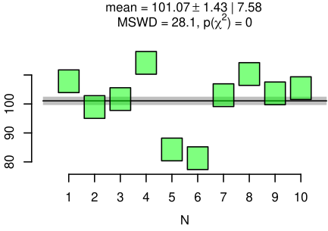
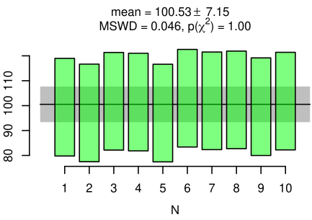
A
B
C

Slide 12
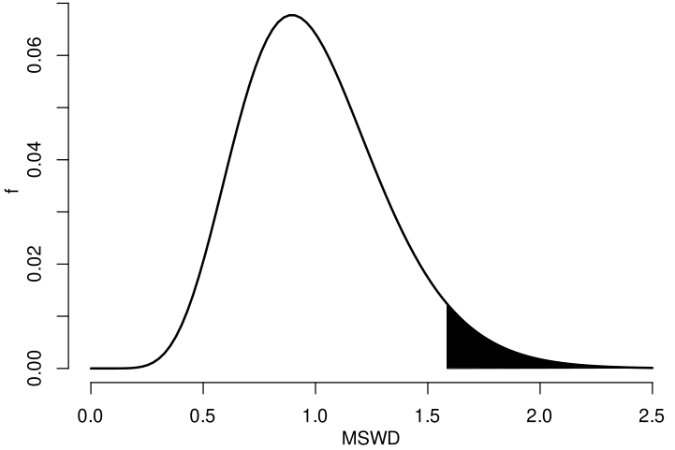




(n=20)
p < 0.05 ⇒ overdispersed
(MSWD > 1.6)

Slide 13
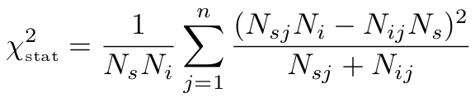

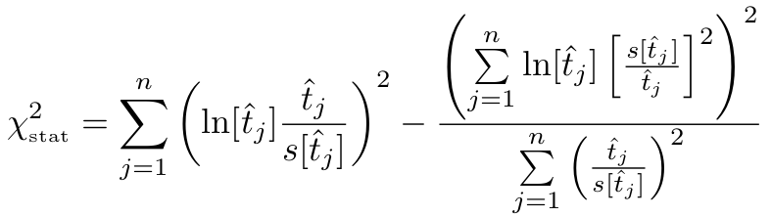
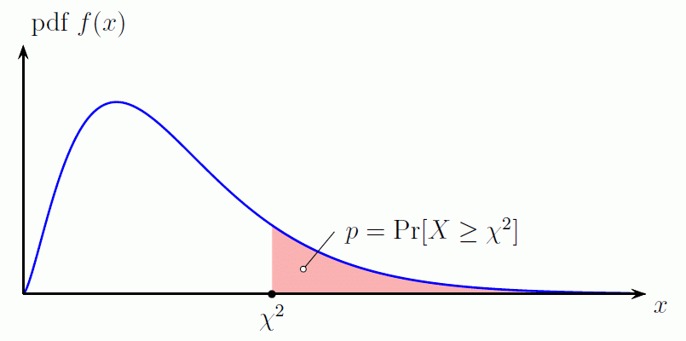

p < 0.05 ⇒ overdispersed

Slide 14
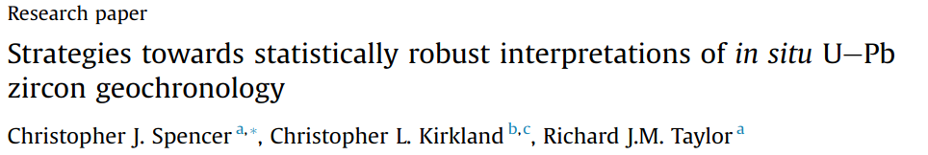
“… with an n of 20 the acceptable [MSWD] is 0.35-1.65 […] Weighted averages with [MSWD] values that fall outside of this range should not be used”

Slide 15
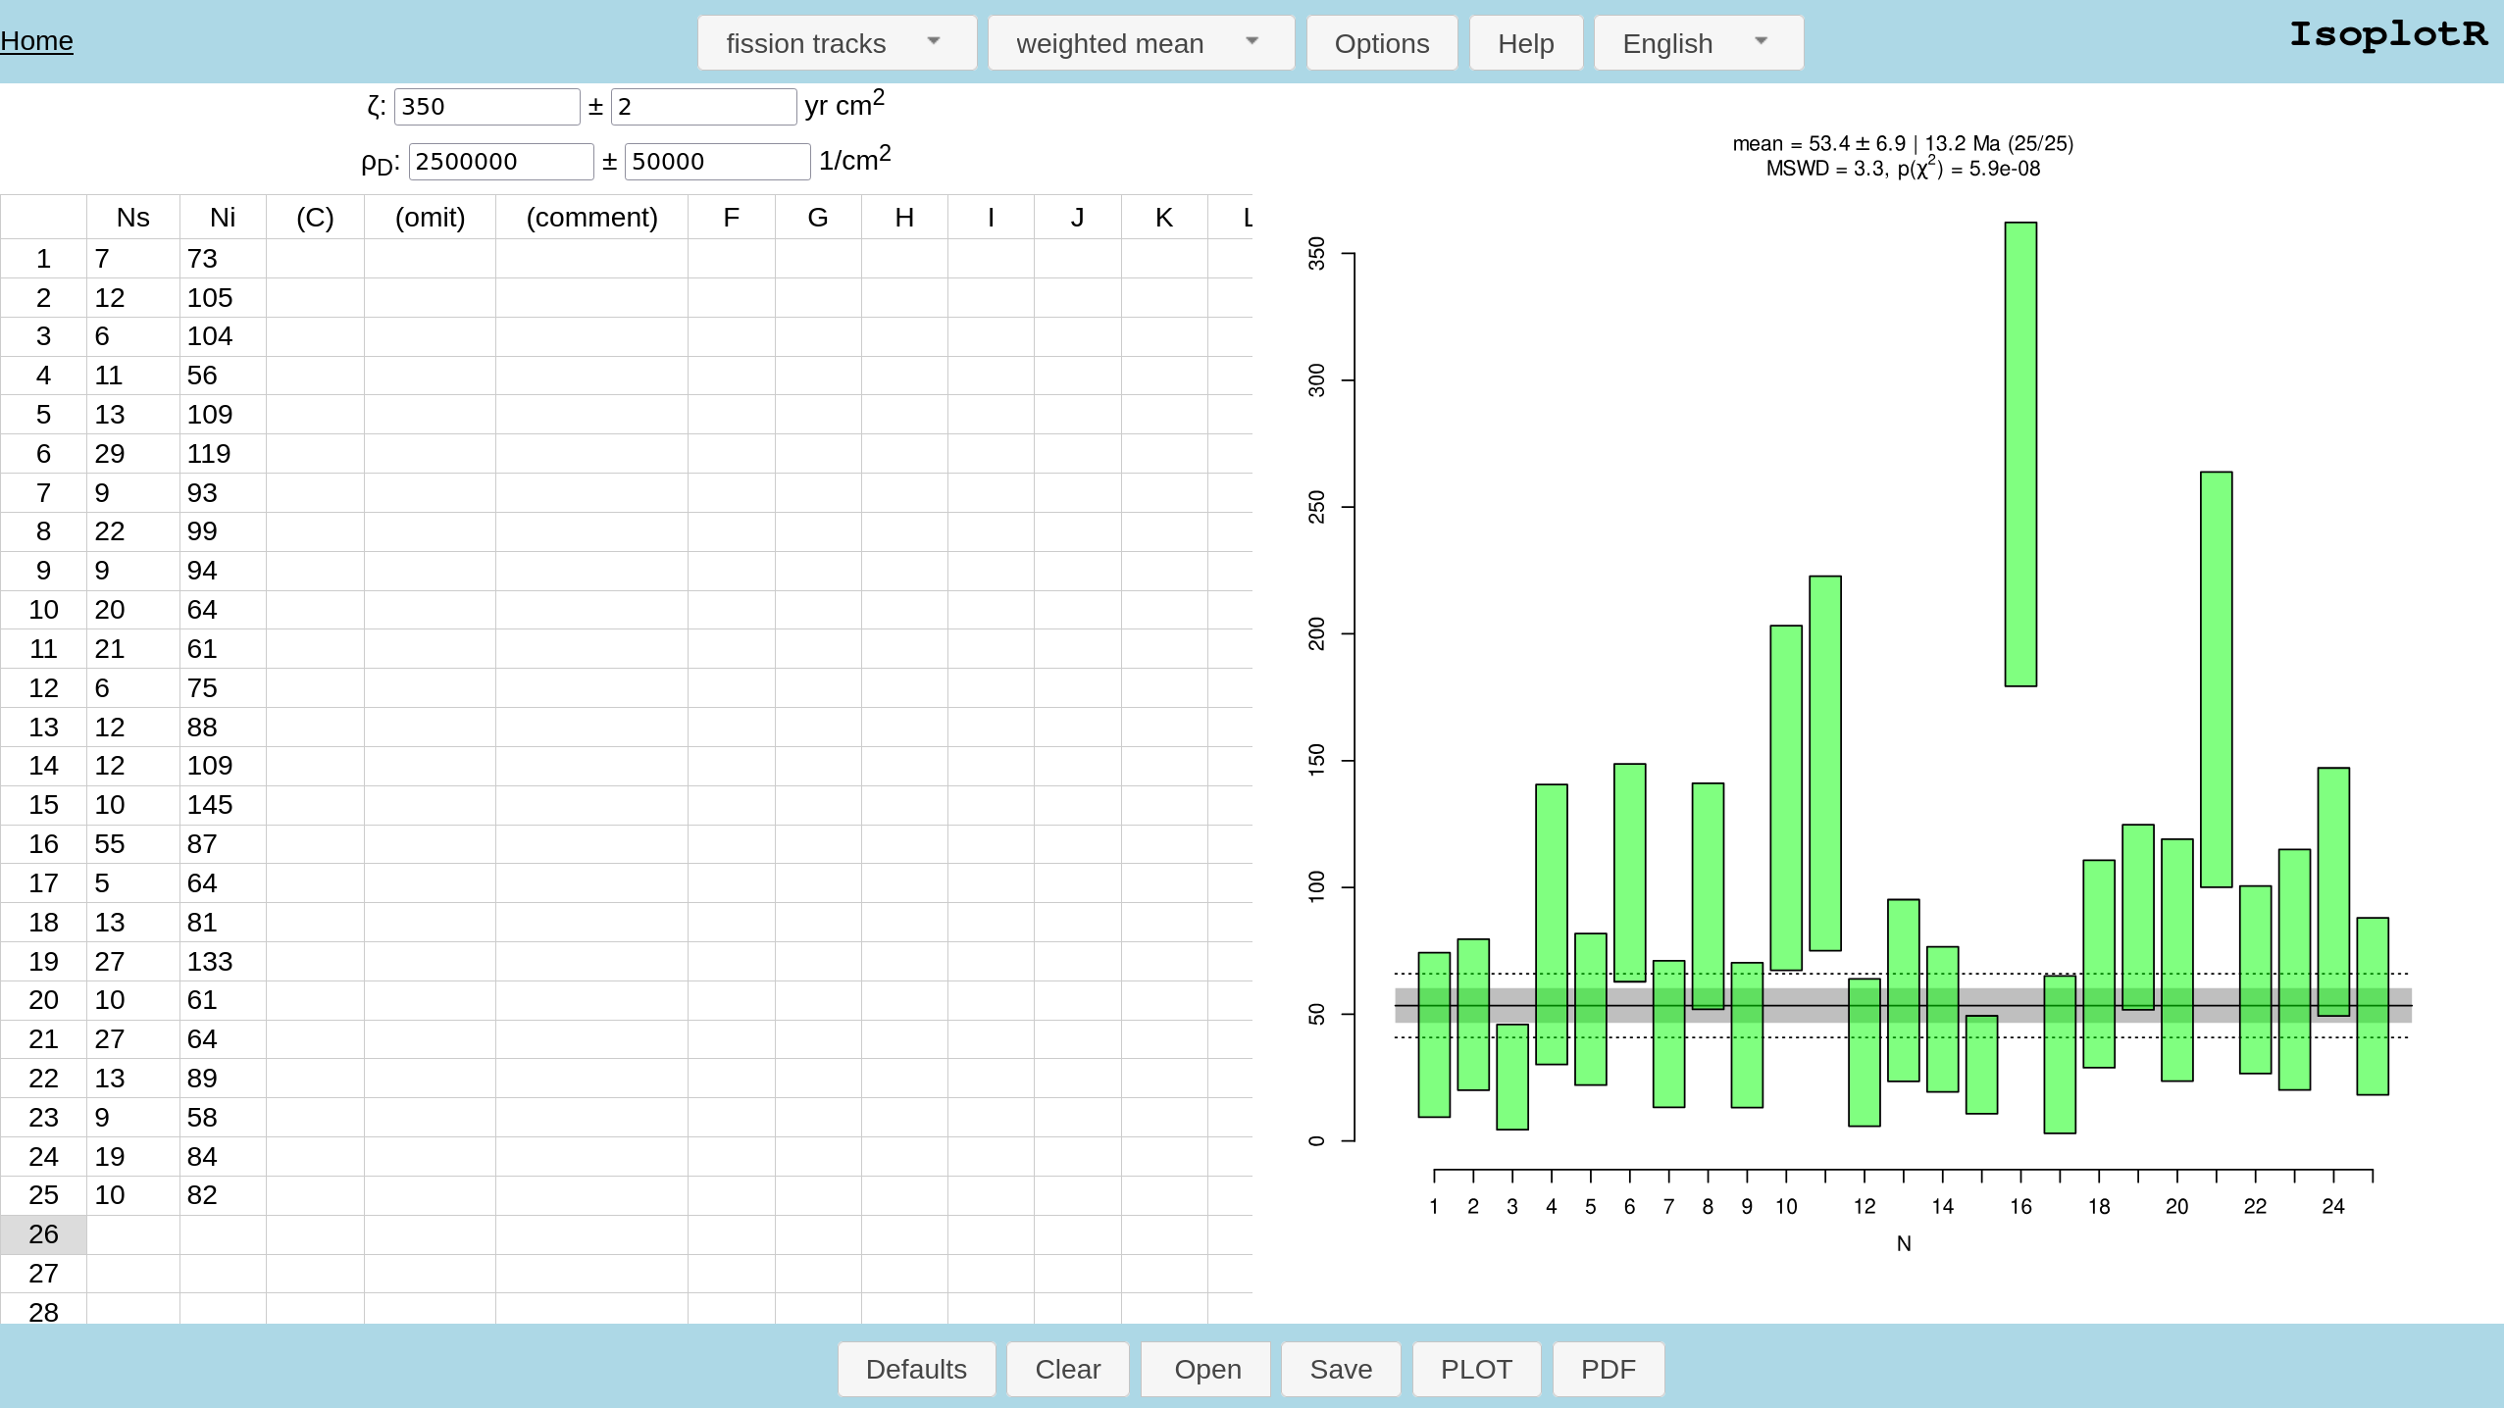
FT3.json

Slide 16
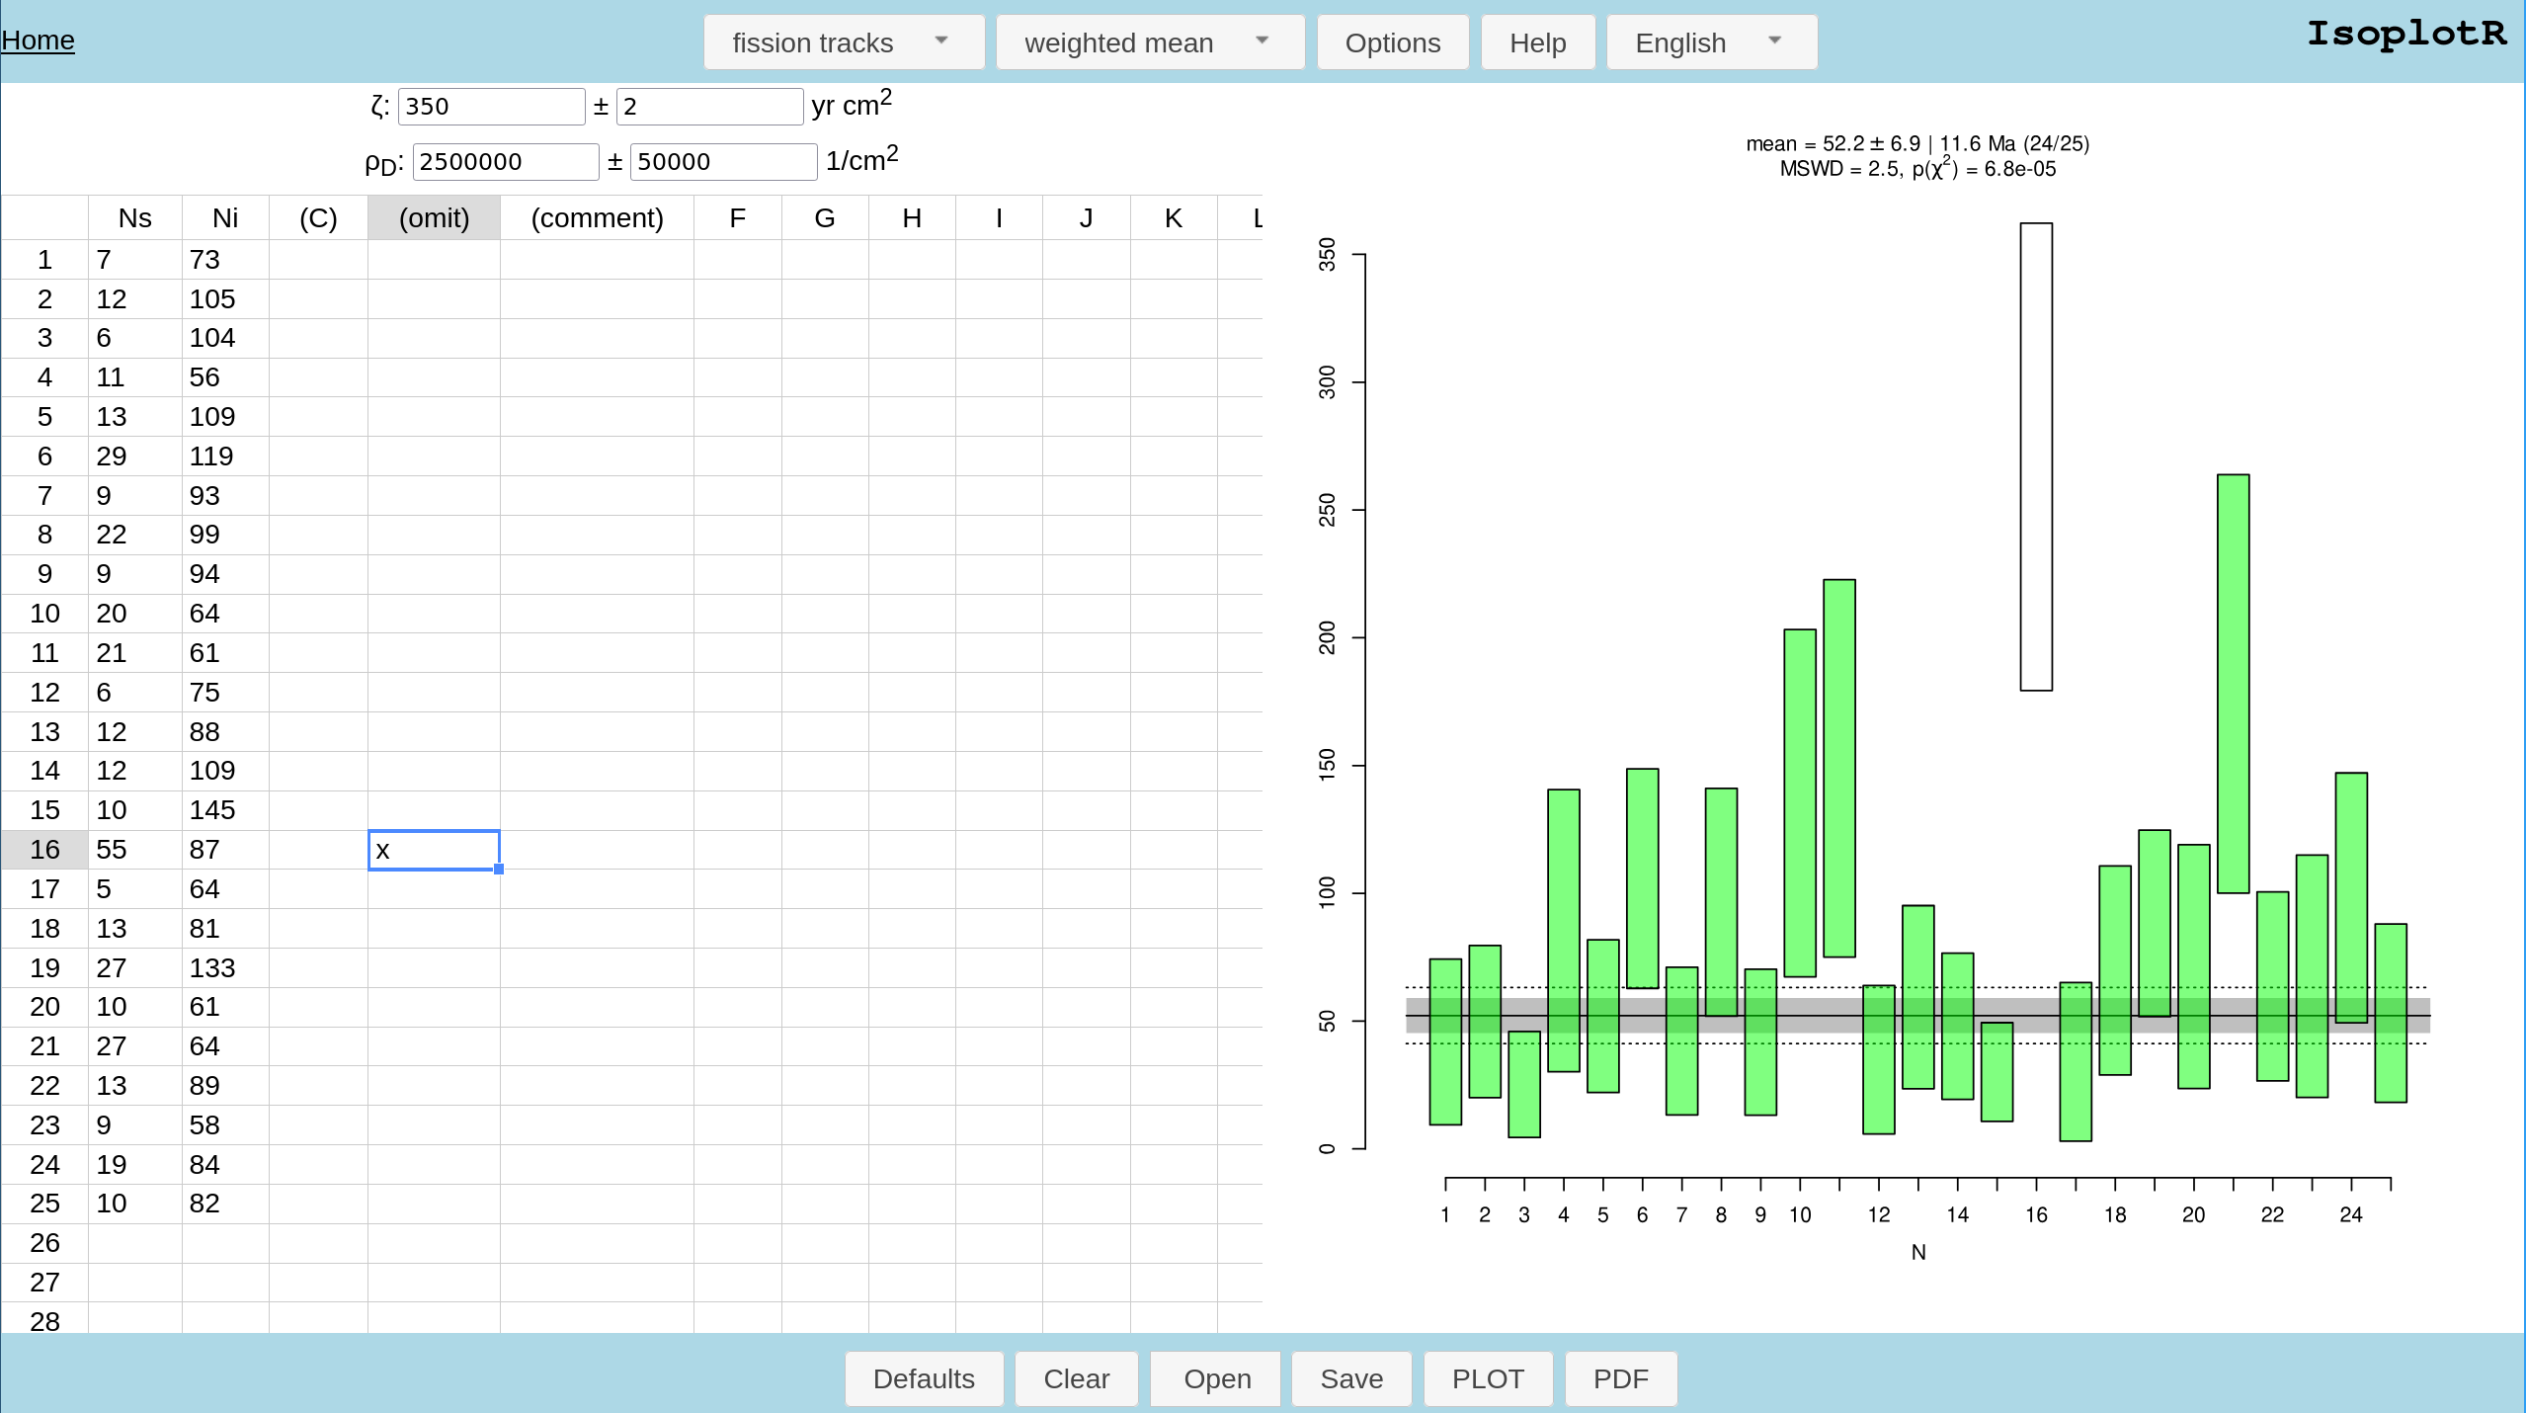

Slide 17
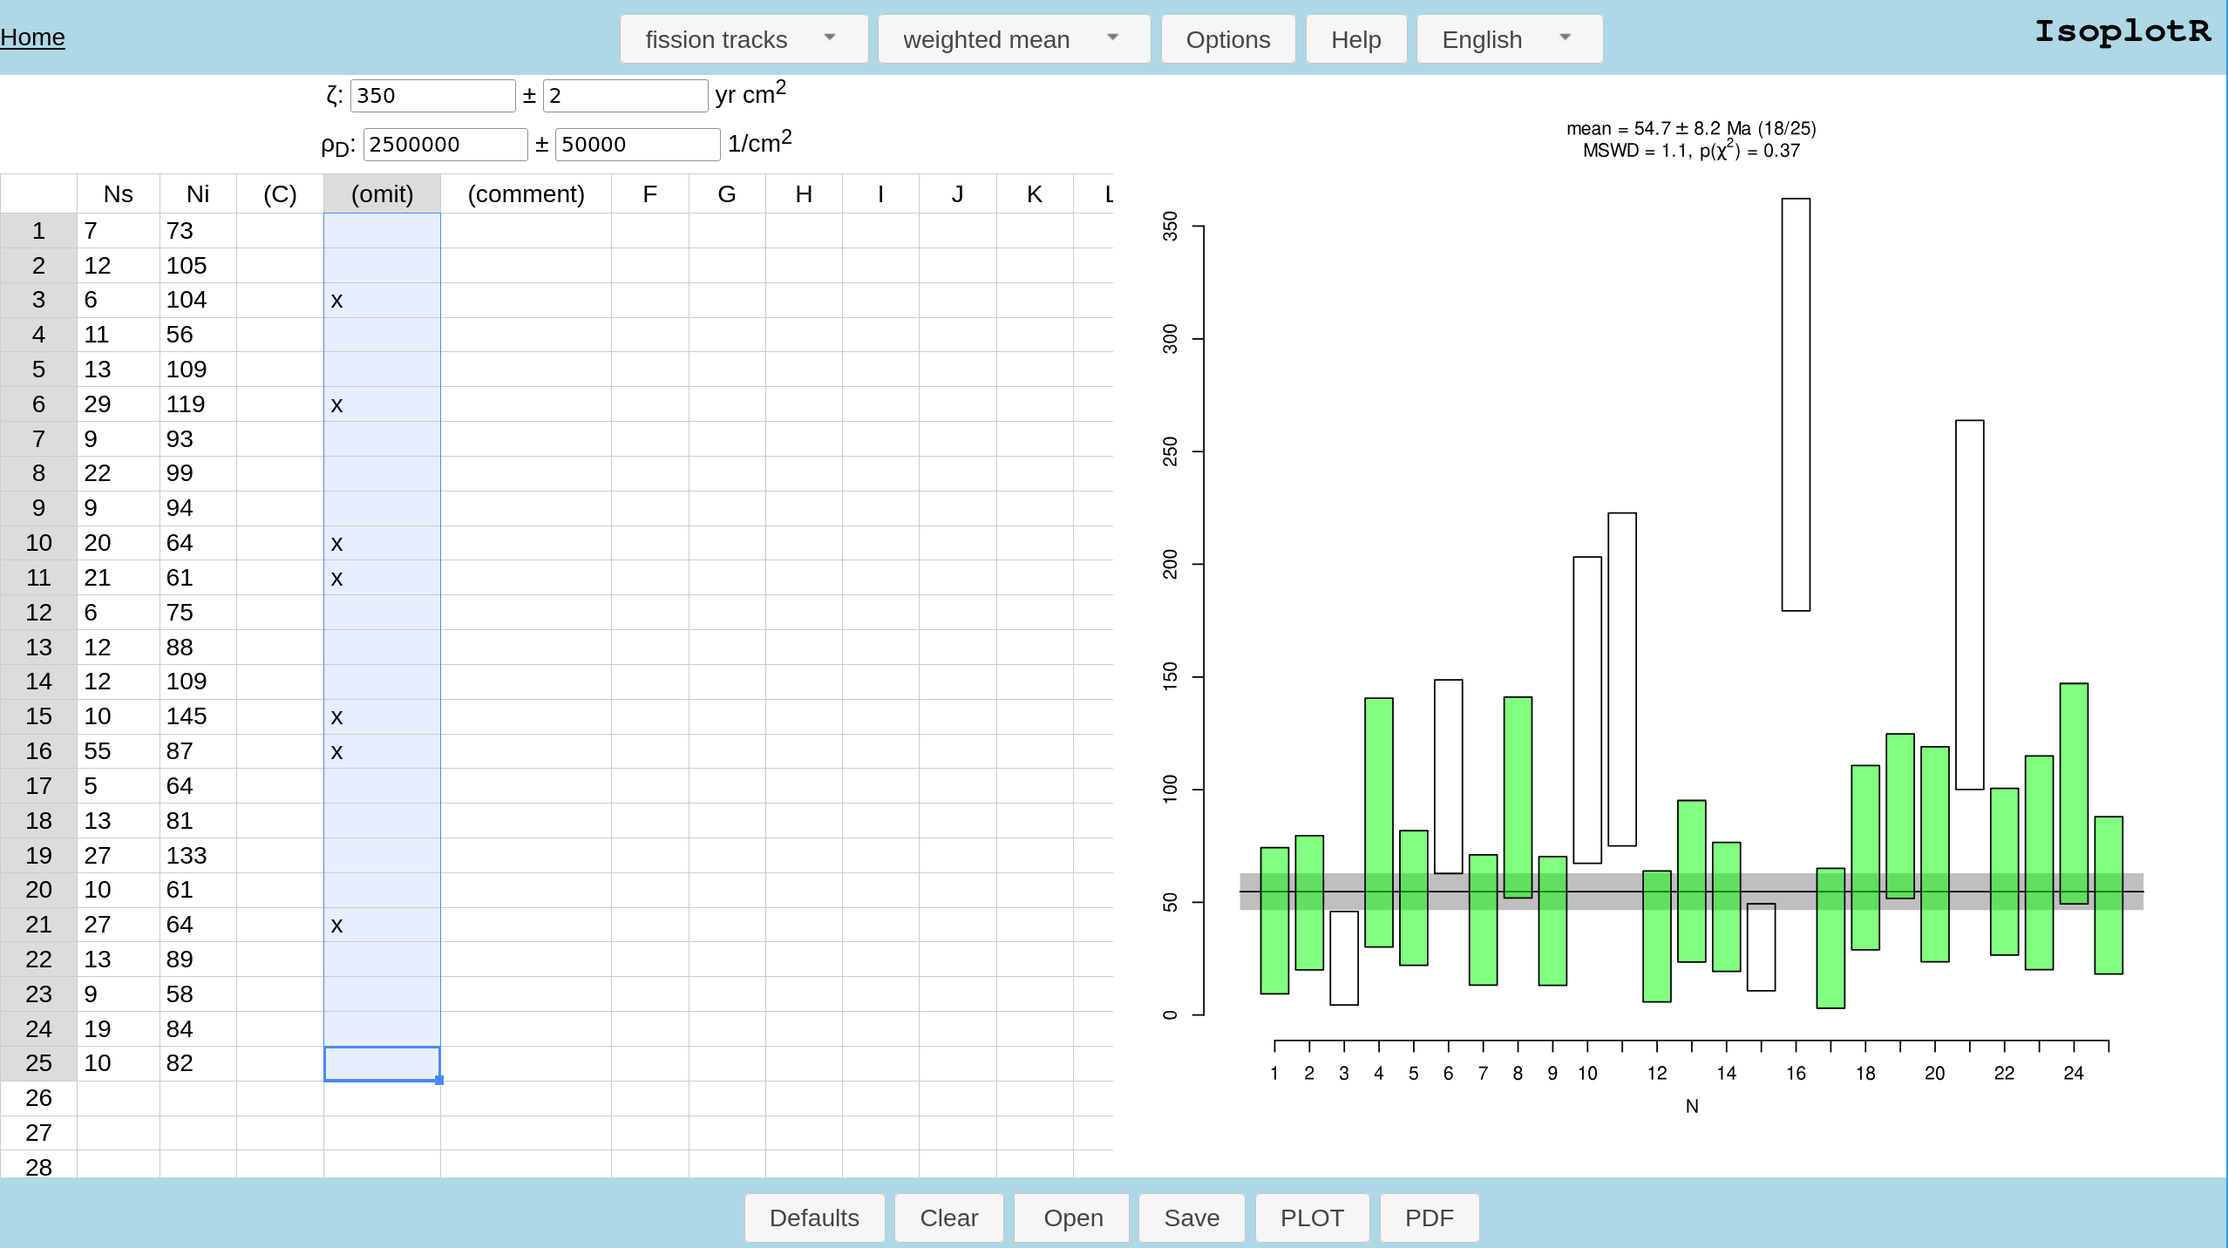

Slide 18
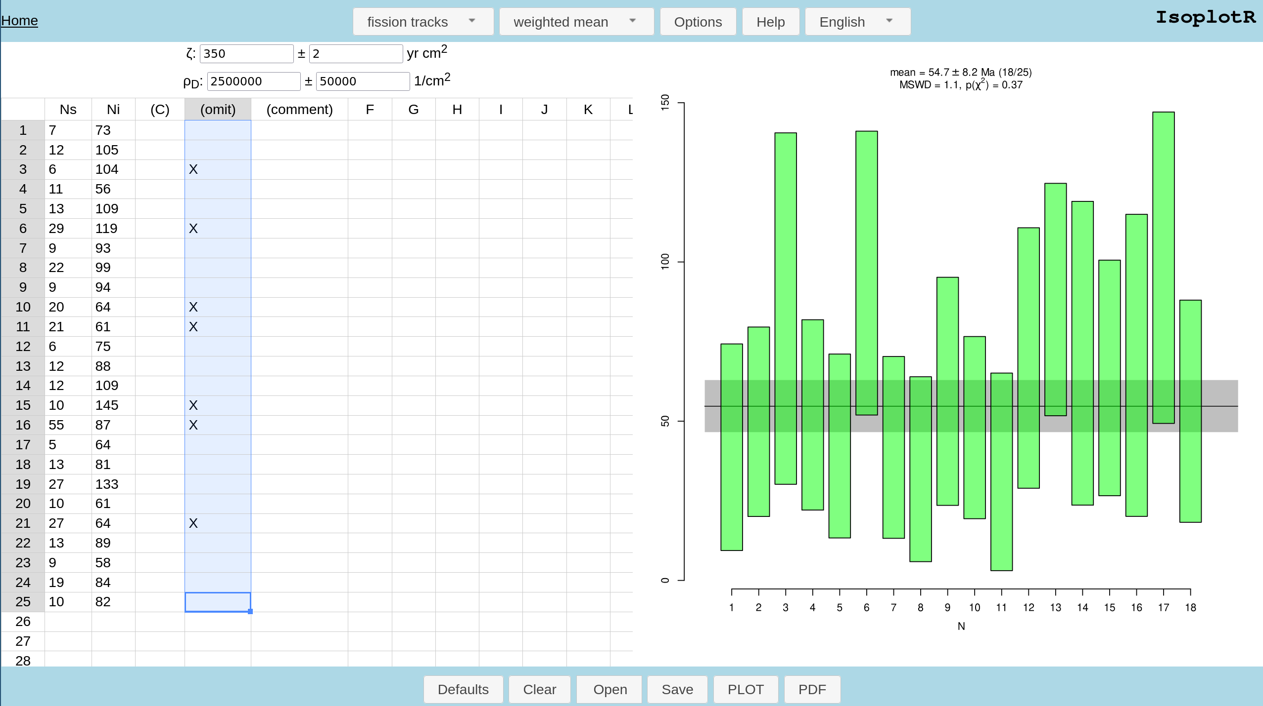

Slide 19

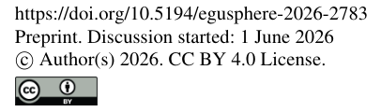
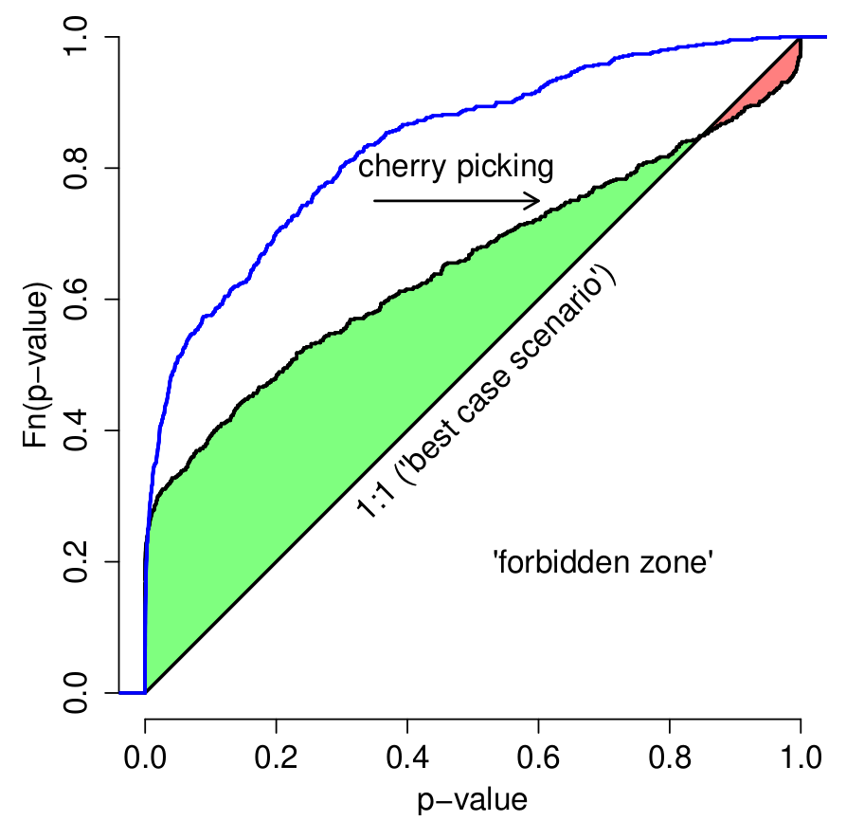


Slide 20
“… with an n of 20 the acceptable [MSWD] is 0.35-1.65 […] Weighted averages with [MSWD] values that fall outside of this range should not be used”

Slide 21

Use this paper to defend yourself against misinformed reviewers

Slide 22
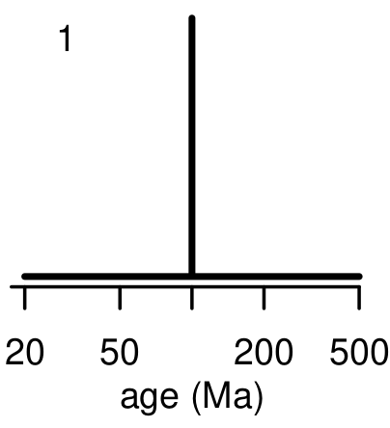
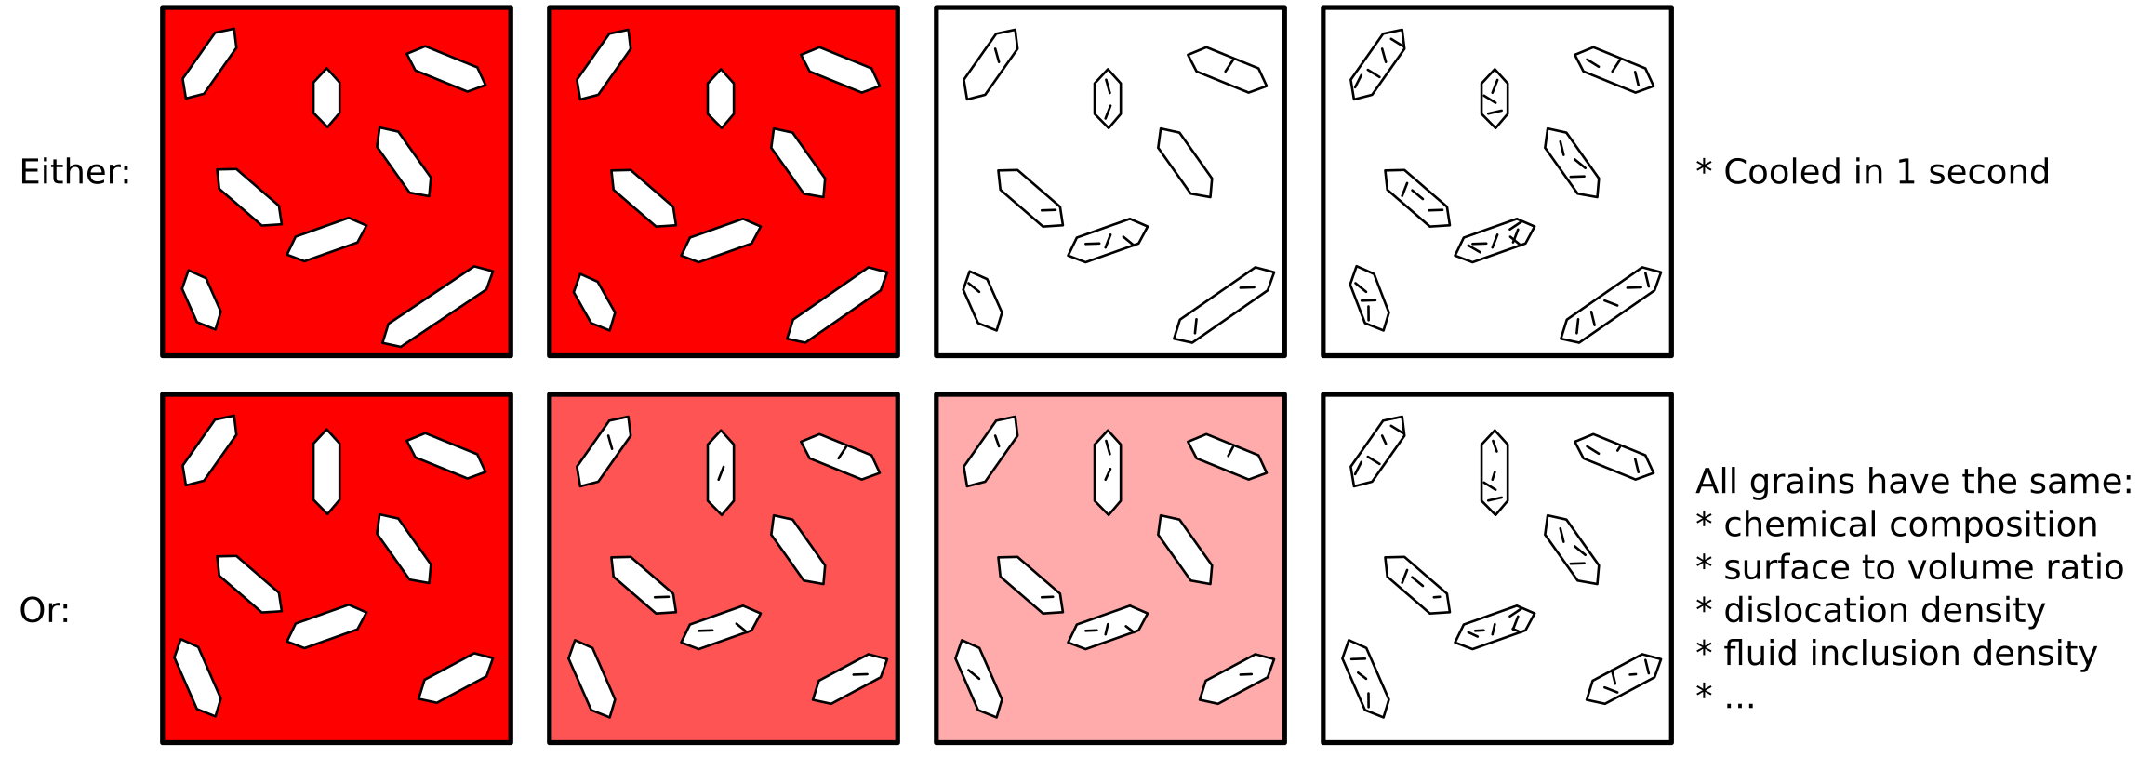
What it means to NOT be overdispersed:
300 Ma
200 Ma
100 Ma
today

Slide 23
MSWD≈1
MSWD ≫ 1
Ages:
FT dates:
U-Th-He
dates:

Slide 24
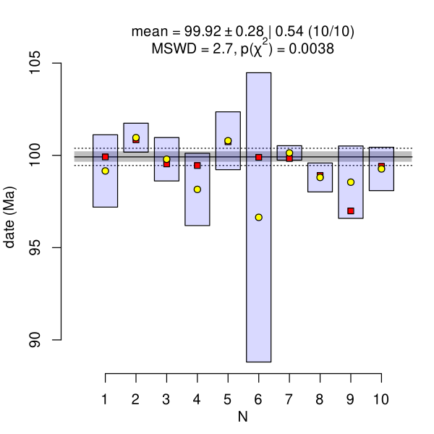
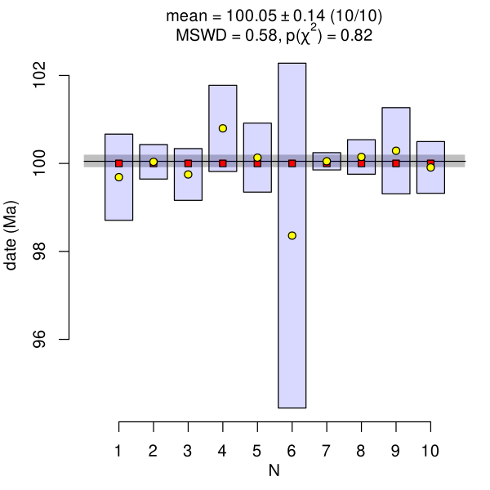

Slide 25
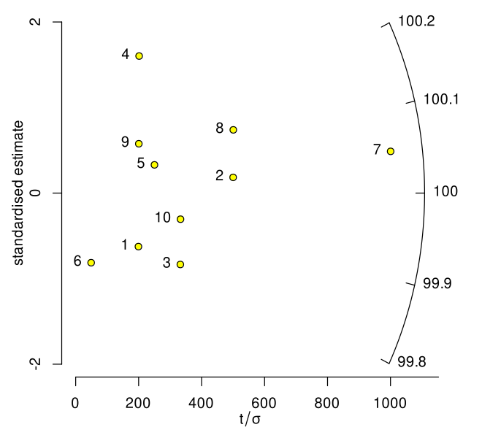
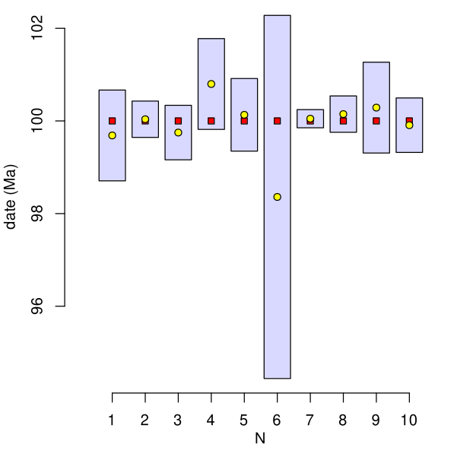
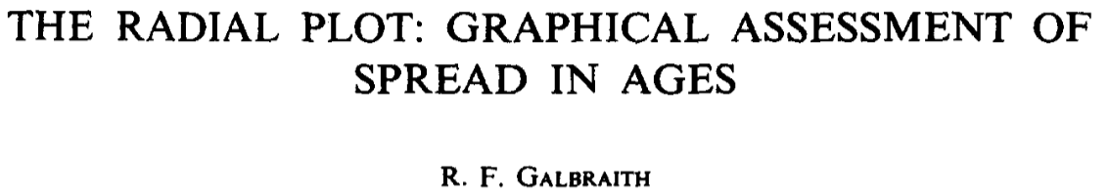

Slide 26
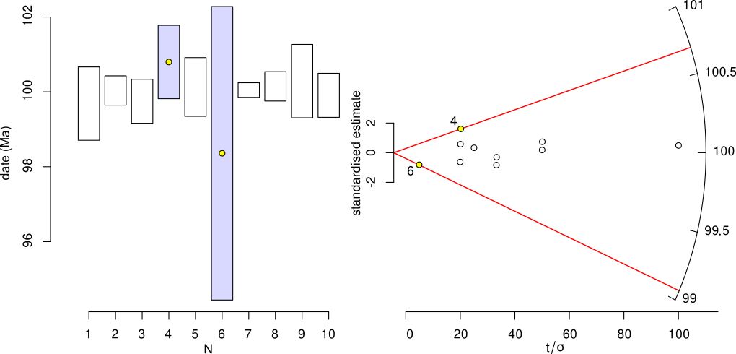
t
log(t/t0)
σ

Slide 27
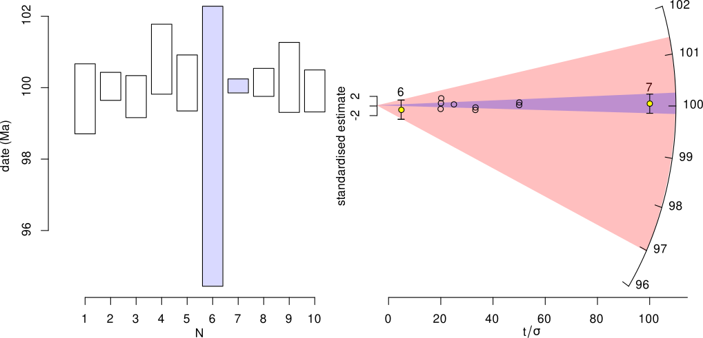

Slide 28
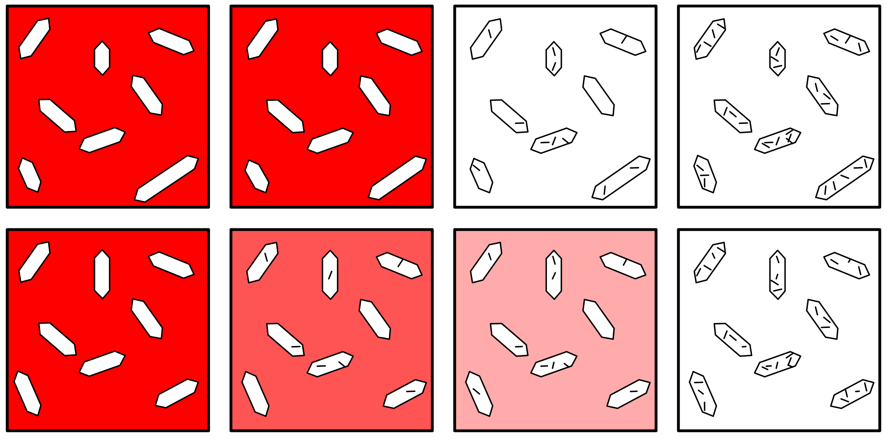
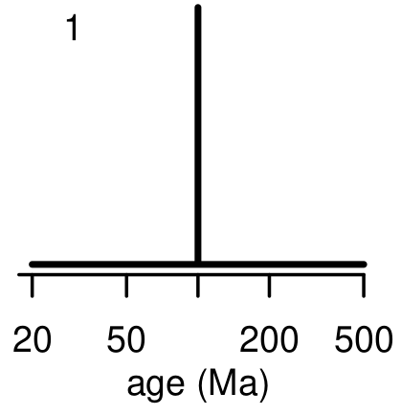
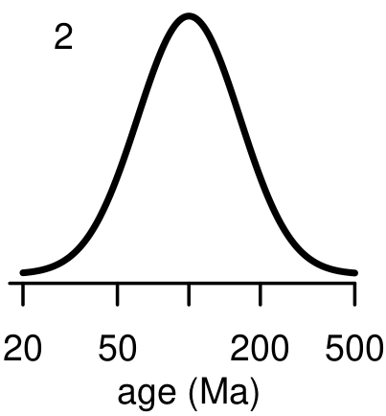




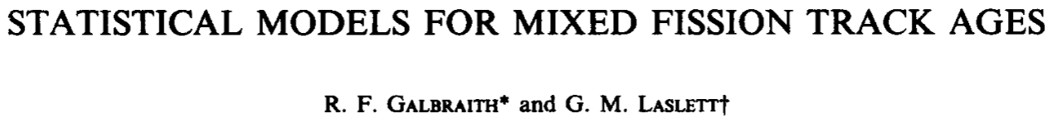
300 Ma
200 Ma
100 Ma
today
Central age
dispersion

Slide 29
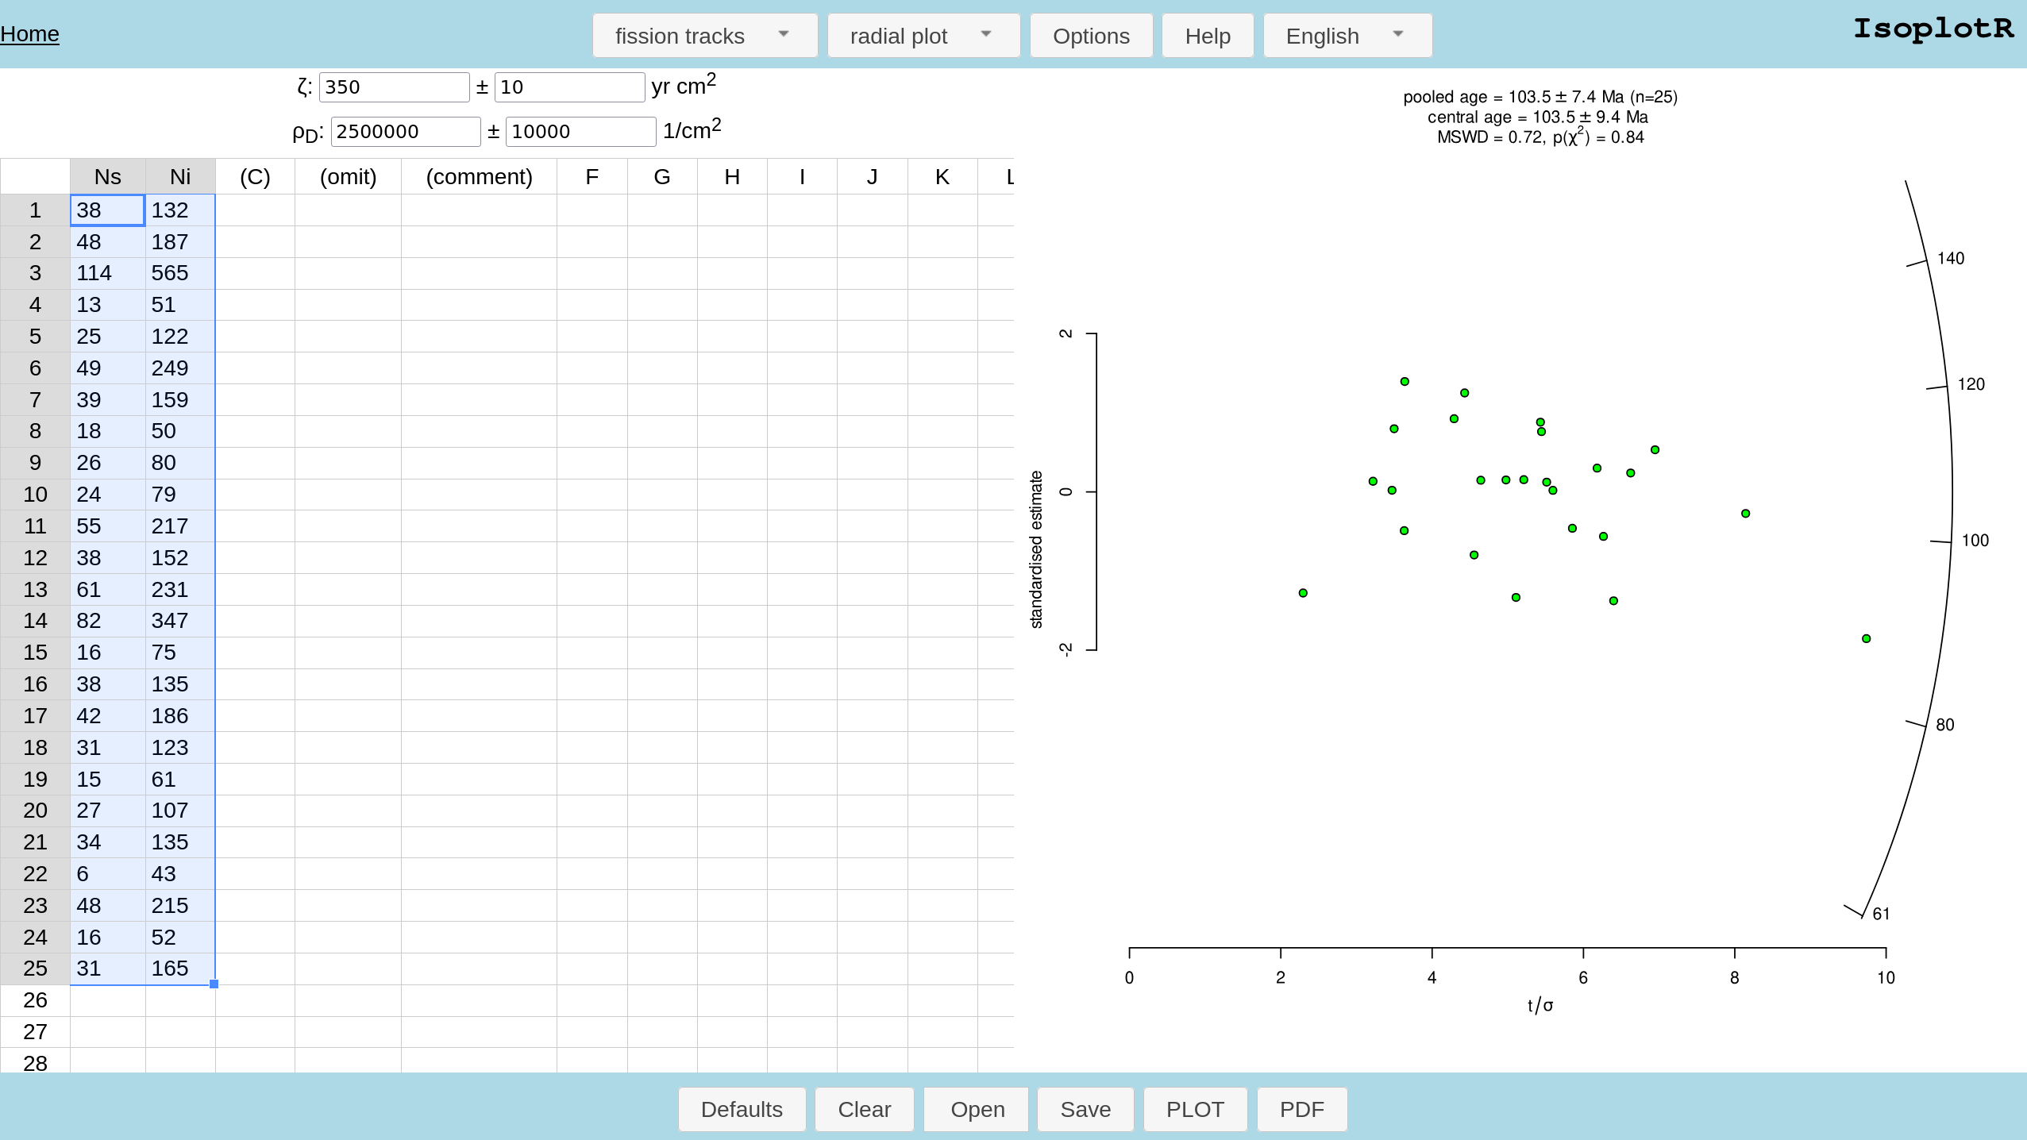
default
dataset
pooled = central

Slide 30

pooled ≠ central
FT2.json

Slide 31


Slide 32

pooled ≠ central
despite passing the χ²-test!

Slide 33
Ages:
FT dates:
U-Th-He
dates:

Slide 34



Slide 35


θ2,1-π1
θ1,π1

Slide 36



How many peaks to fit?

Slide 37


Ages:

Slide 38


Slide 39
The minimum age drifts to younger ages with increasing sample size

Slide 40


Ages:

Slide 41

Ages:
Fission tracks
U-Th-He

Slide 42

FT3.json

Slide 43

FT4.json

Slide 44


Slide 45

Ages:
3p-1 parameters, including p σs→ requires very large datasets

