Slide 1



Slide 2
Quiz:
During WWII, the British Royal Air Force looked at where returning planes had been hit by flak. They decided to add armour to the most damaged areas (the wing tips and fuselage).
The statistician Abraham Wald told them they were doing the exact opposite of what they should do. He suggested armouring the places where there were no bullet holes (the engines and cockpit).
What was his reasoning?

Slide 3
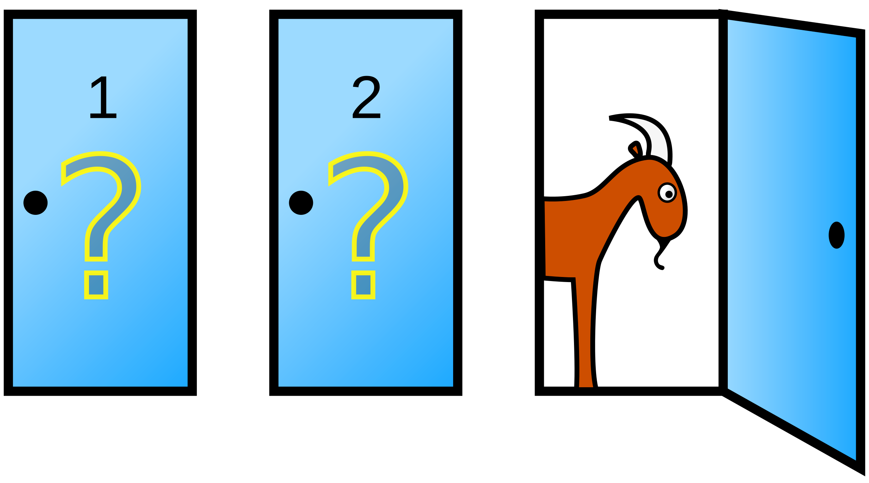
You are a contestant on a game show with three closed doors. One door hides a car, and the other two hide goats. You choose one door (for example, Door 1). The host, who knows what is behind each door, then opens a different door (for example, Door 3) and reveals a goat. The host then offers you the option to switch your choice to the remaining unopened door (Door 2). Should you switch doors to improve your chances of winning the car?

Slide 4
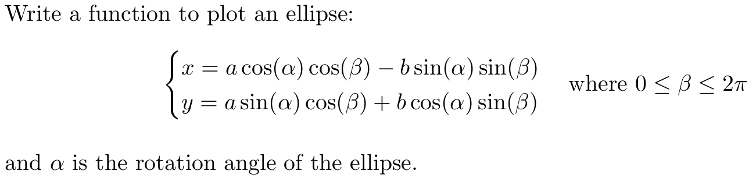

Slide 5
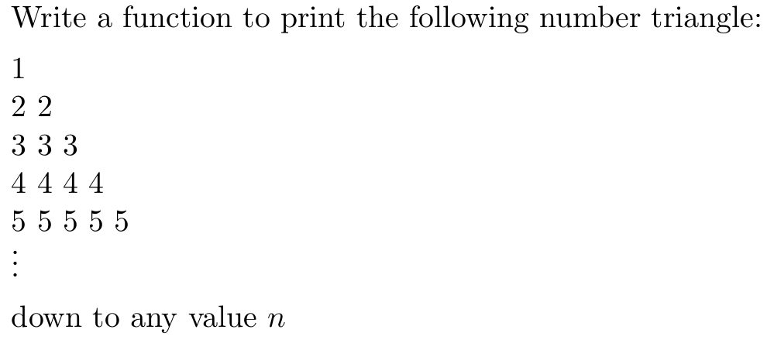

Slide 6


Slide 7
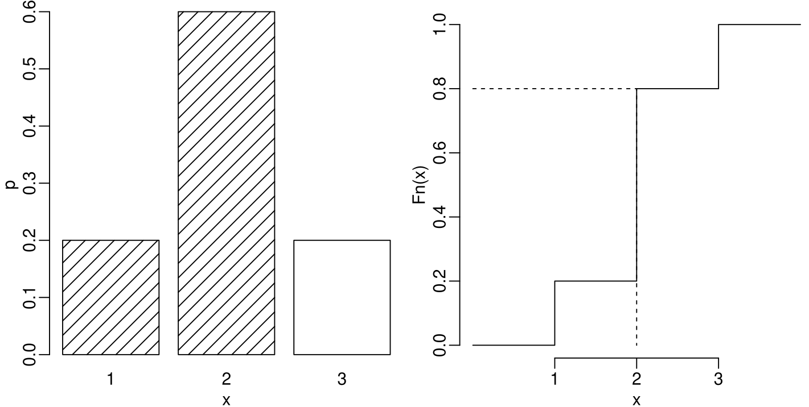
A discrete distribution:

Slide 8
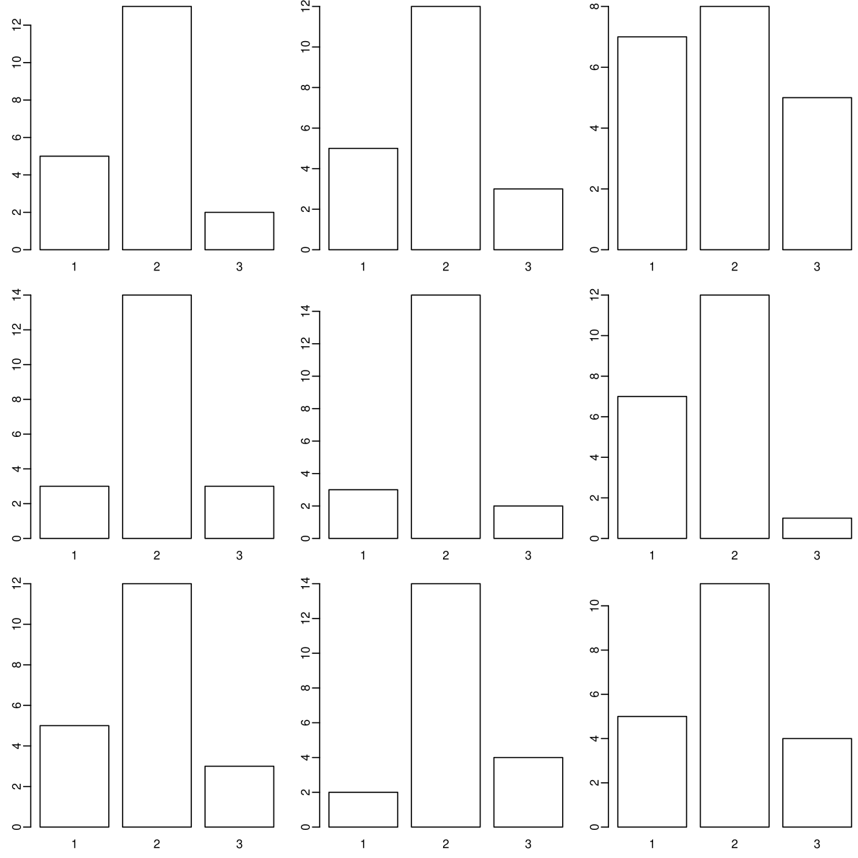
9 random samples
of 20 values from
the distribution:

Slide 9
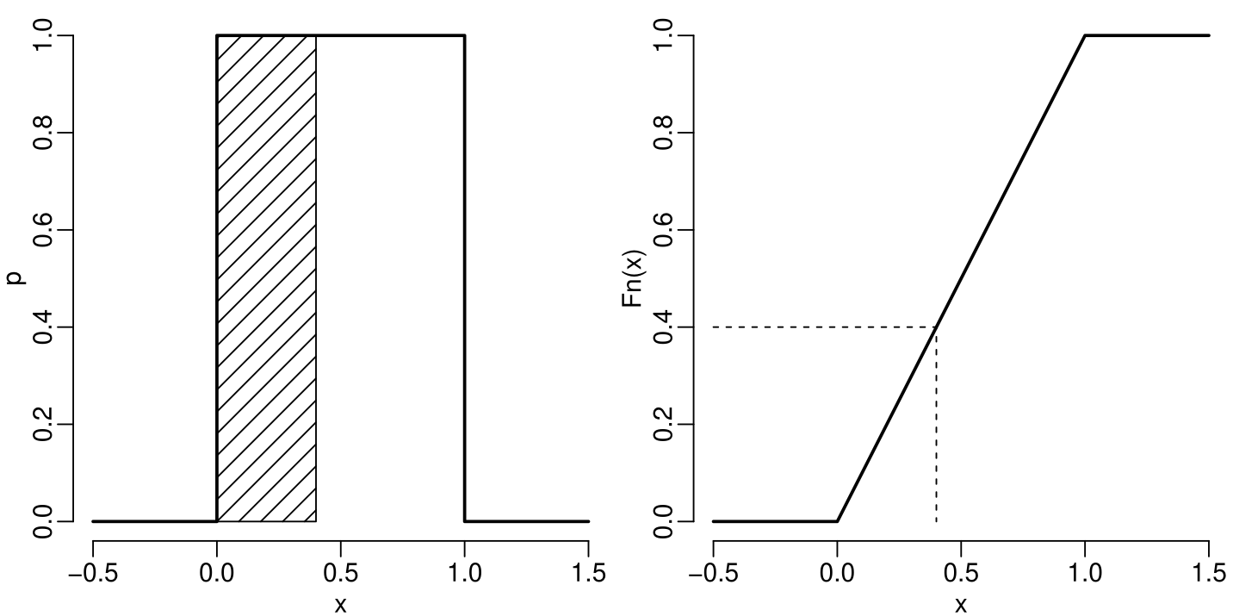
A continuous distribution:

Slide 10
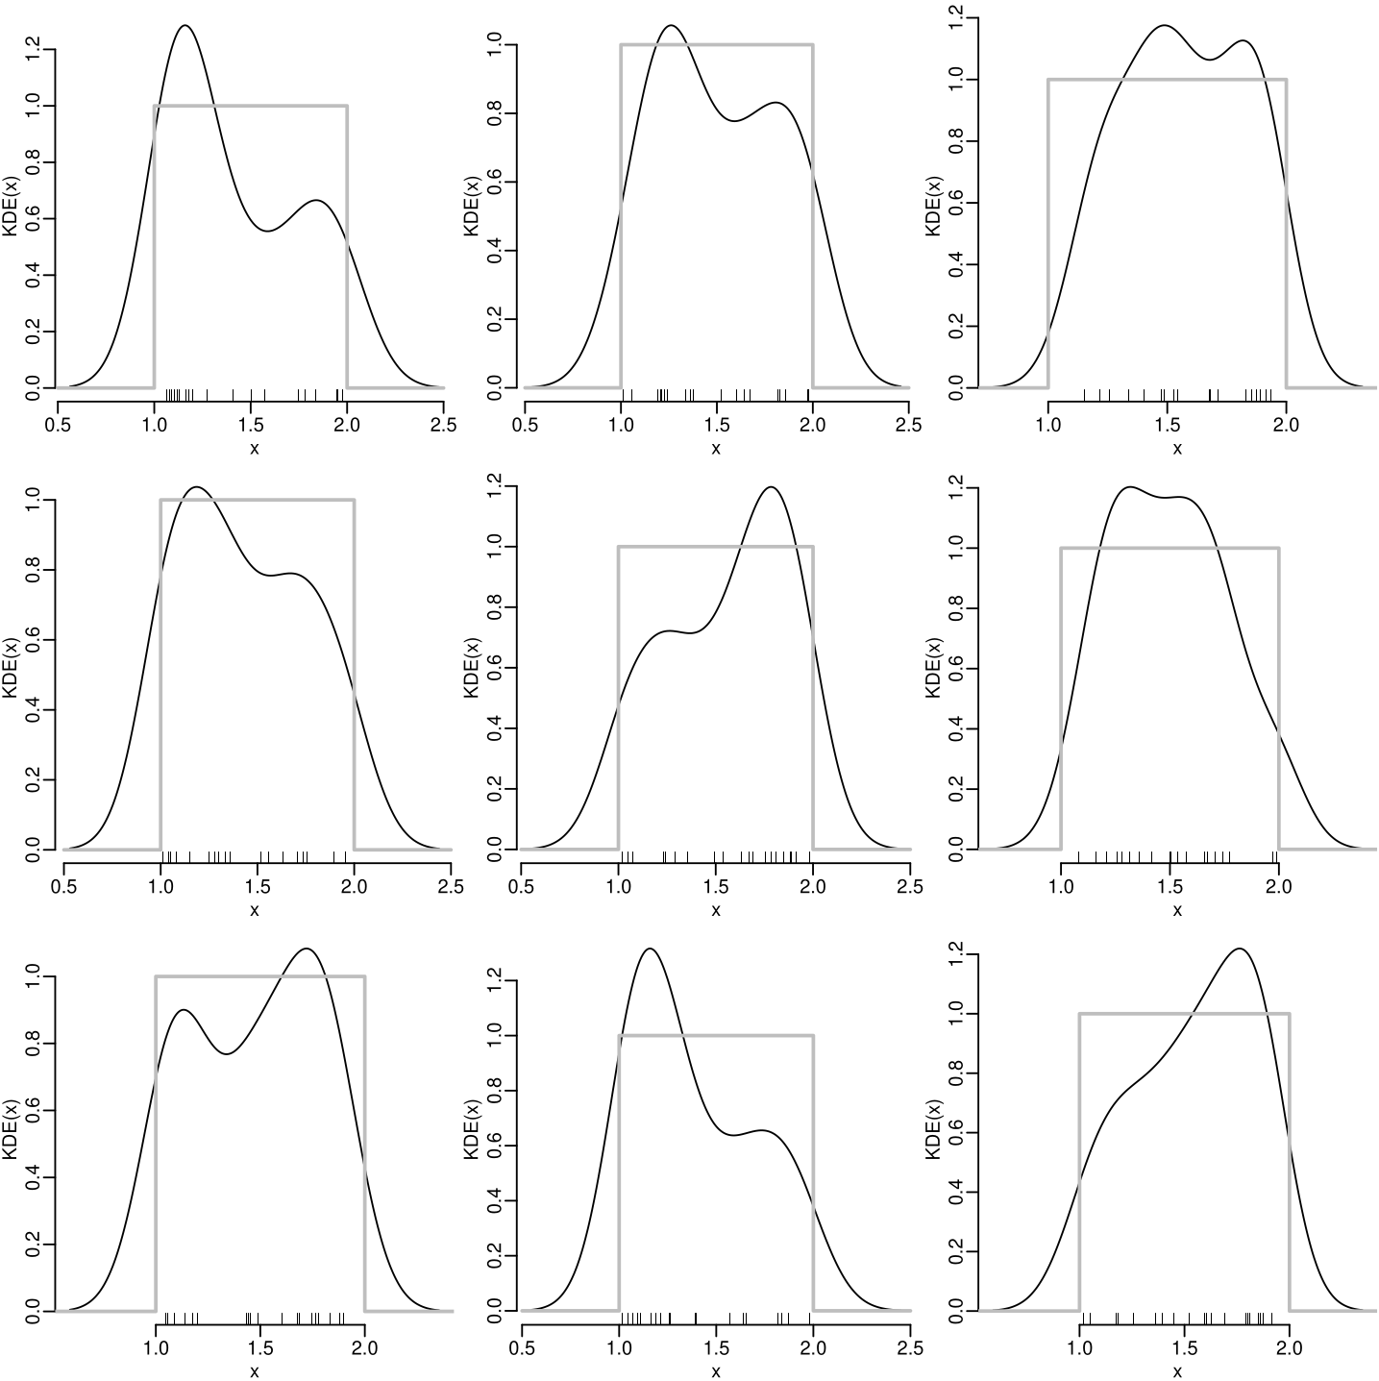
9 random samples
of 20 values from
the distribution
(bandwidth = 0.1):

Slide 11
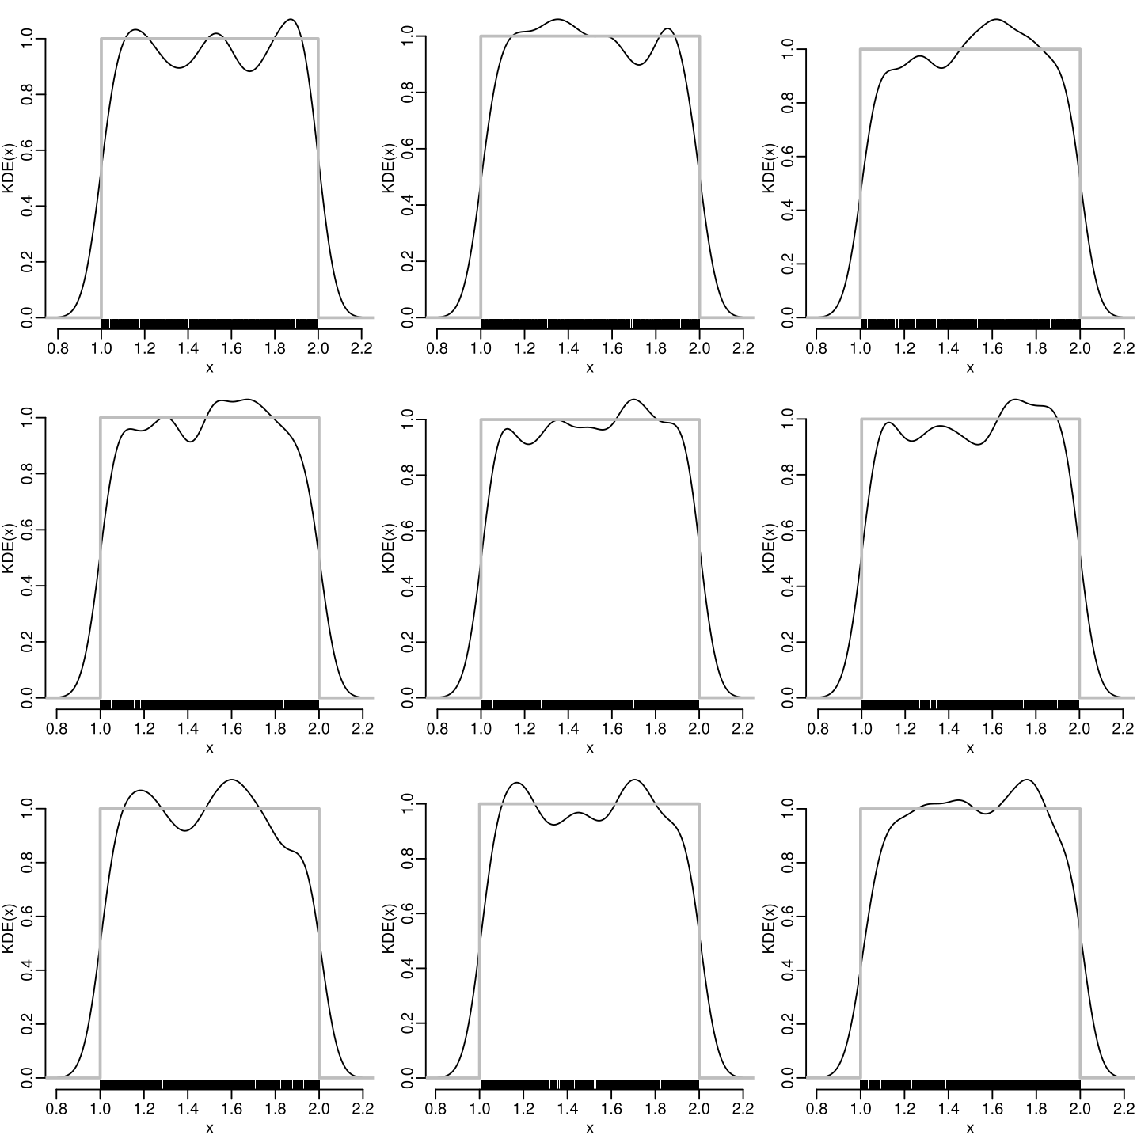
9 random samples
of 1000 values from
the distribution
(bandwidth = 0.01):

Slide 12
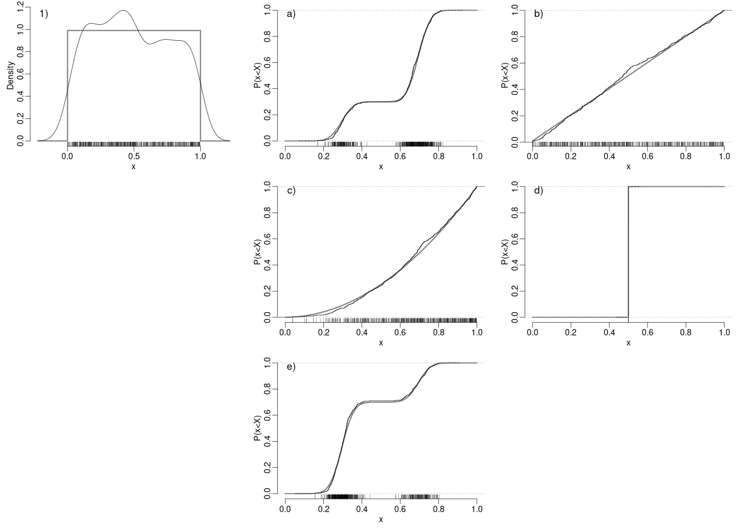

Slide 13
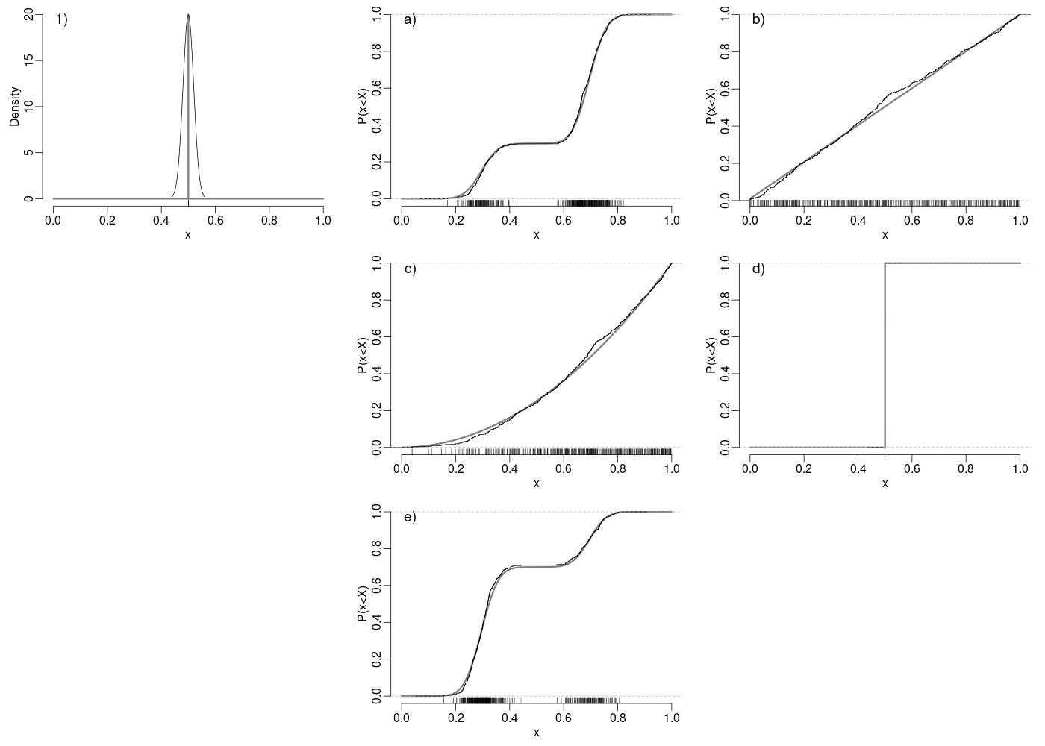

Slide 14
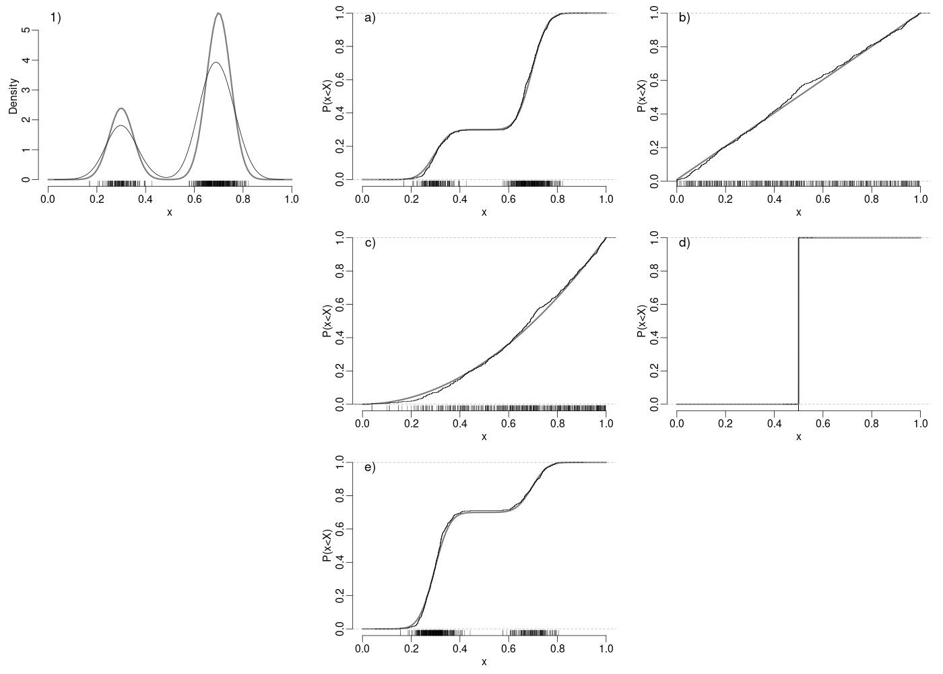

Slide 15
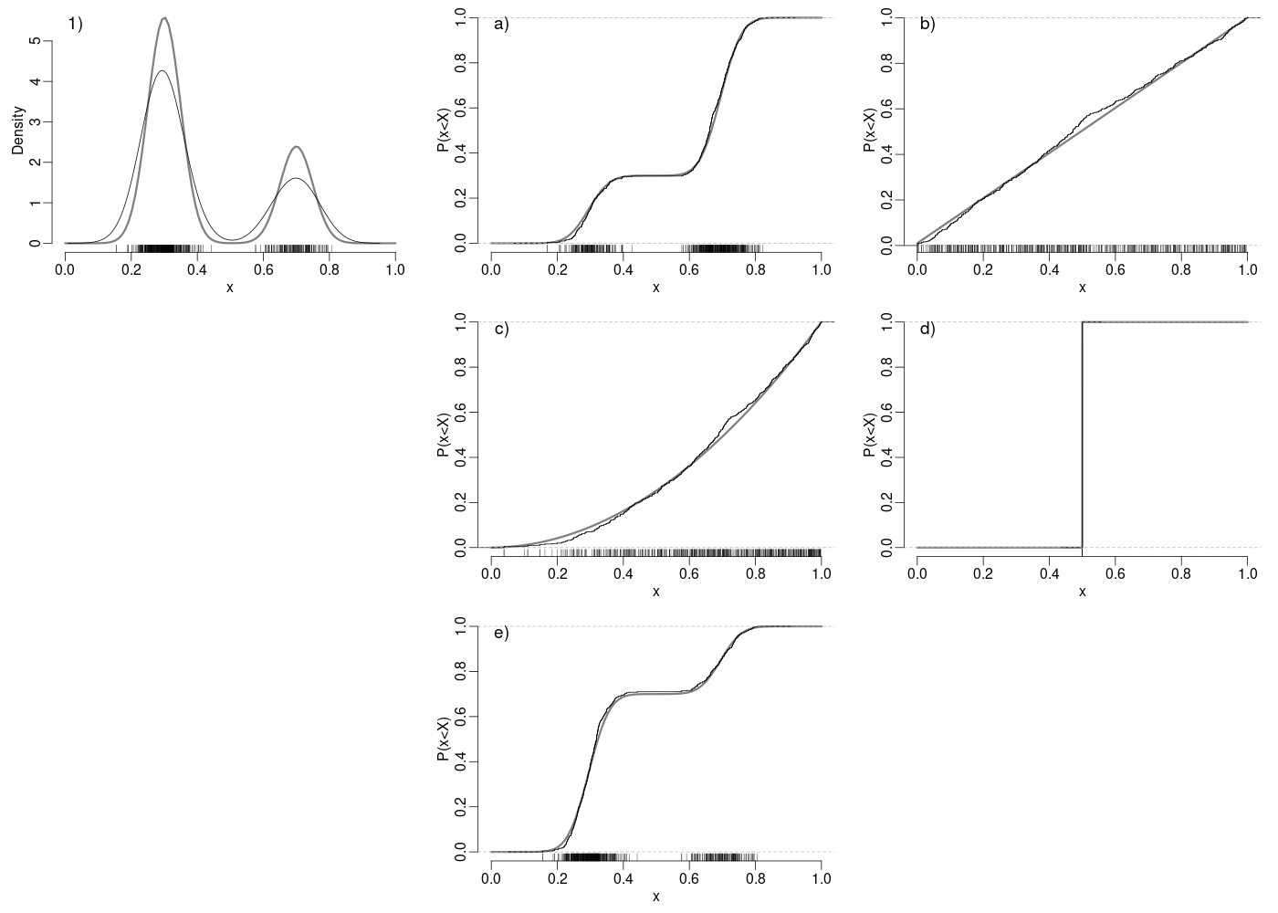

Slide 16
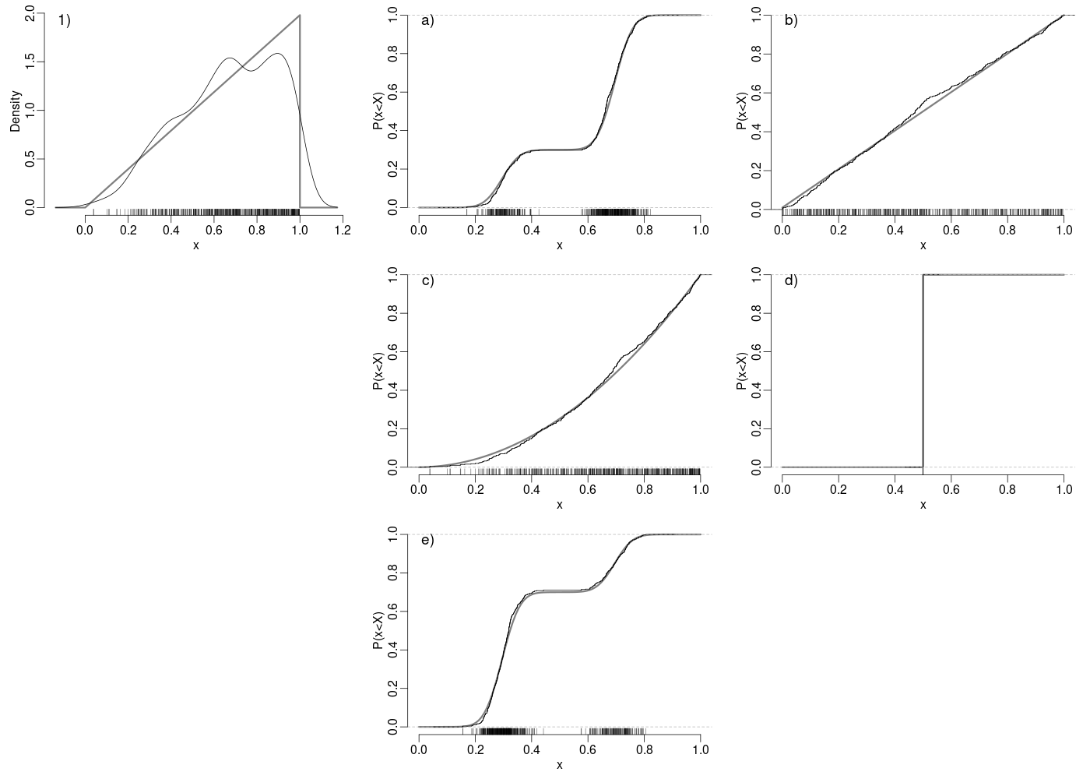

Slide 17
Generate two samples (A and B, say) of 100 random numbers between 0 and 1
Calculate the ratios A/B and B/A
Create a 4 x 4 figure with KDEs and rug plots of A/B, B/A, ln(A/B) and ln(B/A).

Slide 18


Slide 19
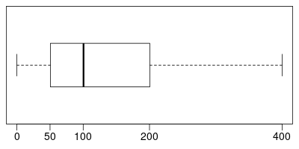
1. Is this sample positively or negatively skewed?
2. What is its interquartile range?

Slide 20
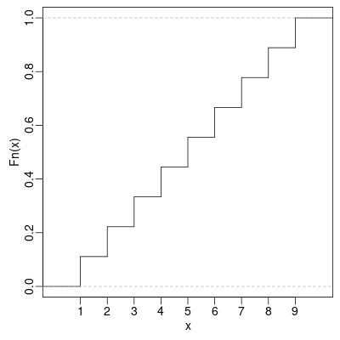
What is the third quartile of this distribution?

Slide 21
Using R, generate two samples (A and B) of 100 random numbers between 0 and 1, and calculate their logratio ln(A/B). Repeat 10 times and visualise the results as a box plot.

Slide 22


Slide 23

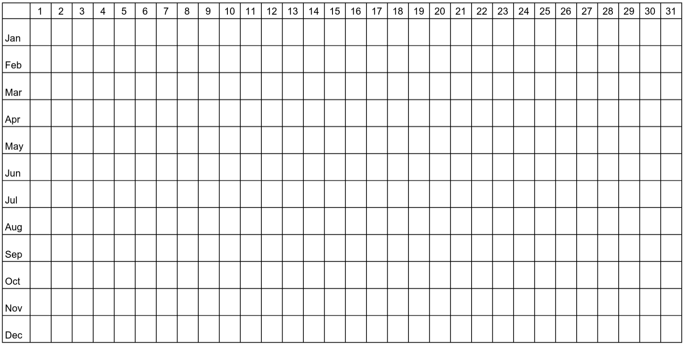
https://www.menti.com/alqnaz9suej4

Slide 24
How many ways are there to draw a hand of 2 cards from a deck of 52 when the order of the hand matters?

Slide 25
How many ways are there to draw a hand of 2 cards from a deck of 52 when you don't care about the order of the hand?

Slide 26
How many ways are there to shuffle 4 cards?

Slide 27
How many ways are there to pick 3 geologists from a group of 5?

Slide 28
95% of iron ore deposits are characterised by magnetic anomalies, and so are 98% of chromium deposits, and 1% of other rocks. 0.1% of all rocks contain iron ore, and 0.05% of rocks contain chromium ore. Suppose that we have found a magnetic anomaly. What is the probability that this is caused by an ore deposit?

Slide 29
How many ways are there to shuffle 52 cards?
(use R)

Slide 30
How many ways are there to rank one million people?
(use R)

Slide 31
How many ways are there to draw 6 lottery numbers from a collection of 59?
The order of the numbers does not matter.
(use R)

Slide 33
What is the chance of guessing two of these multiple choice questions right?
Question 1
Answer a
Answer b
Answer c
Answer d
Question 2
Answer a
Answer b
Answer c
Answer d
Question 3
Answer a
Answer b
Answer c
Answer d
Question 4
Answer a
Answer b
Answer c
Answer d

Slide 34
A Scottish geology student goes mapping on five occasions.
There is an 80% chance of rain per trip. What is the probability
that the student enjoys at least two dry mapping trips?

Slide 35
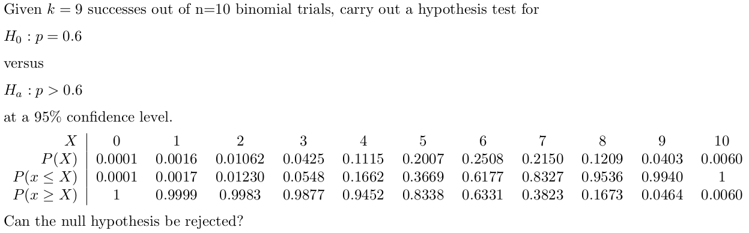

Slide 36
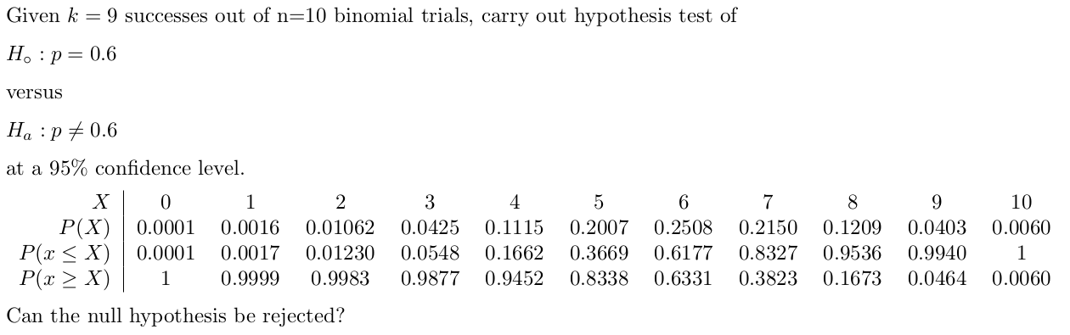

Slide 37
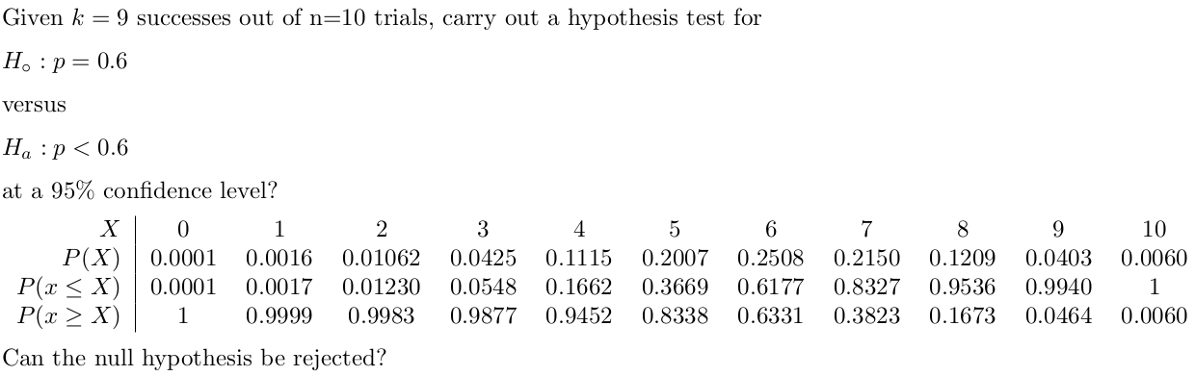

Slide 38
Using R, calculate:
1. the probability of throwing 3 or 4 heads with 10 tosses of an unbiased coin;
2. the probability of throwing 100 fair dice and obtaining 20 or fewer times ⚅ ;
3. the 95 percentile of a binomial distribution with n=100 and p=0.5.

Slide 39
We believe that 50% of all dinosaur fossils are female (and 50% are male).
A bone bed contains 50 dinosaur fossils among which 32 are female
(and 18 are male). Do we have enough evidence to prove that the proportion
of males and females is different? Do our data support the notion that
females are more common than males?

Slide 40
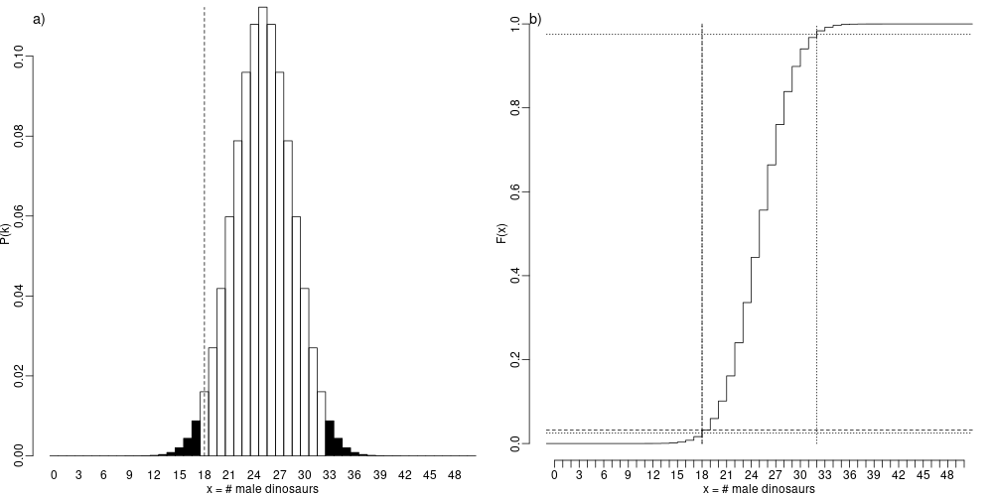
H0: p = 0.5
Ha: p ≠ 0.5
qbinom(p=c(0.025,0.975),size=50,prob=0.5)
k=18
pbinom(q=18,size=50,prob=0.5)
qbinom(p=c(0.025,0.975),size=50,prob=0.5)
Alternatively: binom.test(x=18,p=0.5,n=50,alternative='two.sided')

Slide 41
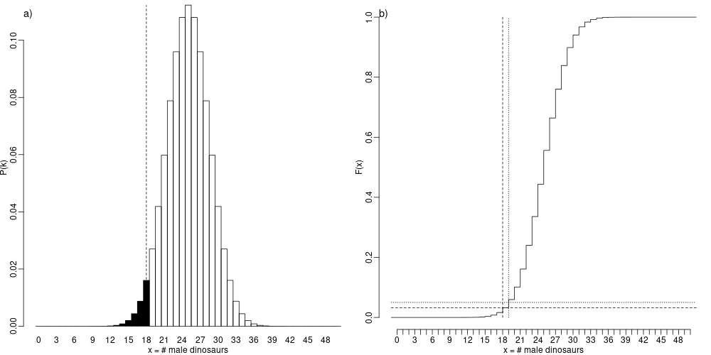
H0: p = 0.5
Ha: p < 0.5
qbinom(p=0.05,size=50,prob=0.5)
k=18
pbinom(q=18,size=50,prob=0.5)
qbinom(p=0.05,size=50,prob=0.5)
Alternatively: binom.test(x=18,p=0.5,n=50,alternative='less')

Slide 42
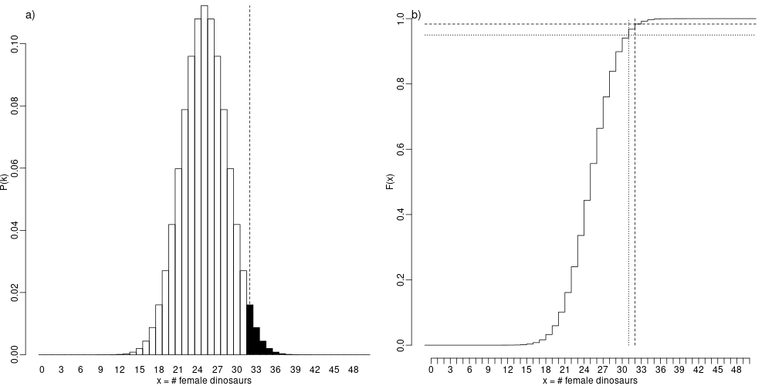
H0: p = 0.5
Ha: p > 0.5
k=32
pbinom(q=32,size=50,prob=0.5)
qbinom(p=0.95,size=50,prob=0.5)
qbinom(p=0.95,size=50,prob=0.5)
Alternatively: binom.test(x=32,p=0.5,n=50,alternative='greater')

Slide 44
For a fixed sample size, the probability of committing a type 1 error
a. increases with decreasing significance level
b. decreases with decreasing significance level

Slide 45
For a fixed sample size, the probability of committing a type 2 error
a. increases with decreasing significance level
b. decreases with decreasing significance level

Slide 46
Increasing sample size decreases the probability of incurring:
a. only type 1 errors
b. only type 2 errors
c. both type 1 and type 2 errors
d. neither type 1 nor type 2 errors

Slide 47
Consider the following hypothesis test:
H0: p = 0.8
Ha: p < 0.8
Suppose that the true value of p = 0.2
What is the power of the Binomial test for n = 3 and α = 0.05?

Slide 48
Using R, determine the rejection region for the following binomial hypothesis test:
H0: p=0.1
vs.
Ha: p<0.1
for n=1000 and α=0.01

Slide 49
Using R, compute the probability of committing a type-2 error for the following binomial hypothesis test:
H0: p=0.1
vs.
Ha: p<0.1
for n=1000 and α=0.01 when the true parameter value is p=0.07.

Slide 51
What is the lower limit of a 95% confidence interval for a Bernoulli experiment with =0 successes out of =10 tries?

Slide 52
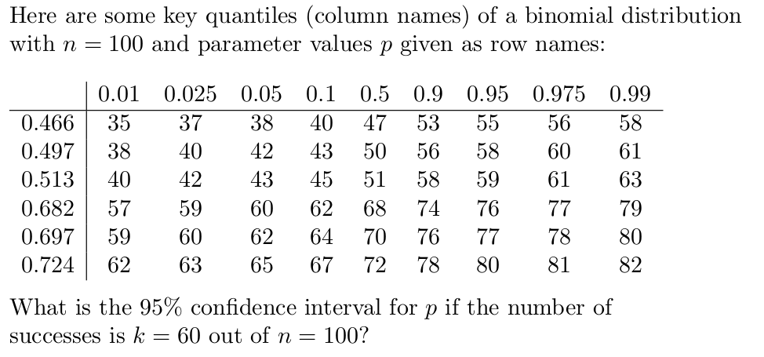

Slide 53
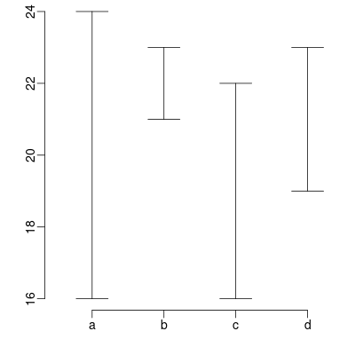
Four estimated 95% confidence intervals for a binomial parameter are shown as error bars:
Assuming that all four estimates were drawn from the same population, which of these samples is the biggest (has the biggest )?

Slide 54
What is the upper limit of a 95% confidence interval for a Bernoulli experiment with =0 successes out of =10 tries?

Slide 55
Suppose that we have counted 20 pollen and counted the number of arboreal (A) or non-arboreal (N) species among them. Further suppose that the true arboreal/non-arboreal pollen ratio in the soil is 4. What is probability that the arboreal/non-arboreal ratio of the 20 counts is 9 or greater?
Hint: can you calculate p(A) from p(A)/p(N)?

Slide 56
Given =12 arboreal pollen and =8 non-arboreal pollen, compute a 95% confidence interval for the /-ratio of the soil.

Slide 57
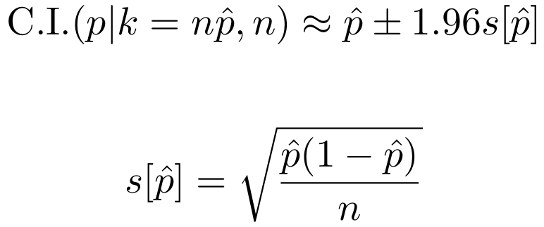
Given the approximate formula for binomial 95% confidence intervals:
How large a sample do you need to reduce the width of a 95% confidence interval for p to 0.01 when k/n = 0.5?

Slide 59
Consider a sequence of 20 Poisson numbers that add up to 80. What is the standard deviation of the underlying Poisson distribution?

Slide 60
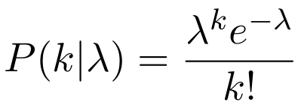
On average a magnitude ≥ 9 earthquake occurs once every 13.5 years.
What is the probability that two such earthquakes will happen next year?
What is the probability that none will happen in the next century?

Slide 61
Sally Clark was an English solicitor who, in November 1999, was found guilty of the murder of her two infant sons. Clark's first son died in December 1996 within a few weeks of his birth, and her second son died in similar circumstances in January 1998. A month later, she was arrested and tried for both deaths. The defense argued that the children had died of sudden infant death syndrome (SIDS). The prosecution case relied on statistical evidence presented by paediatrician Professor Sir Roy Meadow, who testified that the chance of two children from an affluent family suffering SIDS was 1 in 73 million.
In January of 2003, there was a retrial and Sally Clark was cleared of all guilt, after spending more than three years in prison. This is because Sir Roy made three statistical mistakes. Can you identify at least one of them?

Slide 62
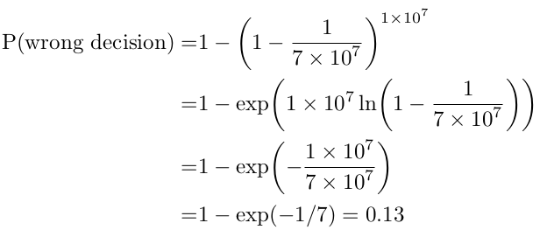


1. Multiple comparisons
(assuming 1 in 7x10⁷ value is correct):
2. Statistical independence: P(1st SIDS) = 1/1300, P(2nd SIDS) = 1/228
3. The "prosecutor's fallacy":
(it is not)
P(1st homicide) = 1/21700, P(2nd SIDS) = 1/123

Slide 63
Using R:
compute the probability of k=6 successes in a Poisson experiment with parameter λ=3.
compute the probability of observing more than 3 successes in a Poisson experiment with λ=3.
compute the 10th percentile of a Poisson distribution with λ=100.
compute the upper limit of a 95% confidence interval for the mean of the Poisson variable given k=7 successes.

Slide 64
The Orange River in South Africa is famous for its alluvial diamonds. In order for mining operations to be profitable, placer deposits must contain at least 2 diamonds per tonne. A diamond mining company has sieved 10 tonnes of sand and found 12 diamonds. Assuming that the diamonds are randomly distributed in the sand, should the company cease operations? Or would it be premature to do so and should they acquire some more data first?

Slide 66
A 10x10 grid of Poisson values sharing the same parameter 𝜆 are summed together. What is the distribution of the sum?
a. Poisson
b. Normal and (approximately) Poisson
c. Normal
d. Poisson and (approximately) normal

Slide 67
IQ scores follow a normal distribution with a mean of 100 and a standard deviation of 15. Approximately what percentage of the population has an IQ of more than 130?

Slide 68
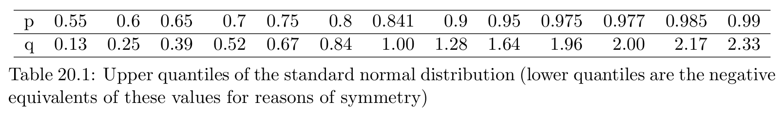
The ℮-symbol on packaging guarantees consumers that they receive at least the amount of product that they paid for. For example, 0.75 L℮ means that at most 1.5% of the containers with this label are allowed to contain less that 0.75 L of fluid. Suppose that the amount of wine that is dispensed by a bottle filling machine follows a normal distribution with a standard deviation of 2 ml. On average, by how much do we have to overfill the bottles to ensure that our wine receives the ℮-label? Work out the solution by hand using Table 20.1.

Slide 69
The height of men follows a normal distribution with a mean of 175 cm and a standard deviation of 7.7 cm. The height of women follows a normal distribution with a mean of 160 cm and the same standard deviation. Using Table 20.1, determine the approximate percentage of men who are shorter than the tallest 10% of women.

Slide 70
Given that IQ follows a normal distribution with 𝜇=100 and 𝜎=15.
Using R, what proportion of the population has an IQ between 80 and 110?

Slide 71
Using R, what is the upper quartile of a normal distribution with 𝜇=−25 and 𝜎=50?

Slide 72


Slide 73
The spontaneous potential between lithologies A and B in a borehole is −20±4 mV.
The spontaneous potential between lithologies A and C in a borehole is 50±3 mV.
Assume that the uncertainties of the two measurements are independent.
What is the uncertainty of the spontaneous potential between lithologies B and C?

Slide 74
Consider a 10×10 grid of Poisson variables with parameter 𝜆=4.
Estimate the standard error of the expected mean for these values.

Slide 75
Let x = 25 be the outcome of a Poisson experiment
Let y = 9 and s[y] = 3
Let z = x √y
Estimate s[z]
Assume that x and y are independent

Slide 76
x and y form a bivariate normal distribution with
μx = 10 and σx= 4
μy = -5 and σy = 3
z = x - y also forms a normal distribution with
μz = 15 and σz = 3
What is σx,y?

Slide 78
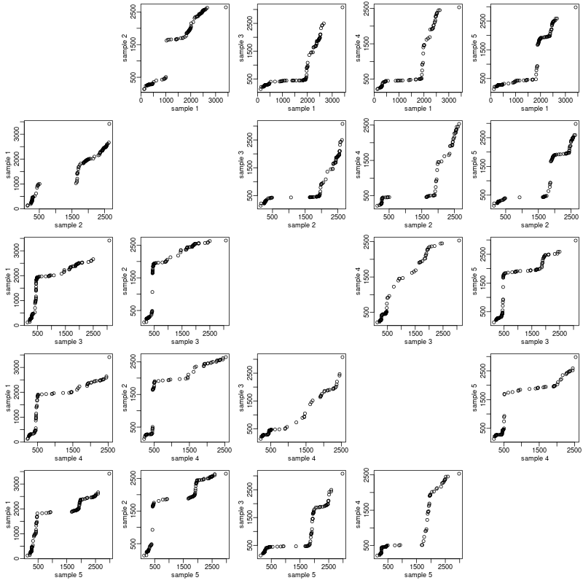
Which two samples are most similar?

Slide 79
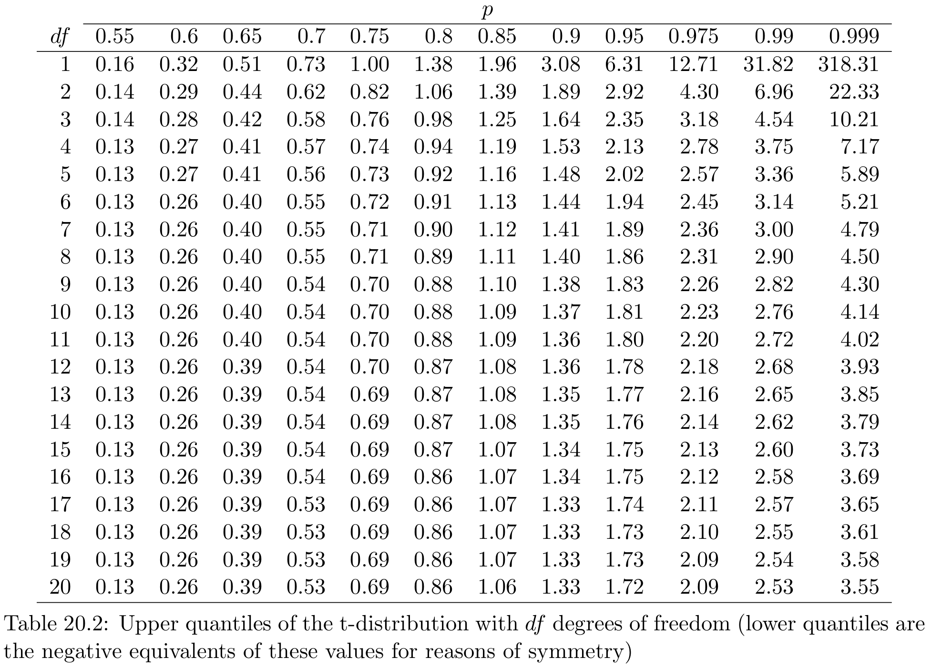
What is the 20-percentile of the t-distribution with 15 degrees of freedom?

Slide 80
We have measured the contents of five randomly selected bottles of wine:
750.1, 750.4, 749.9, 750.3, 750.3
Can we conclude, at a 95% confidence level, that the mean volume exceeds 750 ml?

Slide 81
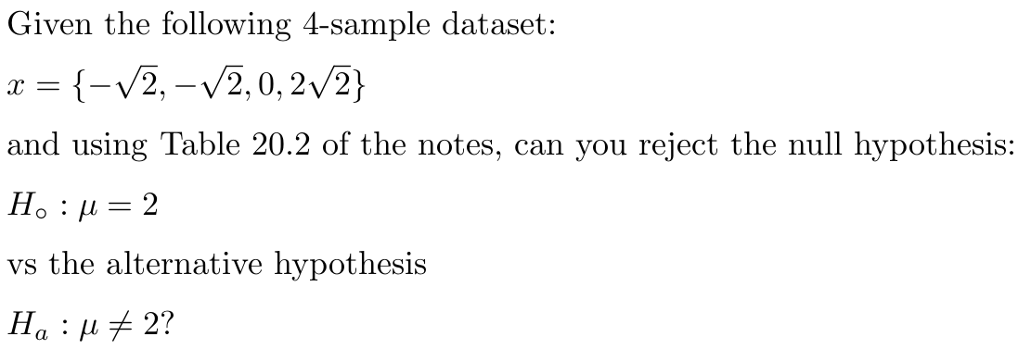

Slide 82
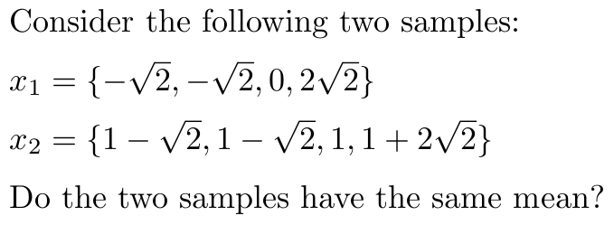

Slide 83
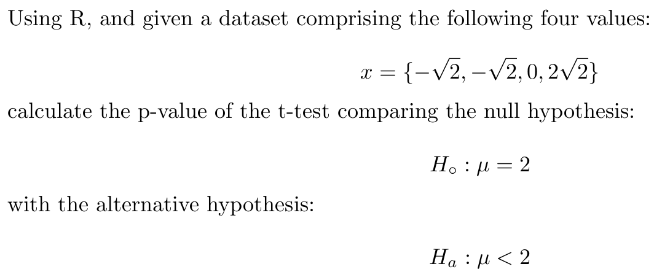

Slide 84
Using R, compute the rejection cutoff (either positive or negative) for a one-sided t-test with 3 degrees of freedom and confidence level 𝛼=0.05.

Slide 86
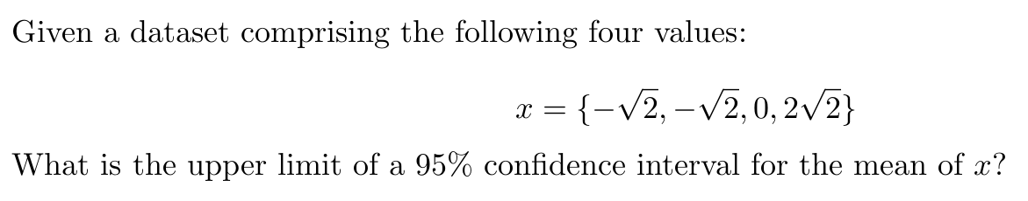

Slide 87
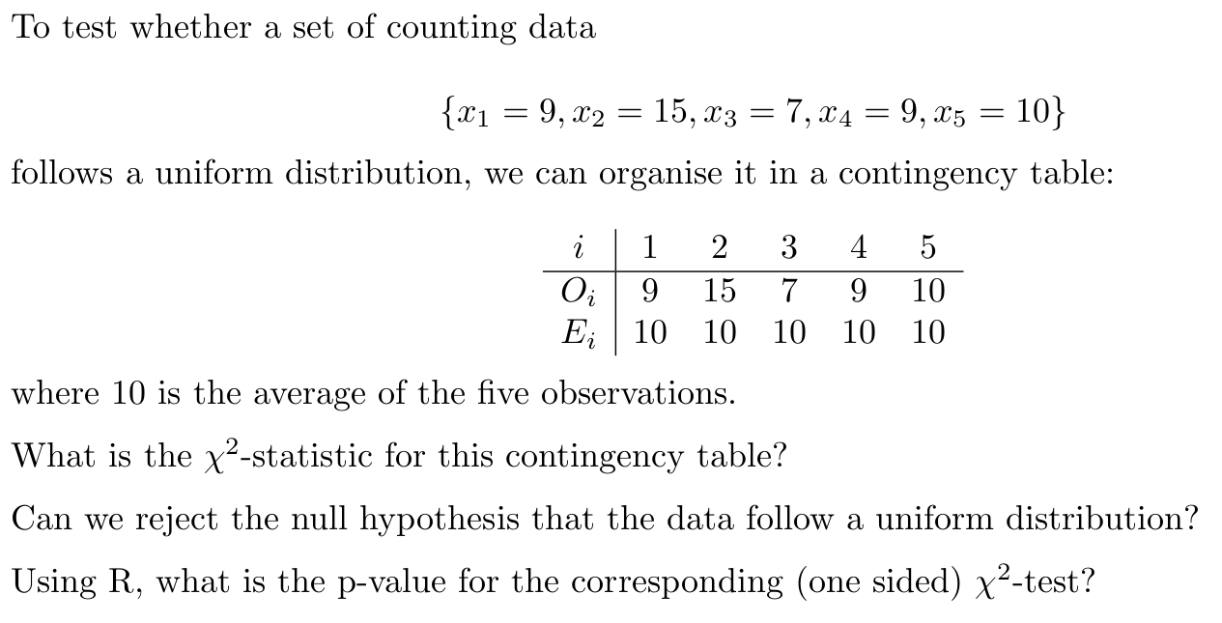

Slide 90
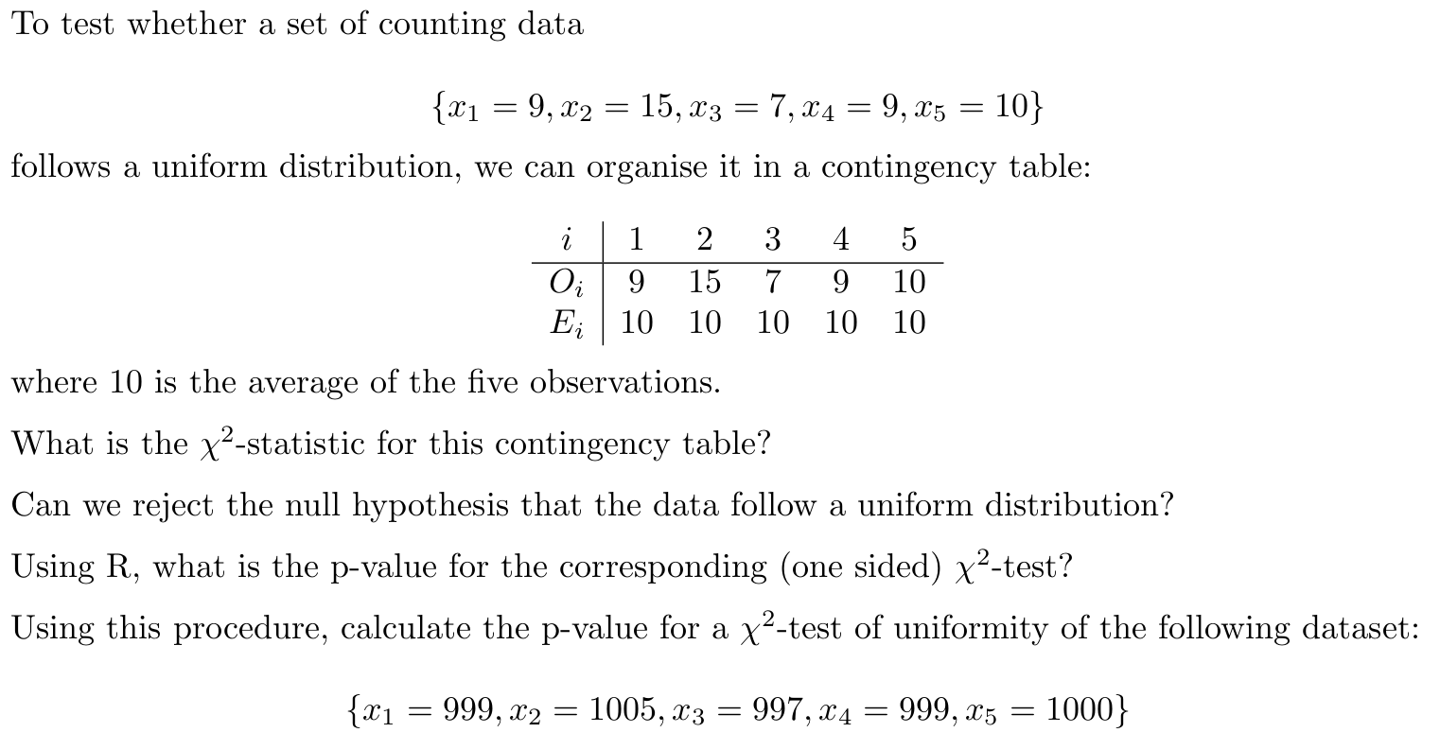

Slide 92
Consider two χ²-tests with significance level 𝛼=0.05 and the following effect sizes:
w (test 1) = 0.1
w (test 2) = 0.3
Let P1 be the probability of committing a type-1 error under the first hypothesis, and
let P2 be the probability of committing a type-1 error under the second hypothesis.
Then which statement is correct?
a. P1 = P2
b. P1 < P2
c. P1 > P2

Slide 93
Consider two χ²-tests with significance level 𝛼=0.05 and the following effect sizes:
w (test 1) = 0.1
w (test 2) = 0.3
Let P1 be the probability of committing a type-2 error under the first hypothesis, and
let P2 be the probability of committing a type-2 error under the second hypothesis.
Then which statement is correct?
a. P1 = P2
b. P1 < P2
c. P1 > P2

Slide 94
Consider the following two samples:
A = {3}
B = {9, 8}
What is the p-value of one-sided Wilcoxon test for
H0: median(A) = median(B)
vs.
Ha: median(A) < median(B)

Slide 95
FYI: it’s not always that simple!
W=3
W=5
A1,A2,B1,B2
A1,A2,B1,B2
A1,B1,A2,B2
A1,B1,B2,A2
A1,B2,A2,B1
A1,B2,B1,A2
A2,A1,B1,B2
A2,A1,B1,B2
A2,B1,A1,B2
A2,B1,B2,A1
A2,B2,A1,B1
A2,B2,B1,A1
B1,B2,A1,A2
B1,B2,A2,A1
B1,A1,A2,B2
B1,A1,B2,A2
B1,A2,A1,B2
B1,A2,B2,A1
B2,B1,A1,A2
B2,B1,A2,A1
B2,A1,A2,B1
B2,A1,B1,A2
B2,A2,A1,B1
B2,A2,B1,A1
A1,A2,B1,B2
A1,A2,B1,B2
A1,B1,A2,B2
A1,B1,B2,A2
A1,B2,A2,B1
A1,B2,B1,A2
A2,A1,B1,B2
A2,A1,B1,B2
A2,B1,A1,B2
A2,B1,B2,A1
A2,B2,A1,B1
A2,B2,B1,A1
B1,B2,A1,A2
B1,B2,A2,A1
B1,A1,A2,B2
B1,A1,B2,A2
B1,A2,A1,B2
B1,A2,B2,A1
B2,B1,A1,A2
B2,B1,A2,A1
B2,A1,A2,B1
B2,A1,B1,A2
B2,A2,A1,B1
B2,A2,B1,A1
p = 2!2!/4! = 1/6
p = 1/3

Slide 96
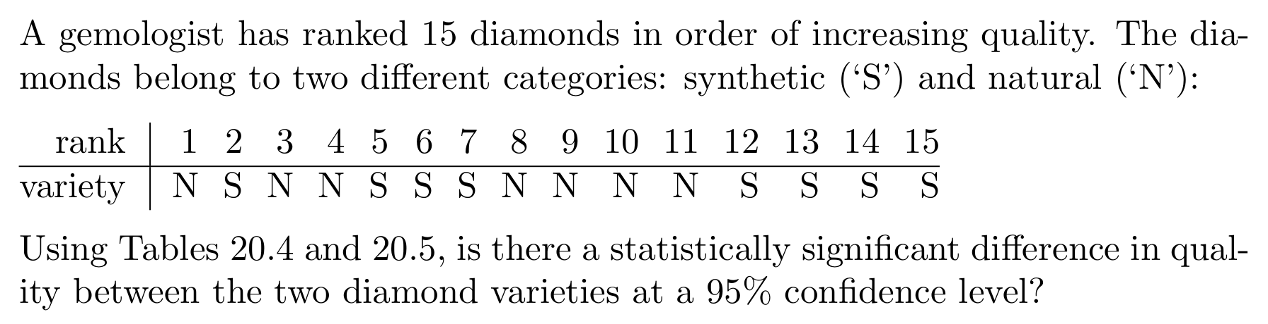

Slide 97
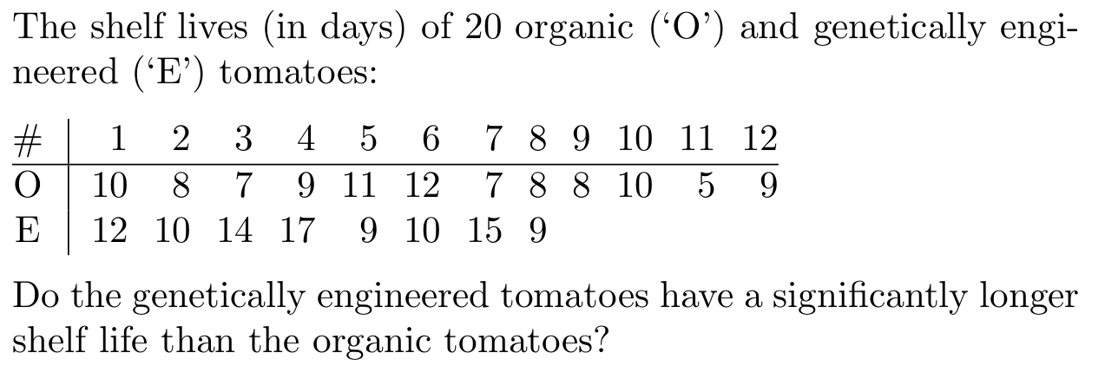

Slide 98
Consider the following two samples:
A: {69, 0, 64, 81, 6}
B: {156, 105, 115, 171, 122}
Using a two-sample Kolmogorov-Smirnov test with a significance level of 𝛼=0.05, can we reject the null hypothesis that both of these samples were drawn from the same distribution?

Slide 99


Slide 100
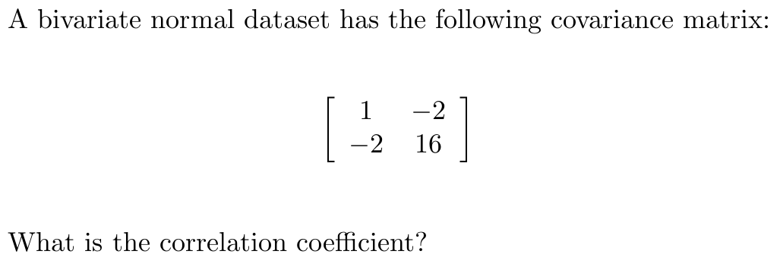

Slide 101
Let:
μ[x] = 4, σ[x] = 2
μ[y] = 2, σ[y] = 1
μ[z] = 3, σ[z] = 1
ρ[x,y] = 0, ρ[x,z] = 0, ρ[y,z] = 0
What is ρ[x/z,y/z]?
What if:
ρ[x,y] = -0.1, ρ[x,z] = 0, ρ[y,z] = 0?
Or
ρ[x,y] = -0.5, ρ[x,z] = 0, ρ[y,z] = 0?

Slide 102
Two sets of 11 values 𝑥={𝑥1,𝑥2,…,𝑥11} and 𝑦={𝑦1,𝑦2,…,𝑦11} are characterised by a correlation coefficient of 𝑟=−0.7. Is the correlation statistically significant at an 𝛼=0.05 confidence level?

Slide 103
geostats contains a dataset called worldpop, which tallies the world's population from 1750 until 2014. From 1960 onwards, the world population has been growing at an approximately linear rate.
1. Fit a straight line through these values and extrapolate to today.
2. Compute a 95% confidence interval
3. Compute a 95% prediction interval
4. Compare your prediction with the value reported on
https://www.worldometers.info

Slide 104


Slide 105
Given a Gutenberg-Richter law where
log10[N/N0] = 5.09−1.15 × magnitude
how much more common are magnitude 6 earthquakes than magnitude 7 earthquakes?

Slide 106
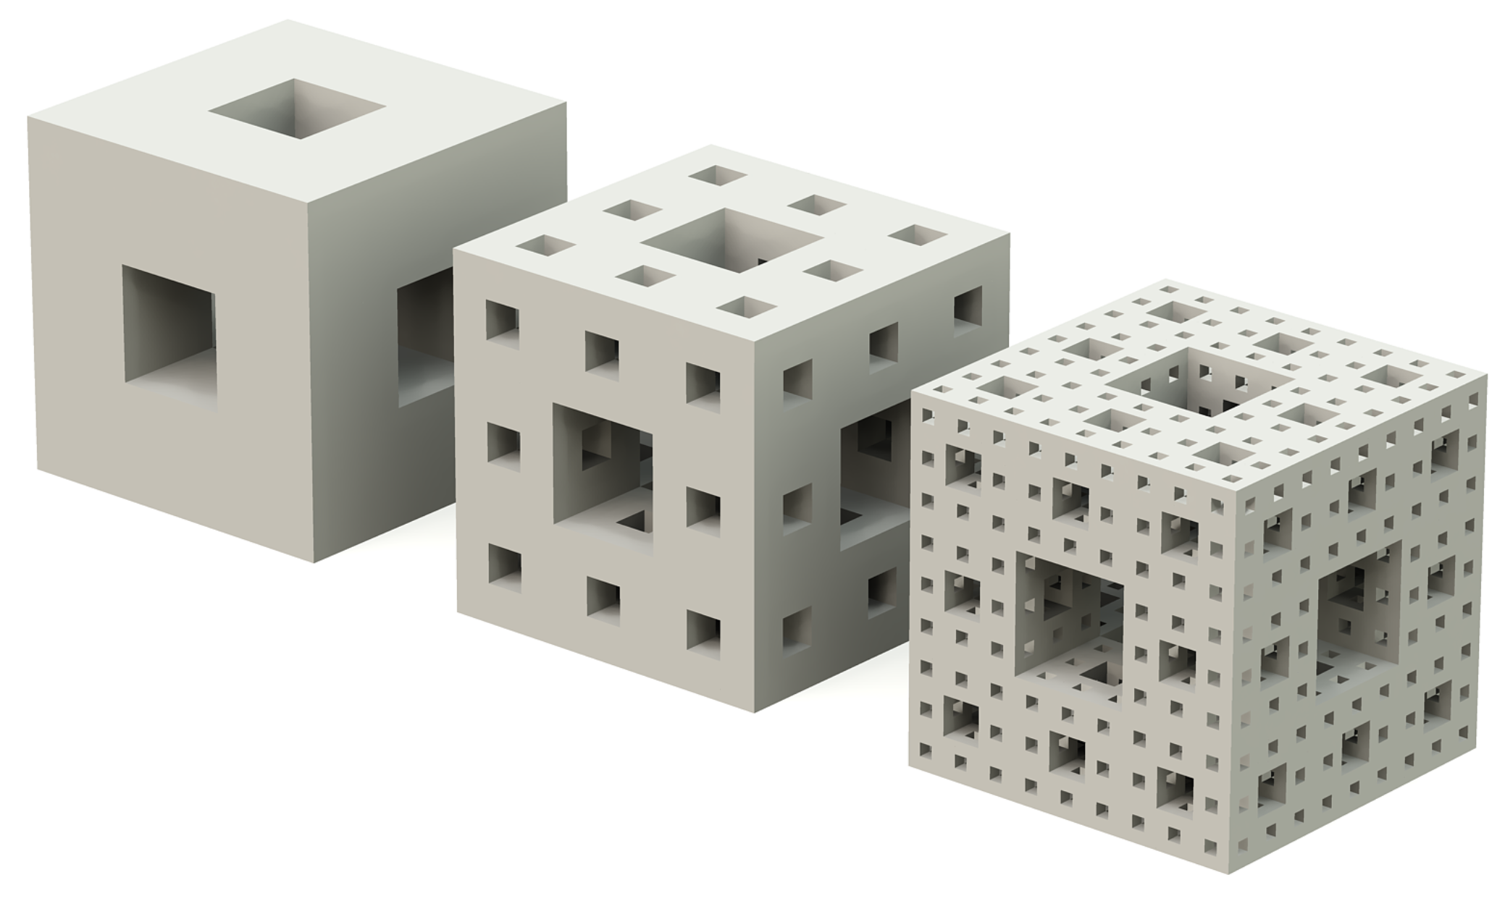
Is the fractal dimension of the Menger sponge
0 < D < 1
1 < D < 2
2 < D < 3
3 < D < 4
D > 4 ?

Slide 107
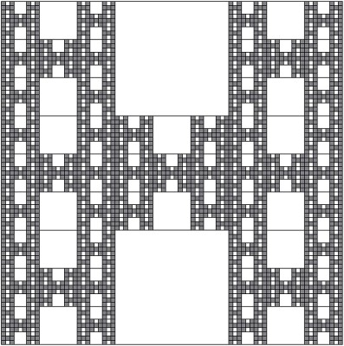
What is the fractal dimension of the Rivera H?

Slide 108
Use geostats' pendulum function to repeat the pendulum experiment of Section 11.4 of the notes. Try different initial positions, velocities, numbers of magnets etc. See ?pendulum for details.

Slide 110
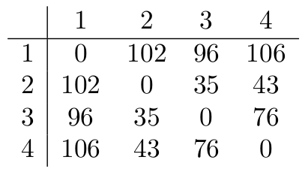
Draw the hierarchical clustering tree for the following distance matrix:

Slide 111
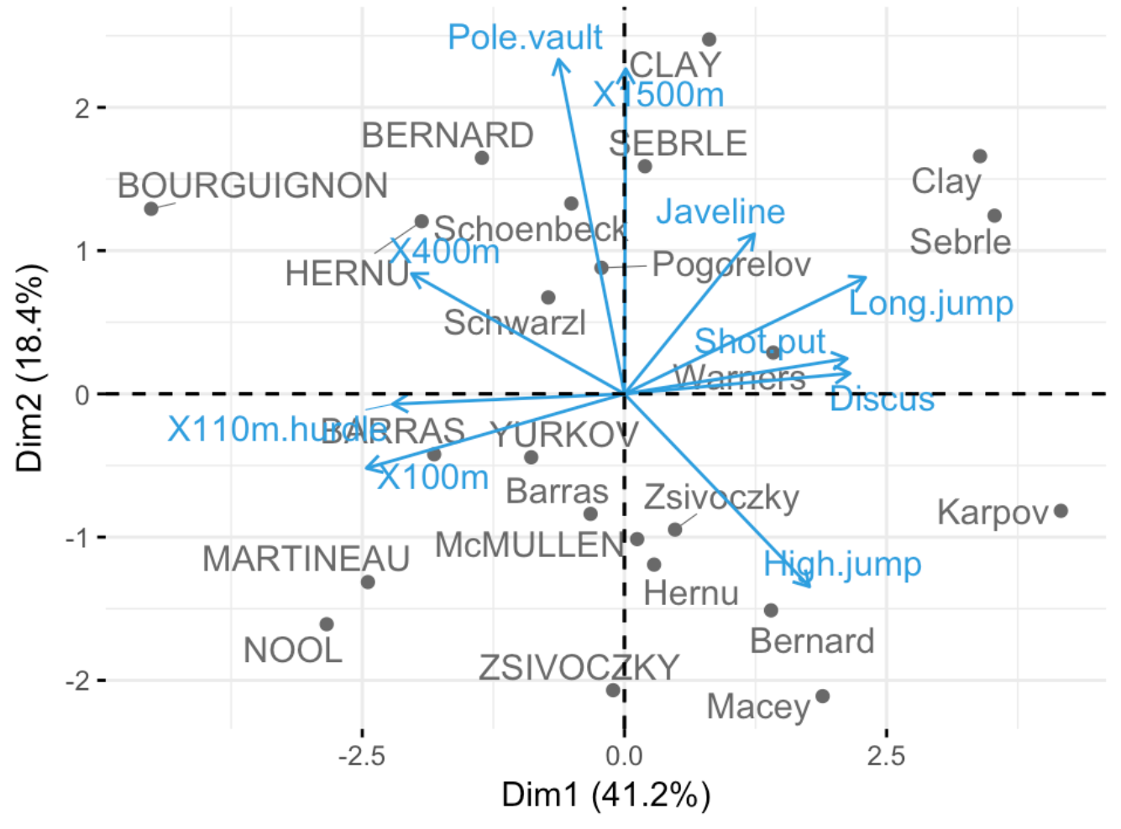
This is a PCA biplot of heptathletes during the Decastar competition (uppercase) and the Olympic games (lowercase):
1. Roman Šebrle is the former world record holder. What was his greatest strength? Running or throwing?
2. How do Sebrle and 2008 Olympic champion Bryan Clay compare in terms of specialisms?
3. Are high jumping and long jumping compatible or incompatible with each other? How about javelin and shot put? And the 100m dash and 110m hurdles?
4. How did Claston Bernard’s Decastar performance compare with his Olympics?
5. Which two sports are the best discriminators: discus and 100m dash, or pole vault and high jump?

Slide 112
Rescale the USArrests dataset so that all four variables have the same variance:
crime <- scale(USArrests)
Subject the resulting crime dataset to a hierarchical clustering analysis to form four groups. Do the states of Alaska and Texas fall in the same cluster?
Subject the crime dataset to a k-means clustering analysis to form four groups. Do the states of Alaska and Texas fall in the same cluster?

Slide 113


Slide 114
Let
MR(QDA,training) be the misclassification rate of a quadratic discriminant analysis on a set of training data.
MR(QDA,test) be the misclassification rate of a quadratic discriminant analysis on an independent set of test data.
MR(LDA,training) be the misclassification rate of a linear discriminant analysis on a set of training data.
MR(LDA,test) be the misclassification rate of a linear discriminant analysis on an independent set of test data.
Which of the following statements is correct?
a. MR(QDA,training) < MR(LDA,test)
b. MR(QDA,training) > MR(LDA,training)
c. MR(QDA,training) > MR(LDA,test)
d. MR(LDA,training) < MR(LDA,test)
e. MR(QDA,training) < MR(QDA,test)
f. MR(QDA,training) > MR(QDA,test)
g. MR(LDA,training) > MR(LDA,test)
h. MR(QDA,training) < MR(LDA,training)

Slide 115
Given the following summary table for a sequence of nested decision trees:
CP nsplit rel error xerror xstd
1 0.4057279 0 1.000000 1.05967 0.028121
2 0.3054893 1 0.594272 0.63484 0.029854
3 0.0429594 2 0.288783 0.32458 0.024730
4 0.0405728 3 0.245823 0.26492 0.022883
5 0.0286396 5 0.164678 0.22673 0.021484
6 0.0190931 6 0.136038 0.18138 0.019544
7 0.0167064 7 0.116945 0.17422 0.019205
8 0.0071599 8 0.100239 0.15513 0.018248
9 0.0047733 11 0.078759 0.13604 0.017205
10 0.0031822 13 0.069212 0.12888 0.016789
11 0.0023866 16 0.059666 0.12649 0.016647
12 0.0014320 30 0.026253 0.13842 0.017341
13 0.0011933 40 0.011933 0.15036 0.017996
14 0.0000000 49 0.000000 0.15036 0.017996
where
CP is the cost-complexity criterion
nsplit is the number of splits in the decision tree
rel error is the relative misclassification rate of the training data
xerror is the 10-fold cross validation error
xstd is the standard error of the cross-validation error
What is the optimal number of splits?

Slide 116
Given the following measurements:
sepal length = 4cm
sepal width = 3cm
petal length = 4cm
petal width = 1cm
1. Estimate the probability that the following flower is of species Versicolor using LDA.
2. Repeat for QDA.
3. Classify the new flower using a decision tree.

Slide 117


Slide 118
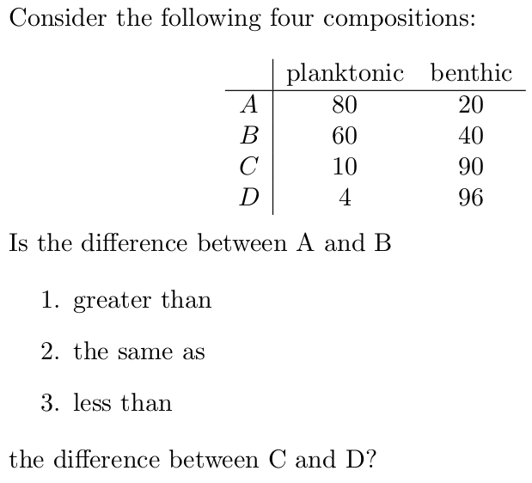

Slide 119
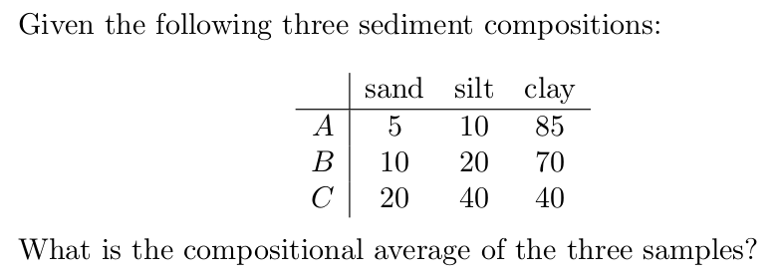

Slide 120
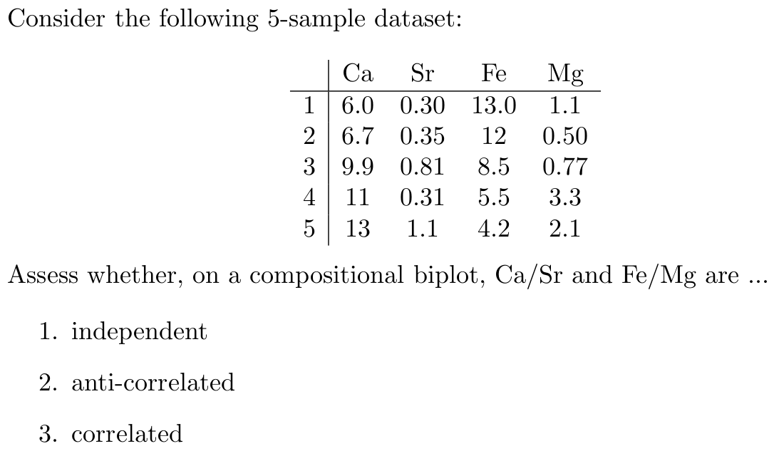

Slide 121


Slide 122
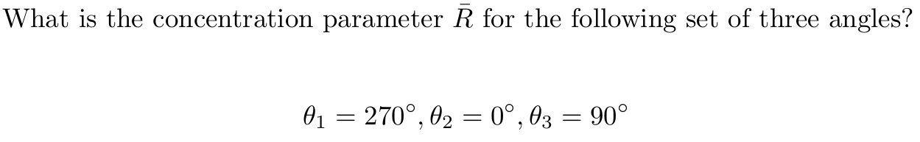

Slide 123
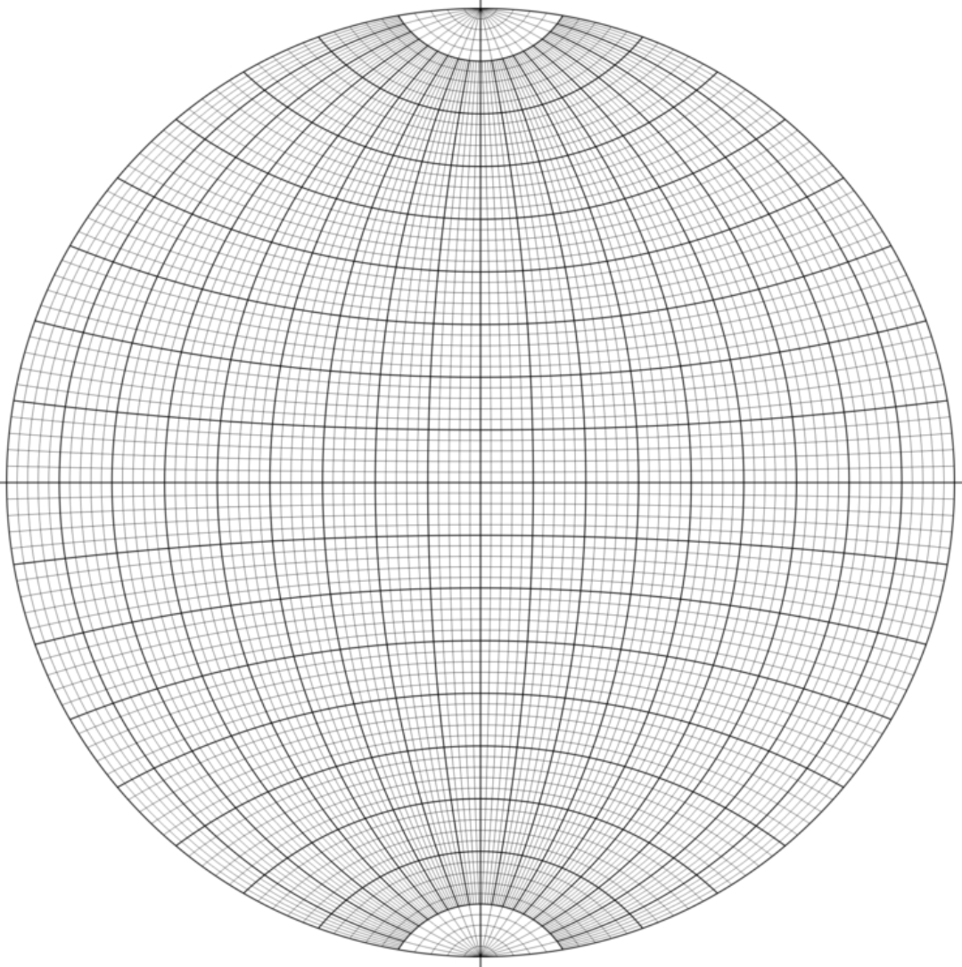
Is this a Wulff net
or a Schmidt net?

Slide 124
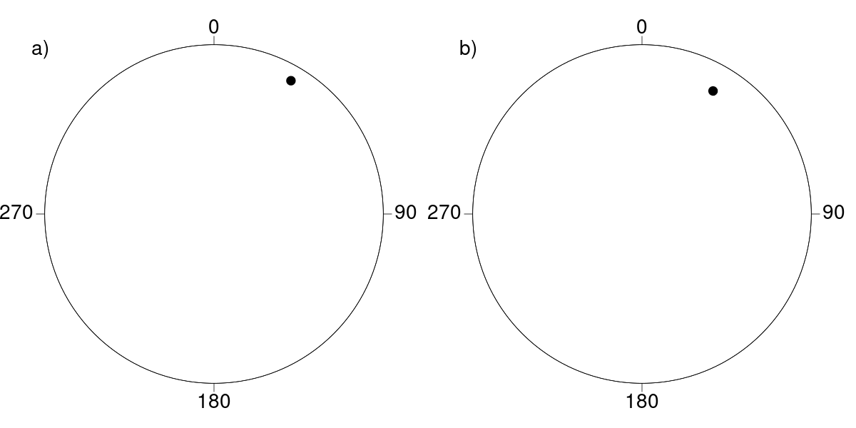
An azimuth value of 30o and a dip of 5o have been plotted on a Wulff and a Schmidt stereonet. Which is the Wulff net?

Slide 125
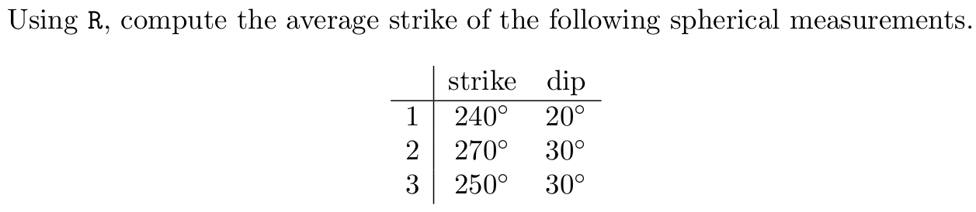

Slide 126
Which of geostats' built-in datasets is more tightly clustered: palaeomag or fault?

Slide 127


Slide 128
Given an exponential semivariogram fit with nugget=0.2, sill=0.7 and range=500m, what is the expected semivariance at 300m?

Slide 129

Rank points a, b and c in order of increasing kriging interpolation uncertainty.

