Slide 1
Natural Sciences Induction, September 2022
An introduction to the Earth Sciences
Prof. Pieter Vermeesch
Nat. Sci. Stream Leader
Department of Earth Sciences
University College London
p.vermeesch@ucl.ac.uk
020 31086369 (office)
078 08011662 (mobile)

Slide 2
Earth Sciences = Natural Sciences
(geo)physics
(geo)chemistry
(palaeo)biology
geology
mineralogy

Slide 3
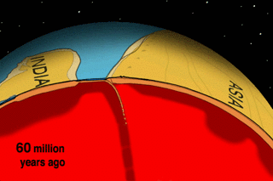
Geodynamics[1/2]: plate tectonics
Notes:
Plate tectonics is an effective mechanism whereby the Earth loses heat. The Earth is hot on the inside and cold on the outside. When cold oceanic crust becomes denser than the underlying mantle, it eventually sinks into it, much like custard convects in a saucepan when it is heated from below and cooled from the top. Any continental crust attached to a down going slab of oceanic crust will be dragged along with it until it collides with another tectonic plate. Such collisions build mountain belts such as the Himalayas and Alps. Plate movements may appear to be smooth over the million year time scales shown in this animation, but over human time scales, plates move in short bursts, resulting in earthquakes.

Slide 4
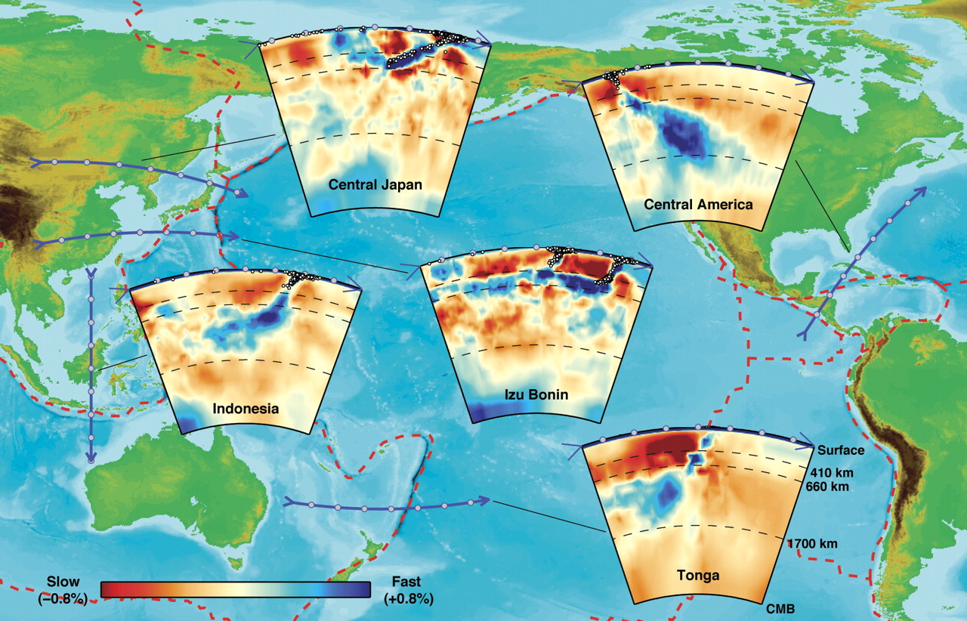
Seismology: tomography of the mantle
Notes:
Earthquakes produce acoustic waves which can be felt across the globe. Tens of thousands of seismometers are deployed around the world and are continuously listening to the seismic 'heartbeat' of the Earth. By logging the arrival times of thousands of significant seismic events in thousands of seismometers, seismologists can reconstruct the 'seismic velocity structure' of the Earth's mantle. Areas characterised by relatively slow seismic velocities characterise cold mantle, whereas high velocity zones characterise relatively hot mantle. Thus, using methods that are in many ways similar to a medical CAT-scan, seismologists, can create a 'tomographic' picture of the mantle, which clearly shows the convection currents inside the Earth

Slide 5
Mantle plumes
Geodynamics [2/2]: Mantle convection = fluid dynamics

Slide 6
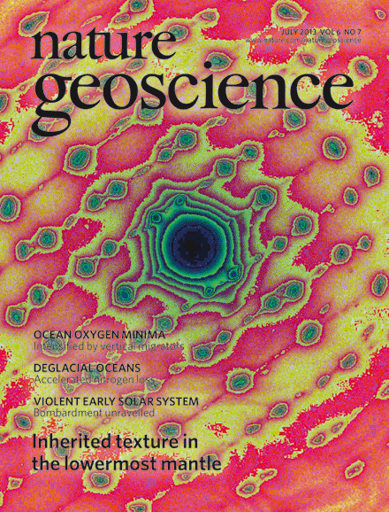
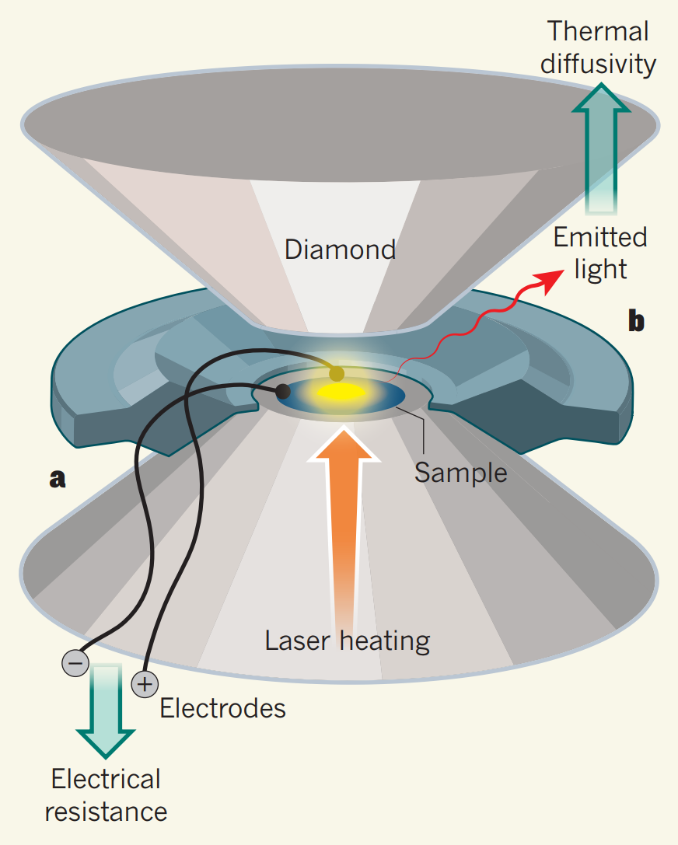
Crystallography: studying the core with diamond anvil cells

Slide 7
Mineral physics: Ab-initio simulations of melting in the lower mantle

Slide 8
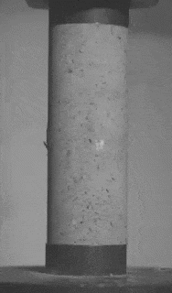
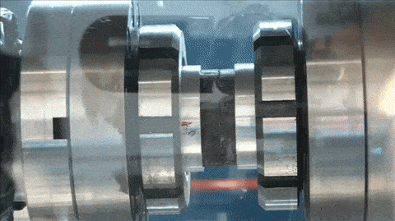
Rock mechanics: laboratory earthquakes
Pure shear
Friction melting

Slide 9
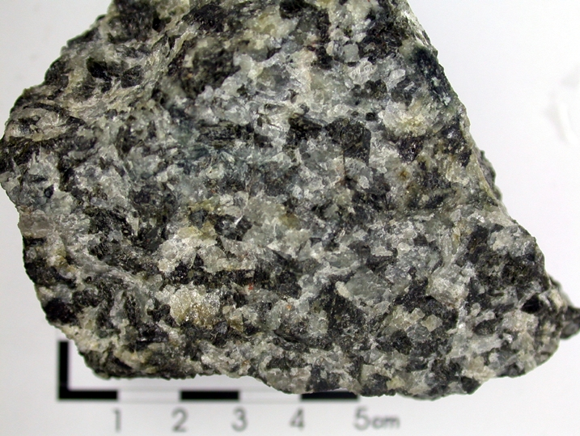
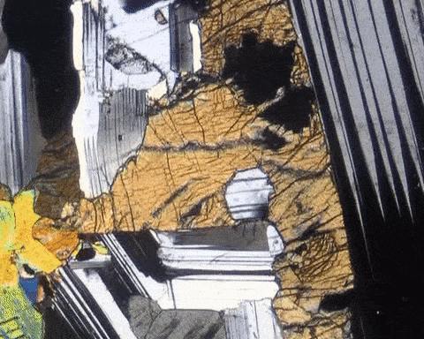
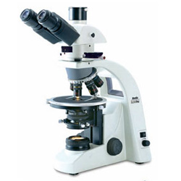
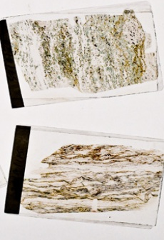
Optical petrography
2cm

Slide 10
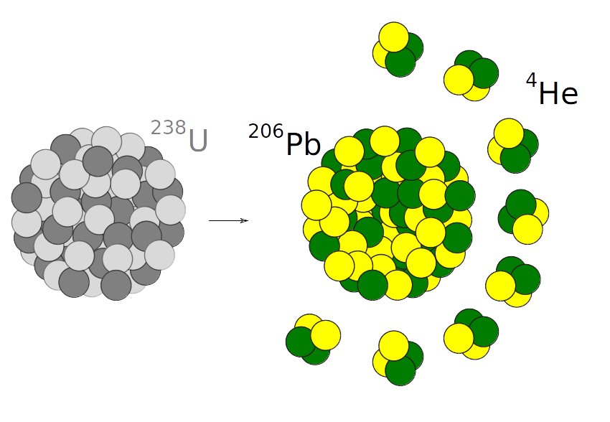
Isotope Geochemistry [2/2]: U-Pb & U/He geochronology
Replace with U, Th
Notes:
Uranium decays to lead and helium (one of the noble gases that won William Ramsay a Nobel Prize). This process happens at a precisely known rate, forming the basis of two geological clocks. The U-Pb clock measures the time elapsed since a U-bearing mineral crystallised. The U-He clock provides a very different kind of information. Helium is the second smallest element in the Universe, and a noble gas. It is not 'happy' sitting in the crystal lattice of a U-bearing mineral and, at high temperatures, will escape. It is only when rocks cool below a certain 'closure temperature' (60-70 degrees C) that the helium gets locked in and that the helium-clock starts ticking. So in contrast with a U-Pb age, a U-He age is not a crystallisation age, but a cooling age. Subsurface temperatures rise at a rate of ca. 30 C/km, and so U-He ages can be used to measure the rate at which rocks are exhumed from 2-3km depths to the surface.

Slide 11
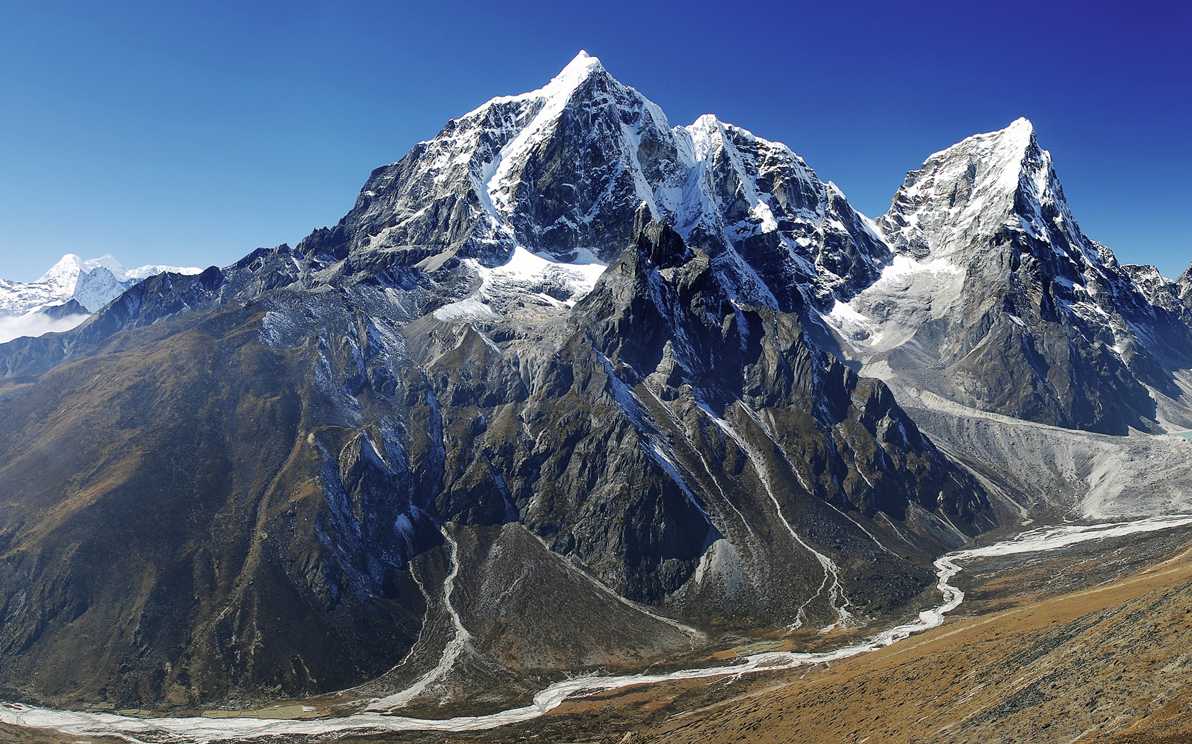
Tectonic geomorphology: He-ages date cooling
He-age = 5 Myr
He-age = 1 Myr
Notes:
The He/U ratio, and hence the U-He age measured on the summits of high mountains is generally greater than that at the foot of said mountains, reflecting the fact that the summits have cooled through the 60-70 C isotherm before the base. The age difference allows geochronologists to calculate how rapidly mountain ranges are rising due to plate tectonic forces. The London Geochronology Centre (LGC) at UCL is the cradle of this field of geochronology, which is also known as 'thermochronology'.

Slide 12
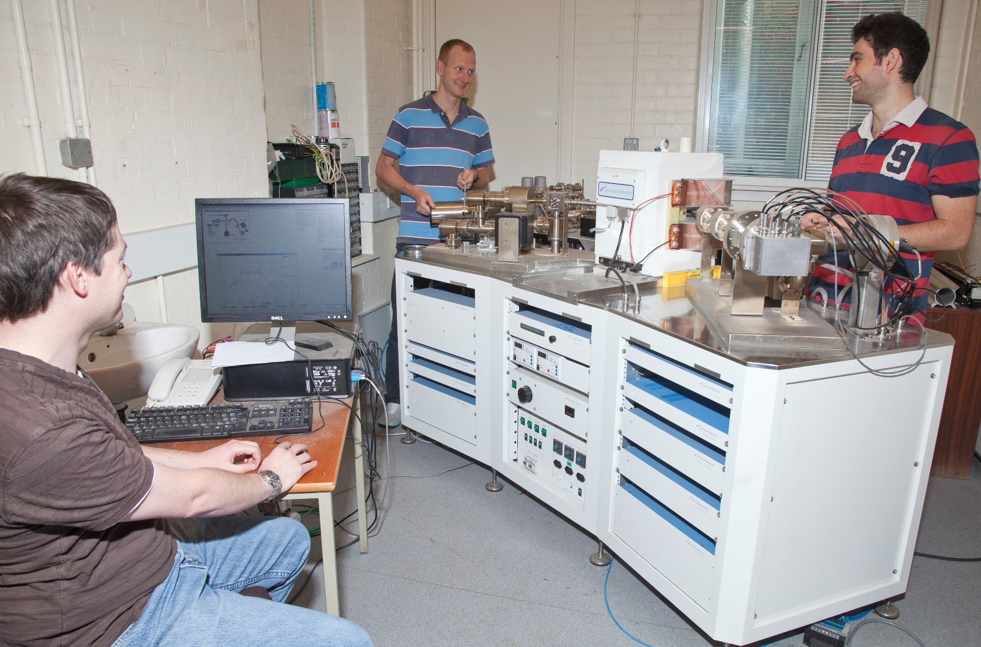
A mass spectrometer at UCL's London Geochronology Centre (LGC)
Notes:
Pb/U and He/U ratios can be precisely measured using sophisticated instruments called 'mass spectrometers', three of which are installed at the LGC.

Slide 13
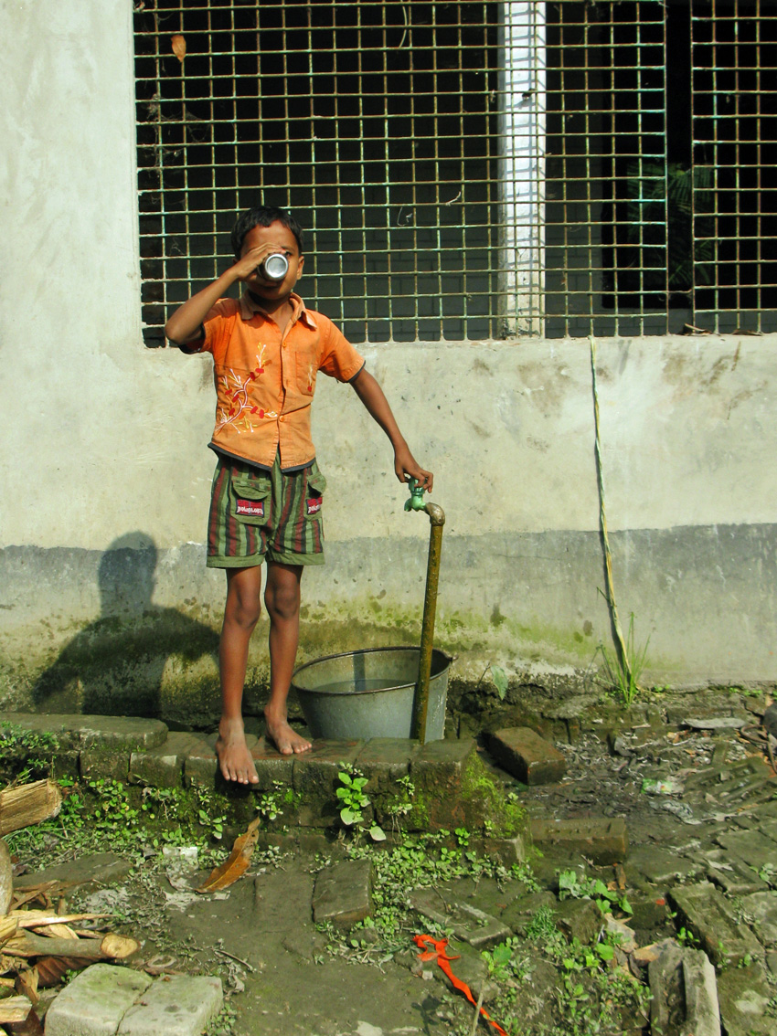
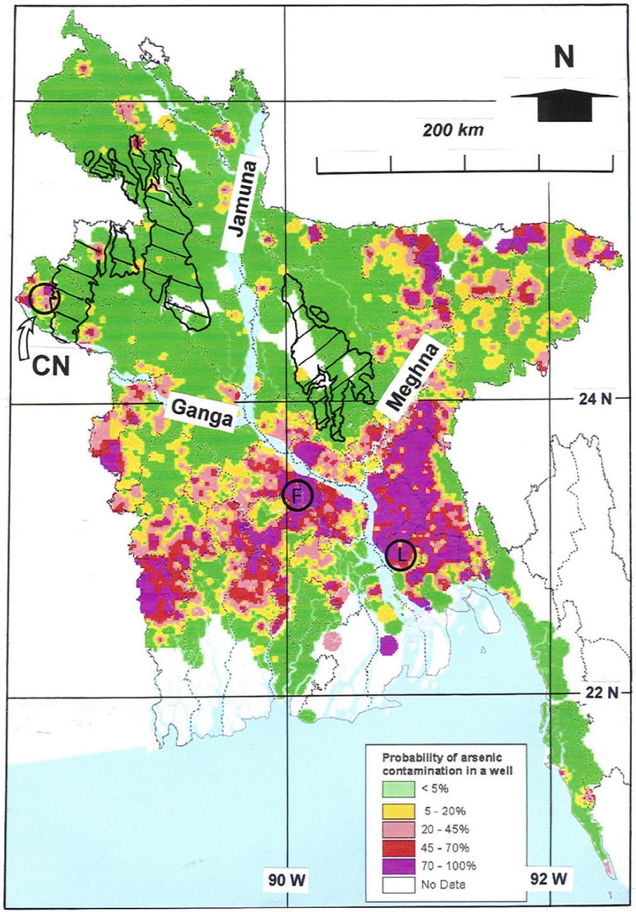
Environmental Geochemistry [1/2]: arsenic poisoning in Bangladesh
Notes:
Thousands of water wells in Bangladesh are contaminated with arsenic, resulting in a major health crisis. The source of the arsenic poisoning was unravelled by Professor John McArthur's research team at UCL.

Slide 14
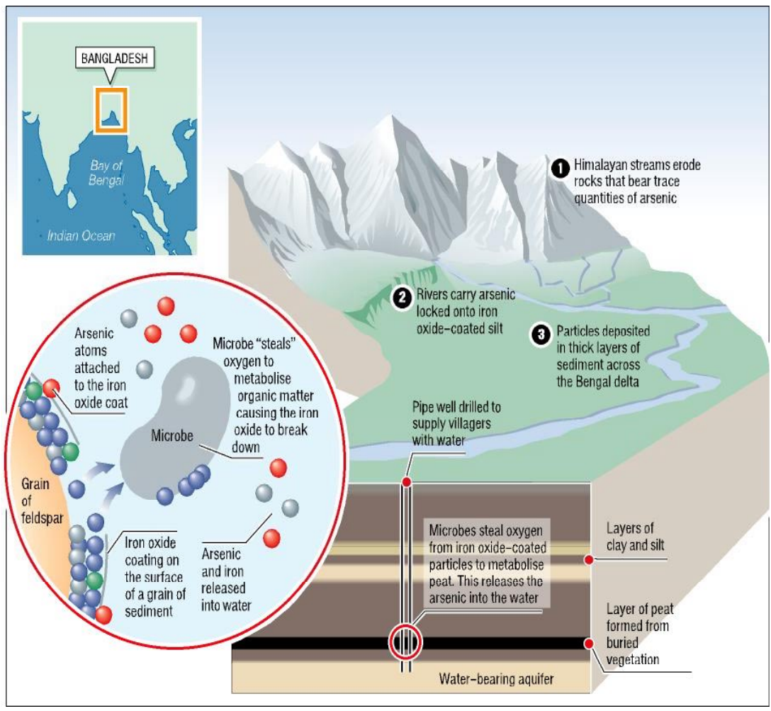
Hydrology: redox reactions in aquifers
C₆H₁₂O₆ + 6O₂
↓
6CO₂ + 6H₂O + ε
2(Fe₂O₃.As) + ε
↓
4Fe + 6O₂ + 2As
Notes:
Arsenic is found in harmlessly low concentrations in the waters of the Ganga and Brahmaputra rivers, which carry billions of tonnes of sediment from the Himalayas to the Bengal lowlands, where they are deposited in fertile marshlands. Ganga and Brahmaputra sediments contain quartz grains which are coated with a thin film of iron oxide ('rust'). Arsenic atoms are adsorbed to these thin coatings and buried in the Ganga and Brahmaputra delta along with large amounts of organic matter. It is the combination of the organic matter, the iron oxides and the arsenic which causes the arsenic poisoning. Micro organisms in the sub-surface require oxygen to digest the organic matter. Once they have used up all the oxygen in the groundwater, these microbes harvest oxygen from the iron-oxide cover of the sand grains. With no iron-oxide left to cling on to, the arsenic is released to the groundwater. Any well drilling into such an aquifer will contain potentially lethal levels of this otherwise entirely natural pollutant.

Slide 15
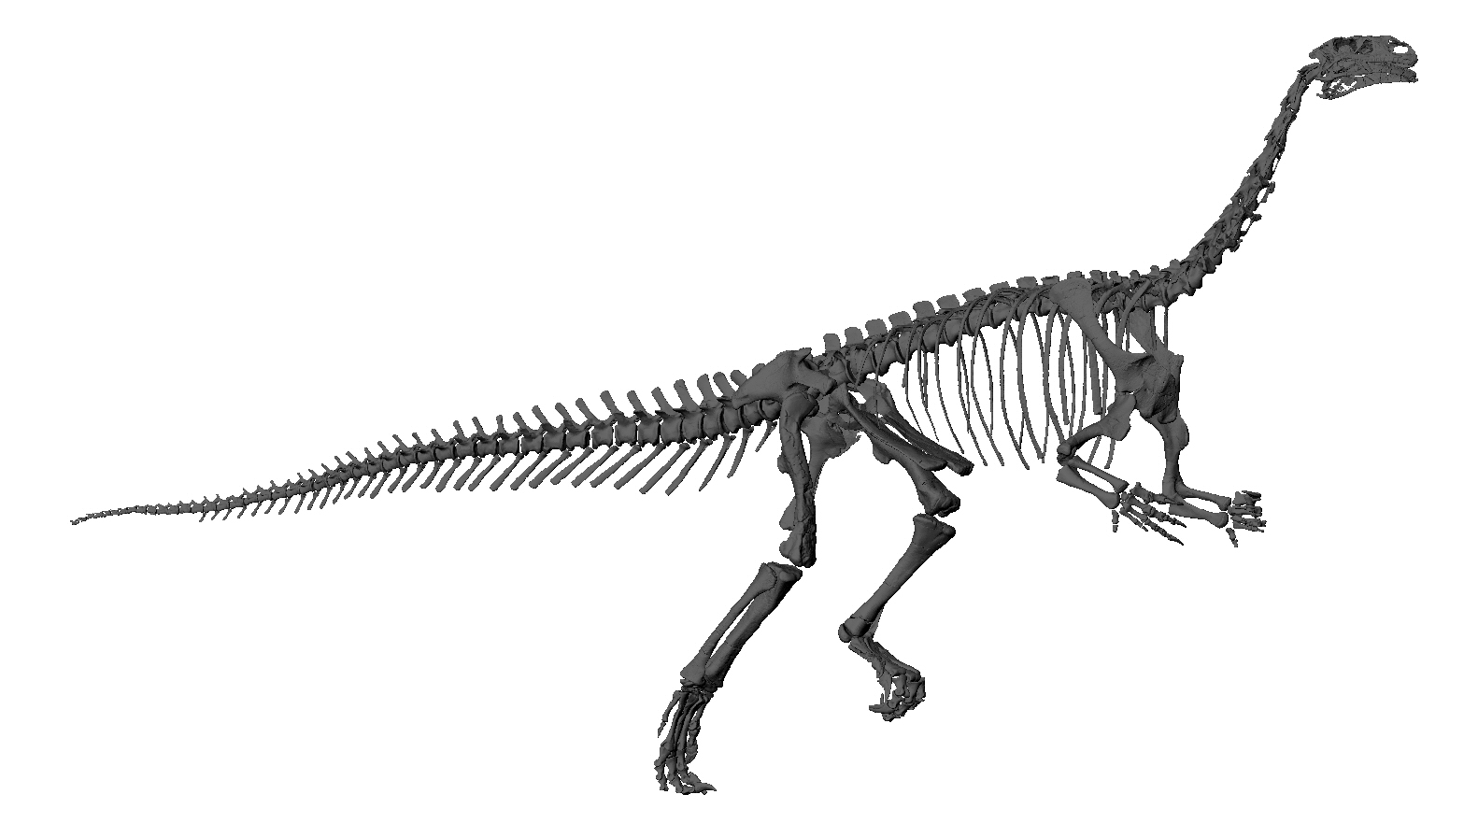
Vertebrate Palaeontology [1/2]
Notes:
The Department hosts some of the world's foremost palaeontologists. Dr. Anjali Goswami and Prof. Paul Upchurch study vertebrate fossils, including dinosaurs. New dinosaur species continue to be discovered in countries like China and Argentina at an increasing rate. Modern imaging technology (CT scans) allow palaeobiologists to image the inside of dinosaur eggs. Computer models can be used to simulate the forces acting on scanned dinosaur bones allowing, for the first time, to constrain the gait and speed of these long extinct species.

Slide 16
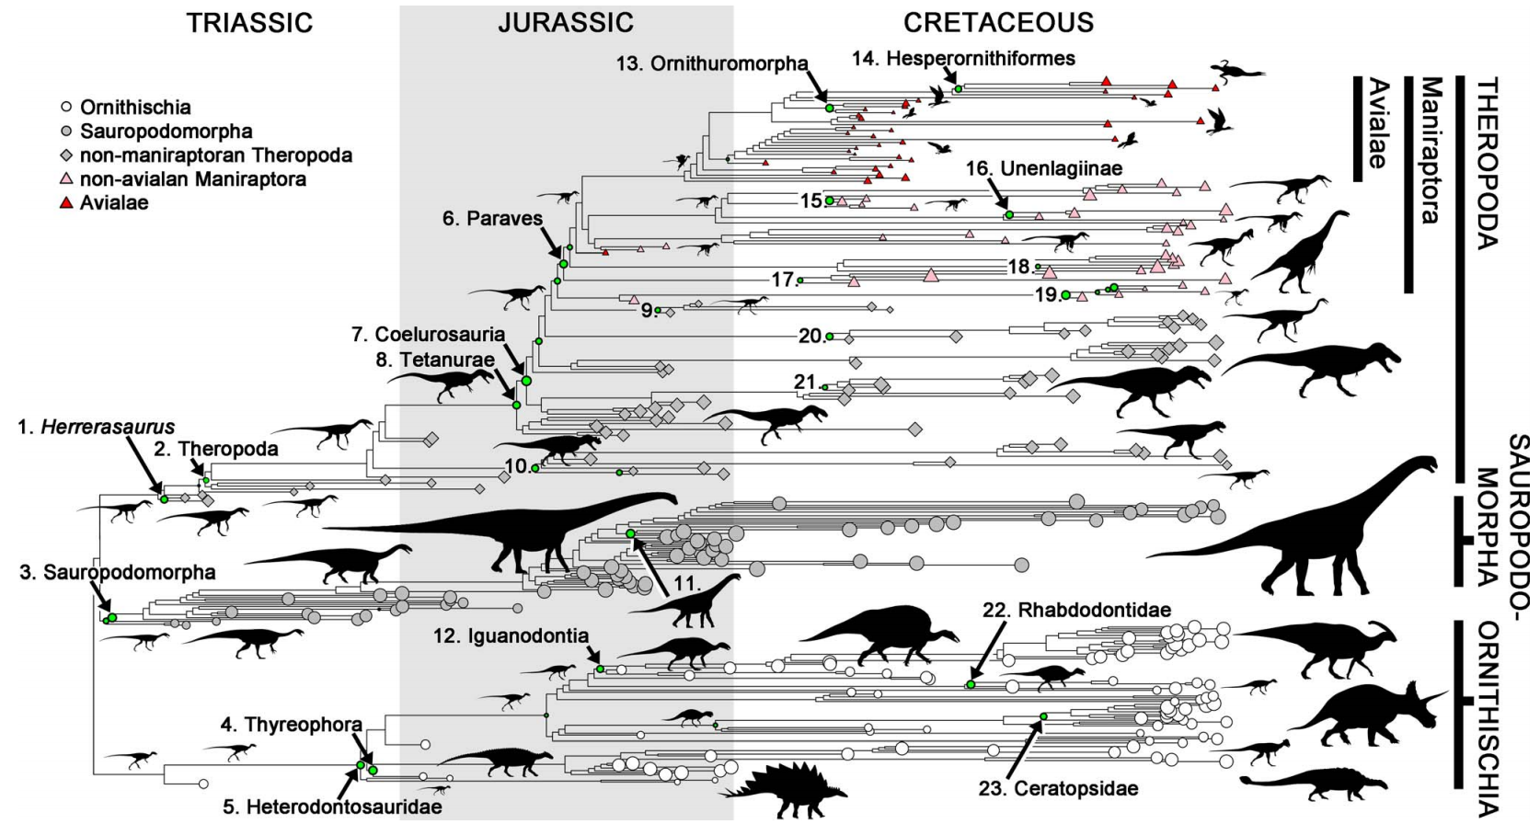
Vertebrate Palaeontology [2/2]: Evolution, the greatest story ever told

Slide 17
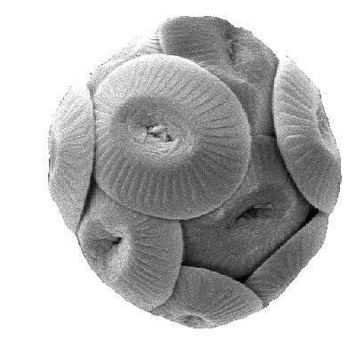
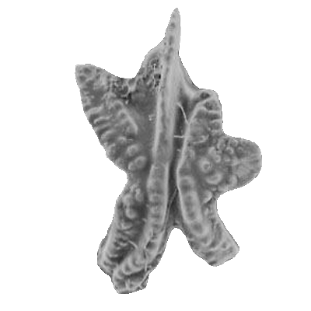
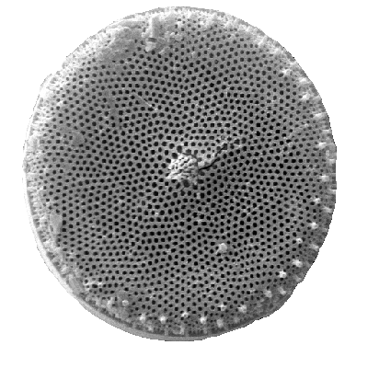
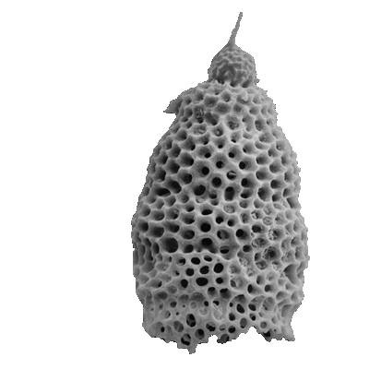
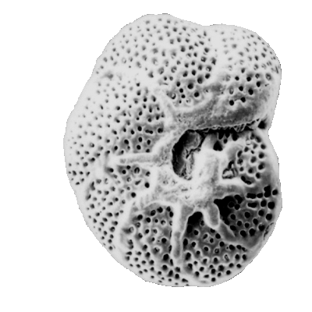
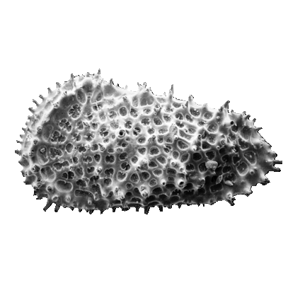
Invertebrate palaeontology [1/2]
100μm
Notes:
Whereas dinosaur fossils are very rare, microfossils are abundant. Profs. Bridget Wade and Paul Bown study the evolution of micro-organisms though geologic time by documenting the fossil content of sedimentary rocks.

Slide 18
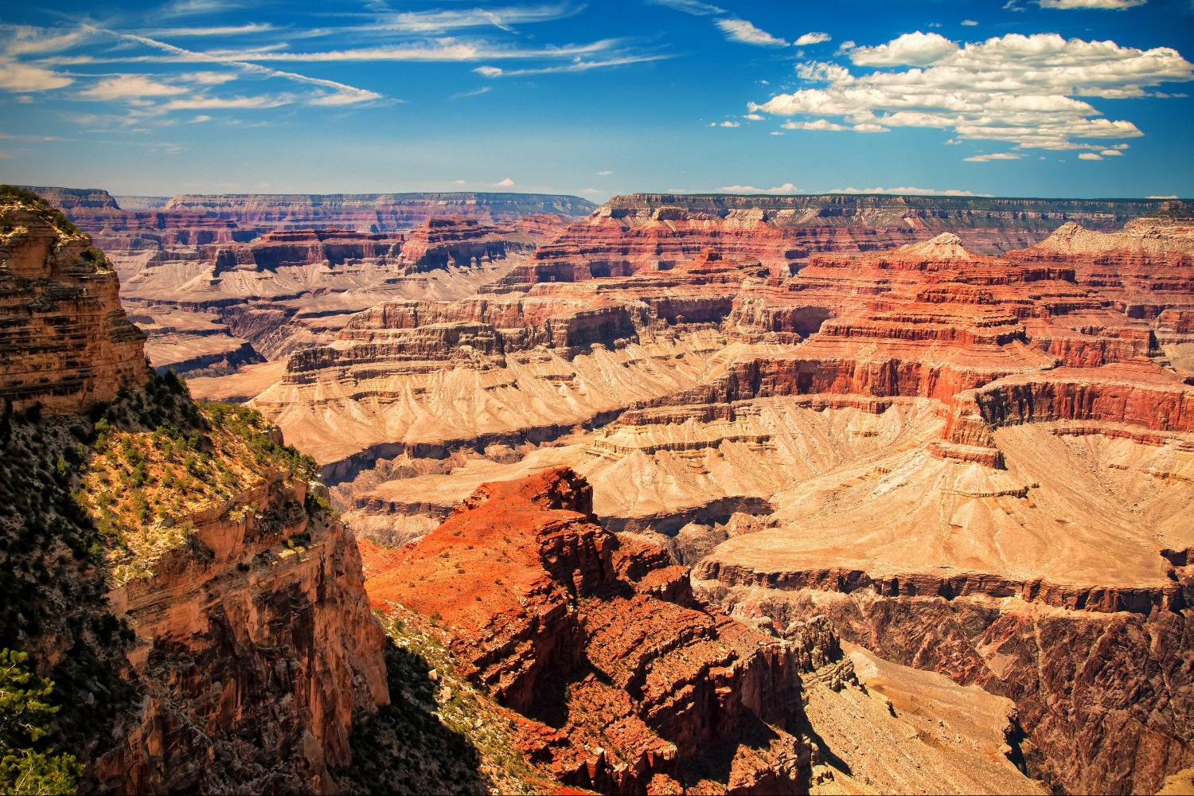
Invertebrate Palaeontology [2/2]: stratigraphy
Notes:
Take, for example, the thick stack of sedimentary rocks exposed in the Grand Canyon, which contain abundant microfossils. The morphologies of these fossils change with time and, hence, elevation within the Grand Canyon, as a result of evolution and natural selection. Once extinct, a fossil never appears in the geologic record again. The biological evolution of micro-fossils forms the basis of a relative time scale which allows sedimentary geologists to date rocks otherwise not amenable to the radiometric techniques discussed before.

Slide 19
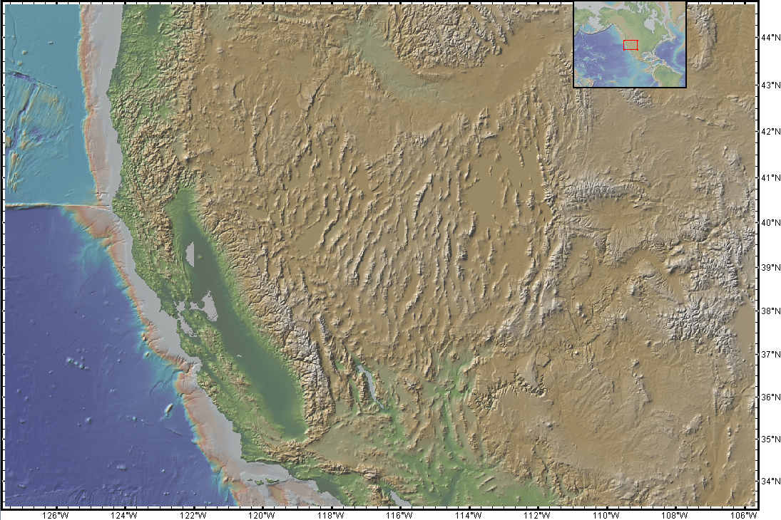
Geology [1/2]: North America's 'Basin and Range' province
Notes:
Geologists combine the latest methods in geochemistry and geophysics with simple but powerful field techniques, which date back to the 19th century and require nothing more than a hand lens, a geological compass/clinometer, and a hammer. Despite the simplicity of these tools, field geology continues produce major discoveries about our planet. Take, for example, the western United States (Nevada), which is characterised by a very peculiar type of topography, which features north-south trending mountain ranges separated by flat areas. This 'basin and range' topography is the surface expression a most peculiar geological phenomenon.

Slide 20
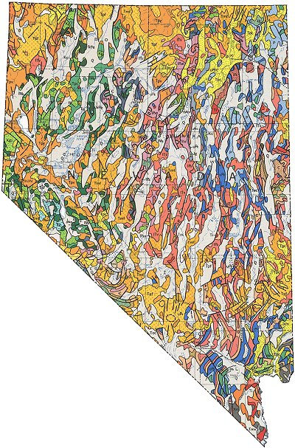
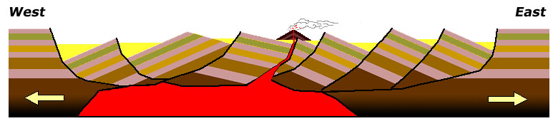
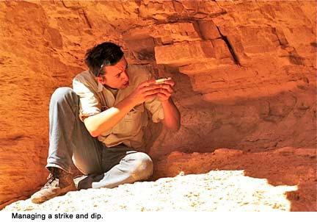
Geology [2/2]: Nevada has widened >100% over the past 25 million years!
Notes:
On the left, this slide shows the geologic map of Nevada, which was created by geologists who, over the course of many years, walked all across this vast area, recording the different rock types found within it. They then marked these different groups of rocks (igneous, metamorphic, sedimentary, old, young) in different colours on a topographic map, along with the dip (tilt) of the beds and major faults (fractures) running through them. After all this work, the geologists came to the conclusion that the Basin and Range Province has been affected by more than 100% of east-west extension over the past 25 million years. In other words, the state of Nevada was only half its current size 25 million years ago. Incredible though this might seem, the geologists' conclusion was confirmed by geodetic (GPS) surveys, which indicate that the Basin and Range is indeed getting wider every year.

Slide 21
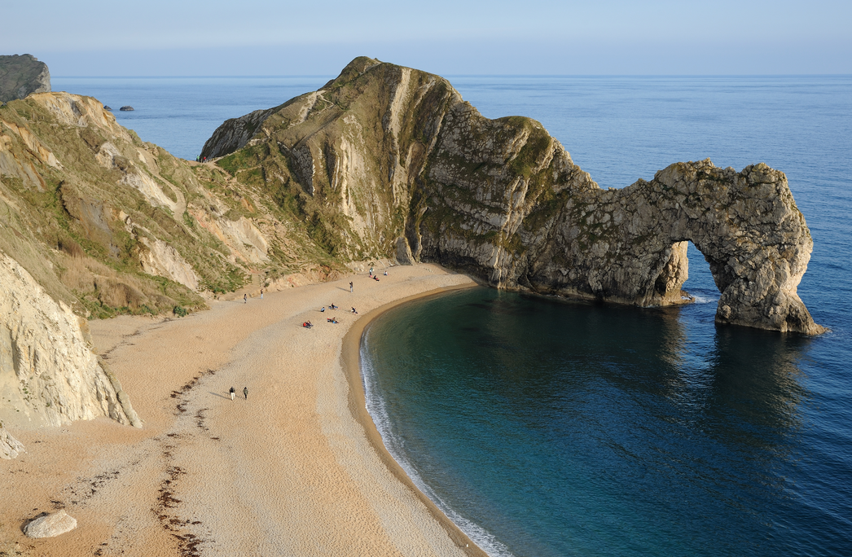
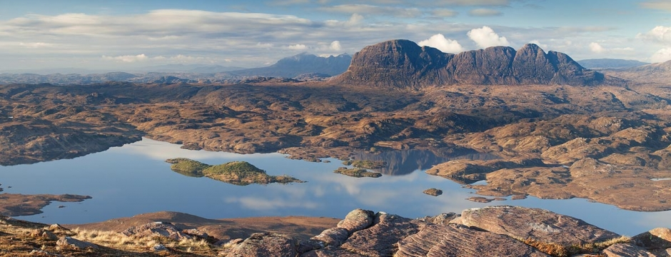
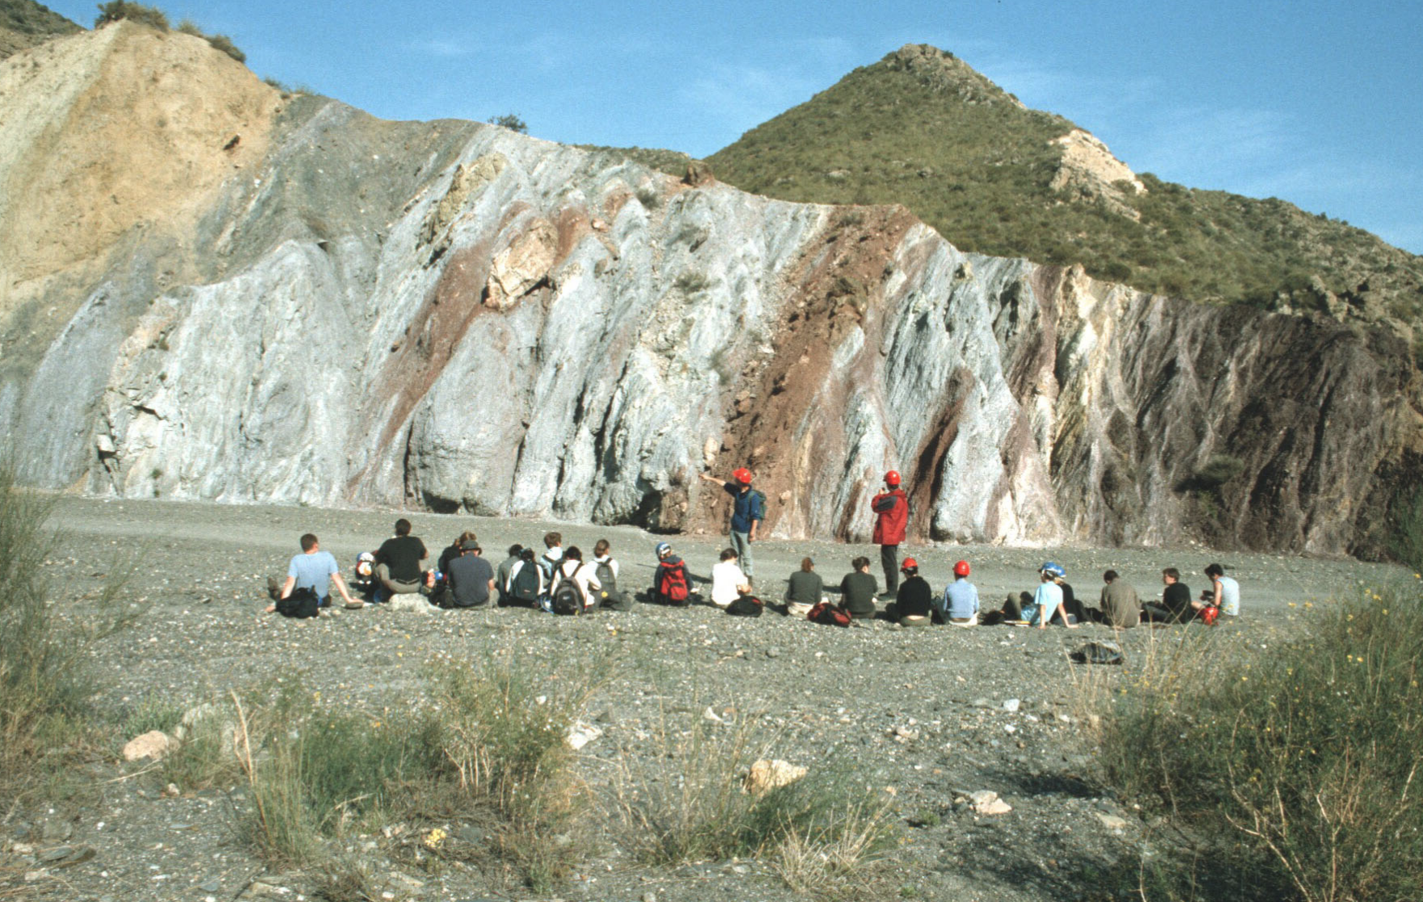
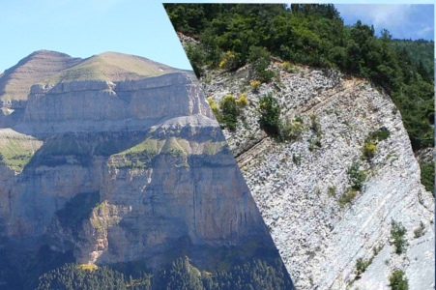
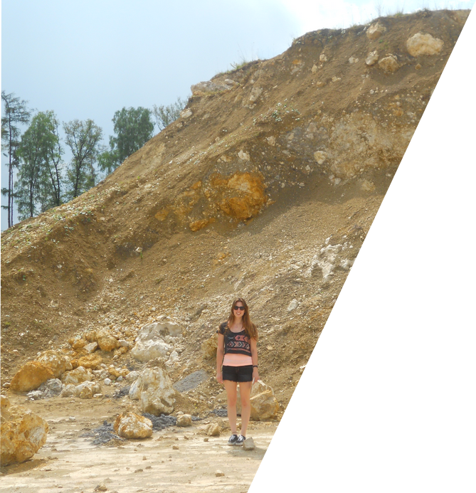
Field courses
Year 1
Year 1-2
Dorset-Cornwall
Assynt (Scotland)
Year 2-3
Year 3-4
Marche (Italy)
Riess (Germany)
Pyrenees
Betics (Spain)
Notes:
The Geology curriculum includes a very significant and rigorous field component during every year of study. The Dorset field trip has already been mentioned before. During their second year of study, Geology students spend several weeks in Scotland to sharpen their mapping skills. Various modules during the later years of study offer further field training in France, Italy, Germany and Spain.

Slide 22
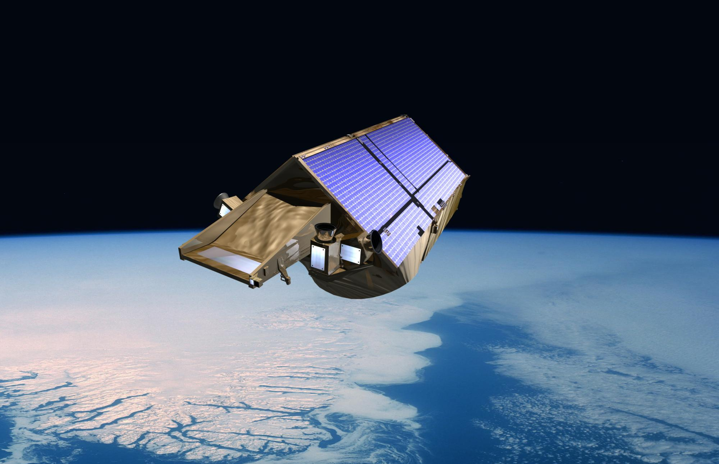
Climatology [1/3]: CRYOSAT-2
Notes:
Climate change is another important environmental problem which is intensively studied at UCL's Earth Science department. The Centre of Polar Observation and Modelling (CPOM) is the control centre of the ICESAT-2 satellite, which continuously monitors ice thickness in the Arctic and Antarctic.

Slide 23
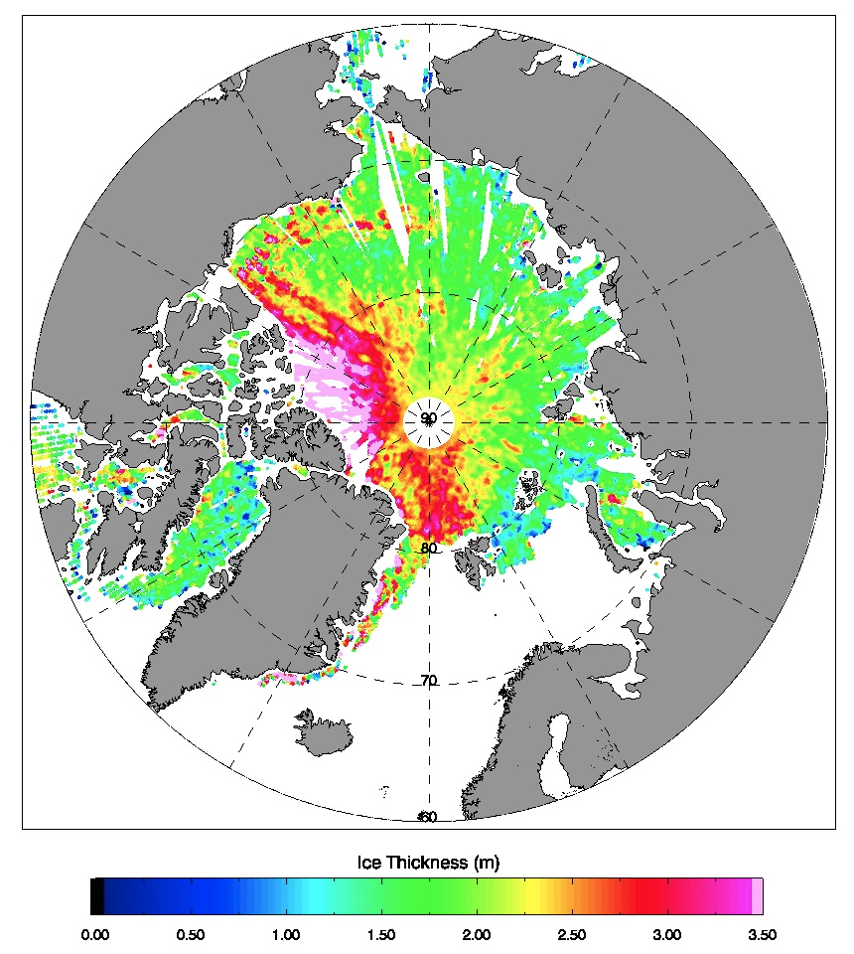
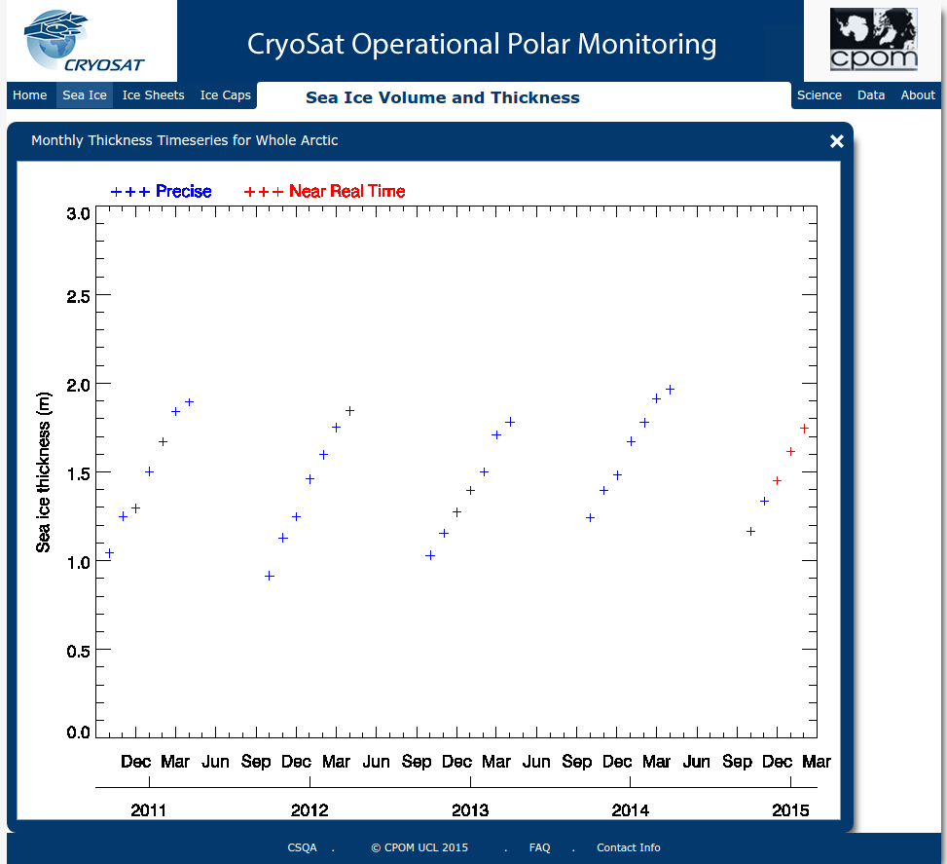
Climatology: Thickness of Arctic sea ice in the spring of 2015
Notes:
ICESAT is the brainchild of our former Head of Department Prof. Duncan Wingham. Data produced by the satellite and processed at CPOM have precisely documented the spectacular decline of sea ice thickness in the Arctic over the past few years, which has exceeded even the most pessimistic climate change scenarios.

Slide 24
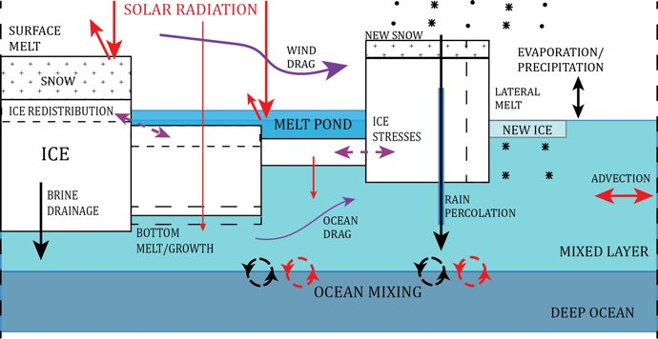
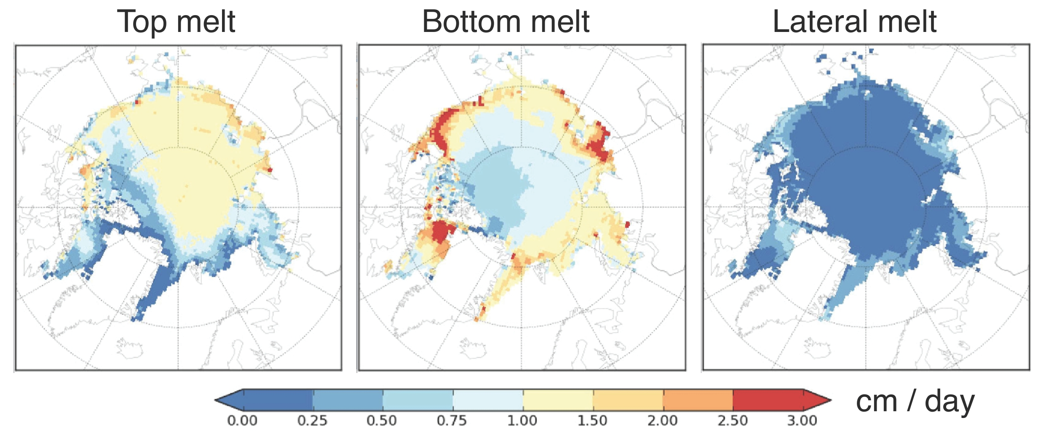
Climatology: Modelling sea ice melting in the Arctic

Slide 25
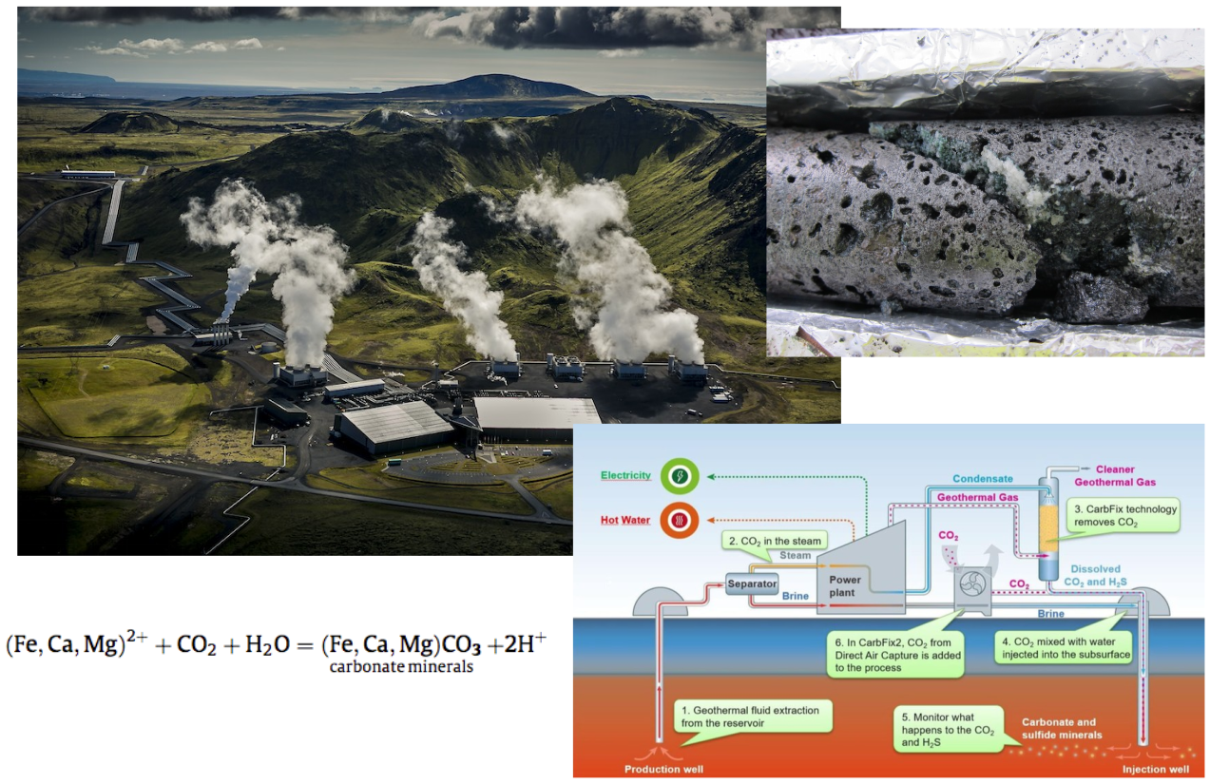
Carbon capturing in Iceland

Slide 26

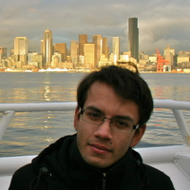



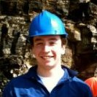


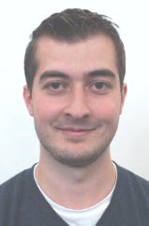
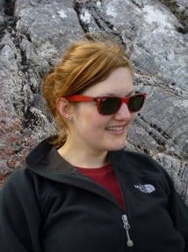

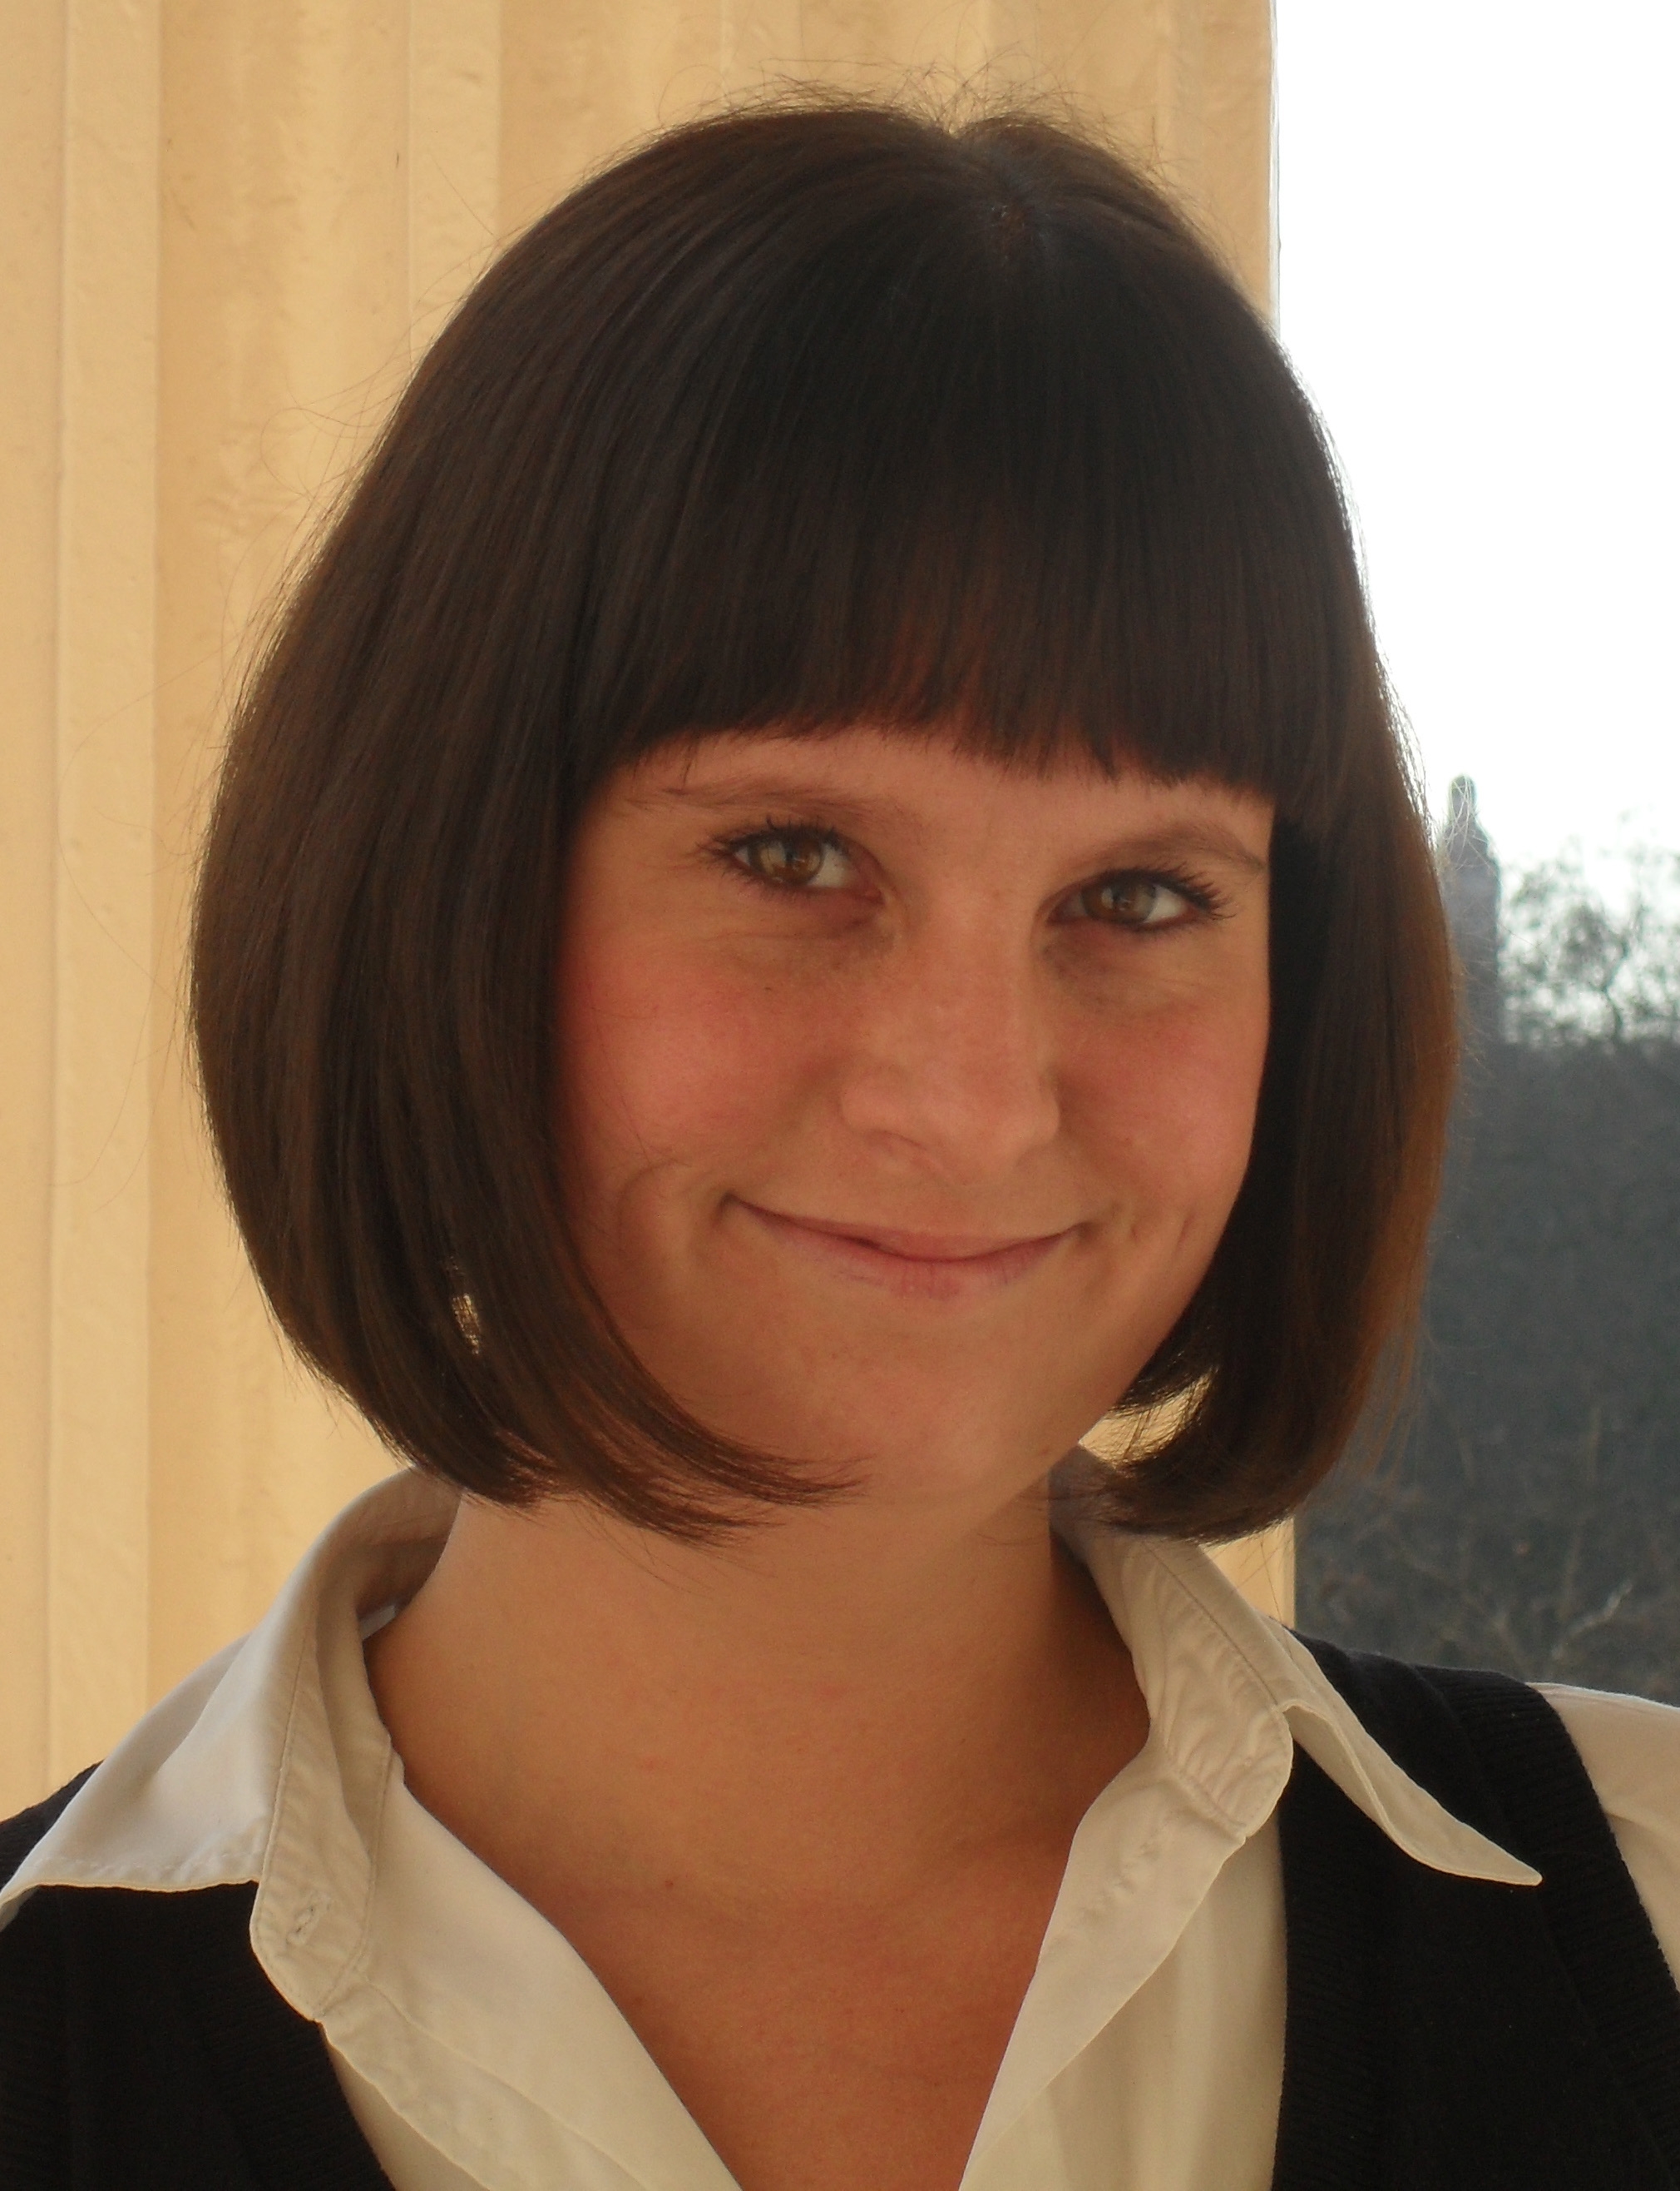

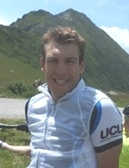
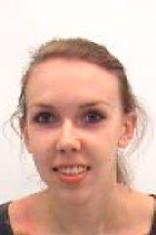

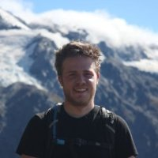
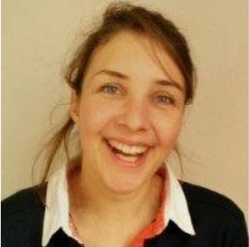

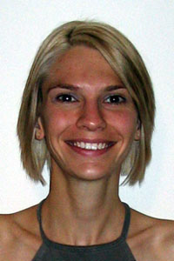

Some recent graduates
http://ucl.ac.uk/careers
PhD (Bristol)
MRes Photonics (UCL)
Perenco Oil & Gas
Parsons Brinckerhoff
Iona Energy
BP
Graduate Trainee
(Imperial College)
Schlumberger
PhD (UCL)
Imperial College
Town and Country
Planning Association
PhD (Oxford)
Lafarge Aggregates
ESA
Neftex Petroleum
Environment Agency
Teacher
EDF Energy
Assoc. Prof. (UCL)
Network Rail
Notes:
A high proportion of our graduates (30 – 50%) go on to further study (Ph.D., M.Sc. Etc.) The remainder enter a wide variety of careers. The UCL Career Centre (www.ucl.ac.uk/careers) provides career advice and organises frequent job fairs where students can meet potential employers and apply for summer internships.

Slide 27

Earth Sciences by numbers
30 staff & 30 research staff and fellows
>20 PhD students
~30 MSc students
~200 undergraduate students
Intake ~60 each 120 this year
staff:student ratio ~ 1:8
Notes:
With a staff-to-student ratio of 1:6, our Department offers excellent opportunities for our students to interact with lecturers and professors. This is especially the case in years 2-4, when specialised modules are delivered to small groups with close to one-on-one tuition. During the first year, each new student is assigned a Personal Tutor who serves as a mentor during the rest of his/her studies at UCL, providing further personal guidance through the university curriculum.

Slide 28

Kathleen Lonsdale Building (KLB)
Cost : £29M
Staff offices: January 2017
Research labs: March 2017
Teaching spaces: January 2018
Official reopening: April 2018
Notes:
With a staff-to-student ratio of 1:6, our Department offers excellent opportunities for our students to interact with lecturers and professors. This is especially the case in years 2-4, when specialised modules are delivered to small groups with close to one-on-one tuition. During the first year, each new student is assigned a Personal Tutor who serves as a mentor during the rest of his/her studies at UCL, providing further personal guidance through the university curriculum.
The £11M refurbishment of the Kathleen Lonsdale Building will bring all the Earth Sciences staff together under one roof for the first time in over four decades. Building works are due to be completed next year. Staff offices are moving in January, research laboratories in March, and the new teaching labs will officially open in September 2017, in time to welcome the 2017 cohort of students to the Department.

Slide 29

Grand opening by Sir David Attenborough on April 17
Notes:
With a staff-to-student ratio of 1:6, our Department offers excellent opportunities for our students to interact with lecturers and professors. This is especially the case in years 2-4, when specialised modules are delivered to small groups with close to one-on-one tuition. During the first year, each new student is assigned a Personal Tutor who serves as a mentor during the rest of his/her studies at UCL, providing further personal guidance through the university curriculum.
The £11M refurbishment of the Kathleen Lonsdale Building will bring all the Earth Sciences staff together under one roof for the first time in over four decades. Building works are due to be completed next year. Staff offices are moving in January, research laboratories in March, and the new teaching labs will officially open in September 2017, in time to welcome the 2017 cohort of students to the Department.

Slide 30





Our staff

Slide 31

Our students

Slide 32


Greenough Society
Wednesday 28/9:
7:00 PM - Icebreakers and welcome drinks in the Kathleen Lonsdale Building (KLB) 1st floor common room (all new students - UG, PG, affiliate, etc.)
Thursday 29/9:
10:30 AM - Greenough information session during freshers' welcome meeting in the 1st floor teaching lab (1st years)
Pizza lunch for 1st years following the meeting - location TBA on the day, depending on the weather
7:00 PM - Pub crawl. Meet in KLB 1st floor common room (ALL students)

Slide 33

SSCC
Year reps to be sought – PV will be in contact

Slide 34

Modules taught in the Earth Sciences department
Year 1
Year 2
Term 1
GEOL0001 Earth Materials
GEOL0007 The Earth
GEOL0008 Geochemistry
Term 2
GEOL0002 * From Petrology to Petrogenesis
GEOL0003 History of Life
GEOL0004 Dynamic Earth
GEOL0006 * Surface Processes
Term 1
GEOL0015* Maps, Images & Structures
GEOL0016 Structural Geology & Tectonics
GEOL0009 Vertebrate Palaeontology & Evolution
GEOL0012 Global Geophysics
Term 2
GEOL0010* Sedimentology and Stratigraphy
GEOL0011 Igneous Petrology
GEOL0013 Principles of Climate
GEOL0017 Isotope Geology
GEOL0018 Numerical Methods for Earth Sciences
Years 3 & 4
Term 1
GEOL0021 Biodiversity & Macroevolutionary Patterns
GEOL0022 Ocean Physics & Climate Change
GEOL0026 Earth & Planetary Materials
GEOL0024* Geological/Environmental
Mapping Project
GEOL0029 Seismology I
GEOL0032 Metamorphism and Metamorphic Processes
GEOL0039* Earth & Planetary System Science
GEOL0041 Physical Volcanology & Volcanic Hazard
GEOL0043 Tectonic Geomorphology
GEOL0060 Numerical modelling of mantle dynamics
Term 2
GEOL0023* Crustal Dynamics & Basin Evolution
GEOL0042 Earthquake Seismology &
Earthquake Hazard
GEOL0025 Earth Resources & Sustainability
GEOL0057 Geodynamics and Global Tectonics
GEOL0027 Groundwater Science
GEOL0030 Seismology II
GEOL0031 Advanced Geochemistry
GEOL0046 Deep Earth & Planetary Modelling
GEOL0061 Statistics for Geoscientists

Slide 35


Field modules
Year 1
Year 1-2
Dorset-Cornwall
Assynt (Scotland)
Year 2-3
Year 3-4
Marche (Italy)
Riess (Germany)
Pyrenees
Betics (Spain)

Slide 36
Stream combinations
This year:
Earth and Environment + Genetics, Evolution and Environment
Earth and Environment + History, Philosophy and Social Studies of Science
Geophysical Sciences + Physical Chemistry
Geophysical Sciences + Astrophysics
Geophysical Sciences + Physics
Geophysical Sciences + History, Philosophy and Social Studies of Science
From next year:
Geoscience + Genetics, Evolution and Environment
Geoscience + History, Philosophy and Social Studies of Science
Geoscience + Physical Chemistry
Geoscience + Astrophysics
Geoscience + Physics
(Geoscience + Mathematics and Statistics)

Slide 37

Term 1: choose a foundation module

Slide 38
Modules taught in the Earth Sciences department
Year 1
Year 2
Term 1
GEOL0001 Earth Materials
GEOL0007 The Earth
GEOL0008 Geochemistry
Term 2
GEOL0002 * From Petrology to Petrogenesis
GEOL0003 History of Life
GEOL0004 Dynamic Earth
GEOL0006 * Surface Processes
Term 1
GEOL0015* Maps, Images & Structures
GEOL0016 Structural Geology & Tectonics
GEOL0009 Vertebrate Palaeontology & Evolution
GEOL0012 Global Geophysics
Term 2
GEOL0010* Sedimentology and Stratigraphy
GEOL0011 Igneous Petrology
GEOL0013 Principles of Climate
GEOL0017 Isotope Geology
GEOL0018 Numerical Methods for Earth Sciences
Years 3 & 4
Term 1
GEOL0021 Biodiversity & Macroevolutionary Patterns
GEOL0022 Ocean Physics & Climate Change
GEOL0026 Earth & Planetary Materials
GEOL0024* Geological/Environmental
Mapping Project
GEOL0029 Seismology I
GEOL0032 Metamorphism and Metamorphic Processes
GEOL0039* Earth & Planetary System Science
GEOL0041 Physical Volcanology & Volcanic Hazard
GEOL0043 Tectonic Geomorphology
GEOL0060 Numerical modelling of mantle dynamics
Term 2
GEOL0023* Crustal Dynamics & Basin Evolution
GEOL0042 Earthquake Seismology &
Earthquake Hazard
GEOL0025 Earth Resources & Sustainability
GEOL0057 Geodynamics and Global Tectonics
GEOL0027 Groundwater Science
GEOL0030 Seismology II
GEOL0031 Advanced Geochemistry
GEOL0046 Deep Earth & Planetary Modelling
GEOL0061 Statistics for Geoscientists

Slide 39

The Earth

Slide 40

Term 2: choose two modules

Slide 41
Term 2: one compulsory module, one optional
Year 1
Year 2
Term 1
GEOL0001 Earth Materials
GEOL0007 The Earth
GEOL0008 Geochemistry
Term 2
GEOL0002* From Petrology to Petrogenesis
GEOL0003 History of Life (EES)
GEOL0004 Dynamic Earth (GS)
GEOL0006* Surface Processes
Term 1
GEOL0015* Maps, Images & Structures
GEOL0016 Structural Geology & Tectonics
GEOL0009 Vertebrate Palaeontology & Evolution
GEOL0012 Global Geophysics
Term 2
GEOL0010* Sedimentology and Stratigraphy
GEOL0011 Igneous Petrology
GEOL0013 Principles of Climate
GEOL0017 Isotope Geology
GEOL0018 Numerical Methods for Earth Sciences
Years 3 & 4
Term 1
GEOL0021 Biodiversity & Macroevolutionary Patterns
GEOL0022 Ocean Physics & Climate Change
GEOL0026 Earth & Planetary Materials
GEOL0024* Geological/Environmental
Mapping Project
GEOL0029 Seismology I
GEOL0032 Metamorphism and Metamorphic Processes
GEOL0039* Earth & Planetary System Science
GEOL0041 Physical Volcanology & Volcanic Hazard
GEOL0043 Tectonic Geomorphology
GEOL0060 Numerical modelling of mantle dynamics
Term 2
GEOL0023* Crustal Dynamics & Basin Evolution
GEOL0042 Earthquake Seismology &
Earthquake Hazard
GEOL0025 Earth Resources & Sustainability
GEOL0057 Geodynamics and Global Tectonics
GEOL0027 Groundwater Science
GEOL0030 Seismology II
GEOL0031 Advanced Geochemistry
GEOL0046 Deep Earth & Planetary Modelling
GEOL0061 Statistics for Geoscientists

Slide 42

Prerequisites

Slide 43

Questions?

