Slide 1
Project Integration Management
Project Management
Paul Vesey
Limerick Institute of Technology
paul.vesey@lit.ie
Spring 2020

Slide 2
Project Management
Project Integration Management Introduction
Project Integration Management
Project Integration Management Spans the 5 PM Process Groups of:
Initiating
Planning
Executing
Monitoring & Controlling
Closing
It is the first of the 10 PM Knowledge Areas that we will cover.

Slide 3
Project Management
Project Integration Management Introduction
Develop Project Charter
The Project Charter is the document that formally authorises the project.
The Project Manager should be appointed at this stage Projects are usually chartered and authorised external to the project organisation by an enterprise, government agency, a program organisation, or a portfolio organisation due to:
Market Demand (e.g. Housing Projects)
Business Need (e.g. New Offices, New IT system) Customer Request (e.g. Construction Contracting) Technological Advance (e.g. Broadband Cabling)
Legal Requirement (e.g. change in air emissions regulations.)
Social Need (e.g. Water Treatment Plant)

Slide 4
Project Management
Project Integration Management Introduction
Develop Project Charter
Developing a charter links the project with the overall goals and strategy of the company (if you can’t link it, why do it?)
Project Charter is primarily concerned with:
Documenting business need Project justification
Current understanding of customers requirements Product, service, or result to satisfy the above

Slide 5
Project Management
Project Integration Management Introduction
Develop Project Charter
The project charter should address the following: Requirements that satisfy customer, sponsor, and other stakeholders needs, wants and expectations
Business Needs, high level project description Project purpose or justification
Assigned Project Manager and authority level Summary milestone schedule
Stakeholder influences
Functional organisation & their participation Organisational, Environmental and External assumptions and constraints
Business Case justifying project; ROI etc Summary Budget

Slide 6
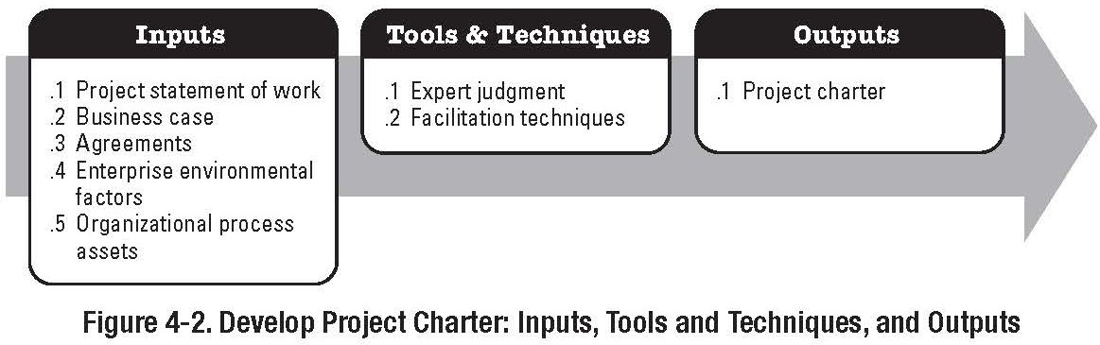
Project Management
Project Integration Management Introduction
Develop Project Charter
Inputs: Refer to Book for details of: Contract
Project Statement of Work Enterprise Environmental Factors Organizational Process Assets

Slide 7
Project Management
Project Integration Management Introduction
Other Tools for Project Charter
Tools:
Project Selection Methods: Allows reader to understand why a particular project was selected
Project Management Methodology: How will be project be managed and controlled
Project Management Information Systems: How will information be distributed and controlled

Slide 8
Project Management
Project Integration Management Introduction
Project Selection Methods
Most companies cannot execute all project proposals; selection methods help to select one project over another in a logical, rational and unbiased manner.
They can be:
Mathematical models
Benefit measurement methods
Scoring Models
Cash Flow Analysis Techniques
Payback Period Discounted Cash Flow NPV
IRR
Cost-Benefit Analysis

Slide 9
Project Management
Project Integration Management Introduction
PM Methodology & PM Information System
May look similar, but very different
Methodologies are PMBOK or similar: May be formal (PMBOK) or an informal technique
Information Systems are generally software tools and techniques that provide details of resources & activities; allow the distribution of information; and assist in scheduling and tracking. Methodologies utilize information systems.

Slide 10
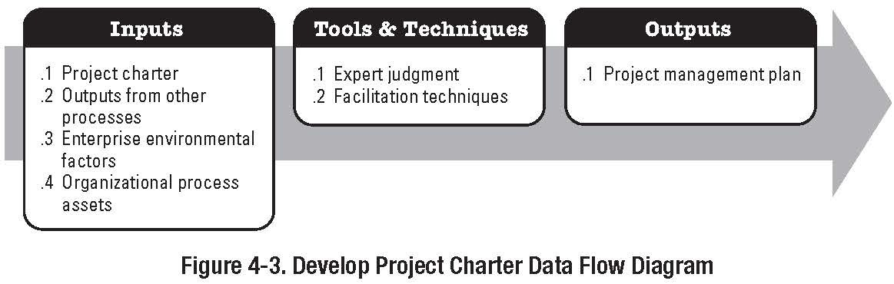
Project Management
Project Integration Management Develop Project Management Plan
Develop Project Management Plan

Slide 11
Project Management
Project Integration Management Develop Project Management Plan
Develop Project Management Plan
Output is the Project Management Plan
The PM Plan is a top level document that details how the project will be managed.
The PM plan is managed throughout the Project It is a ‘live’ document. (Version Control is vital)
Changes to the PM plan are made through the Integrated Change Control Process
The level of information contained within the plan will vary with the complexity of the project
The Project Plan is likely to contain processes and procedures that are common to a company’s project portfolio or project programme

Slide 12
Project Management
Project Integration Management Develop Project Management Plan
Project Management Plan
The Project Management Plan defines how the project is executed, monitored & controlled, and closed.
PM plan can be summary level or detailed and can be comprised of one or more subsidiary plans and/or other components.
For construction projects, the PM Plan usually does comprise of subsidiary plans

Slide 13
Project Management
Project Integration Management Develop Project Management Plan
Project Management Plan
Defines the processes that will be used for the project States the degrees of execution of each process; the tools & techniques from each process; Essential Inputs & Outputs
Documents the dependencies and interactions of the PM processes used to manage the project
Methods for executing the work to fulfill objectives Methods of monitoring and controlling change Methods to perform configuration management Methods for determining and maintaining the validity of performance baselines
Communication needs of the stakeholders
Project Life Cycle, Phases for multi-phase projects Management reviews of issues and pending decisions

Slide 14
Project Management
Project Integration Management Develop Project Management Plan
Project Management Plan Subsidiary Plans
Typically:
Project Scope Management Plan Schedule Management Plan Cost Management Plan
Quality Management Plan Process Improvement Plan Staffing Management Plan Communication Management Plan Risk Management Plan Procurement Management Plan

Slide 15
Project Management
Project Integration Management Develop Project Management Plan
Project Management Plan
Other Elements
Milestone List
Vital on construction projects
Resource Calendar
Identifies working/non-working days in general and for individual resources
Schedule Baseline Cost Baseline Quality Baseline Risk Register

Slide 16
Project Management
Project Integration Management Develop Project Management Plan
Project Management Plan
Dependencies
The top level Project Management Plan contains elements of each of the individual subsidiary plans.
One of the key elements of the top-level plan is that it ‘maps out’ the dependencies between the various processes.
i.e. if you identify a schedule overrun (Schedule Management) you can quickly ascertain the impacts in other plans and processes such as the cost management plan, procurement management plan etc.
Any and all changes must be run through the change control process.
16 / 38

Slide 17
Project Management
Project Integration Management Develop Project Management Plan
Develop PMP
Tools and Techniques
Expert Judgment:
Tailor the process to meet project needs
Develop technical and management details to be included in the plan
Determine resources and skill levels needed
Define the level of configuration management to apply
Determine which project documents will be subject to change control processes
Drawings, specs, minutes of meetings

Slide 18
Project Management
Project Integration Management Develop Project Management Plan
Configuration Management System and Change Control System
Both are subsets of the overall PM information system. Configuration Management System consists of processes:
for submitting proposed changes
that include a tracking system for reviewing and approving or rejecting changes
that define approval levels for authorising changes that define a method of validating approved changes
Normally the Configuration Management System includes the change control system - however sometimes (rarely) it is separated

Slide 19
Project Management
Project Integration Management Develop Project Management Plan
Configuration Management System
The Configuration Mgt System is a collection of formal procedures used to apply technical and administrative direction and surveillance to:
Identify and document the functional and physical characteristics of a product or component
Design Drawings, Specs, etc.
Control any changes to these characteristics Changes to design (move a door) or changes to spec (change the door handles being used)
Record and Report each change and its implications
Necessary for final accounts (read the contract) May have cost, safety or schedule implications
Support the audit of the products or components to verify conformance to requirements

Slide 20
Project Management
Project Integration Management Develop Project Management Plan
Change Control System
Change Control System is a collection of documented procedures that define how project deliverables and documentation are:
Controlled, Changed, and Approved.
Control
Who has the documents and ensuring the correct version is where it should be.
Normally controlled documents have a formal list of recipients - ‘Controlled Copies’ are normally marked as such.
May define a requirement that all controlled copies of superseded drawings and specs are returned to the main contractor or employer for destruction;
20 / 38

Slide 21
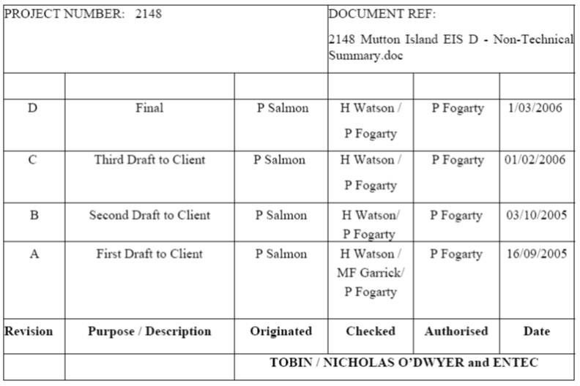
Project Management
Project Integration Management Develop Project Management Plan
Documentation Control
Documentation Issue and Approval
Extracted from Environmental Impact Statement, Mutton Island Upgrade Project

Slide 22
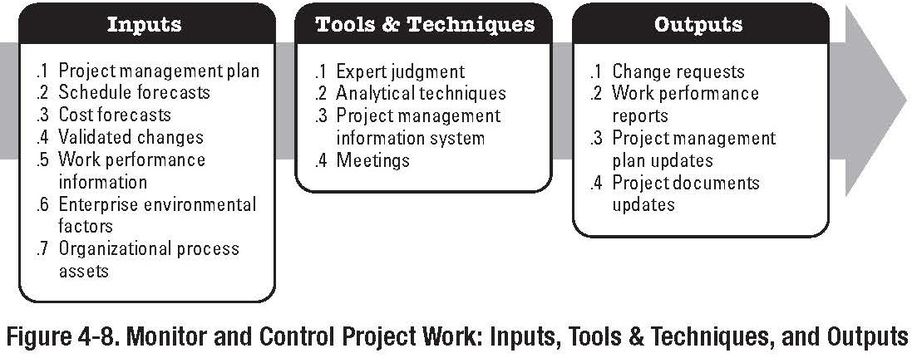
Project Management
Project Integration Management Monitor and Control Project Work
Monitor and Control Project Work
Part of the Monitoring and Controlling Process Group

Slide 23
Project Management
Project Integration Management Monitor and Control Project Work
Monitor and Control Project Work
Involves:
Comparing Actual Performance against Planned Project Performance and PM Plan
Assessing Performance to determine if corrective or preventative actions are required
Analysing, Tracking and Monitoring Project Risks; and documenting findings
Maintaining Accurate Information and ensuring that it can be retrieved in a timely manner
Providing Information for Status Reporting
Providing Forecasts to cost and schedule models and plans
Monitoring the implementation of approved changes

Slide 24
Project Management
Project Integration Management Monitor and Control Project Work
Monitor and Control Project Work
Inputs:
Project Management Plan Performance Reports
Enterprise Environmental Factors Organisational Process Assets
Financial Systems (Purchasing, et al)

Slide 25
Project Management
Project Integration Management Monitor and Control Project Work
Monitor and Control Project Work
Tools and Techniques: Expert Judgement
Project Management Methodology
Methodology used by the PM team to ensure that the project is being executed in accordance with the PM Plan
Project Management Information System
Also used for forecasts
Earned Value Management System
Used to determine current project status, past performance and likely future performance

Slide 26
Project Management
Project Integration Management Monitor and Control Project Work
Monitor and Control Project Work
Outputs:
Change Requests
Corrective Actions - Documented recommendations required to bring expected future project performance into conformance
Preventative Actions - Documented recommendations that reduce the probability of non-conformance events Recommended Defect Repair - Repair of Defects or
non-conformances identified during Quality Management
Project Document Updates - Forecasts
ECT, EAC, Projected Completion Date etc.
Project Management Plan Updates

Slide 27
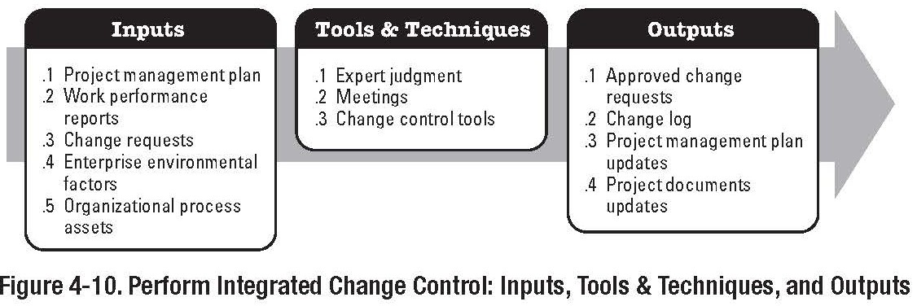
Project Management
Project Integration Management Perform Integrated Change Control
Perform Integrated Change Control
Part of the Monitoring and Controlling Process Group

Slide 28
Project Management
Project Integration Management Perform Integrated Change Control
Perform Integrated Change Control
Integrated Change Control is required throughout the project lifecycle
PM Plan, Scope Statement, Specifications need to be controlled and maintained throughout the course of the project.
Progressive Elaboration
Changes requests can be either rejected or approved

Slide 29
Project Management
Project Integration Management Perform Integrated Change Control
Perform Integrated Change Control
Change Management Activities:
Identifying that a change needs to occur or has occurred
Influencing the factors that circumvent integrated change control so that only approved changes are implemented
Scope Creep
Reviewing and approving requested changes
Managing the approved Changes when and as they occur
Maintaining the integrity of baselines by releasing only approved changes
Approved changes typically modify baseline information
Reviewing and Approving all recommended corrective and preventative actions

Slide 30
Project Management
Project Integration Management Perform Integrated Change Control
Perform Integrated Change Control
Change Management Activities:
Coordinating change across the entire project
Controlling and Updating Scope, Cost, Budget, etc., based upon approved changes
One change can effect a multitude of documents Documenting the complete impact of requested changes
It is not always possible to predict ahead of time what the exact impact of a change may be. An initial estimate of 2 weeks delay may prove to be inaccurate.

Slide 31
Project Management
Project Integration Management Perform Integrated Change Control
Perform Integrated Change Control
Proposed Changes can require new or revised: Cost estimates
Schedule activity Schedule dates Resource requirements
Risk analysis and response Also may require modification to:
Scope Deliverables Etc.

Slide 32
Project Management
Project Integration Management Perform Integrated Change Control
Perform Integrated Change Control
Every documented requested change must be either accepted or rejected.:
Requires persons in authority
Change Review Boards may be formed

Slide 33
Project Management
Project Integration Management Perform Integrated Change Control
Perform Integrated Change Control
Inputs:
Project Management Plan Work Performance Information Change Requests
Enterprise Environmental Factors Organisational Process Assets
Procedures for change control, etc.

Slide 34
Project Management
Project Integration Management Perform Integrated Change Control
Perform Integrated Change Control
Tools and Techniques: Expert Judgement
Approval Authorities are assumed to posses expert judgement. . . .
Change Control Meetings
Both Will normally require Information Systems

Slide 35
Project Management
Project Integration Management Perform Integrated Change Control
Perform Integrated Change Control
Outputs:
Change Request Status Updates Approved Change Requests Rejected Change Requests
Approved Corrective Actions Approved Preventative Actions Approved Defect Repair
Project Management Plan Updates Project Document Updates

Slide 36
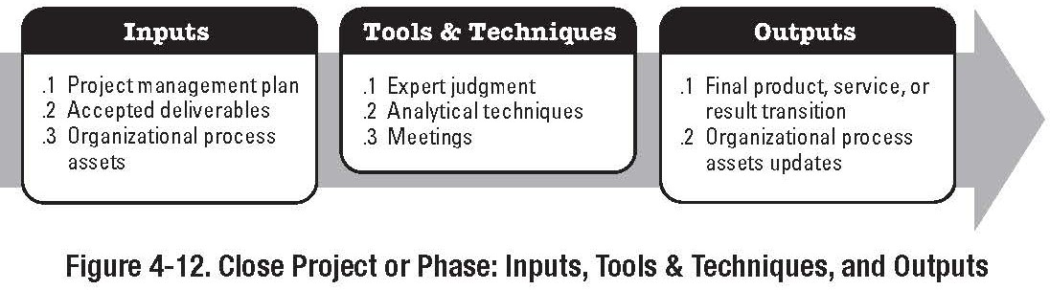
Project Management
Project Integration Management Close Project or Phase
Close Project or Phase
Part of the Closing Process Group

Slide 37
Project Management
Project Integration Management Close Project or Phase
Close Project
Close Project involves performing the project closure portion of the PM Plan.
The ‘Close Project’ process can be applied to the project as a whole but may also be applied to a project phase
Usually involves verifying and documenting project deliverable acceptances
However sometimes it involves documenting why a project was terminated before completion
Two main activities
Administrative Closure Procedure Contract Closure Procedure

Slide 38
Project Management
Project Integration Management Close Project or Phase
Close Project
Administrative Closure Collection of Project Records Success/Failure Analysis Lessons Learned
Archiving of Project Information
Contract Closure
Activities required to settle or close the contract
TOC; Completion Cert; Defects Liability Period, etc.
Requires verification of project (product) acceptance

