Slide 1
Project Risk Management
Introduction
Project Risk Management
Paul Vesey
Limerick Institute of Technology
paul.vesey@lit.ie
Spring 2020
1 / 98

Slide 2
Project Risk Management
Introduction
Project Risk Management
Risk is a measure of the probability and consequence of not achieving a defined project goal. Risk has two primary components
A probability of occurrence of that event - likelihood Impact of the event occurring - How much will it cost?
Risk is a function of likelihood and impact
1 / 98

Slide 3
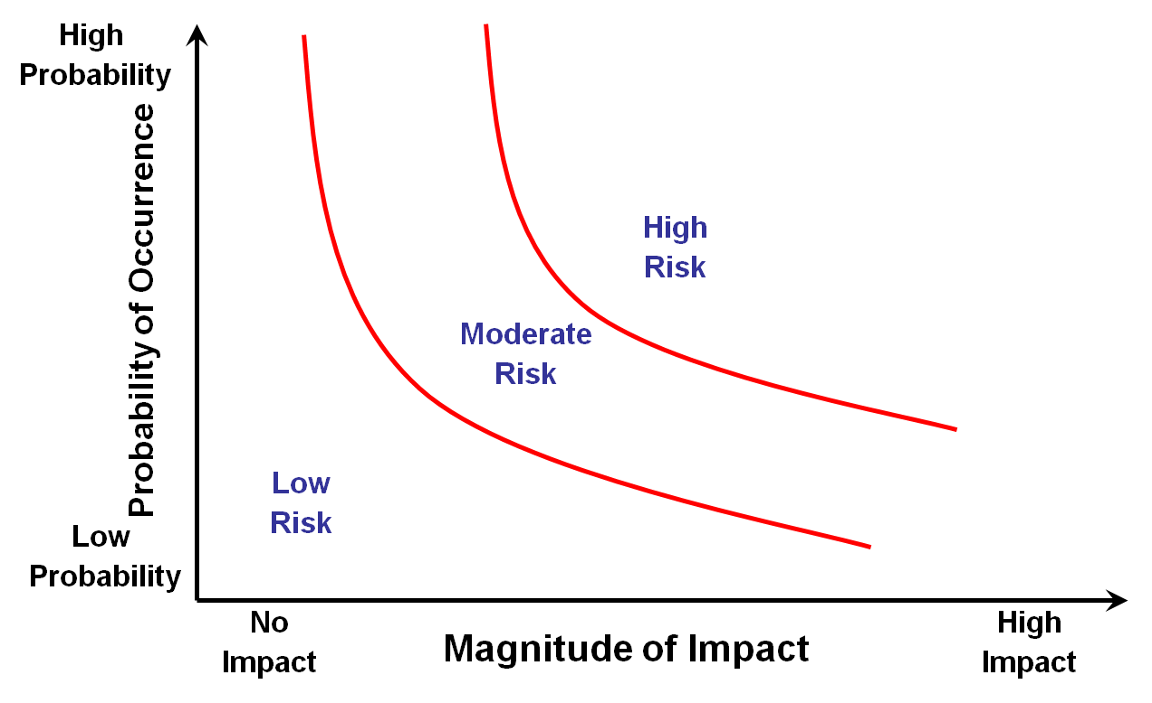
Project Risk Management
Introduction
Project Risk Management
1 / 98

Slide 4
Project Risk Management
Introduction
Project Risk Management
Risk is, in effect, a lack of knowledge of future events
Future events that are favourable are called opportunities Future events that are unfavourable are called risks
Another element of risk is its cause.
This can be something present or something missing This is referred to as a ‘hazard’
1 / 98

Slide 5
Project Risk Management
Introduction
Hazards
Certain hazards can be overcome by: Knowing what they are
Taking action to overcome them
So Risk is also a function of the hazard and the safeguard Risk Increases with hazard and decreases with safeguard
1 / 98

Slide 6
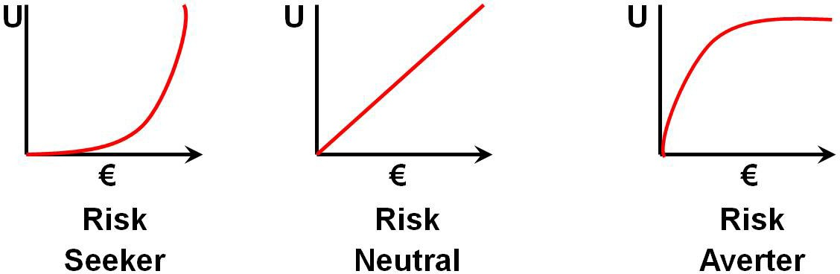
Project Risk Management
Introduction
Tolerance for Risk
Depends on individuals and/or organisations. Some companies seek out risk, others avoid
1 / 98

Slide 7
Project Risk Management
Introduction
Project Risk Management
Risk Seeker
PM’s satisfaction increases at a greater rate as more money is at stake
Risk Averter
Utility rises at a decreasing rate.
As more money is at stake the project managers satisfaction diminishes
1 / 98

Slide 8
Project Risk Management
Introduction
Project Risk Management
The objectives of Project Risk Management are
to increase the probability and impact of positive events
and to decrease the probability and impact of negative events
Project Risk Management includes: Plan Risk Management Identify Risks
Perform Qualitative Risk Analysis Perform Quantitative Risk Analysis Plan Risk Responses
Monitor and Control Risks
1 / 98

Slide 9
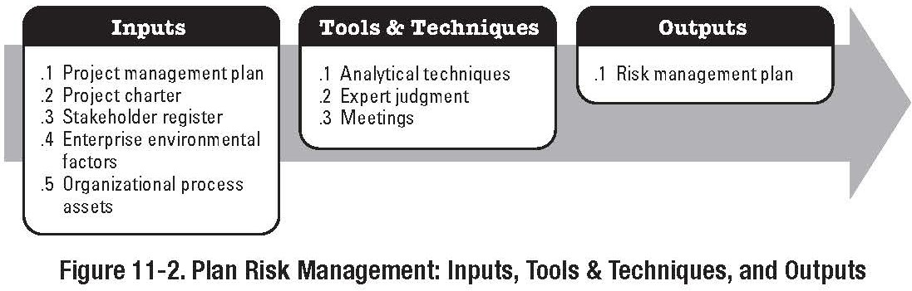
Project Risk Management
Introduction
Plan Risk Mangement
Plan Risk Management
Part of the Planning Process Group
1 / 98

Slide 10
Project Risk Management
Introduction
Plan Risk Mangement
Plan Risk Management
Inputs
Enterprise Environmental Factors
Attitude towards risk and the risk tolerance of the organisation, and individuals
Organisational Process Assets
Predefined approaches to risk management, such as risk categories, standard templates, and authority levels for decision making
Project Scope Statement
Cost/Schedule Management Plans

Slide 11
Project Risk Management
Introduction
Plan Risk Mangement
Plan Risk Management
Tools and Techniques
Planning Meetings and Analysis
Meeting to develop Risk Management Plan Attendees may include PM, PM team, stakeholders
Outputs
Risk Management Plan Methodology
Roles and Responsibilities Budgeting
Timing
Risk Categories
Definitions of Risk Probability and Impact (Probability and Impact Matrix)
Revised Stakeholders Tolerances Reporting Formats
11 / 98

Slide 12
Project Risk Management
Introduction
Plan Risk Mangement
Risk Management Plan
Methodology
Defined approaches, tools, and data sources
Roles and Responsibilities
Defines Lead, support and risk management team membership for each type of activity in the risk management plan, assigns people to these roles, and clarifies their responsibility
Budgeting
Assigns resources and estimated costs needed for risk management.
Included in the project baseline costs

Slide 13
Project Risk Management
Introduction
Plan Risk Mangement
Risk Management Plan
Timing
Defines when and how risk management processes will be performed
Establishes Risk Management activities to be included in project schedule
Risk Categories
Provides a structure that ensures a comprehensive, systematic process to identify risk.
Risk Breakdown Structure (RBS)

Slide 14
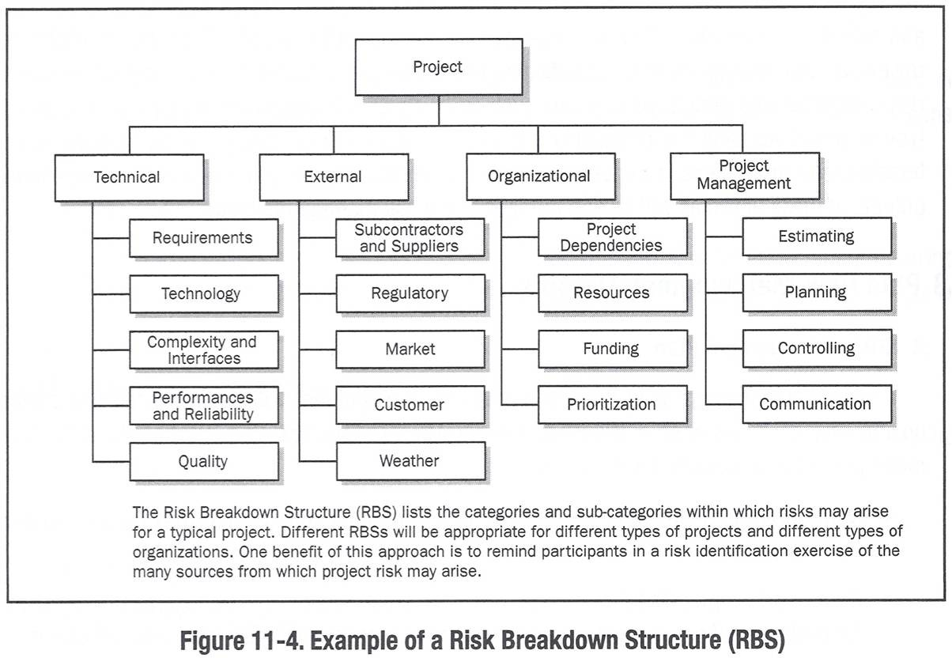
Project Risk Management
Introduction
Plan Risk Mangement
Plan Risk Management
Risk Breakdown Structure (RBS) From PMBOK 4

Slide 15
Project Risk Management
Introduction
Plan Risk Mangement
Risk Management Plan
Definitions of Risk Probability and Impact
The Quality and Credibility of the Qualitative Risk Analysis Process
Assigns a relative scale for probability
‘very unlikely’ to ‘almost certain’
Very unlikely = Government not paying contractor Almost certain = Final account dispute
May also be 1.0 to 0.0
Probability and Impact Matrix

Slide 16
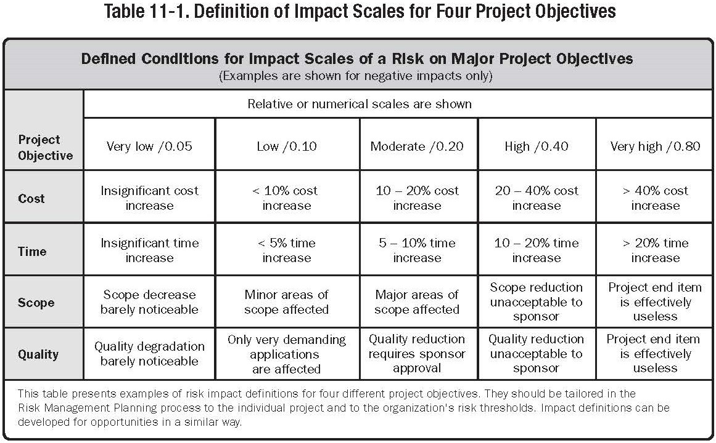
Project Risk Management
Introduction
Plan Risk Mangement
Plan Risk Management
Impact Scale

Slide 17
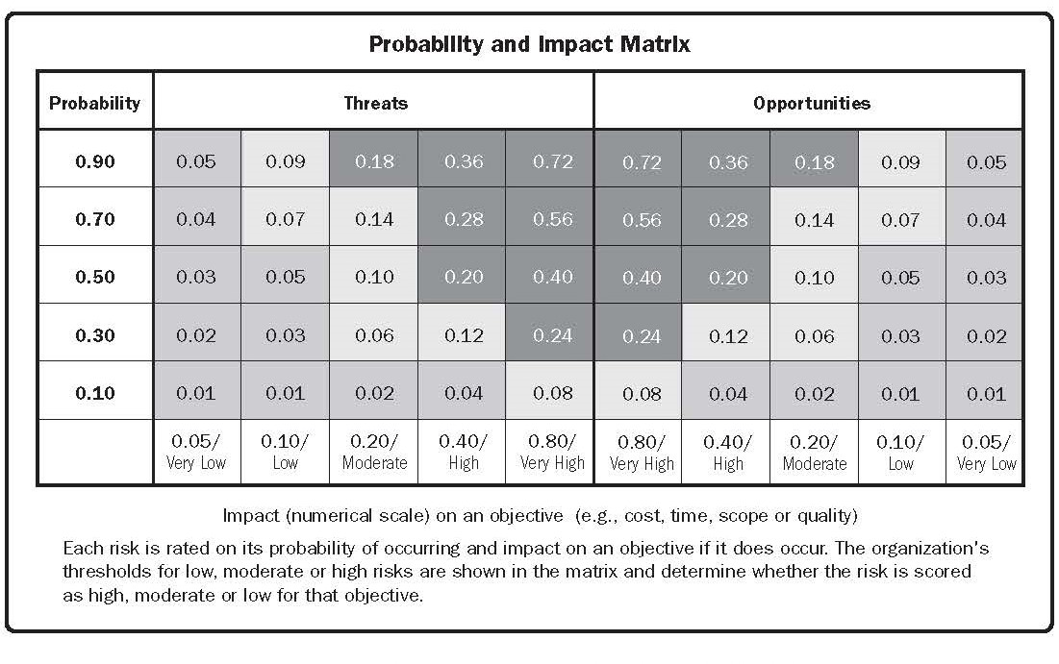
Project Risk Management
Introduction
Plan Risk Mangement
Risk Management Plan
Definitions of Risk Probability and Impact Probability and Impact Matrix

Slide 18
Project Risk Management
Introduction
Plan Risk Mangement
Risk Management Plan
Revised Stakeholders Tolerances - As project risks are identified, stakeholders may change their tolerance for specific risks.
Schedule Risks Budget Risk Quality Risk
Reporting Formats
Content and Format of Risk Register
Defines how outcomes of risk management will be documented
Tracking
Documents how all facets of risk activities will be recorded for the benefit of the current project, future needs, and lessons learned

Slide 19
Project Risk Management
Introduction
Plan Risk Mangement
Project Risk Management
Because of the unique and temporary nature of projects, projects carry a greater level of risk than operations.
Risk may be defined as an uncertain event or condition that, if it occurs, has an effect on the project objectives.

Slide 20
Project Risk Management
Introduction
Plan Risk Mangement
Managing project risk is an integral part of Project Management and critical to project success. Not managing project risk may result in:
Over Budget Over Time
Poor Project Performance Loss of reputation

Slide 21
Project Risk Management
Introduction
Plan Risk Mangement
Risk Management
RM includes the processes concerned with identifying, analysis and responding to uncertainty.
The purpose of risk management is to identify the risk factors for a project and then establish a risk management plan to minimize the probability & impact that the negative risk event will have on the project.
The goal of risk management is to identify project risks and develop strategies, which either significantly reduce them or take steps to avoid them altogether.

Slide 22
Project Risk Management
Introduction
Plan Risk Mangement
Risk Management
A Risk is a potential future problem that has not yet occurred
A reactive project manager tries to resolve issues when they occur.
A proactive project manager tries to resolve potential problems before they occur.

Slide 23
Project Risk Management
Introduction
Plan Risk Mangement
Risk Management
No universal definition of the terms used.
The scope and quality knowledge areas need review to see opportunities or threats.
A single risk event may have multiple effects.
Opportunities for one stakeholder may be a threat for another.
Mathematical techniques used may create a false impression of precision and reliability.
Risk probability x Risk value (their product) is a typical risk quantification procedure.
Responses include: contracting, bonding, contingency planning, insurance, alternative strategies.

Slide 24
Project Risk Management
Introduction
Plan Risk Mangement
Risk Management
RM includes the processes concerned with identifying, analysis and responding to uncertainty.
The key principle of Risk Management is to foresee problems before they occur and plan responses to them
Risk may be defined as an uncertain event or condition that, if it occurs, has an effect on the project objectives.

Slide 25
Project Risk Management
Introduction
Plan Risk Mangement
Risk Management
RM includes the processes concerned with identifying, analysis and responding to uncertainty.
Risk Identification Risk Quantification
Risk Response Development
Risk Response Control & Monitoring

Slide 26
Project Risk Management
Introduction
Plan Risk Mangement
Risk Management
IDENTIFICATION:
Sources, events, probability x amount at stake QUANTIFICATION:
Influence diagrams, probability distribution, probability trees, risk modelling, sensitivity profiles
RESPONSE DEVELOPMENT:
Avoid, transfer, mitigate, retain/accept, RESPONSE CONTROL:
Execute plan in event

Slide 27
Project Risk Management
Introduction Risk Analysis
Risk Analysis
Risk needs to be measured in terms of its potential impact or cost on the project, and the probability that the risk event will actually occur.

Slide 28
Project Risk Management
Introduction Risk Analysis
Qualitative Analysis
The overall risk measure against each risk is a combination of both of the probability that it will occur and the impact that the risk would have should it occur.
Both the probability and impact are qualitative measures based on the team experience and technical knowledge. Risk Prioritisation
The risks analysed are prioritised for action

Slide 29
Project Risk Management
Introduction Risk Analysis
Risk Response
For each risk identified a Risk Response Strategy that should be considered. Choices are:
Risk Avoidance Risk Transference Risk Reduction Risk Acceptance

Slide 30
Project Risk Management
Introduction Risk Analysis
Risk Levels
Risk occurs in different ways at every level of an organisation.
Risk may occur at the strategic level, programme level, project level and operational level.
Strategic Risk may be described as risk to the business strategy and is the concern and responsibility of the Management team.

Slide 31
Project Risk Management
Introduction Risk Analysis
Risk Levels - Programme Risk
Risk at this level could be due to: Interdependencies between projects Overall resource levels
Changes in approved budget Materials supply capability
The wider system - the political, economic, social, technological environment
These risks affect many projects simultaneously, and are managed by the Programme manager.

Slide 32
Project Risk Management
Introduction Risk Analysis
Risk Levels - Project & Operational
Project Risks:
Risks at this level are threats to the success of a single project, and most often impact the principal targets of scope, time, cost, and quality, though may impact other knowledge areas at the same time. Risks that threaten the success of the project are the responsibility of the Project manager.
Operational Risk:
The day-to-day operations are also subject to risks. Matters such as health and safety, industrial relations are amongst the operational risks faced by an organisation.
The identification of risks at different organisational levels allow identification of who has responsibility for the risk.

Slide 33
Project Risk Management
Introduction Risk Analysis
Risk and the Project Life Cycle
The project life cycle which establishes the phases through which a project will pass is so designed to enable the management of risk.
The Knowledge areas also enable the effective management of projects.
The process of risk management requires that risk be managed continuously throughout the life of the project.

Slide 34
Project Risk Management
Introduction Risk Analysis
Risk Identification
The identification of risk should occur as early as possible -
i.e. in the conception and definition phase. Risk identification requires an understanding of the project scope and objectives and deciding what may prevent the achievement of them.
The project charter will set out the high level risks to the project. It will also identify the success criteria by which the project will be judged later.
The potential risks to the project are identified as comprehensively as possible
Can be helpful to brainstorm in groups and draw on the experience of the project participants

Slide 35
Project Risk Management
Introduction Risk Analysis
Risk Identification
The feasibility study, if required, will identify and assess the risks in determining the best way of undertaking the project and to determine if proceeding with the project is the best option.
In the planning phase the project manager in the development of the project plan will evaluate the project risk and develop a risk response plan.
As part of implementation these plans will be executed. The process of risk identification and analysis should be re-applied through the implementation phase of the project to re-evaluate project risks

Slide 36
Project Risk Management
Introduction Risk Analysis
Risk Categories
Technical Risks
Robustness of the solution Complexity of the system Ownership
Business / Management Risk Financing
Revenue / Cost / Margin Shareholders

Slide 37
Project Risk Management
Introduction Risk Analysis
Risk Categories
Delivery / Operational Risks Training & Training Support
Human Resource Considerations Complexity
Product Life Cycle On going support
Cost Schedule

Slide 38
Project Risk Management
Introduction Risk Analysis
Risk Recording and Scoring
A table for recording project risks is called a Risk Log.
All identified risks must be recorded in the Risk Log. Risks with a significant potential impact may cause immediate alteration of the Project Plan, and therefore another iteration of risk identification is required
Risk Analysis
Risk analysis involves assessing the probability of a risk occurring and its likely impact if it does occur. The ranking or scoring of risk involves the following calculation
Risk Ranking/Scoring = Probability x Impact (High, medium , low)

Slide 39
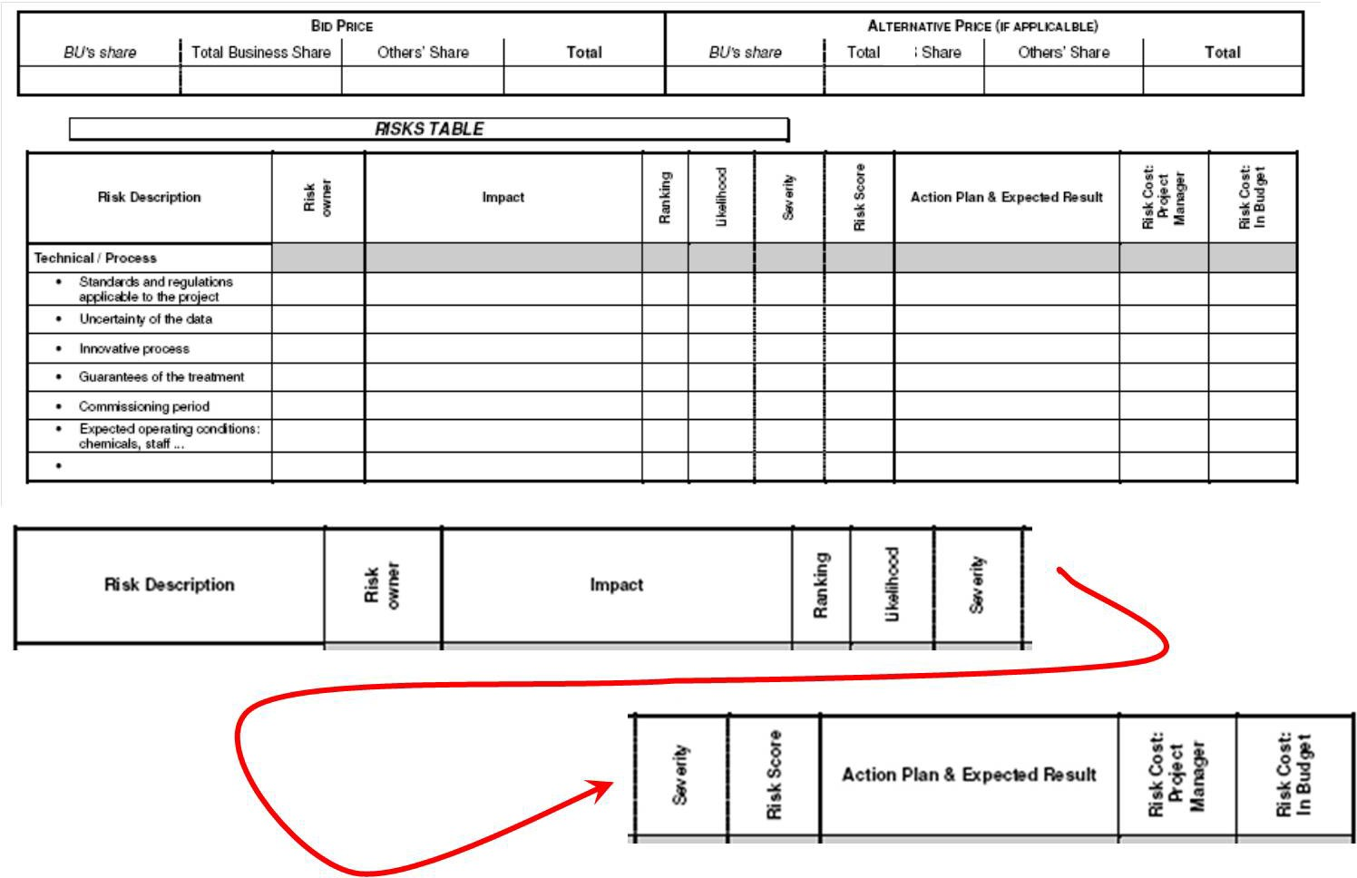
Project Risk Management
Introduction Risk Analysis

Slide 40
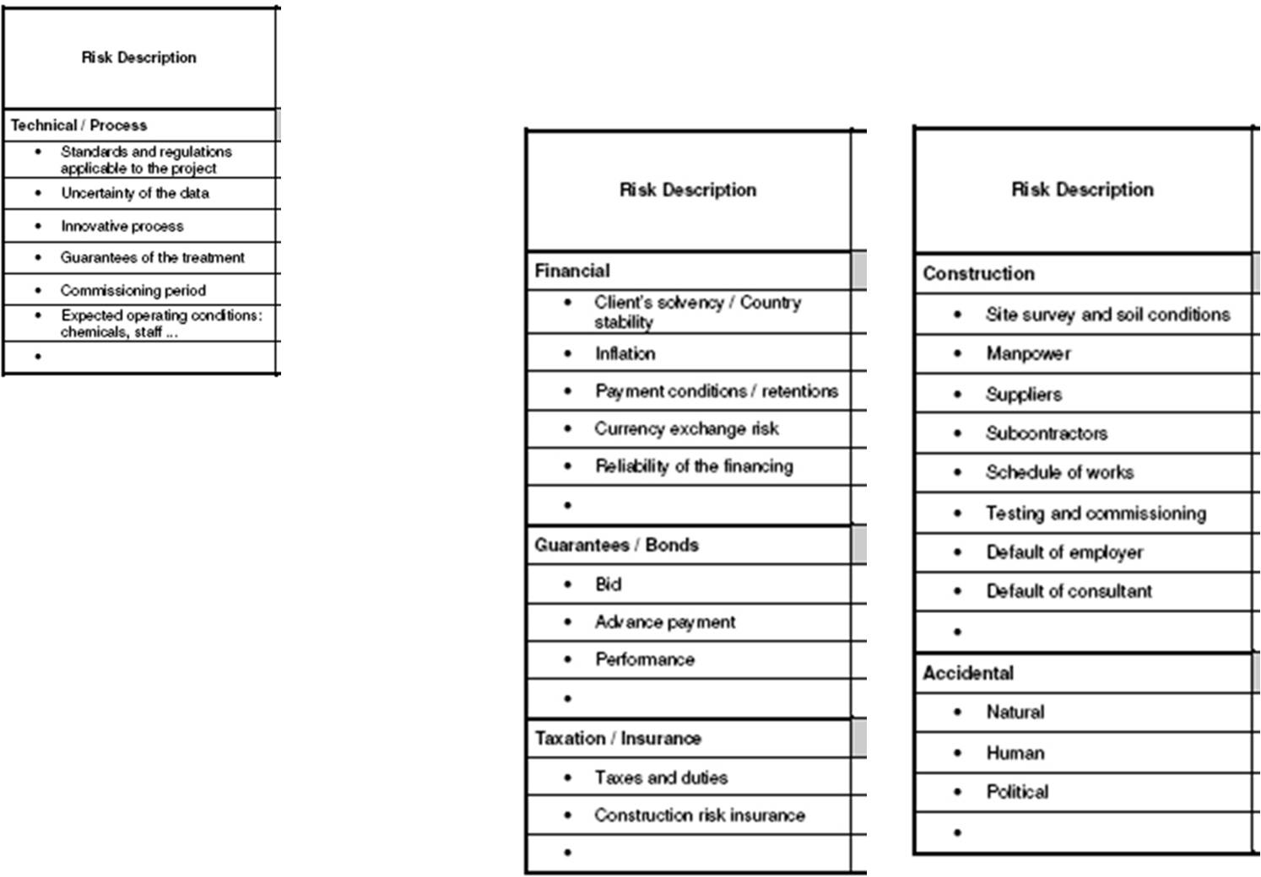
Project Risk Management
Introduction Risk Analysis

Slide 41
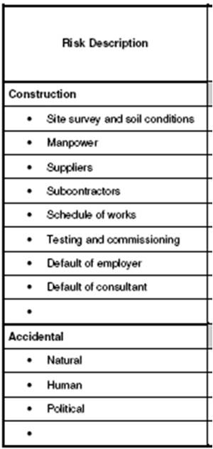
Project Risk Management
Introduction Risk Analysis

Slide 42
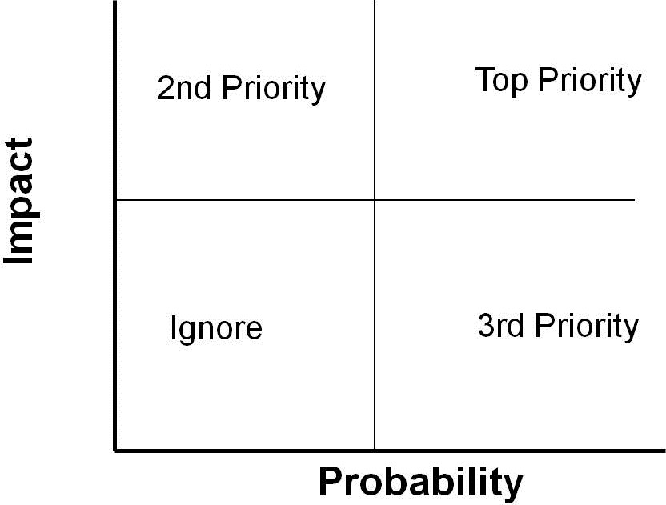
Project Risk Management
Introduction Risk Analysis
Qualitative Analysis

Slide 43
Project Risk Management
Introduction Risk Analysis
Risk Importance
Consider the relative impact each risk will have on the project if it happens.
Note that low probability risks are often high on impact
Alternatively the Risk Probability/Impact Matrix maybe used to establish risk ranking by placing each risk in its correct box in the grid.
The distribution of risks over this matrix gives an overall view of the project risk level.
Low-Medium-High

Slide 44
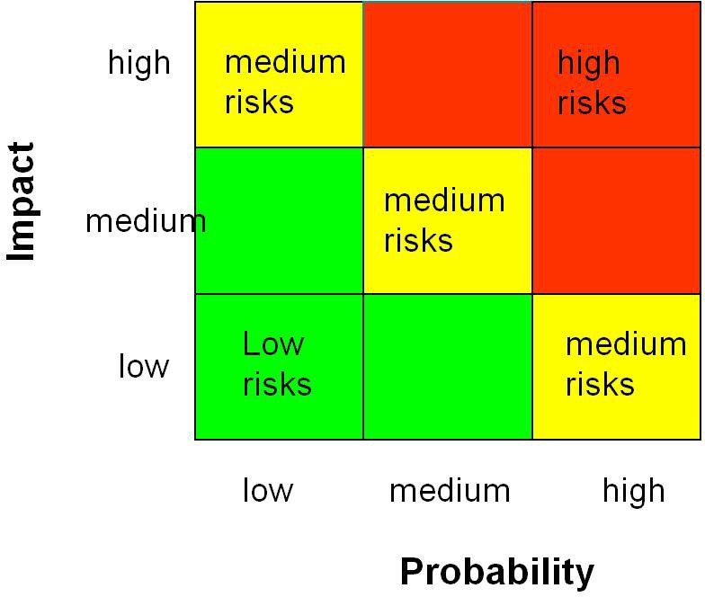
Project Risk Management
Introduction Risk Analysis
Risk Probability & Impact Matrix

Slide 45
Project Risk Management
Introduction Risk Analysis
Risk Response
Once the risks are identified, analysed and prioritised, a plan of action to manage them is developed.
There are 5 response types. (PMBOK gives 4) These are
Avoidance, Transfer, Reduction, Contingency Acceptance.
If a risk has more than one response option, put multiple entries in the Risk Register

Slide 46
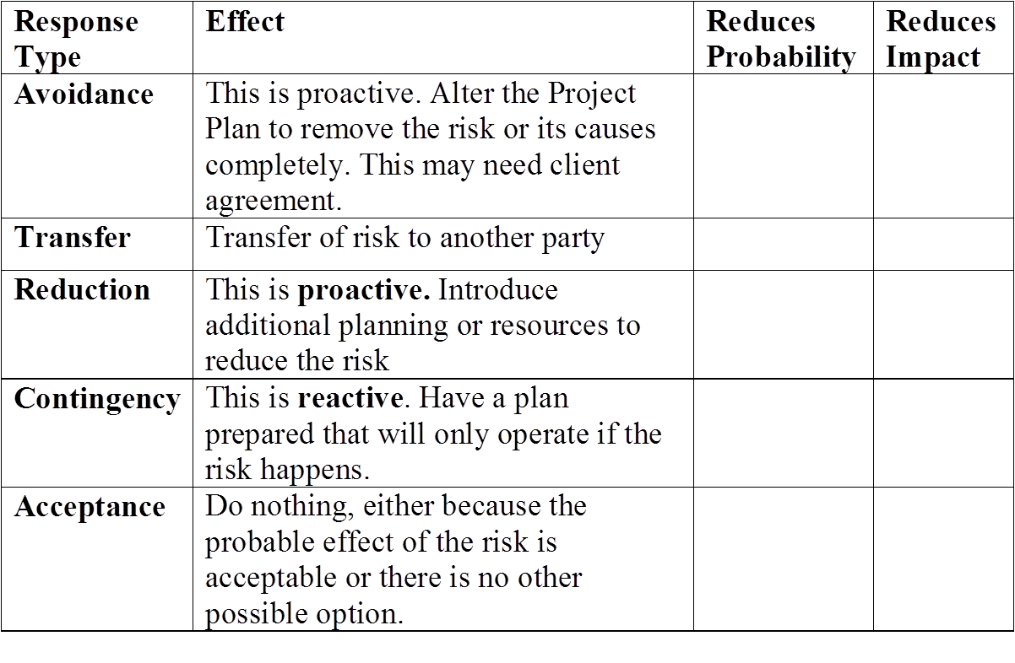
Project Risk Management
Introduction Risk Analysis
Risk Response

Slide 47
Project Risk Management
Introduction Risk Analysis
Response Selection
Do not dwell too long on the Response Type - it is more important to record the details of your risk mitigation.
Responses should be consistent with the project priorities. For example if the schedule is the top priority, try not to plan responses that will add time to schedule.
Make certain that the response you plan does not end up costing more time or money that the risk you are tying to cover.
As you plan each response, identify who is responsible. The same risk occurring at different times may require a different response. Note these as separate entries in the Risk Log.
Given your planned risk responses, reassess the probability and impact ratings for each risk. The aim is reduce each Risk Rating, and therefore the overall project
47 / 98

Slide 48
Project Risk Management
Introduction Risk Analysis
Risk Monitoring
Risks change over time. Having created the Risk Log during the Planning stage, these risks are monitored and controlled during the project execution.
Update the Risk Log as old risks diminish and new risks appear. Reappraise the risk responses in the light of experience and progress. For a long project, this should be done at least monthly.
Sort the Risk Log in order of reducing rank. Review and monitor risks in order of priority

Slide 49
Project Risk Management
Introduction Risk Analysis
Risk Reporting
There may be examples of single, high-ranking project risks that have such a significant impact on the project; they need to be reported singly to the Programme Management Office as required.
This would include risks that would:
Completely halt or unacceptably delay the project or Cause over expenditure for the project,
Create a breech of legislation or law, such as Health & Safety Legislation etc.
Make the planned scope impossible to deliver

Slide 50
Project Risk Management
Introduction Risk Analysis
Decision Trees
Decision trees are composed of nodes(circles, squares and triangles) and branches(lines).
The nodes represent points in time. A decision node(a square) is a time when the decision maker makes a decision. A probability node(a circle) is a time when the result of an uncertain event becomes known. An end node(a triangle) indicates that the problem is completed
-all decisions have been made, all uncertainty have been
resolved and all payoffs have been incurred.

Slide 51
Project Risk Management
Introduction Risk Analysis
Decision Trees
Time proceeds from left to right. This means that branches leading into a node (from the left) have already occurred. Any branches leading out of a node (to the right) have not yet occurred.
Branches leading out of a decision node represent the possible decisions; the decision maker can choose the preferred branch. Branches leading out of probability nodes represent the possible outcomes of uncertain events; the decision maker has no control over which of these will occur.
51 / 98

Slide 52
Project Risk Management
Introduction Risk Analysis
Decision Trees
Probabilities are listed on probability branches. These probabilities are conditional on the events that have already been observed (those to the left). Also, the probabilities on branches leading out of any particular probability node must sum to 1.
Individual monetary values are shown on the branches where they occur, and cumulative monetary values are shown to the right of the end nodes. (Two values are often found to the right of each node: the top one is the probability of getting to that end node, and the bottom one is the associated monetary value).

Slide 53
Project Risk Management
Introduction Risk Analysis
Decision Making
Decision Making Processes: collect information establish root cause generate solutions select best option implement/monitor

Slide 54
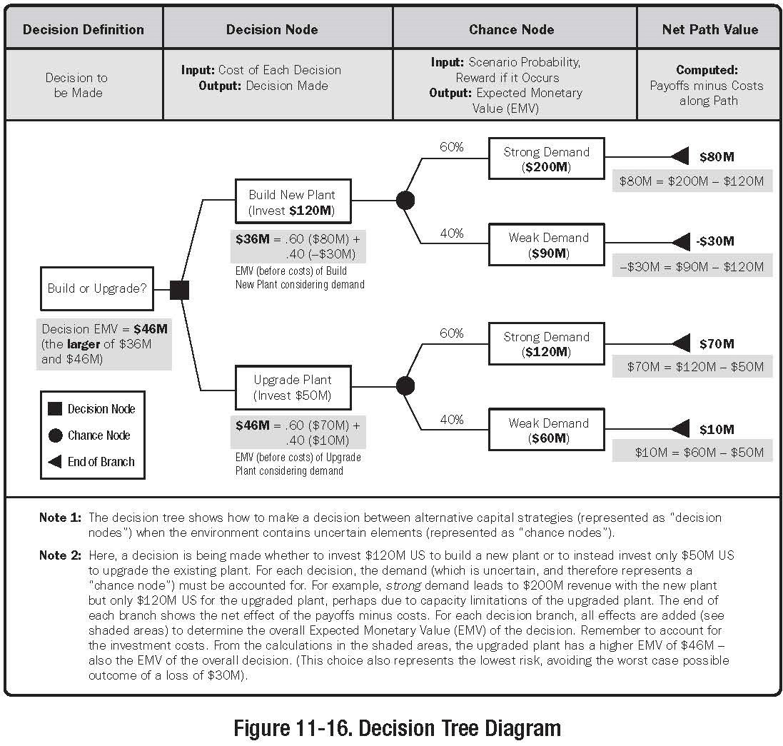
Project Risk Management
Introduction Risk Analysis
Decision Trees

Slide 55
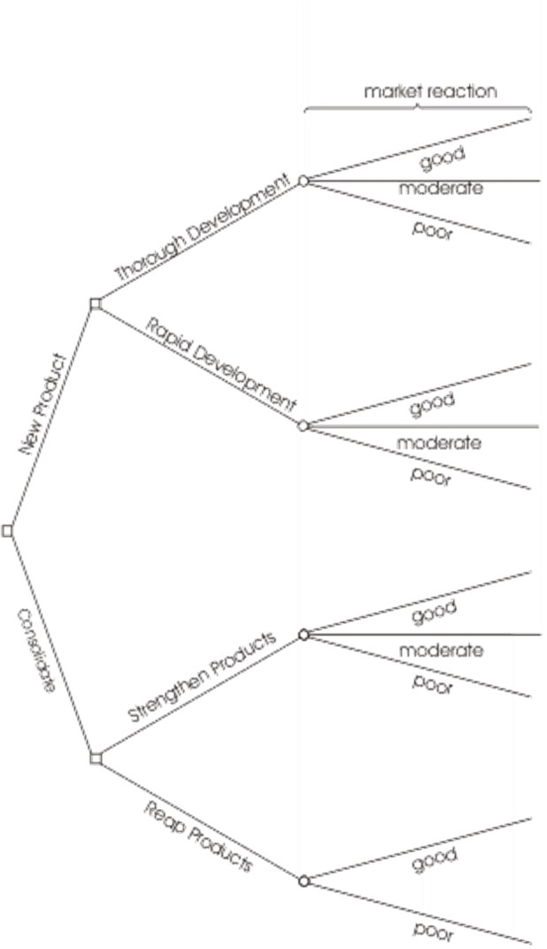
Project Risk Management
Introduction Risk Analysis

Slide 56
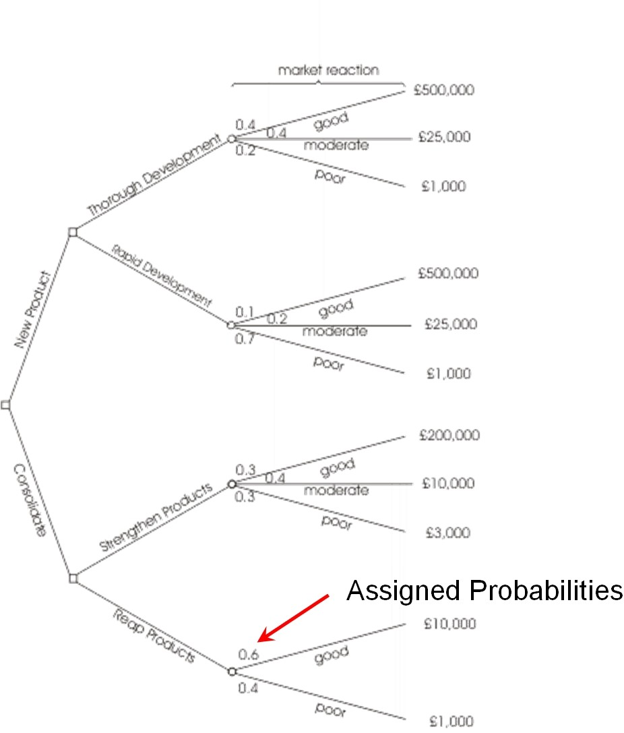
Project Risk Management
Introduction Risk Analysis

Slide 57
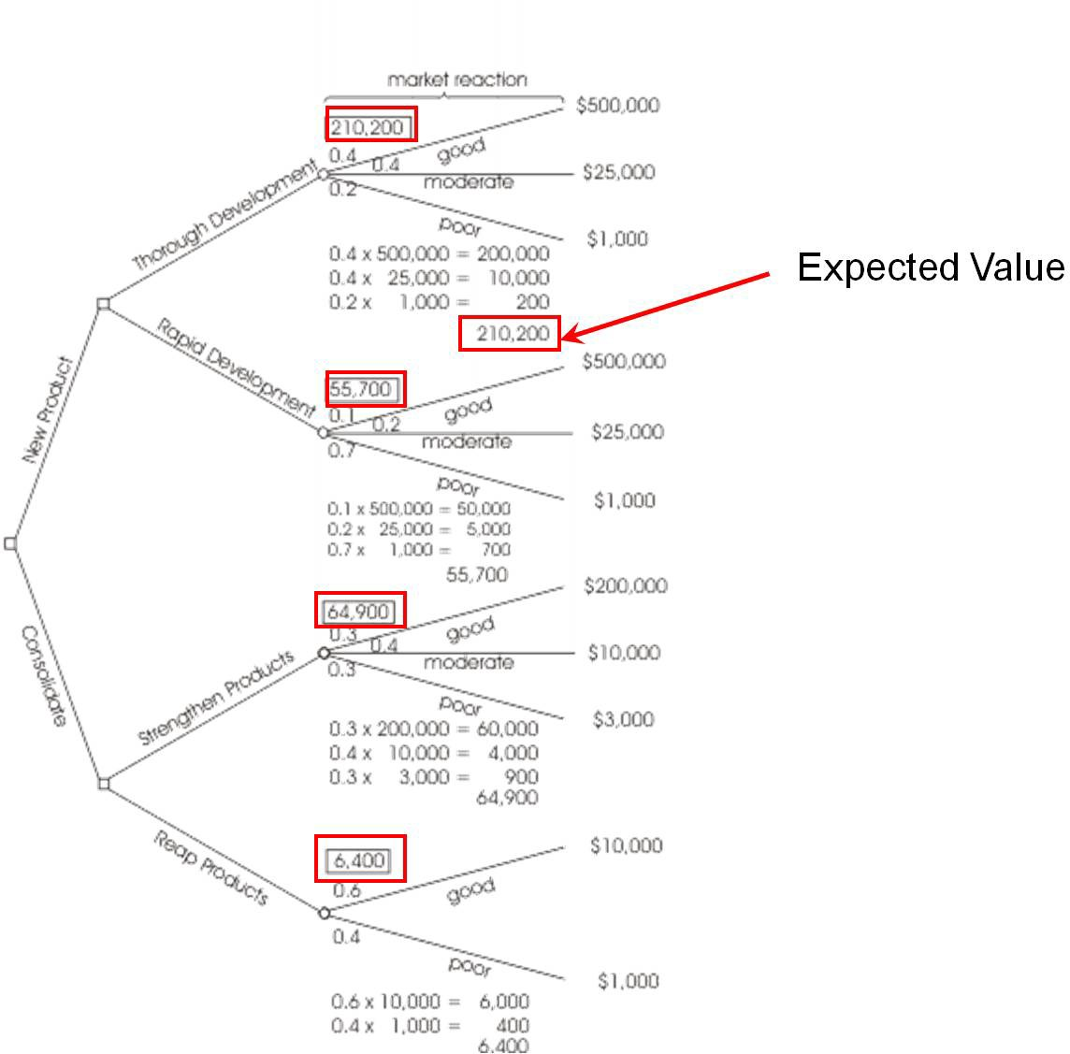
Project Risk Management
Introduction Risk Analysis

Slide 58
Project Risk Management
Introduction Risk Analysis
Tree Construction
Identify the decision points and alternatives actions available at each point
Identify the uncertainties
Estimate quantitative information (costs of possible outcomes, gains resulting from outcomes, probabilities of chance events)
Define criteria of desirability Evaluate tree

Slide 59
Project Risk Management
Introduction Risk Analysis
Key Points
Decision trees provide an effective method of Decision Making because they:
Clearly lay out the problem so that all options can be challenged
Allow us to analyze fully the possible consequences of a decision
Provide a framework to quantify the values of outcomes and the probabilities of achieving them
Help us to make the best decisions on the basis of existing information and best guesses.

Slide 60
Project Risk Management
Introduction Risk Analysis
Need for Care
As with all Decision Making methods, decision tree analysis should be used in conjunction with common sense - decision trees are just one important part of your Decision Making tool kit.

Slide 61
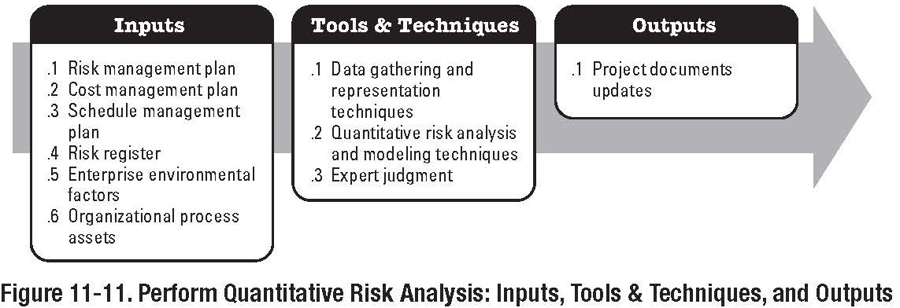
Project Risk Management
Introduction Risk Analysis
Quantitative Risk Analysis
Part of the Planning Process Group

Slide 62
Project Risk Management
Introduction Risk Analysis
Quantitative Risk Analysis
Quantitative Risk Analysis is performed on Risks that have been prioritised by the Qualitative Risk Analysis Process
The Quantitative Risk Analysis process is designed to Quantify the possible outcomes for the project and their probability
Assess the probability of achieving specific project goals Identify risks requiring the most attention by quantifying their relative contribution to the overall project risks Identify realistic and achievable cost, schedule, or scope targets, given the project risks
Determine the best PM decisions when conditions or
outcomes are uncertain

Slide 63
Project Risk Management
Introduction Risk Analysis
Quantitative Risk Analysis
Inputs
Risk Register
List of identified risks, relative priority and ranking, etc.
Risk Management Plan
Roles and Responsibilities, Budgets, Schedules, etc.
Project Schedule Management Plan Project Cost Management Plan Organisational Process Assets
Information on prior, similar projects Studies of similar projects
Risk Databases

Slide 64
Project Risk Management
Introduction Risk Analysis
Quantitative Risk Analysis
Tools and Techniques
Data Gathering and Representation Techniques
Interviewing
Used to quantify the probability and impact of risks on project objectives
Breakdown into ‘optimistic’, ‘most-likely’, and ‘pessimistic’ three point estimates
Can provide information on the reliability and credibility of the analysis
Probability Distributions
Not all probabilities are normally distributed.
For our work, we will only consider the normally distributed probabilities (PERT)
Expert Judgement
Internal or External Experts

Slide 65
Project Risk Management
Introduction Risk Analysis
Quantitative Risk Analysis
Tools and Techniques
Quantitative Risk Analysis and Modelling Techniques
Sensitivity Analysis
Helps to determine which risks have the most potential impact on the project
Examines the extent to which an individual project element
will affect the project, when all other uncertain elements are held at ‘baseline’.
Expected Monetary Value Analysis
EVM is a statistical concept that calculates the average outcome when the future includes scenarios that may or may not happen.
EVM is calculated by multiplying each possible outcome by
its probability
Used in Decision Tree Analysis
Decision Tree Analysis Modelling and Simulation
65 / 98

Slide 66
Project Risk Management
Introduction Risk Analysis
Quantitative Risk Analysis
Tools and Techniques
Quantitative Risk Analysis and Modelling Techniques
Decision Tree Analysis
Uses a diagram to describe a situation under consideration, and the implications of each of the available choices
Uses EVM
Modelling and Simulation
A project simulation uses a model that translates specified project uncertainties into their potential impact on project objectives
Typically the Monte Carlo technique Inputs are randomised, and results computed numerous times. Results are compiled, and a probability distribution is calculated.

Slide 67
Project Risk Management
Introduction Risk Analysis
Sensitivity Analysis Example
Selection of Alternatives
A new hospital facility can be constructed to meet current and future patient projections over the next 20 years, or in two stages, one now and the next ‘n’ years from now
Construction Costs
Full Capacity Construction e140M
Two Stage: 1st Stage e100M 2nd Stage ‘n’ years from now e120M

Slide 68
Project Risk Management
Introduction Risk Analysis
Sensitivity Analysis Example
Assumptions
In each case the hospital facilities will last 40 years and have zero scrap value
Annual O&M Cost are the same for both alternatives 8% interest rate
Calculation
We know the PW of constructing the entire hospital now, so we will use PW analysis
We will use MS Excel, and therefore evaluate the option ‘2 stage construction’ each year

Slide 69
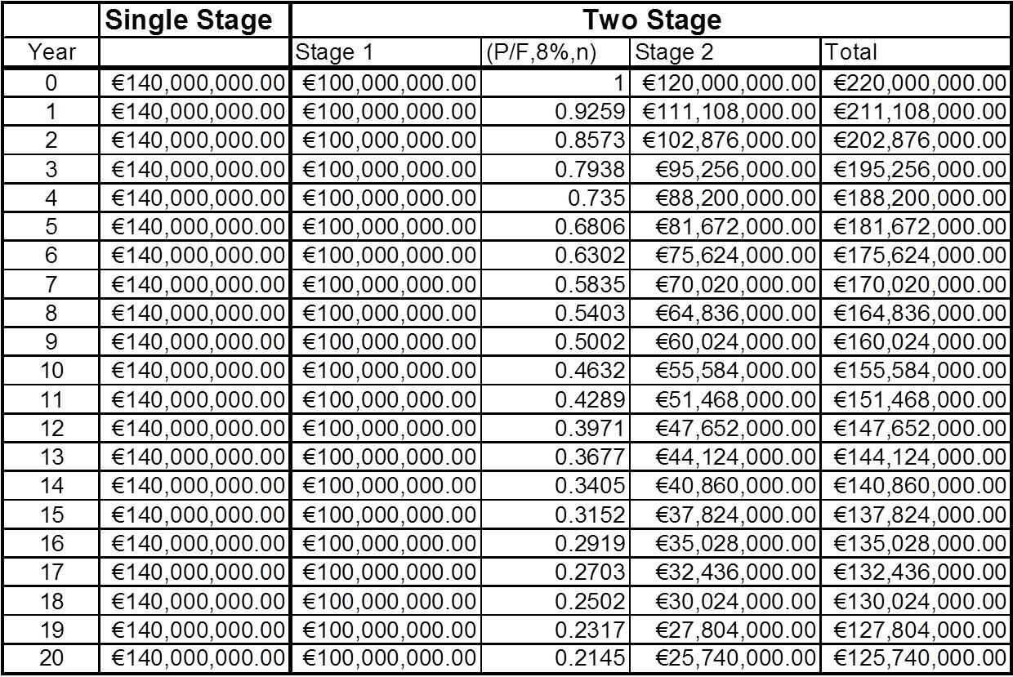
Project Risk Management
Introduction Risk Analysis
Sensitivity Analysis Example

Slide 70
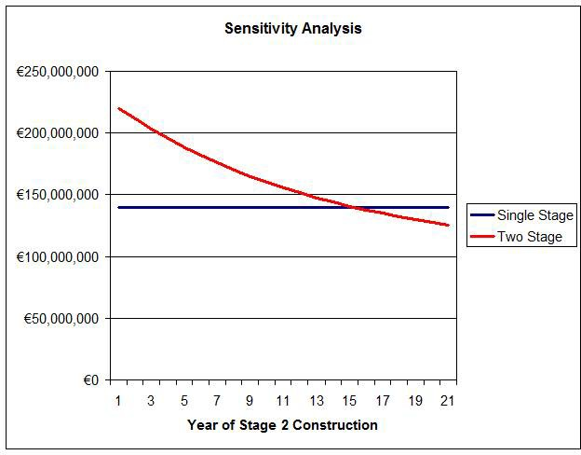
Project Risk Management
Introduction Risk Analysis
After Year 15 it becomes more economical to build in two stages

Slide 71
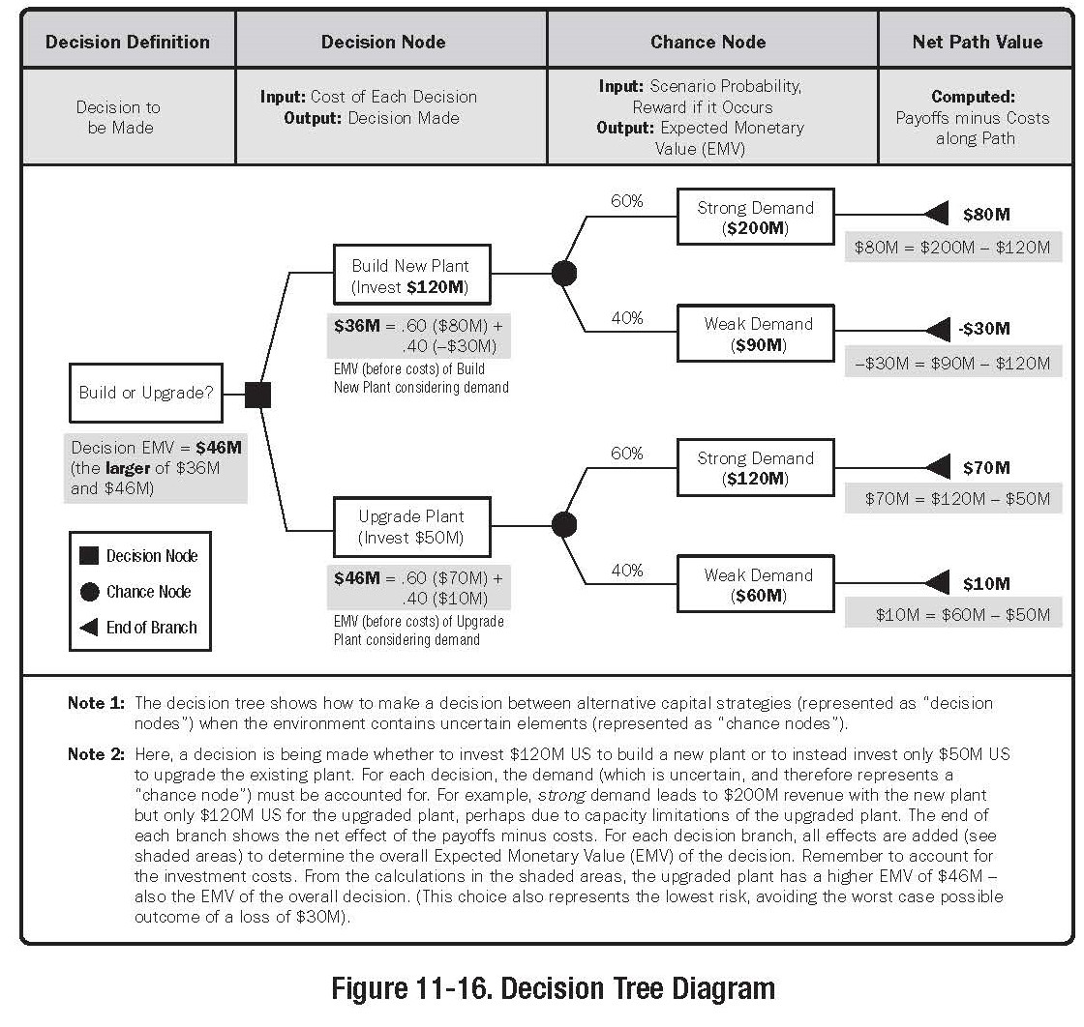
Project Risk Management
Introduction Risk Analysis
Quantitative Risk Analysis
Decision Tree

Slide 72
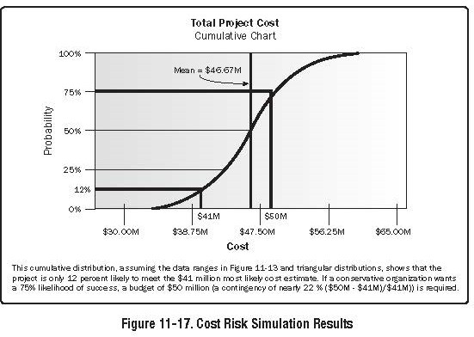
Project Risk Management
Introduction Risk Analysis
Quantitative Risk Analysis
Modelling and Simulation (Monte Carlo)

Slide 73
Project Risk Management
Introduction Risk Analysis
Quantitative Risk Analysis
Outputs
Risk Register (Updates)
Probabilistic Analysis of the Project
Estimates of potential project schedule and cost outcomes Usually expressed as a cumulative distribution Fig. 11-13
Probability of achieving cost and time objectives
From fig 11-13, there is a 12
Prioritised list of Quantified Risks
List of risks that pose the greatest threat, or the greatest opportunity to the project
Trends is Quantitative Risk Analysis Results
As analysis are repeated, trends may become apparent.

Slide 74
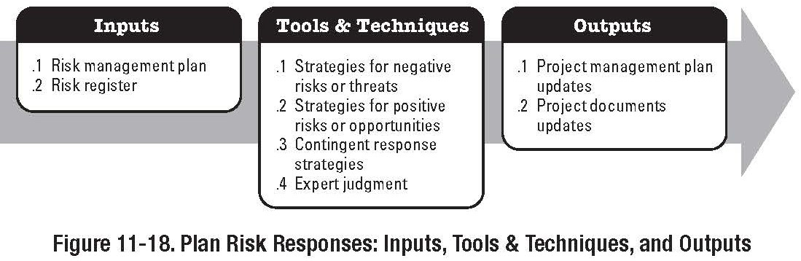
Project Risk Management
Introduction Risk Analysis
Plan Risk Responses
Part of the Planning Process Group

Slide 75
Project Risk Management
Introduction Risk Analysis
Plan Risk Responses
Risk Response Planning is the Process of developing options, and determining actions to enhance opportunities and reduce threats to the project’s objectives.
Much of Risk Management focuses on negative risks; don’t forget about opportunities
Risk Response Planning addresses risks by their priority by including resources, and activities into the budget, schedule, and PM plan, as needed.
Selecting the best response from several possible approaches is very common

Slide 76
Project Risk Management
Introduction Risk Analysis
Plan Risk Responses
Inputs
Risk Management Plan
Roles and Responsibilities Risk Analysis definitions, Risk Thresholds
Refer to book and previous notes
Risk Register
Defines root cause of risks
Includes potential responses, risk owners, symptoms, and warning signs
Includes Relative Rating of Risks

Slide 77
Project Risk Management
Introduction Risk Analysis
Plan Risk Responses
Tools and Techniques
Strategies for Negative Risks or Threats
Avoid
Change PM Plan to eliminate risk or threat. Isolate project objectives from risk’s impact
Some risks can be avoided by clarifying requirements, obtaining information, improving communications, or acquiring expertise
Transfer
Shift negative impact of a threat, along with ownership of the response, to a third party (Insurance, Bonds, etc.) Does not eliminate the risk; just transfers liability
Mitigate
Reduce the probability and/or impact to an acceptable level
Process Improvement, Communications, Testing, Sign-off, etc.

Slide 78
Project Risk Management
Introduction Risk Analysis
Plan Risk Responses
Tools and Techniques
Strategies for Positive Risks or Opportunities
Exploit
Measures to ensure positive risk is realised.
Bonus-Penalty Clause in Contract Share
Allocating ownership to a third party who is best able to capture the opportunity for the benefit of the project
Joint Ventures.. Enhance
Maximisation of the opportunity or positive risk by identifying key drivers
Lobbying for New Road to new/planned Industrial/Commercial Complex

Slide 79
Project Risk Management
Introduction Risk Analysis
Plan Risk Responses
Strategy for Both Threats and Opportunities
Acceptance
Can be passive or active
Most common strategy for acceptance is the allocation of contingency reserves
Contingent Response Strategy
Responses designed to only come into operation or effect when predefined conditions occur
Trigger events: milestones, negative trends on CPI or SPI etc.

Slide 80
Project Risk Management
Introduction Risk Analysis
Risk Response Planning
Part of the Planning Process Group
80 / 98

Slide 81
Project Risk Management
Introduction Risk Analysis
Risk Response Planning
Outputs
Risk Register Updates
After Risk Response Planning, the Risk Register needs to be updated to include the agreed Risk Responses
Refer to book for further details of Risk Register Project Management Plan Updates
PM plan is likely to require changes via the Integrated Change Control Process in order to cater for changes in Budget, Schedule, Scope, etc., due to Risk Response Planning
Risk-Related Contractual Agreements

Slide 82
Project Risk Management
Introduction Risk Analysis
Risk Response Planning
Outputs
Risk-Related Contractual Agreements
Such as Insurances, Bonds, Allocation etc.

Slide 83
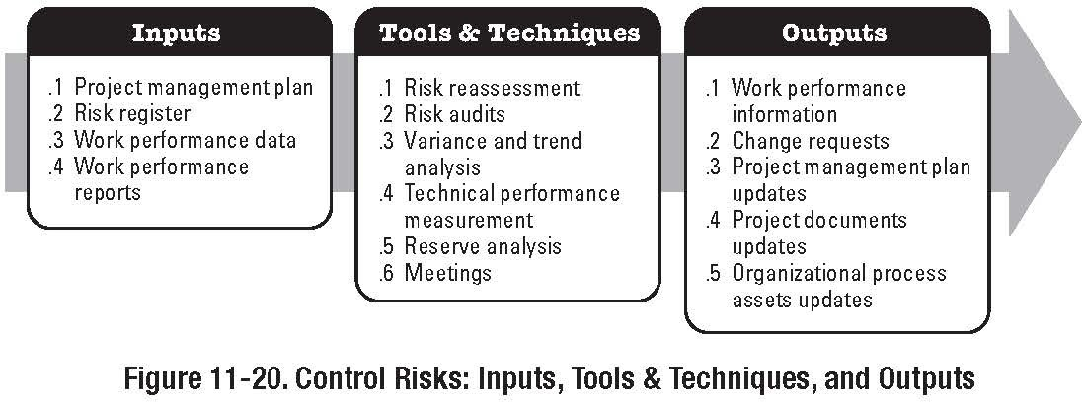
Project Risk Management
Introduction Risk Analysis
Risk Monitoring and Control
Part of the Monitoring and Controlling Process Group

Slide 84
Project Risk Management
Introduction Risk Analysis
Risk Monitoring and Control
Once Risk Responses are in place, it is still necessary to monitor and control risk throughout the project life-cycle.
Risk Monitoring and Control is the process of
Identifying, and planning for newly arising risks
Keeping track of identified risks and those on the watch-list Reanalysing existing risks
Monitoring trigger conditions
Monitoring residual risks
Reviewing the execution of risk responses Evaluating the effectiveness of risk responses

Slide 85
Project Risk Management
Introduction Risk Analysis
Risk Monitoring and Control
Other purposes of Risk Monitoring and Control are to determine if:
Project assumptions are still valid
Risk, as assessed, has changed from its prior state Risk Management policies and procedures are being followed
Modifications are required to contingency reserves
New risks, unidentified risks, etc.

Slide 86
Project Risk Management
Introduction Risk Analysis
Risk Monitoring and Control
Risk Monitoring and Control can involve Choosing alternative strategies Executing a contingency plan
Taking corrective action
Also includes
Updates to organisational process assets
Risk Database Lessons Learned Data
Risk Management Templates

Slide 87
Project Risk Management
Introduction Risk Analysis
Risk Monitoring and Control
Inputs
Risk Management Plan Risk Register
Approved Change Requests
Can include changes to work methods, contract terms, scope and schedule
Work Performance Information
Deliverable Status; Corrective Actions; etc.
Performance Reports
Provide information on project work performance

Slide 88
Project Risk Management
Introduction Risk Analysis
Risk Monitoring and Control
Tools and Techniques
Risk Reassessment
Identification of new risks, validation of previous risk assessments, etc.
Should be scheduled at regular intervals throughout the course of the project
Risk Audits
Examination and Documentation of the effectiveness of risk responses
Variance and Trend Analysis
Earned Value Management et al
Technical Performance Measurement
Actual Technical Performance against Baseline Plans
Reserve Analysis
Comparison of actual reserves against planned reserves throughout the project life-cycle to determine if remaining reserves are adequate
88 / 98

Slide 89
Project Risk Management
Introduction Risk Analysis
Risk Monitoring and Control
Outputs
Risk Register Updates
Outcomes of risk assessments, risk audits and periodic risk reviews
Actual outcomes of project risks
Helps in determining risk probability; feeds into Risk Database etc.
Change Requests
Implementing Contingency Plans often involves changes to the overall Project Management Plan; these need to be run through the Integrated Change Control Procedures
Recommended Corrective Actions
Contingency Plans and Workarounds Require Integrated Change Control

Slide 90
Project Risk Management
Introduction Risk Analysis
Risk Monitoring and Control
Outputs
Recommended Preventative Actions
Recommendations to bring project back into compliance
Organisational Process Assets Updates
Risk Template Updates Risk Database Updates
Project Document Updates

Slide 91
Project Risk Management
Introduction Risk Analysis
Monte Carlo Simulation Example
A project is expected to cost e120,000. Six independent risks and one opportunity have been identified during ‘Risk Identification’.
A, cost of occurrence: e7,500; prob of occurrence 0.20 B, cost of occurrence: e5,000; prob of occurrence 0.35 C, cost of occurrence: e6,500; prob of occurrence 0.15 D, cost of occurrence: e2,000; prob of occurrence 0.40 E, cost of occurrence: e4,000; prob of occurrence 0.35 F, cost of occurrence: e2,500; prob of occurrence 0.10 X, opportunity value: e3,500; prob of occurrence 0.12

Slide 92
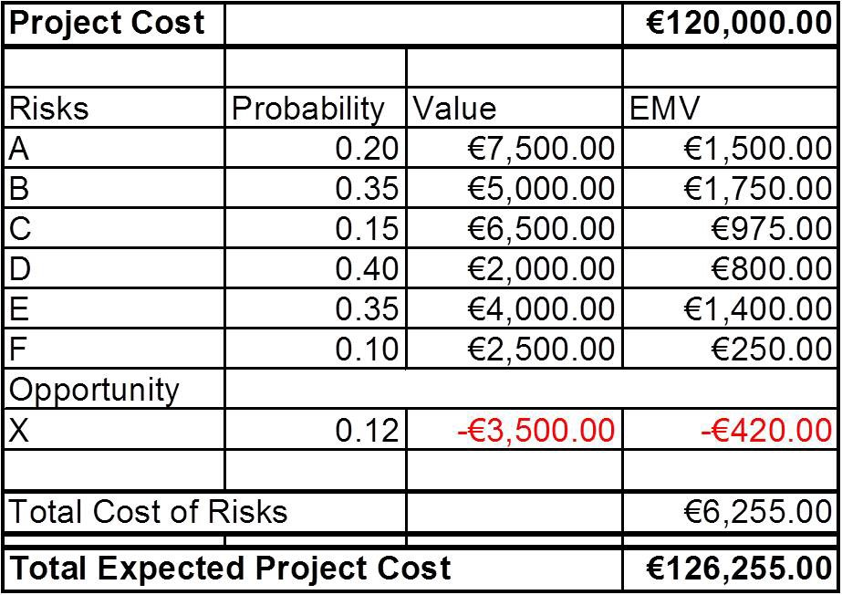
Project Risk Management
Introduction Risk Analysis
Expected Monetary Value Example
Using simple Expected Monetary Value (EMV) analysis, the expected cost of the project is determined to be:

Slide 93
Project Risk Management
Introduction Risk Analysis
Monte Carlo Simulation Example
Further simple analysis will yield Max Project Cost: e147,500 Min Project Cost: e116,500
This yields a mean cost of e132,000

Slide 94
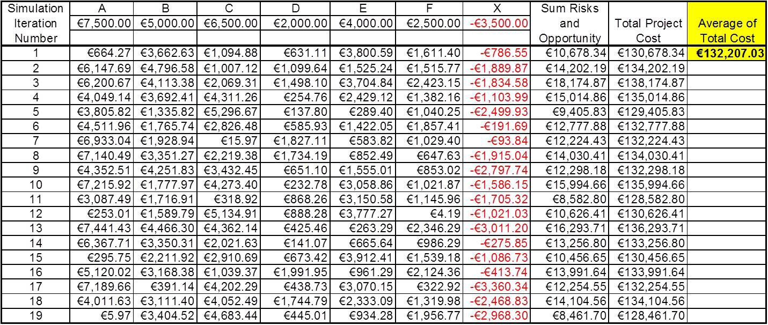
Project Risk Management
Introduction Risk Analysis
Monte Carlo Simulation Example
You do not need to assign probabilities for a Monte Carlo Simulation
The average figure ties in with the average determined by the max and min Project Costs

Slide 95
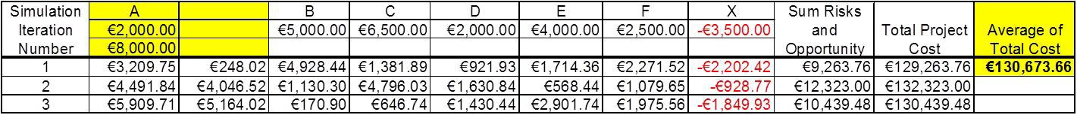
Project Risk Management
Introduction Risk Analysis
Monte Carlo Simulation Example
So why undertake a Monte Carlo?
By undertaking an Monte Carlo simulation, additional information can be obtained, such as the standard deviation. (circa e3638.00)
Risks can also be modelled to more detail
For instance, If the cost of Risk Event a was a range as opposed to an exact figure, this aspect can also be modelled. Range of A from e2,000 to e8,000; Yields Average of circa e130,000

Slide 96
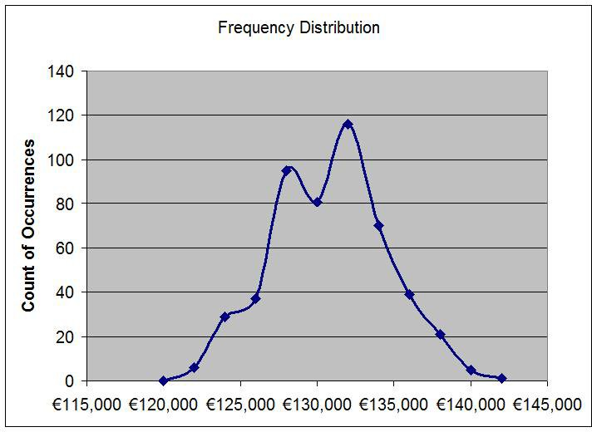
Project Risk Management
Introduction Risk Analysis
Monte Carlo Simulation Example

Slide 97
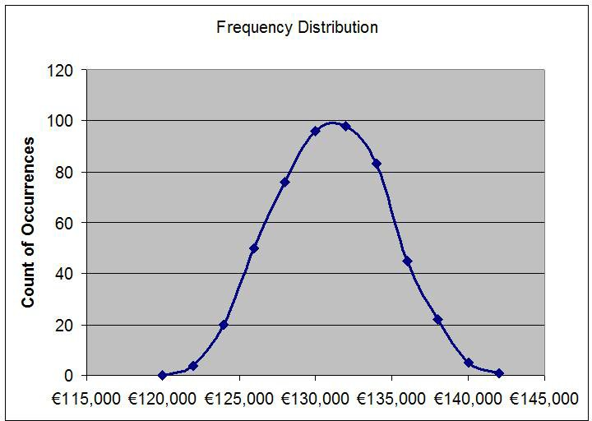
Project Risk Management
Introduction Risk Analysis
Monte Carlo Simulation Example

Slide 98
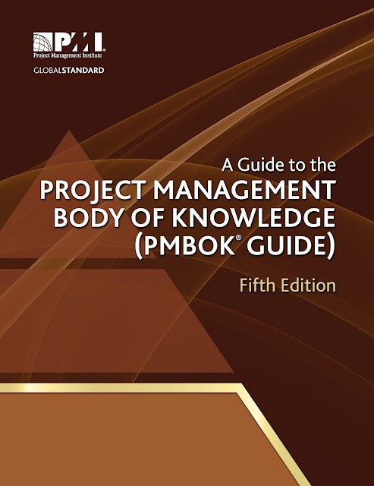
Project Risk Management
Introduction Risk Analysis
Next Lecture
Reading: ‘A Guide to the Project Management Body of Knowledge’
Chapter 12 - Project Procurement Management

