Slide 1
Project Communications Management
Project Management
Paul Vesey
Limerick Institute of Technology
paul.vesey@lit.ie
Spring 2020

Slide 2
Project Management
Project Communications Management
Project Communications Management
Project Management - Year 4
If you have to choose to believe the paperwork, you have already chosen wrongly.

Slide 3
Project Management
Project Communications Management
Project Communications Management
Project Communications Management involves the processes required to ensure timely and appropriate generation, collection, distribution, storage, retrieval, and ultimate disposition of project information.
The processes provide the critical links among people and information that are necessary for successful communications.

Slide 4
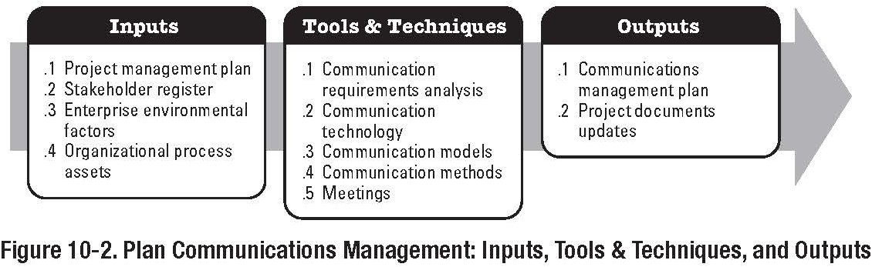
Project Management
Project Communications Management
Plan Communications
Part of the Planning Process Group

Slide 5
Project Management
Project Communications Management
Plan Communications Inputs
Communications Technology: - Technology Factors: Urgency of the need of information
Availability of Technology: Broadband / HSDPA for site office
Expected Project Staffing:
Site office with 2 persons v. 8 persons PABX, LAN, WAN, etc
Do people know how to use the communication systems or will they have to be trained?
Length of Project
8 persons in office for 2 weeks v. 8 persons for 18 months Will technology change over the course of the project?
Project Environment: Face to Face or Virtual Environment?

Slide 6
Project Management
Project Communications Management
Plan Communications Inputs
Communication Methods
Interactive Communications
Web 2.0 Applications, Meetings, Skype, etc.
Push Communications
Letters, Memo, Reports, etc.
No Guarantee that recipient has received or understood the message.
Always ask for ‘read receipt’ or ‘acknowledgment’
Pull Communications
Information repositories, such as Moodle, shared drives, etc.
User selects the information relevant to them. Requires considerable levels of control.
Communication Models

Slide 7
Project Management
Project Communications Management
Plan Communications
Tools and Techniques
Communication Requirements Analysis
Requirements are defined by combining the type and format of information needed with an analysis of the value of that information, for instance technical information;
Format: drawing, specification, or both?
Value: Drawing of Air Handler is vital for installation; performance specification is vital for purchase
Project Resources should only be used on communications that contribute to project success or where lack of communications lead to project failure

Slide 8
Project Management
Project Communications Management
Plan Communications Tools and Techniques
Communication Requirements Analysis
Information required to determine project communications requirements typically include:
Organisation Charts
Project Organisation and Stakeholder Responsibility Relationships
Disciplines, Departments, and specialties involved in the project
Logistics of how many people will be involved in the project, and their location
Internal Information needs External information needs Stakeholder Information

Slide 9
Project Management
Project Communications Management
Plan Communications Outputs
Communications Management Plan
Stakeholder Communication Requirements
Information to be communicated: Format, Content, level of detail
Person Responsible for communicating information Person or Groups who will receive the information Methods or Technologies used: Paper, email, etc. Frequency of the communications: weekly; monthly Escalation requirements
Method of updating and refining the communications plan as the project progresses
Glossary
‘CPM’ - ‘Critical Path Method’ or ‘Construction Project Manager’?
‘CPI’ - ‘Consumer Price Index’ or ‘Cost Performance Index’?

Slide 10
Project Management
Project Communications Management
Plan Communications
Outputs
Communications Management Plan
includes details of:
Site Meeting (PM team)
Progress Meetings (Client Meeting)
Drawing Specifications (AutoCAD layers, etc.) Software to be used
MS Excel, Word, Powerpoint, AutoCAD 2014, MapInfo, etc. Backwards Compatibility may be an issue

Slide 11
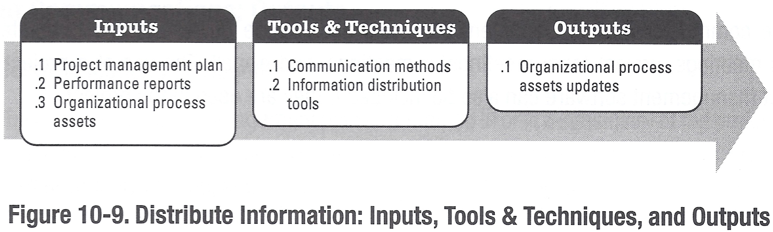
Project Management
Project Communications Management
Distribute Information
Part of the Executing Process Group

Slide 12
Project Management
Project Communications Management
Distribute Information
Information Distribution involves making information available to project stakeholders in a timely manner.
It includes implementing the communication management plan and responding to unexpected requests for information.

Slide 13
Project Management
Project Communications Management
Elements of Communications Theory
Sender Receiver Models
Feedback Loops and barriers to communication
Media Choice
Verbal, Conversation; Presentation; etc.
Written
Memo (email); Report; Drawings; etc

Slide 14
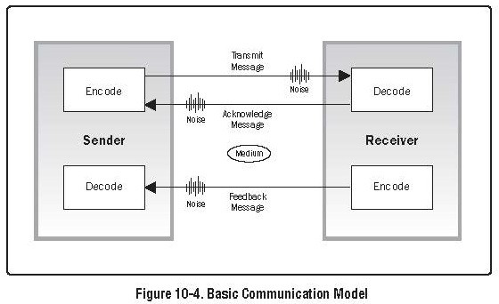
Project Management
Project Communications Management
A model of communications
Encode - translation of thoughts or ideas onto language the is understood by others.
Message - the output of encoding.
Medium - method used to convey the message.
Noise - anything that interferes with the transmission and understanding of the message.
Decode - translation of the message back into meaningful thoughts or ideas.
14 / 35

Slide 15
Project Management
Project Communications Management
Active v. Passive Voice
Examples
The project management plan is intended to facilitate key stakeholder involvement in the project (passive).
With our project management plan, we intend to obtain key stakeholder involvement. (active).
Reports are written in the third person impersonal (passive).
Write reports in third person impersonal (active).
This can run into conflict with 3rd person convention used in scientific and engineering communications.

Slide 16
Project Management
Project Communications Management
Active v. Passive Voice
Characteristics of Passive Voice
You can’t assign responsibility.
‘Reports are written’ - this is an instruction from whom? Readers have to perform extra work to understand the sentence.
Sentences tend to be longer.
Can usually be identified by:
Word | Example
is | is dismissed
are | are completed
was | was vacated
were | were reversed
been | been filed
being | being confirmed
be | be approved
am | am honoured

Slide 17
Project Management
Project Communications Management
Distribute Information
Inputs
Project Management Plan Performance Reports Organisational Process Assets
Refer to Book

Slide 18
Project Management
Project Communications Management
Distribute Information Tools and Techniques
Communication Methods Information Distribution Tools Note the importance of:
General communications skills
Ensuring the right person gets the right information
Ensuring that the receiver correctly interprets the information, i.e.FEEDBACK
Lessons Learned Processes
To capture communications (and project) methods that were successful or failed; and the reasons why.
Not easy to achieve in the construction sector. Most PM team members in construction are involved in a number of projects, they may not always have the time to engage in a ‘project post-mortem’.

Slide 19
Project Management
Project Communications Management
Distribute Information Tools and Techniques
Communication Methods
Meetings, Document Distribution, Shared Access Databases, etc.
Email, Fax, Voice, Video Conferencing, Web Conferencing, Skype, Google Hangouts
MS Project Enterprise Edition et. al. Information Distribution Tools
Tools to control the methods above.
Note the importance of tracking who has received and needs to receive information.
Speed and ease of use are vital to successful distribution systems.

Slide 20
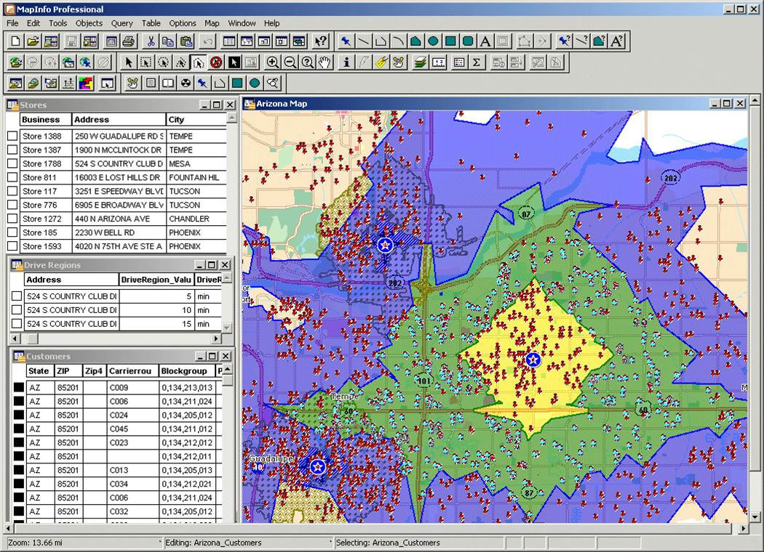
Project Management
Project Communications Management
MapInfo Professional

Slide 21
Project Management
Project Communications Management
Distribute Information Outputs
Organisational Process Assets Updates
Stakeholder Notifications Project Reports
Project Presentations Project Records
Feedback from Stakeholders Lessons Learned Documentation
Requested Changes (PMBOK 3rd Edition)
Changes to the Information Distribution Process, which should be run through the Integrated Change Control Process

Slide 22
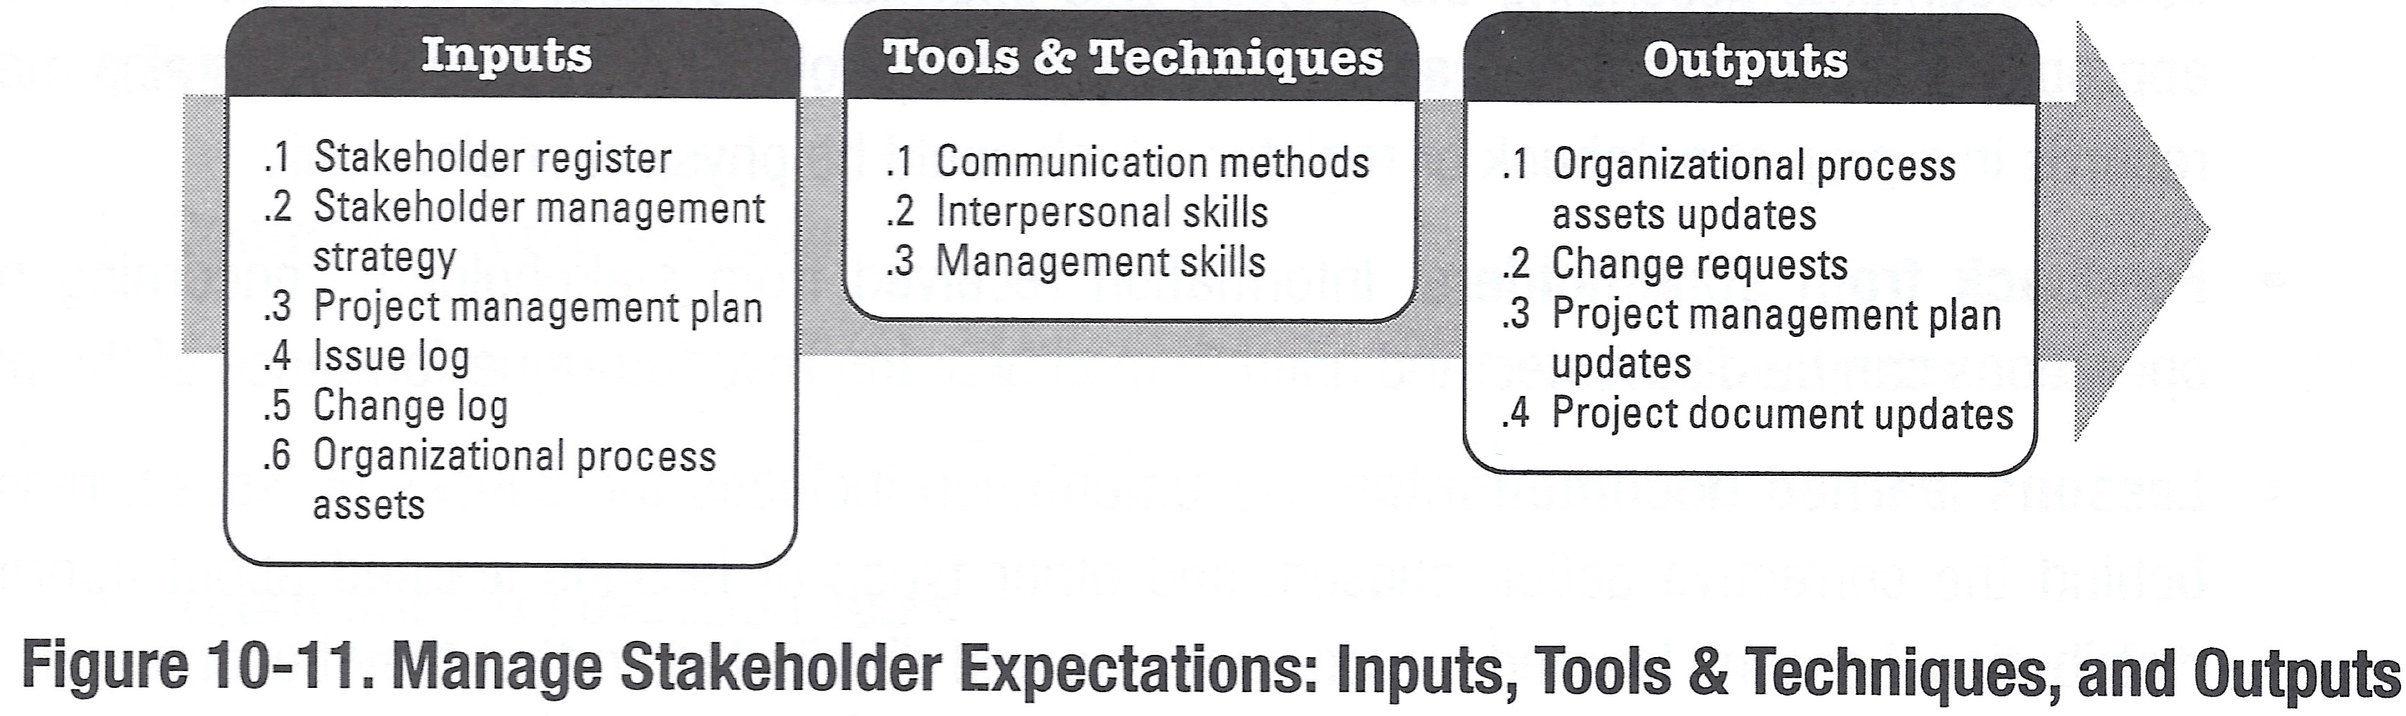
Project Management
Project Communications Management
Manage Stakeholder Expectations
Part of the Monitoring & Controlling Process Group

Slide 23
Project Management
Project Communications Management
Manage Stakeholders
Managing Stakeholders refers to Managing Communications to satisfy the needs of, and resolve issues with, project stakeholders.
Actively Managing Stakeholders increases the likelihood that the project will not veer off track due to unresolved issues.
It also enhances the ability of persons to operate synergistically.
The construction sector is notoriously adversarial. Why?

Slide 24
Project Management
Project Communications Management
Manage Stakeholder Expectations
Inputs
Project Management Plan Communications Management Plan
Stakeholders communications needs and expectations are documented in the Communications Management Plan
Organisational Process Assets Issue Management Procedures Change Control Procedures Stakeholder Register
Stakeholder Management Strategy Change Log

Slide 25
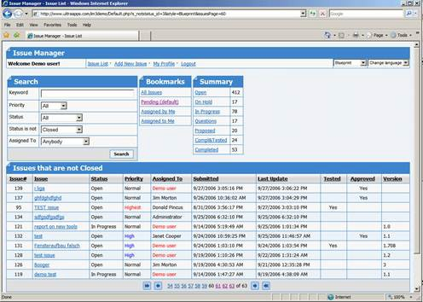
Project Management
Project Communications Management
Manage Stakeholder Expectations Inputs
Issue Log
Tool that can be used to document and monitor the resolution of issues
An issue is clarified and stated in a way that it can be resolved. An owner is assigned and a target date usually established for closure
Unresolved Issues can become a major source of conflict

Slide 26
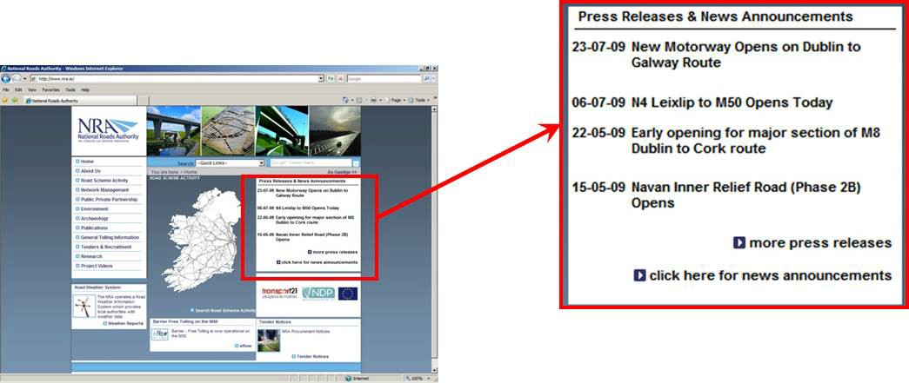
Project Management
Project Communications Management
Manage Stakeholder Expectations Tools and Techniques
Communications Methods: Face to Face; Verbal Written; Reports etc.
Mass Media; Billboards, Local and National Press, Radio, Web, etc.

Slide 27
Project Management
Project Communications Management
Manage Stakeholder Expectations Techniques
Tools and
Interpersonal Skills Building Trust Resolving Conflict
Overcoming Resistance to change Active Listening
Management Skills Presentation Skills Negotiating Writing
Public Speaking

Slide 28
Project Management
Project Communications Management
Manage Stakeholder Expectations
Outputs
Organisational Process Assets Updates
Lessons Learned Documentation etc.
Causes of Issues / Reasons for corrective actions taken
Change Requests
Project Management Plan Updates Project Document Updates
Stakeholder Management Strategy Stakeholder Register
Issue Log

Slide 29
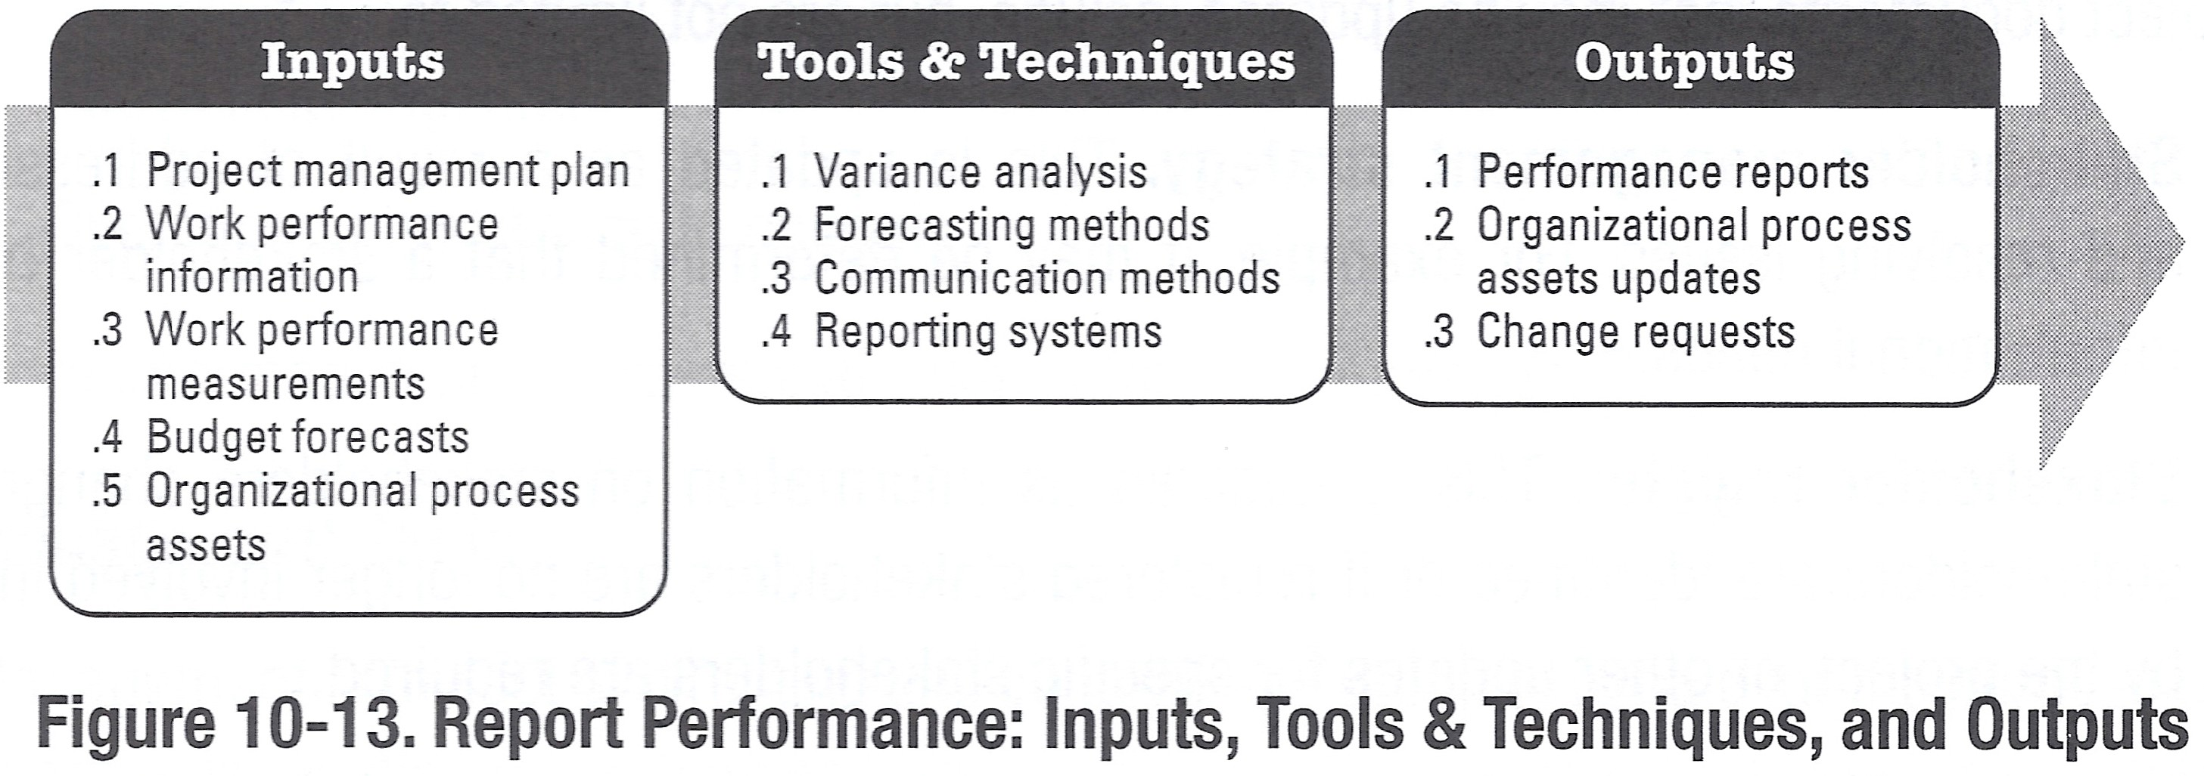
Project Management
Project Communications Management
Report Performance
Part of the Monitoring & Controlling Process Group

Slide 30
Project Management
Project Communications Management
Report Performance
The Performance Reporting Process involves the collection of all baseline data, and distribution of performance information to stakeholders. Performance Information includes data in relation to:
Scope Schedule Cost Quality Risk
Procurement Etc.

Slide 31
Project Management
Project Communications Management
Report Performance Inputs
Project Management Plan
Performance Measurement Baseline
Work Performance Information
Completion Status of Deliverables
Work Performance Measurement
SV; SPI; CPI; etc.
Budget Forecasts
EAC; ETC; Trend Analysis
PMBOK 3rd Edition also included:
Quality Control Measures: Actual Quality Measurements WWTP Commissioning; BOD₅, Suspended Solids, Nitrogen, Phosphorous
Large Buildings: AHU performance; volumetric flow rates Approved Change Requests: Approved Changes to Project Scope
31 / 35

Slide 32
Project Management
Project Communications Management
Report Performance Tools & Techniques
Variance Analysis Forecasting Methods
Time Series Methods: Historical Data used to predict future outcomes
Causal/Econometric Methods: Cause and Effect used to predict future outcomes. It relies on determining the variables which will have the greatest effect on the outcome.
Judgmental Methods
Intuitive Judgment, opinions and probabilities
Others
Simulation, etc.

Slide 33
Project Management
Project Communications Management
Report Performance
Tools & Techniques
Communications Methods
Status Review Meetings
Reporting Systems
Systems have to be designed and implemented to support the performance reporting.

Slide 34
Project Management
Project Communications Management
Report Performance Outputs
Performance Reports
Summary and Presentation of the information gathered, and results of any analysis against baseline information, may include S-curves, EVM, etc.
Current Status of Risks and Issues
Work to be completed during the next reporting period Summary of changes approved in the reporting period Recommended Corrective Actions: actions required to bring the project back on schedule etc.
Forecasts: Completion Forecasts based on performance information (EAC and ETC)
Change Requests
Performance analysis often generates change requests. . . These should be run through the Integrated Change Control Process
34 / 35

Slide 35
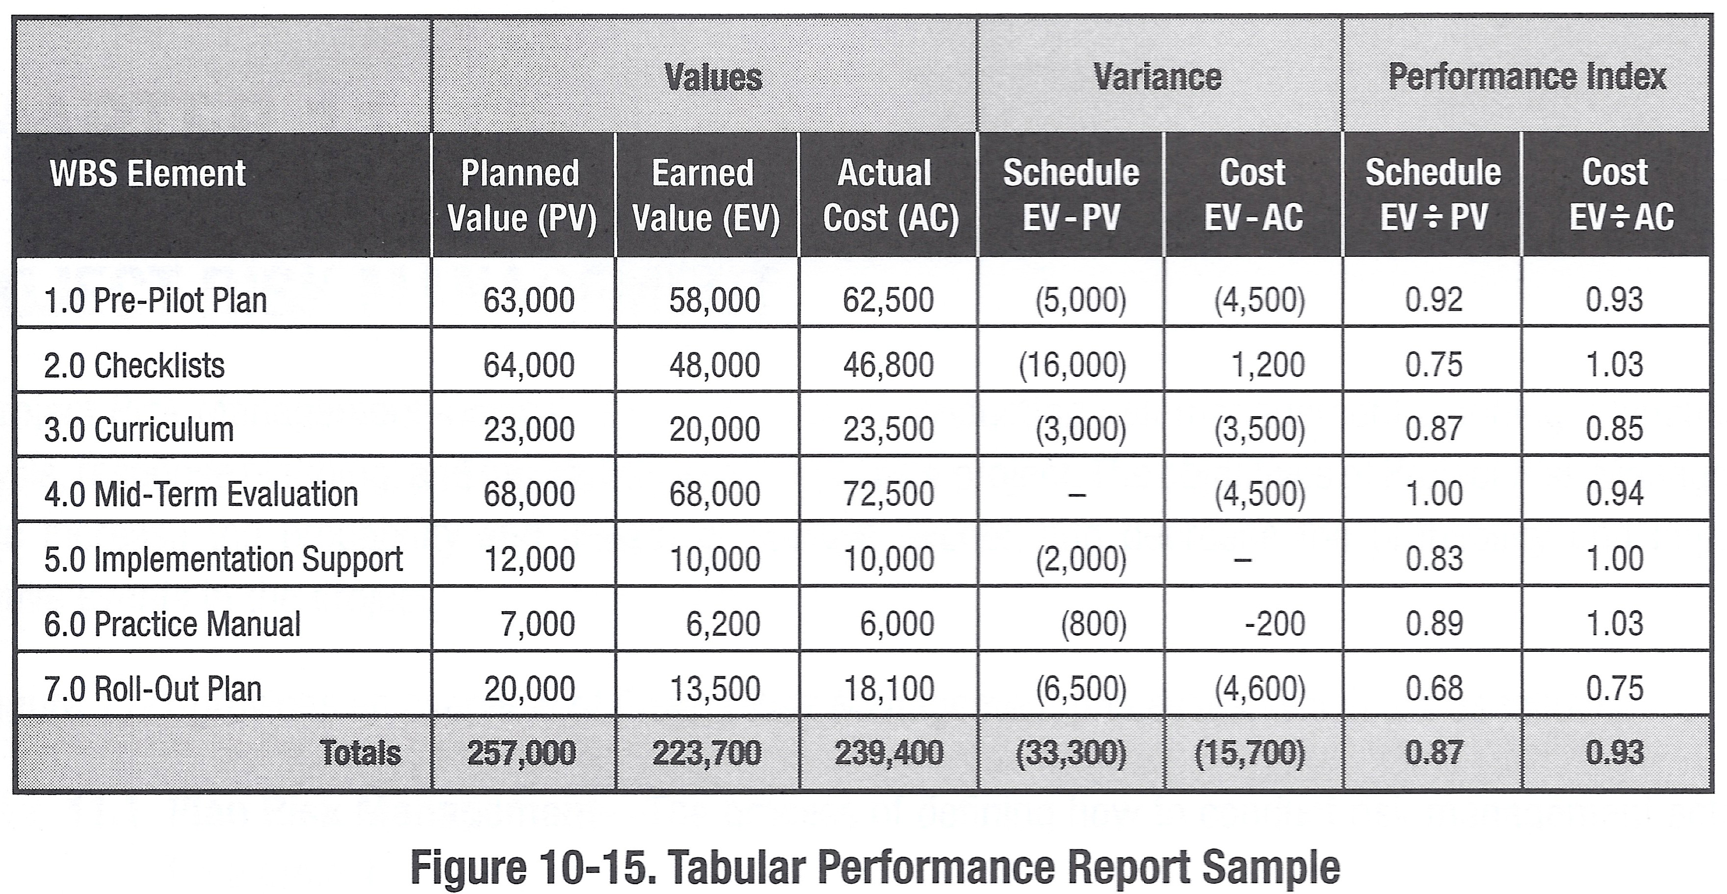
Project Management
Project Communications Management
Report Performance
35 / 35

