Slide 1
Introduction to Project Management
Introduction
Introduction to Project Management
Paul Vesey
Limerick Institute of Technology
paul.vesey@lit.ie
Spring 2020
1 / 71

Slide 2

Introduction to Project Management
Introduction
What is a Project?
A project is a temporary endeavour to create a unique product, service or result.
Temporary: it has a start and an end Unique Product, Service or Result Progressive Elaboration
2 / 71

Slide 3

Introduction to Project Management
Introduction
Project v. Operational Work
Work can be categorised as either projects or operations, although there may be an overlap.
Shared Characteristics:
Performed by people Constrained by resources Planned, executed and controlled
3 / 71

Slide 4

Introduction to Project Management
Introduction
Project v. Operational Work
Design of a new car Manufacture of a car Design of a building Construction of a building
Annual Accounts of a building company
4 / 71

Slide 5
Introduction to Project Management
Introduction
Project v. Operational Work
Design of a new car – Project Manufacture of a car – Operations Design of a building – Project (overlap?)
Construction of a building – Project (overlap?) Annual Accounts of a building company – Operations
5 / 71

Slide 6
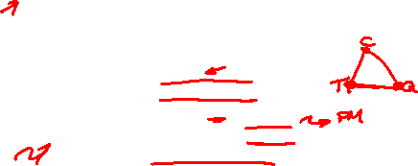
Introduction to Project Management
Introduction
What is Project Management?
Project Management is the application of knowledge, skills, tools and techniques to project activities to meet project requirements.
Managing Projects includes:
Identifying Requirements
Establishing clear and achievable objectives Balancing quality, scope, time and cost
Adaptation of specs, plans, and approach to meet the requirements of project stakeholders
6 / 71

Slide 7
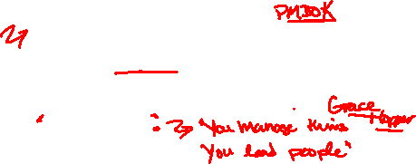
Introduction to Project Management
Introduction
Project Management
Project Management is the application of knowledge, skills, tools and techniques to project activities to meet project requirements.
Areas of Expertise:
Project Management Body of Knowledge
Application Area Knowledge, standards and Regulations (in our case construction)
Understanding the Project Environment General Management knowledge and skills Interpersonal Skills
7 / 71

Slide 8
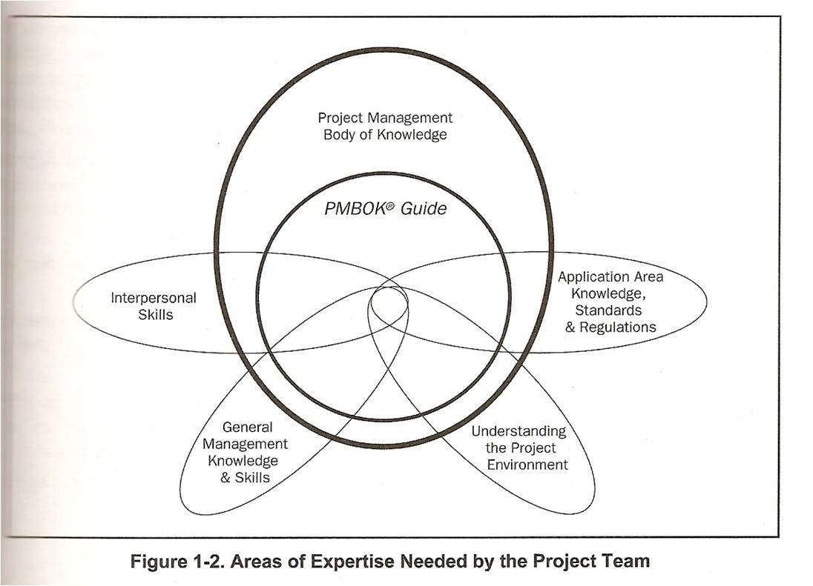
Introduction to Project Management
Introduction
Areas of Expertise
Figure: Ref: Project Management Institute (2004) A Guide to the Project Management Body of Knowledge (PMBOK Guide), 3rd Edition; Project Management Institute, ISBN 978-1-930699-45-8
8 / 71

Slide 9

Introduction to Project Management
Introduction
Application Area Knowledge
Functional Departments and Supporting Disciplines legal, finance, marketing, logistics
Technical Elements engineering, etc.
Management Specialization contracting, new products, etc.
Industry Groups
Construction, Financial Services, Automotive, etc.
9 / 71

Slide 10

Introduction to Project Management
Introduction
Project Environment
Cultural & Social Environment
How will the project effect people and/or how will people effect the project? Shell to Sea
International & Political Environment
Impact of Local Legislation; Stability of political regime Do you want to be a contractor in Iraq, Syria, Afghanistan?
Physical Environment
Impact on local ecology, geography, historical sites etc.

Slide 11

Introduction to Project Management
Introduction
General Management Knowledge & Skills
Financial Management & Accounting Purchasing & Procurement
Sales & Marketing
Contracts & Commercial Law Logistics & Supply Chain
. . .

Slide 12

Introduction to Project Management
Introduction
Interpersonal Skills
Effective Communication Influencing the Organisation Leadership
Motivation
self and others
Negotiation & Conflict Management Problem solving
Skill and judgment, not just authority to make decisions

Slide 13

Introduction to Project Management
Introduction
Project Management Body of Knowledge (PMBOK®)
Consists of Ten (10) Knowledge Areas
Project Integration Management
Project Scope Management
Project Time Management
Project Cost Management
Project Quality Management
Project Human Resource Management
Project Communications Management
Project Risk Management
Project Procurement Management
Project Stakeholder Management

Slide 14
Introduction to Project Management
Introduction
Areas of Expertise
Figure: Ref: Project Management Institute (2004) A Guide to the Project Management Body of Knowledge (PMBOK Guide), 3rd Edition; Project Management Institute, ISBN 978-1-930699-45-8

Slide 15
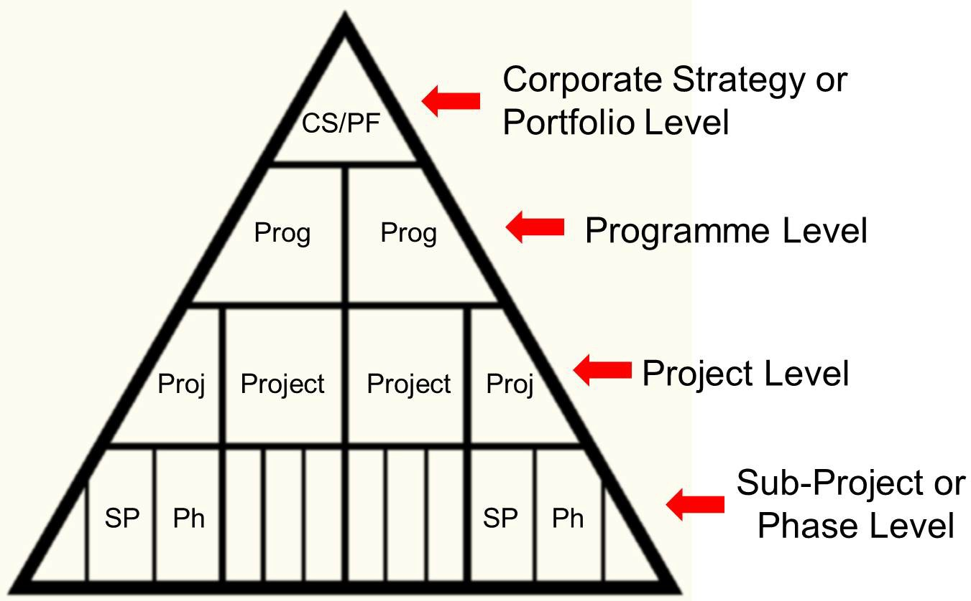
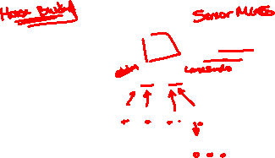
Introduction to Project Management
Introduction
Project Management Context
Figure: Project Management tends to exist within a larger framework

Slide 16
Introduction to Project Management
Introduction
Project Management Context
Portfolio
Collection of Projects or Programs grouped together to facilitate effective management
Program
Group of related projects managed in a coordinated way in order to obtain benefits not available from managing individually
Sub-Project
Projects in their own right, but form part of a larger overall project.

Slide 17

Introduction to Project Management
Project Life Cycle
Project Life Cycle
Any project can be broken down into several discrete phases. These phases then make up the overall Project Life Cycle.
Knowledge of the project life cycle will give an insight into:
Cash flow projections Resource projections Stakeholder influence Cost of changes
Etc.

Slide 18
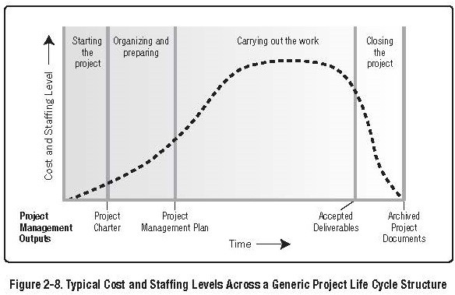

Introduction to Project Management
Project Life Cycle
Characteristics of the Project Life Cycle

Slide 19
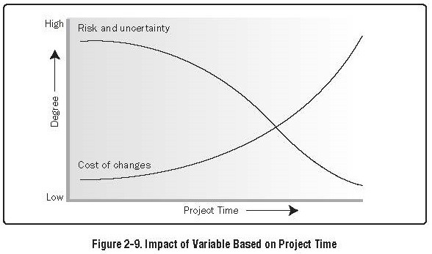

Introduction to Project Management
Project Life Cycle
Characteristics of the Project Life Cycle

Slide 20
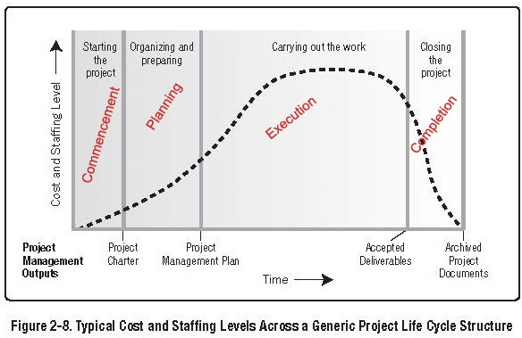

Introduction to Project Management
Project Life Cycle
Characteristics of the Project Phases

Slide 21

Introduction to Project Management
Project Life Cycle
Characteristics of the Project Life Cycle
Phases Generally Define
What technical work to undertake in each phase such as Feasibility, Design, Tender, Construction, Handover
What the deliverables are for each phase i.e Feasibility Report, Design and Tender Specifications, Completed Building or Infrastructure, Taking-Over-Cert.
Who is involved, such as Finance House, Architects, Consultant Engineers, Contractors, Project Sponsor etc.
How to Control & Improve each phase

Slide 22
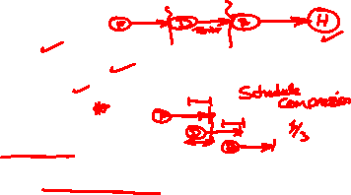
Introduction to Project Management
Project Life Cycle
Characteristics of Project Phases
Phases generally:
are sequential
have specific deliverables may be sub-divided conclude with a review
‘proceed to next’ or ‘kill point’
Can be ‘fast-tracked’
Commencement of next phase before completion of preceding; carries increased risk
Formal Phase Completion does not include authorising the next phase commencement

Slide 23

Introduction to Project Management
Project Life Cycle
Characteristics of Project Phases
General Comments
Likelihood of Project Completion is low at the start, and increases over the life cycle; even with huge cost overruns
Panama Canal, Concorde, Dublin Port Tunnel
Decisions made early in the project life-cycle have a profound effect on project costs
Costs of Change increase through the project lifecycle
Phase completion and/or commencement should be controlled

Slide 24

Introduction to Project Management
Project Life Cycle
Relevance to Project Planning
Life Cycle Phasing not intended to ‘handcuff’ the Project Manger
the life-cycle phase approach provides a methodology for uniformity in project planning.
allows for the use of standardised checklists, procedures, activities etc.
allows for phase control - (project gates)
At the end of each phase there is a meeting of the project manager, sponsor, senior management to review the phase completed, and to obtain authorisation to proceed to the next phase.

Slide 25

Introduction to Project Management
Project Life Cycle
Phase Control - Gating the Project
‘end of phase’ meeting’
Work to date is assessed Budgets affirmed or updated Schedules affirmed or updated
Decision to proceed or otherwise is made.
Possible Decisions
Proceed to next phase based on approved funding level Proceed to next with new or modified objectives
Postpone approval: More information required; major budget review; etc
Terminate Project: Off-ramp, Kill Point

Slide 26

Introduction to Project Management
Project Life Cycle
Example of Life Cycle & Phasing
Consider a company that has defined the following life-cycle Conceptualisation
Feasibility Preliminary Planning Detail Planning Execution
Commissioning & Handover

Slide 27

Introduction to Project Management
Project Life Cycle
Example of Life Cycle & Phasing
Procedures for Conceptualisation could include:
Brainstorming to identify as many solutions to a particular problem as possible
Describe problem solutions in detail
Procedures for Feasibility could include: Evaluation of all alternatives identified above Evaluation of Market Potential
Evaluation of Cost Effectiveness Evaluation of Technical Issues Selection of Optimum Solution
Preparation of Project Goals and Objectives
Prepare Preliminary Cost Estimates and development Plan

Slide 28
Introduction to Project Management
Project Life Cycle
Example of Life Cycle & Phasing
Procedures for Preliminary Planning could include: Implementation of Development Plan as derived previously Completion of the Following Elements
General Scope of Works Contractors Tasks Performance Requirements Documentation Requirements Risk Assessment

Slide 29
Introduction to Project Management
Project Life Cycle
Example of Life Cycle & Phasing
Conceptualisation Feasibility Preliminary Planning Detail Planning Execution
Commissioning & Handover
−→−→−→ Gate 1
−→−→−→ Gate 2
−→−→−→ Gate 3
−→−→−→ Gate 4
−→−→−→ Gate 5
−→−→−→ Gate 6

Slide 30
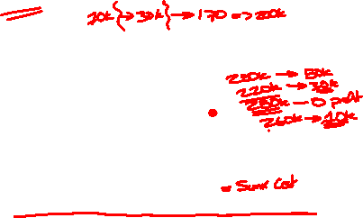
Introduction to Project Management
Project Life Cycle
The Kill Point
Abandoning a project gets more difficult as time progresses Sometimes abandoning a project is the most pragmatic business decision.
So why to stakeholders continue?
Principle of Irrational Escalation
Personally invested
Emotion; ego; refuse to admit defeat; reputation; etc. Time; cannot turn back; delivery deadline
Money; non-recoverable investment
Failure to recognise abandonment as an viable option

Slide 31

Introduction to Project Management
Project Stakeholders
Project Stakeholders
Stakeholders are individuals or organisations that are actively involved in the project, or whose interests may be effected as a result of the project execution or completion. (PMBOK Defn.)
They may exert influence over the project
Project Management Teams must identify and manage them.
Cannot ignore them

Slide 32
Introduction to Project Management
Project Stakeholders
Project Stakeholders
Stakeholders have varying levels of responsibility, authority, and input.
These levels can change over the course of the project
General Population can exert a great influence during the planning stage (Jury’s Hotel Dublin)
Influence of Population greatly diminished once planning is obtained, however may disrupt progress on other issues, such as noise, dust, traffic etc.

Slide 33
Introduction to Project Management
Project Stakeholders
Project Stakeholders
Stakeholders are not always easy to identify
Failure to Identify Key Stakeholders can have a serious negative effect on a project
UK NHS IT Project (NPfIT)
Stakeholders can have a negative or positive effect on the project
Positive Stakeholders are those who will benefit from the successful outcome of the project
Usually easy to identify
Negative Stakeholders are those who will see negative outcomes from the projects success.
A New Hotel Project will have a negative effect on the trade of nearby hotels
A new factory may have negative effect on an existing factory’s ability to retain workers

Slide 34
Introduction to Project Management
Project Stakeholders
Project Stakeholders
Positive Stakeholders
Their interests are best served by helping the project to succeed
Negative Stakeholders
Their interests are best served by impeding project progress
Ignoring Negative Stakeholders can put an entire project at risk of failure; suspension; financial ruin; or worse.

Slide 35

Introduction to Project Management
Project Stakeholders
Project Stakeholders
Key Stakeholders on every Project include:
Project manager. The person responsible for managing the project.
Customer/user. The person or organization that will use the project’s product. There may be multiple layers of customers. For example, the customers for a new pharmaceutical product can include the doctors who prescribe it, the patients who take it and the insurers who pay for it.
Performing organization. The enterprise whose employees are most directly involved in doing the work of the project.
Project team members. The group that is performing the work of the project.

Slide 36

Introduction to Project Management
Project Stakeholders
Project Stakeholders
Key Stakeholders on every Project include:
Project management team. The members of the project team who are directly involved in project management activities.
Sponsor. The person or group that provides the financial resources, in cash or in kind, for the project.
Influencers. People or groups that are not directly related to the acquisition or use of the project’s product, but due to an individual’s position in the customer organization or performing organization, can influence, positively or negatively, the course of the project.
PMO. If it exists in the performing organization, the PMO can be a stakeholder if it has direct or indirect responsibility for the outcome of the project.
36 / 71

Slide 37
Introduction to Project Management
Project Stakeholders
Project Stakeholders
Stakeholders can be further categorized into:
Internal External Owners Investors Sellers Contractors
Government agencies Lobbying organisations
Stakeholders roles can overlap
Construction of new fabrication unit for a factory
Self Financed (Sponsor); End User; PM Team Members etc.

Slide 38
Introduction to Project Management
Project Stakeholders
Project Stakeholders
Project Managers must manage stakeholders;
This is not an easy task as often stakeholders interests oppose each other.
Example: Wind Farms:
Most people when asked say they agree that wind farms are necessary; green energy etc.
Traditionally it was very difficult to obtain PP from local authorities. Legislation had to be enacted to change this. Kerry CC, Slaheny Energy Ltd., March 2003

Slide 39

Introduction to Project Management
Project Stakeholders
Responsibility of a Project Manager to Stakeholders
Rooted in Ethics and Ethical Behaviour Truthful representation of all information Full disclosure of all information
Protection of company-proprietary information Responsibility to report violations
Full disclosure, and in a timely manner of all conflicts of interest
Ensure that all PM team members comply with the above
Ethical Behaviour may be either voluntary, or imposed by Company Policy.

Slide 40

Introduction to Project Management
Project Stakeholders
Managing Stakeholders
Responsibility for Managing Stakeholders rests firmly with the Project Management Team; and the PM Team stand to lose the most if it not effective
Primary Requirement is Open Communications and Managed Expectations

Slide 41

Introduction to Project Management
Project Stakeholders
Managing Stakeholders
Managing Expectations:
Always build Contingency into your plans
Be ready to offer alternatives/options that continue to meet project objectives
Never offer an alternative or bow to stakeholder pressure unless you are sure that your (or their) alternative will work
Request time to evaluate alternatives
If you don’t, you run the very real risk of signing up to ‘mission impossible’ and causing real damage to the trust between parties
Beware of modifying yours, or others, estimates on time/cost/complexity etc.
Estimates are often used as the first point of attack on a plan. i.e. ‘You are too conservative here; you can shave a week off that . . . .’

Slide 42
Introduction to Project Management
Project Stakeholders
Managing Stakeholders
Giving Commitments
At some point you have to give a commitment, so. . .
Never commit [to a deadline] too early
Make sure you know what the customer is expecting; this is normally based on what you have led them to believe
Know what elements on your project have no margin for error, and make sure that nothing goes wrong with them.
When giving a commitment, make sure that you can at least meet it, and hopefully exceed it.
If you are going to fail to meet a commitment, make sure you have a fallback position.

Slide 43
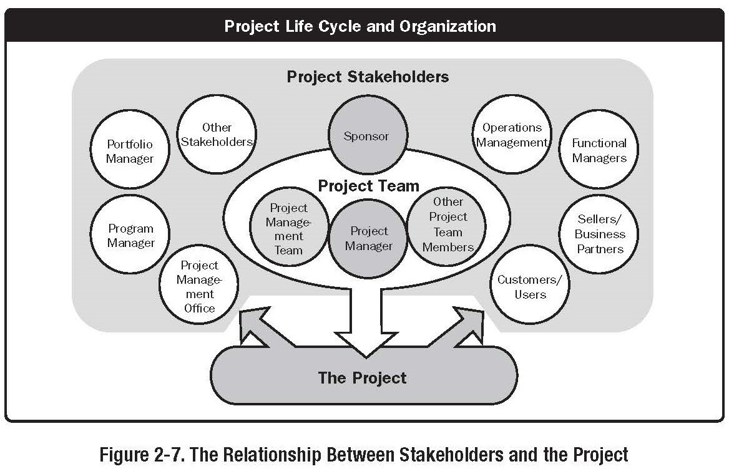
Introduction to Project Management
Project Stakeholders
Project Stakeholders

Slide 44
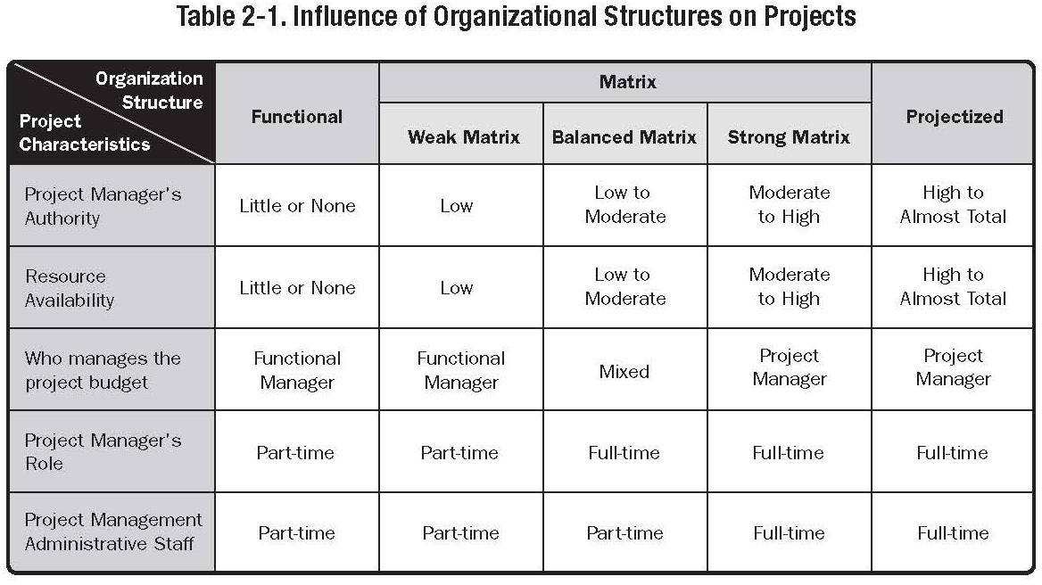

Introduction to Project Management
Project Organization
Project Organization

Slide 45
Introduction to Project Management
Project Organization
Organisational Influences
Projects are typically part of an organisation that is larger than the project
HSE is bigger than a new hospital
The maturity of an organisations Project Management Systems can (and normally does) influence the project
Key Aspects of these orgainsations are their:
Organisational Systems Organisational Cultures and Styles Organisational Structures

Slide 46
Introduction to Project Management
Project Organization
Organisational Systems
Organisational Systems can be: Financial Systems Reporting Systems Procurement Systems
IT Systems Communications Systems Departments
In basic terms, the organisational infrastructure required to support projects
PMBOK® refers to many of these as Organisational Process Assets

Slide 47
Introduction to Project Management
Project Organization
Organisational Systems
Project-based organisations are those whose operations consist primarily of projects
Two categories:
Organisations that derive their revenue primarily from performing projects for others under contract
Organisations that have adopted Management by Projects
Non-Project based organisations often lack the management systems to support projects effectively.

Slide 48
Introduction to Project Management
Project Organization
Organisation Cultures and Styles
Cultures and Styles can be
Shared Values, norms, beliefs and expectations Policies and Procedures
View of Authority Relationships Work ethic and work hours
Such as:
Entrepreneurial Leadership: More likely to take on high risk project
Bureaucratic Style: Less likely to take on risk
Participative Style: Assists in project communications and ultimately project sucess

Slide 49
Introduction to Project Management
Project Management Processes
Project Management
Up to now we have been ‘setting the seen’, i.e. looking at what a project is, who is involved, what organisation structures best support projects & project mangers, etc.
This lecture presents an overview of the project management processes used in industry.
Over the coming weeks & months these areas are going to be presented in detail.

Slide 50
Introduction to Project Management
Project Management Processes
Project Management Processes
Project Management is accomplished through processes, using PM knowledge, skills, tools and techniques that:
Receive inputs Generate outputs

Slide 51
Introduction to Project Management
Project Management Processes
Project Management Processes
In order for a project to be successful, the PM team must Select appropriate Processes
Use a defined approach to adapt specifications and plans to meet project (and/or product) requirements
Comply with requirements to meet stakeholders needs, wants and expectations
Balance the demands of Scope, Time, Cost, Quality, Resources, and Risk.

Slide 52
Introduction to Project Management
Project Management Processes
Project Management Process Groups
There are 5 process groups:
Initiating Process Group
Planning Process Group
Executing Process Group
Monitoring and Controlling Process Group
Closing Process Group
PROCESS GROUPS ARE NOT PROJECT PHASES

Slide 53
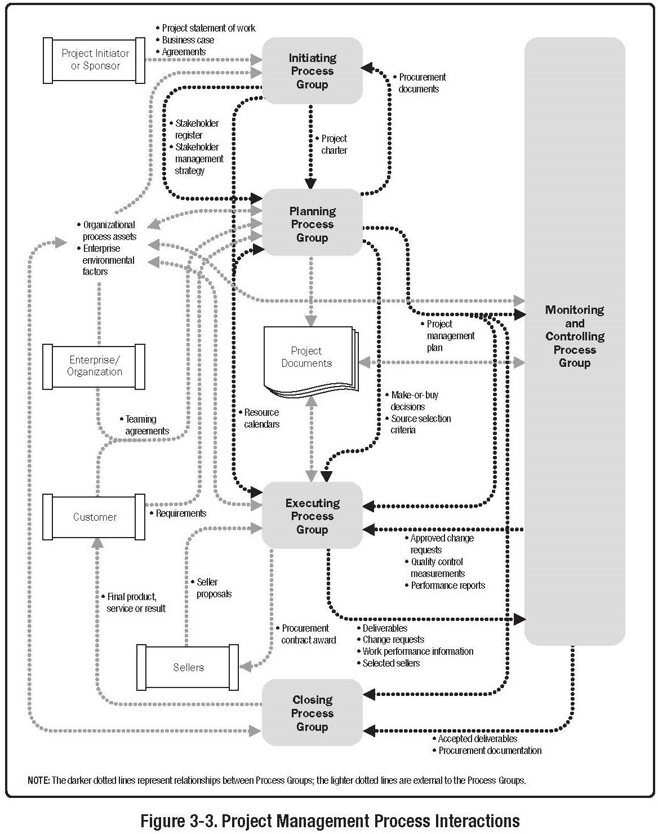
Introduction to Project Management
Project Management Processes
Project Management Process Groups - Overview

Slide 54
Introduction to Project Management
Project Management Processes
Initiating Process Group
The Initiating Process Group Consists of the processes that facilitate the formal authorisation to start a new project or phase.
Elements are often carried out external to the project scope of control;
i.e. before embarking on a project an organisation may document its requirements, evaluate alternatives, and chose one; a project scope statement may also be generated.
This can ‘blur’ the boundary between the original investigation (feasibility study) and the formal initiation of the project

Slide 55
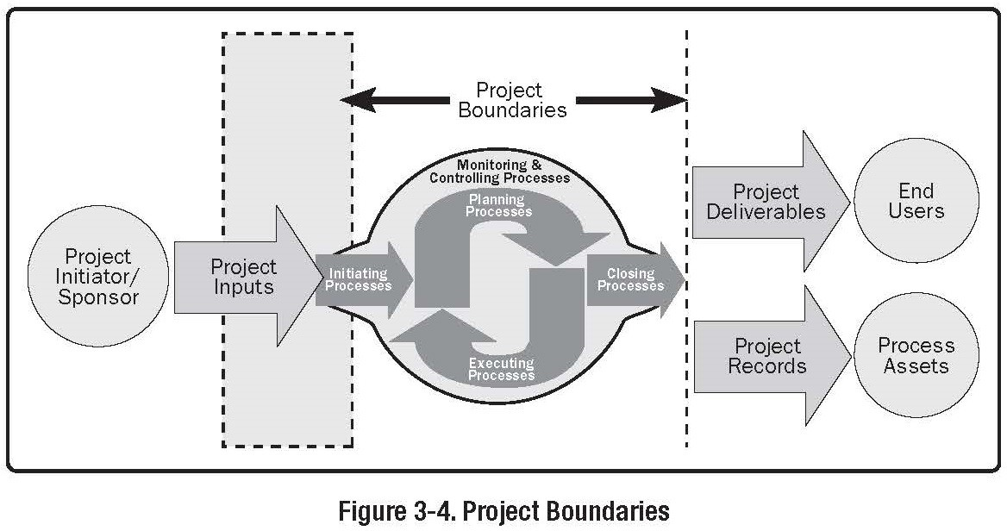
Introduction to Project Management
Project Management Processes
Initiating Process Group

Slide 56
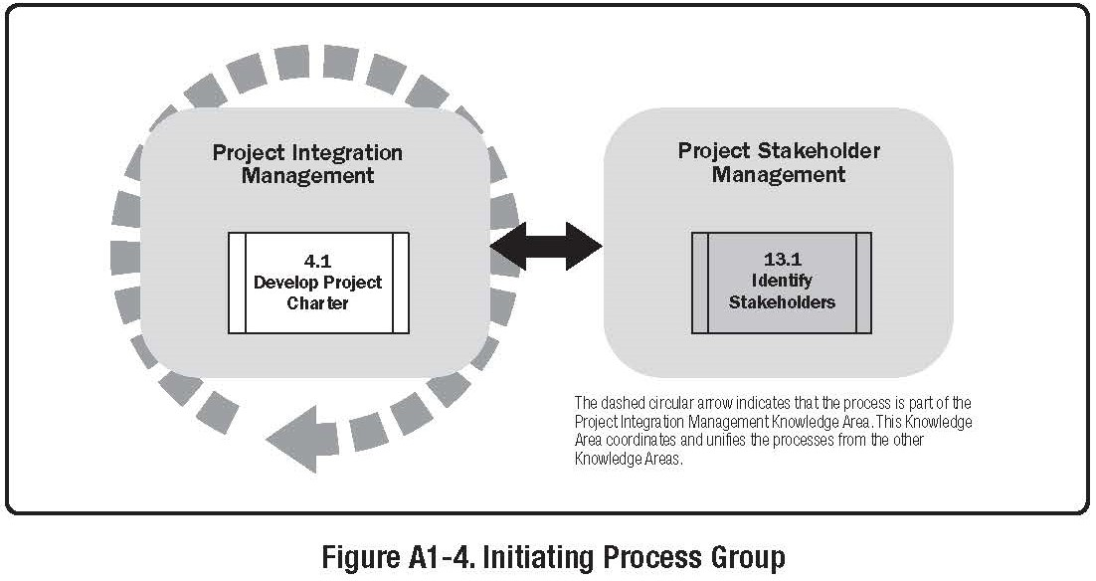
Introduction to Project Management
Project Management Processes
Initiating Process Group

Slide 57
Introduction to Project Management
Project Management Processes
Initiating Process Group
This is the formal commencement of the Project Used to validate the assumptions, decisions and
constraints previously made and identified (Kill Point?)
Project Manger is usually appointed at this stage

Slide 58
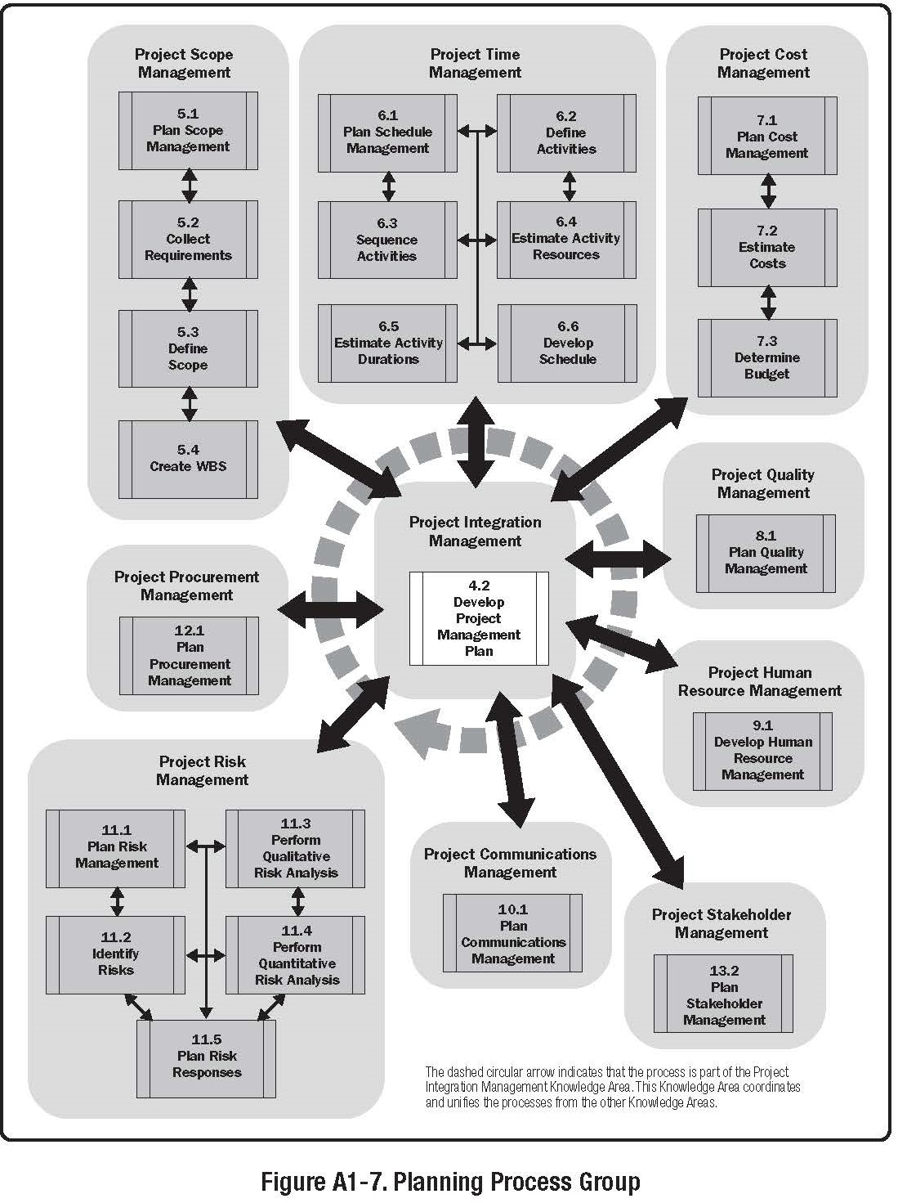
Introduction to Project Management
Project Management Processes
Planning Process Group

Slide 59
Introduction to Project Management
Project Management Processes
Planning Process Group
Thought by many to be the most important
it is vital, but pointless if not integrated into all other aspects of Project Management Process Groups
PP Group is used to develop the PM Plan
These processes identify, define and mature the project scope, cost, and schedule
The PP Group should involve all relevant stakeholders - NPfIT Project failed in this respect
It is an iterative process
For instance a schedule risk may not be identified until ‘activity duration estimating’ has been completed
Cannot continue indefinitely; the executing organisation should set a date for completion, dependant on the nature of the project. (General Management Issue)

Slide 60
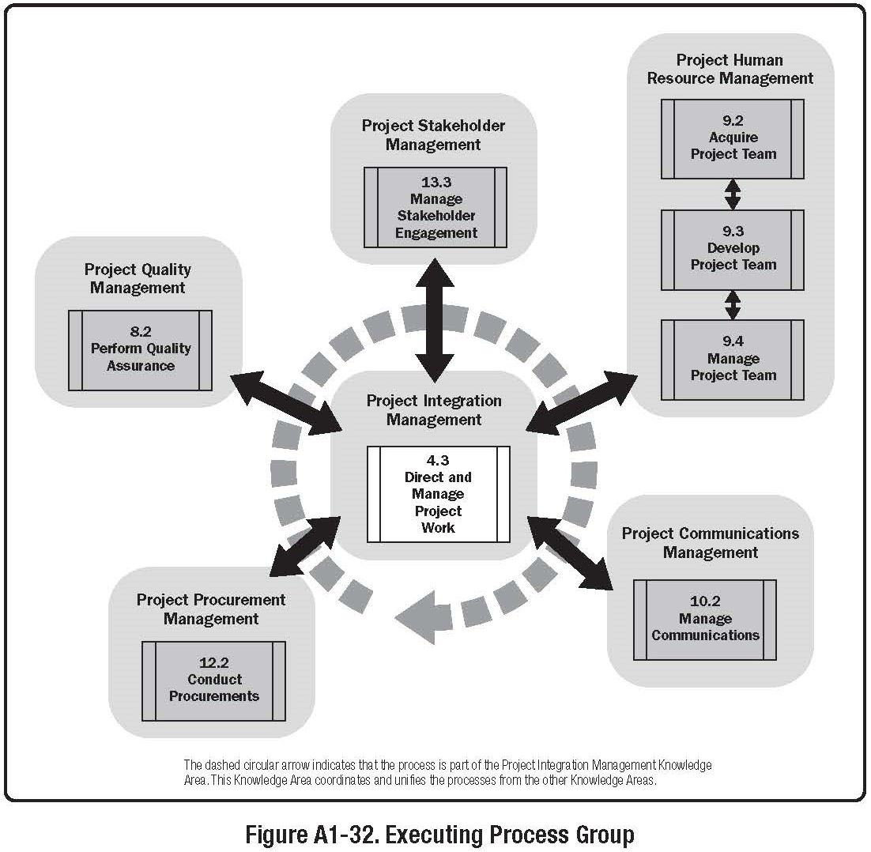
Introduction to Project Management
Project Management Processes
Executing Process Group

Slide 61
Introduction to Project Management
Project Management Processes
Executing Process Group
This process group consists of processes used to complete the work defined in the project management plan.
The Executing P.G. involves coordination of people and resources, as well as integrating and performing the activities in accordance with the PM Plan
This process group also addresses issues of Scope and change control.
Normally, execution will cause changes to planning; identify previously unknown risks; etc. Not all changes effect the PM Plan, but usually require analysis
The vast majority of the Project Budget is expended in performing the Executing Process Group.

Slide 62
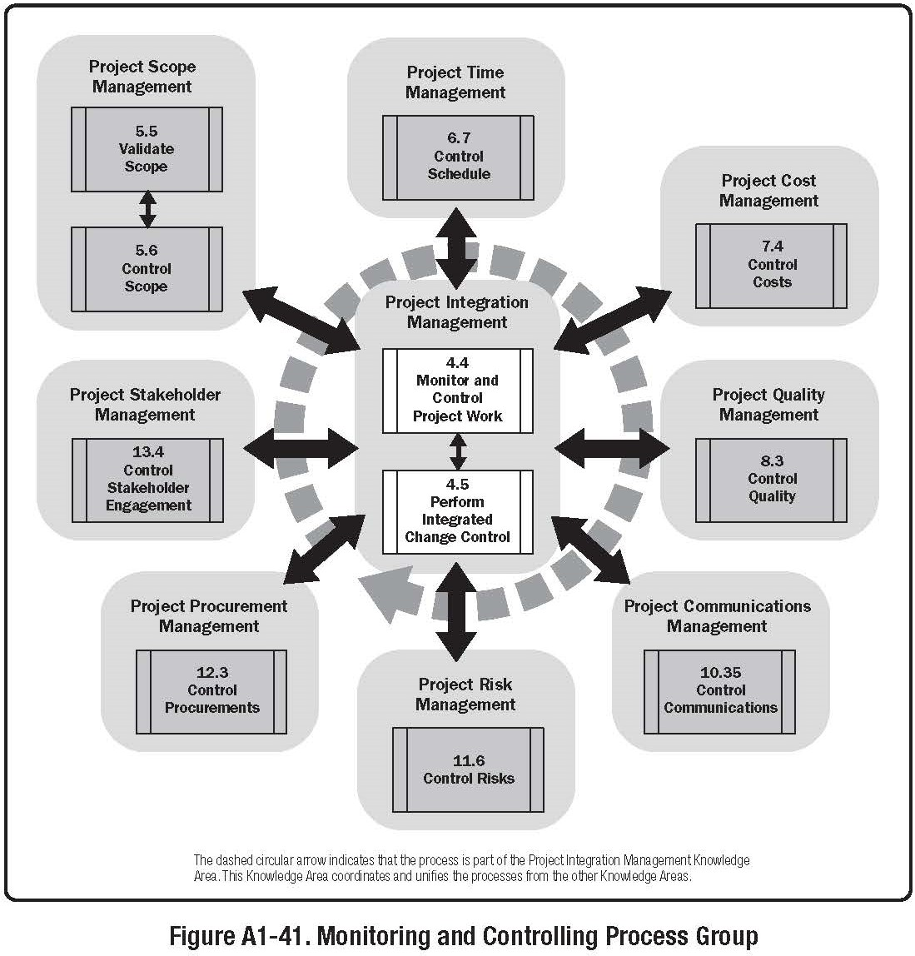
Introduction to Project Management
Project Management Processes
Monitoring & Controlling Process Group

Slide 63
Introduction to Project Management
Project Management Processes
Monitoring & Controlling Process Group
The M&C process group consists processes used to
observe project execution.
Used to identify potential problems, corrective actions, and control project execution.
The output of these processes are compared with the project plan
Also includes Change Control, Preventative Actions,
It is a continuous process, providing an insight into the status of the entire project at any given time
This information may necessitate the modification of the overall project plan.

Slide 64
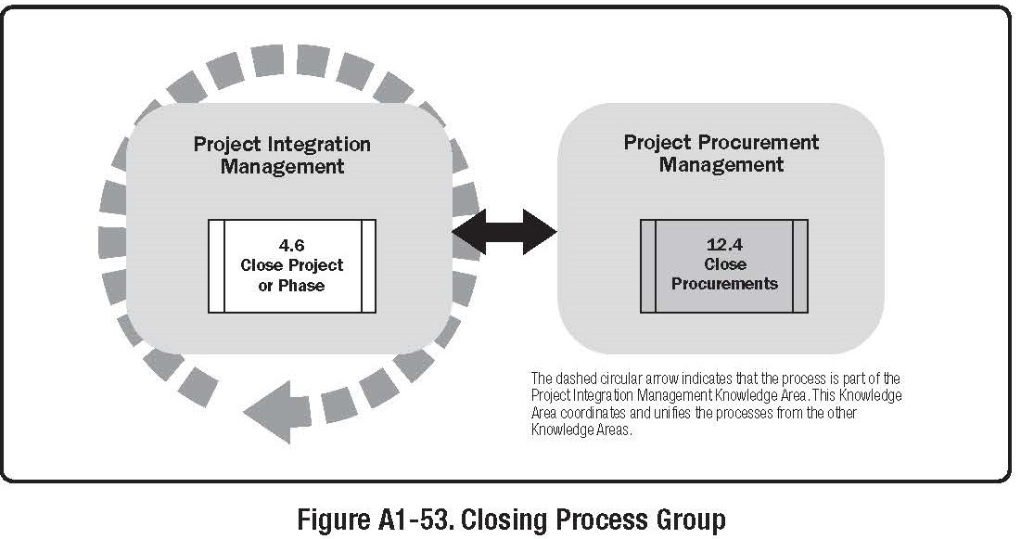
Introduction to Project Management
Project Management Processes
Closing Process Group

Slide 65
Introduction to Project Management
Project Management Processes
Closing Process Group
The closing process group includes processes used to formally terminate all activities of a project or project phase
When completed, this process group verifies that all processes defined within the other process groups are completed, and formally establishes that the project or project phase is finished.

Slide 66
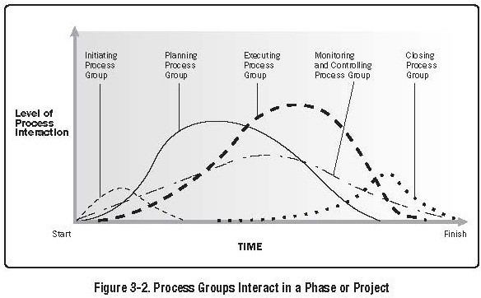
Introduction to Project Management
Project Management Processes
Process Interactions

Slide 67
Introduction to Project Management
Project Management Processes
Process Interactions
The Process Groups are linked; they are not independent of each other.
Generally the output of one process becomes the input of another process
Processes Groups are seldom, if ever, discrete events; often overlap with other groups.
The level of interaction generally depends on how far the project has progressed.
If a project is split into formal phases, these interactions may cross over project phases.
Tends to present difficulties when it does.

Slide 68
Introduction to Project Management
Project Management Processes
Process Interactions
Not all processes are required on all projects; not all process interactions are present on all projects
The PM team must decide which processes to run and how to run them.
(may be governed/dictated by PMO, or Company Protocol)

Slide 69
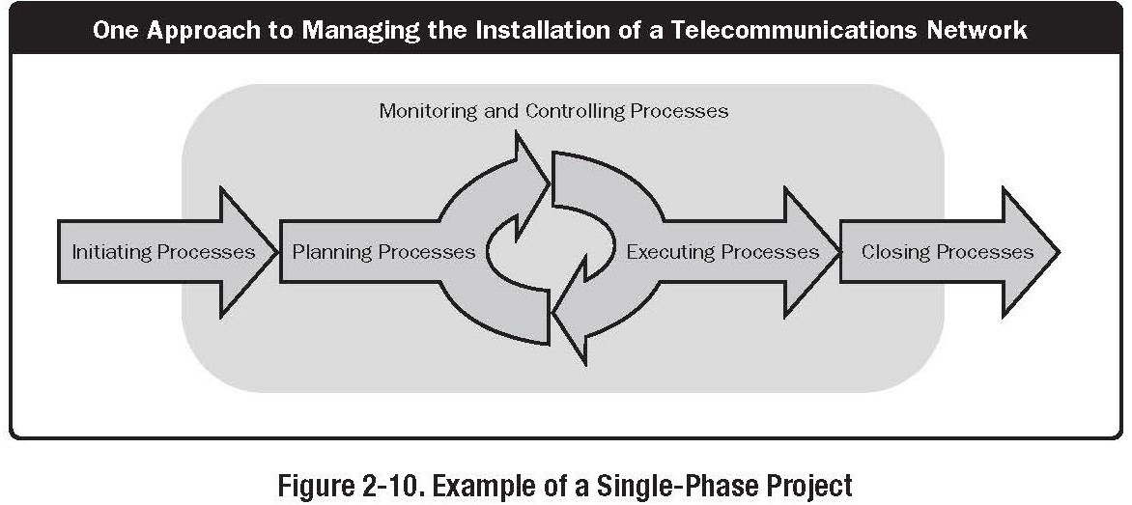
Introduction to Project Management
Project Management Processes
Single Phase Project

Slide 70
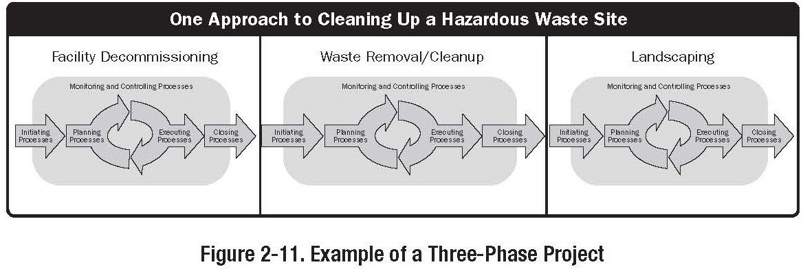
Introduction to Project Management
Project Management Processes
Multiphase project

Slide 71
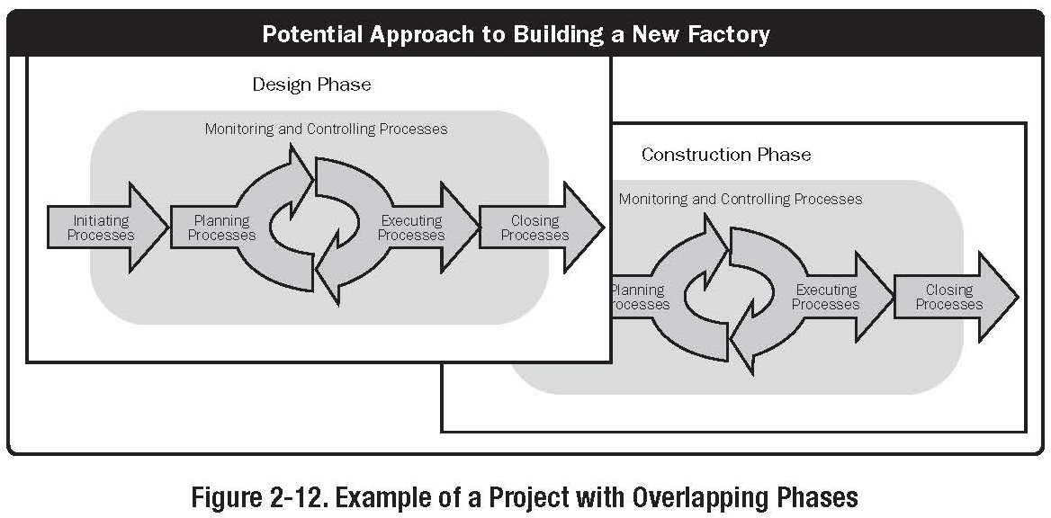
Introduction to Project Management
Project Management Processes
Overlapping Phases

