Slide 1
Project Procurement Management
Project Management
Paul Vesey
Limerick Institute of Technology
paul.vesey@lit.ie
Spring 2020

Slide 2
Project Management
Project Procurement Management Introduction
Project Procurement Management
Project Procurement Management includes the processes to purchase or acquire the products, services, or results needed from outside the project team to perform the work.
Project Procurement Management includes the contract management and change control processes required to administer contracts or purchase orders.

Slide 3
Project Management
Project Procurement Management Introduction
Project Procurement Management Proceses
Plan Procurements
What, When and How - Documenting requirements and identifying potential sellers
Conduct Procurements
Request Seller Responses
Obtaining information, bids, quotations, proposals
Select Sellers
Reviewing offers, choosing potential sellers, negotiating written contract with sellers
Administer Procurements
Managing Contract Relationships; reviewing and documenting seller performance; change management
Close Procurements
Completing and Settling each contract

Slide 4
Project Management
Project Procurement Management Introduction
Contractual Obligation
Contract
Legally Binding
Product, Service, Result, in exchange for Consideration Can be simple or complex
All contracts should be tailored to the specific needs of the project;
Contracts require a more rigorous internal approval procedures
Contracts present an opportunity for the performing organisation to avoid; mitigate; or transfer risk.
When using standard forms of contract (MF1, FIDIC, etc.), any amendments need to be very carefully considered.
Change may introduce unanticipated errors

Slide 5
Project Management
Project Procurement Management Introduction
Contracts
Complex Projects typically include multiple contracts.
These contracts can come into effect and be discharged at any time during the project
The buyer-seller relationship can exist at many levels on any one project
Sellers will typically manage their work as a project; unless their work is restricted to supply only

Slide 6
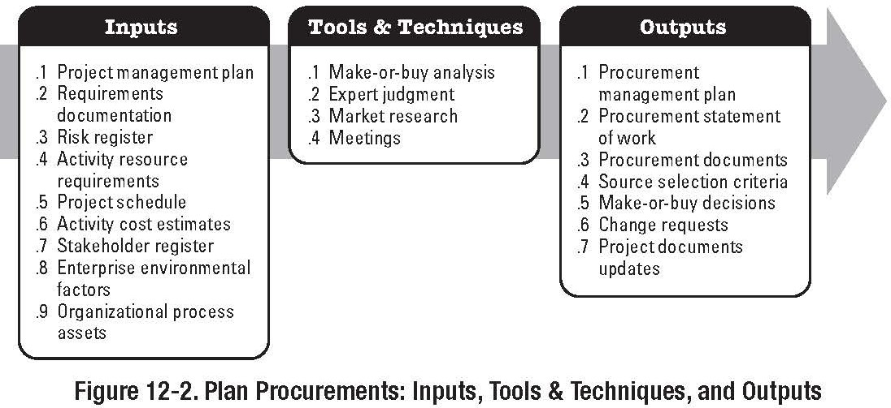
Project Management
Project Procurement Management Introduction
Plan Procurements
Part of the Planning Process Group

Slide 7
Project Management
Project Procurement Management Introduction
Plan Procurements
Identifies which project needs can best be met by purchasing or acquiring products, services or results from outside the project organisation, and which project needs can be accomplished by the project team
Also includes detailing who is responsible for obtaining and holding permits, licences, etc. - i.e. main contractor or
sub-contractor
The process also includes reviewing the risks involved in each make-or-buy decision; reviewing the type (form) of contract that will be used for mitigating, avoiding or transferring risk

Slide 8
Project Management
Project Procurement Management Introduction
Plan Purchases and Acquisitions Inputs (Incomplete list)
Enterprise Environmental Factors
Market Place Conditions
Availability of products and services
Organisational Process Assets
Formal and Informal procurement policies
Approval procedures; approved suppliers; contract terms
Project Scope Statement - information on:
How much money is available Required by dates
Health & Safety, Security, Performance, Insurances, etc. Deliverables and Acceptance Criteria

Slide 9
Project Management
Project Procurement Management Introduction
Plan Purchases and Acquisitions Inputs (Incomplete list)
WBS & Dictionary: Provides the relationship amongst components of the project and detailed description of the works within each WBS element.
PM Plan: Provides guidance and direction for procurement planning
Risk Register: Risk Related contractual Agreements Activity Resource Requirements
Project Schedule Activity Cost Estimates Cost Baseline

Slide 10
Project Management
Project Procurement Management Introduction
Plan Purchases and Acquisitions Techniques
Tools and
Make-or-Buy Analysis
Produced by the project team or bought in
Needs to consider short-term and long-term business planning. Purchase of Assets; Acquisition of Corporate Capability and Knowledge etc.
Expert Judgement
Can be used to develop or modify criteria used to evaluate offers or proposals: Typical example, Legal Experts

Slide 11
Project Management
Project Procurement Management Introduction
Plan Purchases and Acquisitions Techniques
Tools and
Contract Types
Fixed Price or Lump-sum contracts Cost Reimbursable Contracts
Cost plus Fee
Cost plus Percentage of Cost Cost plus Fixed Fee
Cost plus Incentive Fee
Time and Material Contracts

Slide 12
Project Management
Project Procurement Management Introduction
Plan Purchases and Acquisitions Techniques
Tools and
Standard Forms and Standard Contracts Standard Descriptions of Procurement Items Specifications
Non Disclosure Agreements Proposal Evaluation Criteria
MEAT
Intellectual Property Rights Expert Judgement
Refer to Book and previous notes

Slide 13
Project Management
Project Procurement Management Introduction
Plan Purchases and Acquisitions Outputs
Procurement Management Plan
Describes how the procurement processes will be managed from developing procurement documentation through contract closure. Includes:
Types of Contracts to be used Standardised Procurement Documents
Co-ordinating Procurement with other project activities Identifying Performance Bonds and/or Insurances Establishing the form and format for contract statement of work
Prequal sellers
Procurement Metrics to be used to evaluate sellers

Slide 14
Project Management
Project Procurement Management Introduction
Plan Purchases and Acquisitions Outputs
Procurement Statement of Work
Defines the work to be contracted.
Based on the Scope and Primary Statement of Work Typically, elaboration is required
Must be Clear, Complete and Concise
Requirements, Acceptance Criteria, Bonds, Insurances, Completion Dates, Liquidated Damages
Beware of Back-to-Back
Make or Buy Decisions
Documentation of what is to be bought in and why
Requested Changes
Run through the Integrated Change Control Processes

Slide 15
Project Management
Project Procurement Management Introduction
Plan Purchases and Acquisitions
Outputs
Procurement Documents
Invitation to Bid, Request for Proposal
The complexity and level of detail of procurement documentation should be consistent with the value of, and risk associated with the planned purchase or acquisition
Procurement Statement of Work (Updates)
Modifications to contact statements of work identified during procurement documentation development

Slide 16
Project Management
Project Procurement Management Introduction
Plan Purchases and Acquisitions
Outputs
Source Selection Criteria
Does the seller understand the need? Overall or Life-cycle cost
Does the seller have the technical capability? Seller Management Approach
Financial Capacity Production Capacity Business size and type References
Intellectual Property Rights

Slide 17
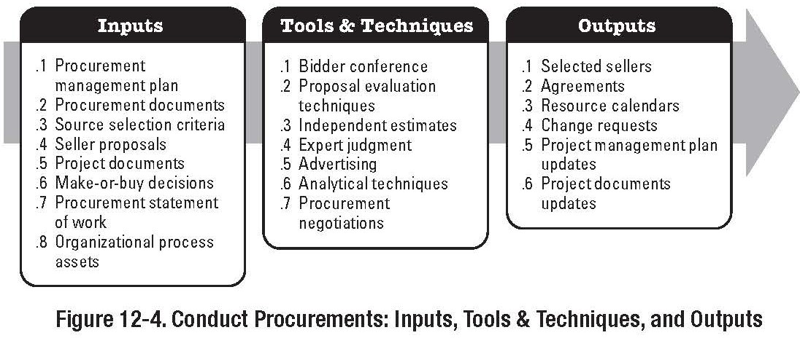
Project Management
Project Procurement Management Conduct Procurements
Conduct Procurements
Part of the Executing Process Group

Slide 18
Project Management
Project Procurement Management Conduct Procurements
Conduct Procurements
Process of obtaining responses from sellers, such as Quotations, Bids, and Proposals from Prospective Sellers.
Sellers expend most of the effort in this process
Bidding can be expensive for sellers
Often ‘quotations’ are requested in the very early stages of a project to assist in budget formation.

Slide 19
Project Management
Project Procurement Management Conduct Procurements
Conduct Procurements Inputs
Organisational Process Assets
Lists and information on prospective or previously qualified sellers
List should contain information on past performance and other characteristics of the seller
Some organisations only use sellers they have vetted.
Achilles Supplier Qualification Databases http://www.achilles.ie
Procurement Management Plan
Refer to book and previous notes
Procurement Documents
Refer to book and previous notes

Slide 20
Project Management
Project Procurement Management Conduct Procurements
Conduct Procurements Tools and Techniques
Bidder Conferences
Meetings with prospective sellers prior to preparation of a bid or proposal
Used to ensure all sellers have a clear and common understanding of requirements
In construction a tender procedure is normally followed.
Advertising
Advertising in publications
http://www.etenders.gov.ie
Develop Qualified Sellers List
Can be done with or without seller involvement

Slide 21
Project Management
Project Procurement Management Conduct Procurements
Conduct Procurements Outputs
Qualified Sellers List Procurement Document Package
Buyer Prepared Document Package: ITT’s Contract, Employers Requirements, General Specification, Particular Specifications, Drawings, Bills, EIS, Ground Investigations, etc.
Proposals
Seller Prepared Document Package: Form of Tender, Insurance Declarations, Bond Undertakings, Design Documents, Completed Bills, Safety Procedures, Environmental Procedures, Risk Procedures, Methods Statements, Drawings, etc.
Usually Requires Clarification
May also involve interview and/or presentation

Slide 22
Project Management
Project Procurement Management Conduct Procurements
Selecting Sellers
Process of Receiving Bids, Proposals, Tenders, etc., and applying evaluation criteria as applicable, to select one or more sellers.
Price can be a primary determinant for off the shelf items;
but beware, can the seller deliver?
Proposals are normally evaluated under technical and financial criteria
Multiple sources should be considered for critical elements;
reduces risk associated with supply
usually costs more in overhead and loss of quantity discounts

Slide 23
Project Management
Project Procurement Management Conduct Procurements
Selecting Sellers Tools and Techniques
Weighting System
Minimise the effect of personal preference or prejudice Involved assigning a numerical weight to each evaluation criteria, and rating each seller or proposal against these criteria
Independent Estimates
AKA ‘should-cost’ estimate
Significant deviation from this estimate gives an indication that something is wrong.. Either with the proposal or the request
Screening System
Minimum criteria that must be met prior to consideration of the proposal; Annual Turnover, Number of Employees, H&S History, etc.

Slide 24
Project Management
Project Procurement Management Conduct Procurements
Selecting Sellers
Tools and Techniques
Contract Negotiation
Clarifies structure and requirements for the contract
Responsibilities, applicable laws and language, financing, etc.
Seller Rating System
Records of Sellers past performance
Quality, Delivery Performance, Contractual Compliance, etc.

Slide 25
Project Management
Project Procurement Management Conduct Procurements
Selecting Sellers
Tools and Techniques
Expert Judgment
Multi-Discipline Review Team Legal, Financial, Technical, etc.
Team prepares report on proposal and makes recommendations
Proposal Evaluation Techniques
Weighting Systems et. al.

Slide 26
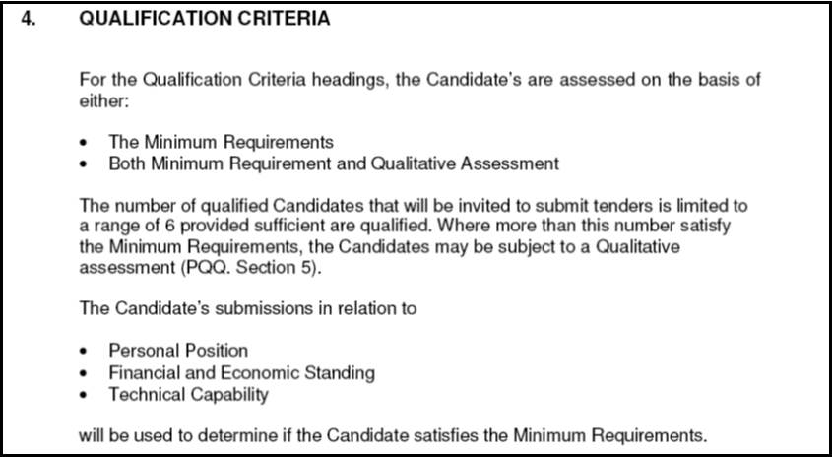
Project Management
Project Procurement Management Conduct Procurements
NRA Pavements and Minor Works Contracts

Slide 27
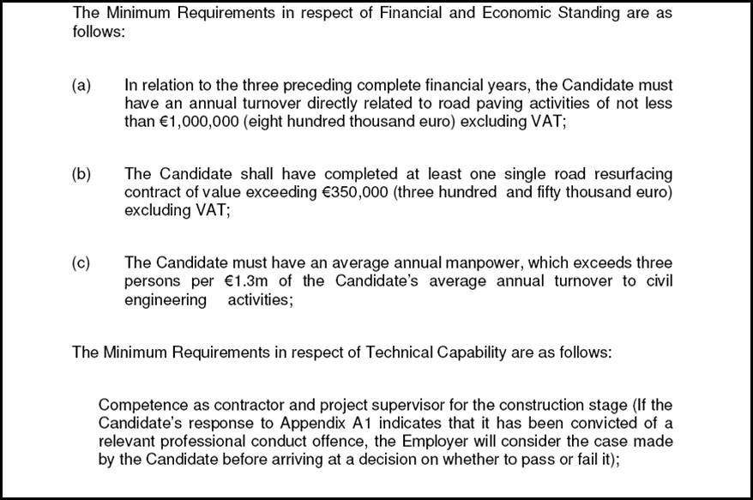
Project Management
Project Procurement Management Conduct Procurements
NRA Pavements and Minor Works Contracts

Slide 28
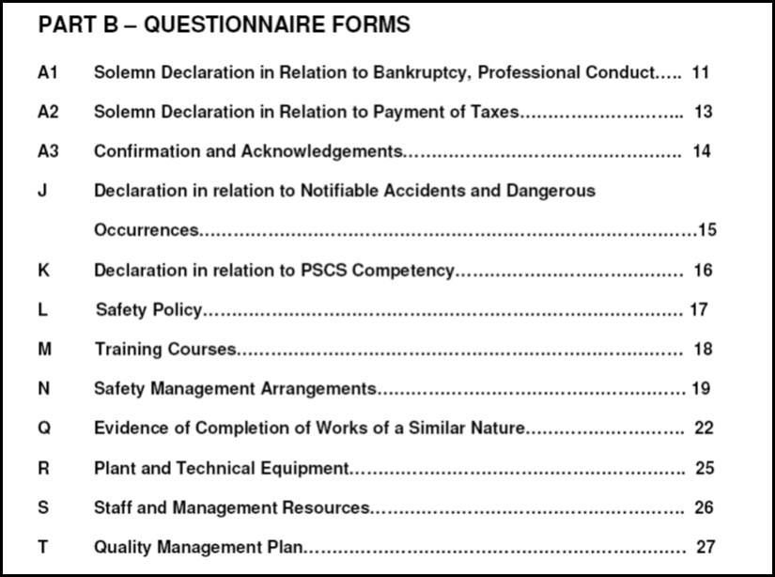
Project Management
Project Procurement Management Conduct Procurements
NRA Pavements and Minor Works Contracts

Slide 29
Project Management
Project Procurement Management Conduct Procurements
Selecting Sellers Outputs
Selected Sellers
Those sellers judged/determined to be within competitive range
Contract
May be a complex contract or a PO
Contract Management Plan
Plan to administer the contract
Who, What, When, etc; Resource Availability Procurement Management Plan (Updates) Requested Changes

Slide 30
Project Management
Project Procurement Management Conduct Procurements
Select Sellers Outputs
Contract (cont.):
May contain the following elements (no specific order):
Section Headings | Statement of Work | Schedule
Period of Performance | Roles & Responsibilities | Pricing & Payment
Inflation Adjustments | Acceptance Criteria | Warranty
Product Support | Limitation of Liability | Fees
Retention | Penalties & Incentives | Insurances
Performance Bonds | Subcontractor Approval | Change Request Handling
Termination and Dispute Handling Procedures

Slide 31
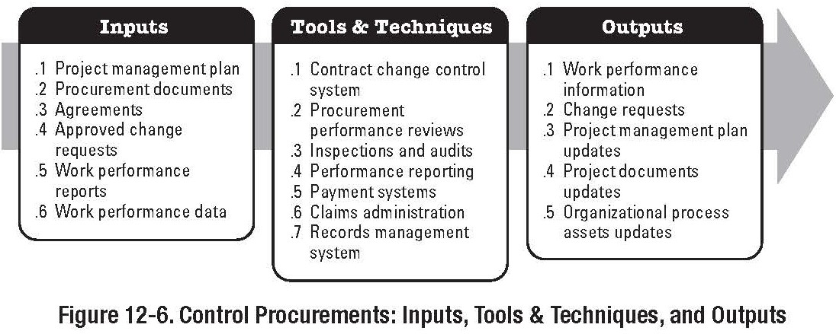
Project Management
Project Procurement Management Administer Procurements
Administer Procurements
Part of the Monitoring and Controlling Process Group

Slide 32
Project Management
Project Procurement Management Administer Procurements
Contract Administration
Each party to a contract needs to ensure that they are meeting their own contractual obligations, and that the other party is meeting theirs.
Both parties need to ensure that their own legal rights are being protected
The legal nature of contractual relationships makes it vital that the project management team is acutely aware of the legal implications of actions taken when administering contracts

Slide 33
Project Management
Project Procurement Management Administer Procurements
Contract Administration
Due to legal considerations, many organisations will treat contract administration as an administrative function.
The ‘contract administrator’ may or may not be part of the project team
This can lead to difficulty for the project management team
Contract Administration also has a financial component; monitoring payments made to the seller (such as a
sub-contractor)
Must ensure payments are within the terms defined by the contract, and that ‘payment certification’ is appropriate
33 / 47

Slide 34
Project Management
Project Procurement Management Administer Procurements
Contract Administration
Contract Administration also reviews and documents how a seller is performing, or has performed, based on the contract and established corrective actions
Determine sellers competency or lack of competency Contract Administration includes managing early termination of contract
Usually difficult to terminate a contract
Limerick City Council v. Uniform Construction Limited: Clear grounds for termination must be established

Slide 35
Project Management
Project Procurement Management Administer Procurements
Contract Administration
BEWARE: Modification of Contract by Mutual Consent
Minutes of Meetings, Memo’s, supposedly benign offers can, in effect, modify the contract.
Usually caused by variations, or changes in scope, etc.
Project Management Team must fully investigate the impact of variations, or changes in scope.

Slide 36
Project Management
Project Procurement Management Administer Procurements
Administer Procurements Inputs
Procurement Documents Project Management Plan Contract
Performance Reports
Seller Related Performance Documentation includes: Seller-developed technical documentation and other deliverables information developed in accordance with the contract
Seller Performance Reports Approved Change Requests Work Performance Information

Slide 37
Project Management
Project Procurement Management Administer Procurements
Administer Procurements Inputs
Approved Change Requests
Approved Change Requests can include modifications to the contract: Scope, Spec, Price, Time, etc.
Beware of Verbal Changes or Aggreements - Can modify the contract by mutual consent if it is recorded; including notes in a diary.
Work Performance Information
Extent to which quality standards are being met Costs / Certificates to date
Deliverables Status
Build in status reporting into contact, AND payment mechanism.

Slide 38
Project Management
Project Procurement Management Administer Procurements
Administer Procurements Tools and Techniques
Contract Change Control System
Defines the process by which the contract can be modified: May include review by lawyer, etc.
Buyer Conducted Performance Review
Performance Review is a structured review to determine the sellers progress to deliver project scope and quality, within cost and schedule, as compared to the contract
Inspections and Audits
Conducted by the buyer during the course of the contract to identify any weaknesses in the sellers work processes or deliverables
Inspections and Audits should be built into the contact

Slide 39
Project Management
Project Procurement Management Administer Procurements
Administer Procurements Tools and Techniques
Performance Reporting
Provides management with information about how effectively the seller is achieving the contractual objectives
Payment System
Payment system includes appropriate reviews and approvals
Must be made in accordance with the contract
Claims Administration
Contested and Constructive Changes PMBOK®refers to ‘Claims’ as being contested, or not agreed by the parties
Litigation, Arbitration, etc.
Normal ‘Variations’ are not considered part of this ‘Claims’ must follow the dispute procedure as set down in the contract.
39 / 47

Slide 40
Project Management
Project Procurement Management Administer Procurements
Administer Procurements
Tools and Techniques
Records Management System
Part of the Project Management Information system Indexing of Project Documentation and Records
Information Technology
Use of Information Technology and Communications Technologies to enhance the efficiency and effectiveness of contract administration
Payment Systems, Databases, etc.

Slide 41
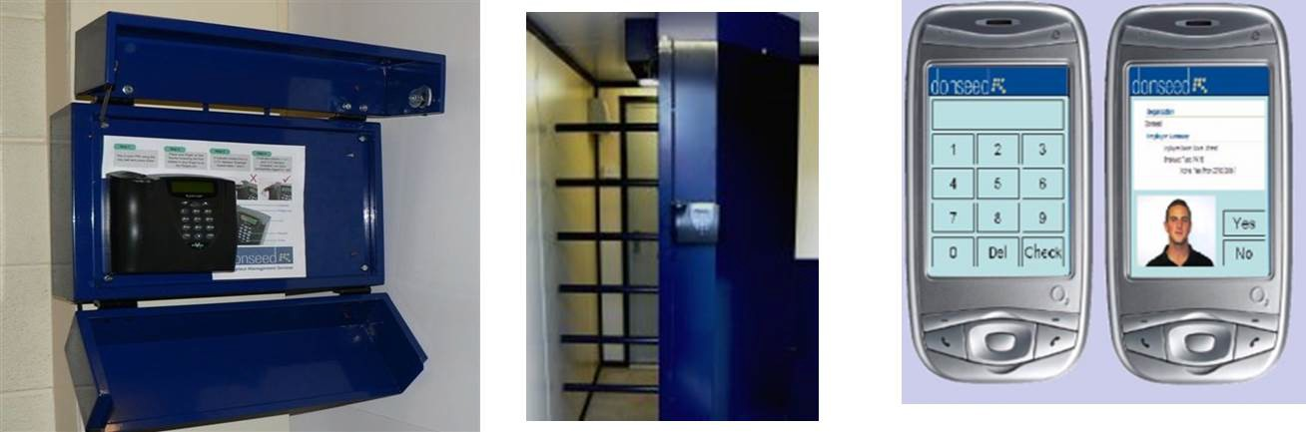
Project Management
Project Procurement Management Administer Procurements
Administer Procurements Tools and Techniques
Information Technology (cont.) Biometric Information Systems
Site Access Control and Monitoring Donseed: Biometric Access systems etc.
http://www.donseed.com

Slide 42
Project Management
Project Procurement Management Administer Procurements
Administer Procurements Outputs
Procurement Documentation
Contract, and Supporting Documentation, etc.
Organisational Process Assets Updates
Correspondence
Payment Schedules and Requests
Seller Performance Evaluation Documentation
Change Requests
Project Management Plan Updates
Procurement Management Plan Baseline Schedule

Slide 43
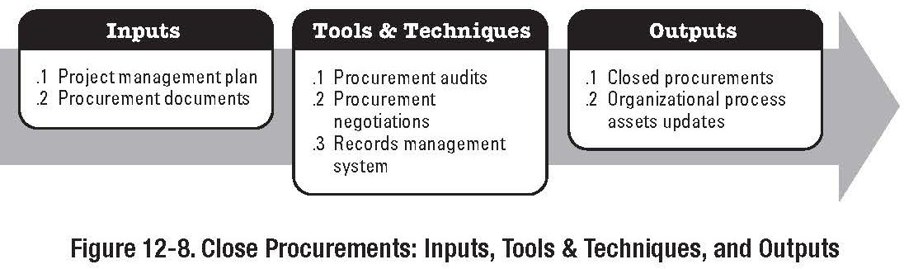
Project Management
Project Procurement Management Close Procurements
Close Procurements
Part of the Closing Process Group

Slide 44
Project Management
Project Procurement Management Close Procurements
Close Procurements
Contract Closure Supports the ‘Close Project or Phase’ process
Involves verification that all work and deliverables were acceptable
Also involves administrative work such as: Updating records to reflect final results Archiving information for future use
May also involve unresolved claims and disputes Contracts can also be closed by mutual agreement
Not the same as termination or discharge

Slide 45
Project Management
Project Procurement Management Close Procurements
Close Procurements
Inputs
Project Management Plan Procurement Documentation
Tools and Techniques Procurement Audits Negotiated Settlements Records Management System

Slide 46
Project Management
Project Procurement Management Close Procurements
Close Procurements
Outputs
Closed Procurements
Buyer provides seller with formal notification of completion of contract; TOC, etc.
Organisational Process Assets
Contract File Deliverable Acceptance
Lessons Learned Documentation

Slide 47
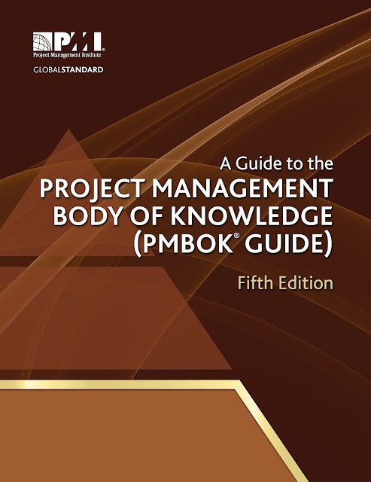
Project Management
Project Procurement Management Close Procurements
Next Lecture
Reading: ‘A Guide to the Project Management Body of Knowledge’
Chapter 10 - Project Communications Management

