Slide 1
Project Quality Management
Project Management
Paul Vesey
Limerick Institute of Technology
paul.vesey@lit.ie
Spring 2020

Slide 2
Project Management
Project Quality Management Introduction
Project Quality Management
Project Quality Management Processes include all activities of the performing organisation that determine quality policy, objectives, and responsibilities so that the project will satisfy the needs for which it was undertaken.
Processes are:
Plan Quality
Perform Quality Assurance Perform Quality Control

Slide 3
Project Management
Project Quality Management Introduction
Project Quality Management
PMBOK processes are intended to be compatible with International Organisation for Standardisation (ISO) standards. Other Standards include:
Total Quality Management (TQM) Six Sigma
Failure Mode & Effect Analysis Etc.

Slide 4
Project Management
Project Quality Management Introduction
Project Quality Management
Project Quality Management must address the management of projects and the product of the project.
Project Quality Management applies to all projects regardless of the nature of the product.
Project Quality Techniques are specific to the particular type of product produced by the project.

Slide 5
Project Management
Project Quality Management Introduction
Project Quality Management
Quality is:
the degree to which a set of inherent characteristics fulfill requirements, American Society for Quality, 2000
The critical element is to turn stakeholder needs, wants and expectations into requirements through Stakeholder Analysis, performed during Project Scope Management

Slide 6
Project Management
Project Quality Management Introduction
Quality and Grade
Quality and Grade are not the same.
Grade is a category assigned to products or services having the same functional use but different technical characteristics.
5* Hotel 2* Hotel
Both serve the same function (provide a bed) but differ greatly technically.
Low Quality is always a problem Low Grade may not be a problem
Ryan Air: low grade (no frills), high quality.

Slide 7
Project Management
Project Quality Management Introduction
Precision and Accuracy
Precision and Accuracy are not the same. Precision is consistency that the value of repeated measurements are clustered and have little scatter
Multiple Unit similarity
Accuracy is how ‘close’ the measured value is to the real value Measurement Error
Inaccurate measurement can yield false precision

Slide 8
Project Management
Project Quality Management Introduction
QM and PM
Quality Management and Project Management both recognize the importance of:
Customer Satisfaction Prevention over Inspection Management Responsibility Continuous Improvement

Slide 9
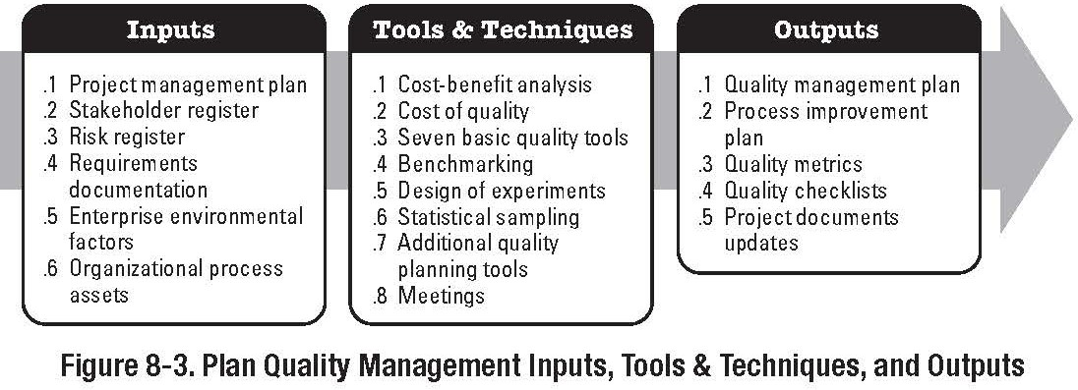
Project Management
Project Quality Management Plan Quality
Plan Quality
Part of the Planning Process Group

Slide 10
Project Management
Project Quality Management Plan Quality
Plan Quality
‘Quality is Planned, Designed, and Built in - Not Inspected in.’ Quality Planning involves identifying which quality standards are relevant to the project and determining how to satisfy them. Quality Planning should be performed in parallel with all other planning processes
If high grade finished are required, then high grade resources (employees and/or subcontractors) need to be used in order to achieve the quality objective of ‘high grade finish’

Slide 11
Project Management
Project Quality Management Plan Quality
Plan Quality
Inputs
Enterprise Environmental Factors
Government Rules, Standards, Regulations, Industry Best Practice etc.
Organisational Process Assets
Performing Organisations Quality Policies, Procedures, Guidelines etc.
If they do not exist, the PM team needs to generate them

Slide 12
Project Management
Project Quality Management Plan Quality
Plan Quality
Inputs
Scope Baseline
Details Major Deliverables, Project Objectives, Thresholds, and Acceptance Criteria
Thresholds: limits of cost, time, resources
Acceptance Criteria: performance requirements and essential conditions that must be met before project deliverables are accepted
Etc.
Refer to Book

Slide 13
Project Management
Project Quality Management Plan Quality
Plan Quality Tools and Techniques
Cost - Benefit Analysis (CBA)
Remember Ford Pinto? Cost of improved quality must be less than the potential savings or benefit
Benefits can be realised by less Rework, Higher Productivity, increased stakeholder satisfaction (clients and employees)
Benchmarking
Comparing actual or planned projects practices to those of other projects to generate ideas for improvement and to provide a basis by which to measure performance: Dominos Pizza

Slide 14
Project Management
Project Quality Management Plan Quality
Plan Quality Tools and Techniques
Design of Experiments (DOE)
Statistical Method that helps identify which factors may influence specific variables of a product or process under development.
Also used for optimisation of processes
Provides a framework that can be used to modify several important factors in parallel
Cost of Quality (COQ)
Total Costs incurred by investment in preventing
non-conformance to requirements, appraising the product or service, etc.
Failure Costs are often split into Internal Costs and External Costs

Slide 15
Project Management
Project Quality Management Plan Quality
Plan Quality
Tools and Techniques
Quality Planning Tools: Brainstorming Affinity Diagrams Matrix Diagrams Etc.
Control Charts:
See next slide and refer to book

Slide 16
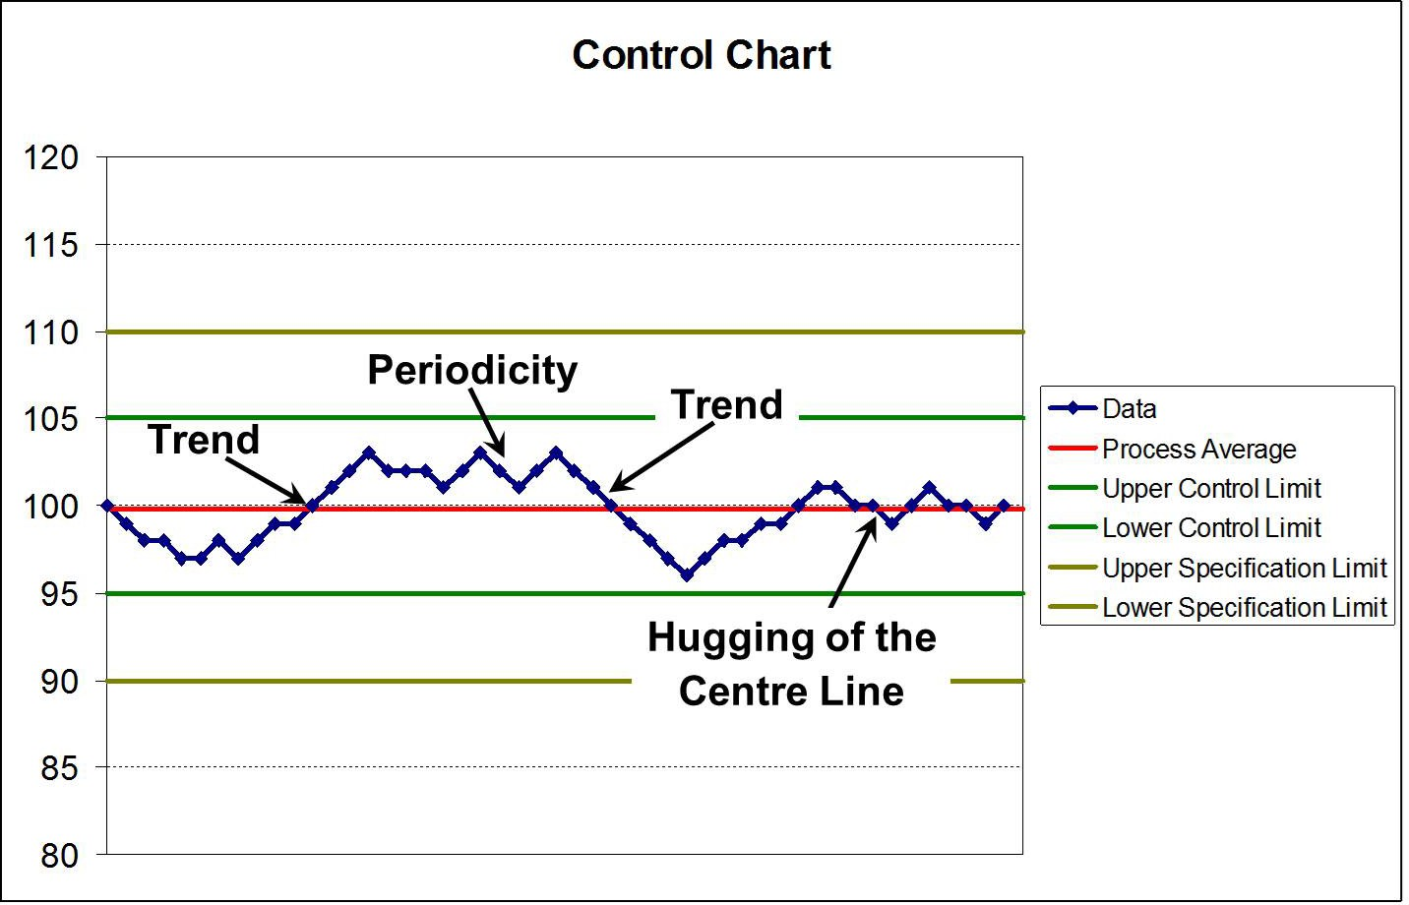
Project Management
Project Quality Management Plan Quality
Control Charts

Slide 17
Project Management
Project Quality Management Plan Quality
Plan Quality Outputs
Quality Management Plan:
Describes how the PM team will implement the Quality Policy
QM Plan is an input to the overall PM Plan
Quality Metrics:
An Operational Definition that describes, in very specific terms, what something is and how the quality control process measures it.
Quality Checklists:
A structured tool used to verity that a set of required steps has been performed, very common in H&S

Slide 18
Project Management
Project Quality Management Plan Quality
Plan Quality
Outputs
Process Improvement Plan:
Subsidiary of the PM Plan
Details Steps for Analysing Processes that will facilitate the identification of waste and non-value added activity.
Project Document Updates
As per book

Slide 19
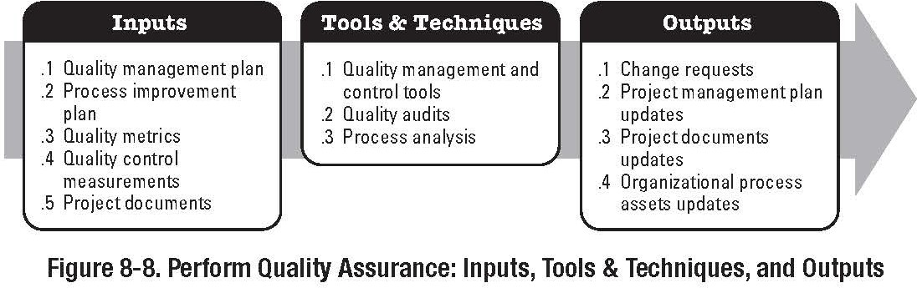
Project Management
Project Quality Management Plan Quality
Perform Quality Assurance
Part of the Executing Process Group

Slide 20
Project Management
Project Quality Management Plan Quality
Perform Quality Assurance
Quality Assurance is the application of planned, systematic quality activities to ensure that the project will employ all processes needed to meet requirements.
Quality Assurance is about implementing systems and procedures that will lead to fulfilment of project objectives and deliverables.

Slide 21
Project Management
Project Quality Management Plan Quality
Perform Quality Assurance Inputs
Project Management Plan Quality Plan, etc. refer to book Process Improvement Plan
Quality Metrics
Already covered, refer to book
Work Performance Information
Work Performance Information including technical performance measures, project deliverable status, required corrective actions, performance reports, etc. EVMS yields performance information in relation to costs and schedules

Slide 22
Project Management
Project Quality Management Plan Quality
Perform Quality Assurance
Inputs
Quality Control Measurements
Results of the Quality Control Activities.
Results are fed back into fed back into the QA process to determine the success of Corrective Actions, and to determine if changes to the QA process are successful

Slide 23
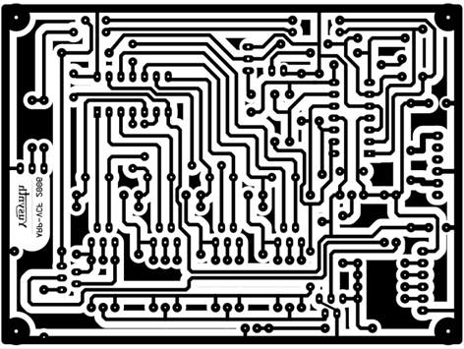
Project Management
Project Quality Management Plan Quality
Perform Quality Assurance Tools and Techniques
The tools and techniques for quality planning can be applied to quality assurance
Quality Audits:
Structured, independent review to determine whether project activities comply with organisational and project policies, processes and procedures. for instance Reuters PCB Quality policy required that tracks on PCB’s should could only change direction in two 45◦ steps.

Slide 24
Project Management
Project Quality Management Plan Quality
Perform Quality Assurance
Tools and Techniques
Process Analysis
Process Analysis follows the steps outlined in the process improvement plan to identify needed improvements from an organisational and technical standpoint
Most Business Processes could be improved by analysis Purchase Order Processing; value under e1000.00 Technical Processes can be more difficult to analyse Includes Root Cause Analysis etc.

Slide 25
Project Management
Project Quality Management Plan Quality
Perform Quality Assurance
Outputs
Organisational Process Assets Updates Change Requests
Recommended Corrective Actions
Corrective Actions is an action that is recommended immediately as a result of QA audits and processes
Project Management Plan Updates Project Document Updates

Slide 26
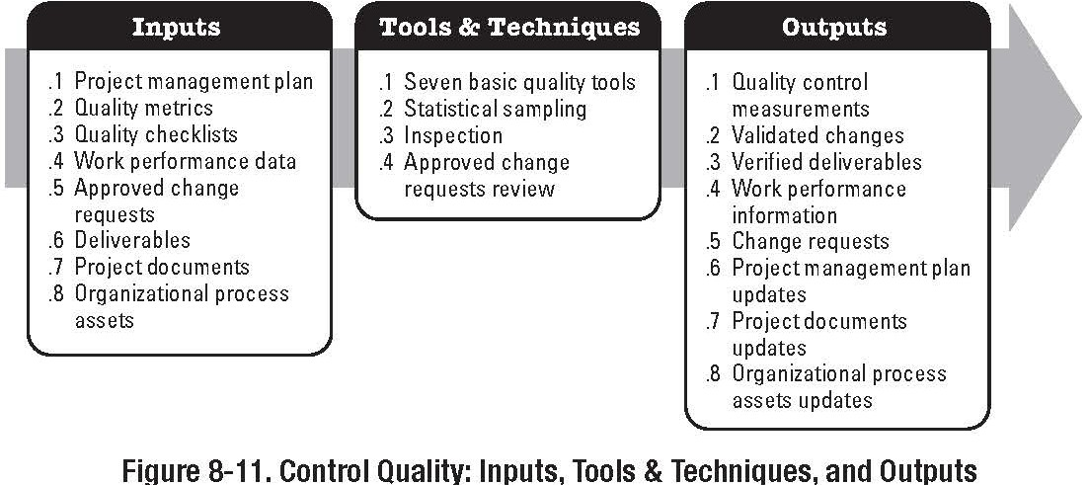
Project Management
Project Quality Management Plan Quality
Control Quality
Part of the Monitoring and Controlling Process Group

Slide 27
Project Management
Project Quality Management Plan Quality
Perform Quality Control
Quality Control involves monitoring specific project results to determine whether they comply with relevant quality standards.
Also involves identifying ways to eliminate causes of unsatisfactory results.

Slide 28
Project Management
Project Quality Management Plan Quality
Perform Quality Control
PM Team should be know the following terms:
Prevention
Keeping errors out of the process
Inspection
Keeping errors out of the hands of the customer.
Attribute Sampling
The result conforms or does not (Binary)
Variables Sampling
Result is measured on a continuous scale that measures the degree of conformity (Continuous)

Slide 29
Project Management
Project Quality Management Plan Quality
Perform Quality Control
PM Team should be know the following terms:
Special Causes
Unusual Events
Common Causes
Normal Process variation
Tolerance
The result is acceptable if it falls within the range specified
Control Limit
The process is in control if the result falls within the control limits

Slide 30
Project Management
Project Quality Management Plan Quality
Perform Quality Control
Inputs
Project Management Plan - Already Covered, refer to Book Quality Metrics - Already Covered, refer to Book
Quality Checklists - Already Covered, refer to Book Work Performance Information
Technical Performance measures, Schedule performance measures, project deliverable status, etc.
Planned versus Actuals

Slide 31
Project Management
Project Quality Management Plan Quality
Perform Quality Control
Inputs
Approved Change Requests: Change Control System
Applies to processes and product Deliverables
Organisational Process Assets - Already Covered, refer to Book

Slide 32
Project Management
Project Quality Management Plan Quality
Perform Quality Control Tools and Techniques
Cause and effect diagram Control Charts Flowcharting
Histogram Pareto Chart Run Chart Scatter Diagram
Statistical Sampling Inspection
Approved Change Request Review

Slide 33
Project Management
Project Quality Management Control Quality
Control Quality
Part of the Monitoring and Controlling Process Group

Slide 34
Project Management
Project Quality Management Control Quality
Perform Quality Control
Tools and Techniques
Cause and effect diagram ✓
Control Charts Flowcharting Histogram Pareto Chart
Run Chart / Trend Analysis Scatter Diagram
Statistical Sampling Inspection
Defect Repair Review

Slide 35
Project Management
Project Quality Management Control Quality
Control Charts

Slide 36
Project Management
Project Quality Management Control Quality
Trends
Trend
If there is a continued rise or fall in a series of points, this pattern is called a trend.
In general, if 7 consecutive points rise or fall, there is an abnormality.
Periodicity
Points that show the same pattern of change (rise or fall) over equal intervals
Hugging of the Centre Line
Points that are close to the central line, or to a control limit, are said to hug the line
Can be indicative of a process abnormality if there is a bias.

Slide 37
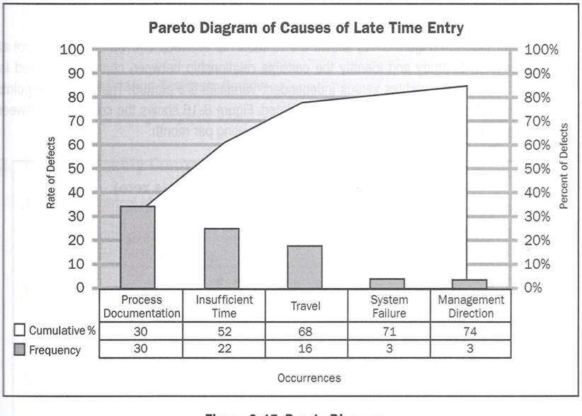
Project Management
Project Quality Management Control Quality
Pareto Diagram
A Pareto Diagram is a specific type of histogram that is ordered by frequency of occurrence. Organising the data in this way prioritizes the actions required to reduce non-conformance.

Slide 38
Project Management
Project Quality Management Control Quality
Pareto Analysis
There are 3 types of Pareto Analysis: Basic
Comparative Weighted
Basic Pareto Analysis
Identifies the vital few contributors that account for most non-conformances
Comparative Pareto Analysis
Combines two or more Pareto Charts for the same process variable for comparison
Weighted Pareto Analysis
Applies a level of significance to other factors such as time, cost, and criticality.

Slide 39
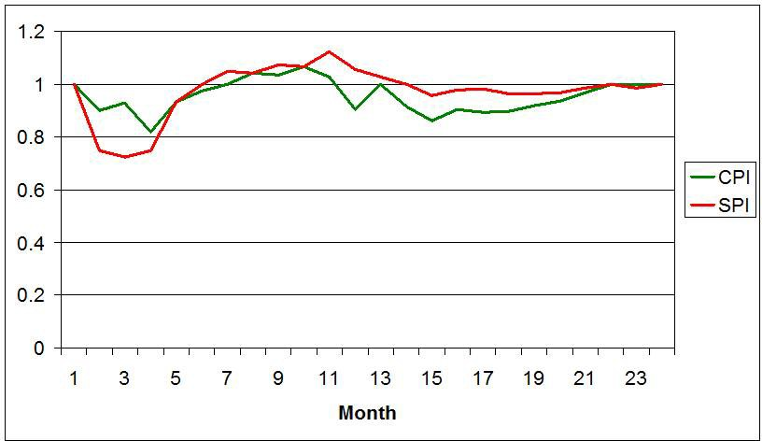
Project Management
Project Quality Management Control Quality
Run Chart
Trend Analysis is performed using Run Charts

Slide 40
Project Management
Project Quality Management Control Quality
Run Chart & Trend Analysis
Run Chart shows: History
Pattern of Variation
Run Charts show trends in processes over time.
Trend Analysis involves using mathematical techniques to forecast future outcomes based on historical results.

Slide 41
Project Management
Project Quality Management Control Quality
Trend Analysis
Trend Analysis is a statistical method for determining the equation that best fits the data in a scatter plot or scatter diagram.
Trend Analysis quantifies the relationships of the data, determines the equation and measures the fit of the equation to the data, e.g. Curve Fitting.
One of the most important aspects of trend analysis is that it can be used for forecasting

Slide 42
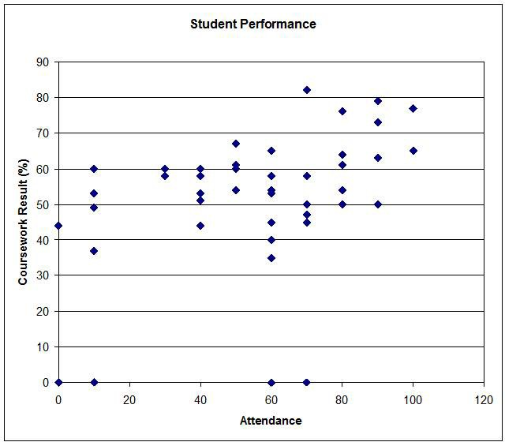
Project Management
Project Quality Management Control Quality
Scatter Diagram - Student Performance

Slide 43
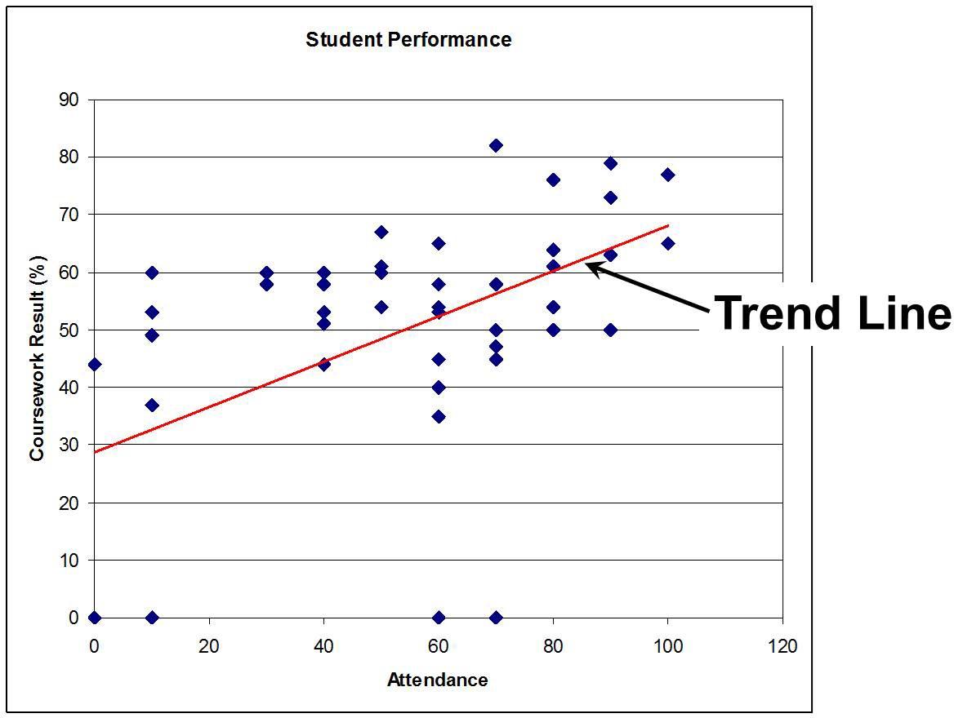
Project Management
Project Quality Management Control Quality
Student Performance - Trend Line

Slide 44
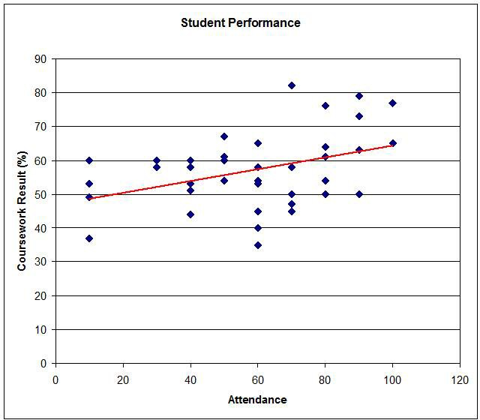
Project Management
Project Quality Management Control Quality
Scatter Diagram - Outliers Removed

Slide 45
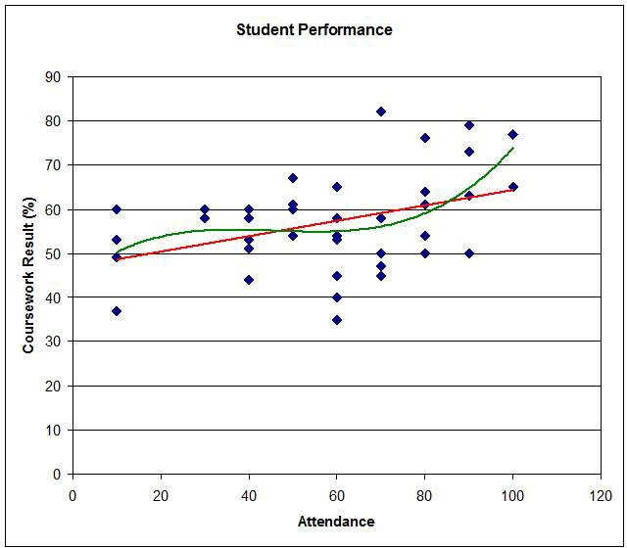
Project Management
Project Quality Management Control Quality
Scatter Diagram - Polynomial

Slide 46
Project Management
Project Quality Management Control Quality
Scatter Diagram
Scatter diagrams organise data using two variables An input (or independent) variable
An output (or dependant) variable
The relationship between variables fall into several categories: Positive correlation (Student Performance.)
Negative correlation Curvilinear correlation No correlation

Slide 47
Project Management
Project Quality Management Control Quality
Statistical Sampling
Often it is impractical or impossible to inspect all incoming or outgoing materials or products.
In these instances it is more practical to randomly select a smaller number of items and test for conformance. This is known as acceptance sampling
If the sample set passes, then the lot is accepted If the sample set fails, the entire lot is rejected

Slide 48
Project Management
Project Quality Management Control Quality
Statistical Sampling
Common Sampling plans:
Single Sampling - Lot is accepted or rejected based on one sampling run
Double Sampling - A small sample size is tested. If the results are not conclusive, a second sample is tested
Multiple Sampling - Several small lots are sampled
Sampling errors can occur:
An acceptable lot can be rejected
An unacceptable lot can be accepted

Slide 49
Project Management
Project Quality Management Control Quality
Inspection
Inspection is the examination of a work product to determine whether it conforms to standards.
Typically involves the selection and measurement of specific characteristics.
For instance timber:
Type Size Warp Finish

Slide 50
Project Management
Project Quality Management Control Quality
Defect Repair Review
Action taken to ensure that product defects are repaired and brought into compliance with requirements or specifications

Slide 51
Project Management
Project Quality Management Control Quality
Perform Quality Control Outputs
Quality Control Measurements
Measurements that are fed back into the Quality Assurance Process
Validated Changes
Re-inspection after repair; results in either acceptance or rejection
Validated Deliverables
Validation that project deliverables conform to requirements.
Organisational Process Assets Updates
Completed Checklists
Lessons Learned Documentation

Slide 52
Project Management
Project Quality Management Control Quality
Perform Quality Control Outputs
Change Requests
Recommended Corrective and Preventative Actions must be sent through the Integrated Change Control Process
May be actions taken as a result of QC measurements
Recommended Defect Repair
Repair required to address a non-conformance
Project Management Plan Updates Quality Management Plan Process Improvement Plan
Project Document Updates
Quality Standards, Procedures, Test Specs, etc.

