Slide 1
Project Human Resource Management
Project Management
Paul Vesey
Limerick Institute of Technology
paul.vesey@lit.ie
Spring 2020
1 / 71

Slide 2
Project Management
Project Human Resource Management Introduction
Project HRM
Project HRM includes the processes to organise and manage the Project Team.
The Project Management Team is a subset of the Project Team.
The Project Management Team are responsible for:
Planning Controlling Closing
The Project Sponsor works with the Project Management Team.
1 / 71

Slide 3
Project Management
Project Human Resource Management Introduction
Project HRM
The Project HRM processes are:
Develop Human Resource Plan
Identifying and documenting project roles, responsibilities, and reporting relationships, as well as creating the staffing management plan
Acquire Project Team
Obtaining the human resources required to complete the project.
Develop Project Team
Improving Competencies and interactions of team members to enhance project performance
Manage Project Team
Tracking team member performance, providing feedback, resolving issues, and coordinating changes to enhance project performance
1 / 71

Slide 4
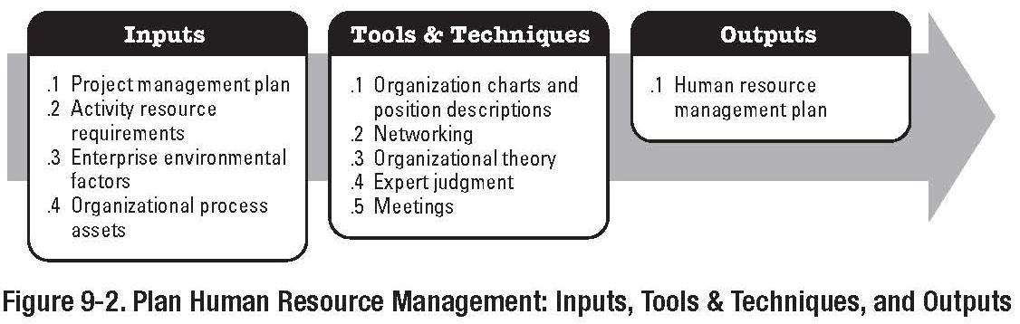
Project Management
Project Human Resource Management Develop HR Plan
Develop Human Resource Plan
Part of the Planning Process Group
1 / 71

Slide 5
Project Management
Project Human Resource Management Develop HR Plan
Develop HR Plan
HR Planning determines: Project Roles Responsibilities Reporting Relationships
Staffing Management Plan
Project Roles can be for persons or groups
Staffing Management Plan typically details when resources will be required and where they will come from - Staff, Contract, Subcontractor, etc.
1 / 71

Slide 6
Project Management
Project Human Resource Management Develop HR Plan
Staffing Management Plan
Records Details of:
When Resources will be required. Where they will come from.
Staff, Contract, Subcontractor, etc.
Criteria for release from the project.
Deliverables achieved, Project Complete, Task Complete, etc.
Training Needs.
Will resources require specific training before embarking on the project?
Other Criteria.
Background checks?
1 / 71

Slide 7
Project Management
Project Human Resource Management Develop HR Plan
Staffing Management Plan
Records Details of:
Plans for Recognition and Reward. Safety Issues.
Impact of the Staffing Management Plan on the Organisation.
Critical for SME’s. If all resources are being tied up on one project, then how does this effect other projects?
1 / 71

Slide 8
Project Management
Project Human Resource Management
Develop HR Plan
Develop HR Plan Inputs
Enterprise Environmental Factors:
Organisational
Which Departments? What are their working arrangements? What formal or informal relationships do they have?
Technical
What disciplines are needed for the project? Systems Engineering?
Interpersonal
Reporting relationships; Supplier-Customer Relationships; Cultural issues?; Trust and Respect..
Logistical
Where are people in relation to each other and the work?
Political
Individual and Group Politics
A good PM is usually a politician, whether they like it or not.. Q
8 / 71

Slide 9
Project Management
Project Human Resource Management Develop HR Plan
Develop HR Plan Inputs
Enterprise Environmental Factors (cont)
Organisational Structure
Functional, Weak Matrix, Strong Matrix, etc. Refer to early lectures
Collective Bargaining Agreements
Contractual agreements with Unions or other employees. Will there be issues of Demarcation?
Economic Conditions
Internal; Training Fund; Recruitment Freeze (HSE since September ’07)
External; Competition, Economic Environment, etc.

Slide 10
Project Management
Project Human Resource Management Develop HR Plan
Develop HR Plan Inputs
Organisational Process Assets
Historical Information - Lessons Learned Templates
Organisation Structures Job Descriptions Performance Appraisals Employee Voice Systems
Conflict Management Systems
Checklists
Typical Competencies
Safety Considerations, Tax Clearance Certs, etc. Safe Pass
Insurance
Vetting (South Midland Construction)

Slide 11
Project Management
Project Human Resource Management Develop HR Plan
Develop HR Plan
Inputs
Activity Resource Requirements:
Resource Type and Quantity can be determined from:
WBS
Parametric Estimating Etc.

Slide 12
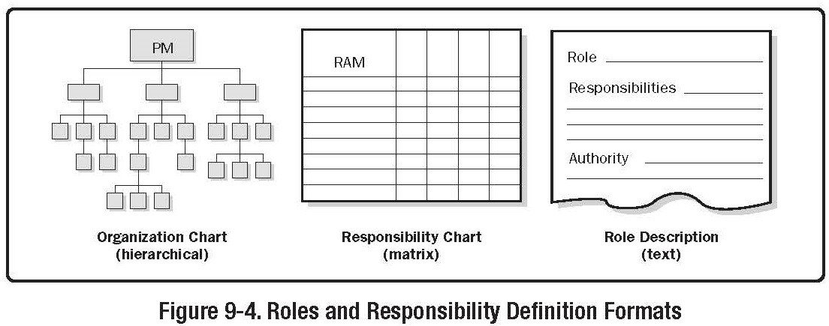
Project Management
Project Human Resource Management Develop HR Plan
Develop HR Plan Tools and Techniques
Organisational Charts and Position Descriptions.
Typically 3 types:

Slide 13
Project Management
Project Human Resource Management Develop HR Plan
Develop HR Plan
Hierarchical-Type
Typical Organisational Chart
Organisational Breakdown Structure
Top-Down Format
Those at the bottom tend not to like it..
Resource Breakdown Structure
Breaks down resources according to skills and competencies

Slide 14
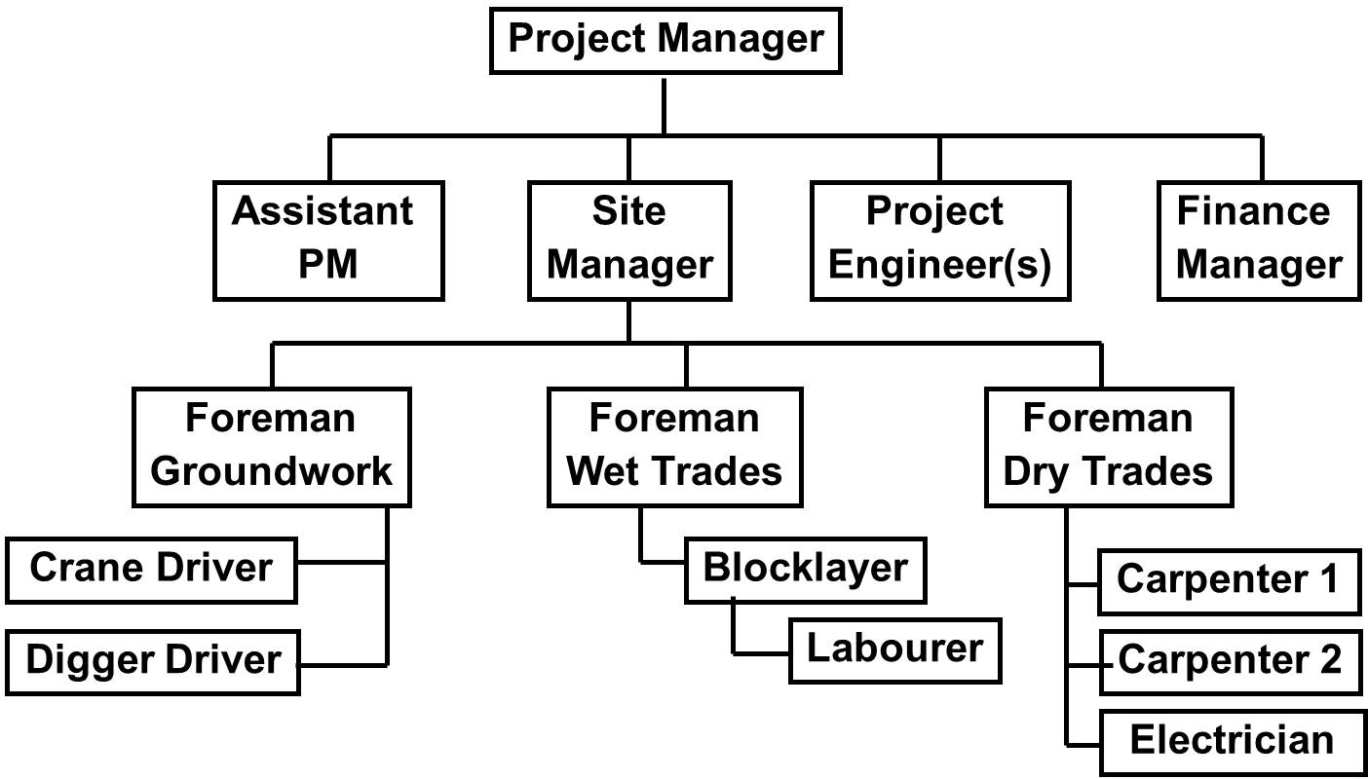
Project Management
Project Human Resource Management Develop HR Plan
Organisational Breakdown Structure

Slide 15
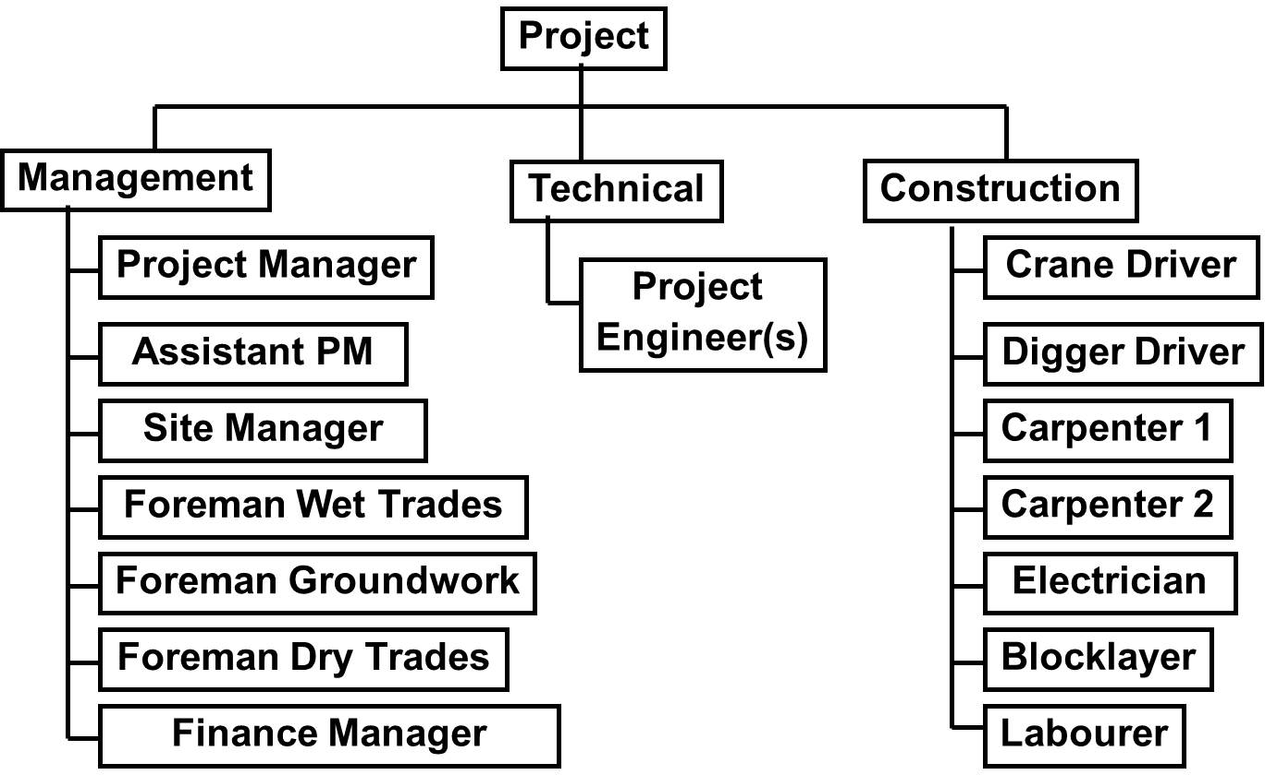
Project Management
Project Human Resource Management Develop HR Plan
Resource Breakdown Structure

Slide 16
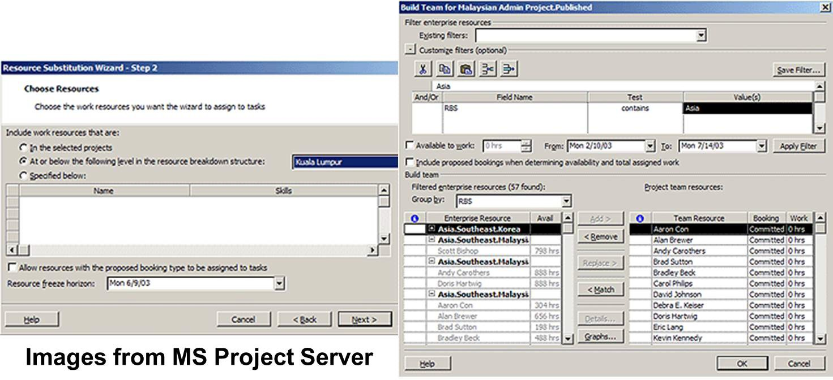
Project Management
Project Human Resource Management Develop HR Plan
RBS and Project Management Software
More sophisticated PM Software, such as Primavera and MS Project Server will include RBS functionality.
Note that Standard MS Project does not include RBS functionality

Slide 17
Project Management
Project Human Resource Management Develop HR Plan
RBS - Further Information
RBS (MS Project Server)
Databases allow greater information to be stored:
Skills Availability Location
Responsibility Level Etc.

Slide 18
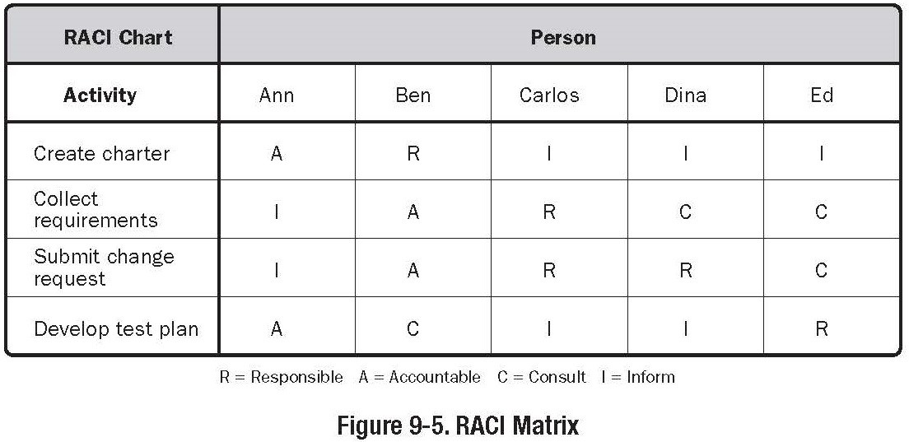
Project Management
Project Human Resource Management Develop HR Plan
Matrix Charts
Responsibility Assignment Matrix
Illustrates the connection between the work required from the WBS and who will be responsible for it from the OBS or RBS

Slide 19
Project Management
Project Human Resource Management Develop HR Plan
Matrix Charts
RACI Responsibility Assignment Matrix Responsible - Responsible for Task Accountable - To whom ‘R’ is Accountable
Consult - Has capability and/or information necessary to perform the work
Inform - Must be notified of results, but does not need to be consulted

Slide 20
Project Management
Project Human Resource Management Develop HR Plan
Typical Process to Generate an RACI Chart:
Identify all of the activities involved in the project (WBS!)
Identify all roles necessary to complete the project.
Identify who will satisfy R, A, C, I for each task
In general only one person or group should be assigned as ‘Responsible’
Resolve overlaps and gaps Overlap; more than one R Gap; no R, no A, etc.

Slide 21
Project Management
Project Human Resource Management Develop HR Plan
Develop HR Plan Tools and Techniques
Organisation Charts and Position Descriptions
Text Orientated Formats
Usually an outline form.
Provides information such as responsibility, authority, competencies, and qualifications.
Good for capturing lessons learned information.
Networking
Organisation Theory
Information regarding the ways people, teams and organisational units behave such as the Hawthorne Studies, Maslow, Theory X-Theory Y, etc.

Slide 22
Project Management
Project Human Resource Management Develop HR Plan
Develop HR Plan
Outputs
Human Resource Plan Roles and Responsibilities
Role Authority Responsibility Competency
Project Organisation Charts Staffing Management Plan
Staff Acquisition Timetable Release Criteria Training Needs
Recognition and Rewards Compliance and Safety

Slide 23
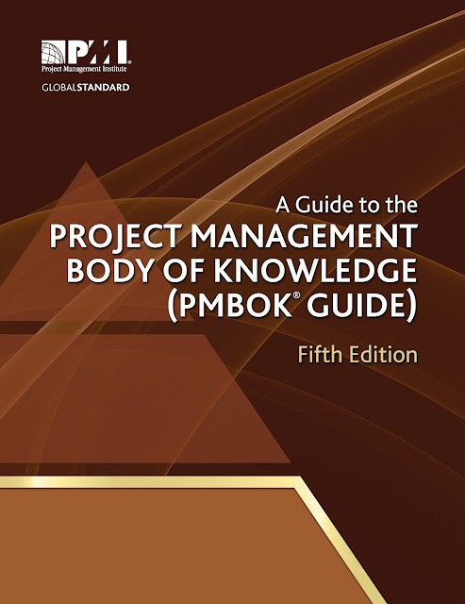
Project Management
Project Human Resource Management Develop HR Plan
Next Lecture Reading:
‘A Guide to the Project Management Body of Knowledge’ Chapter 9

Slide 24
Project Management
Project Human Resource Management HR Planning
HR Planning Outputs
Roles and Responsibilities
Role: Label describing the portion of the project for which an individual is responsible
Authority: Authority to apply project resources, make decisions, and sign approvals
Responsibility: Work that a PM team member is expected to perform in order to complete the project’s activities
Competency: Skill and Capacity required to complete project objectives

Slide 25
Project Management
Project Human Resource Management HR Planning
HR Planning Outputs
Responsibility and Authority are not the same thing
Individuals will perform best when they responsibility and authority are matched.
Responsibility / Authority miss-match is very common. How many times have you experienced either:
Someone’s decision/instructions being reversed or changed?
Someone having to constantly respond with ‘I need approval from X before I can give you the go-ahead’

Slide 26
Project Management
Project Human Resource Management HR Planning
HR Planning Outputs
Project Organisation Charts
Graphic Representation of project team members and their reporting relationships which are usually included in H&S Plan, Quality Plans, etc.

Slide 27
Project Management
Project Human Resource Management HR Planning
HR Planning Outputs Staffing Management Plan
Staff Acquisition:
Where will staff come from; Subcontract, Direct Staff, Contract Staff
Proximity; Do staff need to be in the same location? Not always the case; does QS or Engineer need to be on site all, day every day?
HR Department; Can HR Department assist in staffing the project?
Timetable; When will staff be required. When will acquisition (recruitment) have to start in order to meet requirements?

Slide 28
Project Management
Project Human Resource Management
HR Planning
HR Planning Outputs Staffing Management Plan
Release Criteria:
Method and Timing for release of staff.
Method: Milestone, Time based, Task based, etc.
Timing: Need to consider how individuals are transferred to other projects.
Training Needs:
What training staff will be required to undertake
Recognition and Rewards:
Clear reward structure; ideally aligned with the individuals performance on the project
Compliance:
Strategies to comply with Government Regulations Construction Worker Pension Scheme (Supreme Court Ruling 9th May 2013)
Safety Policies and Procedures that protect staff from
hazards
28 / 71

Slide 29
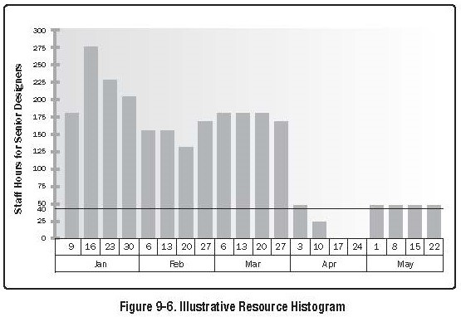
Project Management
Project Human Resource Management HR Planning
Resource Histogram
Details quantity and timing of resources. Does not detail skill level.

Slide 30
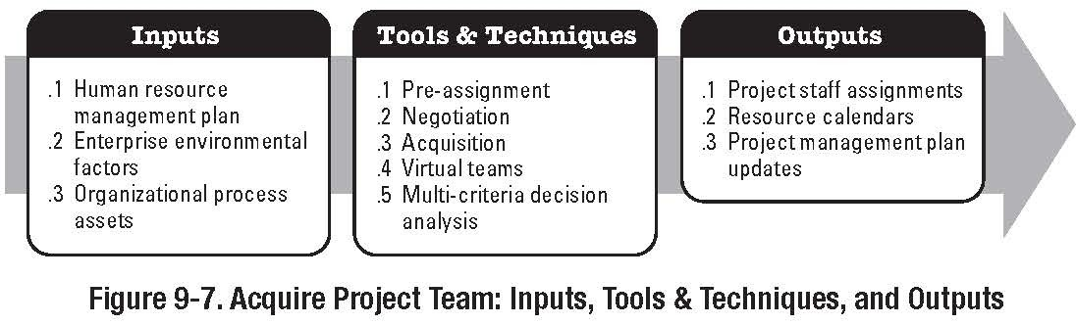
Project Management
Project Human Resource Management HR Planning
Acquire Project Team Part of the Planning Process Group

Slide 31
Project Management
Project Human Resource Management HR Planning
Acquire Project Team
Inputs
Process of obtaining the resources required to complete the project
Enterprise Environmental Factors:
Availability Ability Experience Interests Cost

Slide 32
Project Management
Project Human Resource Management HR Planning
Acquire Project Team Inputs
Organisational Process Assets
HR Department
Policies and Procedures in relation to staff; Disciplinary procedures, Annual Leave, etc.
Roles and Responsibilities
Definition of positions, competencies, skills etc.
Project Organisation Chart
Refer to book and earlier notes
Staffing Management Plan
Refer to book and earlier notes

Slide 33
Project Management
Project Human Resource Management HR Planning
Acquire Project Team
Tools and Techniques
Pre-Assignment:
Team Members, particularly senior staff, may have been allocated to the project at tender stage, and/or may have been a included as part of the tender proposal.
Very common on Construction Projects; Usual get-out is a provision somewhere in the tender that states that the staff are ‘indicative’.
Need to be very careful; can lead to a tender being deemed non-compliant.

Slide 34
Project Management
Project Human Resource Management HR Planning
Acquire Project Team Tools and Techniques
Negotiations
Organisation Structure;
Functional organisation; PM will have to negotiate with Functional Managers in order to obtain staff.
Competition from other PM teams within the organisation.
Acquisition
Source resource from outside organisation: Recruit; Hire Consultant; etc.
Virtual Teams: Groups of people with shared goals who fulfil their roles with little or no time spent meeting face to face. Most Construction Contract Management Teams.

Slide 35
Project Management
Project Human Resource Management
HR Planning
Acquire Project Team Outputs
Project Staff Assignments
Project is staffed when appropriate people have been assigned to work on it.
Resource Availability
Documents the time period that each team member can work on the project.
Very difficult in most environments; often availability issues lead to project delays.
Staffing Management Plan (Updates)
People seldom fit the original requirements profiles. Usually the Plan will have to be modified to fit with individuals
Over the course of the project individuals may leave the project unexpectedly; promotion, annual leave, resignation, etc.
35 / 71

Slide 36
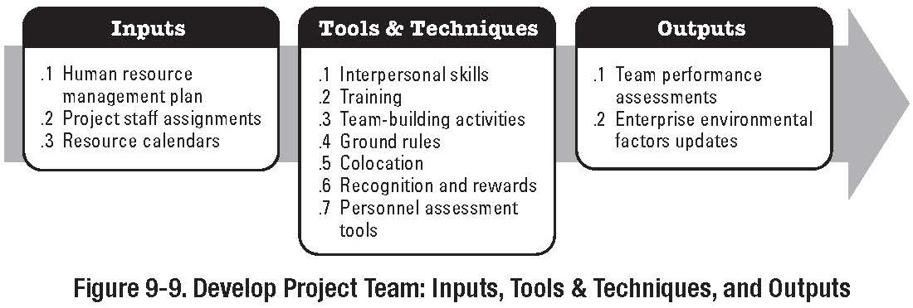
Project Management
Project Human Resource Management HR Planning
Develop Project Team
Part of the Executing Process Group

Slide 37
Project Management
Project Human Resource Management HR Planning
Develop Project Team Objectives:
Improve skills of Team Members.
Improve feelings of trust and cohesiveness among team members.
Construction Sector is notoriously bad at this, evidenced by the levels of conciliation, arbitration, etc.
Best accomplished at the start of the project
Group Dynamics Bruce Tuckman 1965
Forming; coming together
Storming; unsettled, team members vie for position
Norming; team members adjust and moderate
Performing; team gets work done
Mourning; completion of task and break-up of team

Slide 38
Project Management
Project Human Resource Management HR Planning
Develop Project Team
Inputs
Project Staff Assignments
List of team members
Staffing Management Plan
Refer to book an previous notes
Resource Calendar
Resource availability information

Slide 39
Project Management
Project Human Resource Management HR Planning
Develop Project Team
Tools and Techniques
General Management Skills
Soft Skills
Interpersonal Skills
Understanding sentiments of project team Listening to what is being said
Understanding the individual circumstances of team members
Anticipating Likely reactions

Slide 40
Project Management
Project Human Resource Management HR Planning
Develop Project Team Tools and Techniques
Training
Training Activities designed to enhance the competencies of team members
Mentoring & Coaching becoming more popular
Team Building Exercises
On-site / Offsite / formal / informal
Designed to improve interpersonal relationships by shared experience
Needs to be treated with care; 4WD day; what if someone can’t drive?

Slide 41
Project Management
Project Human Resource Management HR Planning
Develop Project Team Tools and Techniques
Ground Rules
Clear expectation regarding individual team behaviour and expectations
Co-Location
Locating team members in the same place to enhance team performance
Not always practical for construction work.
International construction companies often locate staff in ‘ex-pat’ compounds.
Recognition and Rewards
Recognizing and Rewarding desirable behaviour
Needs to be treated with care; refer to book

Slide 42
Project Management
Project Human Resource Management HR Planning
Develop Project Team
Outputs
Team Performance Assessment
Measures of:
Improvements in skill levels
Improvements in competencies and sentiments Reduction in staff turnover rate

Slide 43
Project Management
Project Human Resource Management HR Planning
Next Lecture Reading:
‘A Guide to the Project Management Body of Knowledge’ Chapter 9

Slide 44
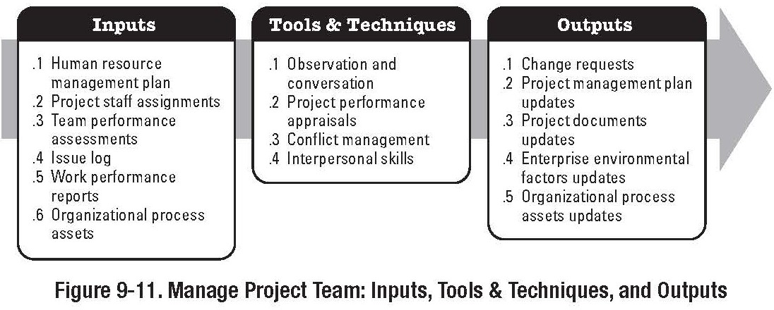
Project Management
Project Human Resource Management Manage Project Team
Manage Project Team
Part of the Monitoring and Controlling Process Group

Slide 45
Project Management
Project Human Resource Management Manage Project Team
Manage Project Team
Involves:
Tracking Team Member performance Providing Feedback
Resolving Issues Coordinating Change

Slide 46
Project Management
Project Human Resource Management Manage Project Team
Manage Project Team
Inputs
Organisational Process Assets
Organisations policies, procedures and systems for rewarding employees
Project Staff Assignments
Refer to book and previous lectures
Staffing Management Plan
Refer to book and previous lectures

Slide 47
Project Management
Project Human Resource Management Manage Project Team
Manage Project Team
Inputs
Team Performance Assessment
Formal and Informal assessment of team performance. Good PM will identify and resolve issues and potential issues early
Work Performance Information
PM team directly observes Project Team Performance: Team Member participation in meetings; Follow-up on actions; Communications; Etc.

Slide 48
Project Management
Project Human Resource Management Manage Project Team
Manage Project Team
Inputs
Performance Reports
Refer to Section 10; Project Communications Management and EVMS, Comparison between actual and planned progress, etc.

Slide 49
Project Management
Project Human Resource Management Manage Project Team
Manage Project Team
Tools and Techniques
Observation and Conversation
Keeps PM in touch with work and attitudes of project team members
Project Performance Appraisals
Formal and Informal
360 degree feedback - controversial
Re-clarification of Roles and Responsibilities
Conflict Management Issue Log

Slide 50
Project Management
Project Human Resource Management Manage Project Team
Manage Project Team
Tools and Techniques
Conflict Management:
Sources of Conflict
Scarce Resources
Scheduling Priorities
Personal Work styles
Differences of opinion can be healthy, but need to be monitored and controlled in order to avoid creating a negative atmosphere. Most conflicts amongst team members will resolve themselves. PM needs to monitor, and may have to facilitate resolution.

Slide 51
Project Management
Project Human Resource Management Manage Project Team
Manage Project Team
Tools and Techniques
Issue Log
Refers to recording project team management issues as they arise.
If using this technique, be very careful with the information recorded. A benign phrase about one person, when taken out of context, can have disastrous effects
Better to keep records to issues of unanticipated responsibilities for future ‘lessons learned’

Slide 52
Project Management
Project Human Resource Management Manage Project Team
Manage Project Team
Outputs
Change Requests
Sent through the Integrated Change Control Process Recommended Corrective Actions
Staffing Changes Additional Training Disciplinary Actions
Recommended Preventative Actions
Solve issues before they arise, may require additional training; cross training, clarification of roles, responsibility, authority, etc.

Slide 53
Project Management
Project Human Resource Management Manage Project Team
Manage Project Team
Outputs
Organisational Process Assets (Updates)
Input to organisational performance appraisals
Project Staff should be prepared to provide input for performance appraisal of any project team member with whom they interact in a significant way. Needs to be treated with caution
Lessons Learned documentation
Organisation Charts, Position Descriptions, Staffing Management Plans etc.
Project Management Plan (Updates)

Slide 54
Project Management
Project Human Resource Management Manage Project Team
Project HR Management Project Manager as a Leader
3 elements of leadership:
The person leading
The people being led
The situation (i.e. the project environment)
Democratic or Participative Leadership
PM encourages involvement in decision making
Laisse-Faire Leadership
PM turns things over to the project team..
Autocratic Leadership
PM focuses on tasks with little or no consideration for those performing the work

Slide 55
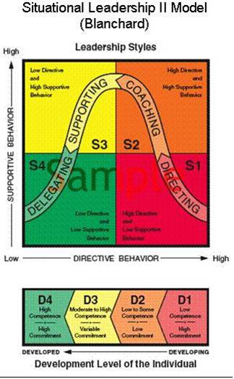
Project Management
Project Human Resource Management Manage Project Team
Blanchard - Hersey Situational Model of Leadership
Leadership style changes according to the situation and the level of subordinates competence.
Reasonable model of how good leaders actually behave.
Attributes of subordinates are considered.
Provides framework for
subordinate development.

Slide 56
Project Management
Project Human Resource Management Manage Project Team
Project HR Management Barriers to Project Team Development
Differing outlooks priorities and interests
Role Conflicts
Project objectives/outcomes unclear
Dynamic Project Environment
Competition over team leadership
Lack of team definition and structure
Credibility of project leader
Lack of team member commitment
Communications Problems
Lack of Senior Management Support
56 / 71

Slide 57
Project Management
Project Human Resource Management Manage Project Team
Project HR Management
Project Manager pitfalls
Lack of self-knowledge, ie, your own strengths and weaknesses
Activity traps
‘Means becomes the end’ rather than ‘the means to achieve the end’
Managing versus doing
Delegating work instead of doing it yourself
People versus task skills
Do you use people you get along with in preference to those who can do the task?
Ineffective communications Time Management Management bottlenecks

Slide 58
Project Management
Project Human Resource Management Manage Project Team
Project HR Management Effective Time Management
Delegate
Follow the schedule Decide fast
Decide who should attend Learn to say no
Start now
Do the tough part first
Control telephone and email time Refuse to do the unimportant

Slide 59
Project Management
Project Human Resource Management Manage Project Team
7 Habits of Highly Effective People - Steven Covey
Be Proactive
Begin with the end in mind
Put first things first
Think win-win
Seek first to understand and then to be understood
Synergize
Sharpen the saw

Slide 60
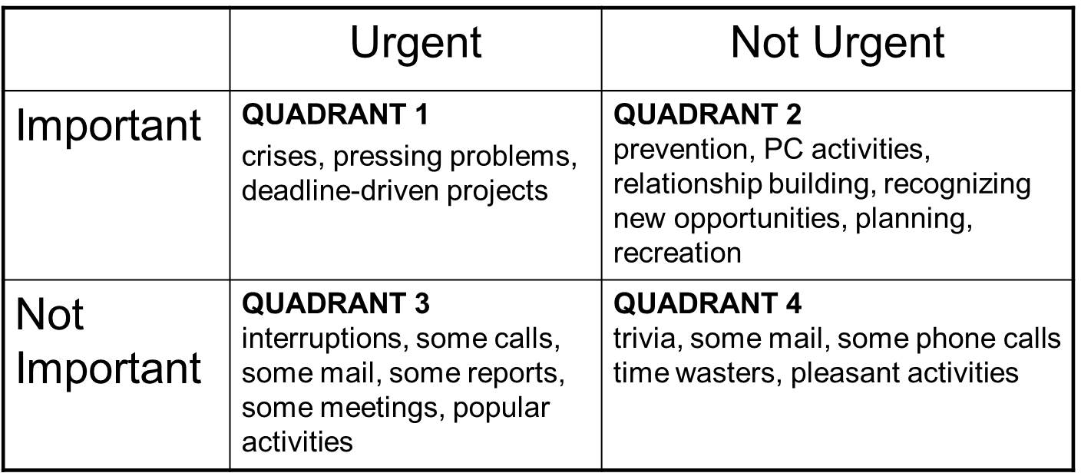
Project Management
Project Human Resource Management Manage Project Team
Habit 3 - Put first things first
The trick is to stay out of Quadrant 3 and 4.
The less time you spend in 3 & 4 the more time you have for 1 & 2.
If you work in Quadrant 2, then less activities will end up in Quadrant 1

Slide 61
Project Management
Conflict Management, Mediation, Negotiation.
Project HR Management
Management of Conflicts
Study the problem and collect all available information Develop a situational approach or methodology
Set the appropriate atmosphere or climate
Confrontation Meeting steps
Establish a willingness to participate
Analyse perceptions
Collect Information; get issues out in the open
Define and clarify all problems from both sides
Make information available to both parties
Set priorities for resolution - what is most important to resolve?
Get agreement (or otherwise) and move on
Follow up afterwards

Slide 62
Project Management
Conflict Management, Mediation, Negotiation.
Project HR Management
Conflict Minimisation Procedures
Pause and Think before reacting
Build Trust
Try to understand the conflict motives
Keep the meeting under control
Listen to all involved parties
Maintain a give and take attitude
Tactfully inform others of your view
Be willing to admit when you are wrong

Slide 63
Project Management
Conflict Management, Mediation, Negotiation.
Project HR Management Successful Mediation
Selecting the Mediator
Both parties must be comfortable and trust the mediator to act in an impartial manner
Preparation for Mediation
Do your homework; know everything you can about the issue under dispute
Commitment
Both parties need to enter mediation (conciliation) with the intension of resolving the issue
Authority to Act
Those attending the meeting must have the authority to negotiate and agree resolution
Finality
Agreement should put the issue to rest.

Slide 64
Project Management
Conflict Management, Mediation, Negotiation.
Project HR Management
Negotiation
Objectives
Win-Win (ideal)
Win-Lose (problematic)
Lose-Lose (all to often the result)
Preparation
Analyze Competition (Purchasing) Information Gathering
Setting Objectives Selecting Negotiating Team

Slide 65
Project Management
Conflict Management, Mediation, Negotiation.
Project HR Management
Negotiation
Principles of Negotiation - Persuasion Compromise - both parties concede or agree Bargaining - ‘trading’ options
Coercion - forcing other party to agree (requires power) Emotion - “I’m not comfortable with. . . ”
Logical Reasoning - building a solid case to undermine other side

Slide 66
Project Management
Conflict Management, Mediation, Negotiation.
Project HR Management
Negotiation
Principles of Negotiation
Listening
Creating an atmosphere
Seek Opportunities (Alan Sugar on Sat dishes)
Know the other side and try to understand their position Assumptions (don’t make them)
Question - get answers to assumptions!
Continually summarise current position during negotiations

Slide 67
Project Management
Conflict Management, Mediation, Negotiation.
Project HR Management
Negotiation
Negotiation Do’s
Prepare Aim high
Confirm Authority to make decisions
Maintain control - keep questioning and putting points forward
Be professional -joke, gesture, attitude, etc.

Slide 68
Project Management
Conflict Management, Mediation, Negotiation.
Project HR Management
Negotiation
Negotiation Dont’s
Give unnecessary information Assume anything
Get uncomfortable with silence (pregnant pause) Give agreement signals (nodding, etc.) Negotiate with something you don’t have

Slide 69
Project Management
Conflict Management, Mediation, Negotiation.
Project HR Management
Negotiation
Closing Down
Confirm Agreement in detail
Allow all parties closing statements
Debrief Negotiation Team (What worked, what didn’t, what to do next, etc.)

Slide 70
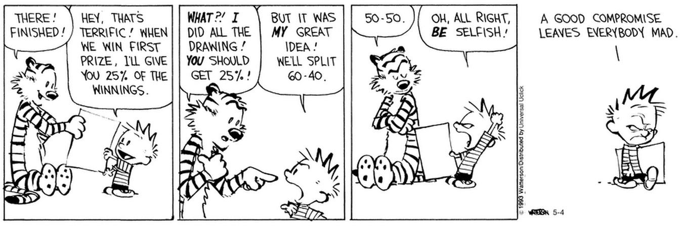
Project Management
Conflict Management, Mediation, Negotiation.
Project HR Management
Negotiation
Figure: Calvin & Hobbs - Bill Waterson

Slide 71
Project Management
Conflict Management, Mediation, Negotiation.
Next Lecture Reading:
‘A Guide to the Project Management Body of Knowledge’ Chapter 11

