Slide 1
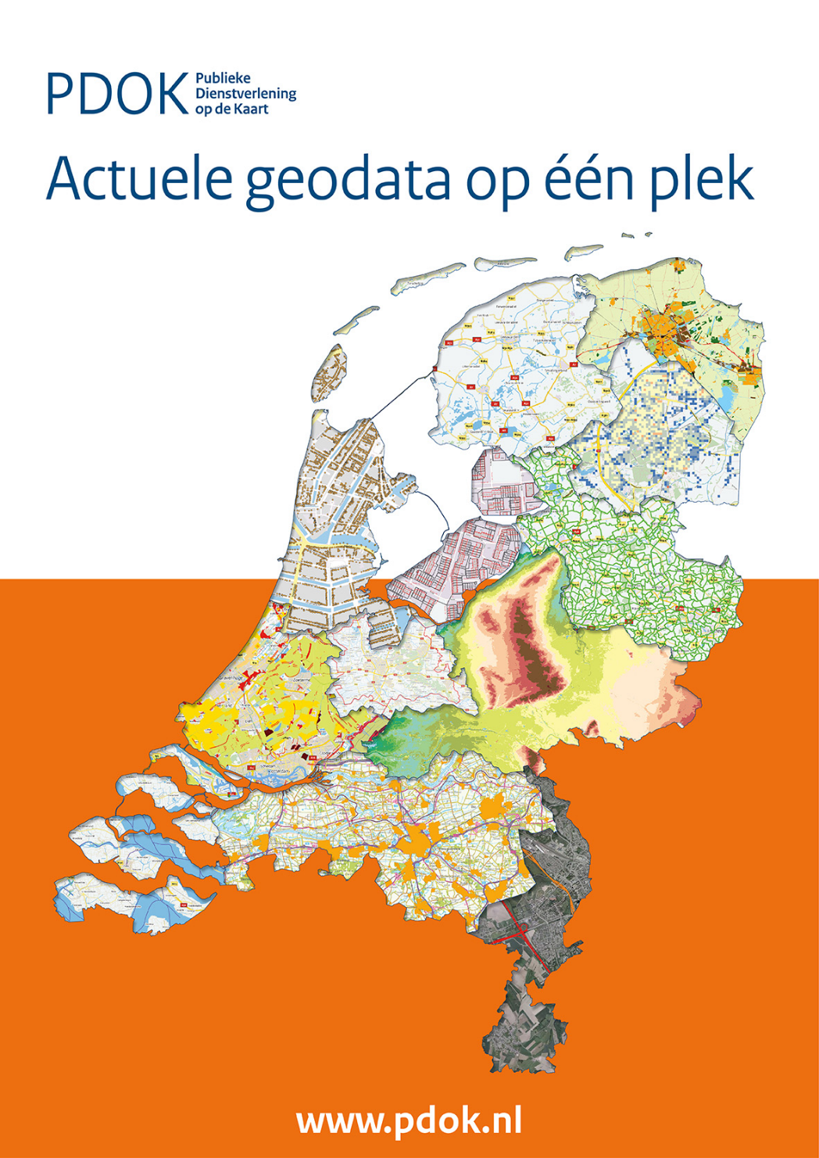
Dutch National GeoRegistry
INSPIRE conference
September 2017, Strasbourg
Nicolien Jongerius (Kadaster)
Ine de Visser (Geonovum)
Paul van Genuchten (GeoCat)
"

Slide 2
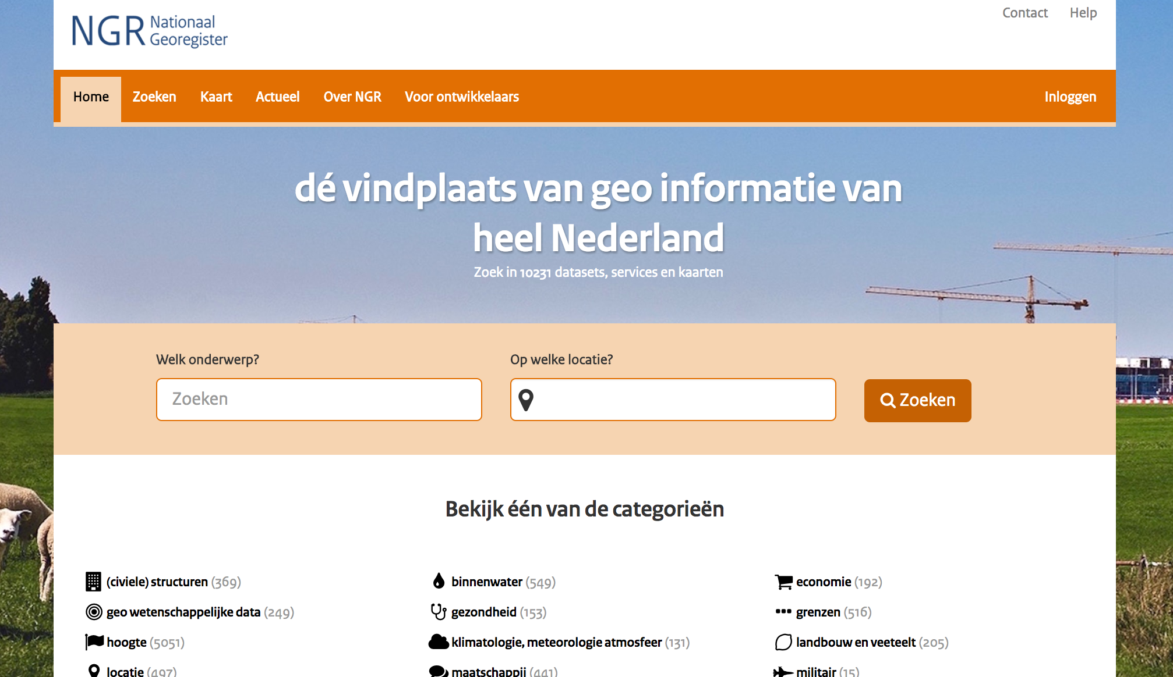
National Georegistry
National registry for geospatial datasets and services
3rd version released start of 2017
Based on GeoNetwork Opensource

Slide 3
Diagram
PDOK
Kadaster, Geonovum, Rijkswaterstaat & 2 Ministeries
Resonance group
NGR
Geonovum

Slide 4
Diagram
Various Portals
Manual registration
NGR
Search engines
Open data Portal
INSPIRE Portal

Slide 5
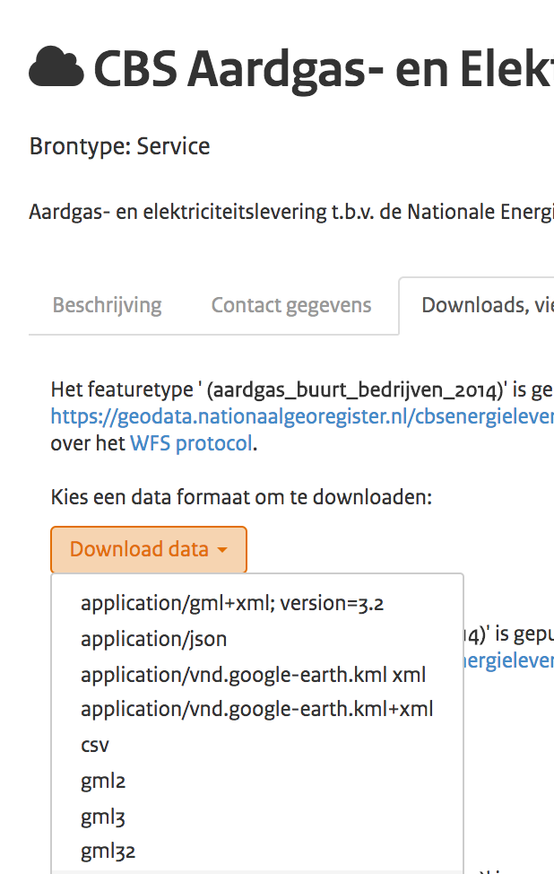
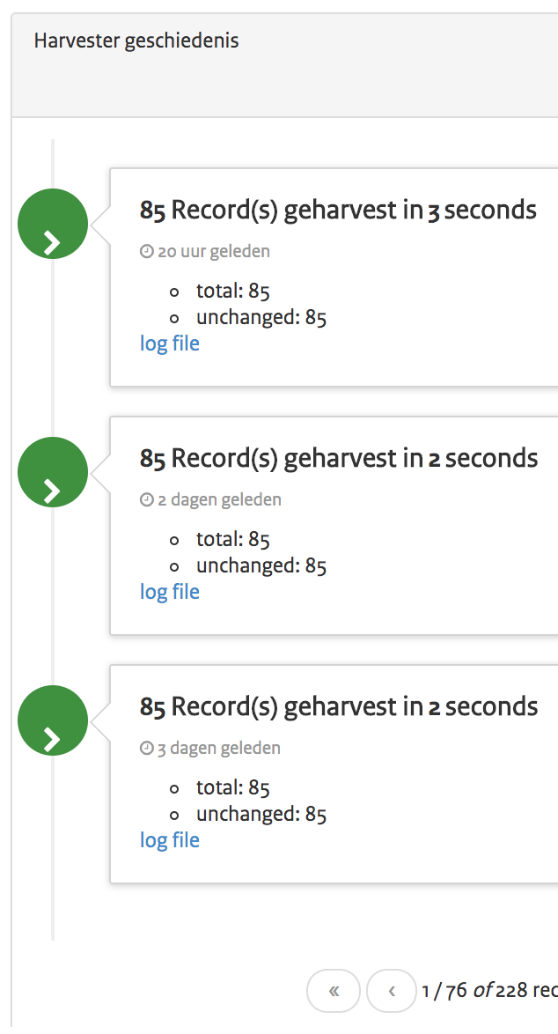
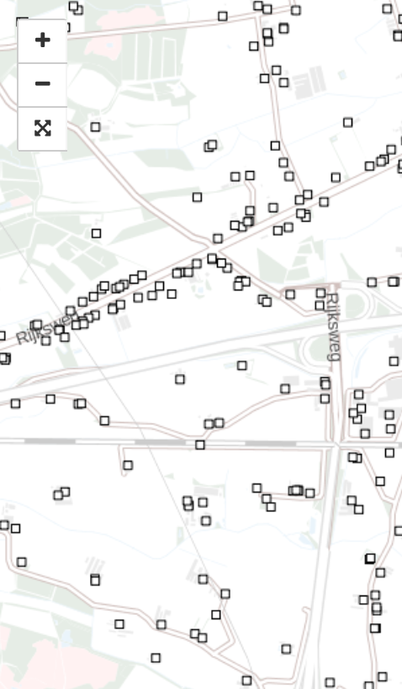
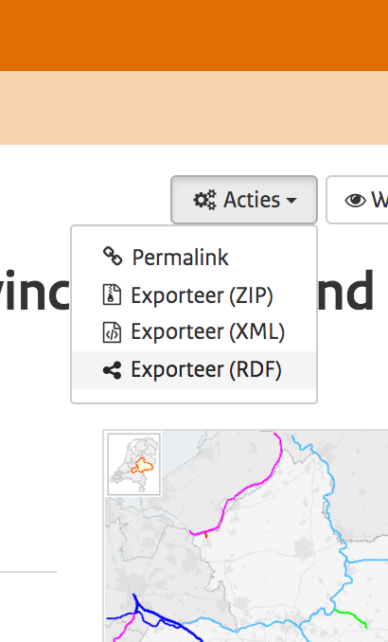
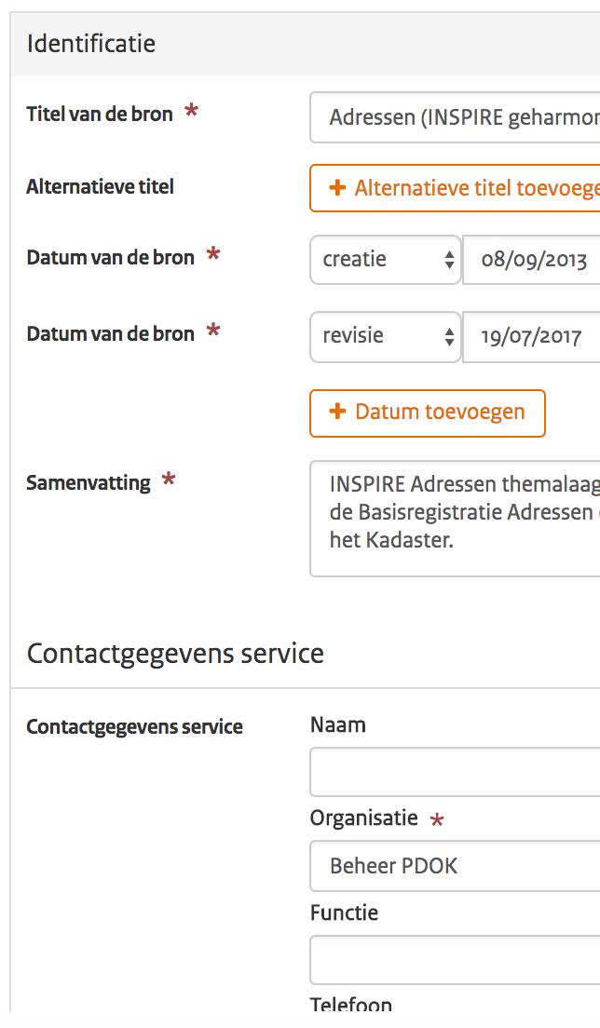
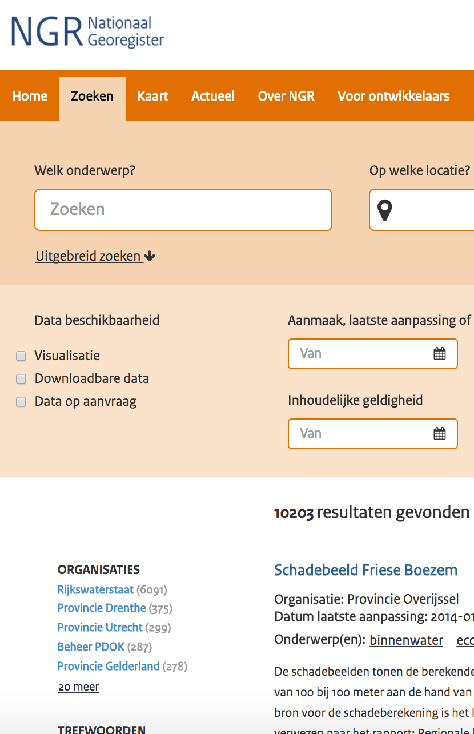
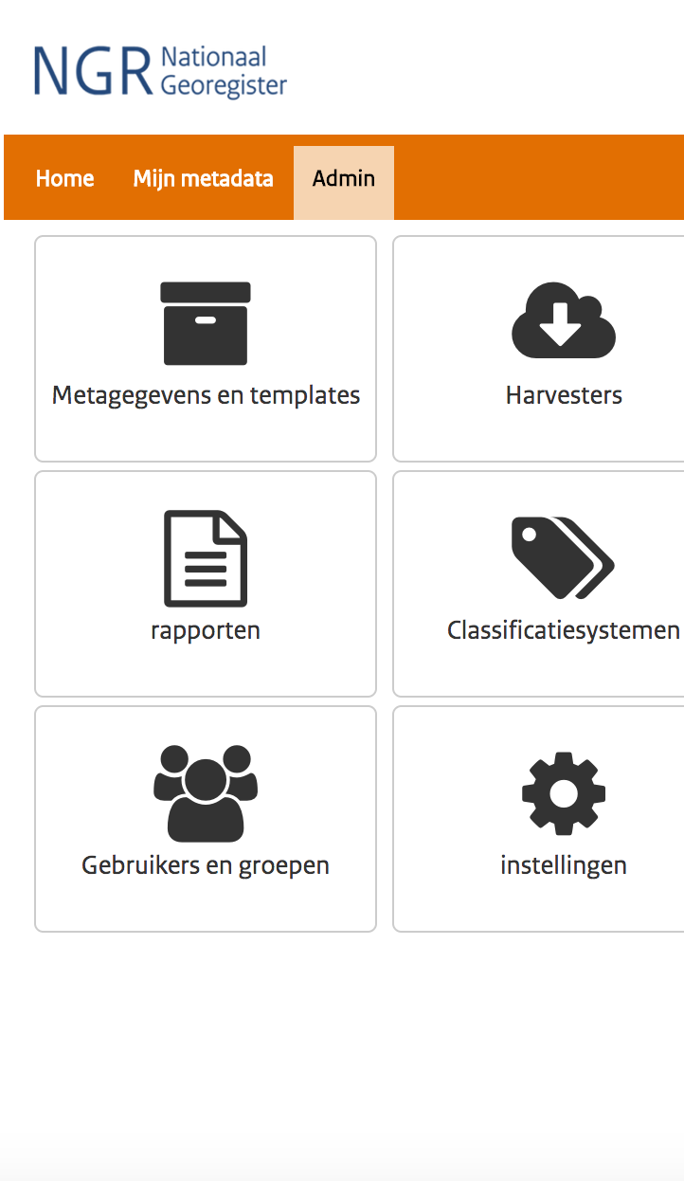
Main functionalities
Quick Search
Advanced search
Editor
Map viewer
Metadata transformation
Harvesting
Configuration management
WFS download wizard

Slide 6
Focus on Ease of Use
A design company designed a skin
Early feedback from a resonance group
Video’s with usage instructions
Basic editor with only required fields
Extract metadata from linked service capabilities

Slide 7
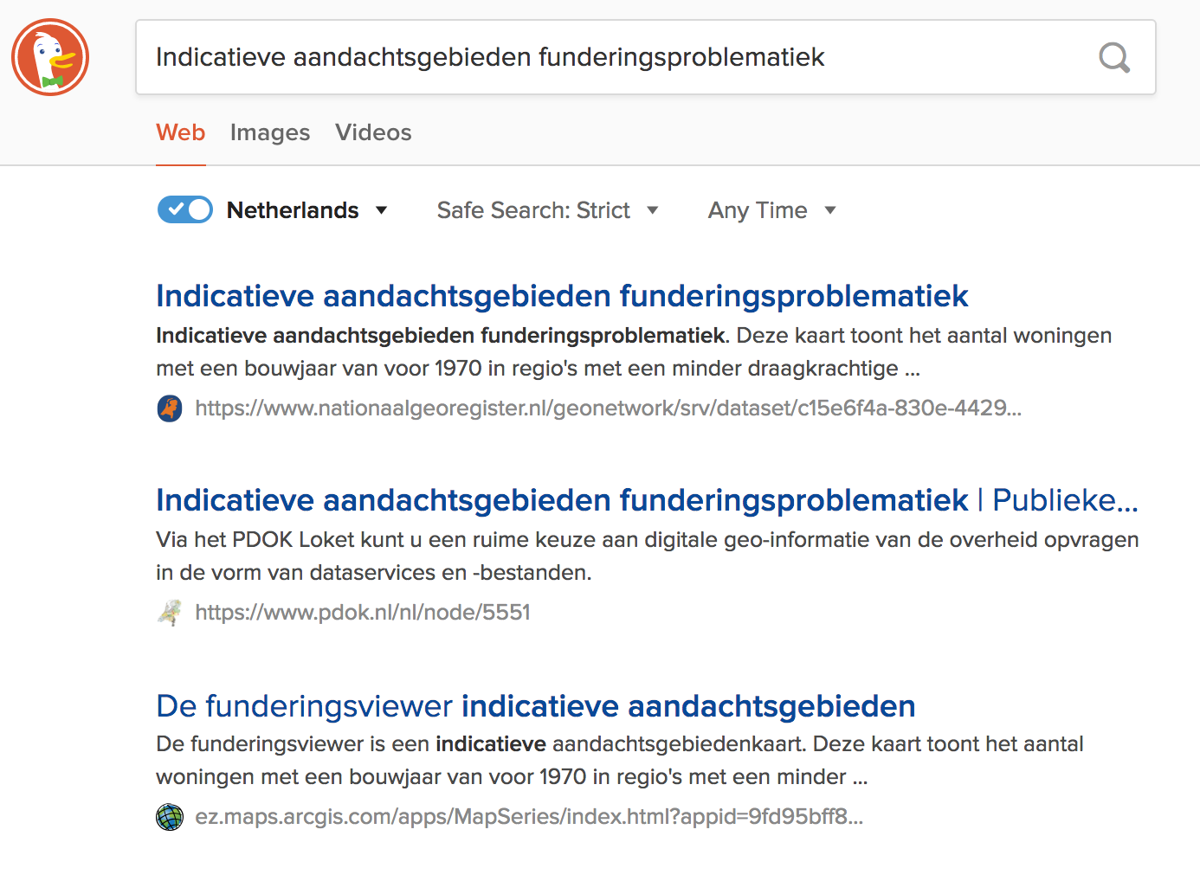
Search Engine Optimisation
GeoNetwork is not optimised for search engine spidering out of the box (sitemap, formatter)
schema.org/Dataset annotation in HTML markup

Slide 8
DCAT-ap for open data
NGR uses the Are3na ISO-to-Geo-dcat-ap conversion to provide DCAT export capabilities
Re-use minted URI’s at search engine optimisation
Looking for use cases, the open data portal currently does not support DCAT yet

Slide 9
HTTP vs HTTPS
Opening http services in a https website causes mixed content issue
Login over http is unsafe and denied by modern browsers
That’s why we run the default website on http, but when users login they are redirected to https
All parts of Dutch government should implement https by the end of this year…
If all data providers are on https, NGR can also move to https

Slide 10
Cross site Scripting
In SDI Web Clients like GeoNetwork it is quite common to open services from various domains (wms/wfs/csw/wps)
Browsers deny this as unsafe, unless the external domain provides a CORS header
A workaround is to proxy the outside traffic via the GeoNetwork server
This workaround is resource consuming and unsafe
Notify your data providers to activate the CORS header

Slide 11
2 Dutch schema profiles
A schema profile plugin is a code-plugin for GeoNetwork that enables additional validation and extraction methods related to a certain localised metadata profile
NGR introduces 2 dutch schema profile plugins, one for iso19115 (datasets) and one for iso19119 (services)
We now have very specific display, form and validator behaviour for datasets and services
Schema profile plugins are advertised at metadata101.org

Slide 12
thank you
Thank you
http://nationaalgeoregister.nl

