Slide 1
Open Source at ISRIC - World Soil Information
FOSS4G NL, Wageningen, july 2025 Paul van Genuchten

Slide 2
ISRIC - World Soil Information
Foundation funded by Dutch Government to maintain a collection of reference soil samples
Collects and harmonizes soil observation data from around the globe (WOSIS)
Predect the distribution of soil properties globally (Soilgrids)
Capacity building on soil data management at soil institutes around the globe
Participate in research projects to innovate the soil sciences

Slide 3
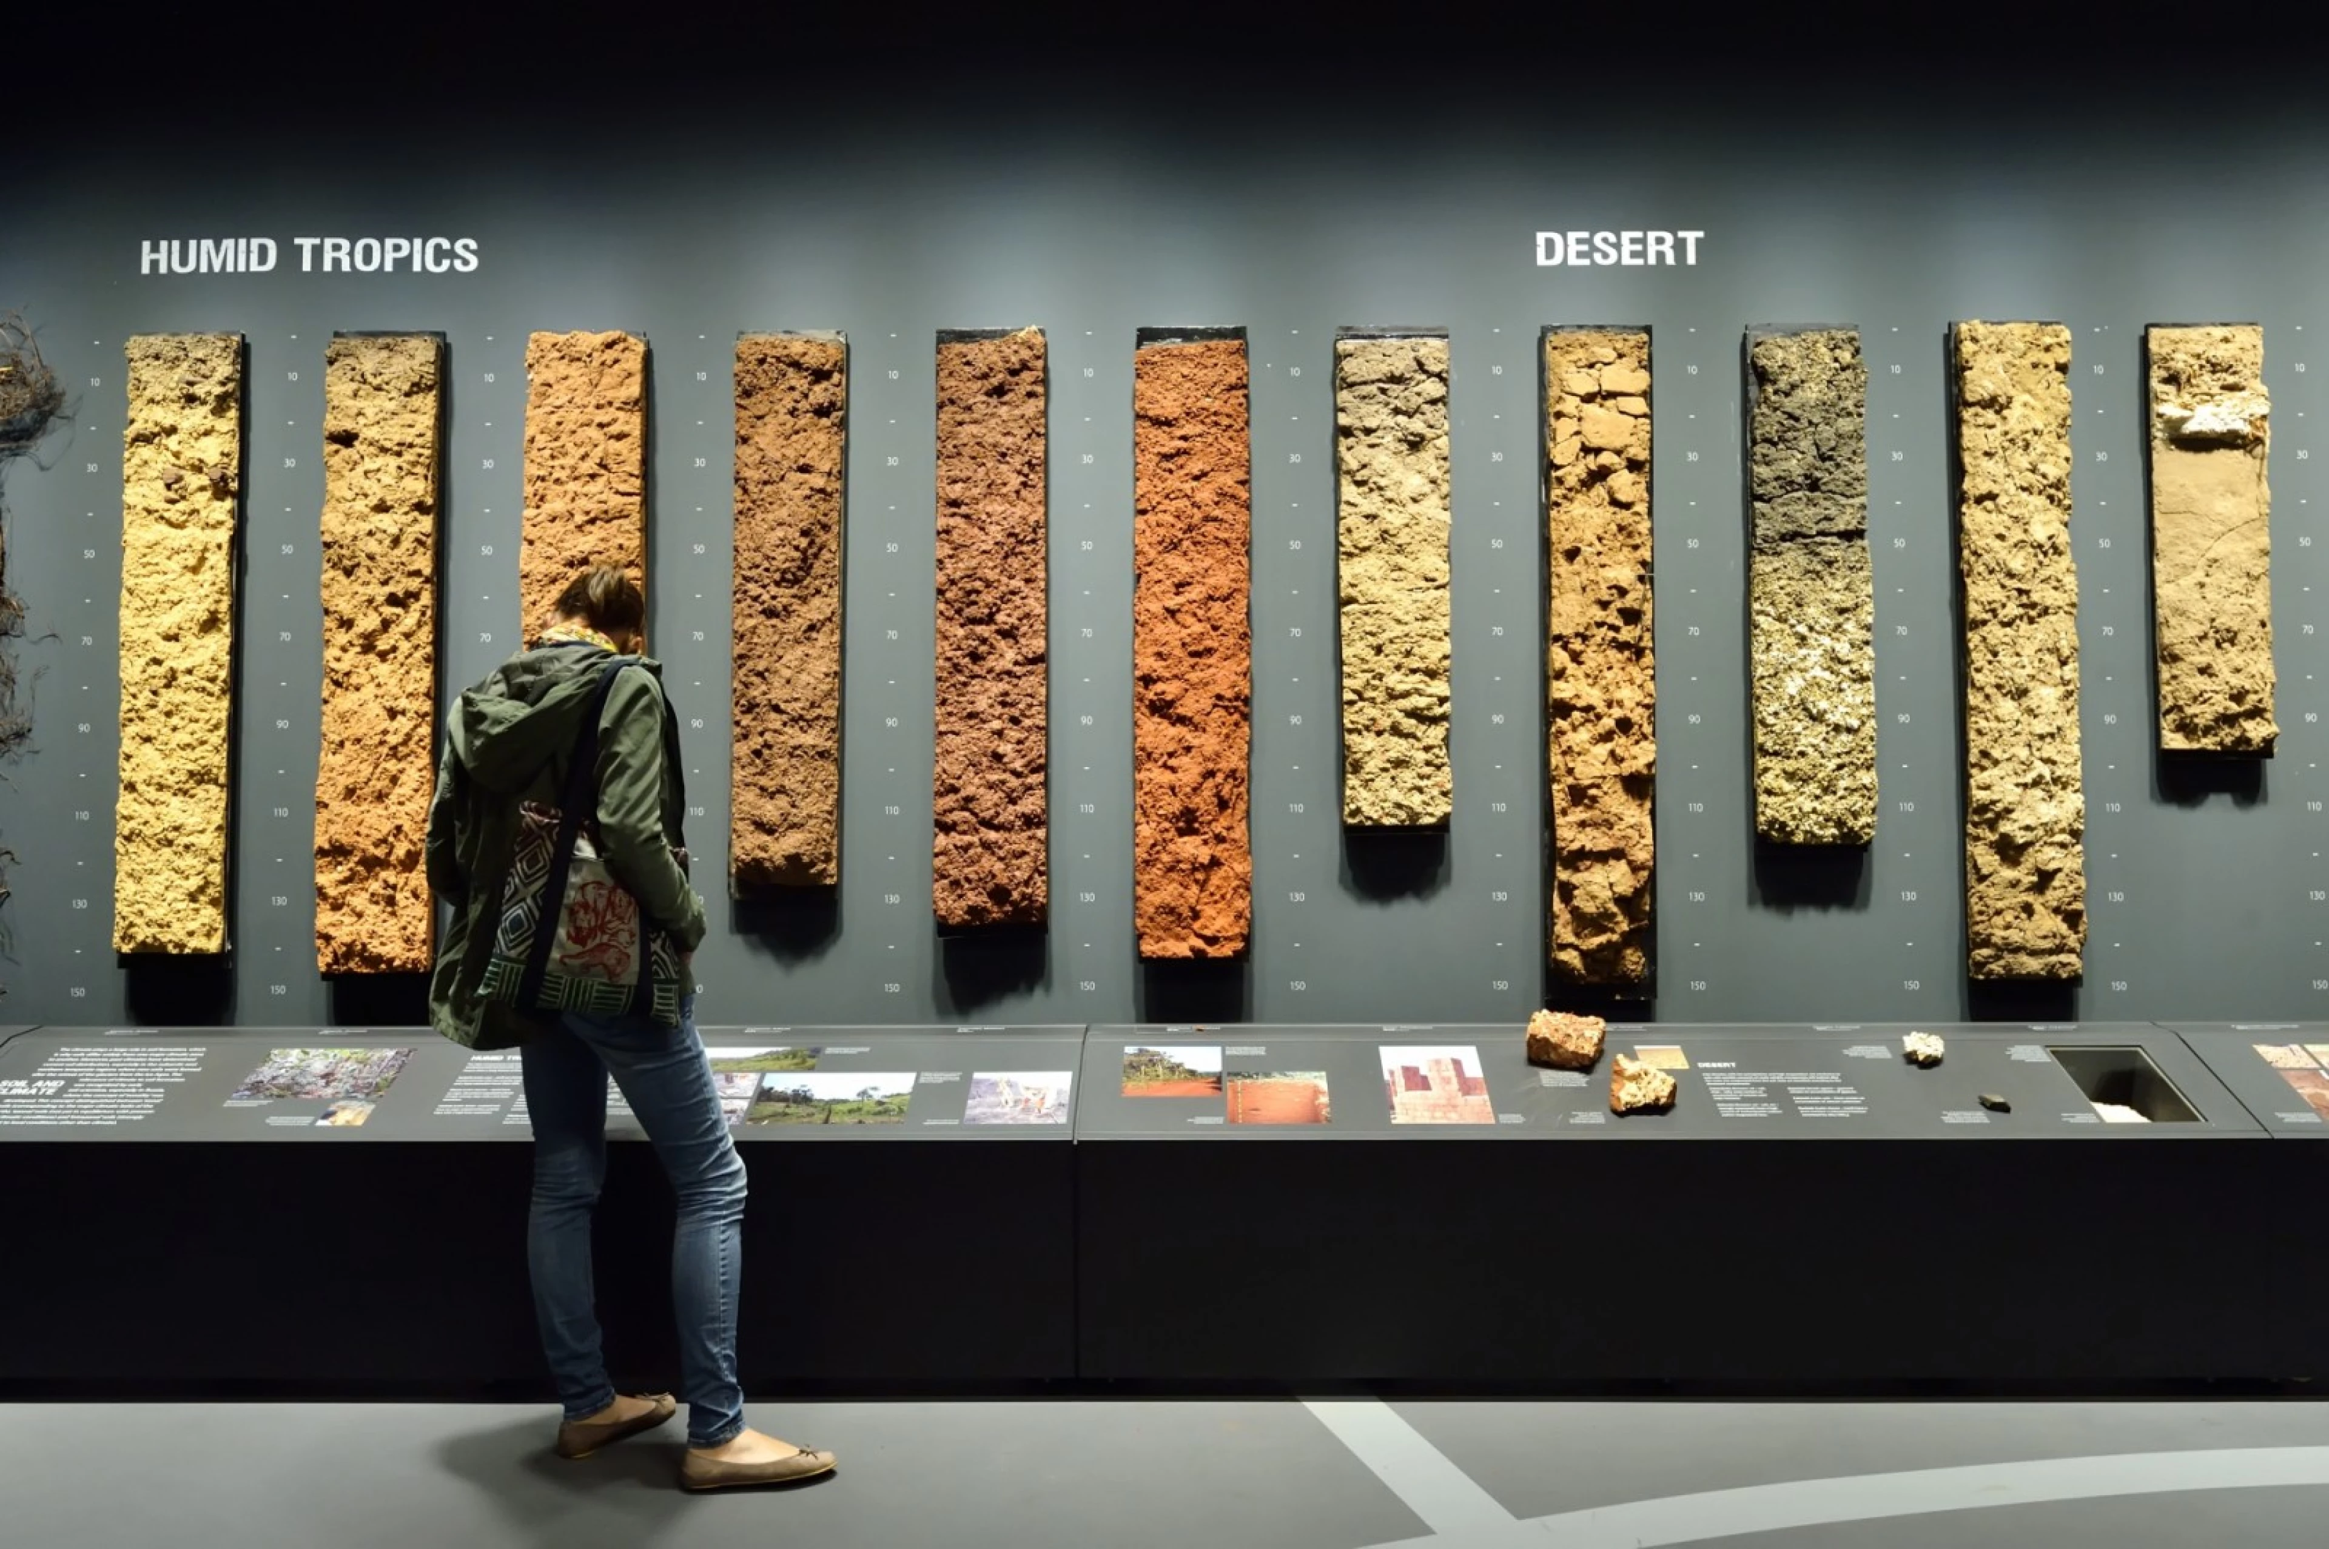
Soil museum
Soil museum by @tinker.nl

Slide 4
Typical use cases for OSGEO

Slide 5
Shift from open source developer to customer

Slide 6
ISRIC and FAIR

Slide 7
Principles on Findability
Metadata and data should be easy to find for both humans and computers.
human readable (html)
machine readible (xml/json/rdf using a standardised model)
Persistent identification
Use wise names and locations
Use an identification proxy (doi.org/handle.net)

Slide 8
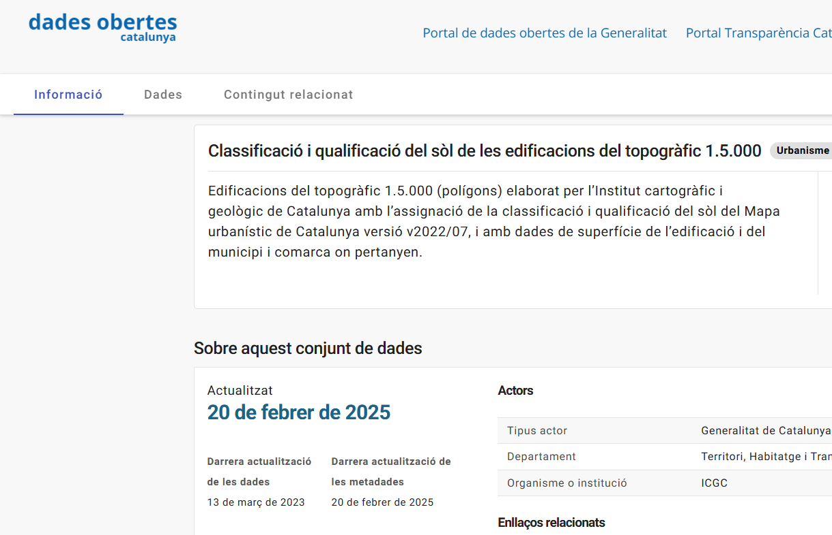
Human readable

Slide 9
Machine readable
<script type="application/ld+json"> { "@context": "http://schema.org", "@type": "Dataset", "name": "Classificació i qualificació del sòl de les edificacions del topogràfic 1.5.000", "description": "Edificacions del topogràfic 1.5.000 (polígons) elaborat per l’Institut cartogràfic i geològic de Catalunya amb l’assignació de la classificació i qualificació del sòl del Mapa urbanístic de Catalunya versió v2022/07, i amb dades de superfície de l’edificació i del municipi i comarca on pertanyen.", "keywords": [ "urbanisme i infraestructures", ... </script>

Slide 10
Q. Which URI’s are likely more persistent
https://www.project-marvic.eu/datasets/3265-456-67788?uuid=3265-456-67788
https://analisi.transparenciacatalunya.cat/Urbanisme-infraestructures/Classificaci-i-qualificaci-del-s-l-de-les-edificac/qgtr-hfva/about_data
https://134.421.56.113:8080/geoserver/wms
https://catalegs.ide.cat/geonetwork/srv/dut/catalog.search#/metadata/edafologia-wms
https://doi.org/10.5281/zenodo.15050634

Slide 11
Q. How can people cite a database which is continuously updated?

Slide 12
Standards for metadata exchange
Community | Standard | Protocol
Open data/Sematic web | DCAT | SPARQL
Science | Datacite | OAI-PMH
Geospatial | iso19115 | CSW
Earth observation | STAC | STAC
Search engines | Schema.org | json-ld/microdata
Ecology | EML

Slide 13
Catalogues
Catalogues offer a search functionality on sets of records
Catalogues exchange records to increase discoverability
Catalogues cross borders between communities by transforming metadata to relevant standards and protocols

Slide 14
Q. How is google able to locate datasets

Slide 15
Accessible

Slide 16
Principles on Accessibility
Data are retrievable by their identifier using a standardised communications protocol
Metadata are accessible, even when the data are no longer available

Slide 17
Data sovereignty
Publish at an acknowledged repository (zenodo, dataverse) provides persistence
Use local tools to share data provides full control and trust

Slide 18
Q. Which URI’s are likely more trusted
https://www.youtube.com/watch?v=YMsrVpVUyOw
https://zenodo.org/records/15050634
https://www.openstreetmap.org/relation/349053
https://administraciodigital.gencat.cat/ca/dades/dades-obertes/informacio-practica/llicencies/

Slide 19
Standardised communications protocol
Generic protocols, http/ftp
Standardised (OGC) API’s vs tailored REST API’s
Traditional WMS, WFS, WCS
OGCAPI-Features / EDR
SensorThings API (SoilThings)

Slide 20
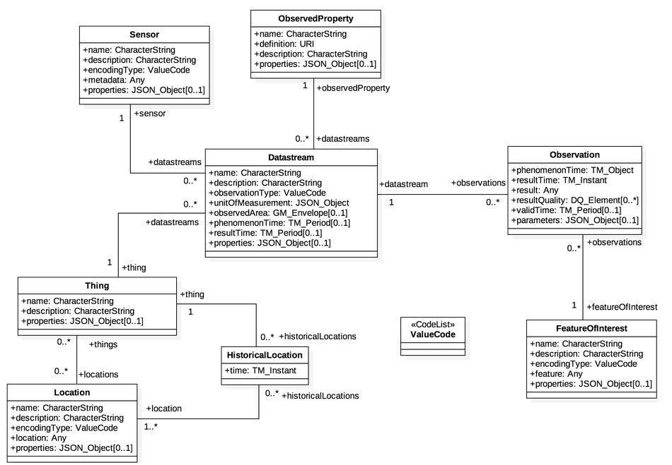
Sensorthings

Slide 21
Repository software
Webdav (or webserver software)
Zenodo, Dataverse
Document Management Systems (DMS)
Cloud storage (Github, Dropbox, Youtube, Amazon, Sharepoint)

Slide 22
Testing tools
Automated link checking
Usage logs
Google Search Console notifies broken links
Availability monitoring
Content validation

Slide 23
Interoperable

Slide 24
Principles on Interoperability
(Meta)data use a formal, accessible, shared, and broadly applicable language for knowledge representation.
(Meta)data use vocabularies that follow FAIR principles
(Meta)data include qualified references to other (meta)data

Slide 25
Universal formats
Facilitates accessing a resource with commonly available tooling
Proprietary vs Open (eg. ecw vs tiff)
De facto vs Formalised (eg. YAML vs XML)
Binary vs text based (eg. shapefile vs GeoJSON)
Cloud optimised vs Cloud native vs traditional (eg. COG vs GeoZarr vs GeoTiff)
Embedded metadata

Slide 26
Adopt common vocabularies
Adopting a standardised model enables aggregation of data.
Relational models (INSPIRE GeoPackage, iso28258asPostGres)
UML/GML models (ISO28258 iso11074)
Semantic web ontologies (Glosis-ld, vocabs)
Thesauri (WRB, Gemet, Agrovoc)

Slide 27
Reusable

Slide 28
Principles on Re-use
(Meta)data are richly described with a plurality of accurate and relevant attributes
(Meta)data are released with a clear and accessible data usage license
(Meta)data are associated with detailed provenance
(Meta)data meet domain-relevant community standards

Slide 29
What if my repository does not offer extended metadata options?
Use keywords from relevant thesauri to extend
Add a readme.txt file with extended information
Data model (which property, unit, analysis procedure)
Lineage (which data were used as a source)
Use a stuctured format for readme.

Slide 30
Metadata flows, ISRIC style

Slide 31
Design considerations
A set of conventions and tools to create and share metadata of datasets
Soil scientists know their data, and should prepare the metadata records
Integrate in their environment, stay close to the tools they already use: R, Python, Git, Excel…?
Focus on spatial standards, because we’re in the spatial domain

Slide 32
3 use cases
A team of soil scientists describes their source data, models and data outputs, for tracability and future re-use
An organisation aims to share a subset of their resources as open access data
A community aims to collect relevant remote resources in a thematic catalogue

Slide 33
Describe resources at their source
Builds on a convention of placing a README.txt file in a project folder, describing the source, attribution.
Based on standards, using Metadata control file (mcf)
We’ve built a crawler tool, which
extracts embedded metadata from data to create initial mcf
extracts metadata from a set of project folders into a central index

Slide 34
Example flow
Prepare a set of source data and covariates in a folder, import metadata from external sources
Model generates a distribution prediction based on inputs, model generates some metadata
Crawler tool combines generated metadata with embedded metadata (projection, bounds, bands)
Scientists verifies the generated metadata
Metadata is ingested into central index, quarable by colleagues

Slide 35
Try it out
docker run -it --rm -v$(pwd):/tmp \ pvgenuchten/geodatacrawler:1.3.5 crawl-metadata \ --mode=init --dir=/tmp

Slide 36
Share as open access data
Import the indexed records in a catalogue
Use metadata to set up OGC data api’s (WMS, WFS, WCS)
Add the service endpoint back into the catalogue metadata

Slide 37
Example flow
Subset of records and data files from previous flow are exported to an external catalogue
Datasets are made available through conveniance API
Users find the data in the catalogue and access it through the conveniance API
Users can suggest improvements to the (meta)data thourgh Git (or email)

Slide 38
A thematic participatory data portal
Metadata from external sources is harvested (ingested and harmonised) to the central index
Harvest definition (url + filter + frequency) is stored on Git
Havests run at intervals using CI-CD pipelines (Github actions)
Users can suggest changes to the harvest definition (new url’s)

Slide 39
Example flow
A set of relevant records is identified to be harvested
Definitions are updated in Git
Users provide feedback on outdated or missing records

Slide 40
Oh, but this is quite technical!
ISO19139 and DCAT and their tools (GeoNetwork, CKAN, Dataverse) also have their peculiarities
Alternative to pull request in GIT? Use git issues and let others in the community fix
YAML has its caveats (indenting, reserved characters), use YAML check in text editor
We created a web-form for mcf editing, mdme

Slide 41
Read more
FAIR principles
EJPSoil soil data assimilation cookbook
LSC Hubs data workshop
pygeometa
GeoDataCrawler

