Slide 1
Open Source at ISRIC - World Soil Information
FOSS4G NL, Wageningen Paul van Genuchten

Slide 2
ISRIC - World Soil Information
Foundation funded by Dutch Government to maintain a global collection of reference soil samples (ISIS)
Collect and harmonize soil observation data from around the globe (WOSIS)
Globally predict the distribution of soil properties (Soilgrids)
Capacity building on soil data management at soil institutes around the globe (Academy)
Participate in research projects to innovate the soil sciences

Slide 3
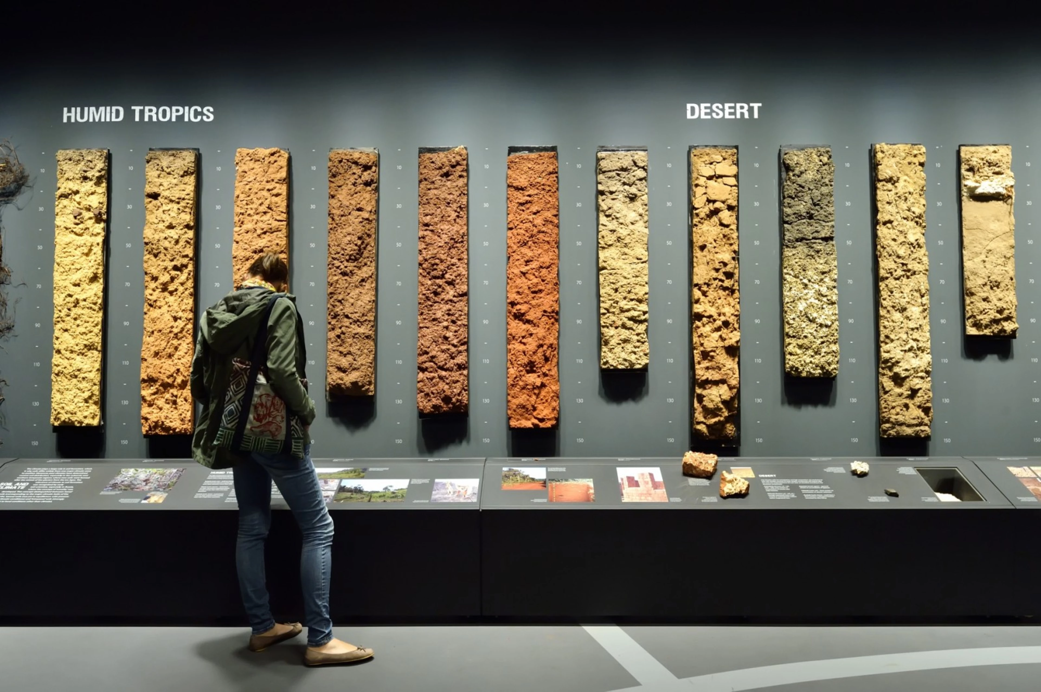
World Soil Museum
World Soil Museum by tinker.nl

Slide 4
Typical use cases for FOSS(4G) software
Field data collection (OpenDataKit)
Harmonize soil data (Hale, PostGres, Postgraphile, Apache Superset)
Predict soil property distribution (R, Terra, GDAL)
Cataloguing (pygeometa, pycsw, geonetwork)
Data API’s (Mapserver, FastAPI, Virtuoso)
Content management (Quarto, Drupal)
GIS viewers (QGIS, Leaflet, Deck.gl, TerriaJS)
DevOps (Kubernetes, Gitlab, Argo)

Slide 5
OSGeo and Open GeoSpatial Consortium
The OGC community provides standards for data api’s & data formats
As independent foundation we aim to be neutral to software vendors, offered by standardised api’s
OSGeo tools are commonly OGC compliant, many innovations at OGC are driven by open source software
Open formats enable future backwards compatibility for today’s datasets

Slide 6
Relevant OGC standards
Web Map Service, Web Coverage Service, Web Feature service, Catalogue service for the web
Sensor Observation Service (INSPIRE Soil is based on Observations&Measurements)
GeoPackage (See INSPIRE Good Practice on GeoPackage)
Styled Layer Descriptor (SLD)
Cloud Optimised GeoTiff (COG)
OGC API - Records

Slide 7
OGC and FAIR
FAIR principles (Findable Accessible Interoperable Reusable) are popular in academia (and beyond)
FAIR and OGC pursue slightly different goals, however OGC recently started a working group on open science
Academia assumes a dataset as a stable set of records, preferably reviewed and identified with a persistant identifier (DOI)
OGC API’s facilitate extracting subsets of a dataset, datasets are usually not stable over time
Novel data formats allow subsetting via range requests, they may facilitate both uses (GeoParquet, COG)
Alignment of vocabularies is relevant for both communities, not many tooling available (SKOS)

Slide 8
Shift from OSGeo developer to OSGeo user
3yrs ago, I shifted from software development to ISRIC
Current tasks are data science, DevOps, software development
Some experiences around OSGeo software from a user perspective

Slide 9
Mapserver
We hire a consultant from the mapserver developer community for expert advice and development
Some minor bug fixes on our behalf
SLD support, you can now use a SLD file to configure the style of a layer
Currently working on Mapserver Homepage, presenting a list of the services available in a server
I’m not following the mailinglist as much as needed

Slide 10
TerriaJS
We use TerriaJS in 5-10 websites. Mostly to share our data products to potential users and stakeholders.
Any frontend application typically has many potential improvements
Especcially improvements around OGC interactions best be merged upstream
The TerriaJS community is not very aware of OGC standards, so it requires quite communication to land a Pull Request
We work with a frontend developer not related to the project, because it was difficult to reach out to direct contributors

Slide 11
CKAN
We asked university-support to deploy a default instance of CKAN (+SOLR), however it does then not include the spatial modules and tailored layout
We consulted a regional company knowledgable on CKAN implementations, they advised us to use the CKAN backend only and build a dedicated fromtend
The spatial modules of CKAN seem not maintained
We decided not to continue with CKAN for now

Slide 12
pycsw
A minimalistic catalogue implementation, but very focussed on OGC standards support
Since OGC API’s pycsw has a (html) user interface
We feel it is a good fit for our use cases
Sometimes I get complaints that it is not as full featured as CKAN, but it’s hard to understand what’s actually missing
We recently landed Facet filters on OGC API Records and in pycsw
A group in norway is implementing a SOLR backend for pycsw

Slide 13
Cloud Optimised Geotiff / GDAL
Tiff is an important format for us, we have 100’s of GB of tiff data
Previously we would use tiff image pyramids to store global data, now switching to COG
Mapserver with a COG backend is many times faster then a plain tiff backend
Direct access from web to COG is not feasible yet, because our tiff data does not use a mercator projection, many repositories do not allow CORS
We’re open to suggestions…

Slide 14
Apache Superset
I really enjoy creating diagrams of arbitrary data
Unfortunate that it is a complex tool with many dependencies (redis, postgres)

Slide 15
Humboldt Alignment Editor (HALE)
Hale is a relevant tool for working with rich UML data models, such as soil observation data
Developers tend to focus on exporting postgres data to INSPIRE GML, but our use case is often vice versa
We hired the Wetransform team for a training and Q&A on specific data (20hrs)
With the experts available, we were productive in 2 days, I wonder if I would have managed by myself, GML has its peculiarities
I notice our data scientists prefer data migration through R/Python scripts. However I see value in a visual Hale approach.

Slide 16
Quarto
Static Site Generators fit our approach very well, performant, stable, secure
Some colleagues have challenges with the markdown in gitlab (and prefer wordpress)
Intially we started with hugo
Quarto was used by our data scientists for documentation, we aligned with them
I do appreciate Quarto now, it is less flexible, but full featured, it generated these slides

Slide 17
Conclusions

Slide 18
Questions / Comments

