Slide 1
(Meta)Data management at ISRIC - World Soil Information
Discovery & Metadata Expert Group with the Digital Research Alliance of Canada Paul van Genuchten

Slide 2
ISRIC - World Soil Information
Foundation funded by Dutch Government on promoting soil awareness and advancing the use of soil information to help build a more sustainable future.
Maintain a global collection of reference soil samples (ISIS)
Globally predict the distribution of soil properties (Soilgrids)
Capacity building on soil data management at soil institutes around the globe (Academy)
Participate in research projects to innovate the soil sciences

Slide 3
World Soil Museum
World Soil Museum by tinker.nl

Slide 4
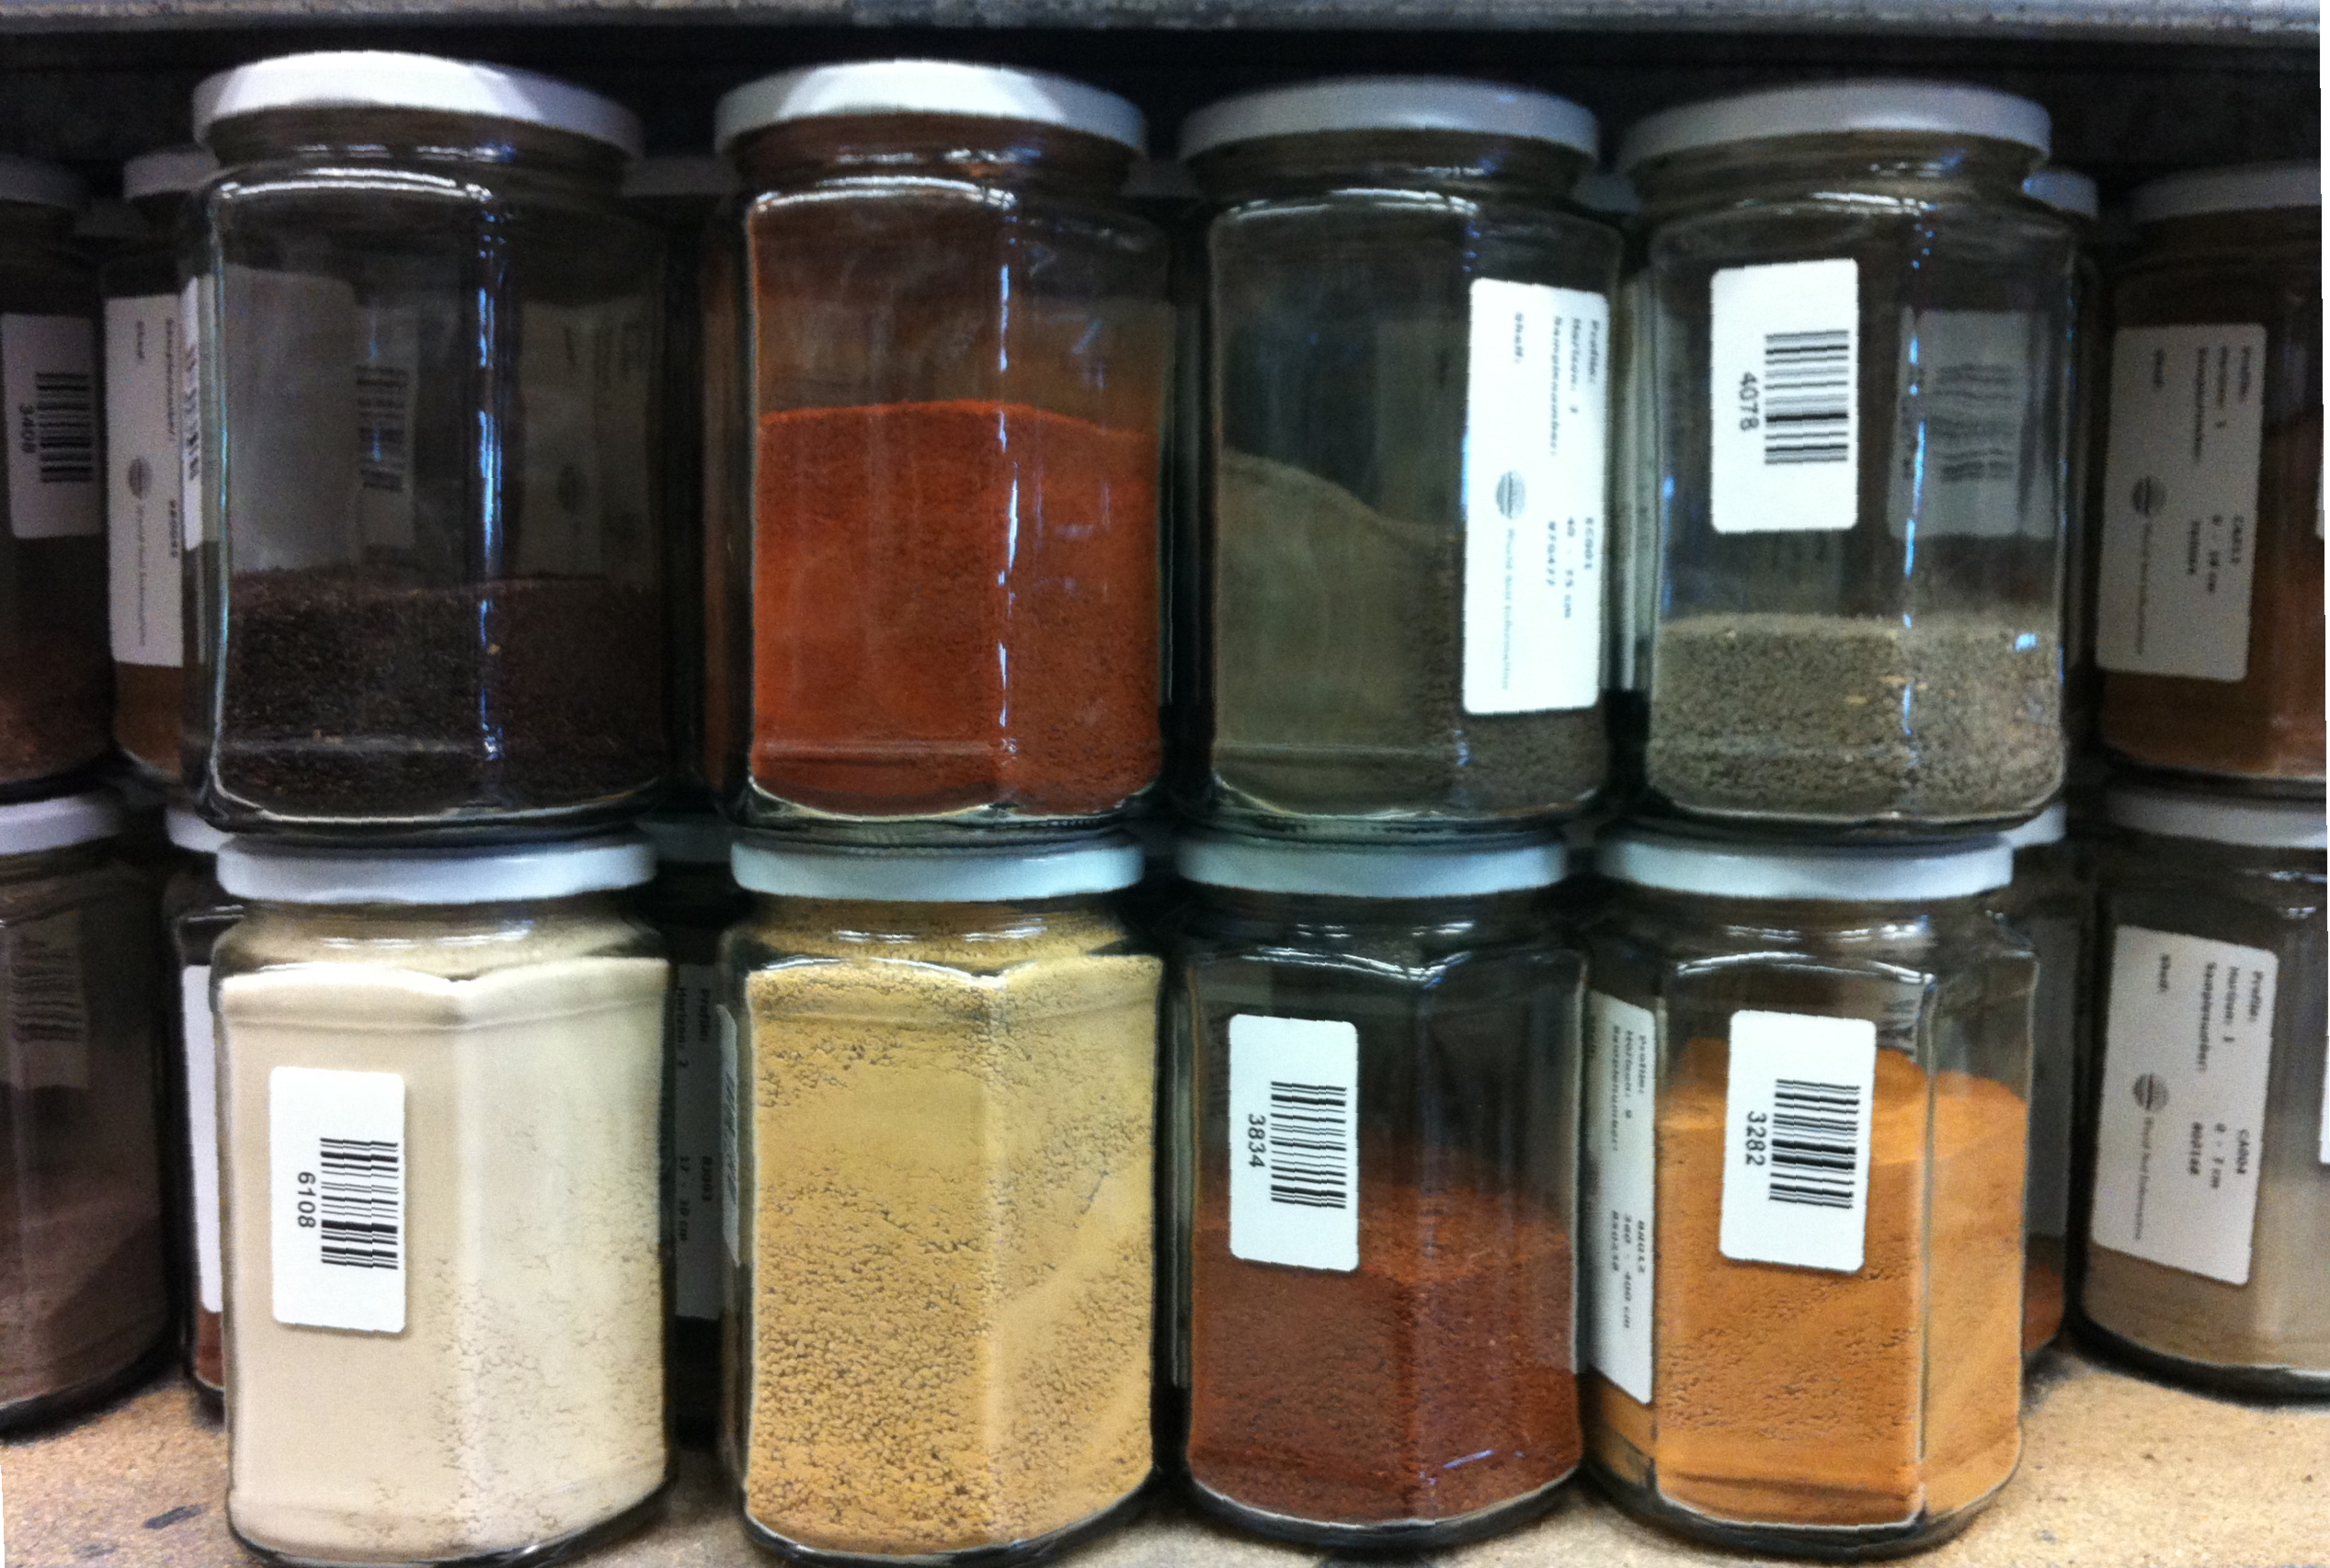
Collection of reference profiles
Samples of reference profiles

Slide 5
(meta)data flows at isric
Museum exhibits and collection management
Participation in research projects (consortia)
Global soil products
Capacity building at national soil insititutes
Meta studies on availability of works about a topic

Slide 6
ISRIC & academia
Foundation embedded in Wageningen University
Advance the soil sciences through research activities
Research deliverables are advertised in the academic domain through Citations and DOI

Slide 7
ISRIC & Open GeoSpatial Consortium
Spatial distribution of soils explains our interest in spatial standards
Standardised formats and protocols facilitate long term access to data
National soil institutes are exchanging soil data through OGC protocols

Slide 8
ISRIC & Open Source Software
Tracability of research outputs is facilitated by Open Source Software
OSGeo tools are commonly OGC compliant, many innovations at OGC are driven by open source software
Open formats enable future backwards compatibility for today’s datasets
Sustainability of contributions to Open Source Software
Open Source software is often cost effective
R - GDAL - GRASS - QGIS - Mapserver - pycsw - TerriaJS

Slide 9
Creation of Soil Maps
Soil Property Distribution is predicted by a random forest model on sampling data and covariates (geology, hydrology, satelite imagery)
Data is organised and produced in folders on a shared file system
Effective metadata management is crucial for reproducability (and attribution)

Slide 10
Embedded metadata or Sidecar
Metadata is automatically embedded in model outputs
Or a sidecar metadata file is placed alongside a data file (readme.txt)
Which model to adopt?
Facilitated by the format (MS Excel, GeoTiff, GeoPackage)
Common in the community (iso19115, DCAT, Datacite, schema.org)

Slide 11
A set of tools to work with sidecar files
pygeometa converts sidecar files between models (mcf, iso, dcat, schema.org)
geodatacrawler crawls a (network) drive for sidecar files, as input for a catalogue
MDME provides user friendly model driven metadata editing
Git as a storage for sidecar files facilitates rich history and remote contributions

Slide 12
Data model metadata
In soil sciences, a lot of observation data is collected
Observation data is 75% metadata and 25% data (where, what, when, who, how)
Soil institutes are endorsed to capture metadata as part of dataset metadata
The data model metadata is important information when harmonizing multiple datasets
But also to filter datasets by measured property in a catalogue

Slide 13
CSVW approach for observation data
in the Soilwise project we’re experimenting with users on annotating their observation data
CSVW is a standard of W3C to annotate CSV columns so the data can be converted to a knowledge graph
Average soil scientiests experience the CSVW syntax as complex, we’re setting up tools to facilitate the conversion
Other tools convert the Knowledge Graph data to GeoPackage

Slide 14
Open challenges
Limited metadata model in popular repositories such as Dataverse.nl, Zenodo.org, Pangea.de
How to use sidecar metadata when publishing data in repositories
Commonly accepted vocabularies to reference observed soil properties and observation procedures

Slide 15
Questions / Comments?

