Slide 1
Interoperability and data governance
Soil information systems for decision making in Africa Paul van Genuchten

Slide 2
ISRIC
ISRIC - World Soil Information has been founded in 1966 after designation to the Netherlands by Unesco, in close cooperation with FAO and IUSS
The institute with its unique global soil monolith collection is hosted at Wageningen University
ISRIC contributes to data collection and standardization efforts globally, with a special focus on Africa

Slide 3
Interoperability projects
participated in the Global Soil Map project (2009-2013)
participated in the Africa Soil Information Service project (2009-2016)
hosted the recent Soils for Africa project (2021-2025)
contributes to the African Soil Observatory project (2025-2029)
hosts the WOSIS profiles database and the SoilGrids Global Soil Map (250m)

Slide 4
Paul van Genuchten
Trained as a soil scientist (Wageningen University, 1999)
Extensive experience in spatial data and IT
Joined ISRIC four years ago as a Data Infrastructure Specialist
Maintains ISRIC’s data infrastructure and contributes to soil data management projects, with a focus on metadata and interoperability

Slide 5
Interoperability and data governance
I was asked to present about these 2 topics
Interoperability is a pillar of data governance
Both are large topics…

Slide 6
Data governance
Roles, Responsibilities, and Accountability
Data Quality and Lifecycle Management
Policies, Standards, and Interoperability
Security, Privacy, and Legal Compliance
Data Sharing, Access, and Value Creation

Slide 7
FAIR principles
The FAIR principles provide a governance framework for data, from a reuse perspective:
Findable
Accessible
Interoperable
Reusable

Slide 8
Soil data specifics
legacy data and formats
interaction with many other domains (agriculture, pollution, carbon sequestration, build environment, hydrology)
Management practices & LTE
large number of soil indicators
long history of (local) practices

Slide 9
Findable data
Rich metadata searchable via a catalogue

Slide 10
What is a dataset?
civil cervant: a database which is continuously updated, exposed via an API
academic: a validated collection of records at a given point in time, which I can uniquely reference in my publication

Slide 11
Datasets as a source for digital soil mapping (DSM)
DSM is the process of prediction of soil property distribution in space and time
DSM efforts happen irragularly, based on latest snapshots of source data and covariates
data from the own organisation as well as remote sources
the academic view on dataset is more appropriate for DSM

Slide 12
Use of repositories
Easy to find and reference
Find today, find in 10 years time
Common data and knowledge repositories offer persitent storage over time
Aggregators (openaire, google) harvest from repositories to optimize findability

Slide 13
Persistent Identification is an aspect of findability (identifiers)
datasets should be uniquely identified (uuid)
Strong push to adopt identification platforms such as DOI and Handle.net
Proper identification facilitates citation from reports/scientific articles
For large data, or specific use cases (map vizualisation), data can also be shared using an api or web service, but it complicates identification

Slide 14
Accessible data
Data is made available through an open protocol (http)
Metadata should still exist, even if the data itself is discarded
Metadata Public; Data public, protected or internal

Slide 15
Tiered access and national stewardship
As open as possible, as closed as necessary
As data steward you should have control on access to the data, even when handed over to a secondary hosting provider (repository)
Alternatively author the DOI of the data, arbitrary where the data is hosted
Ultimately the enclosed metadata indicates the usage restrictions of the data

Slide 16
Interoperable data
Use standardized data formats and controlled vocabularies to enable data exchange and reuse across tools and disciplines

Slide 17
Process of standardisation
Standardised Operating procedure (Field and Laboratory)
GSP Glosolan
Soils for Africa project
Describe existing practices
Refer to common vocabularies

Slide 18
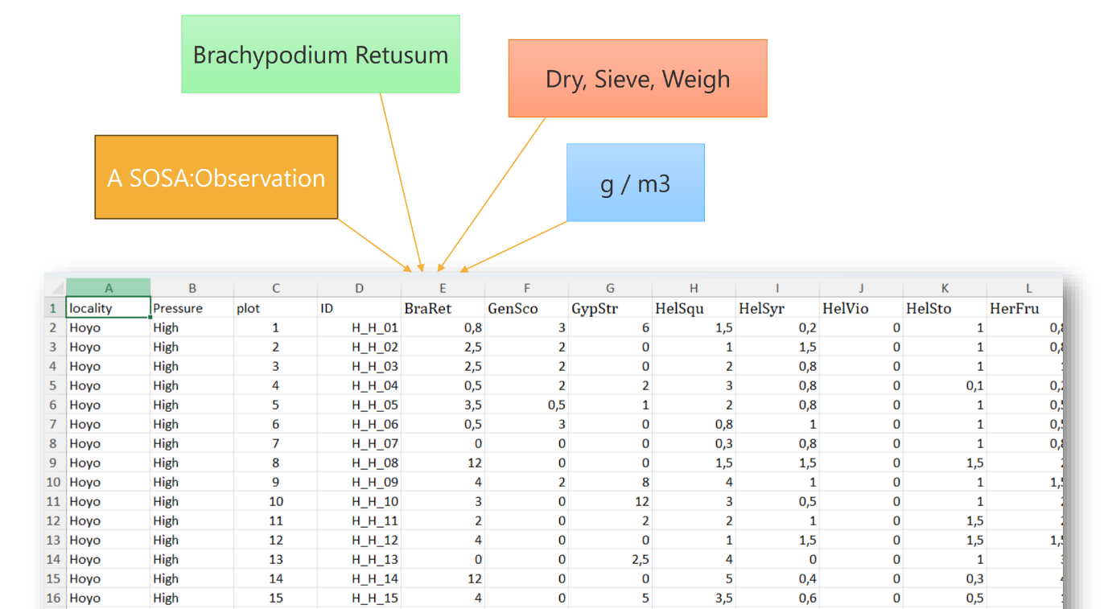
Tabular annotated
interoperable

Slide 19
Role of common vocabularies
The use of common multi-lingual vocabularies provide a mechanism to describe data using universal definitions
Common vocabularies such as Agrovoc, WRB, GLOSIS, ISO11074, GEMET
Use Agrovoc terms as keywords in metadata
Describe columns in a dataset using terms from GLOSIS
Express unit of measure using QUDT concepts

Slide 20
Reusable data
Describe the provenance of the data, so potential users understand if and how they can use the data.
Apply a relevant license; as open as possible, as closed as necessary

Slide 21
Describe a dataset using rich metadata for findability and resuability
Generic properties are covered in most metadata models
Metadata model can be extended by adding a metadata sidecar file (RO-Crate approach)

Slide 22
Use of common repositories
Common repositories, such as Zenodo, OSF, Pangaea, Dataverse, offer many of the FAIR principles by default
As a contributor you are owner of the data
Data can be published with tiered access
Funders may endorse the use of a certain repository
Understand the jurisdiction of the country where the repository is hosted
Consider the reliability of the repository (timespan 20-50 years)

Slide 23
Some data publication samples
Soils for Africa
Tanzania SIS
Kenya SIS

Slide 24
Data aggregators are not a good fit for publishing your data
Various soil data aggregators exist, which harmonize and clean soil data
Examples such as ISRIC, ISDA, Varda
The aggregators are able to make good soil maps
Data contributed to an aggregator is out of your control
Instead publish the data in a repository and share the DOI with the aggregator
The feedback from the aggregator about your data is actually very useful, make sure to retrieve it

Slide 25
Frameworks to support implementation
Cabi and Gates foundation prepared a framework to put the FAIR principles in action in the environmental domain.
Cabi, ISRIC and Gates foundation also prepared a framework for Soil Information System design.
The SIS framwork includes some case studies from various African countries.

Slide 26
Conclusions
Data governance is a wide topic, interoperability is an important pillar
FAIR principles provide a framework for governance focussed on reuse
Soil data is special for its specific use cases, interaction with many domains and long time span
Harmonization is important, but do not replace the source data

Slide 27
Questions?

Slide 28
More details on data governance
The extra slides provide some details on the topic of data governance

Slide 29
Roles, Responsibilities, and Accountability
Define who owns, stewards, custodians, and uses data.
Establish decision-making bodies (e.g. data governance boards).
Clarify responsibilities across ministries, agencies, and local governments.

Slide 30
Data Quality and Lifecycle Management
Ensure data is accurate, complete, consistent, timely, and fit for purpose.
Define standards for data collection, validation, maintenance, archival, and disposal.
Monitor and improve data quality through metrics and audits.

Slide 31
Policies, Standards, and Interoperability
Develop common data standards, metadata, reference data, and vocabularies.
Promote interoperability between government systems.
Standardize formats, identifiers, APIs, and data models to enable data sharing

Slide 32
Security, Privacy, and Legal Compliance
Protect sensitive and personal information.
Comply with relevant legislation (e.g. GDPR, freedom of information laws, records management requirements).
Define access controls, classification schemes, and procedures for handling breaches.

Slide 33
Tiered access
User | Level of access
General public | Aggregated statistics, maps, open datasets
Researchers | Detailed but anonymized observations under a data-sharing agreement
Government agencies | Full datasets needed for regulatory or policy purposes
Data stewards | Ability to edit, correct, and approve records
System administrators | Technical access to the platform, but not necessarily permission to use the data analytically

Slide 34
Tiered access supports governance objectives
Privacy and confidentiality: Protects personal, commercially sensitive, or nationally sensitive information.
Legal compliance: Helps meet obligations under regulations such as GDPR, freedom of information laws, or sector-specific legislation.
Data integrity: Limits editing rights to authorized users, reducing the risk of accidental or unauthorized changes.
Need-to-know principle: Users receive only the information necessary for their role.
Encouraging openness: Governments can publish as much data as possible while still protecting restricted information.

Slide 35
Data Sharing, Access, and Value Creation
Establish policies and agreements for sharing data within government and with external stakeholders.
Balance openness with confidentiality through open data, licensing, and access controls.
Promote reuse of data for evidence-based policymaking, service delivery, transparency, and research.

Slide 36
These five aspects are often supported by cross-cutting activities such as:
Metadata management
Master and reference data management
Risk management
Training and capacity building
Monitoring, compliance, and continuous improvement

