Slide 1
Soil Information System for Africa
Updating soil information for Africa: supporting agriculture and promoting synergies Paul van Genuchten

Slide 2
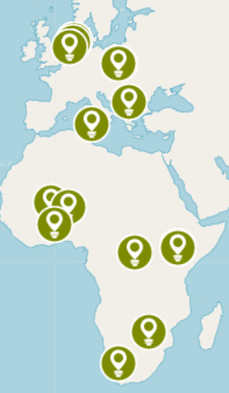
The project
1 June 2020 - 31 May 2025
Led by ISRIC - 16 partners
Funded by EU Horizon 2020
Budget: € 6.7M
S4a partners

Slide 3
Background
The AFSIS project showed the value of a continental map
It also showed the challenges of map construction
availability of observation data
limited description of the data (difficult to harmonize)
unclear usage constraints/ownership

Slide 4
A continental campaign
Optimized sampling design
Standardised Operating Procedures for Field Survey, Transport and Laboratory
Analysis by a single lab
Full data description and clear licence description
Dissiminaton of the results for various target audiences

Slide 5
From observations to maps…
Link laboratory observations to field sampling locations
Harmonize data from various campaigns
Can observations be compared? conversion required?
Field expertise or spatial algorythms to predict distribution (co-variates)
Add a legend of classes (high-medium-low)
From the map product, attribute the source data

Slide 6
Concepts and Methods of data acquisition and
sharing

Slide 7
Concepts of data acquisition
Sampling design
Standard Operating Procedures

Slide 8
Methods of data acquisition
The SOP manual

Slide 9
Concepts of sharing
For each observation describe the soil property, the observation procedure, unit of measure, date
In tabular data of a single campaign, this metadata may be stored at column (or dataset) level
Deposit verified data (snapshot) in a repository, collect a DOI for sustainable citation
Assign a relevant license (and embargo) to the data
Additional publications for dedicated audiences (OGC,)

Slide 10
Methods of sharing

Slide 11
Examples of data sharing

