Slide 1
GitOps SDI
Infrastructure as Code inspired Spatial Data Infrastructures Paul van Genuchten, Tom Kralidis

Slide 2
Contents
What is GitOps?
Why GitOps?
Metadata at the source
About the workshop
Technologies

Slide 3
What is GitOps
“Git” & “Operations” (like DevOps)
Git is a source of truth (apps, containers, configuration)
A GitOps process automatically delivers changes in an online cluster.
A monitoring process detects difference between desired state and the target cluster

Slide 4
5 principles
Express the desired state declaratively
Version control the desired state
Automatically apply the desired state
Reconcile the desired state
Visibility and control

Slide 5
Why GitOps?
At ISRIC - World Soil Informtion
We run various SDI’s to facilitate projects
SDI’s should be robust, requiring little maintenance

Slide 6
Metadata at the source
Researchers use many field and earth observation data to predict distribution of Soil properties
They use tools like Excel, R and Python, generally not aware of metadata standards
Add a README.txt to describe the resources in a folder
Why not structure the content in the README, so also machines can read it?

Slide 7
About the workshop
A self guided tutorial at https://pvgenuchten.github.io/training-gitops-sdi/
Two moments to summarize
Welcoming your feedback at https://forms.gle/J59DjGbTBx1s1Tus7
Ask questions via https://github.com/pvgenuchten/training-gitops-sdi/discussions/5

Slide 8
Technologies
MCF
pygeometa
pyGeoDataCrawler
pycsw
mapserver
terriajs

Slide 9
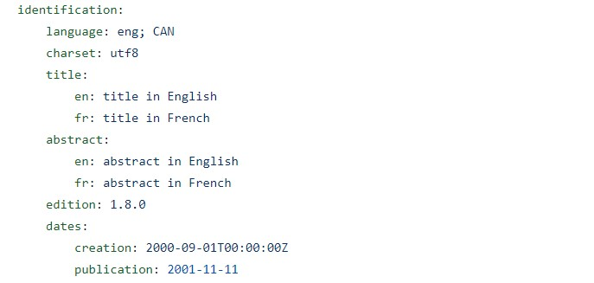
Metadata Control File
A convention of the pygeometa community (Meteo Canada)
YAML, easy to read by humans and machines
A subset of the ISO19115 standard for metadata
MCF

Slide 10
pygeometa
a library to work with MCF
exports MCF to various metadata models (iso, dcat, stac)
https://github.com/geopython/pygeometa

Slide 11
pyGeoDataCrawler
Developed at ISRIC in the last year
On the shoulders of giants; GDAL, pygeometa, pandas
Generates MCF files for a file repository
Imports metadata from external sources
Extracts MCF files from a repository to load it into a catalogue
Creates map services configuration for files in the repository

Slide 12
pycsw catalogue
A catalogue implementation in Python
Limited funtionality, easy maintenance
Wide range of supported catalogue standards, serves many communities
Database backend
Skin customisable with Jinja templates
Related products; GeoNetwork, CKAN, dataverse

Slide 13
MapServer
Recent versions of MapServer support the old and new standards
Features and Maps
No tiles (mapproxy), No coverages yet
No records/stac, by design
Related products; GeoServer, QGIS server, pygeopai

Slide 14
TerriaJS
An Open Source javascript WebGIS application
Related products; GeoNode, GeoMoose, MapBender, Oskari, GisQuick

Slide 15
Quarto
Static site generator from Markdown
Add diagrams or maps with Python and R scripting
Other interesting option is the W3C MapML

