Slide 1
Cotton Yield Prediction

Slide 2
Preprocess Data
Raw data has 870 observations
Compare to Akash’s CH value -> keep 805 observations left
Remove observation that has yield value is 0 -> keep 802 observations left

Slide 3
Preprocess Data
Parameters used: CH, CV, NDVI, ExG, Bollsize, Bollnum, BollVolumn, irrigation, FC (optional)
GRNN parameters: CH, CV, NDVI, ExG
Use recorded day in range 0 – 105
Interval days: 7
Standard deviation of GRNN model: 10
Normalization the result -> (802, 15) each -> (802, 60)
Extra parameters: Bollsize, Bollnum
Normalize three columns -> (802, 3)
Hot encoded parameters: Irrigation (Yes/ No)
Hot encoded column -> (802, 2)
Input size in total (802, 65)

Slide 4
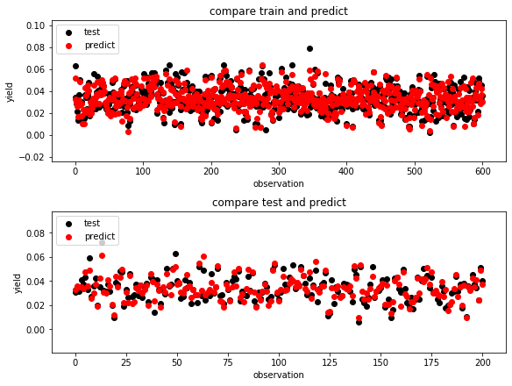
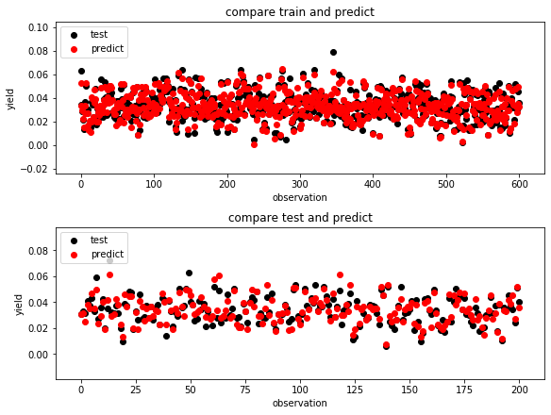
Train model – CH, CV, ExG, NDVI in 150 epochs and 300 epochs
r2 score = 0.8381281244361883 / 1.0 r2 score = 0.8154170015645147 / 1.0
r2 score = 0.8851214004428811 / 1.0 r2 score = 0.8013891897892582 / 1.0

Slide 5
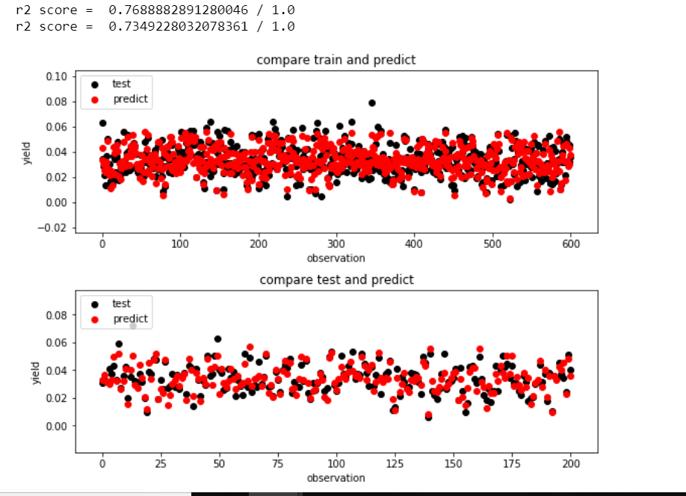
Only CH – in 50 epochs

Slide 6
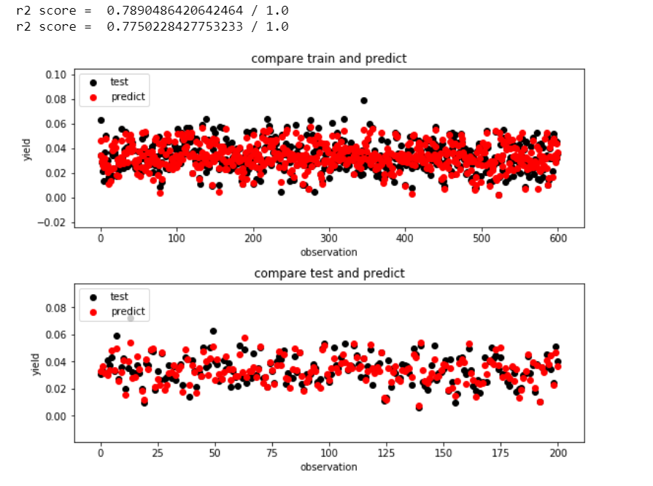
Use Ch, CV in 50 epochs

Slide 7
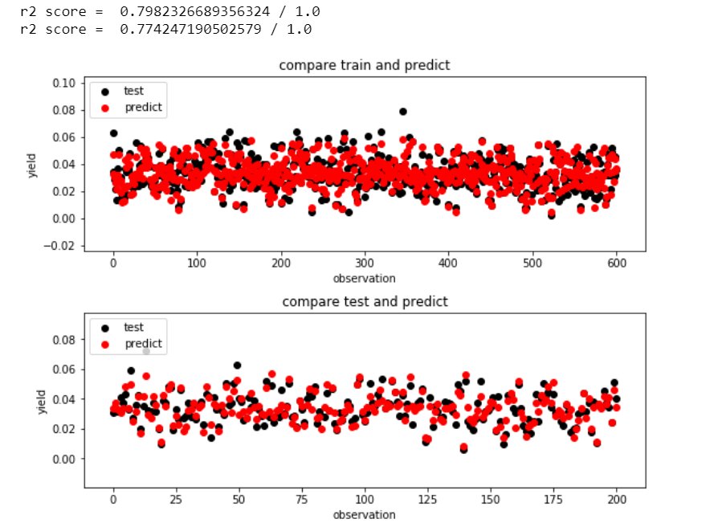
Use CH, CV, and ExG in 50 epochs

