Slide 1
Cotton Yield Prediction – Sigmoid function

Slide 2
Preprocess Data
Data has 802 observations
Two parameters: CH, CV. Each has 26 recorded days [ 12 15 27 36 46 50 53 57 61 63 75 78 81 84 88 91 99 104 107 110 112 116 119 124 130 134]

Slide 3
Preprocess Data
Parameters used: CH, CV, Bollsize, Bollnum, BollVolumn, irrigation
Sigmoid parameters: CH, CV
Use recorded day in range 0 – 107
Extra parameters: Bollsize, Bollnum, bollvol
Normalize three columns -> (802, 3)
Hot encoded parameters: Irrigation (Yes/ No)
Hot encoded column -> (802, 2)
Input size in total (802, 65)

Slide 4
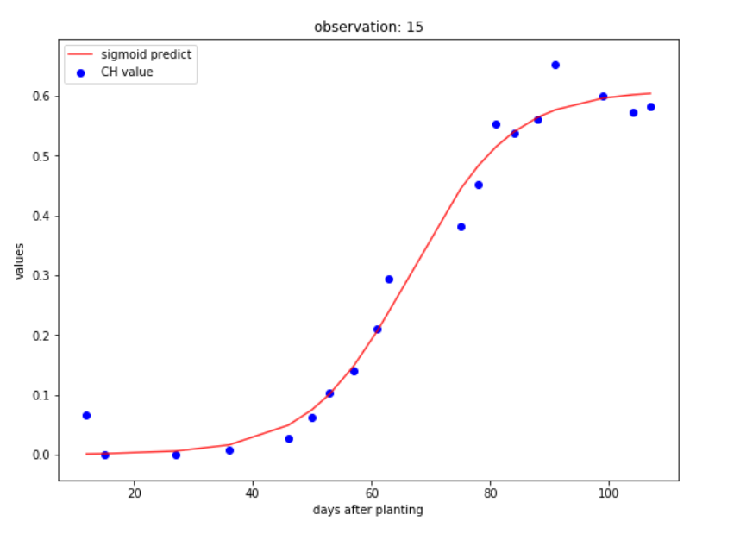
Sigmoid function
Generate Sigmoid function that fit parameters value (y) according days after planting (x)
Function used (3 parameters): y = a / (1 + np.exp(-(x-c)/b))
Base on sigmoid function’s characteristic: the maximum value is the last day (107)

Slide 5
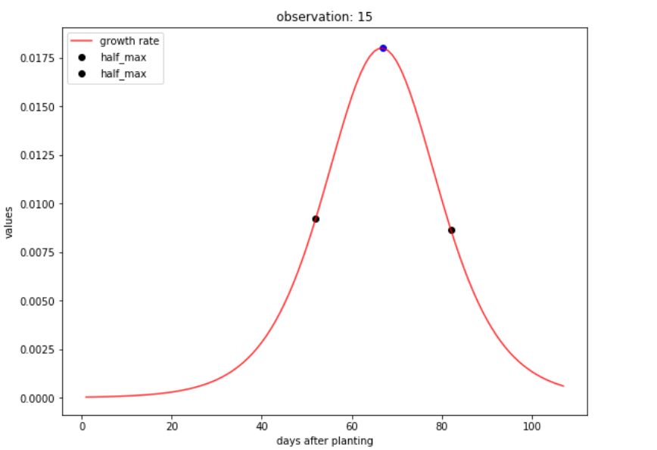
Derivative of sigmoid function – Growth Rate
Generate derivative of sigmoid function – growth rate -> apply growth rate function for all days in range (0, 107) to get the growth rate curve
Get the maximum growth rate, at which day
Get the half maximum growth rate, at which days, and their difference (duration)

Slide 6
Preprocess data
For each parameters value(CH, CV): generate 6 columns max_value , max_growth_rate, half_max_growth_rate, first_day_half_max , second_day_half_max, duration_half_max
Combine Bollsize, Bollnum, BollVolumn and irrigation
Input shape: (802, 6x2 + 3 + 2) = (802, 17)

Slide 7
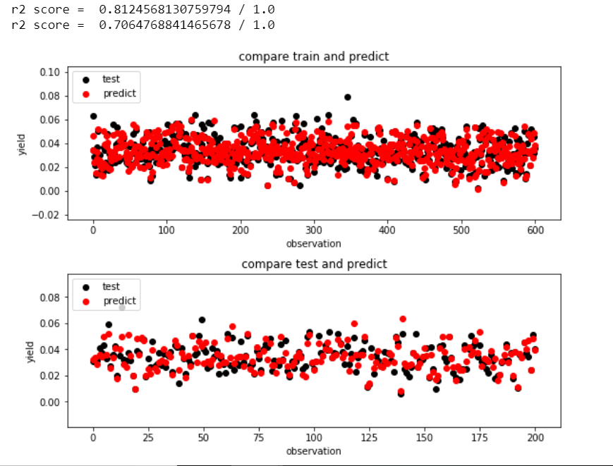
Train model to predict yield
Train model with 300 epochs

