Slide 1
Linux Final Project Report
Author: Phan Vu Huynh Tuan – 13.09.2025

Slide 2
Agenda
Project Overview
Driver Development
QT Application
Lesson learn

Slide 3

1. Project Overview

Slide 4
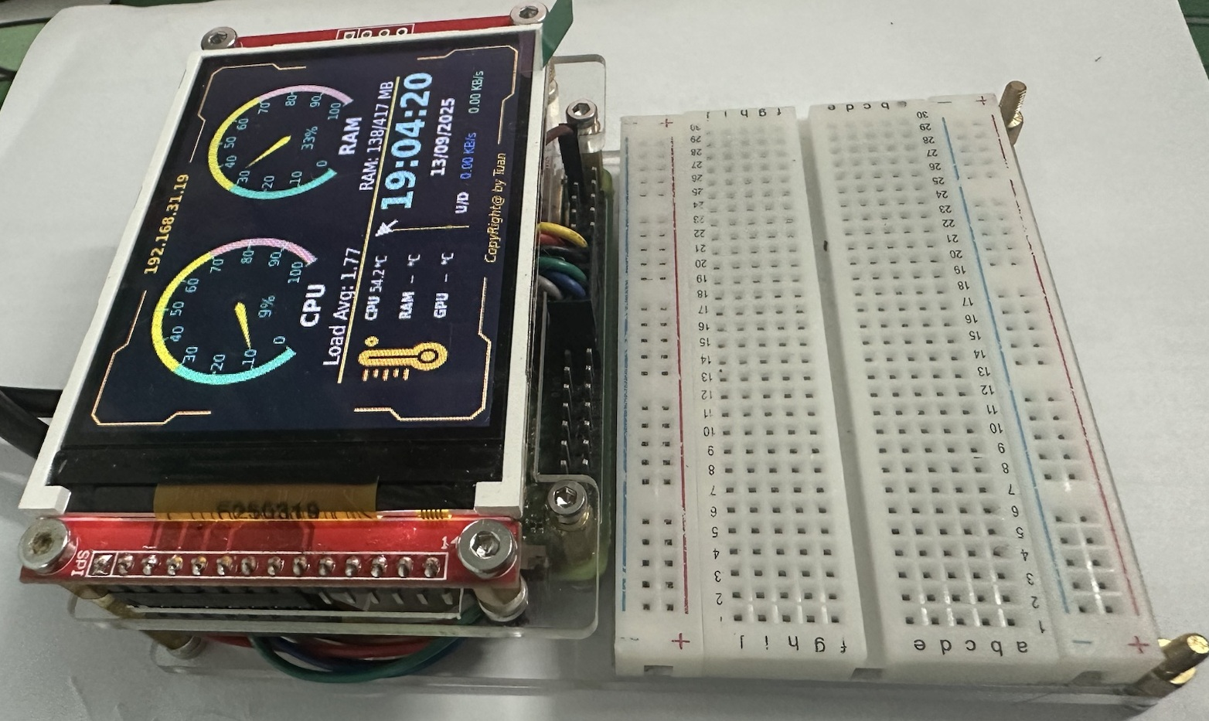
1. Project Overview
1.1. System Information
System description
Build a real-time monitoring and analysis application for the performance of a development board.
The system will track key resources such as CPU usage, memory consumption, network bandwidth, and other critical system metrics.
The purpose of this application is to provide continuous monitoring of system resources and help maintain system stability through a dedicated display interface.
System’s Components
Hardware:
+ Development board: Raspberry Pi Zero 2W.
+ Screen: LCD TFT 2.8” ILI9341 (w/o touch)
Operating system: Raspberry Pi OS, kernel version: 6.12.25
QT Framework version: 6.4.2.

Slide 5
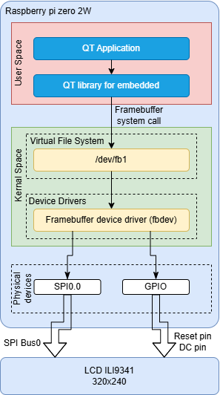
1. Project Overview
1.2. Application Architecture
System Structure
The system consists of two separate components: the Driver and the Application.
The Driver is built based on the framebuffer driver, enabling applications in user space to communicate with the hardware (LCD) via the SPI bus. In this setup, two physical devices are used:
+ SPI – handles data transfer.
+ GPIO – controls reset and switches between command/data modes for the LCD.
The Application is developed using the Qt framework, which provides developers with a user-friendly environment and simplified tools for building GUI applications.

Slide 6

2. Driver development

Slide 7
2. Driver development
2.1. Driver Overview
Driver Components: Framebuffer Handling and Data Transfer Handling
Framebuffer Handling: The primary function of framebuffer handling is to receive data from user space through system calls, store or modify it in virtual memory, and then trigger deferred I/O transfers.
Virtual memory size is determined by the maximum pixel resolution (320 × 240) multiplied by the number of bytes per pixel (2 bytes). The result is then rounded up to match the kernel memory page size.
The deferred I/O transfer delay is set to 20ms.
Data Transfer Handling: This component provides the functions to configure the SPI device and initiate data transfers to the LCD.
SPI speed: 32 MHz
SPI transfer via DMA: Not used

Slide 8
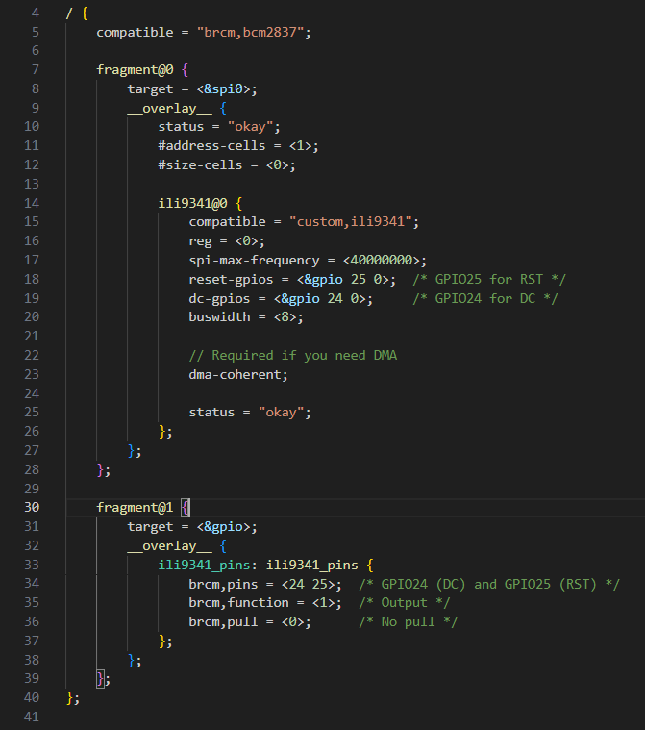
2. Driver development
2.2. Device tree
In this system, the device tree was created as an overlay in order to:
Minimize the time required to investigate other components (e.g., framebuffer, Qt, etc.).
Reduce the effort of rebuilding the Yocto project, which can otherwise be very time-consuming.
The device tree have 2 parts:
fragment@0 (SPI): Defines a custom node ili9341@0, created specifically for the LCD device. The compatible field is set to "customer,ili9341".
fragment@1 (GPIO): Configures the GPIO pins used to control the RST and DC signals.

Slide 9
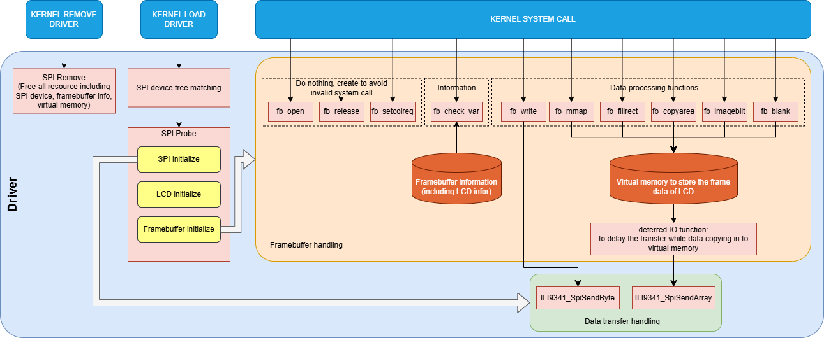
2. Driver development
2.3. Driver Structure

Slide 10
3. QT Application

Slide 11
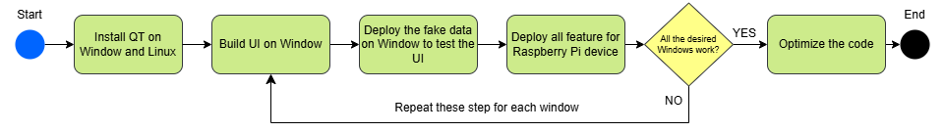
3. QT Application
3.1. Application Overview
Application development flow:
Framework used: In this system, Qt Widgets is chosen as the UI framework instead of Qt Quick because::
It is lightweight, making it suitable for applications running on limited CPU/GPU resources.
It does not require hardware acceleration (GPU) to function effectively.
Application Description: The application consists of four windows:
Main Window: Displays most of the system data using compact components such as meters and labels.
CPU Window: Provides a detailed graph of sub-CPU usage.
Memory Window: Shows detailed information about RAM and storage utilization.
Time Window: Presents the current time with a visually distinctive colored background.

Slide 12
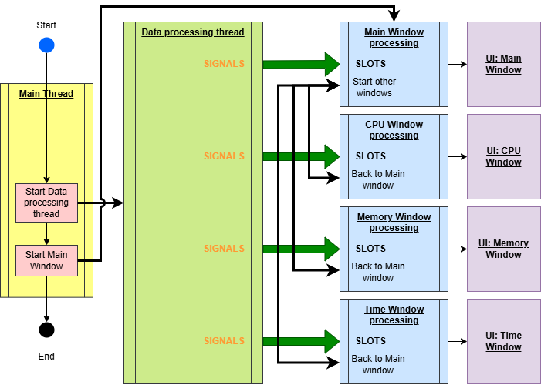
3. QT Application
3.2. Application Architecture

Slide 13
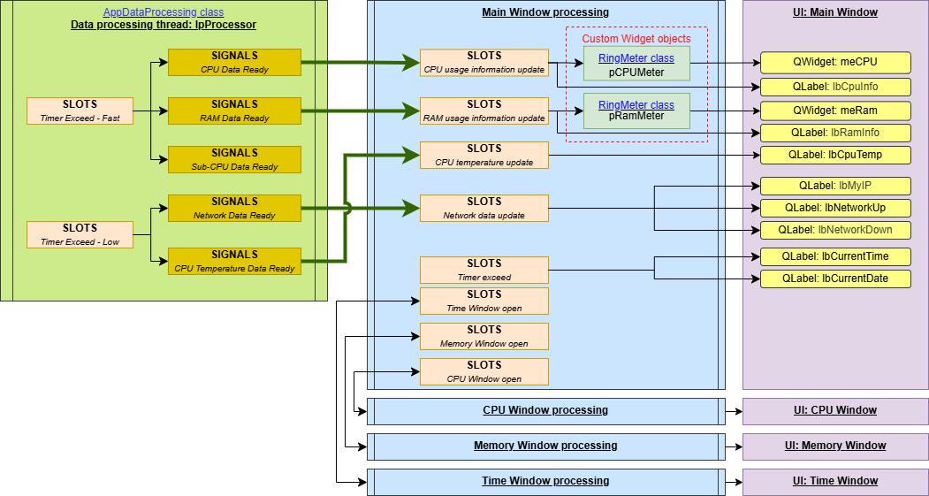
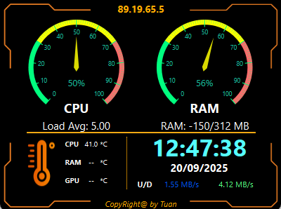
3. QT Application
3.3. Application Detail Design – Main Window

Slide 14
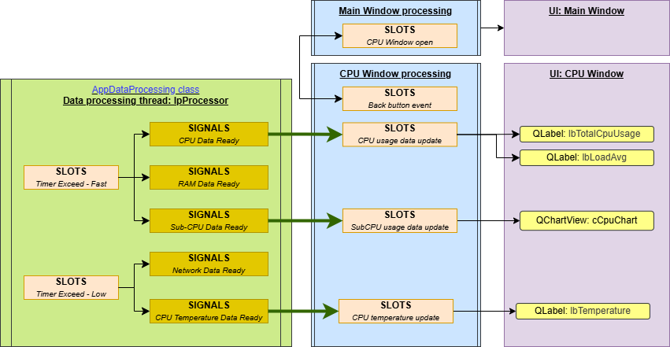
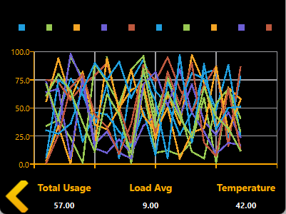
3. QT Application
3.4. Application Detail Design – CPU Window

Slide 15
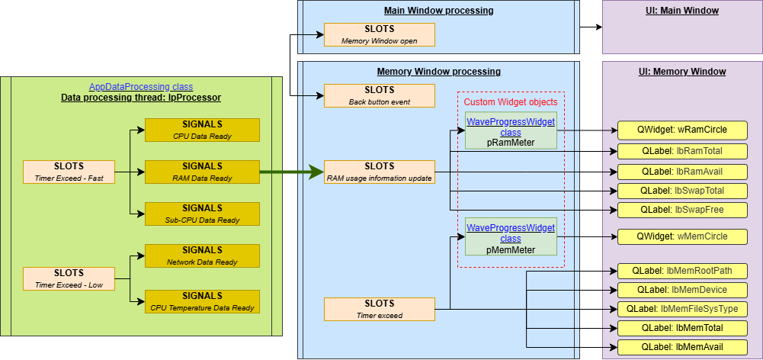
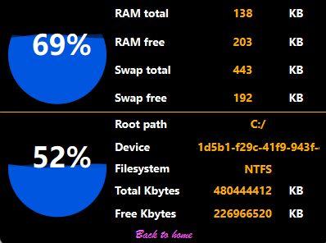
3. QT Application
3.5. Application Detail Design – Memory Window

Slide 16
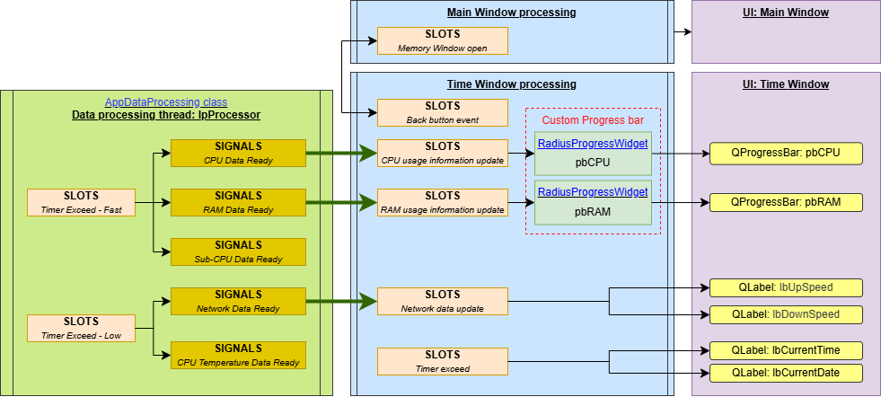
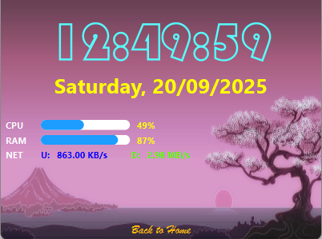
3. QT Application
3.6. Application Detail Design – Time Window

Slide 17

4. LESSON LEARN

Slide 18
4. Lesson learn
Part | Issue | Description | Solution | Disadvantage / Residual risk
Device Tree | Conflict to load module | When the compatible is “ili9341”, an autoload module which integrated in the image was load as a frame buffer device. Tried to use but can’t work. | Using another compatible name like “customer,ili9341” to prevent the autoload module. | -
Driver | Incorrect color | Due to the endian type of Linux kernel on Raspberry Pi (Little Endian), the high byte and low byte in a pixel data (16-bit) is swapped. | swap the buffer every 2 bytes before sending to LCD via SPI | Can’t swap on virtual buffer due to application will update into it. Creating new buffer with the same size shall increase the memory consumption
Driver | Low FPS of LCD | From the specification of ILI9341, the supported SPI speed is 10MHz only. With this speed, LCD works with high latency (low FPS). | Even the LCD specification describes that low SPI speed is expected. I tried to use the SPI speed up to 36MHz and it works. | Unstable data can be happened ➔ Haven’t observed so far.
Application | QT Framework install | As recommendation from QT, Cross-compile should be used to speed up the build time as well as resource optimization. But install the cross-compile between Windows and Raspberry Pi is too difficult and take much time. | Create the QT project on Windows, testing by using the fake data (random). Upload the source code to Raspberry Pi device via FTP. Compile the source code on Raspberry Pi directly. | Slow speed of compilation on RPi (around 5 minutes).
Application | Missed text font on RPi device | When design the UI on Windows, we can’t know that which font is available on RPi. | Install the corresponding font on the RPi. | -

