Slide 1
Plotting with seaborns and matplotlib
Fall 2024
Lecture 3; 08/28/2024
Dr. Jessica Huynh-Westfall

Slide 2
Agenda
Plotting libraries seaborn and matplotlib
relplot()
jointplot()
catplot()

Slide 3


Plotting with matplotlib and seaborn
Used for creating static, interactive, and animated visualizations in Python. Matplotlib allows you to generate plots, histograms, bar charts, scatter plots, etc.
Library for creating statistical graphics in Python. It is based on Matplotlib and integrates with Pandas data structures.

Slide 4
Display your plots in Jupyter notebook
Be sure to use the command %matplotlib inline to render and display the plot in Juypter notebook.
import pandas as pd
import seaborn as sns
import matplotlib.pyplot as plt
%matplotlib inline

Slide 5
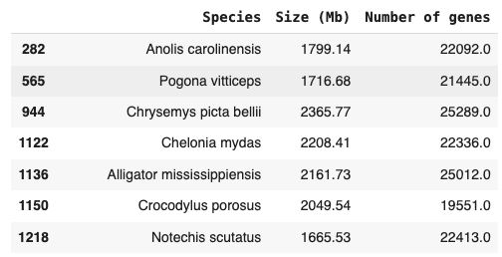
Investigating the relationship between two variables
We want to understand the relationship between ‘Species’ and ‘Number of genes’
Would it be easier to see the relationship visually?
Using relplot() function to show the relationship between two variables with semantic mappings of subsets.
kind parameter to select the axes-level function to use:
scatterplot() (with kind="scatter"; the default)
lineplot() (with kind="line")

Slide 6
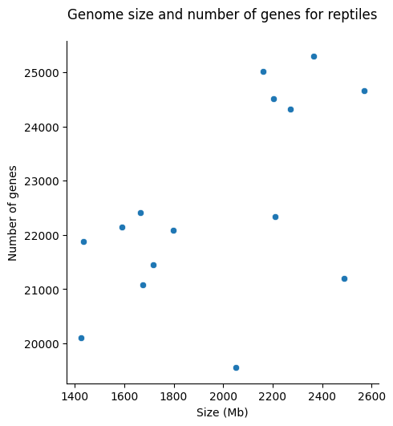
Visualizing the relationship between two variables
sns.relplot(data=selected, x="Size (Mb)", y="Number of genes")
plt.title("Genome size and number of genes for reptiles", pad=20)

Slide 7
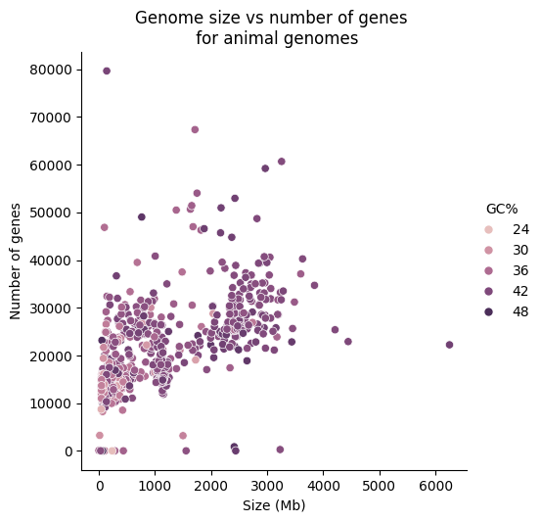
Adding color to our visualization
sns.relplot(data=animals, x="Size (Mb)", y="Number of genes", hue="GC%")
Setting hue argument (seaborn) on a column to add color to each point.
Additionally, this enable us to visualizing a 3rd variable.
Do you think the color scale for hue is impacted by missing data?
https://seaborn.pydata.org/tutorial/color_palettes.html
Notes:
Use panda’s dropna() to remove rows with missing data before we plot our data
Why? So that it won’t impact seaborn’s ability to choose the color scale for hue

Slide 8
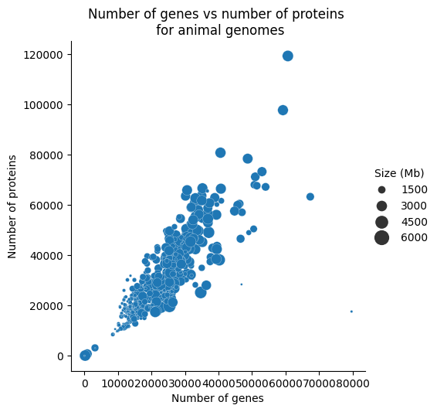
Mapping size of data point to our visualization
sns.relplot(data=animals,x="Size (Mb)", y="Number of genes", size="Size (Mb)", sizes=(1, 200))
We can map the size of the data point using the size argument
Select which column you want to map
Set the minimum and maximum sizes of the points you want on the plot

Slide 9
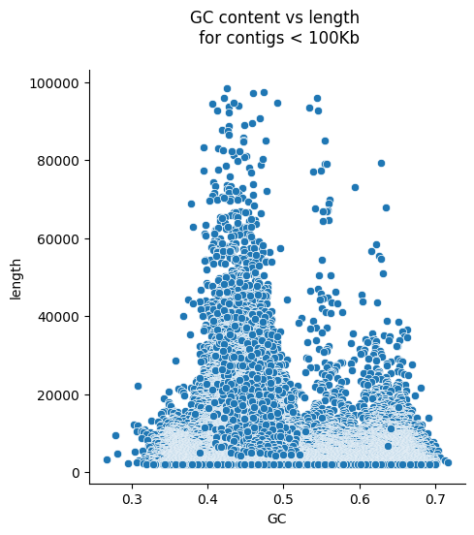
Changing transparency of data points with alpha( )
sns.relplot(data=con[con.length < 100000], x="GC", y="length", alpha=0.01)
Plot hard to visualize because there are too many points on top of one another.
To address this we can set the points to be transparent using the alpha argument.
alpha=0.01 makes each point 99% transparent

Slide 10
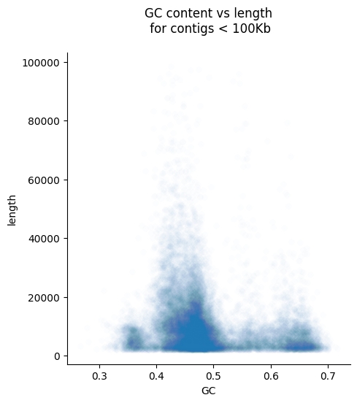
Changing transparency of data points with alpha( )
sns.relplot(data=con[con.length < 100000], x="GC", y="length", alpha=0.01)

Slide 11
jointplot() to create a bivariate plot
jointplot() show the relationship between two numerical variables and include the individual distribution along the axes
parameter kind=”hex”
Creates a hexbin plot by grouping data points into hexagonal bins and color them based on density
pfig = sns.jointplot(data=con[con.length < 100000], x="GC", y="length", kind=”hex”, gridsize=30)
Notes:
Hexbin plot is hexagonal binning plot instead of plotting individual data points.
gridsize=30 tells us how many hexes wide and high

Slide 12
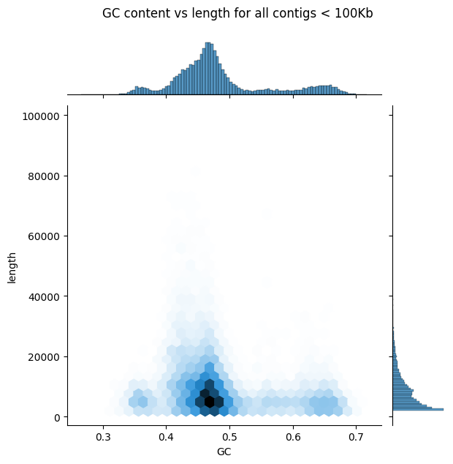
Hexagonal bin plot is useful for large dataset
Hexbin plot
Group data points instead of visualizing individual points.
Outlier disappear from plot because of low count
Plot useful to visualize large dataset where a scatter plot would be too clutter
Notes:
Hexagonal Bins: Instead of individual scatter points, data is grouped into hexagonal regions.
Color Intensity: The color of each hexagon represents the density of points in that region.
Clearer Visualization: Works well for large datasets where a scatter plot would be too cluttered.

Slide 13
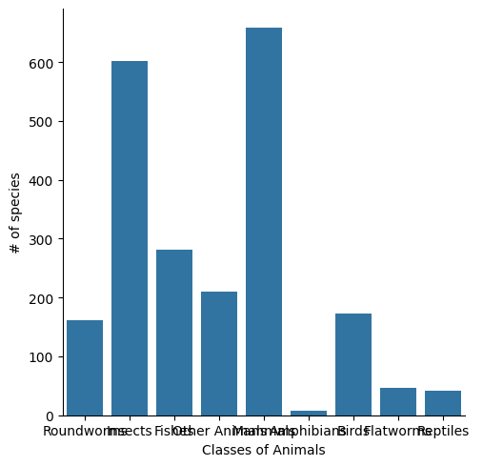
catplot() to create a categorical plot
catplot() show the relationship between two categorical variables
parameter kind
Multiple type of plots including box (box plot), violin (kde-based distribution), bar, count, point (to show means and confidence interval)
Resource: https://seaborn.pydata.org/generated/seaborn.catplot.html
sns.catplot(data=animal_df, x="Animals", kind=”count”)
Notes:
.to_frame(): To convert Series to dataframe

Slide 14
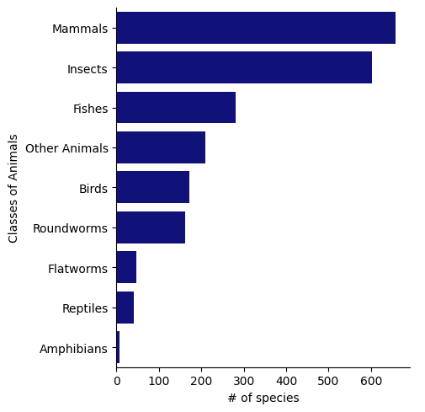
catplot() parameters
parameter kind
order, hue_order - to order the categorical levels
row_order, col_order - organize the row &/or columns
sns.catplot(data=animal_df, x="Animals", kind=”count”, order=animals_df['Animals'].value_counts().index)

Slide 15
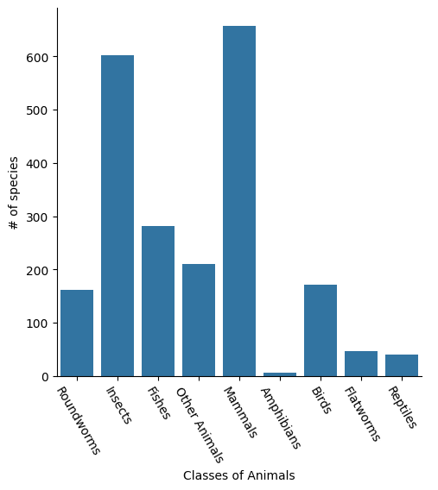
Customize plot using figure-level function
sns returns a FacetGrid object
fig = sns.catplot(
x='Animals',
data=animals_df,
kind='count'
)
fig.set_axis_labels('Classes of Animals', '# of species')
fig.set_xticklabels(rotation=300);
Notes:
figure-level function provides a high-level way to create multiple subplots and control layout easily.
Returns a figure-level object(FacetGrid) instead of an axes object
There are no function on sns for set_axis_labels etc. This is a method of the FacetGrid object so it must be called on the object returned by sns.catplot

