Slide 1
CEIS101 · FINAL PROJECT
Home Automation Security System
A sensor-driven smart home security prototype, designed and simulated in TinkerCad.
Philip Villalobos · DeVry University

Slide 2
OVERVIEW
Project Summary
This project explored how automation and security work together in a smart home. Using TinkerCad's circuit simulator, I designed a prototype that combines an ultrasonic distance sensor, LEDs, and an active buzzer to trigger alarm responses when an object comes within range — a hands-on introduction to how IoT sensors and automation logic interact in real-world security applications.
02 / 06
PHILIP VILLALOBOS

Slide 3
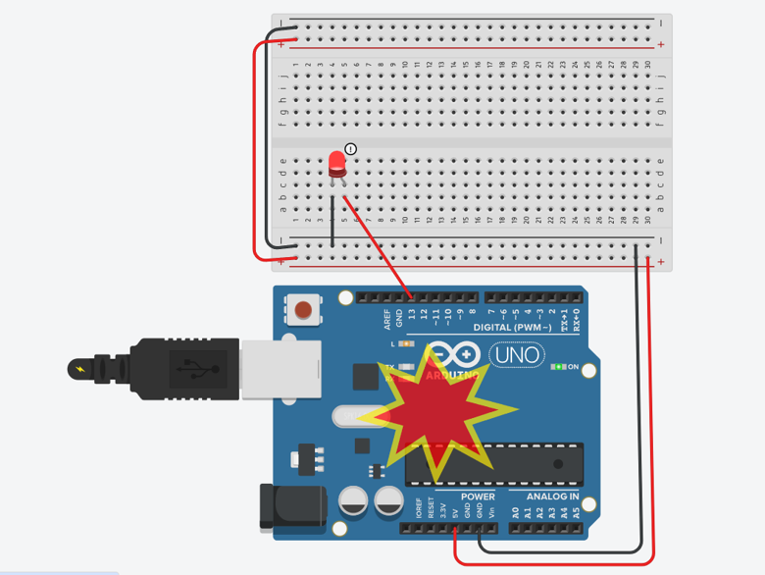
BUILD
Circuit Design & Wiring
The system runs on an Arduino Uno wired to an ultrasonic sensor, three LEDs, a photoresistor, and an active buzzer through a breadboard. Each component was mapped and wired individually before being integrated into a single automated circuit, with block code and Arduino IDE sketches controlling the sensor logic and alarm triggers.
03 / 06
PHILIP VILLALOBOS

Slide 4
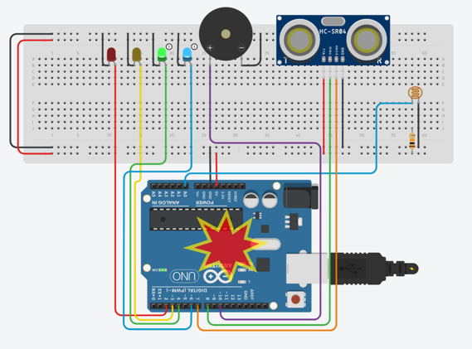
RESULTS
Automated Response & Testing
Once wired, the system was tested by moving objects at varying distances to trigger the correct LED and buzzer alarm codes. Sensor readings were logged and plotted to visualize distance data over time, confirming the automation responded reliably and consistently across repeated test runs.
04 / 06
PHILIP VILLALOBOS

Slide 5
SKILLS DEMONSTRATED
What This Project Built
Sensor-Based
Automation Logic
Circuit Design &
Wiring (TinkerCad)
Arduino IDE
Programming
Testing, Debugging
& Data Analysis
05 / 06
PHILIP VILLALOBOS

Slide 6
CONCLUSION
This project strengthened my understanding of how smart home technology works — from sensor calibration to automation logic — and built my confidence working hands-on with TinkerCad and the Arduino IDE. It's a foundation I'm continuing to build on as I move further into IoT and cybersecurity.
06 / 06
PHILIP VILLALOBOS

