Slide 1
CEIS-114 · SIX-WEEK FINAL PROJECT
IoT Traffic Controller
A simulated ESP32 traffic light system, built step-by-step in Wokwi.
Philip Villalobos · DeVry University

Slide 2
OVERVIEW
Project Summary
Over six weeks, I designed and progressively expanded a traffic light control system using the ESP32 microcontroller in the Wokwi virtual environment — starting with a single working light and building up to a full intersection system with pedestrian controls, sound, and visual feedback.
02 / 06
PHILIP VILLALOBOS

Slide 3
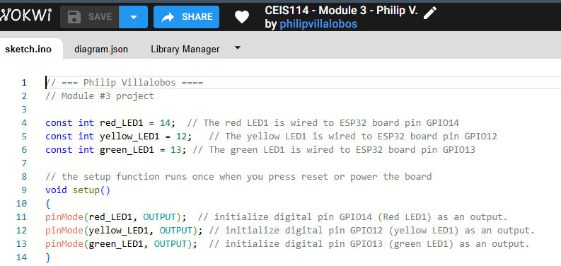
BUILD
System & Code
The final build combines two traffic lights, a pedestrian crosswalk button, a buzzer, and an LCD display, all coordinated through firmware written and tested in the Wokwi code editor. Each stage added new hardware and logic — from basic light timing to full pedestrian-aware sequencing.
03 / 06
PHILIP VILLALOBOS

Slide 4
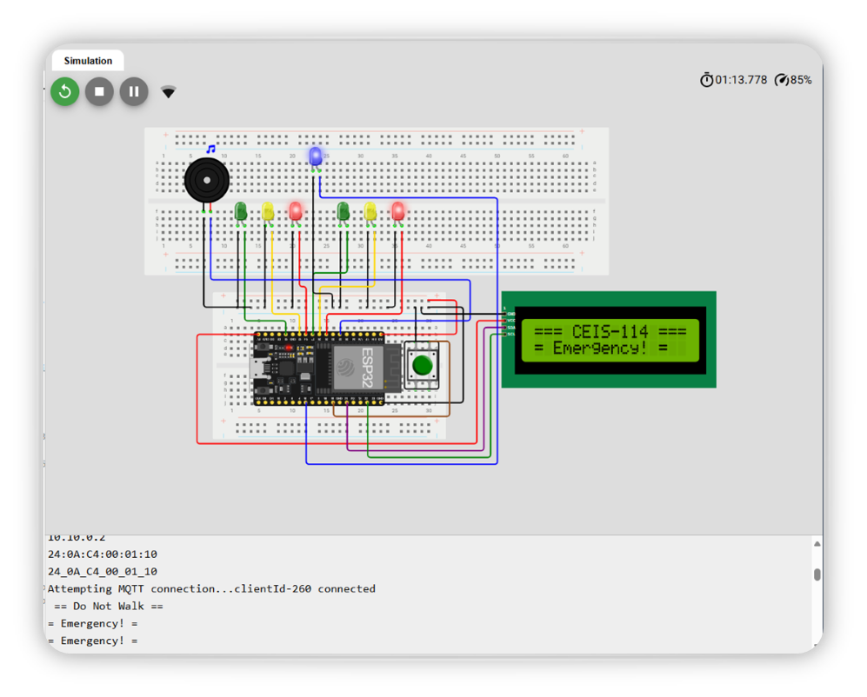
RESULTS
Testing & Integration
The completed system was tested end-to-end in simulation — verifying light sequencing, crosswalk button response, buzzer alerts, and LCD status output — to confirm the hardware and code worked together as one functioning digital device.
04 / 06
PHILIP VILLALOBOS

Slide 5
SKILLS DEMONSTRATED
What This Project Built
Embedded Systems
Programming (ESP32)
Circuit Design
& Wiring
Hardware/Software
Debugging
Timing & System
Synchronization
05 / 06
PHILIP VILLALOBOS

Slide 6
CONCLUSION
This six-week build was a strong lesson in how small components come together into a complete system. Wiring mistakes and timing bugs taught me patience and methodical debugging — skills that carry directly into more advanced IoT and embedded security work.
06 / 06
PHILIP VILLALOBOS

