Slide 1
NETW-191 · END OF COURSE PROJECT
SOHO Network Lab
Designing, configuring, and securing a small office/home office network.
Philip Villalobos · DeVry University

Slide 2
OVERVIEW
Project Summary
This project covered a series of hands-on networking labs focused on configuring, testing, and securing a small office/home office (SOHO) network — including IP addressing, Class C subnetting, connectivity testing, and wireless security controls such as WPA2/WPA3 encryption and MAC filtering.
02 / 06
PHILIP VILLALOBOS

Slide 3
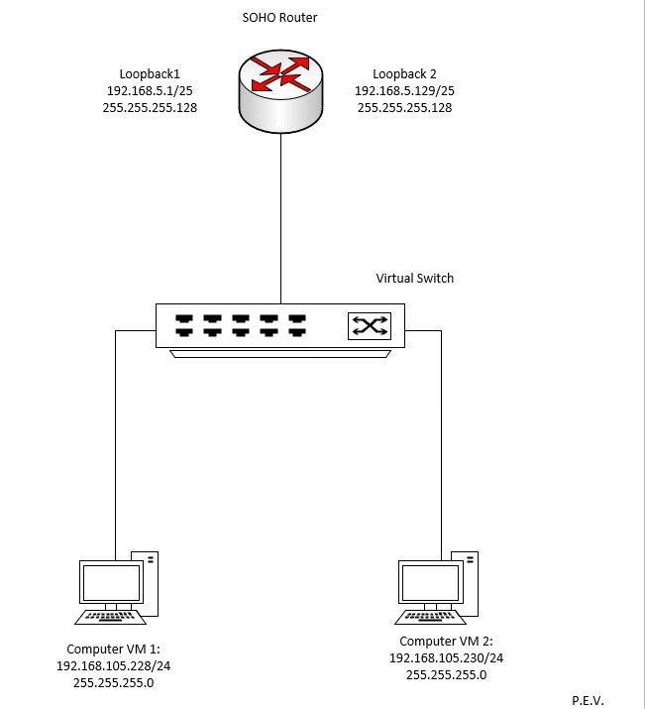
BUILD
Network Design
I mapped the full network topology in Microsoft Visio, documenting the interconnection between client VMs and the SOHO router along with proper IP addressing — the blueprint used to configure and troubleshoot the rest of the lab.
03 / 06
PHILIP VILLALOBOS

Slide 4
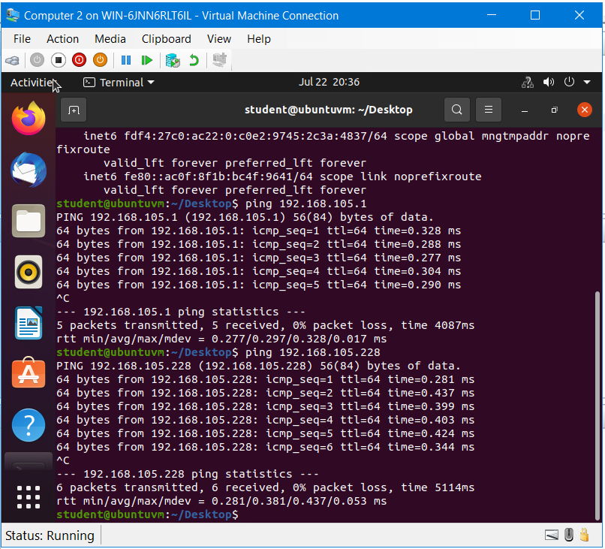
RESULTS
Configuration & Testing
With the network designed, I assigned static and dynamic IP addresses, configured loopback interfaces, and verified device-to-device connectivity end-to-end — confirming the network was properly addressed, routed, and reachable across every segment.
04 / 06
PHILIP VILLALOBOS

Slide 5
SKILLS DEMONSTRATED
What This Project Built
IP Addressing &
Subnetting
Network Diagramming
(Visio)
Connectivity
Troubleshooting
Wireless Security
Configuration
05 / 06
PHILIP VILLALOBOS

Slide 6
CONCLUSION
Through these labs, I built hands-on experience configuring, testing, and securing small networks — strengthening my grasp of core concepts like IP addressing, NAT, and DHCP, along with security practices like encryption and access control that carry directly into IT and cybersecurity roles.
06 / 06
PHILIP VILLALOBOS

