Slide 1
SEC285 · FINAL PROJECT
Fundamentals of Information
Systems Security
“Cybersecurity is not just about technology — it's about protecting the information that drives every organization.”
Philip Villalobos · DeVry University

Slide 2
OVERVIEW
Project Summary
This project applied core information systems security concepts across five hands-on modules — covering encryption, firewall configuration, multifactor authentication, vulnerability assessment, and security policy development — using real security tools in simulated lab environments.
02 / 06
PHILIP VILLALOBOS

Slide 3
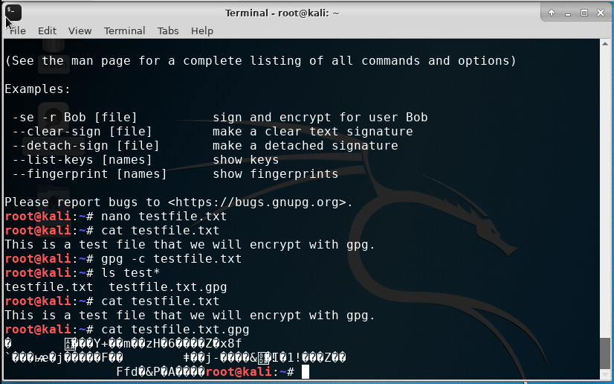
BUILD
Encryption, Firewalls & Access Control
I configured asymmetric file encryption and decryption, built stateful firewall rules with iptables, and set up multifactor authentication with Google Authenticator — then wrote an original BYOD security policy balancing usability with real-world compliance standards.
03 / 06
PHILIP VILLALOBOS

Slide 4
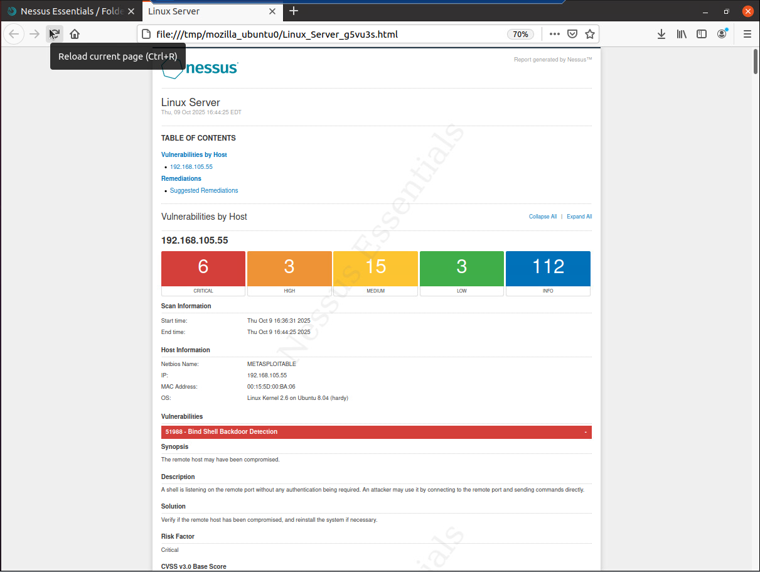
RESULTS
Vulnerability Assessment
Using Nmap, Nessus, and Wireshark, I scanned a lab target system to identify open ports, misconfigurations, and vulnerabilities — then interpreted the results to prioritize which risks mattered most, from critical findings down to informational ones.
04 / 06
PHILIP VILLALOBOS

Slide 5
SKILLS DEMONSTRATED
What This Project Built
Encryption & Key
Management
Firewall Configuration
(iptables)
Vulnerability Scanning
(Nmap / Nessus / Wireshark)
Multifactor
Authentication
Security Policy
Development (BYOD)
Technical Documentation
& Reporting
05 / 06
PHILIP VILLALOBOS

Slide 6
CONCLUSION
This project let me apply core information security principles in real-world scenarios — from firewalls and encryption to policy writing and vulnerability scanning — deepening both my technical skills and my understanding of how to protect systems, data, and users.
06 / 06
PHILIP VILLALOBOS

