Slide 1

Project IMDB dataset
Pablo Villegas Martin
Hari Konda
Abdullah Al Mamun

Slide 2
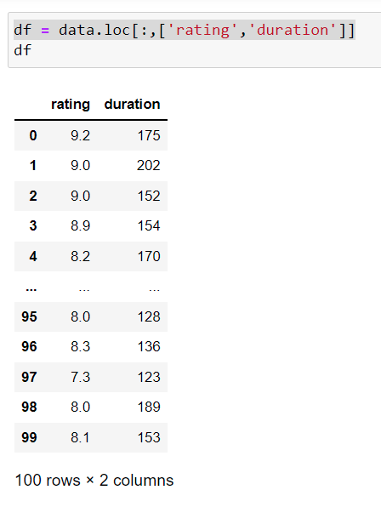
Normalization.

Slide 3
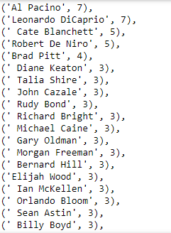
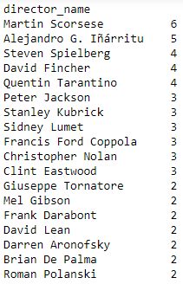
Top 100 movies Directors and Actors

Slide 4
