Slide 1
Best dystopian and post-Apocalyptic fiction
Pablo Villegas Martín
Hari Kishore Reddy Konda
Abdullah Al Mamun

Slide 2
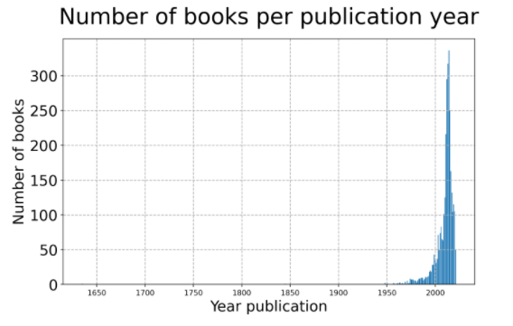

Slide 3
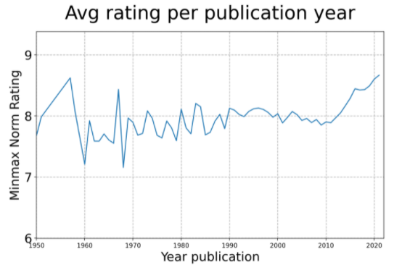

Slide 4
