Slide 1
US Permanent Visa Applications
Burak Sivrikaya
Pragya Vishalakshi

Slide 2

Outline
Problem Definition
Feature Analysis
Pre-processing
Model Training
Results
Future Work

Slide 3
PROBLEM DEFINITION

Slide 4
PROBLEM STATEMENT
USCIS receives and processes about 6 million immigration applications from individuals and employers.
Counting applicants already living in the U.S., experts estimated up to 5.5 million green card applications were pending at the close of 2012.
Predict the USCIS decision based on the data which is kept with US Department of Labor for previous applications.

Slide 5
DATASET
Retrieved from Kaggle
Covers data from 2012-2017 years
Includes information on 153 columns of details about applicant such as employer, position, wage offered, job posting history, employee, education, country etc. and final decision.
374362 applicants and 153 features (including target variable) are present in the dataset.

Slide 6
FEATURE
ANALYSIS

Slide 7
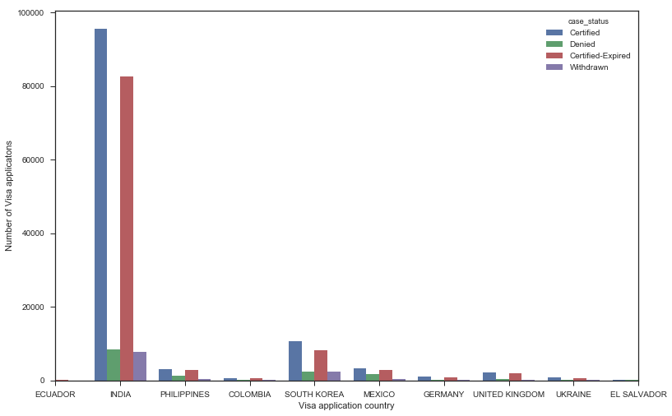
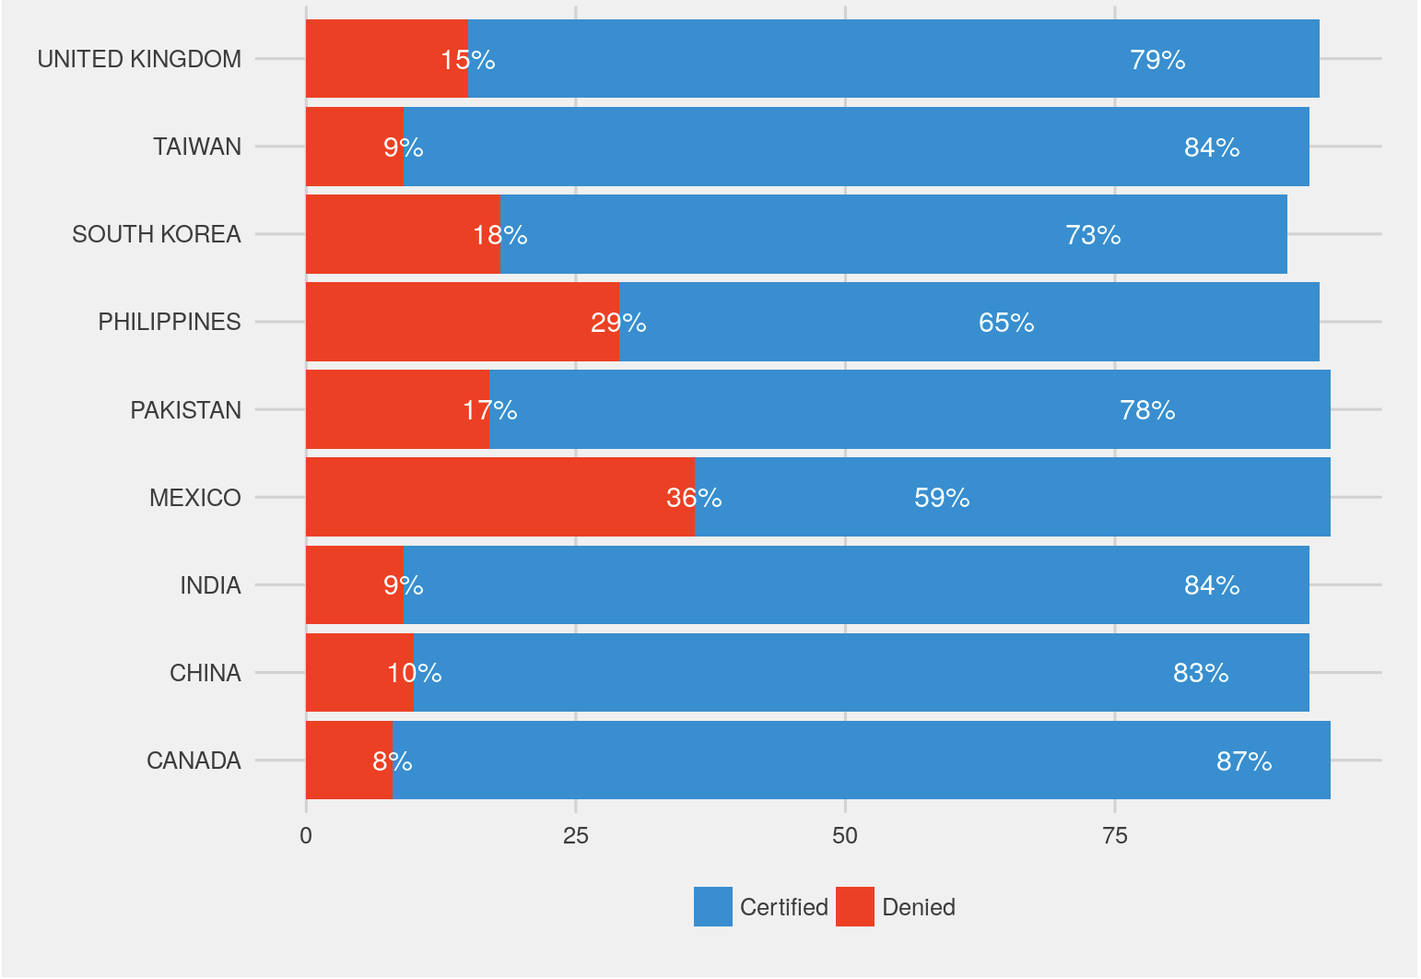
Top Applicant countries with all the classes of “case_status”- without scaling
Top Applicant countries after processing the classes of “case_status”- without scaling on percentage evaluation

Slide 8
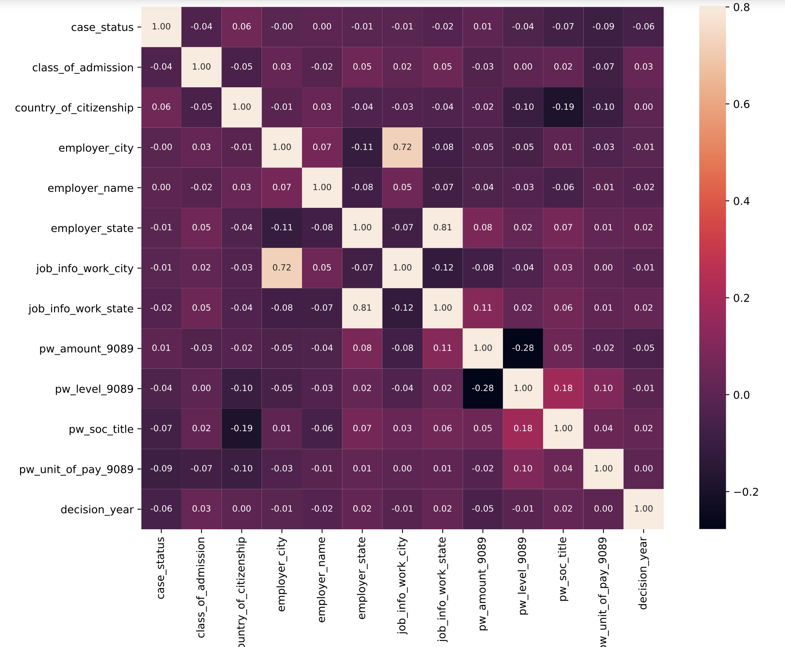
Correlation matrix on features

Slide 9
PRE-PROCESSING OF DATA

Slide 10
PRE-PROCESSING
Understand Multicollinearity and handle it
Removal of columns and rows having null (NaN) values
Removal of Outliers
Make dataset consistent across the column for all the applicants
Labelling (Numerically) and Scaling (MinMax Scaling) the dataset
Update the “case_status” column value according to problem statement requirement
Dataset after pre-processing:
Binary Classification problem
Dataset modulared to 291052 applicants and 9 features (including target variable)

Slide 11
MODEL
TRAINING

Slide 12
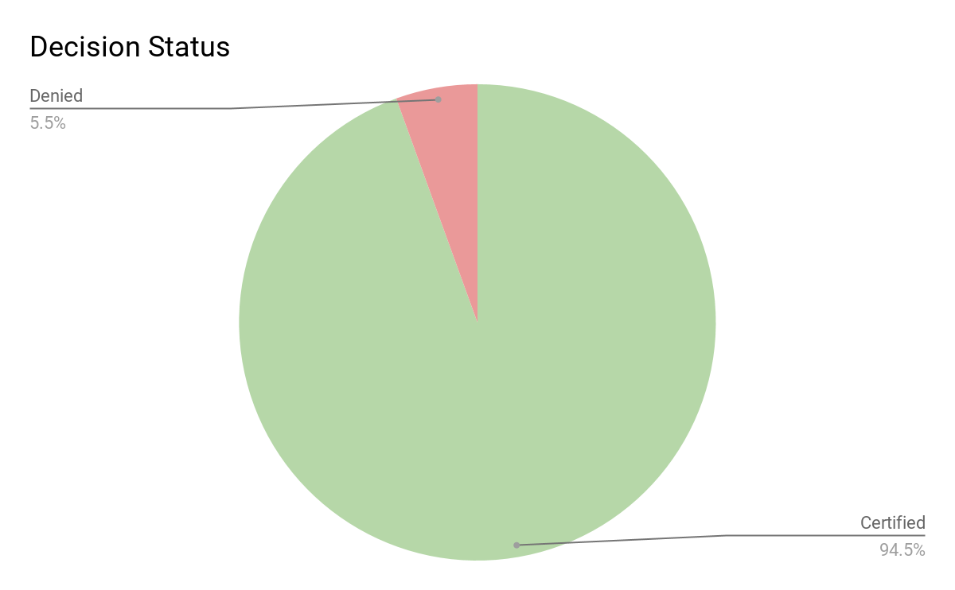
PROBLEM! IMBALANCED CLASSES
274,941
16,111
certified
denied

Slide 13
IMBALANCED CLASSES
Similar cases: Disease screening, fraud detection
Many machine learning algorithms tries to maximize overall accuracy. But, Accuracy is misleading here!
Possible tactics
Up/down sampling
Changing performance evaluation metric
Tree based or cost-sensitive algorithms
Notes:
Why not down/up sampling?
The disadvantage with undersampling is that it discards potentially useful data.
A. The main disadvantage with oversampling, from our perspective, is that by making exact copies of existing examples, it makes overfitting likely.
2. B. Second disadvantage of oversampling is that it increases the number of training examples, thus increasing the learning time.

Slide 14
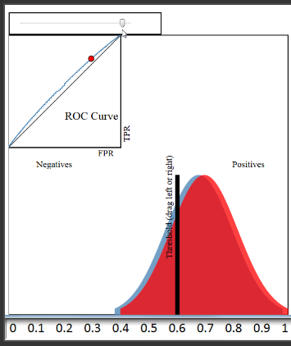
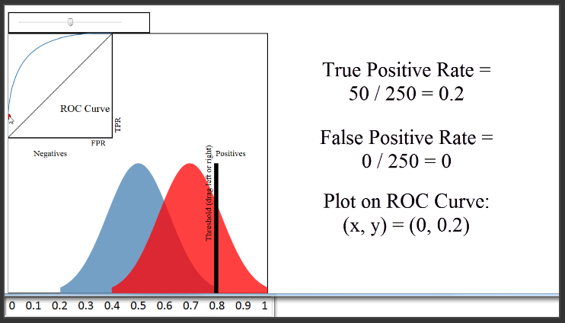
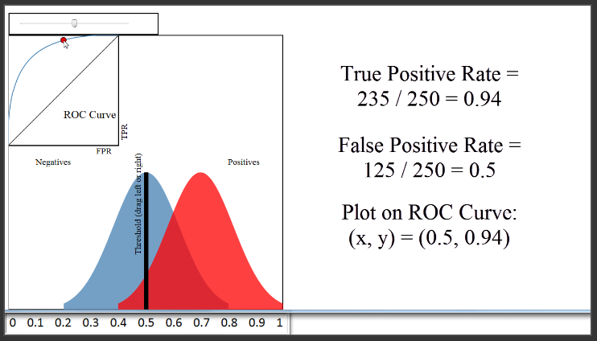
ROC Curves and Area Under the Curve
It is a plot of the True Positive Rate (on the y-axis) versus the False Positive Rate (on the x-axis) for every possible classification threshold.
Only suitable for binary classification cases
Requires prediction probabilities
An ROC curve visualizes all possible classification thresholds, whereas misclassification rate only represents your error rate for a single threshold.

Slide 15
Hyper-parameter selection
Logistic Regression
Regularization type
Regularization constant
Multilayer Perceptron
Learning Rate
Activation Function
Alpha
Hidden Layer Sizes
SVC
C
Kernel
Gamma
Degree
Decision Trees
Max depth
Max features
Random Forest
Max depth
Max features
Number of estimators
AdaBoost
Learning Rate
Number of estimators
k-NN
Number of neighbors

Slide 16
Training & Validation
Train - Test Split
75% / 25%
~ 225K / 75K
5-fold stratified
cross validation
Grid search for parameter sets
Select the best parameters maximizing AUC-ROC

Slide 17
Hyper-parameter selection
Logistic Regression
Regularization type L1
Regularization constant 100
Multilayer Perceptron
Learning Rate 0.1
Activation Function tanh
Alpha 0.001
Hidden Layer Sizes (5,2)
SVC
Kernel radial
C 0.001 , Gamma 0.01
Number of estimators 20
Number of max samples 10000
Decision Trees
Max depth 8
Max features 8
Random Forest
Max depth 8
Max features 8
Number of estimators 50
AdaBoost
Learning Rate 0.1
Number of estimators 50
k-NN
Number of neighbors 100

Slide 18
RESULTS

Slide 19
Results
 | LR | DT | RF | Adaboost | k-NN | MLP | SVC
auc_roc | 0.666 | 0.723 | 0.752 | 0.73 | 0.721 | 0.687 | 0.633
test_acc | 0.9446 | 0.9449 | 0.9462 | 0.9460 | 0.9448 | 0.9446 | 0.9446
train_auc_roc | 0.666 | 0.718 | 0.746 | 0.73 | 0.711 | 0.681 | 0.625
false_positives | 4028 | 3886 | 3880 | 3128 | 3967 | 4028 | 4028
false_negatives | 0 | 120 | 33 | 798 | 51 | 1 | 0
true_positives | 68735 | 68615 | 68702 | 67937 | 68684 | 68734 | 68735
true_negatives | 0 | 142 | 148 | 900 | 61 | 0 | 0
Linear(LR, Linear-SVC) and simple models(MLP with few layers) work poor
Penalized-SVC is potentially promising but could only run with bagging; and worked poor.
Tree-based algorithms works well (Hierarchical structure allows them to learn signals from both classes)
Tree ensembles outperform decision trees
Boosting helps imbalance classes
k-NN is not influenced by the size of the classes

Slide 20
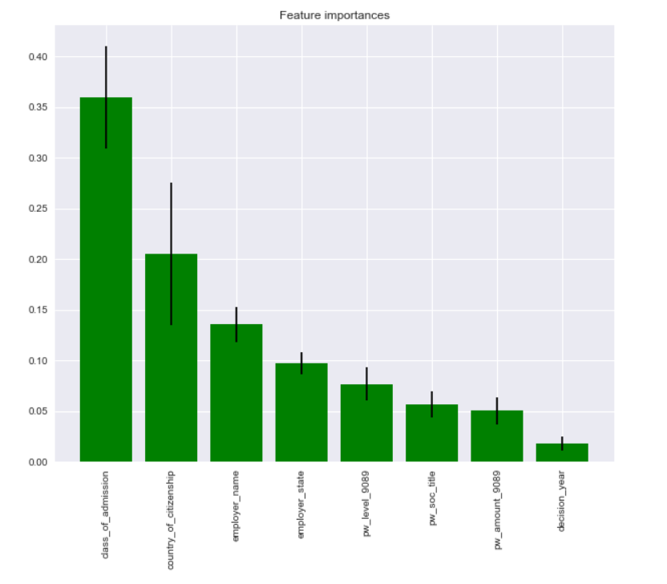
Random Forest performed the best.
So, what features are important?

Slide 21
Future Work
What to do to improve the results?
More extensive hyper-parameter selections
More parameter sets
Apply costly models with high-performance computers
Deep Learning algorithms
Applying on different datasets like H1B visa applications available on Kaggle

Slide 22
THANK YOU
Any questions?

