Slide 1
Active contours, taken seriously, on real endoscopy data
A leakage-audited, shortcut-aware study of active-contour-guided polyp classification on Kvasir
ACPolyp · research prototype · Kvasir v2 (research/education use only)

Slide 2
Why this is harder than the leaderboard suggests
Kvasir v2: 8,000 frames, 8 classes, one hospital
• Polyp detection quality varies between endoscopists; automated support is an active research area.
• Kvasir ships no patient or video IDs, and frames carry acquisition artefacts that leak the class.
• Published accuracies use different class subsets, random splits and preprocessing, so they are not comparable.
• Question asked here: does an unsupervised active-contour prior still help a strong fine-tuned network, and through which mechanism?
ACPolyp · research prototype · Kvasir v2 (research/education use only)

Slide 3
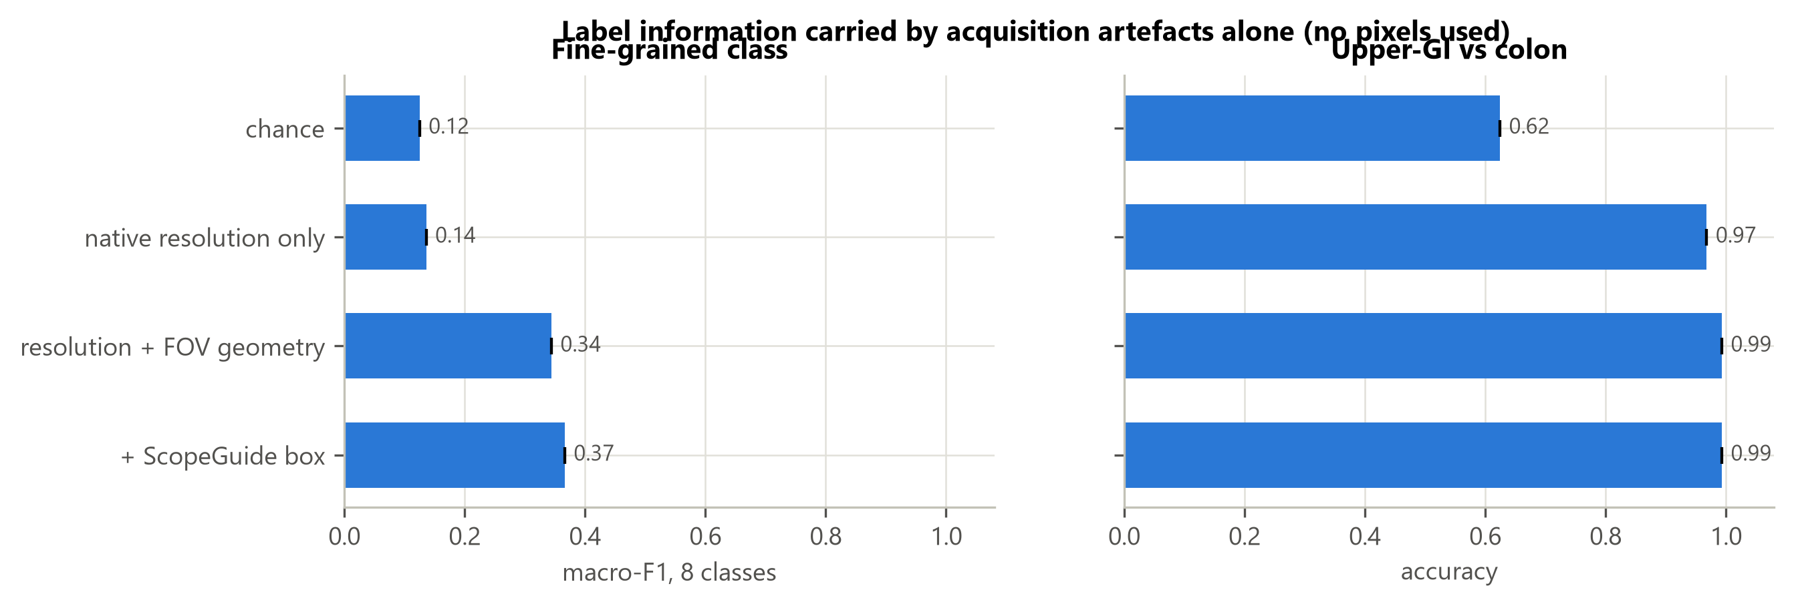
Data audit: what we found before training anything
• 31 duplicate frames removed, including one file filed under two classes (7,969 frames remain).
• Native resolution alone predicts upper-GI vs colon with 96.8% accuracy (majority baseline 62.4%).
• ScopeGuide box in 95% of cecum frames, 0% of upper-GI frames: masked in every frame.
• 550 labels (6.9%) flagged as suspect, mostly esophagitis vs z-line.
• Scene-grouped split: 0 leaking groups (a random split would leak 41).
ACPolyp · research prototype · Kvasir v2 (research/education use only)

Slide 4
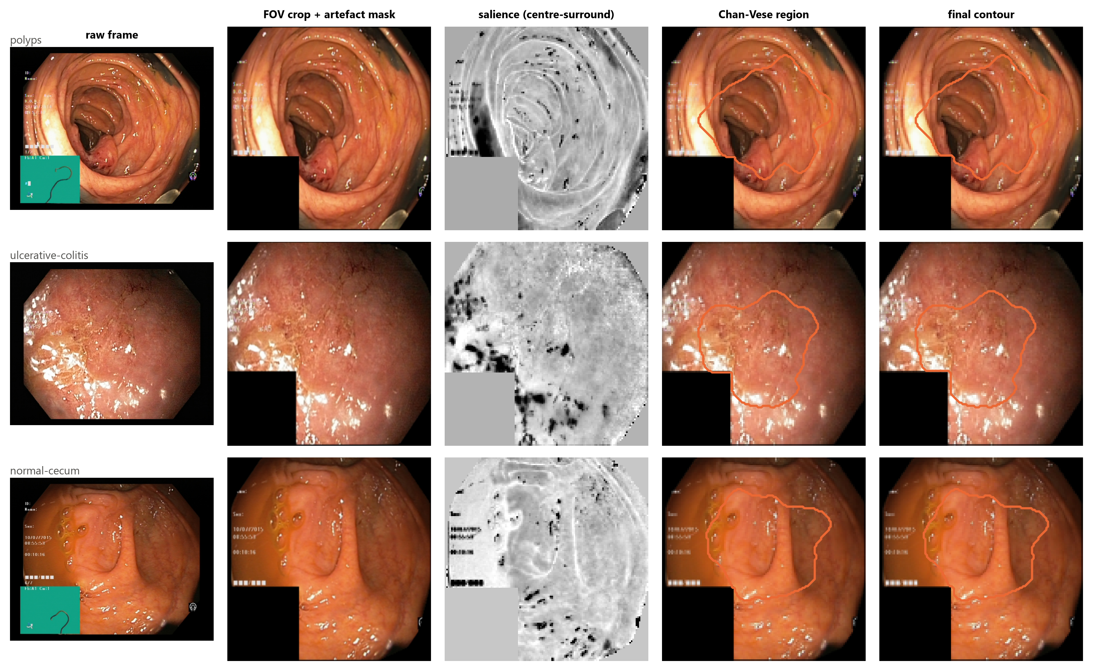
Pipeline: canonicalise → delineate → describe → guide → calibrate
ACPolyp · research prototype · Kvasir v2 (research/education use only)

Slide 5
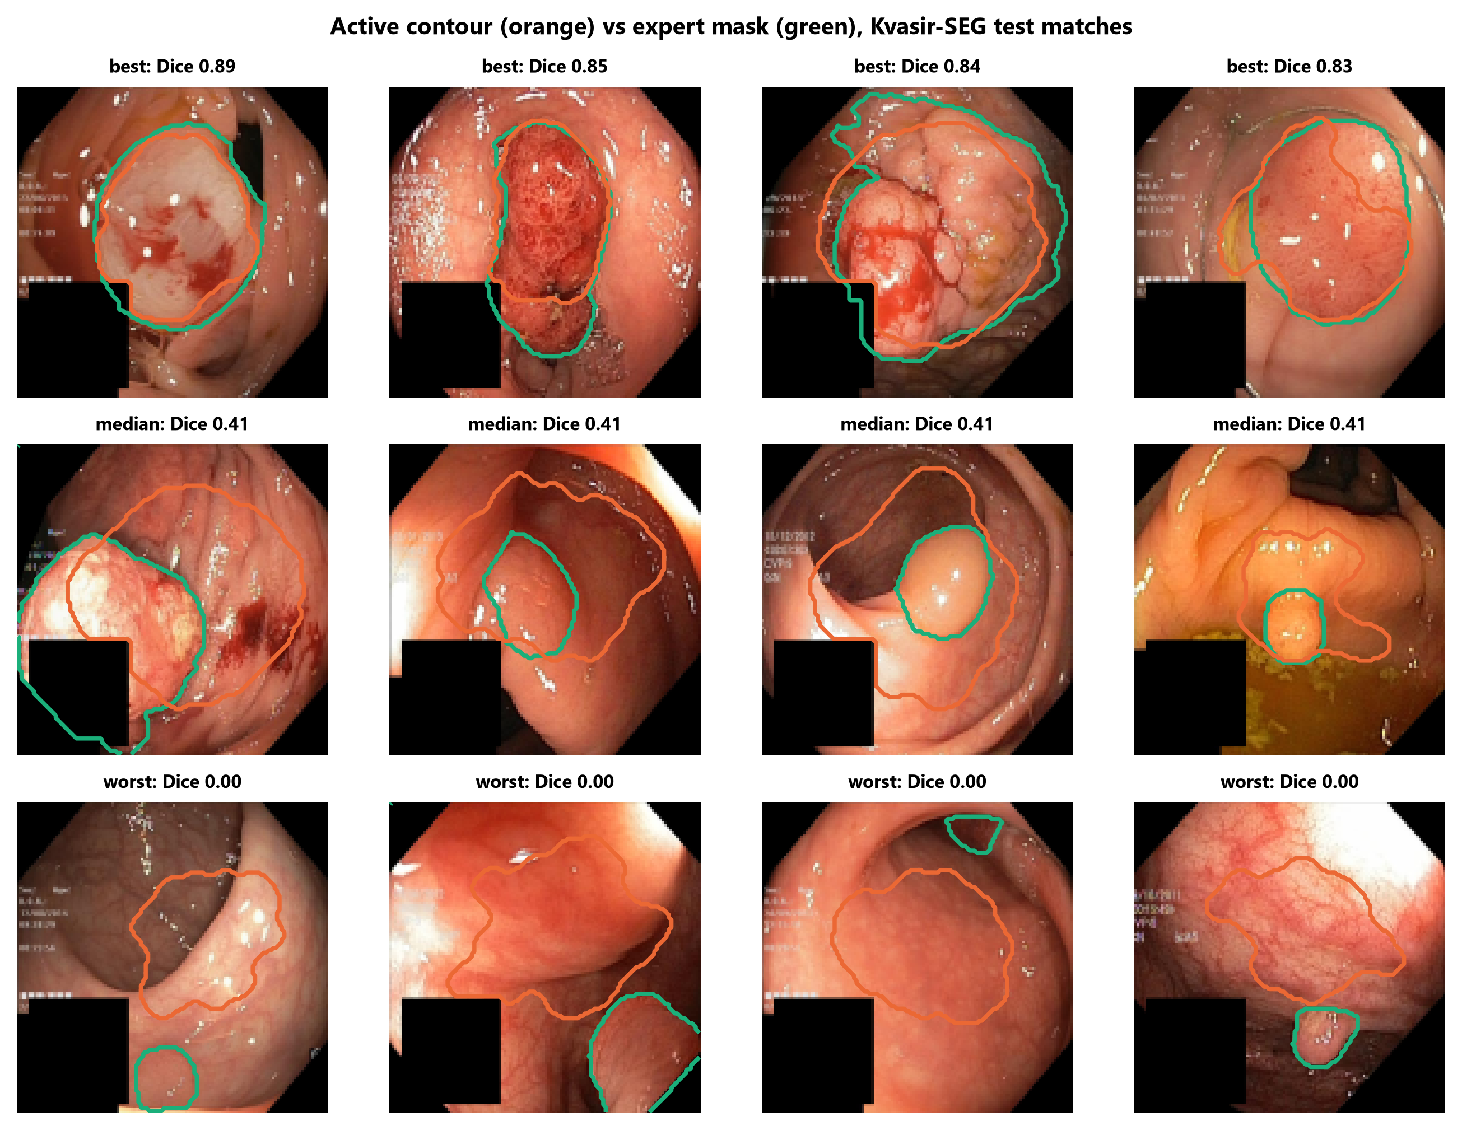
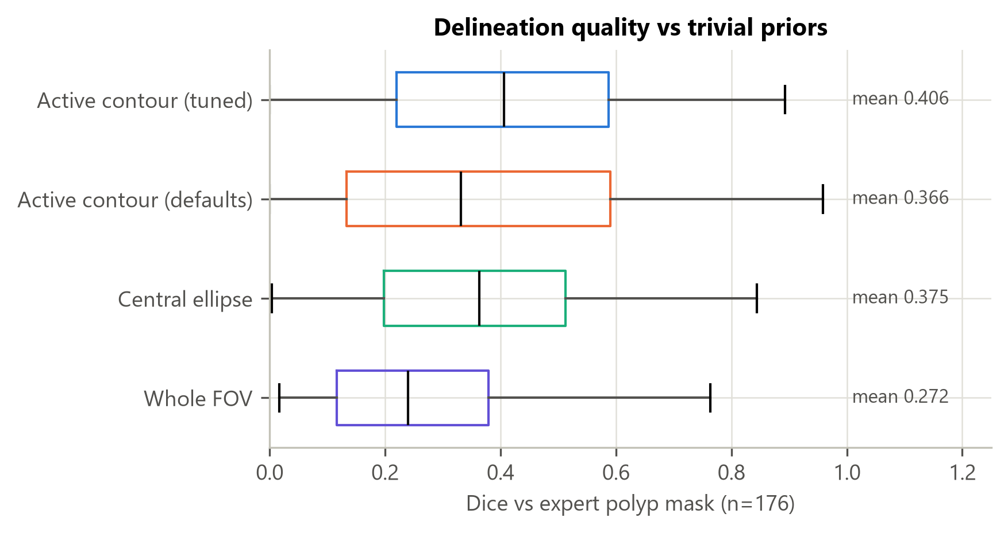
The contour is a weak but real localiser
• Dice 0.406 (95% CI 0.373-0.440) on 176 test-split polyps, tuned on train-matched frames only.
• Central ellipse: 0.375. Paired difference +0.031 (Wilcoxon p = 2.5e-06).
• Over-segments (median 2.4x expert area); Dice 0.21 on small polyps.
ACPolyp · research prototype · Kvasir v2 (research/education use only)

Slide 6
ACGNet and its controls
• Backbone feature map pooled inside / outside the contour, plus 98 contour features.
• Controls that separate 'a mask' from 'this image's contour': shuffled-image contours, central ellipse, non-contour features.
• Same recipe for every variant: AdamW, cosine schedule, bf16, 10 epochs, 3 seeds.
• Paired bootstrap over test images, Holm correction, McNemar and DeLong on seed ensembles.
ACPolyp · research prototype · Kvasir v2 (research/education use only)

Slide 7
Benchmark under one audited protocol
Test split, mean over seeds
Model | Macro-F1 | Accuracy | Polyp AUROC
ResNet-50 | 0.8708 | 0.8712 | 0.9916
EfficientNetV2-S | 0.9257 | 0.9258 | 0.9957
ConvNeXt-T | 0.9233 | 0.9235 | 0.9931
Swin-T | 0.9327 | 0.9327 | 0.9947
DINOv2 ViT-S/14 | 0.9344 | 0.9343 | 0.9916
ACG-ConvNeXt (full) | 0.9277 | 0.9279 | 0.9900
ACG-ResNet-50 | 0.8560 | 0.8565 | 0.9887
LightGBM · global colour/texture | 0.7507 | 0.7513 | 0.9565
LightGBM · contour features only | 0.8063 | 0.8073 | 0.9721
LightGBM · global + contour | 0.7954 | 0.7964 | 0.9716
Logistic reg. · global + contour | 0.7763 | 0.7773 | 0.9712
LightGBM · global + central-ellipse features (control) | 0.8003 | 0.8005 | 0.9788
ACPolyp · research prototype · Kvasir v2 (research/education use only)

Slide 8
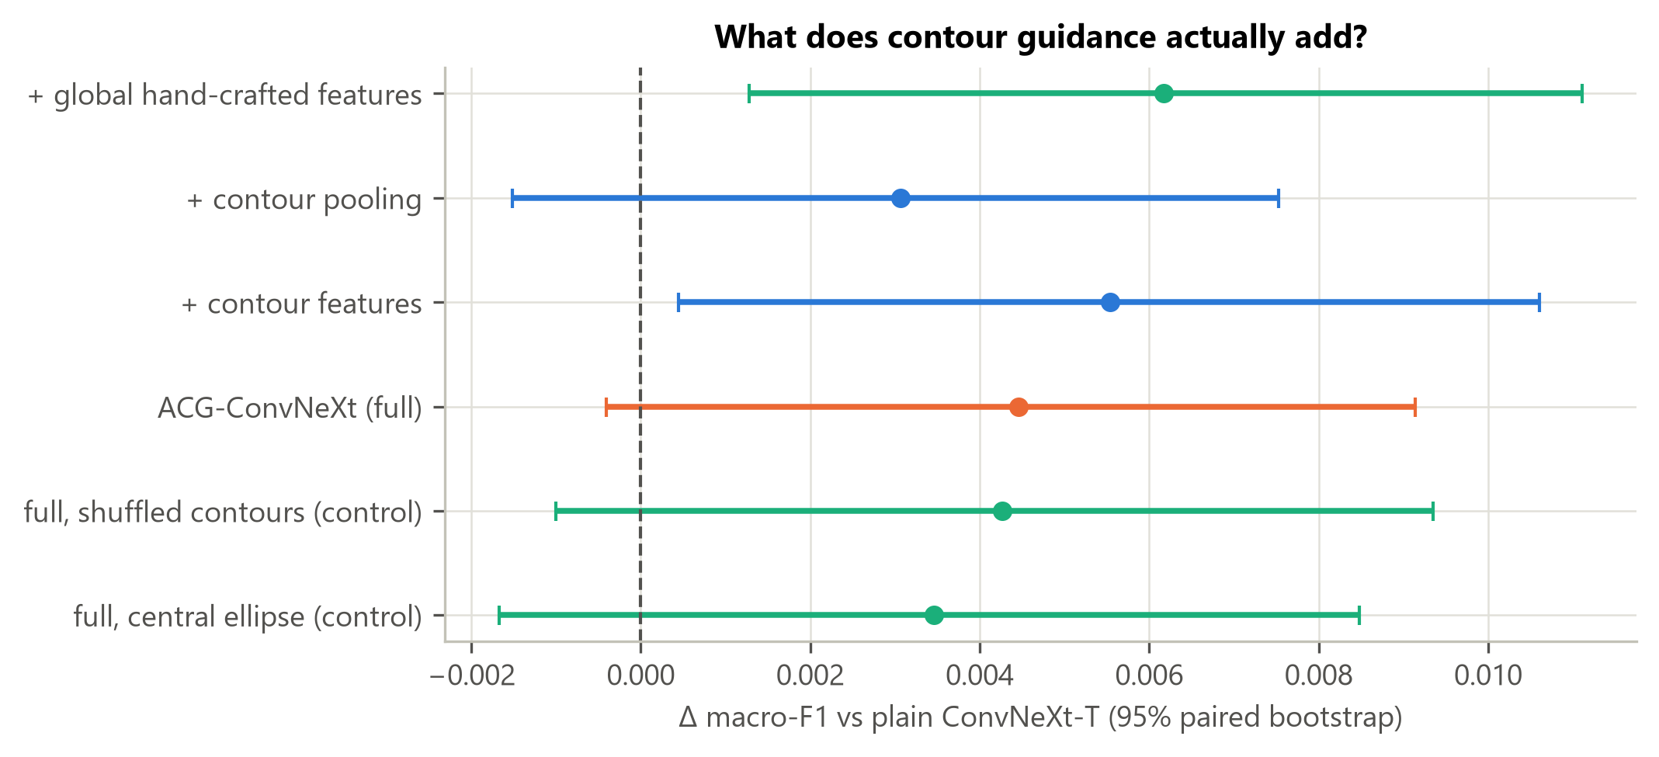
Honest result: contour guidance did not significantly help
• Full model vs plain: +0.0045 macro-F1, 95% CI [-0.0004, +0.0091], Holm p = 0.30.
• Shuffled-contour control +0.0043, ellipse control +0.0035: indistinguishable.
• Small gains track extra hand-crafted inputs, not contour alignment.
ACPolyp · research prototype · Kvasir v2 (research/education use only)

Slide 9
Shortcuts and leakage, measured
• Naive full frames (no crop, no artefact mask): macro-F1 0.9248 vs canonical 0.9233 (difference +0.0015, 95% CI -0.0033 to +0.0060): the shortcuts bought no accuracy.
• Random split: macro-F1 0.9356 and polyp AUROC 0.9994 vs 0.9931 on the grouped split: leakage shows up most in the AUROC.
• Shortcuts still matter for audits: resolution alone predicts upper-GI vs colon at 96.8%.
• Remaining errors are within-region pairs (esophagitis vs z-line, dyed classes) where no shortcut helps.
ACPolyp · research prototype · Kvasir v2 (research/education use only)

Slide 10
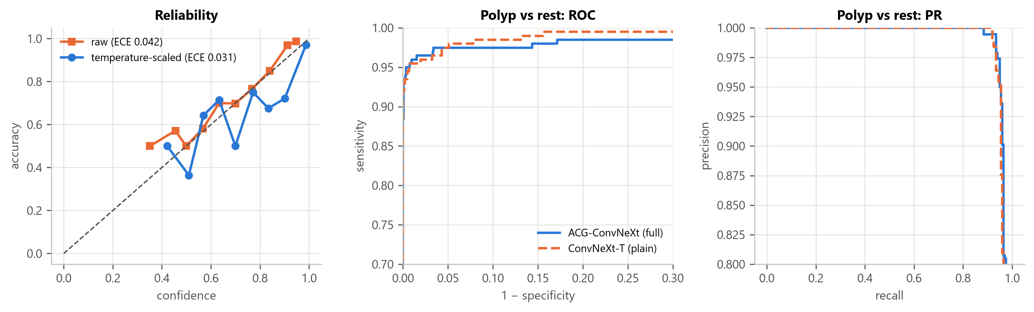
Calibration and conformal prediction
• ECE 0.046 → 0.033 after temperature scaling.
• Validation-calibrated sets cover 92.9% (target 95%): validation was reused for model selection.
• Group-aware test-split calibration: 95.2% coverage, mean set size 1.06.
ACPolyp · research prototype · Kvasir v2 (research/education use only)

Slide 11
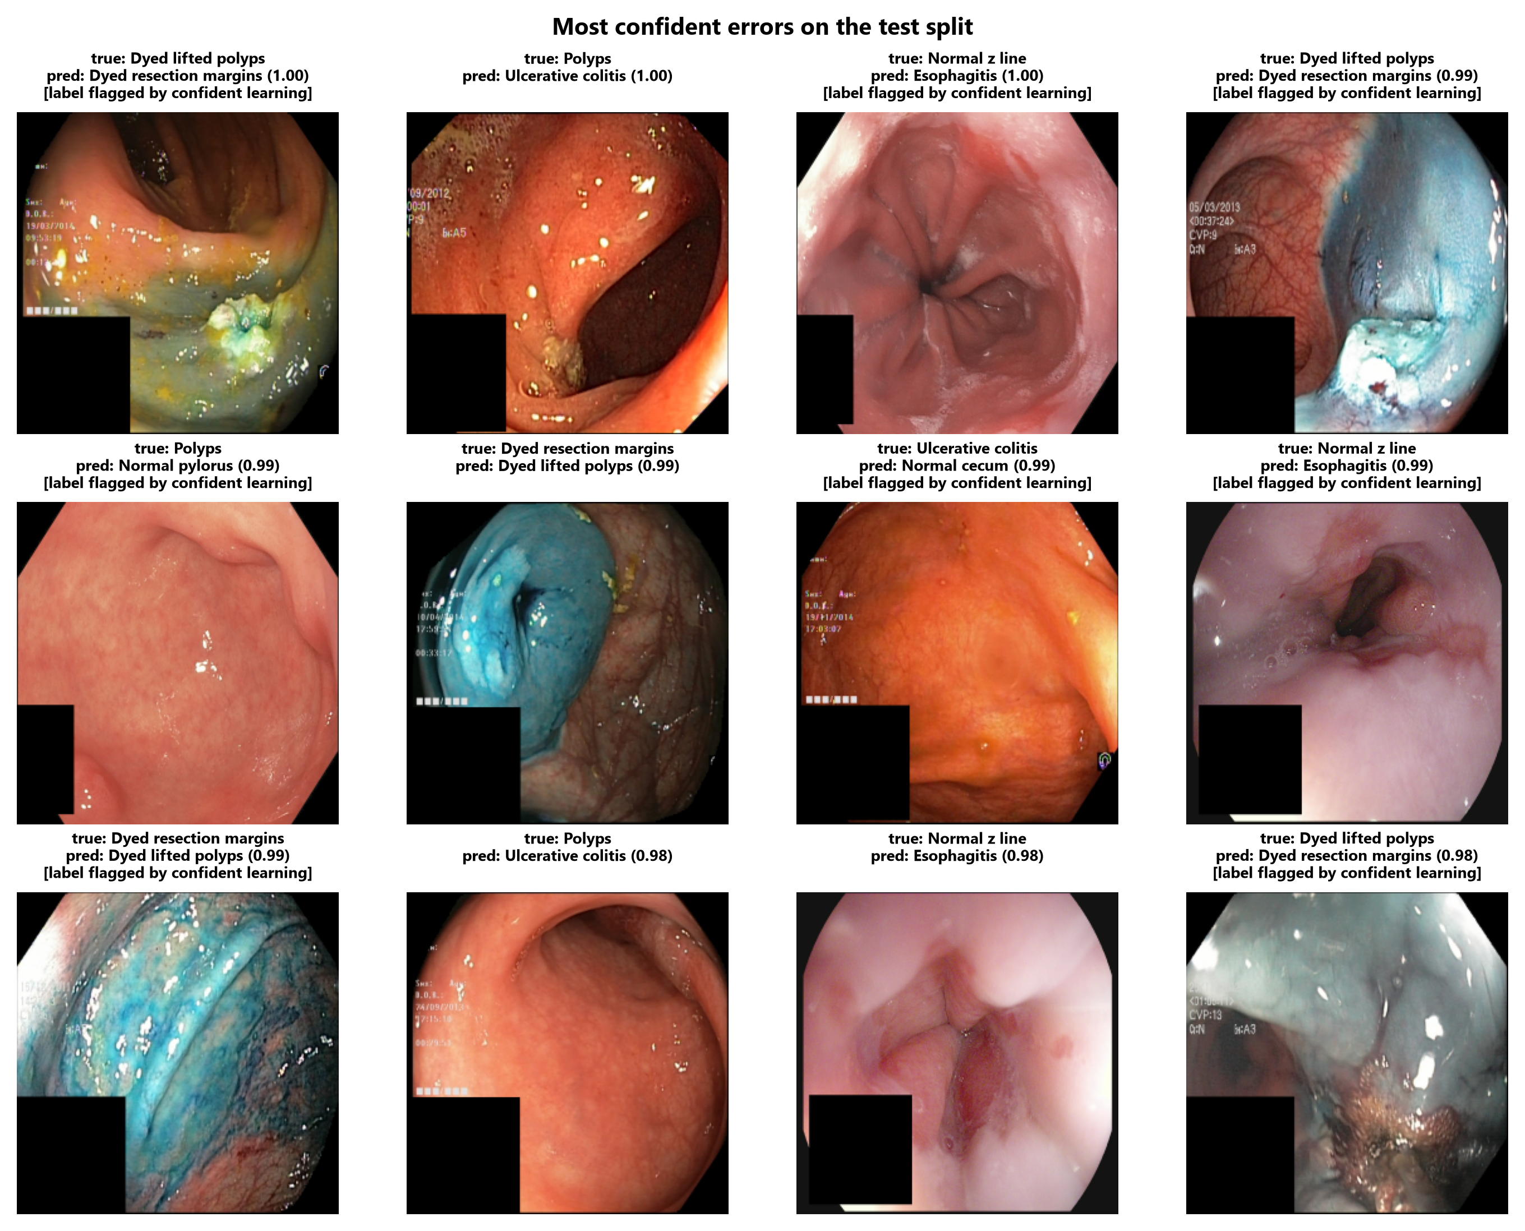
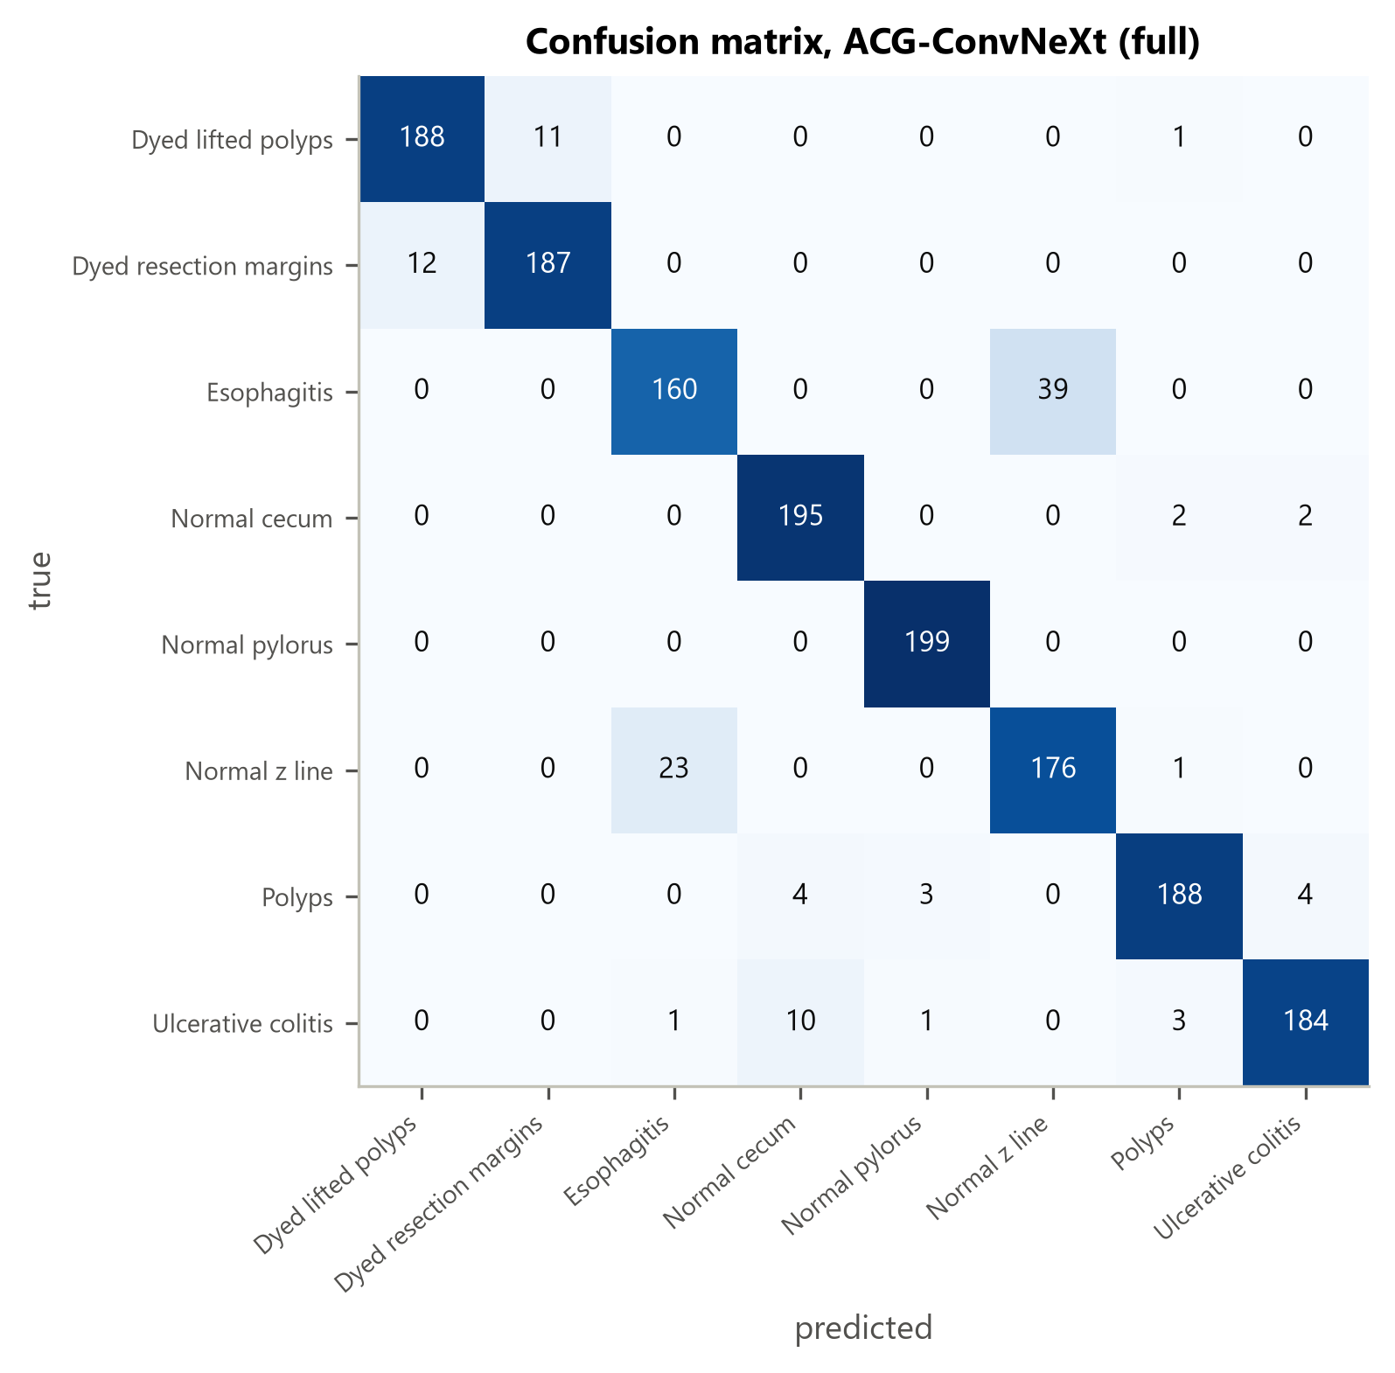
Where the model fails
• 117 errors (7.3%); 73% fall in two confusable pairs.
• 53% of errors involve flagged labels vs 5% of correct predictions.
ACPolyp · research prototype · Kvasir v2 (research/education use only)

Slide 12
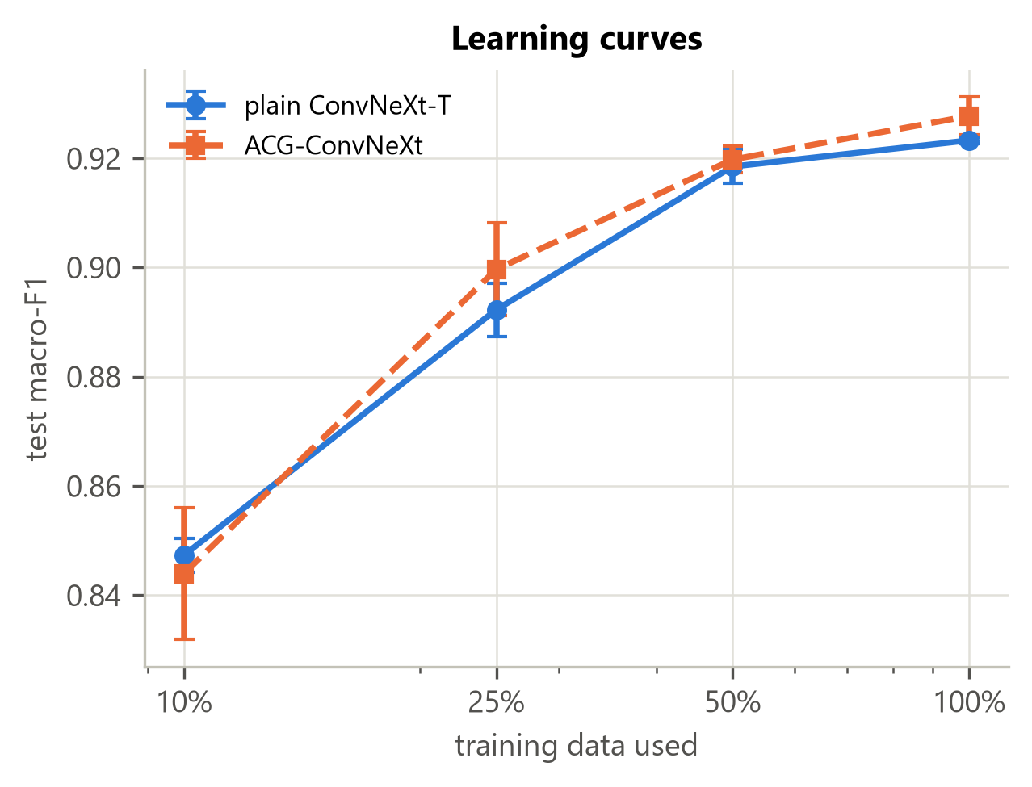
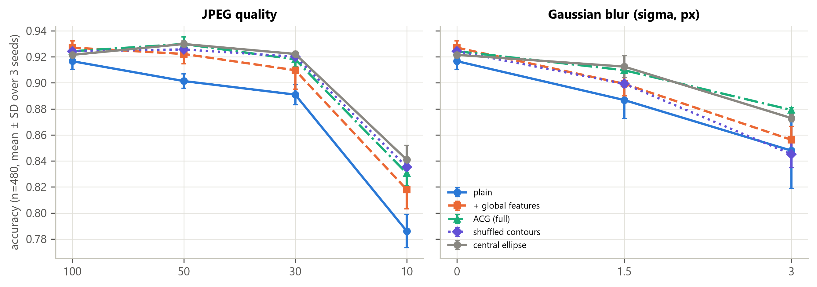
Robustness and data efficiency
ACPolyp · research prototype · Kvasir v2 (research/education use only)

Slide 13
Limitations, licensing, next steps
• Single-centre data, no patient IDs, no external validation: not a medical device.
• Kvasir is research/education only; commercial use needs written permission from Simula.
• Contours were unsupervised and weak; learned or interactive priors are the natural next step.
• Everything is reproducible from one script; all numbers in this deck come from run logs.
ACPolyp · research prototype · Kvasir v2 (research/education use only)

