Slide 1
Applied Data Science Capstone

Slide 2
The problem that is going to be presented are the perks and benefits of living in two Croatian cities: Zagreb and Varaždin.

Slide 3
Data
coffee shops
bars
pubs
clubs
restaurants
theaters
shopping centers

Slide 4
Data
crime rate
quality of life index
average salary
cost of living
apartment price
rent
preschool price

Slide 5
Source Of Data
Foursquare API
www.numbeo.com

Slide 6
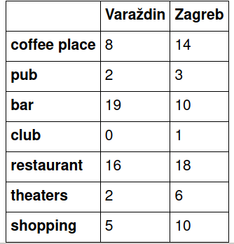
Results

Slide 7
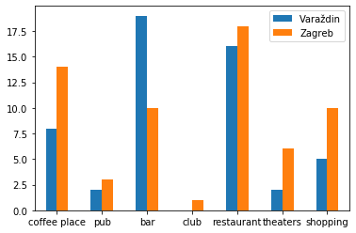

Slide 8
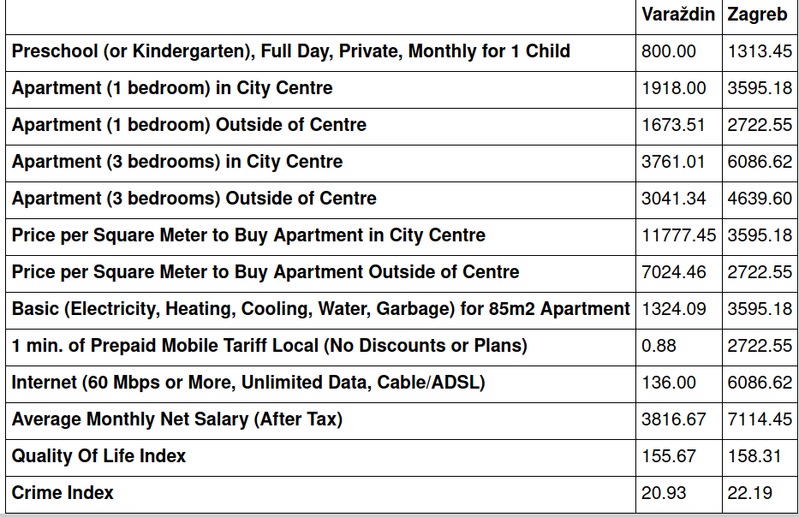

Slide 9
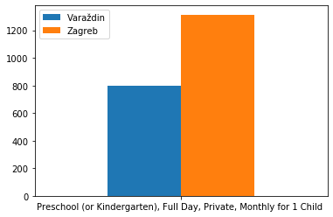

Slide 10
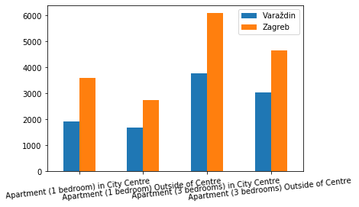

Slide 12
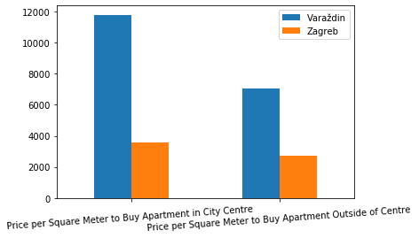

Slide 13
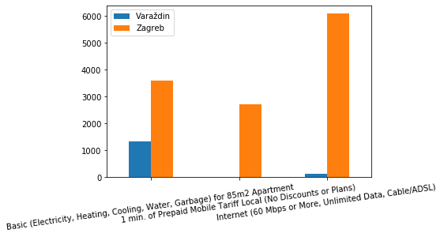

Slide 14
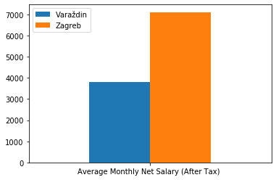

Slide 15
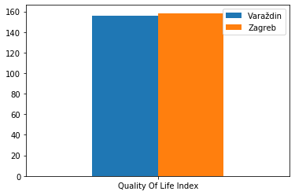

Slide 16
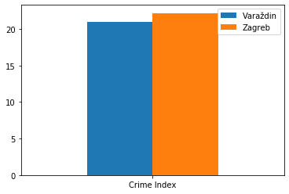

Slide 17
Conclusion
we need more data from numbeo for Varaždin to make some assumptions regarding the prices of living.
We can agree though that Zagreb would be a more interesting place to live for a younger person, but for a family that maybe wants a quiet place that is not so expensive, we can't make much conclusion with this data

