Slide 1
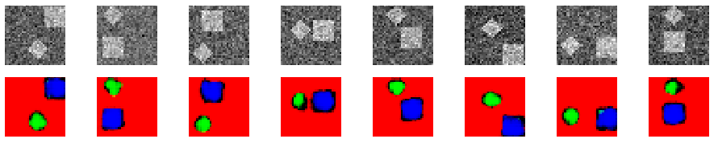
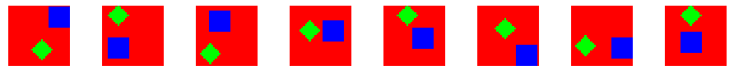
Simple CNN

Slide 2
Supervised approach
Train network by comparing it to the ground truth (labels)
Problem:
You need the ground truth of a big enough subset of dataset

Slide 3
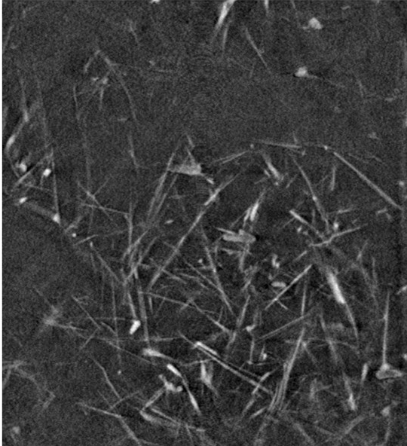
How do we get ground truth?
3D X-ray tomography of silver nanowires

Slide 4
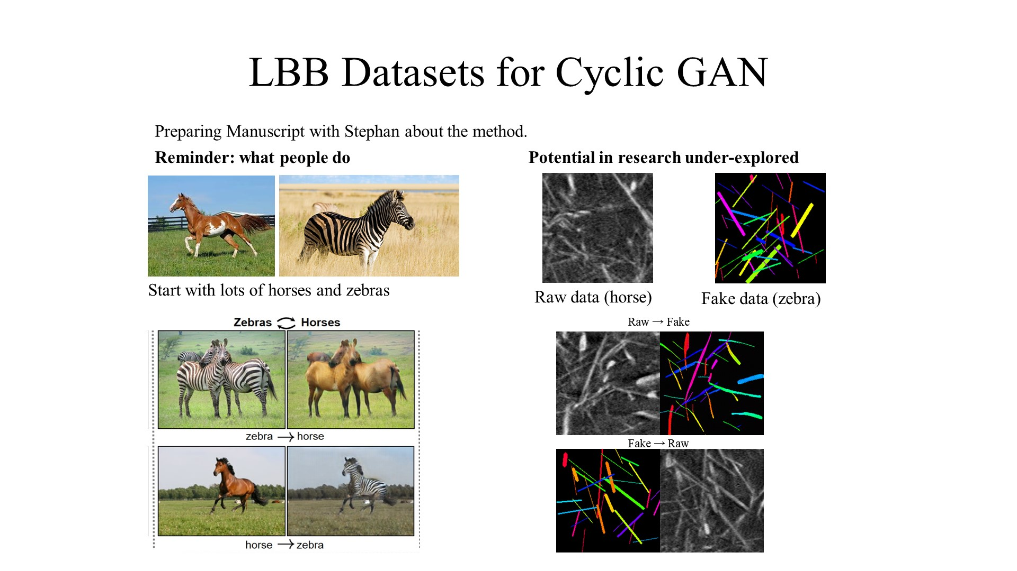
Solution: Generative Adversarial Network (GAN)
Generator
Discriminator
Train
1. Create a fake image
2. Train discriminator to differentiate between fake and real images
3. Train the generator such that it can trick the discriminator

Slide 5
Solution: Generative Adversarial Network (GAN)
Loss_{Dis} = Dis( ) + (1 – Dis( ))
= Dis( ) + (1 – Dis(Gen( )))
Train only Dis
Loss_{Gen} = Dis( )
= Dis(Gen( ))
Train only Gen

Slide 6
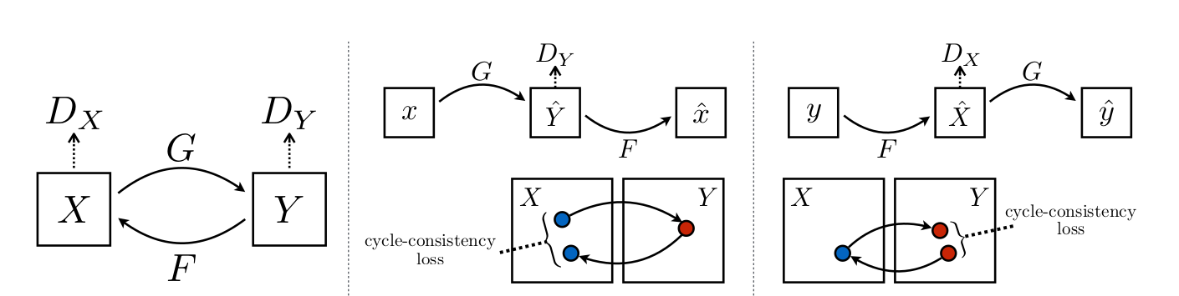
Cyclic Generative Adversarial Network
cycleGAN
Zhu et al.

Slide 7
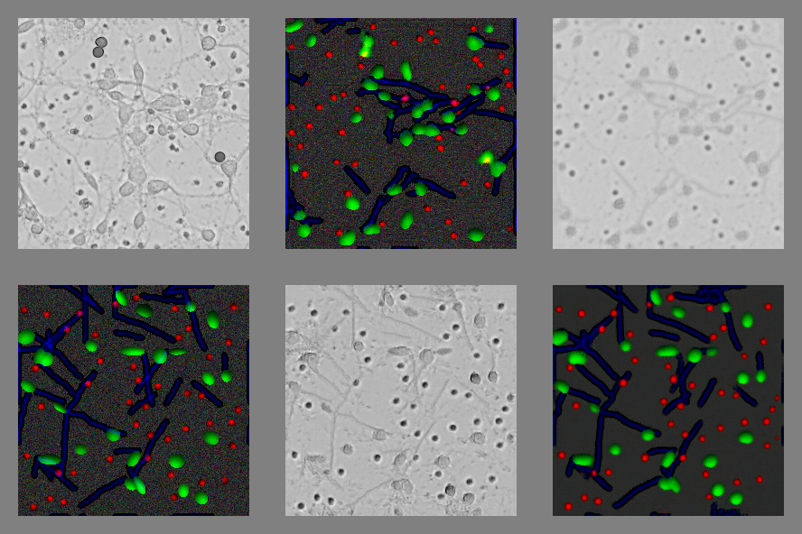
Cyclic Generative Adversarial Network
real
fake
cycle

Slide 8
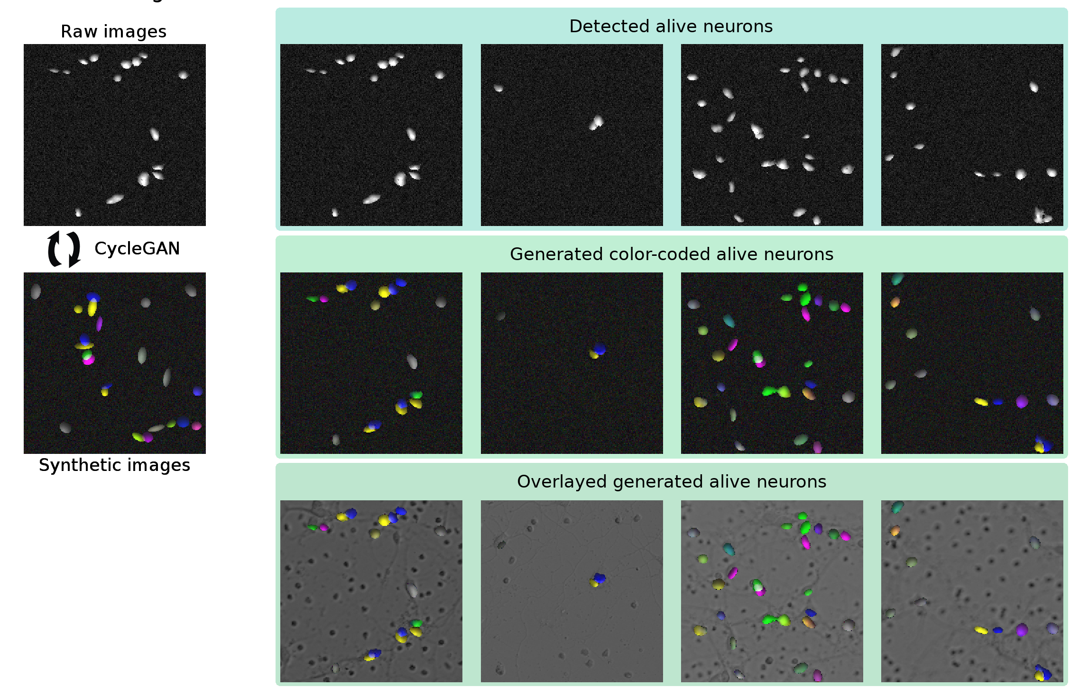
Cyclic Generative Adversarial Network

Slide 9
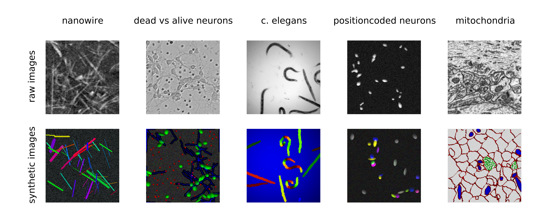
Cyclic Generative Adversarial Network

Slide 10
How does the number of data effect performance?
Capacity vs error (112)
Since it is unsupervised, it is not really that relevant

Slide 11
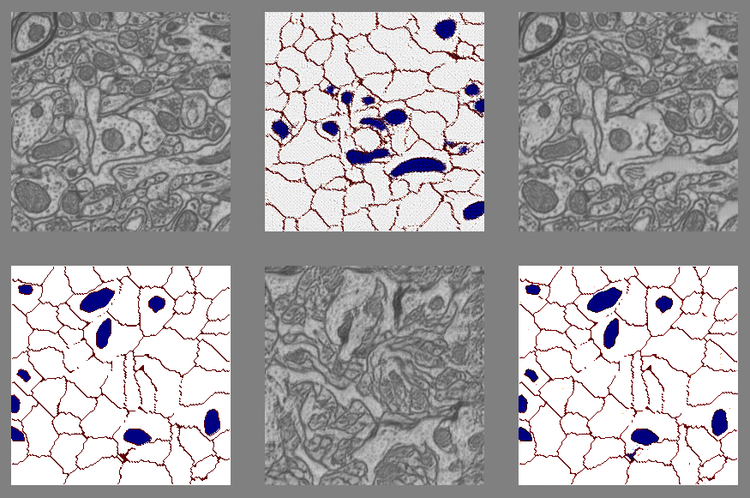
How does the number of data effect performance?
Overfitting regime (not enough data)

Slide 12
Goal of the project: How does datasize effect the error?
error
supvervised vs unsupervised
# samples

Slide 13
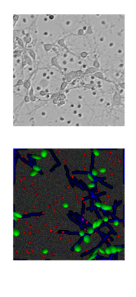
Goal of the project: How different can the datasets be?
error
1
Ratio: Number cells

Slide 14
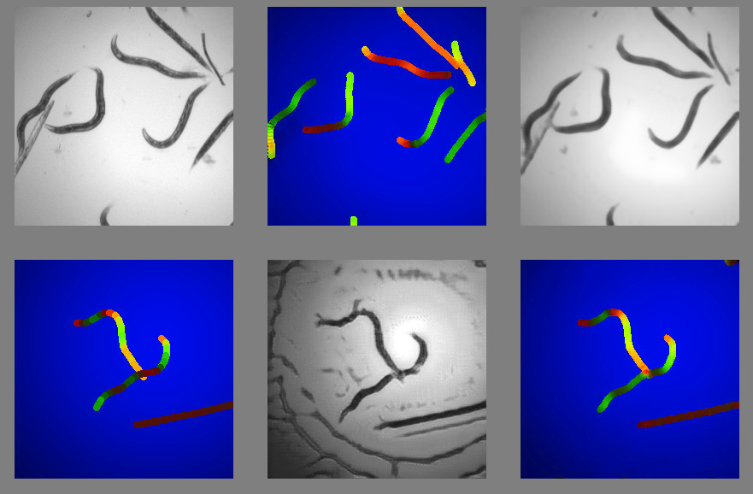

Slide 15
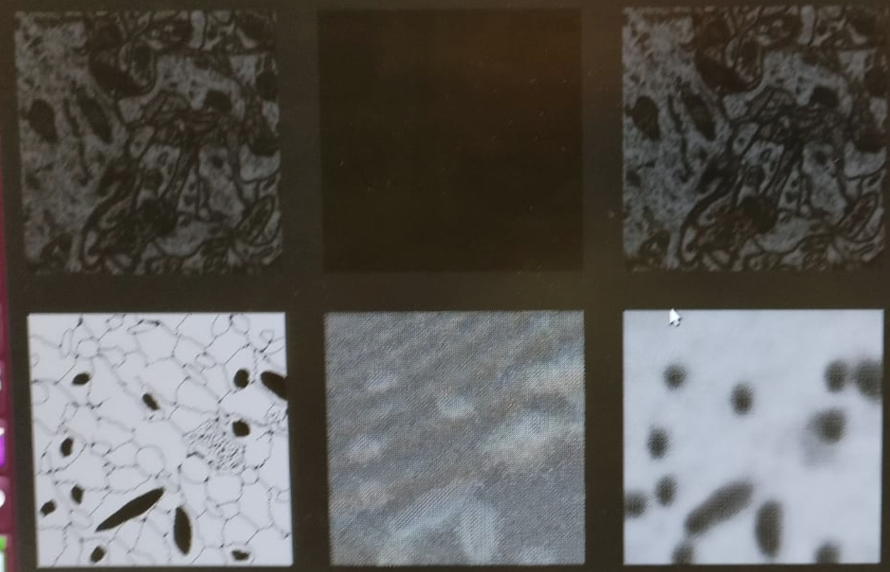

Slide 16
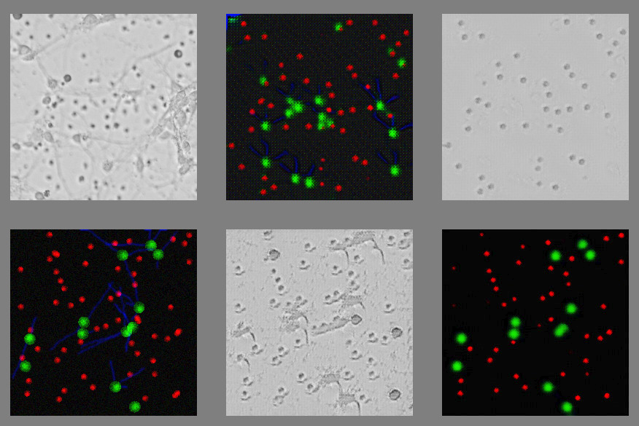

Slide 17


Slide 18

0.642
-0.931
0.04
1.09
generate

Slide 19
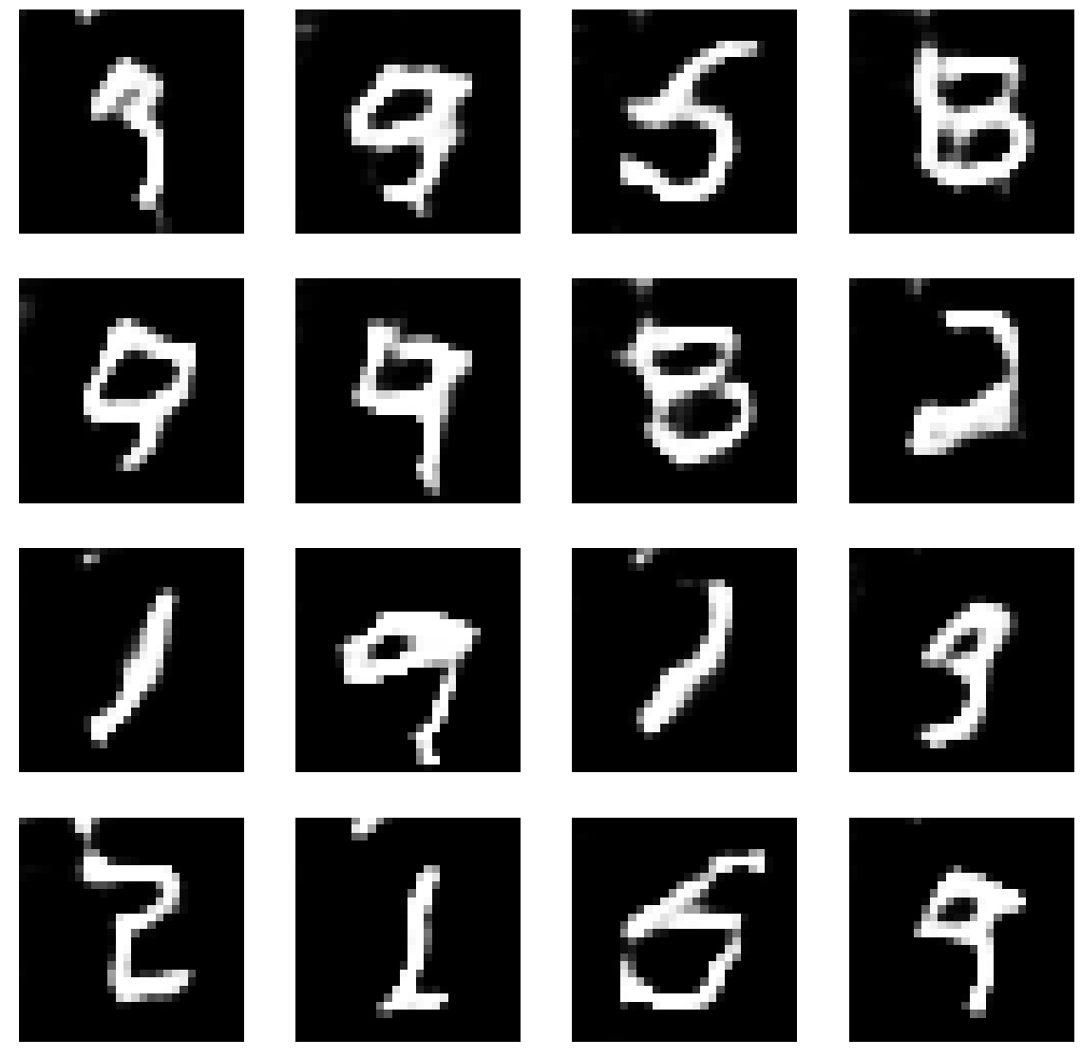

Slide 20
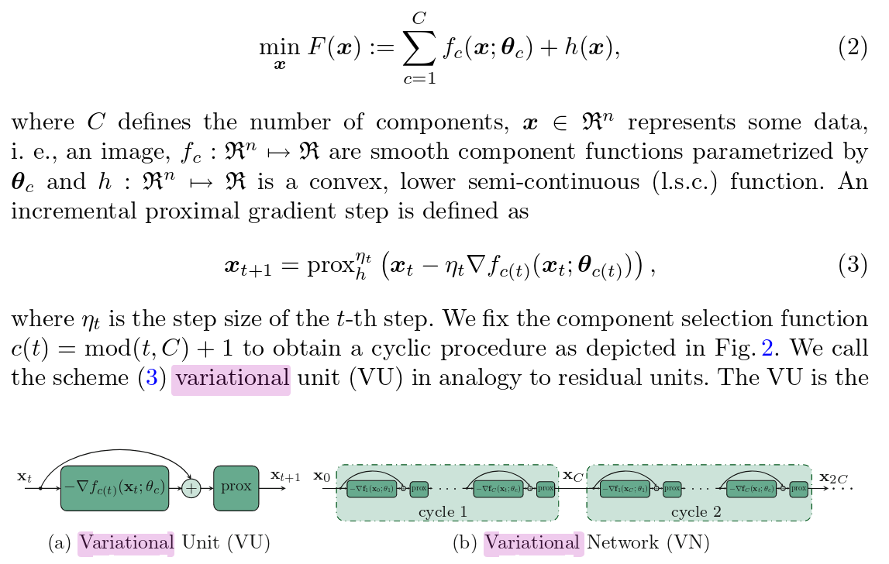

Slide 21
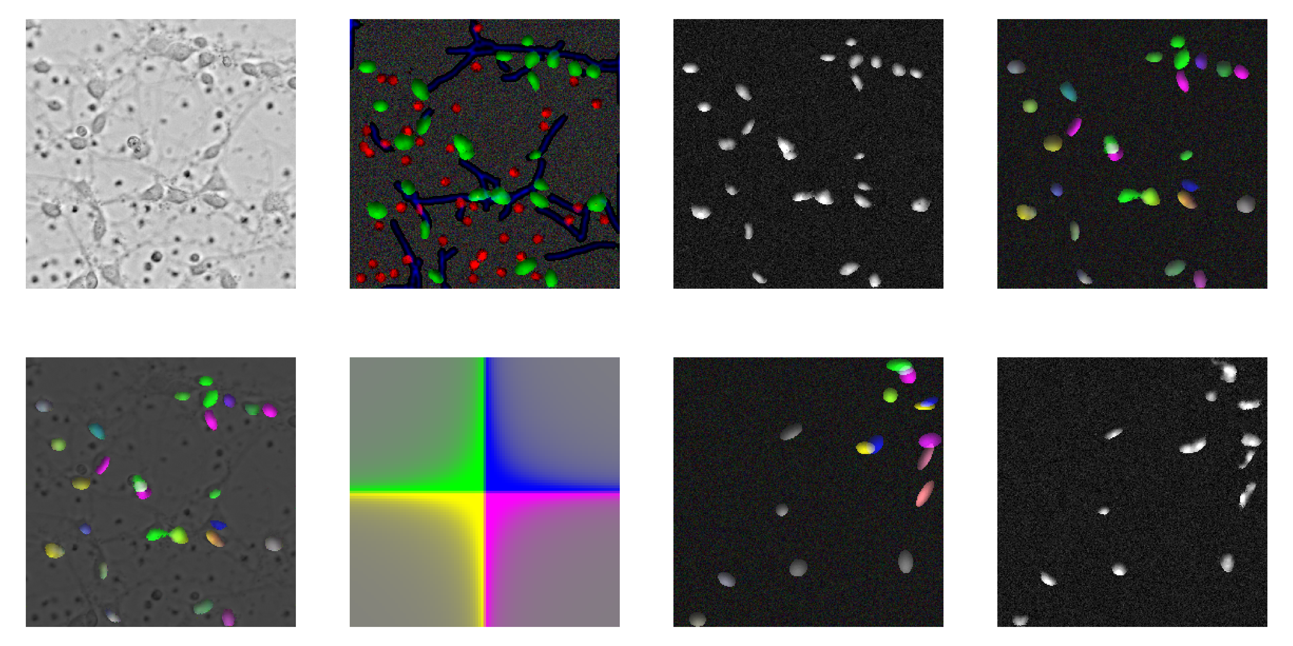

Slide 22


