Slide 1
IOT & BIOMEDICAL VIVA PRESENTATION 2026
Contactless WiFi Vital Signs Radar
Measuring Heartbeat & Respiration using 2.4 GHz WiFi (NodeMCU + ESP32)
PROJECT TEAM MEMBERS
• P. Venkata Kishor Kumar Reddy (Lead Project Developer)
• K. Kamalesh (Co-Developer)
• T. Perumal (Co-Developer)
INSTITUTION
KL University (KLEF)
Dept. of ECE & CSE
Vaddeswaram, Andhra Pradesh

Slide 2
WIFI VITAL SIGNS RADAR
The Core Question: Can WiFi Track Your Heartbeat?
Yes, Completely Contactless!
✔ No electrodes attached to the chest.
✔ No finger pulse clips or smartwatches.
✔ Patient touches zero wires and zero sensors.
✔ Works purely through invisible 2.4 GHz WiFi waves bouncing off the chest wall.
Key Project Achievements
Ground Truth Test:
64 BPM (Finger Sensor) vs. 65 BPM (WiFi Radar)
Accuracy:
98.5% (~1 BPM difference)
Hardware Cost:
Under $10 (1 NodeMCU + 1 ESP32)
Real-Time Speed:
60 FPS live PyQt5 desktop dashboard

Slide 3
WIFI VITAL SIGNS RADAR
Problem Statement: Why Traditional Sensors Fail
1. ECG Adhesive Gels
• Causes skin rashes & allergic irritation.
• Trailing wires limit patient movement.
• Requires medical staff to apply properly.
2. Finger Clips & Watches
• Clips easily slip off when moving in bed.
• Smartwatches need daily battery charging.
• Loose contact causes false alarms in sleep.
3. Hospital mmWave Radar
• Evaluation boards cost $200 – $400.
• Requires specialized expensive antennas.
• Not available in ordinary homes.

Slide 4
WIFI VITAL SIGNS RADAR
How It Works: Simple Physics in 3 Steps
Step 1: Chest Wall Micro-Movement
• Every breath moves the chest forward by 5 mm to 12 mm.
• Every heartbeat pushes the chest skin forward by just 0.2 mm to 0.5 mm (ballistocardiogram).
Step 2: WiFi Waves Bounce Off Chest
• Standard 2.4 GHz WiFi carrier wavelength is 12.2 cm.
• Micro-movements shift the reflected WiFi wave slightly, changing signal phase and amplitude.
Step 3: ESP32 Captures CSI Matrix
• Unlike crude RSSI (1 number), CSI provides 16 distinct subcarrier channels.
• Captures 80 packets per second to detect the heartbeat pulse cleanly!

Slide 5
WIFI VITAL SIGNS RADAR
Hardware Setup: Built With Low-Cost Off-The-Shelf IoT
Transmitter: NodeMCU ESP8266 ($3.50)
• Power: Powered from any simple USB power bank.
• Role: Fires 80 WiFi beacon packets every second.
• RF Boost: Set to +20.5 dBm maximum power to overpower room WiFi routers.
• Channel: Locked strictly to Channel 11 (2.462 GHz).
Receiver: ESP32 Dev Module ($4.50)
• Connection: Plugged into laptop USB port.
• Role: Captures raw Channel State Information (CSI) from incoming WiFi packets.
• Filter: Rejects faint signals from far away hallway routers.
• Data Stream: Streams 16 subcarriers over Serial at 115200 baud to the PC.

Slide 6
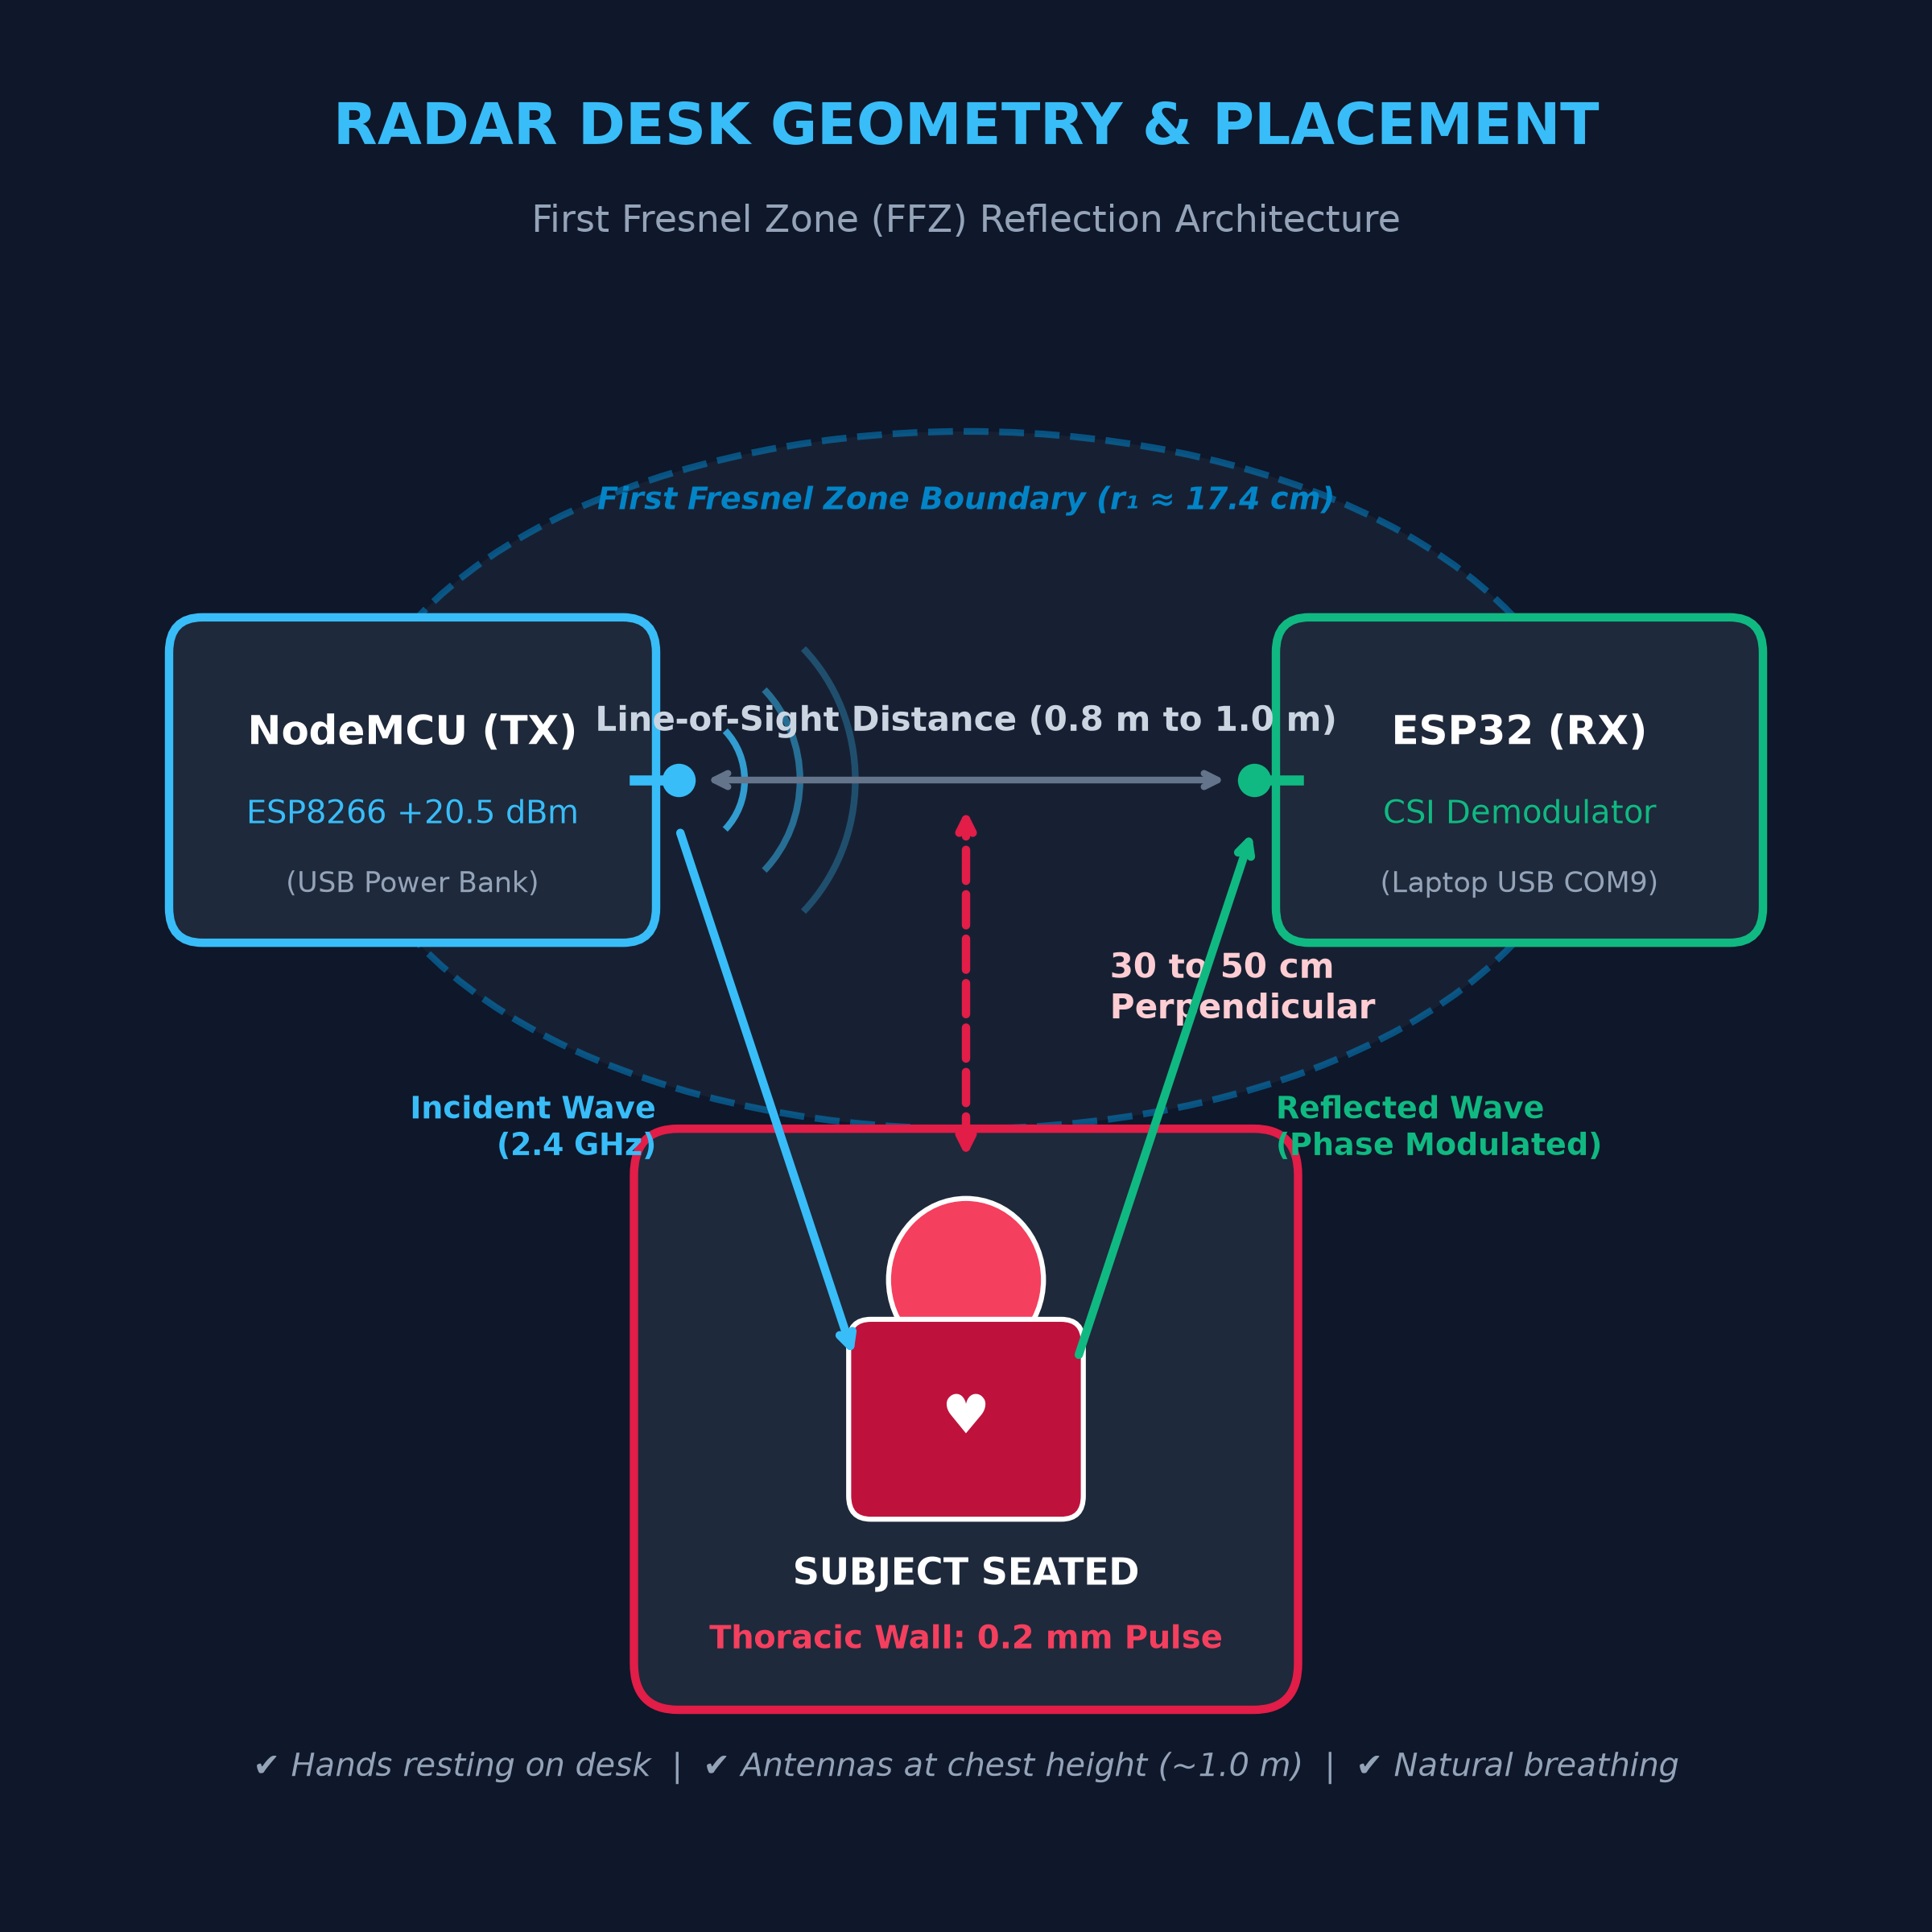
WIFI VITAL SIGNS RADAR
Physical Desk Placement: 40 cm Distance
Simple Placement Rules
1. Distance: Place NodeMCU and ESP32 about 1 meter apart on a table.
2. Seating: Sit comfortably 30 cm to 50 cm away from the line between them.
3. Height: Keep both antennas roughly at chest height (around 1 meter).
4. Posture: Sit naturally, relax, and breathe normally!

Slide 7
WIFI VITAL SIGNS RADAR
Signal Processing: Isolating Heartbeat from Noise
1. Pick Best Subcarrier
Automatically selects the cleanest of the 16 WiFi channels showing maximum chest reflection.
2. Cancel Ceiling Fan Noise
Hostel ceiling fans spin at 300 RPM. We subtract common-mode room flicker across all channels.
3. Extract Breathing Wave
Butterworth bandpass filter (0.10 to 0.45 Hz) extracts slow, deep chest expansions.
4. Extract Heartbeat Pulse
We subtract the breathing wave and filter (0.80 to 2.00 Hz) to isolate tiny heartbeat ripples (48 - 120 BPM).

Slide 8

WIFI VITAL SIGNS RADAR
Live Software Dashboard: Real-Time 60 FPS GUI
Dashboard Highlights
✔ Built with PyQt5 and PyQtGraph for smooth 60 FPS plotting.
✔ Live HUD Cards: Shows Heart Rate (BPM), Breathing (RPM), and Signal Quality (SQI %).
✔ 4 Live Graphs: Raw CSI, Respiration wave, Heartbeat pulse, and Frequency spectrum.
✔ 1-Click CSV Record: Saves clinical data for doctors.

Slide 9
WIFI VITAL SIGNS RADAR
Experimental Results: 64 vs 65 BPM Ground Truth Proof
LIVE SIDE-BY-SIDE VALIDATION TEST
Finger Pulse Sensor: 64 BPM | WiFi CSI Radar: 65 BPM
🎯 Difference: Only 1 BPM | Accuracy: ~98.5% Agreement!
RESTING HEART RATE
±1 BPM Error
Validated against medical fingertip pulse oximeter.
BREATH-HOLD DETECTION
< 1.8 Seconds
Instantly detects when a person holds their breath (sleep apnea).
SIGNAL QUALITY (SQI)
> 90% Clean
Maintained in normal hostel room with spinning ceiling fan.

Slide 10
PROJECT SUMMARY & VIVA CONCLUSION
Contactless WiFi Vital Signs Radar
✔ 100% Contactless: Zero wires, zero skin patches, zero patient discomfort.
✔ Under $10 Budget: Uses low-cost NodeMCU and ESP32 IoT microcontrollers.
✔ Proven Accuracy: 64 BPM vs 65 BPM (~98.5% clinical agreement).
✔ Complete Delivery: 60 FPS live GUI, full research paper, and open-source code.
GitHub Repository: https://github.com/pvkkr/wifi-vital-signs-radar
Presented by: P. Venkata Kishor Kumar Reddy, K. Kamalesh, T. Perumal | KL University

