Slide 1
[AI-S22] Connect 4
University of New Haven
Venkata Krishna Pachava,Venkata Sai Yalla
Intro to AI (6612), Spring 2022

Slide 2
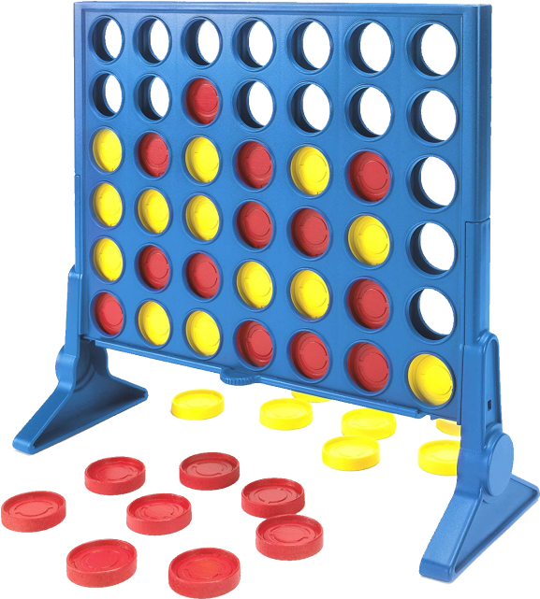
What is Connect 4?
Connect 4 is a board game that needs two players to race by connecting four of their game pieces on a 7 x 6 board..

Slide 3
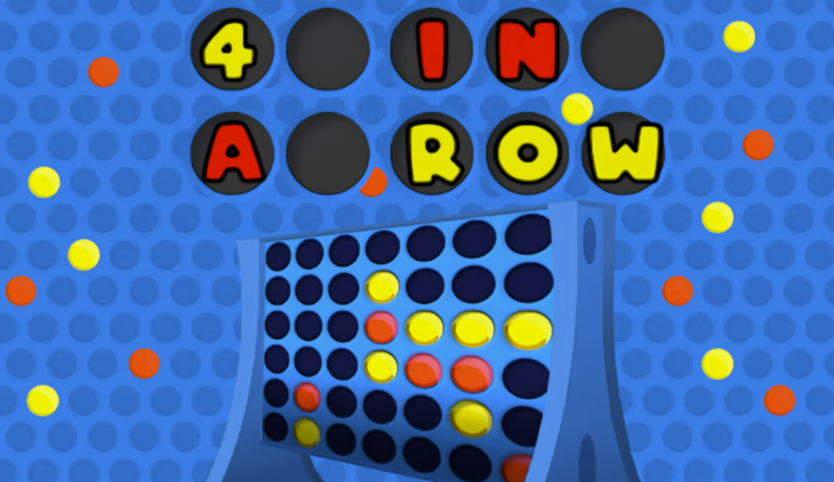
Strategies
Playing middle column
Blocking opponent
Thinking multiple steps ahead

Slide 4
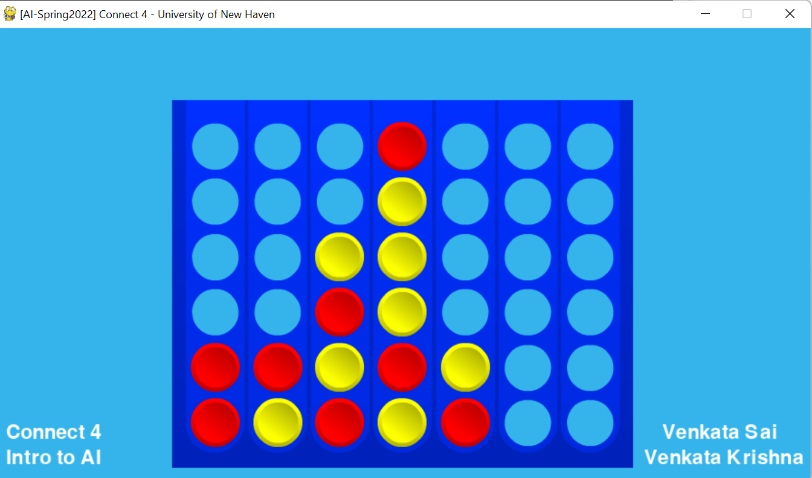
Chosen Algorithm
Alpha Beta
Min-Max

Slide 5
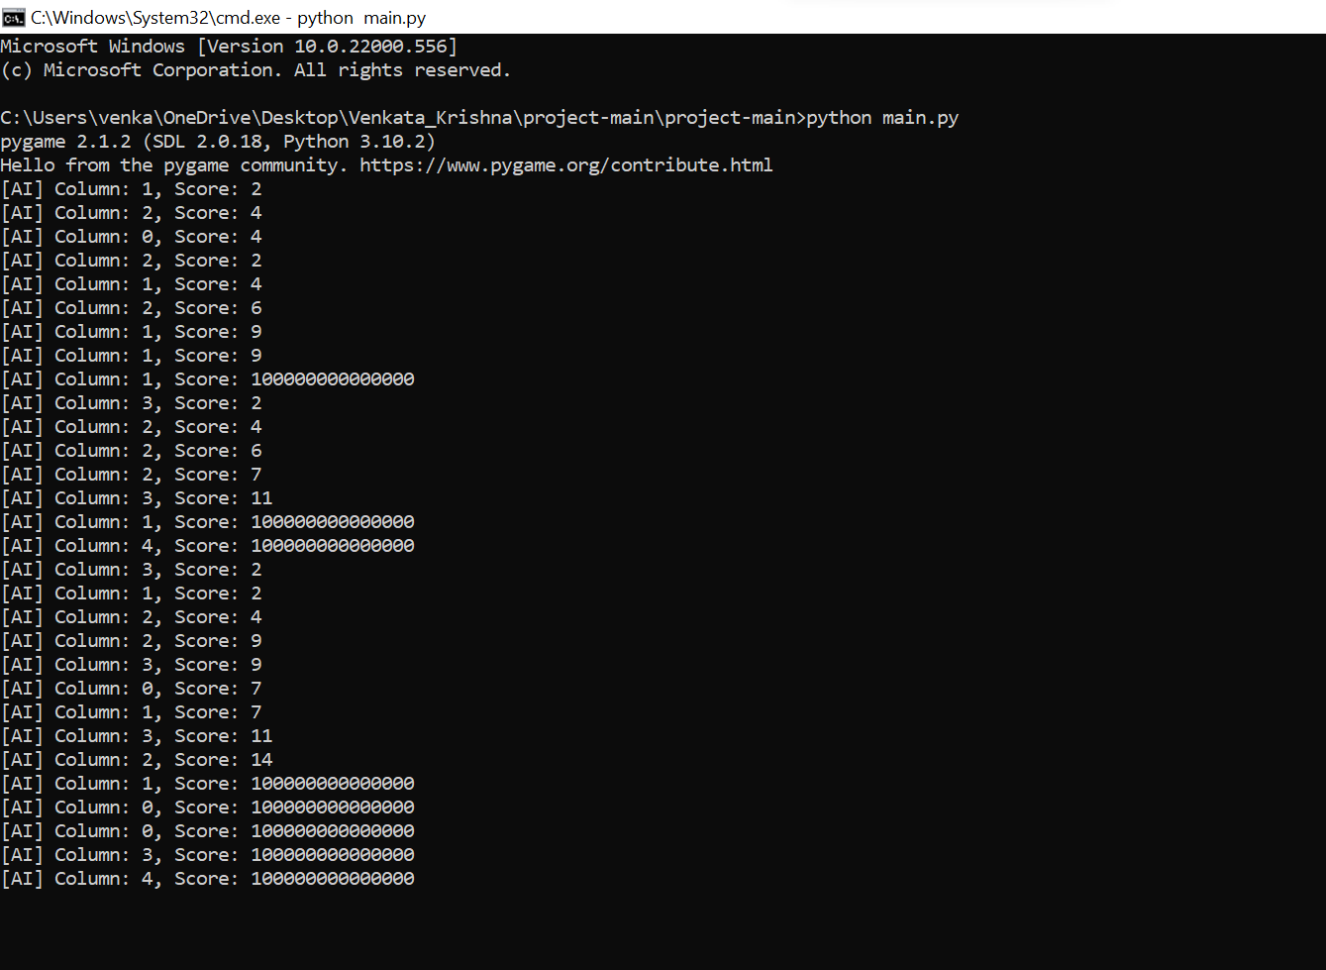

Slide 6
Three Files +
One w/ Globals
Main
GameBoard
Alpha-Beta
Global variables

Slide 7
Main File
Contains main game loop.
Runs the game entirely.

Slide 8
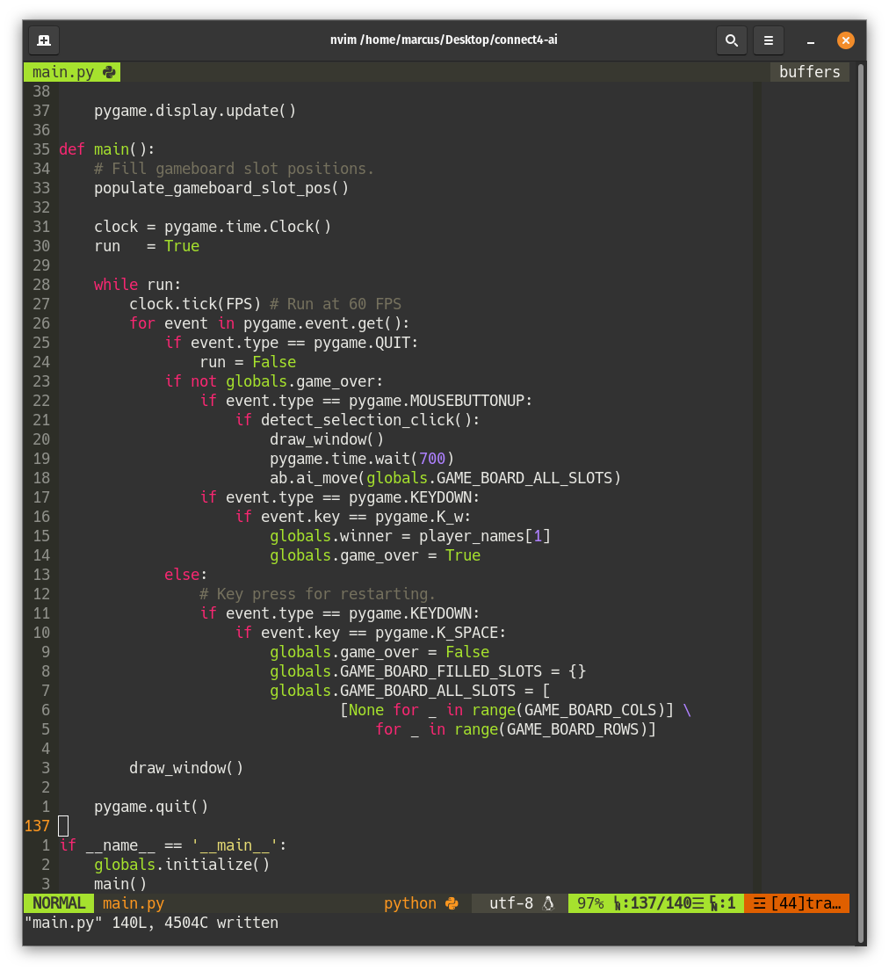

Slide 9
GameBoard
Contains logic for board.
Detects player clicks.
Validates column drops.
Confirms game winner.

Slide 10
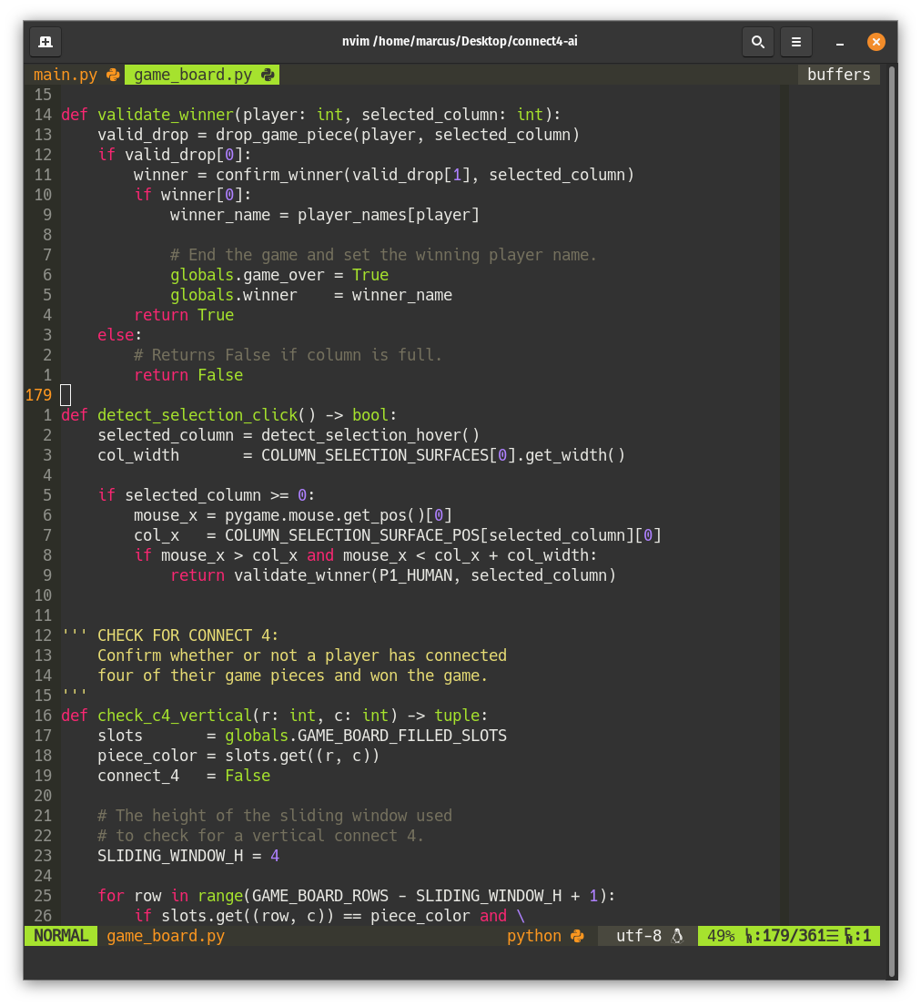

Slide 12
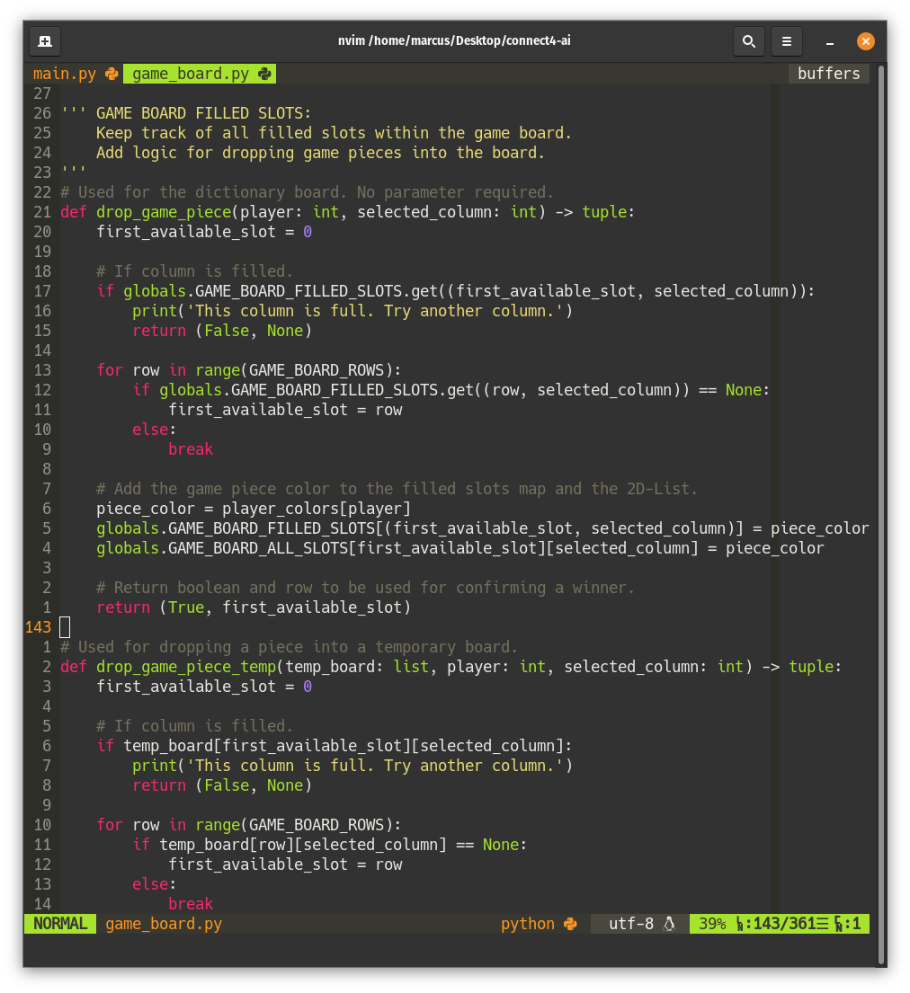

Slide 14
How to
Confirm Winner
Horizontal, Vertical
Sliding Window
Diagonal
Two pointers moving outwards

Slide 15
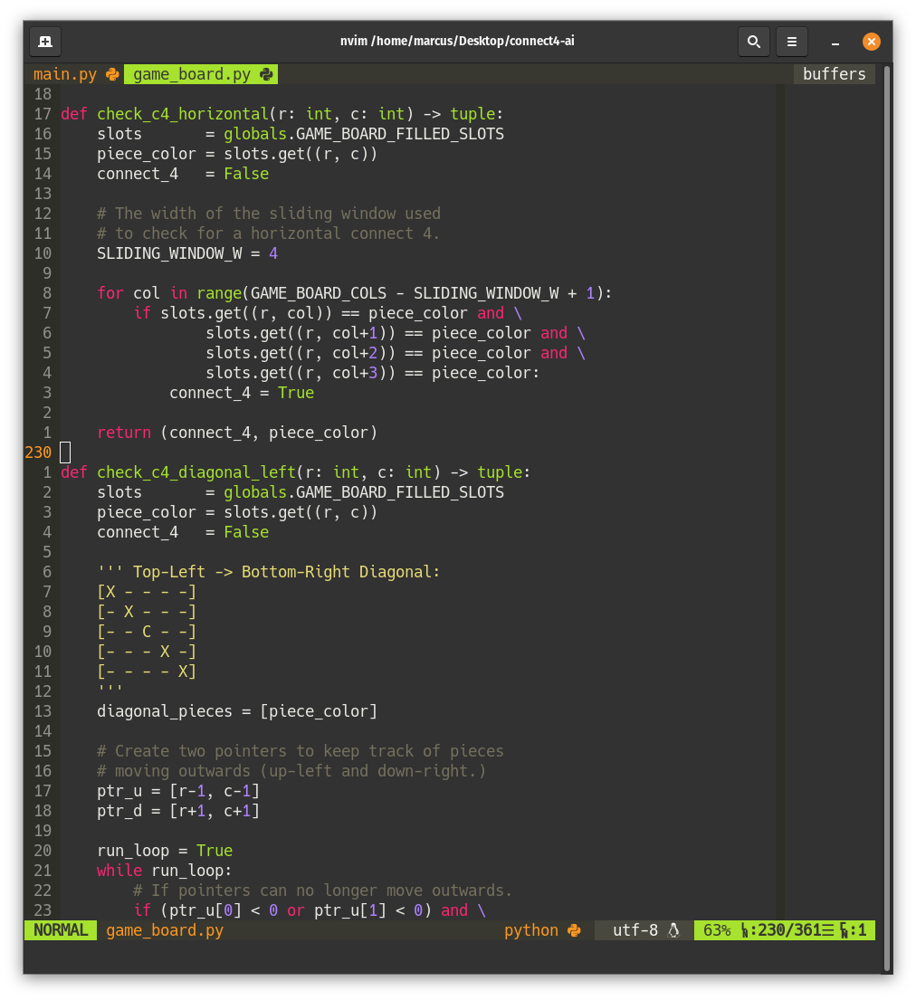

Slide 16
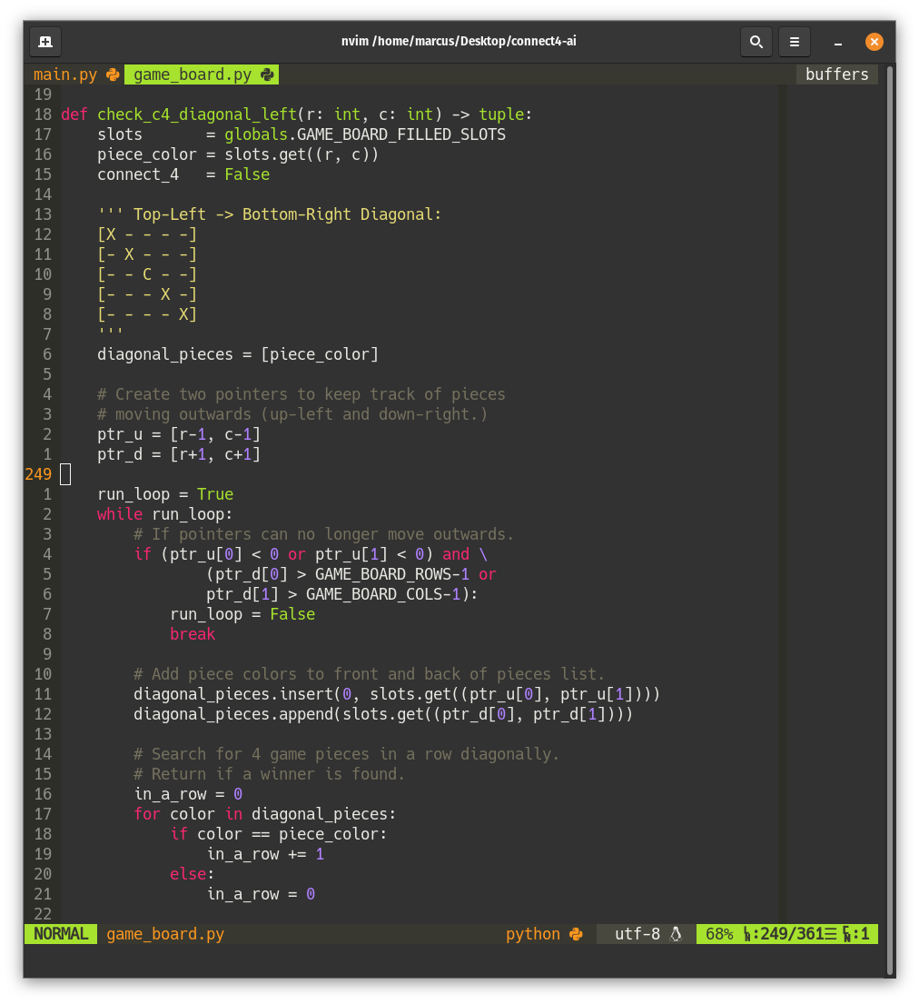

Slide 17
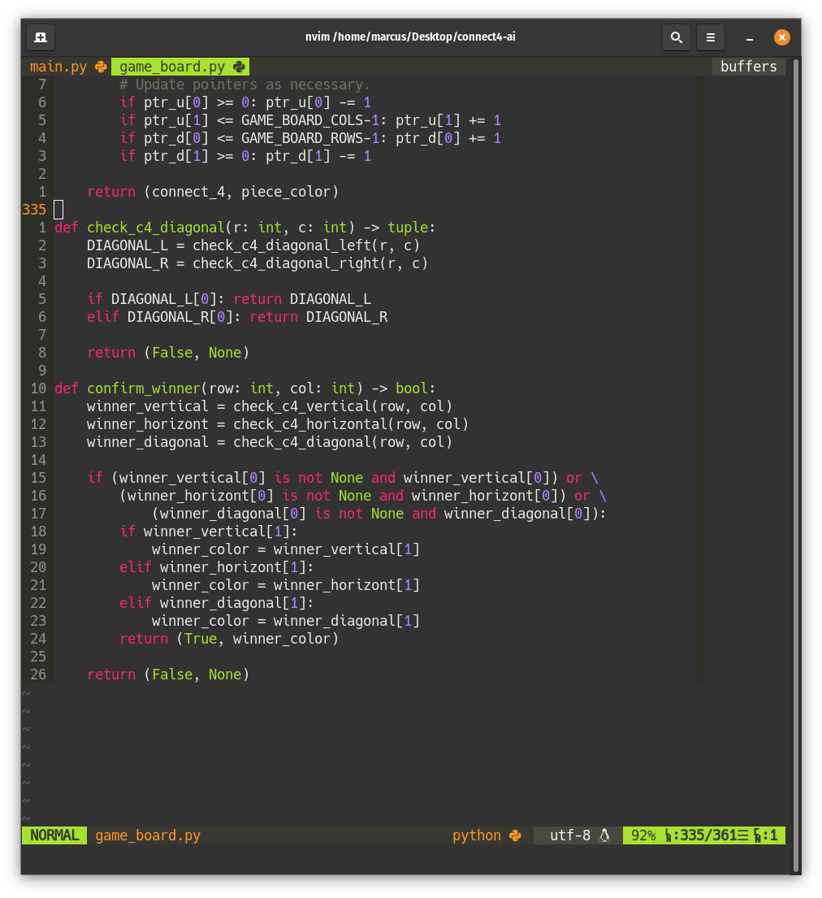

Slide 18
AI +
Alpha Beta
AI Movement
Making decisions
Scoring system
Predictions

Slide 20
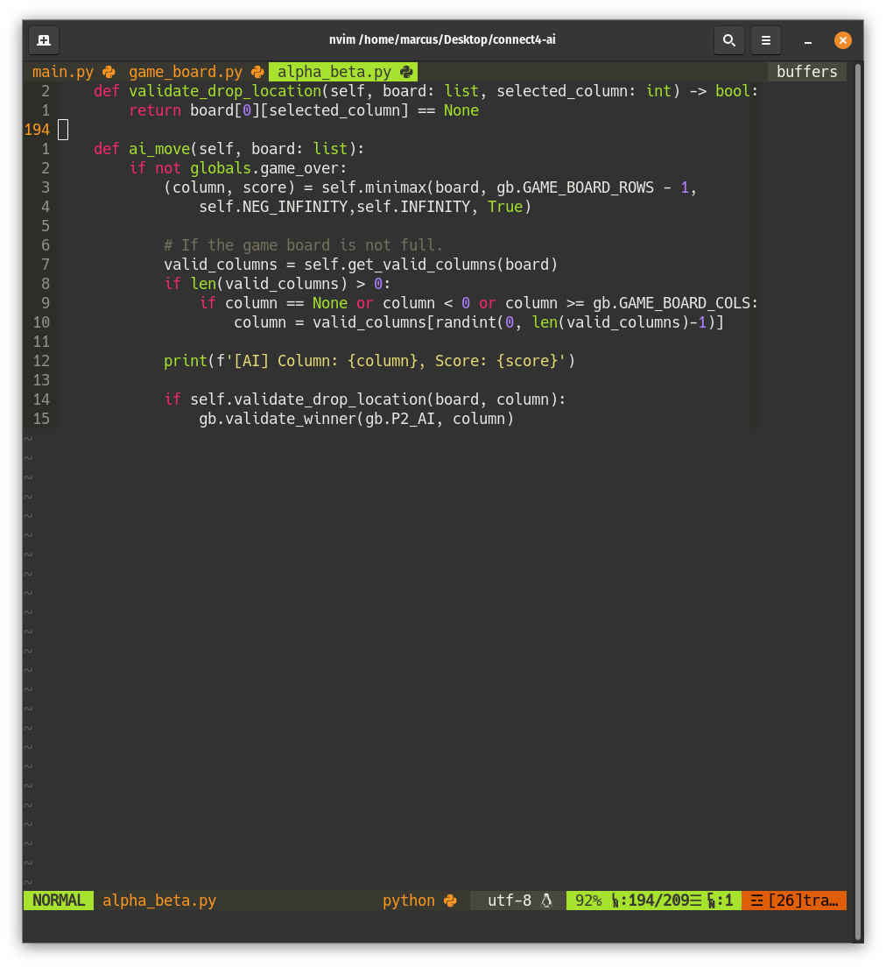

Slide 21
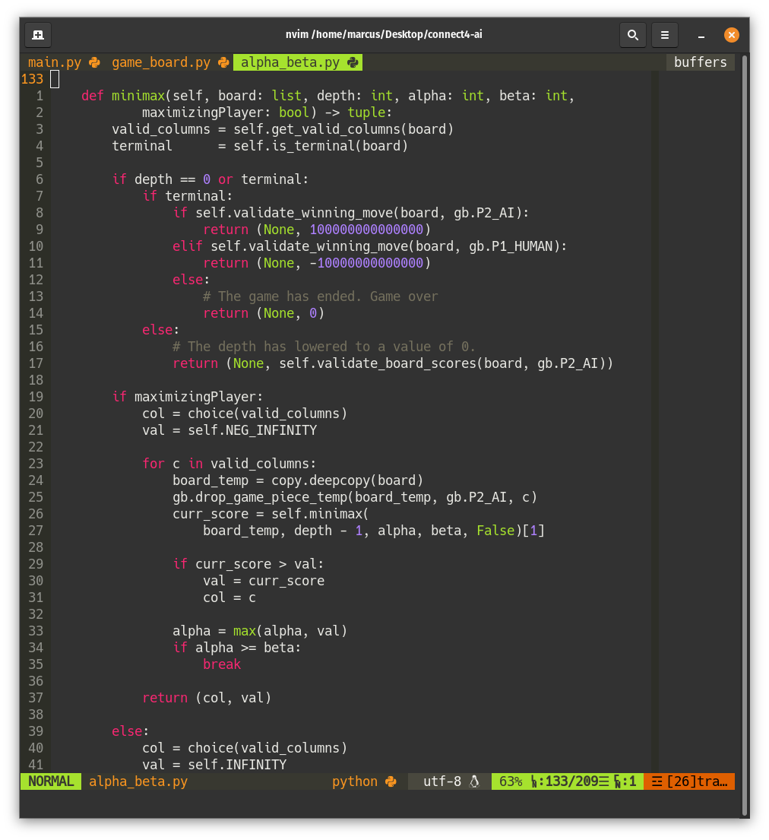

Slide 22
Testing for
Terminal Nodes
Return if any move is terminal (game-winning)
Returns the highest score

Slide 23
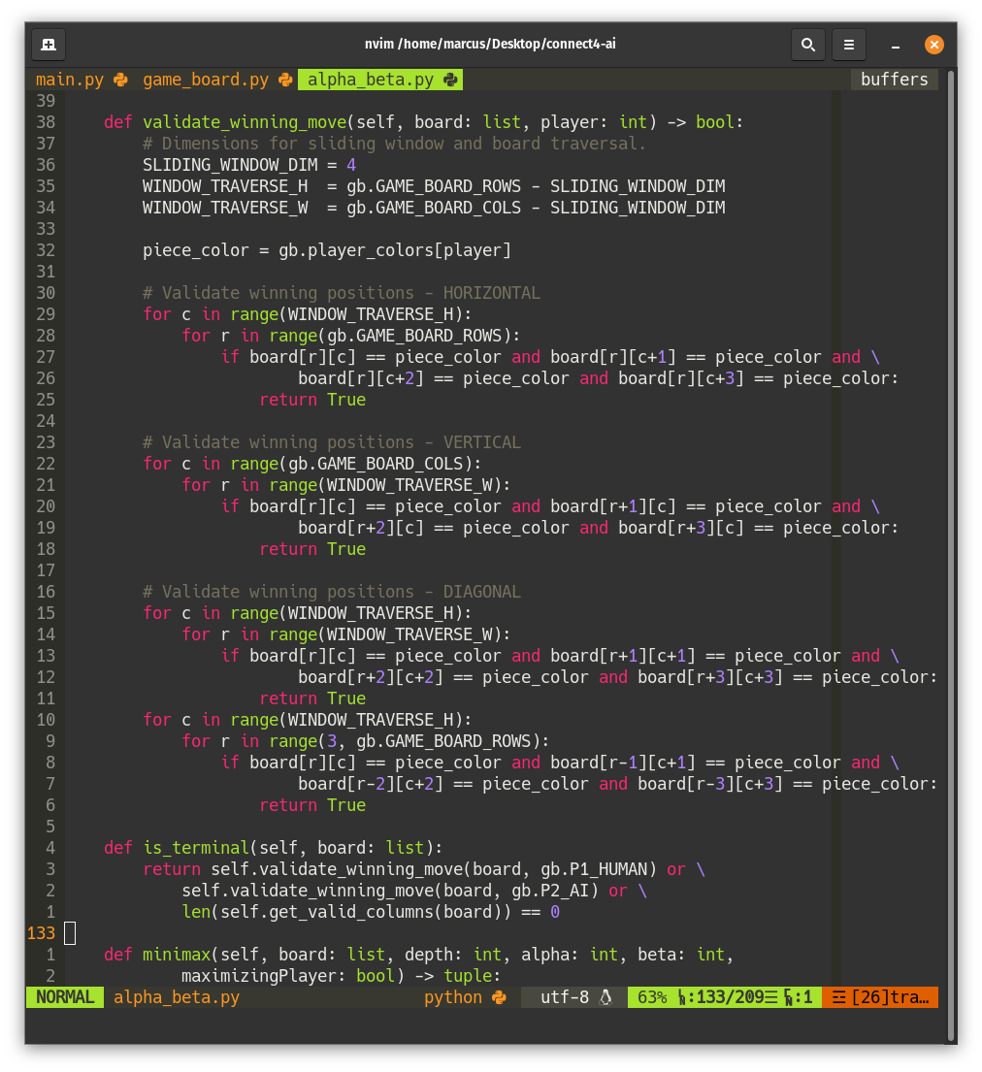

Slide 26
Validate Board Node Scores
If terminal node not yet located

Slide 28
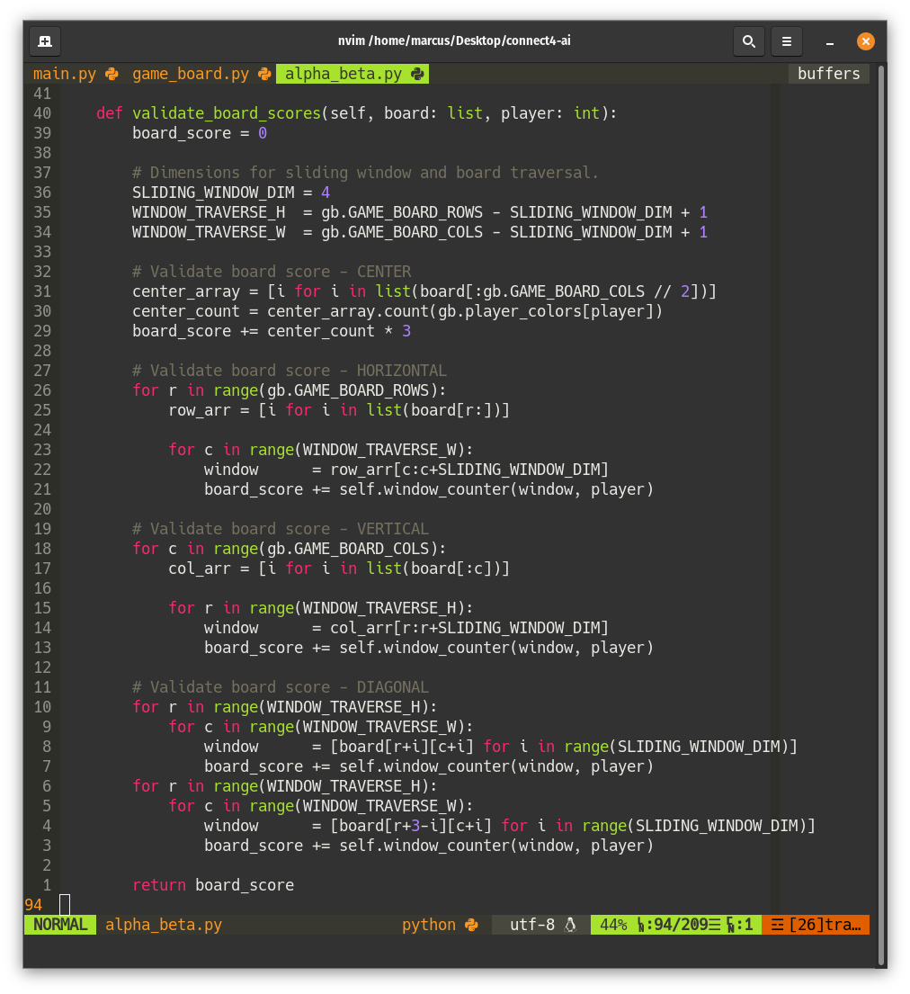

Slide 29
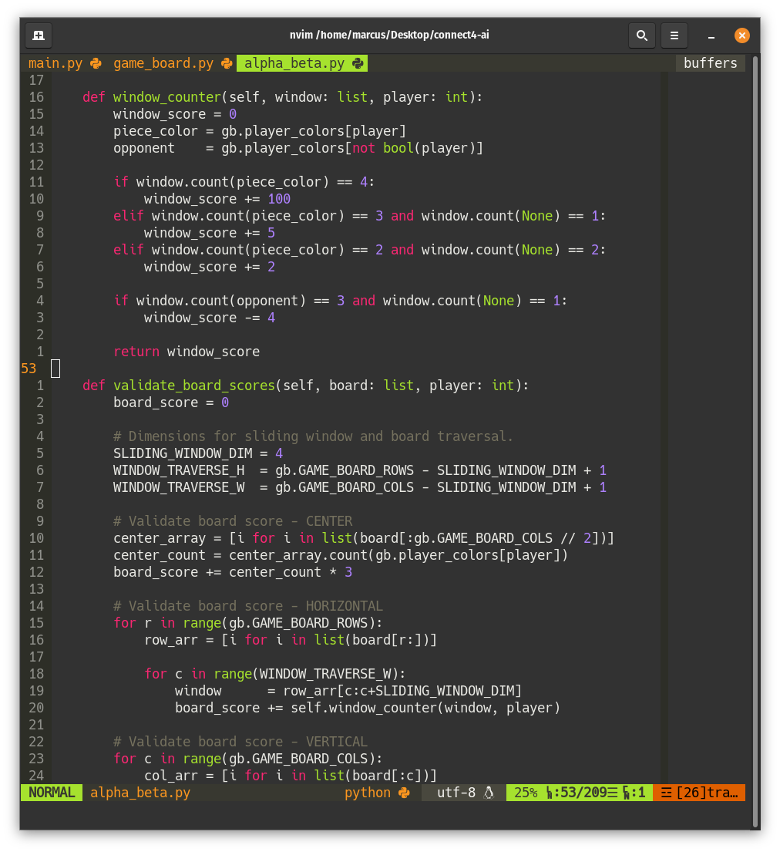

Slide 30
Continuing MiniMax
If depth has not reached 0
Depth is reduced every recursive call
Minimax utilizes alpha, beta, and maximizing player values

Slide 32
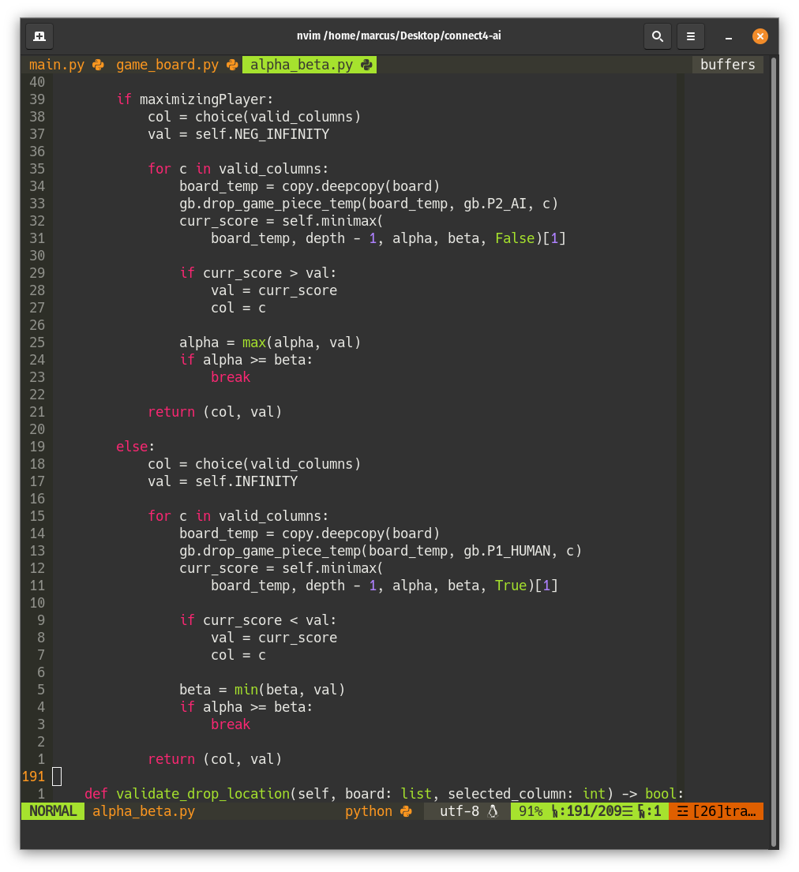

Slide 35
