Slide 1
Rabbit Show Manager
Main Objectives
Automate as far as possible the paper work done by the show secretary.
Allow entries to be made as late as possible. The current system is entirely paper based. Entries have to close Wednesday evening for a show on the following Saturday.
Allow changes to the entries as late as possible. There are rules that state sick animals are not allowed in the show.
Calculate entry fees, and prize money for exhibitor as the entries and results are entered.
Prepare the request for BRC certification, and F&F advert, and the result reports for the both organisations.
Notes:
Allow entries to be made as late as possible. The current system is entirely paper based. Entries have to close Wednesday evening for a show on the following Saturday.
Allow changes to the entries as late as possible. There are rules that state sick animals are not allowed in the show.
Calculate entry fees, and prize money for exhibitor as the entries and results are entered.
Prepare the request for BRC certification, and F&F advert, and the result reports for the both organisations.

Slide 2
Some technical points.
Some values are in the database so that there is less need for maintenance by programmers, and can be changed by the user to change for another type of live stock show on similar Although at present some of it will need changing by a programmer however I plan to rectify this .
Implementation languages
Database is PostgreSQL main program website, with sqlite3 for Android, transfer between the two using JSON.
Java for the main desktop application because it is platform independent. Others considered my personal favourite Pascal using Lazarus for the GUI create is easy, there is currently a bug in the IDE.
PHP/Javascript/CSS for the website these were built for the internet. Others considered JavaSevlets which is still in consideration, no for consideration any longer are Ruby on Rails, PERL.
Android Application almost certainly has to be Java.

Slide 3
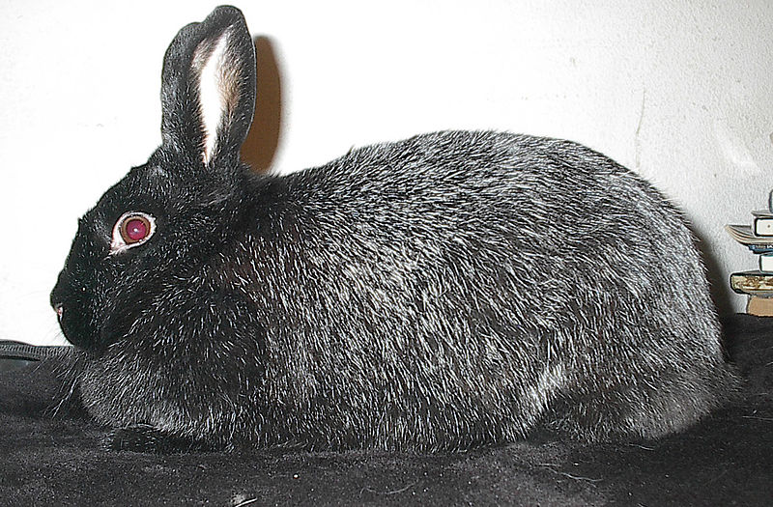
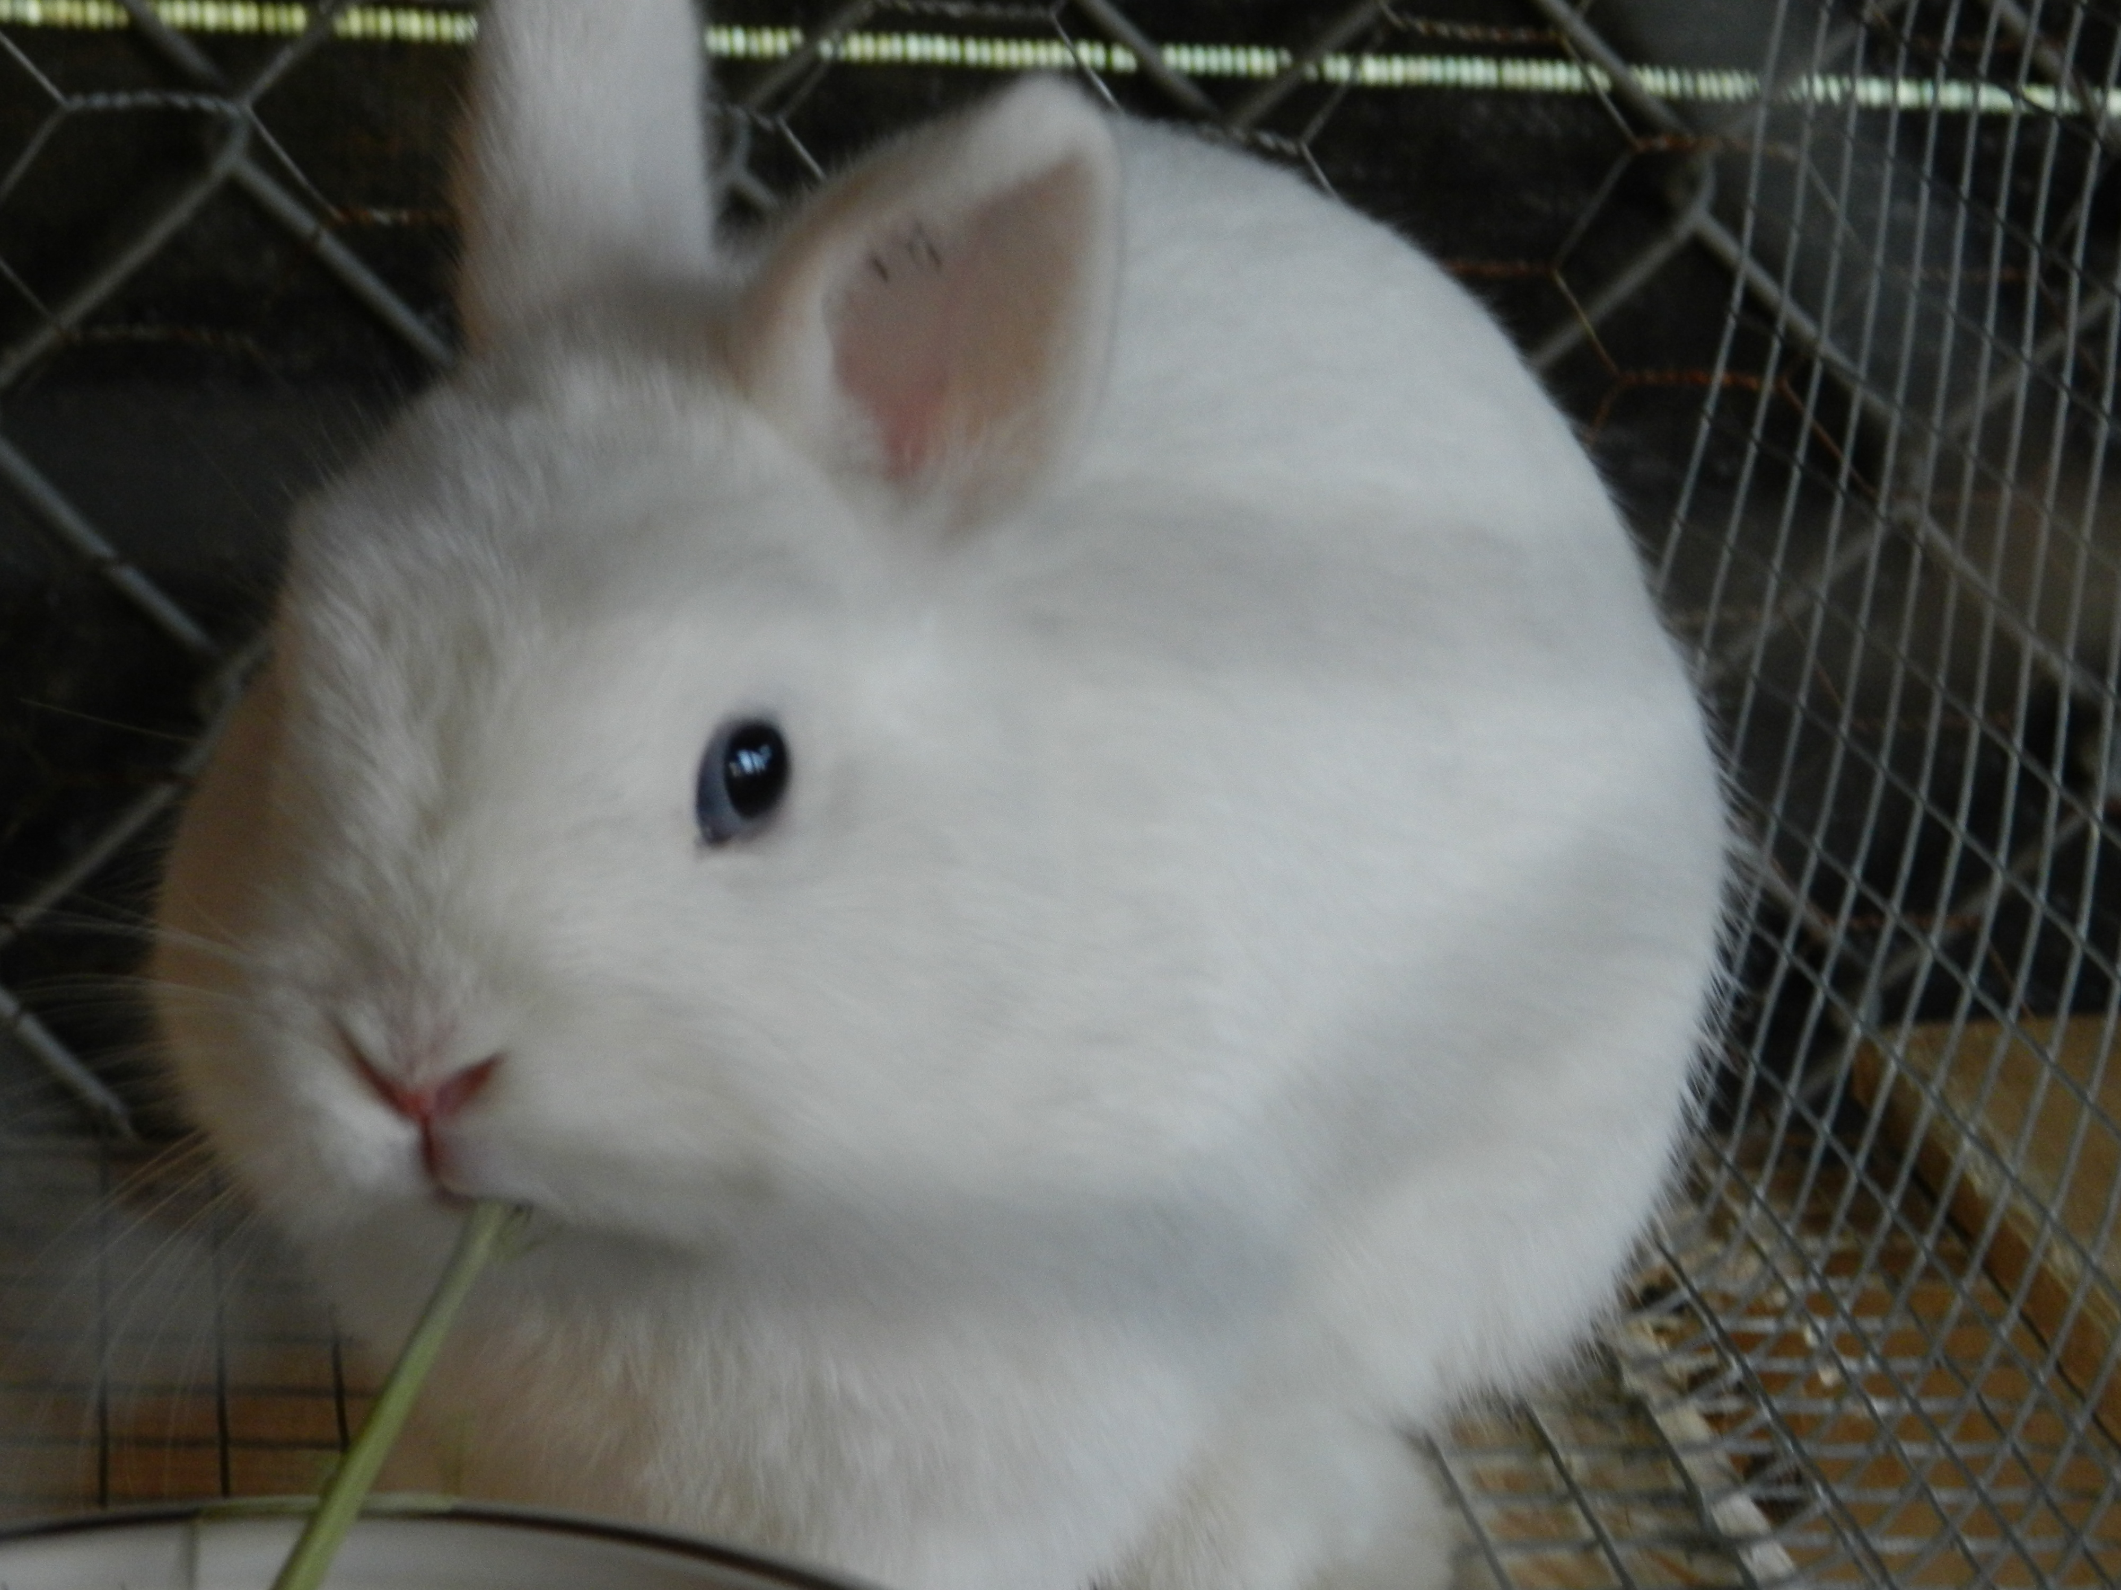
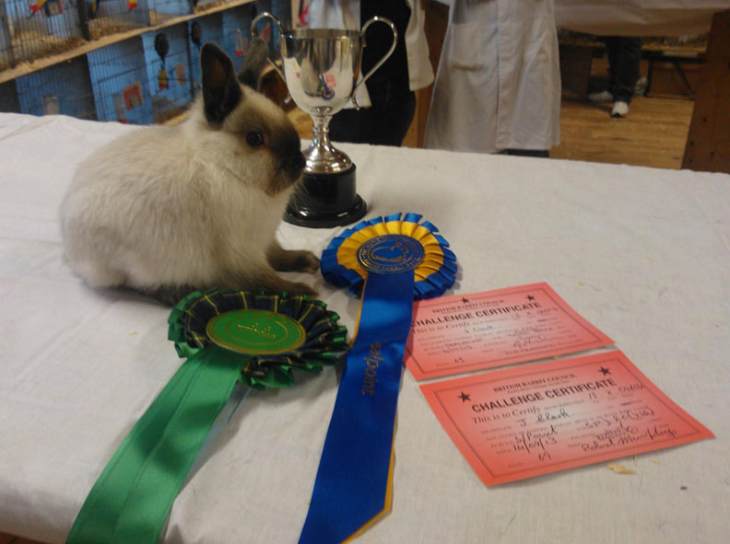
Some back ground information
BRC – The British Rabbit Council the governing body of the rabbit fancy in Great Britain http://www.thebrc.org
F&F – Fur & Feather the publication of the small animal fancy
Show Classes - are of two types, breed classes and duplicates, each exhibit must be entered in only one breed class, there can be an entry in any of the duplicate classes it is eligible to enter.
Sections – There are four elementary sections for the exhibits Fancy, Lop, Fur and Rex, there is a fifth section Open to find Best In Show
Class restrictions are based on both Gender and Age of both exhibit and exhibitor, membership local club.
Black Silver Fox
Netherland Dwarf BEW
Netherland Dwarf Smoke Pearl
Best In Show Picture © http://www.poppyfieldstud.co.uk
From Public domain
From Public domain
Notes:
Sections the four breed sections winners compete in the duplicate section for Best In Show
There is a sixth section Pets for exhibits that are not wearing BRC identification rings. Mainly for children's pets.

