Slide 1
SHAPE OPTIMISATION USING DEEP REINFORCEMENT LEARNING METHODS
Final Presentation of Master Thesis
Philip Varghese Modayil (229225)
TU Dortmund - Information Processing Laboratory
12. September 2024
External Supervisor: Dr.-Ing. Werner John(Associate Lecturer)
Supervisor: Prof. Dr.-Ing. Jürgen Götze
Co-Supervisor: M.Sc. Emre Ecik
Submitted On: 29 June 2024

Slide 2
Contents
Motivation
Necessary Equations – Shape Optimisation
Concept Development
Methods Overview
Degenerate Deep Reinforcement Learning
Cubic Bézier Curve
DRL Methods – Method 4
Test Case Results
Reinforcement Learning & Genetic Algorithm
Conclusion & Future Scope

Slide 3
“Tell me and I forget. Teach me and I remember. Involve me and I learn.“
- Benjamin Franklin
Notes:
The microstrip transmission line consists of a very thin strip of
conductive material on a dielectric substrate that propagates an electromagnetic
wave in the axial z-direction, the existence of which requires axial field strength
components for physical reasons.

Slide 4
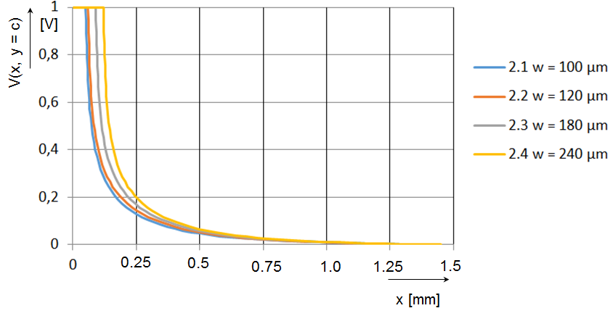
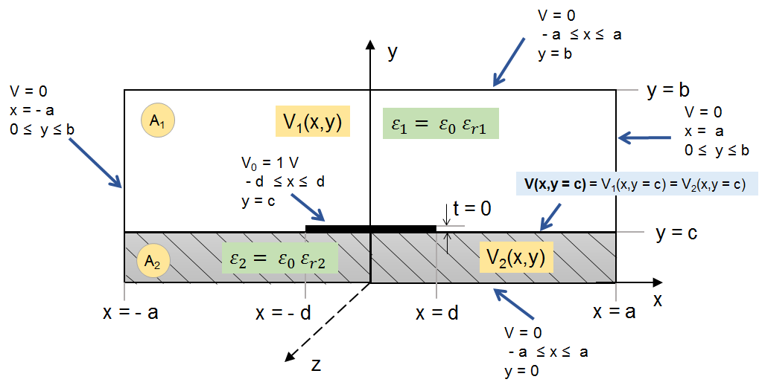
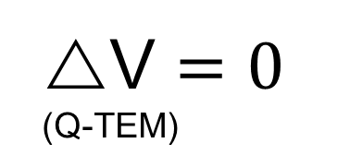
Motivation
Task
Reinforcement Learning Based Calculation of Characteristic Impedance for a Single Microstrip.
To determine
Potential Distribution
Microstrip Arrangement
Solution Approach
Physical/Mathematical Formulation (physical knowledge)
V $=0$
(Q-TEM)
Microstrip Arrangement Boundary Conditions
Notes:
The microstrip transmission line consists of a very thin strip of
conductive material on a dielectric substrate that propagates an electromagnetic
wave in the axial z-direction, the existence of which requires axial field strength
components for physical reasons.

Slide 5
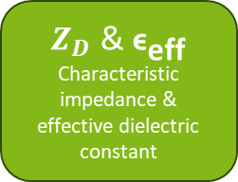
Motivation
PCB design
$Z_{D}$ & ${\text{ϵ}}_{\text{eff}}$
Characteristic impedance & effective dielectric constant
Potential Distribution
In the region
0 < |x| < a
Thomson’s theorem
Shape optimisation
ML approach
The potential distribution follows Thomson’s minimum energy theorem, which states that
“Charges placed on a system of fixed conductors embedded in a dielectric will distribute themselves on the surfaces of these conductors such that the energy of the resultant electrostatic field is a minimum“
Thomson’s theorem: Julius Adams Stratton: Electromagnetic Theory; Mcgraw-Hill (1941); Page 114
Notes:
The microstrip transmission line consists of a very thin strip of
conductive material on a dielectric substrate that propagates an electromagnetic
wave in the axial z-direction, the existence of which requires axial field strength
components for physical reasons.

Slide 6
Motivation – Deep Reinforcement Learning
Problems with conventional methods:
Lack of labelled dataset
Computational complexity
Implementation challenges
Stuck at local optima
Deep Reinforcemet Learning:
Navigate environment without explicit knowledge
No separate objective functions
Easier to implement
Supports exploration
Solution
Notes:
The microstrip transmission line consists of a very thin strip of
conductive material on a dielectric substrate that propagates an electromagnetic
wave in the axial z-direction, the existence of which requires axial field strength
components for physical reasons.

Slide 7
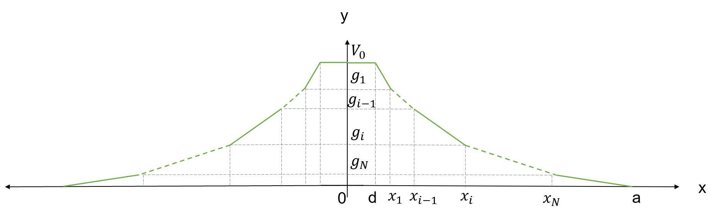
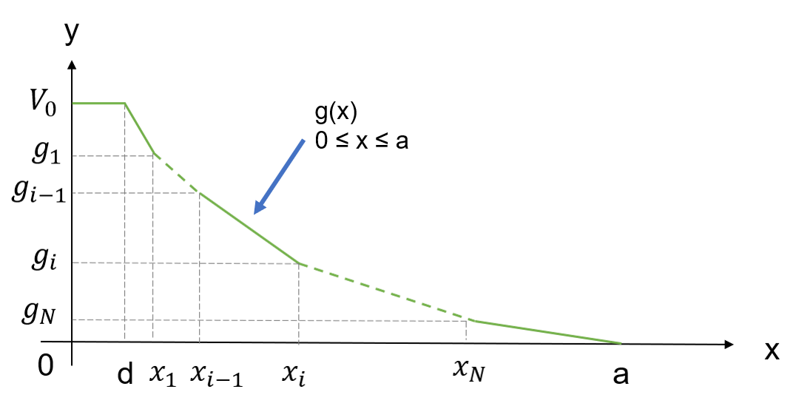
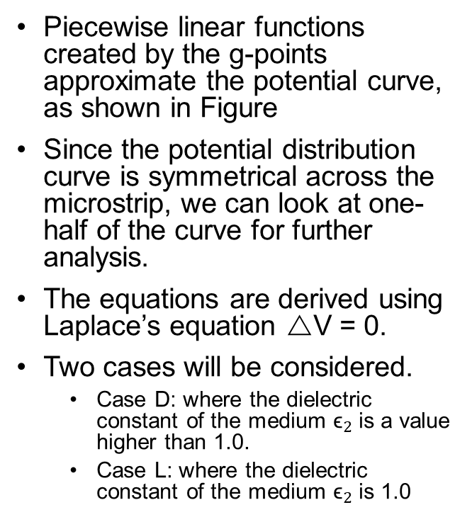
Necessary Equations – Shape Optimisation
Piecewise linear functions created by the g-points approximate the potential curve, as shown in Figure
Since the potential distribution curve is symmetrical across the microstrip, we can look at one-half of the curve for further analysis.
The equations are derived using Laplace’s equation V = 0.
Two cases will be considered.
Case D: where the dielectric constant of the medium ${\text{ϵ}}_{2}$ is a value higher than 1.0.
Case L: where the dielectric constant of the medium ${\text{ϵ}}_{2}$ is 1.0
Notes:
The microstrip transmission line consists of a very thin strip of
conductive material on a dielectric substrate that propagates an electromagnetic
wave in the axial z-direction, the existence of which requires axial field strength
components for physical reasons.

Slide 8

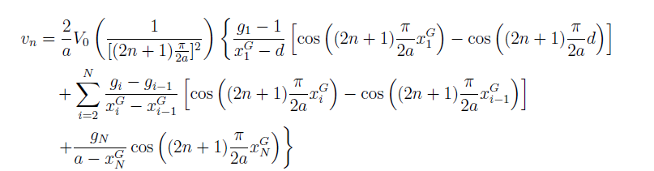
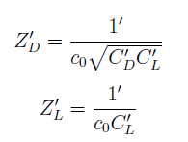
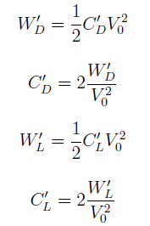
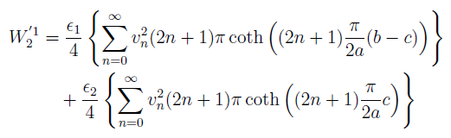




Necessary Equations – Shape Optimisation
Potential distribution,
Where $v_{n}$ is given by,
Where $V_{0}$ = 1,
Normalised for ease of calculations
Characteristic Impedance
Capacitance
Energy of the curve,
Effective Dielectric Constant
& Phase Velocity,
Notes:
The microstrip transmission line consists of a very thin strip of
conductive material on a dielectric substrate that propagates an electromagnetic
wave in the axial z-direction, the existence of which requires axial field strength
components for physical reasons.

Slide 9
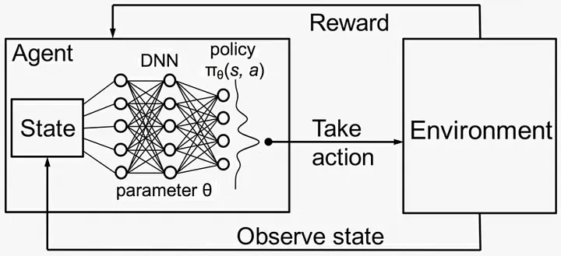
Concept Development
For any DRL problem, we must define the three basic units: Observation Space, Action Space, and Reward Scheme
Necessary conditions
The potential curve is monotonically decreasing
Thomson’s theorem
The potential curve will follow the shape with minimum energy
The potential curve is convex
Image source: https://medium.com/@vishnuvijayanpv/deep-reinforcement-learning-value-functions-dqn-actor-critic-method-backpropagation-through-83a277d8c38d

Slide 10
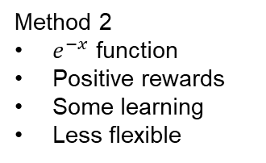
Methods Overview
Method 1
Scatter points
Too random
No learning
Penalizing rewards
Need shape drawing techniques
Method 2
$e^{−x}$ function
Positive rewards
Some learning
Less flexible
Need more flexibility
Method 3
Bézier curve
Better results
Less exploration
Non-scaled rewards
Introduced Bézier Curve
A total of four methods were tried out.
Method 1 had no significant learning.
Detail discussion of Method 4 follows.
Predictions are compared with nominal curves obtained from Yamashita method.
Need more
exploration
scaled reward
Introduced DDRL
Method 4
Scaled reward
Exploration boost
Best results
Paper source: E. Yamashita, H. Ohashi, and K. Atsuki, “Characterization of microstrip lines near a substrate edge and design formulas of edge-compensated microstrip lines (mmics),” IEEE transactions on microwave theory and techniques, vol. 37, no. 5, pp. 890–896, 1989.

Slide 11
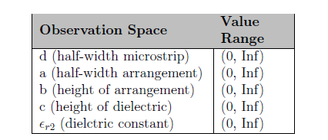
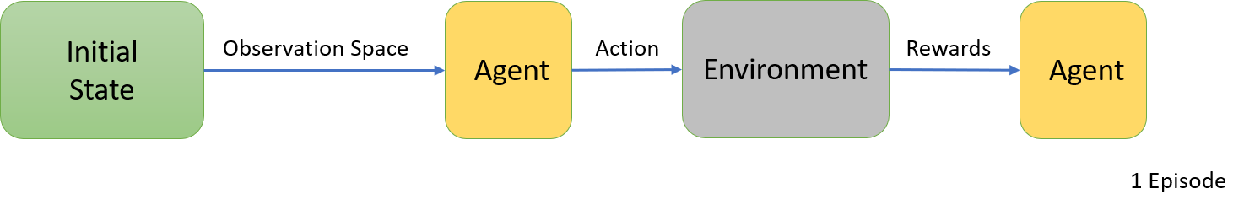
Degenerate Deep Reinforcement Learning
As in Method 1 a normal MDP(Markov’s Decision Process) type DRL approach does not work.
Shape optimisation do not have intermediate state.
In the paper mentioned below researchers have introduced a new approach to how deep reinforcement learning is implemented called Degenerate Deep Reinforcement Learning (single-step DRL).
Observation Space
Paper source: H. Ghraieb, J. Viquerat, A. Larcher, P. Meliga, and E. Hachem, “Single-step deep reinforcement learning for two-and three-dimensional optimal shape design,” AIP Advances, vol. 12, no. 8, p. 110080, 2022

Slide 12
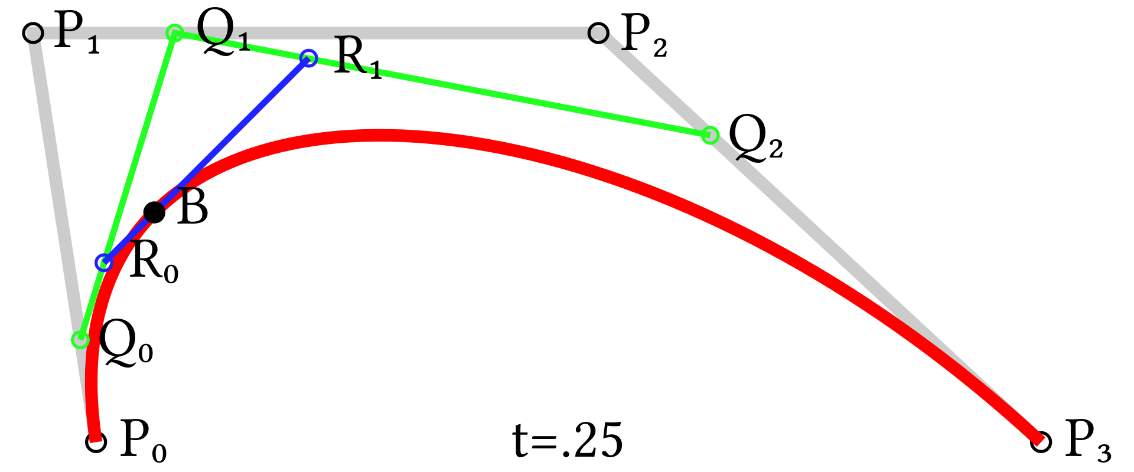
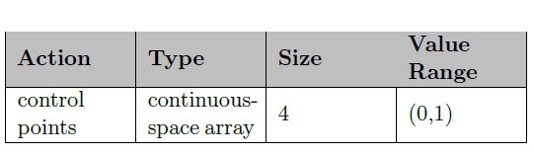
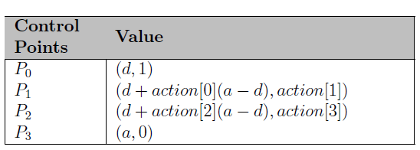
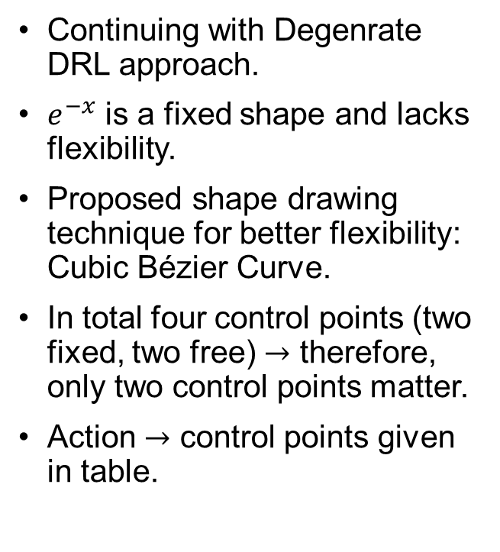
Cubic Bézier Curve
Continuing with Degenrate DRL approach.
$e^{−x}$ is a fixed shape and lacks flexibility.
Proposed shape drawing technique for better flexibility: Cubic Bézier Curve.
In total four control points (two fixed, two free) $→$ therefore, only two control points matter.
Action $→$ control points given in table.
Cubic Bézier Curve
Action for Method 3
Bézier Control Points
Image source:Bézier curve. (2024, July 18). In Wikipedia. https://en.wikipedia.org/wiki/B%C3%A9zier_curve

Slide 13
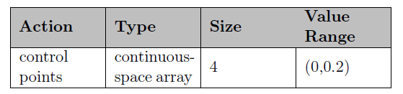
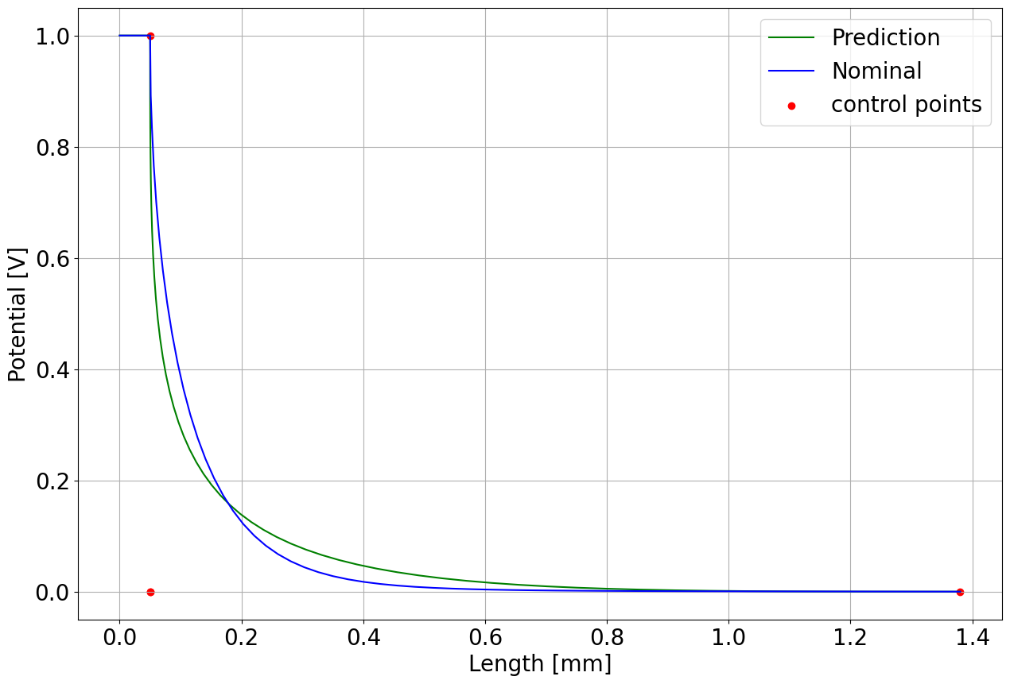
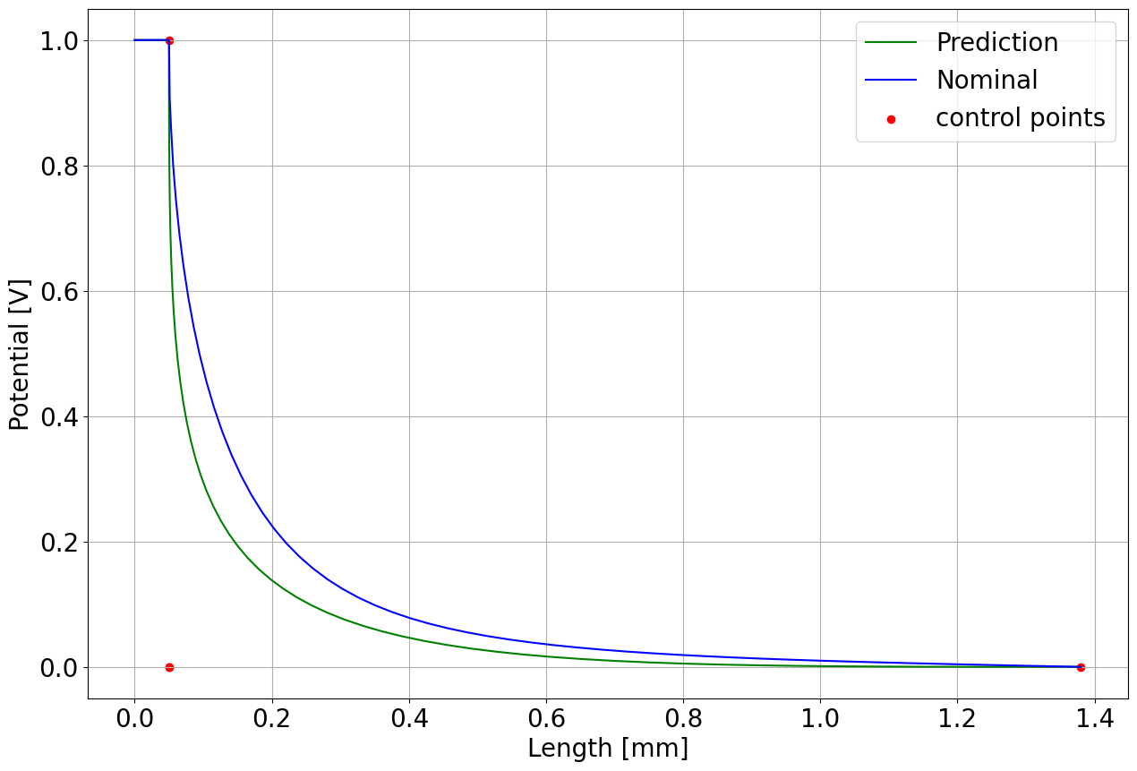
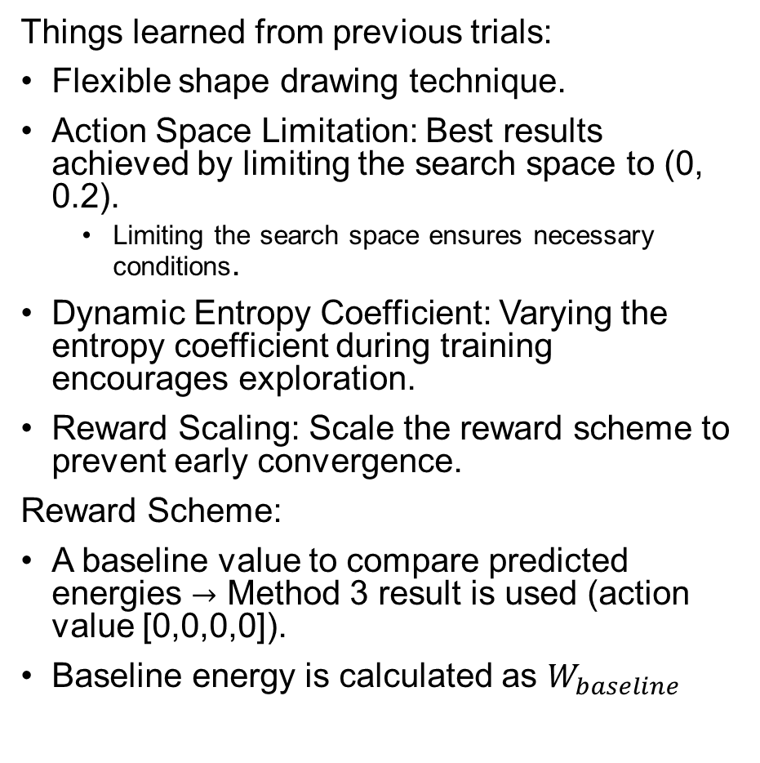
DRL Methods – Method 4
Things learned from previous trials:
Flexible shape drawing technique.
Action Space Limitation: Best results achieved by limiting the search space to (0, 0.2).
Limiting the search space ensures necessary conditions.
Dynamic Entropy Coefficient: Varying the entropy coefficient during training encourages exploration.
Reward Scaling: Scale the reward scheme to prevent early convergence.
Reward Scheme:
A baseline value to compare predicted energies $→$ Method 3 result is used (action value [0,0,0,0]).
Baseline energy is calculated as $W_{baseline}$
Action for Method 4
Case D Baseline Curve
Case L Baseline Curve

Slide 14
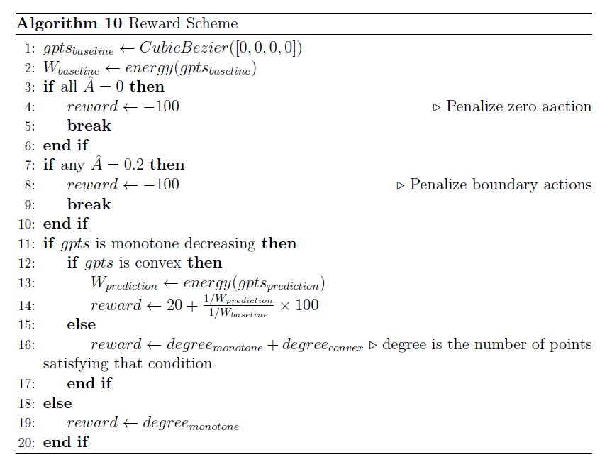
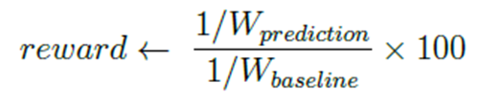
DRL Methods – Method 4
The rewards as a ratio
As the predicted energy of the region decreases and approaches that of the baseline energy, the value will rise to 100. If the energy falls below the baseline, the value will exceed 100.
A check for necessary conditions is also added.
The model is trained with SAC agent for Test Case 2.1 Case D and L Environments separately.
Dynamic entropy coefficients are deployed to boost exploration.
Rewards Method 4

Slide 15
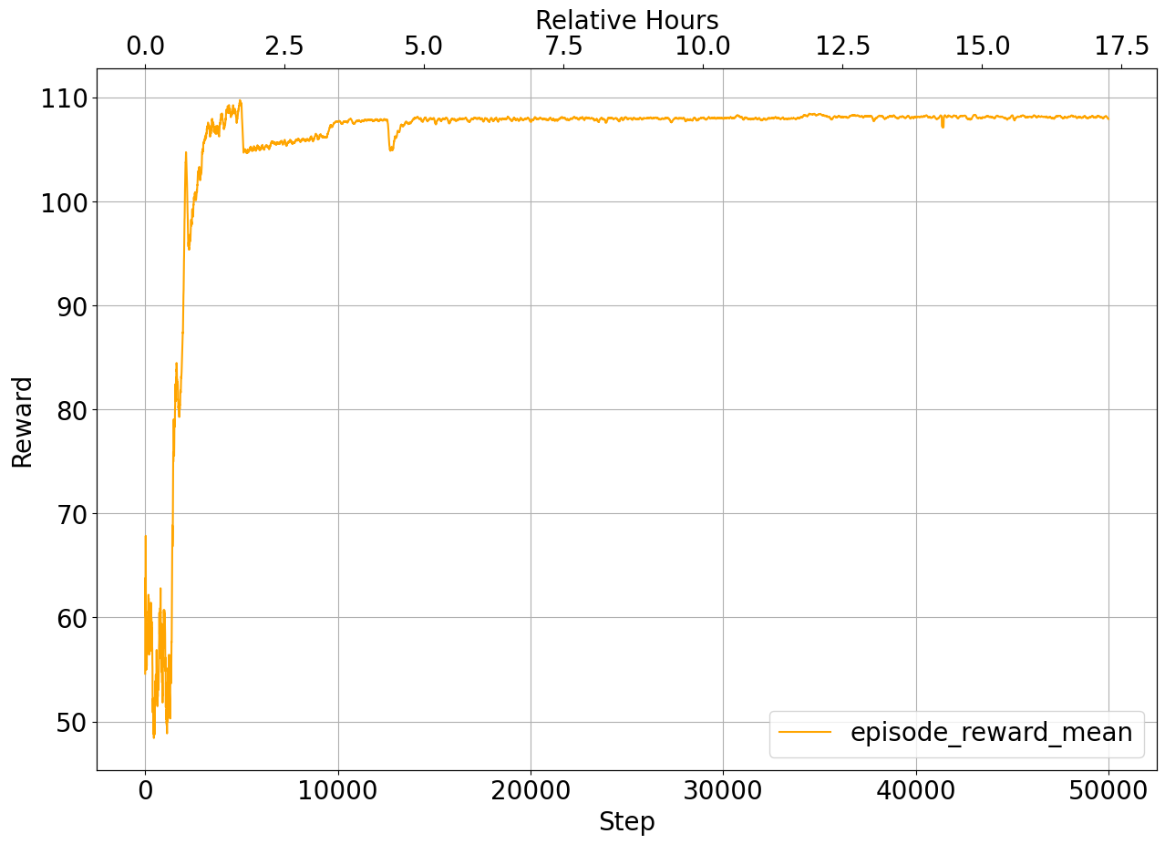
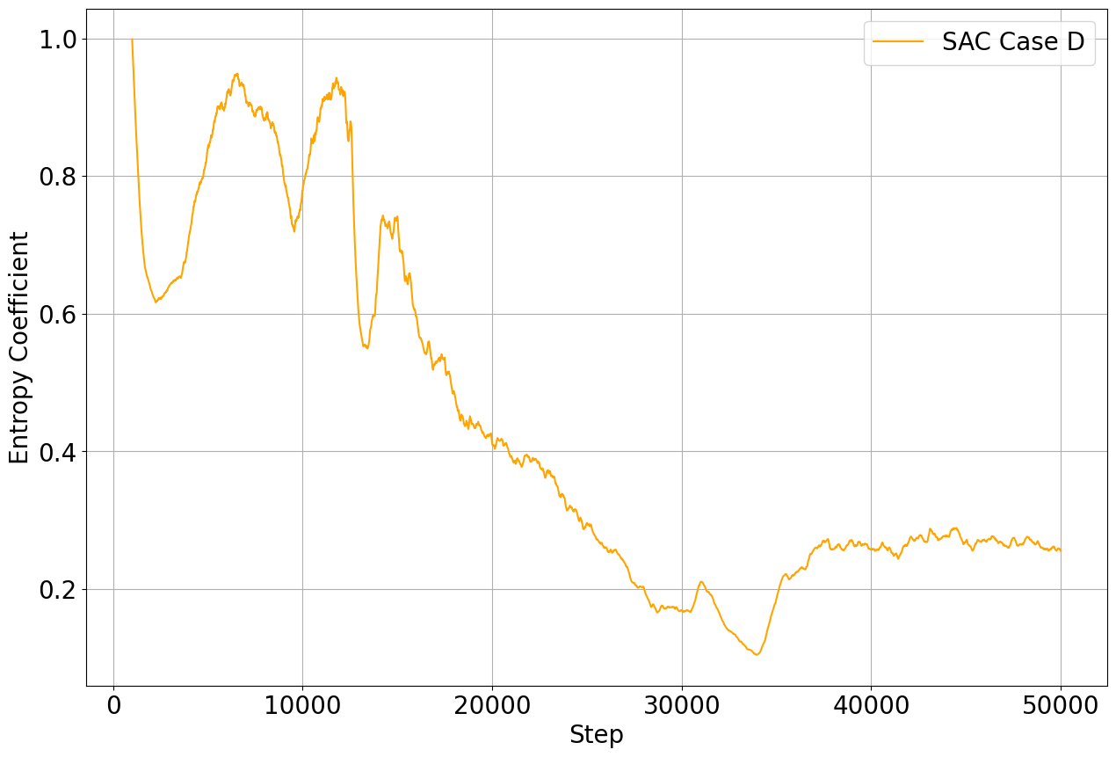
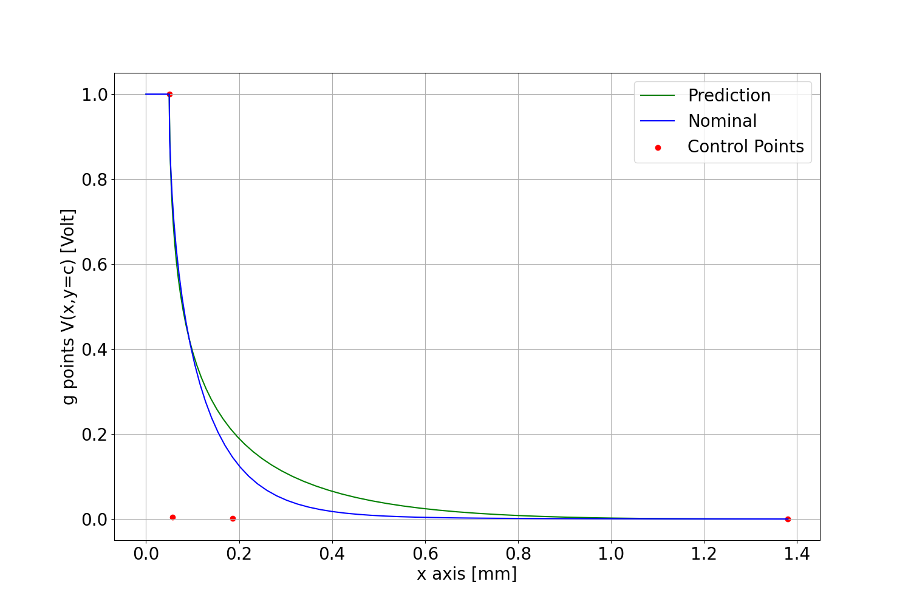
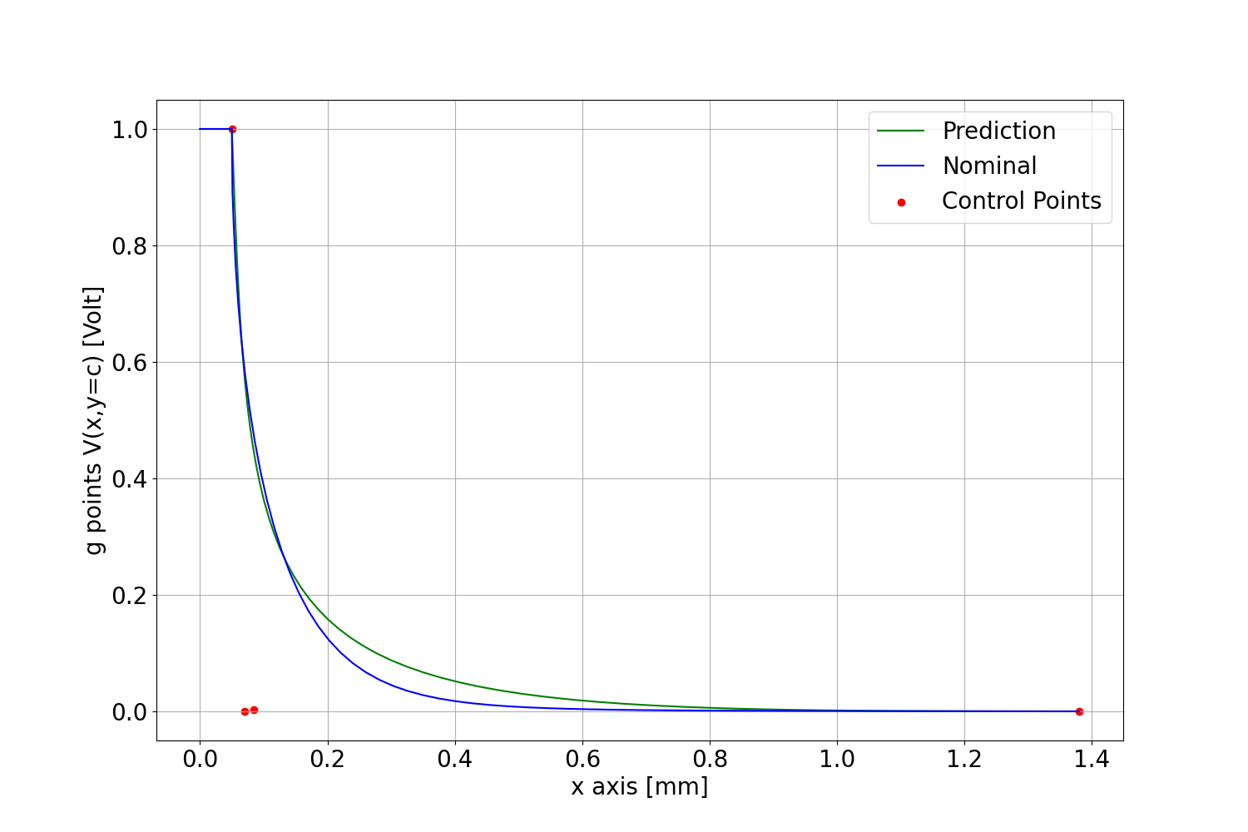
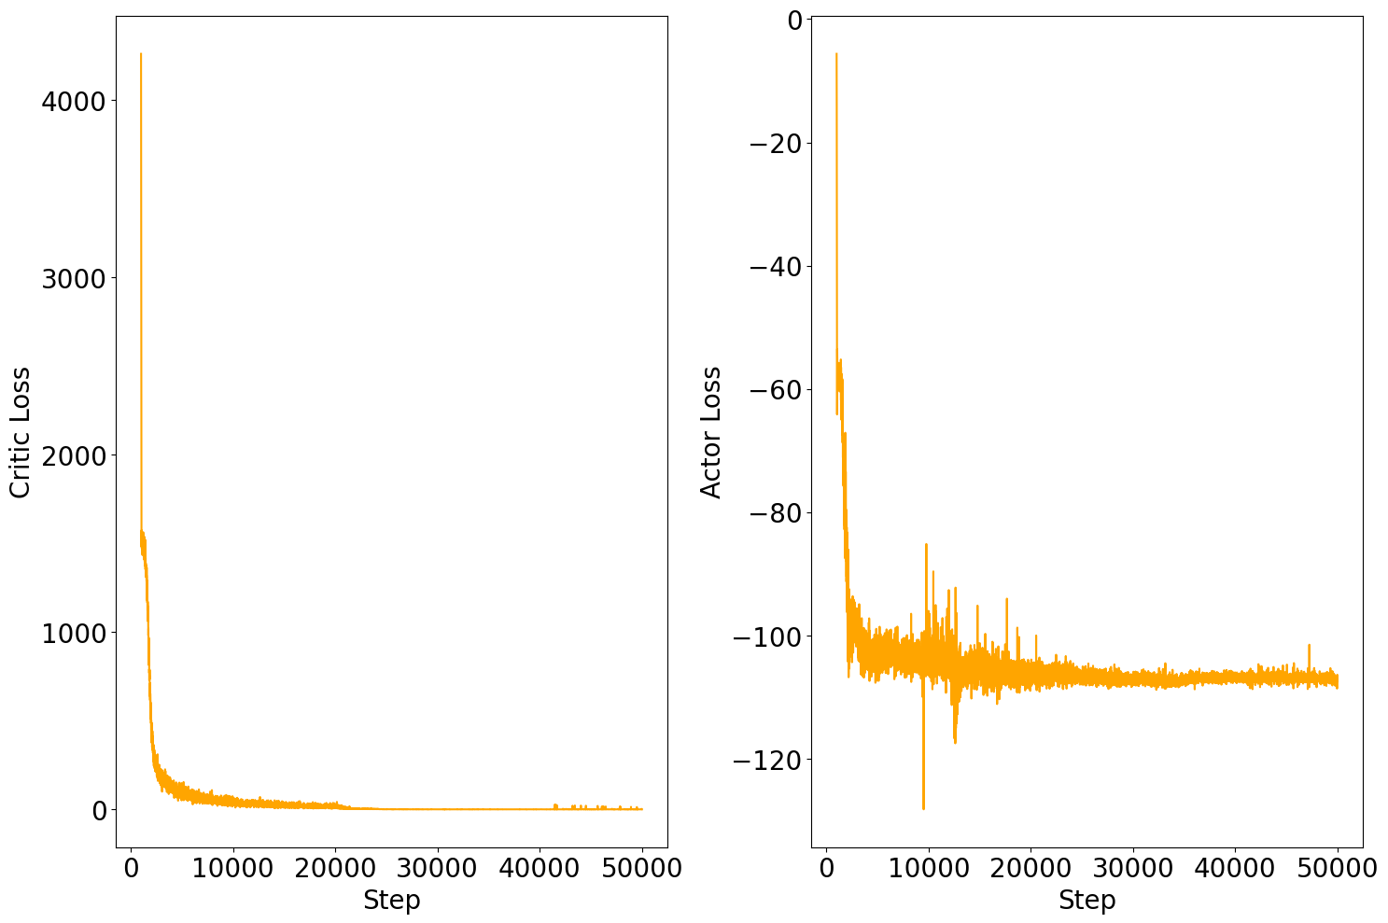
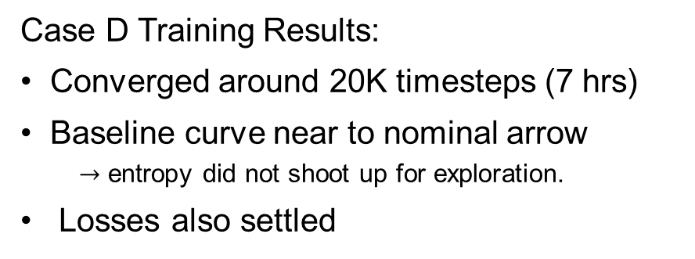
DRL Methods – Method 4 Training Results
Case D Training Results:
Converged around 20K timesteps (7 hrs)
Baseline curve near to nominal arrow
$→$ entropy did not shoot up for exploration.
Losses also settled
Rewards
Entropy
Losses
G-Points at 20K Timesteps for Case D with SAC Agent
G-Points at 50K Timesteps for Case D with SAC Agent

Slide 16
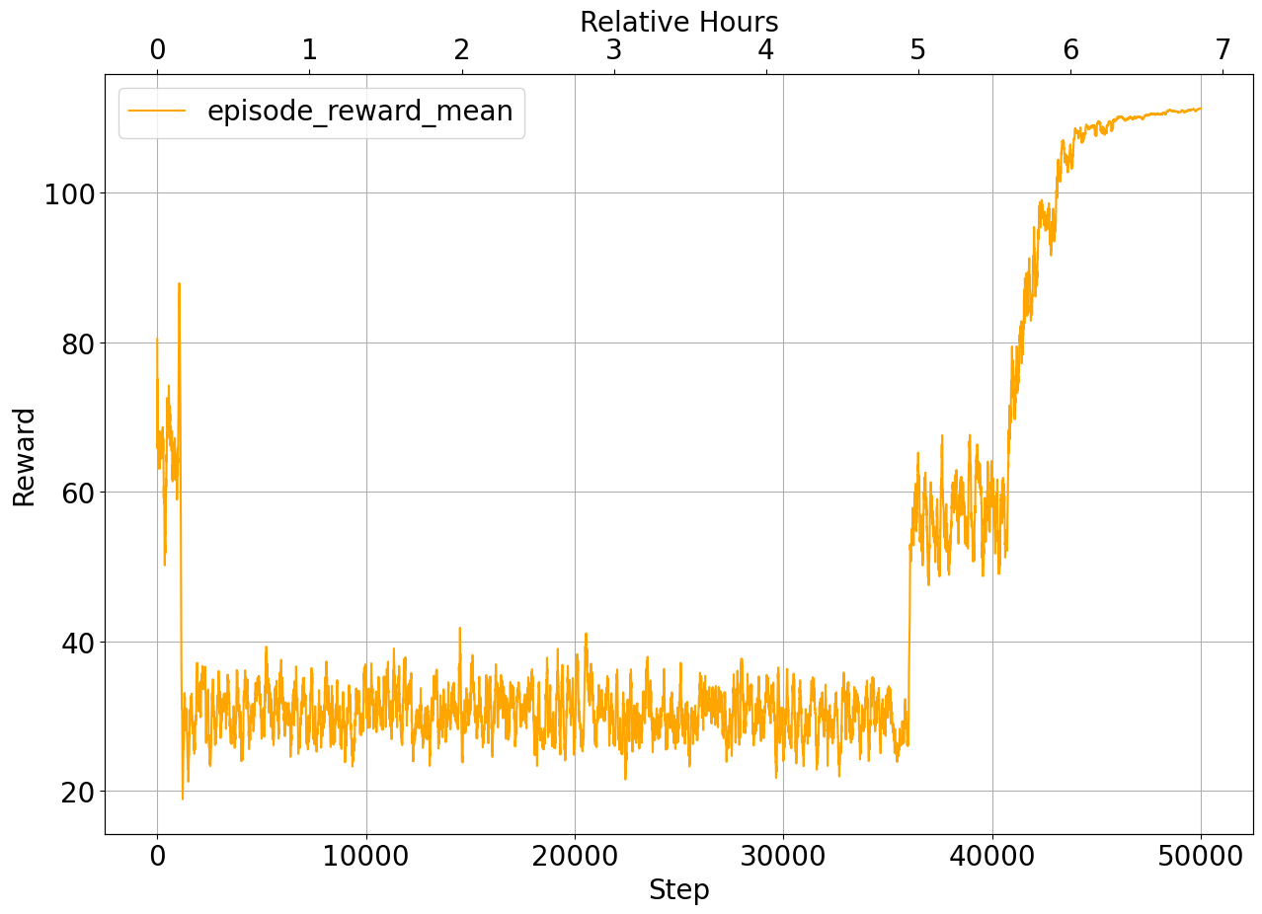
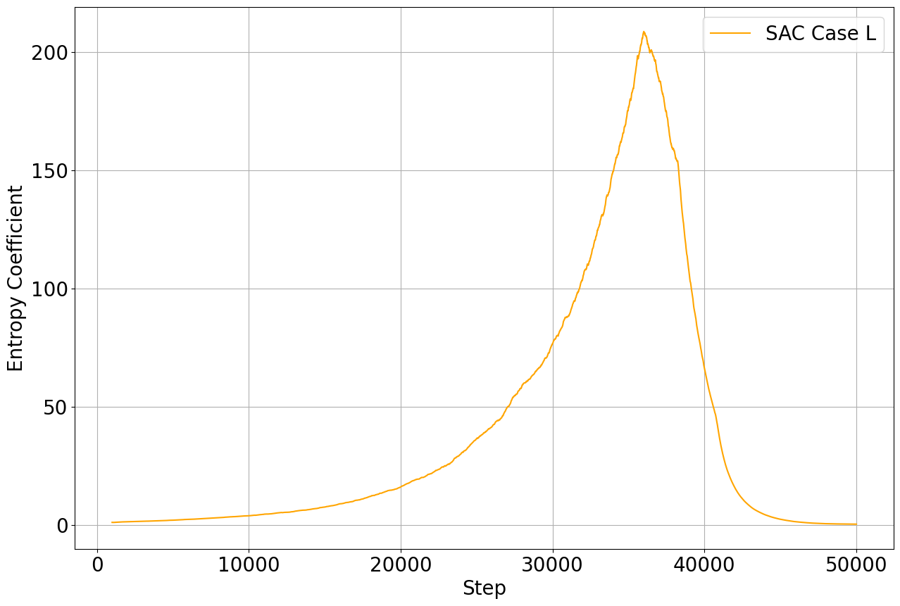
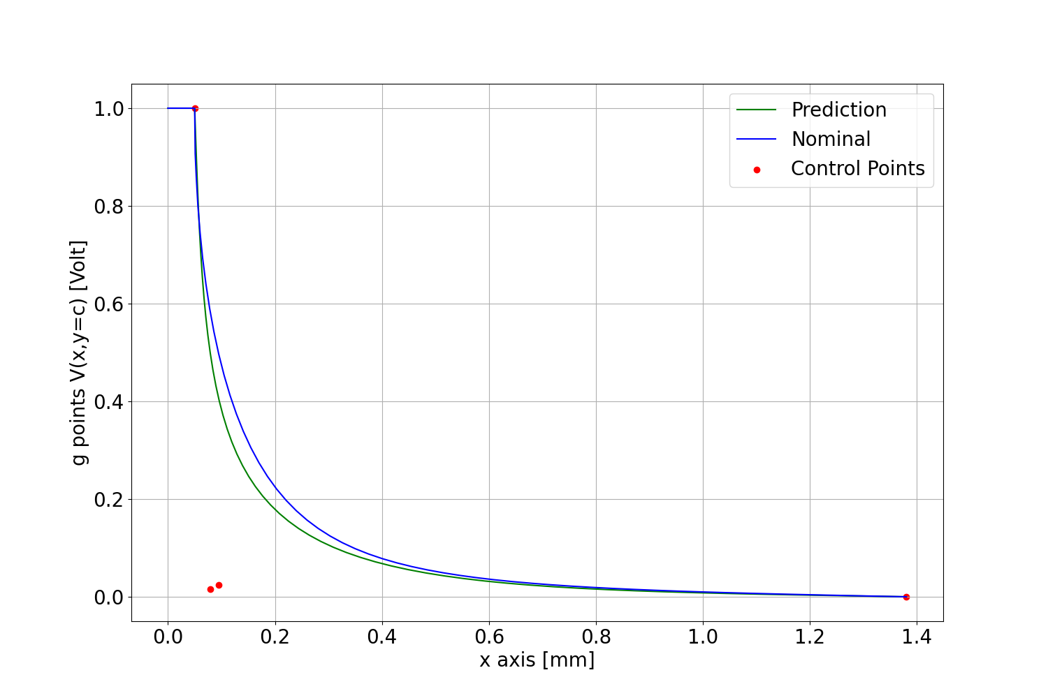
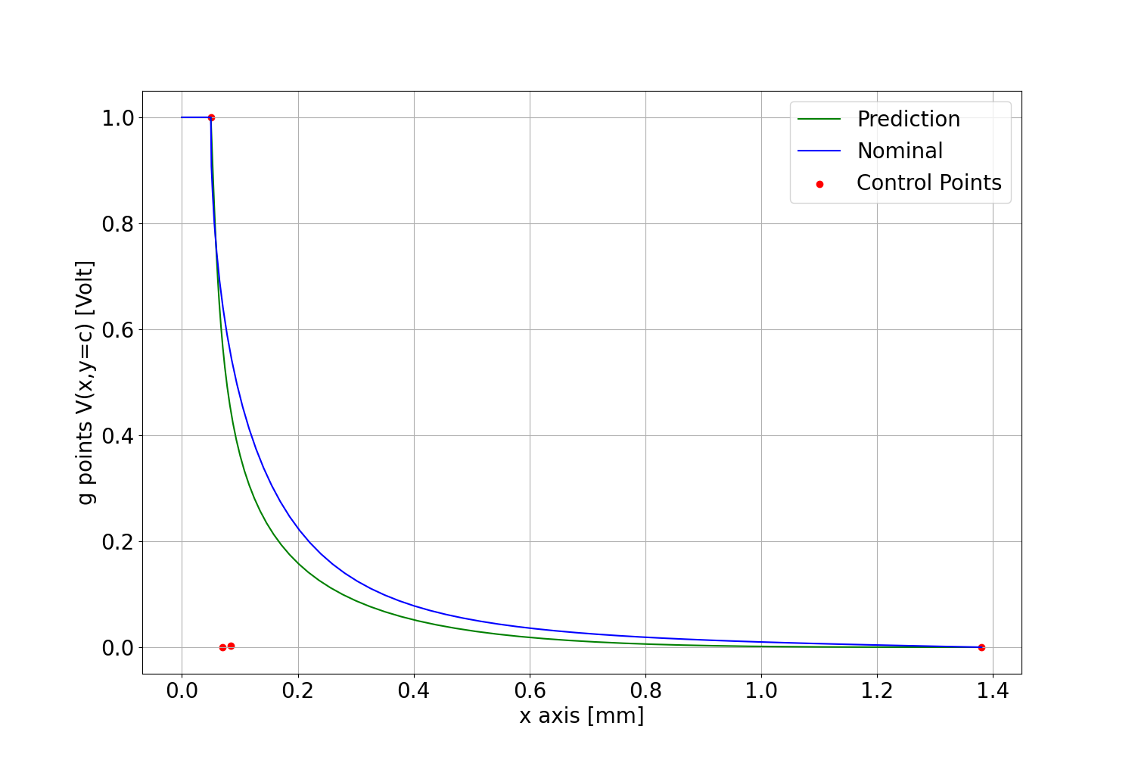
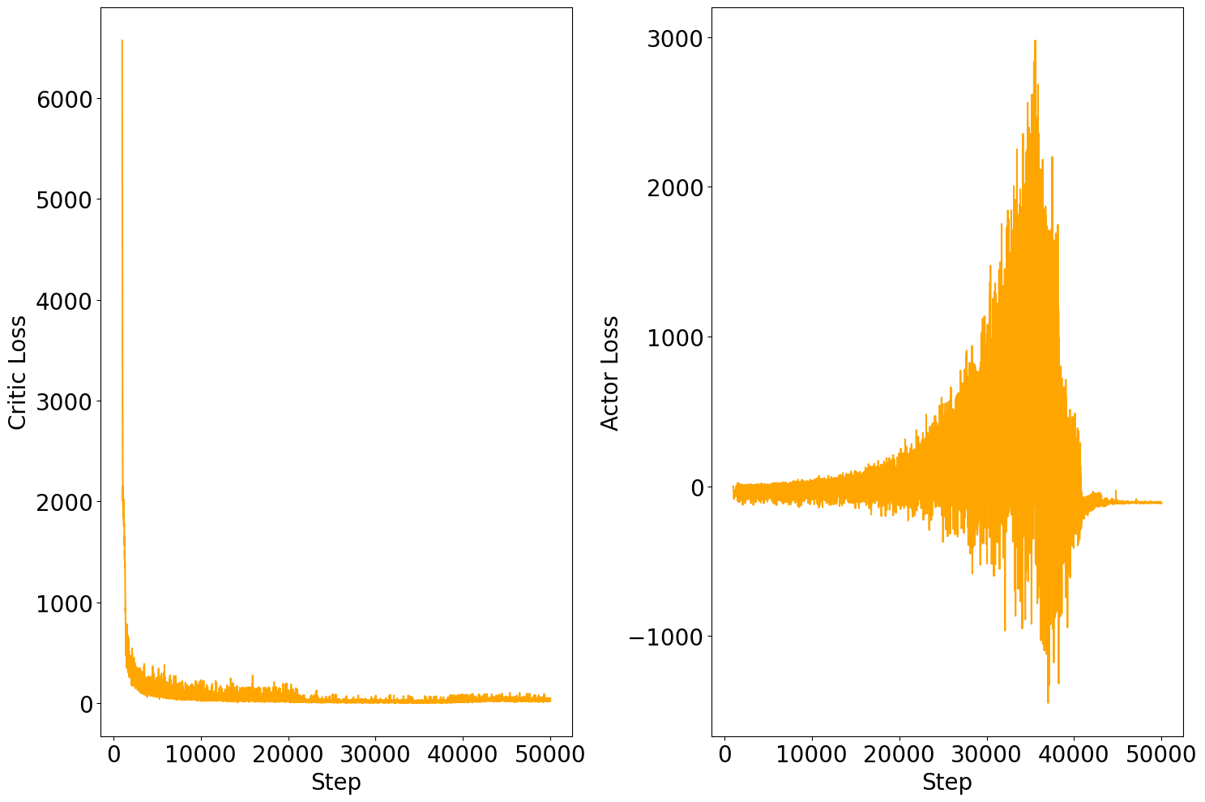
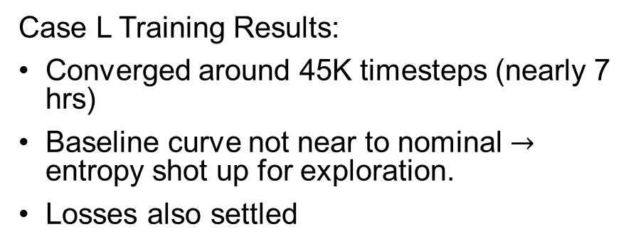
DRL Methods – Method 4
Case L Training Results:
Converged around 45K timesteps (nearly 7 hrs)
Baseline curve not near to nominal $→$ entropy shot up for exploration.
Losses also settled
Rewards
Entropy
Losses
G-Points at 45K Timesteps for Case L with SAC Agent
G-Points at 50K Timesteps for Case L with SAC Agent

Slide 17
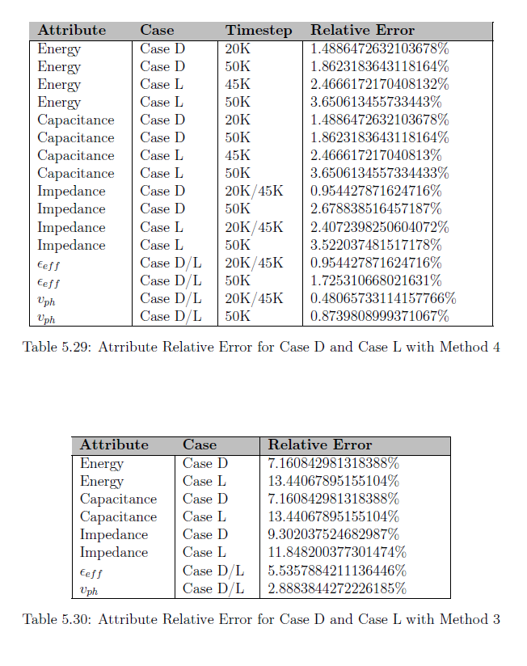
DRL Methods – Method 4
Relative error is very small.
In comparison to the results of Method 3 significant improvement can be observed.
Both Case D and Case L converged around seven hours of training.
Attribute Relative Error for Case D and Case L with Method 4
Attribute Relative Error for Case D and Case L with Method 3

Slide 18
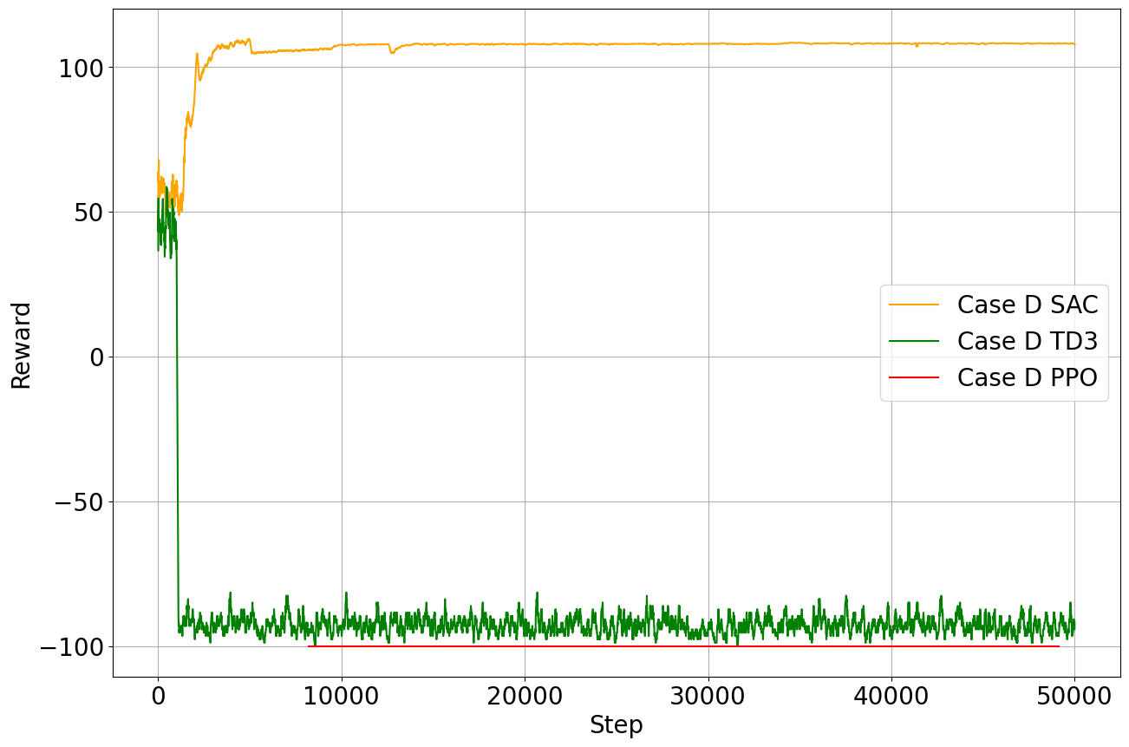
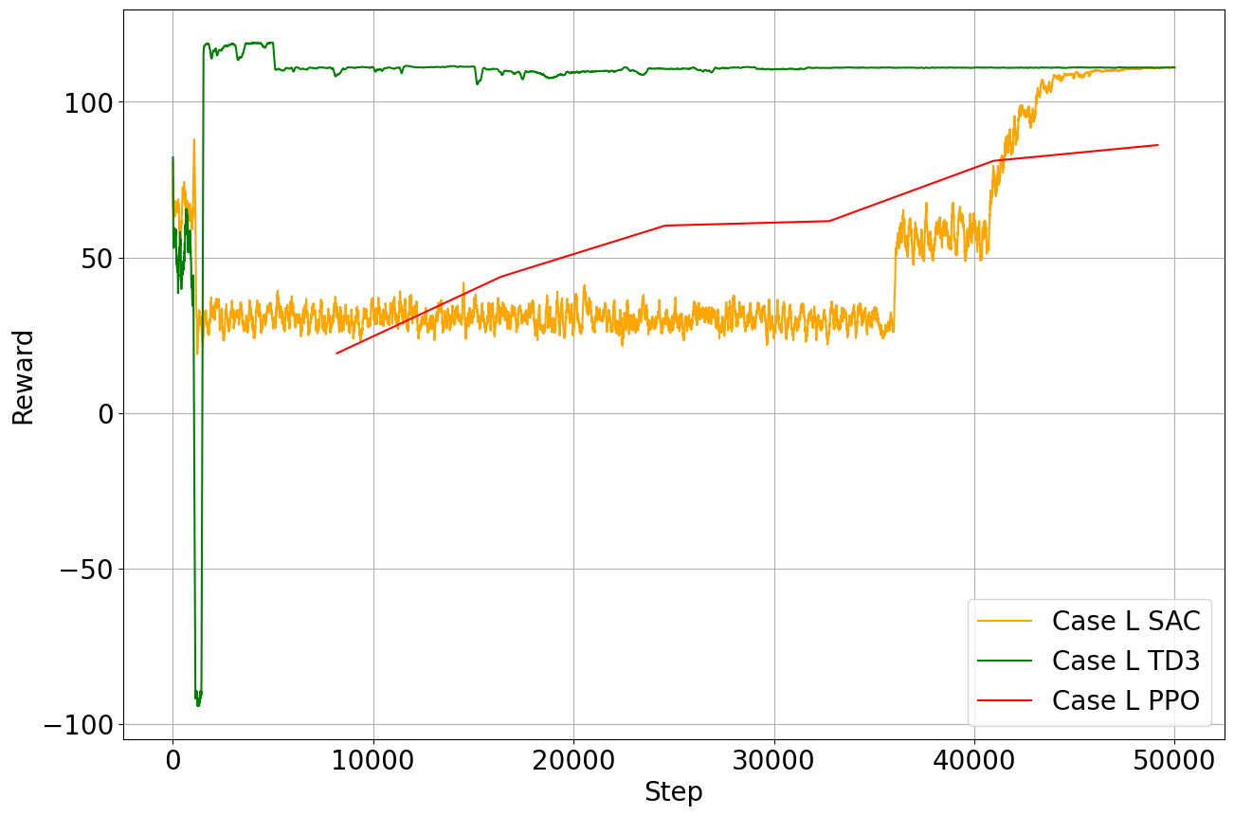
DRL Methods – Method 4
Agent Comparison: Evaluated SAC, TD3, and PPO using Method 4.
SAC performed best in case D; all agents performed well in case L.
TD3 converged faster for Case L, but SAC's slower convergence was due to higher exploration (auto entropy coefficient).
Lack of exploration led to TD3's poor performance in case D; SAC's heavy exploration avoided local solutions.
Further tuning of the entropy coefficient could optimize performance but may not generalize to other environments.
In conclusion it is observed that SAC is more stable and reliable for this problem.
Multiple Agents Episode Reward Mean for Method 4 Case D (Top), Case L(Bottom)

Slide 19

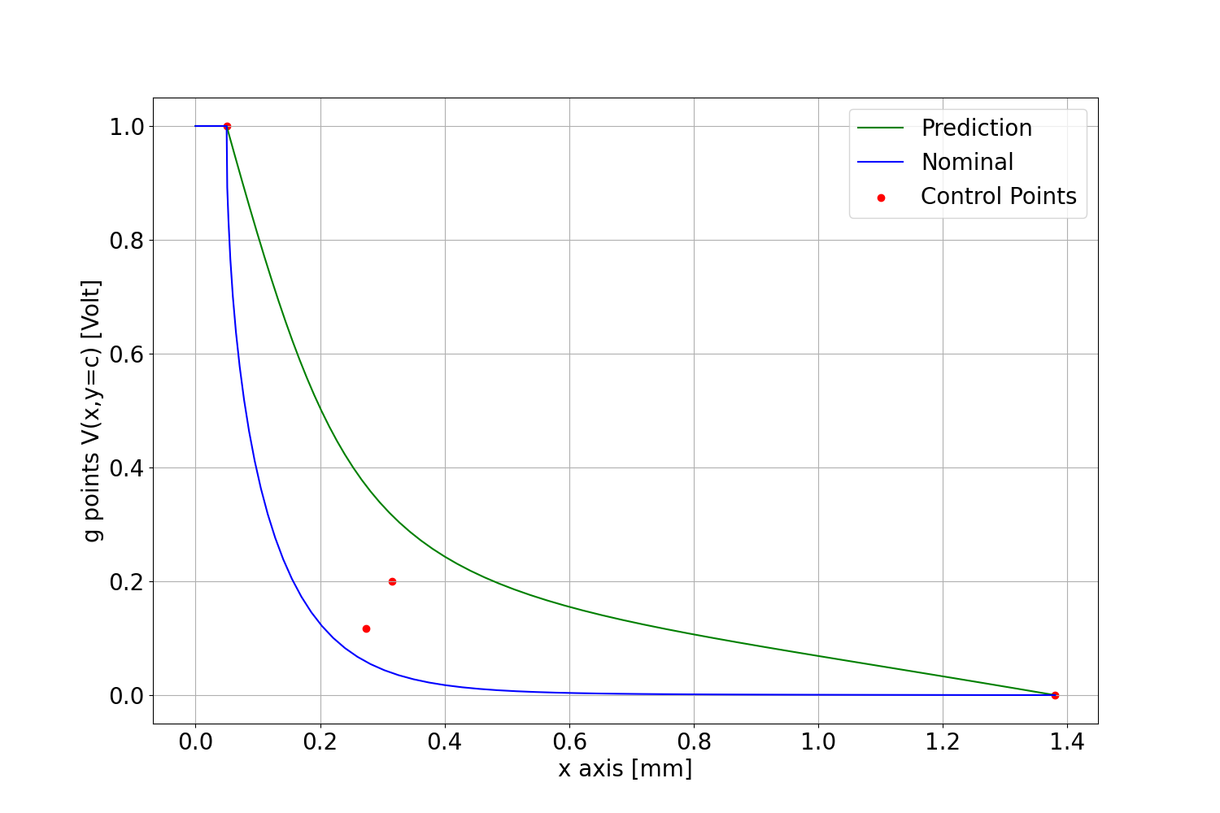
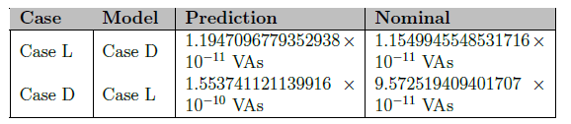
DRL Methods – Method 4
Model Comparison: Alternated models between cases to assess performance.
Case D model performed well for Case L, but the Case L model was poor for Case D.
Case D curve has more flexibility, while Case L curve is flatter.
In conclusion it is observed that training on Case D is sufficient, as it generalizes well to Case L.
Case L predicted with model Case D(Top), Case D predicted with model Case L(Bottom)
Energy after Prediction

Slide 20
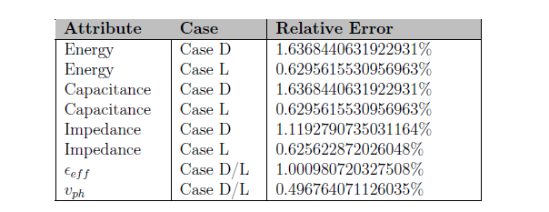
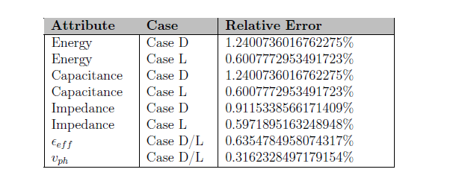
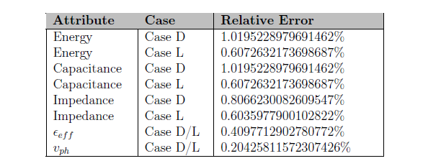
Test Case Results
Motivation: to test whether the trained model can predict for different environments even though it was not specifically trained for it. Stochastic policy like SAC should be able to do this.
Test cases done with 47 G-points and 2000 Fourier coefficients.
It can be observed that the relative error compared to the attributes of the nominal curve is very low, less than 2 %
We are obtaining a near-global solution.
Test Case 2.2
Test Case 2.3
Test Case 2.4
Test Case Relative Errors

Slide 21

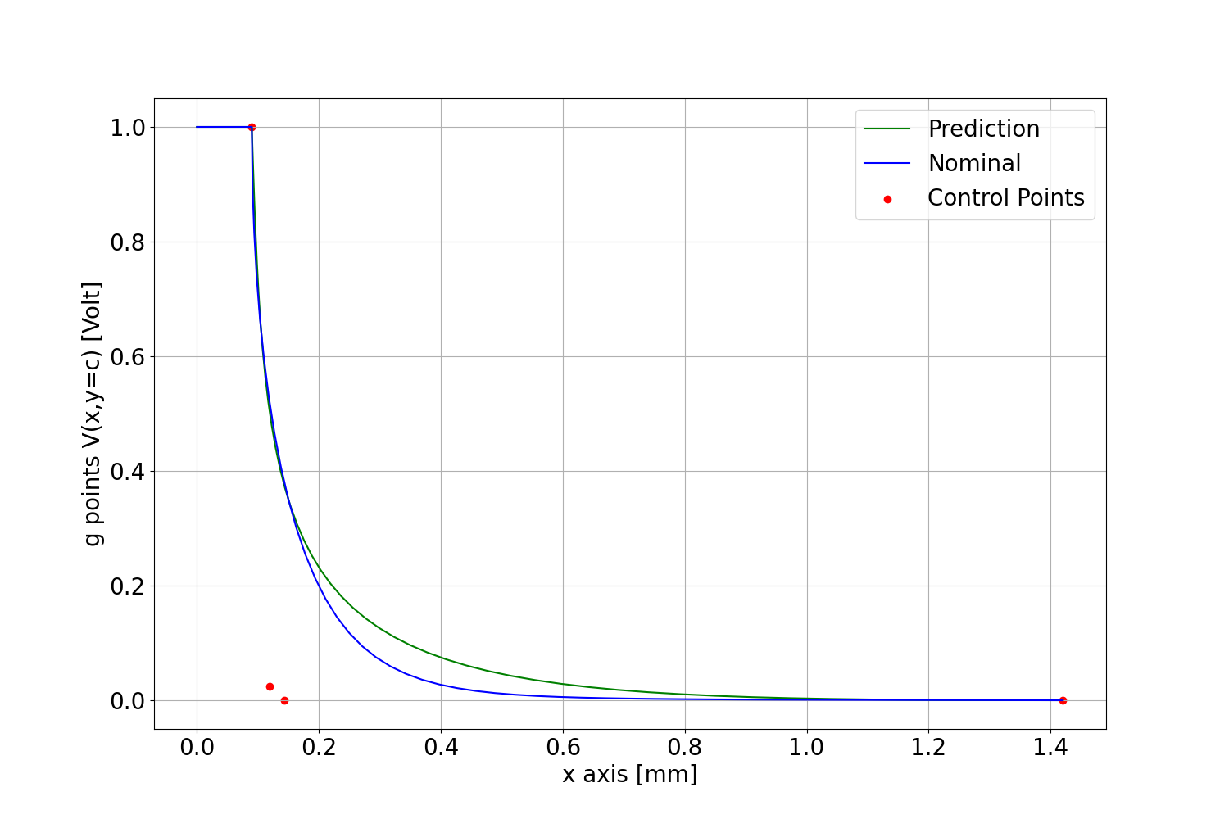

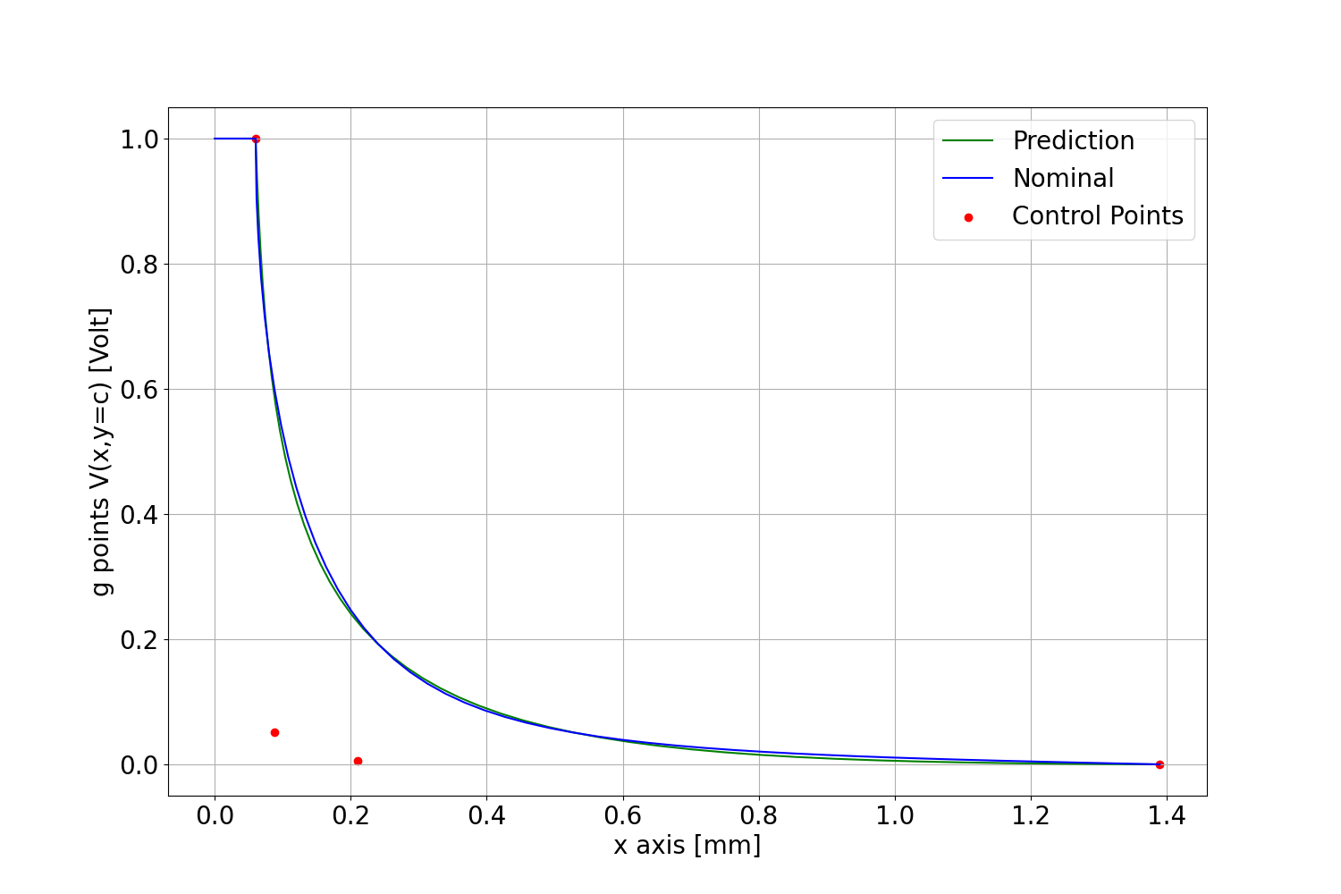
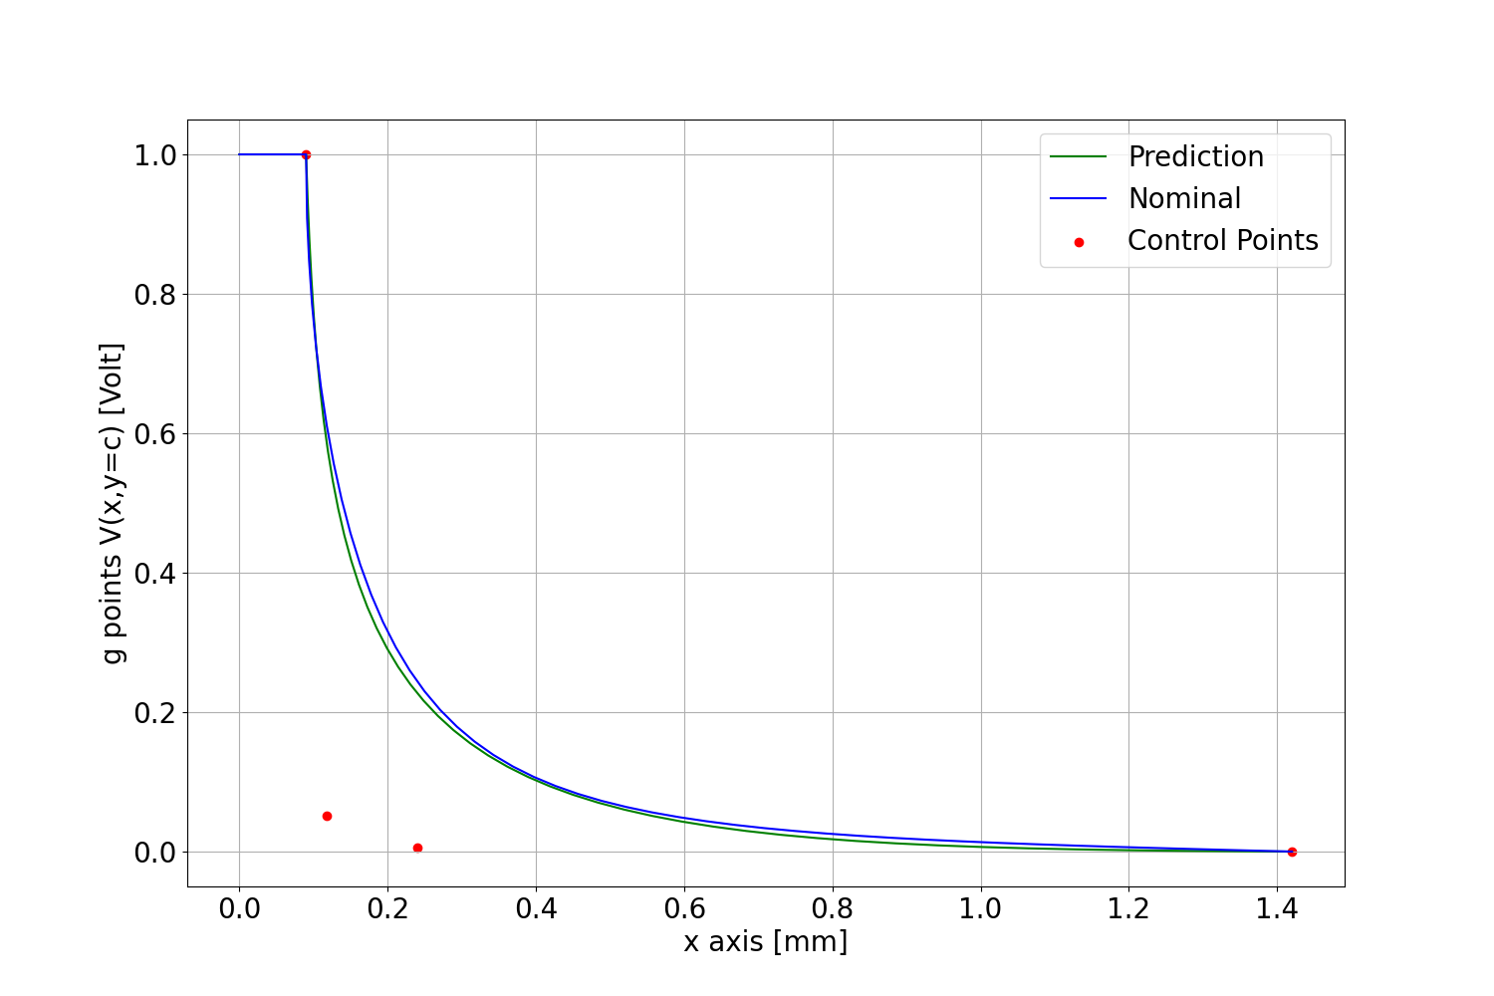
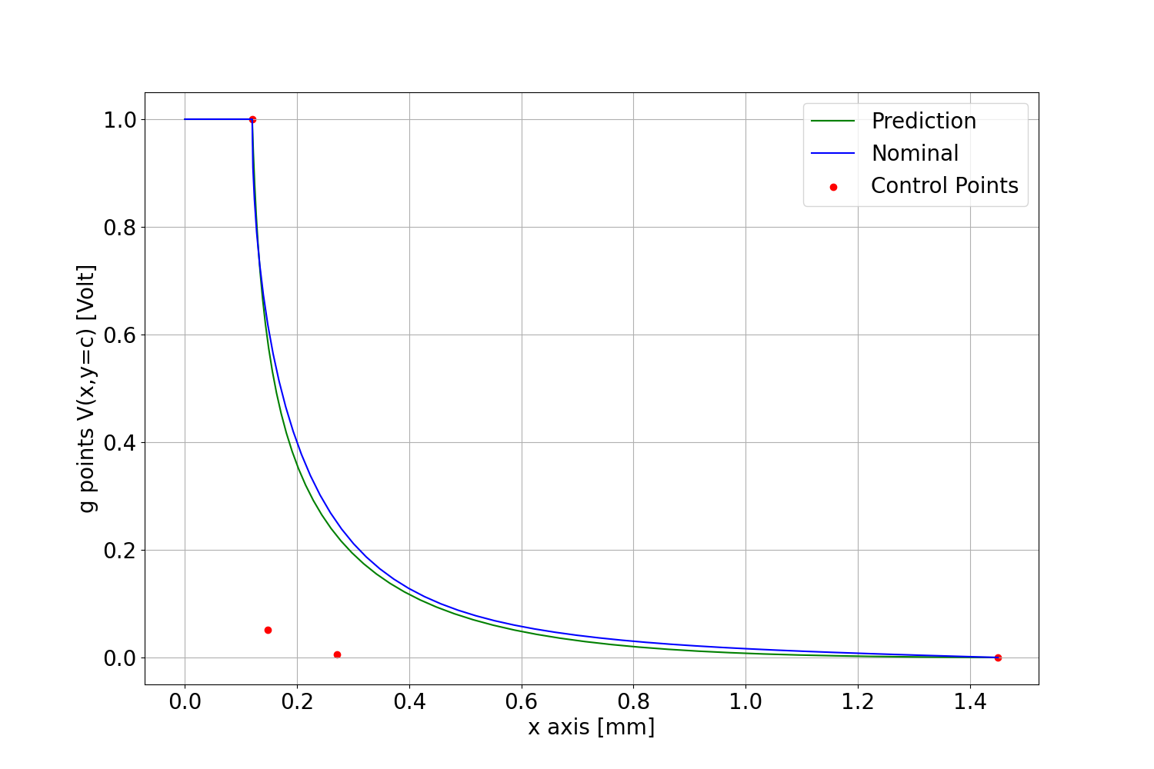
Test Case Results
Case D Test Case 2.2
Case D Test Case 2.3
Case D Test Case 2.4
Case L Test Case 2.2
Case L Test Case 2.3
Case L Test Case 2.4

Slide 22
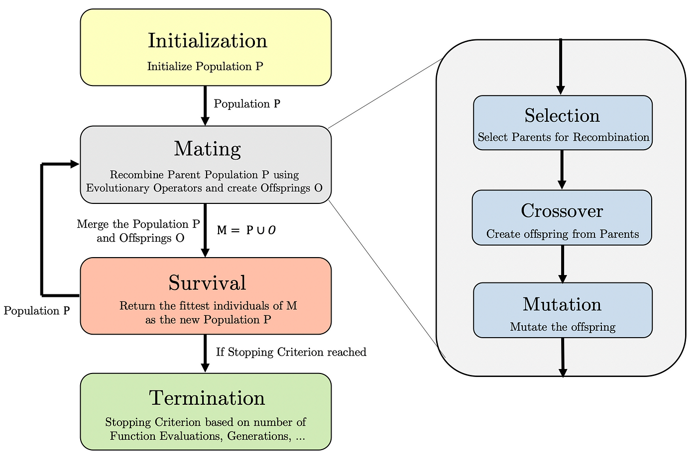
Reinforcement Learning & Genetic Algorithm
RL Limitations
Hyperparameter Challenges:
Too many hyper parameters
Reward Shaping:
Often trial and error method
Debugging Difficulty:
Hard to pinpoint exact issue
Model-Free Learning:
Requires extensive direct environment interactions
Genetic Algorithm
Effective search space exploration and solution convergence.
GA program was adapted from the source code provided by M.Sc. Julian Withöft.
Genetic Algorithm
Image source:https://towardsdatascience.com/an-introduction-to-genetic-algorithms-the-concept-of-biological-evolution-in-optimization-fc96e78fa6db

Slide 23




Reinforcement Learning & Genetic Algorithm
Test Case 2.1 Case D
GA Optimised
Test Case 2.1 Case L

Slide 24

Reinforcement Learning & Genetic Algorithm
The energy value comparison is shown.
The results show convergence to nominal value with 2 floating point precision.
Energy Values for Case D and Case L after GA Optimisation

Slide 25


Reinforcement Learning & Genetic Algorithm
“RL algorithms and their training are usually like searching in the darkness. However, it is the best method for the same”.
Impact of RL
Question: Is the RL-predicted starting curve necessary for GA optimization?
Test: GA optimization was tested without the RL starting curve, using a line segment instead, and compared with RL methods.
Results: GA optimization starting from RL-predicted curves (Methods 3 and 4) converged to the nominal curve; others did not.
Performance: GA starting from RL curves performed better in nearly the same time as GA without RL curves.
Inference: RL's near-global solution is essential for GA to perform well.
Starting Cruves
GA Results

Slide 26


Reinforcement Learning & Genetic Algorithm
Method Comparison:
Method 4 converged faster (400 steps) than Method 3 (600 steps), but Method 3 still provided a sufficient starting point for GA.
Inference:
A good starting curve is beneficial, making RL crucial for effective GA optimization.
RL prediction takes on average 1.75 s ± 30.7 ms.
GA optimization starting from near global solution takes very little time.
With RL + GA we get a suitable solution for the problem.
Method 3 and 4 Convergence
Test Case 2.1 Case D: GA Optimisation Results

Slide 27
Conclusion and Future Scope
Conclusion:
A Reinforcement Learning (RL) algorithm was developed to predict near-global solutions, optimised further using Genetic Algorithm (GA).
The combination of RL + GA proved to be an effective solution.
The Case D RL model + GA was implemented and hosted as a web application with a Graphical User Interface (GUI) using Streamlit. The application allows users to input environment parameters, view live convergence plots, and download resulting curve coordinates.

Slide 28


Slide 29

Conclusion and Future Scope
Future Scope:
Training for cases D and L stabilizes around seven hours, which is long despite achieving near-global accuracy.
Faster implementations of the DRL algorithm, such as JAX and SB3-JAX, could be explored.
Figure shows that compiled languages like C++ and Cython offer significant performance boosts over others

Slide 30
Questions?

Slide 31
Appendix

Slide 32
Shape Optimisation
Gradient-Based Methods:
Prone to local optima in non-linear problems.
Computationally efficient.
Gradient-Free Methods:
Robust against local optima.
Challenging to implement.
Heavily reliant on heuristics and more computationally expensive.
Shape Optimisation
Gradient-Based
Gradient-Free
Genetic Algorithm
Particle Swarm Optimisation
Notes:
The microstrip transmission line consists of a very thin strip of
conductive material on a dielectric substrate that propagates an electromagnetic
wave in the axial z-direction, the existence of which requires axial field strength
components for physical reasons.

Slide 33
Deep Reinforcement Learning
DRL approach
Sequential Decision-Making:
Handling Complex Problems:
Exploration-Exploitation Balance
DRL algorithms explored for this use case are listed
PPO
A2C
On-Policy
DDPG
Off-Policy
TD3
SAC
Off-Policy
Off-Policy
On-Policy
Stable and reliable performance
Struggles with environments requiring precise fine-tuning
Simple and fast to train
High variance in policy gradient compared to other advanced algorithms
Suited for continuous action spaces
Sensitive to hyperparameters and noise
Delayed policy updates and target smoothing enhance robustness
More complex and computationally intensive
Encourages exploration with entropy term
Less sensitive to hyperparameters May underperform in low-exploration environments
https://medium.com/@vishnuvijayanpv/deep-reinforcement-learning-value-functions-dqn-actor-critic-method-backpropagation-through-83a277d8c38d
Notes:
The microstrip transmission line consists of a very thin strip of
conductive material on a dielectric substrate that propagates an electromagnetic
wave in the axial z-direction, the existence of which requires axial field strength
components for physical reasons.

Slide 34
Concept Development – Method 1
The most intuitive approach for our problem is to ask the agent to generate the points for the piece-wise linear function.
Agent predicts the y-coordinates for the preset x-coordinates.
V
Generate g-points in this region
1
x
0
d
a

Slide 35


Concept Development – Method 1
Action Space and Observation Space
Array of size 10
Action for Method 1
Array of size 12
Observation Space for Method 1

Slide 36

Concept Development – Method 1
Reward Scheme is straightforward: checks for necessary conditions and if met, the inverse of the energy value is added as reward.
Less the energy more the reward.

Slide 37

Concept Development – Method 1
The problem at hand is model less environment with continuous action space.
PPO algorithm is deployed with MLP policy for one million timesteps.
The resulting training metrics show poor performance.
Inferences:
g-points generation had higher degree of randomness.
Increased complexity.
Reward scheme had nested penalties.
Penalise positive actions

Slide 38

Training Parameters - Test Case 2.1
Test Case 2.1 Case D Environment Parameters
Test Case 2.1 Case L Environment Parameters

Slide 39




Concept Development – Method 2
Random point generation increases complexity.
Start with an existing monotone decreasing convex shape and then optimise.
Decaying exponential function: $e^{−x}$
$\hat{A}$is the action value. This is used as a compression factor as shown in the equation.
Action for Method 2
Image source: By Plot-exponential-decay.png: PeterQderivative work: Autopilot (talk) - Plot-exponential-decay.png, CC BY-SA 3.0, https://commons.wikimedia.org/w/index.php?curid=11042679

Slide 40


Concept Development – Method 2
Unlike Method 1, the necessary conditions will be satisfied by default.
Hence, the reward scheme only focuses on obtaining the minimum energy shape.
$reward←\frac{1}{W},$
$$where W is the energy of the region$$
Less the energy more the reward
PPO with an MLP policy is deployed.

Slide 41


Concept Development – Method 2
Better results obtained.
The rewards and losses have not converged even after 50 hours of training.
Inferences:
The decaying exponential function method solves the problem of satisfying the necessary conditions,
but limited flexibility as the exponential function always has a base fixed shape.
Higher Fourier coefficients increases calculation complexity. Slow training.
Prediction Energy for Method 2
Rewards Method 2
G Points Method 2
Value Loss (left), Policy Gradient Loss (right) for Method 2

Slide 42



Concept Development – Method 3
Search space (0, 1) $→$ no guarantee for necessary conditions.
Threshold parameter in reward scheme to meet monotonicity. Monotonicity guarantees convexity.

Slide 43


Concept Development – Method 3
Number of Fourier coefficients have direct relation with speed of training.
Non nominal curves have lower energy than nominal curves for certain combinations of number of g-points and number of Fourier coefficients. - Results from M.Sc. Emre Ecik
For testing this should be considered.
Used SAC agent instead of PPO: SAC is chosen for its sample efficiency and exploration flexibility.
SAC requires a symmetric action space $→$ take absolute of the prediction.
Experiment results of M.Sc. Emre Ecik

Slide 44




Concept Development – Method 3
With method 3 model final prediction for test case 2.1 Case D and L
Considerably close to the nominal
Inferences:
Better flexibility achieved with Bézier curve.
Rewards are not properly scaled and exploration not boosted, resulting in fast convergence.
G Points Method 3 Case D
Prediction Energy Values for Method 3 Case D and Case L
Value Loss (left), Policy Gradient Loss (right) for Method 3 Case D
Rewards Method 3 Case D

Slide 45

Concept Development – Soft Actor Critic
In entropy-regularized reinforcement learning, the agent gets a bonus reward at each time step proportional to the entropy of the policy at that timestep.
Where α is the entropy coefficient(trade off coefficient).
SAC Policy Optimisation

Slide 46



Test Cases
Test Case 2.2 Case D Environment Parameters
Test Case 2.3 Case D Environment Parameters
Test Case 2.4 Case D Environment Parameters
Test Case 2.2 Case L Environment Parameters
Test Case 2.3 Case L Environment Parameters
Test Case 2.4 Case L Environment Parameters

Slide 47
References
[1] MMRNDEV. (2024) Understanding bézier curves. [Online]. Available: https: //mmrndev.medium.com/understanding-b%C3%A9zier-curves-f6eaa0fa6c7d
[2] M. S. Emre Ecik, “Relation of fourier coefficients and number of g points for energy calculation,” 2024, internal Communication.
[3] A. Fawzy, “An introduction to genetic algorithms: The concept of biological evolution in optimization,” Towards Data Science, 2019.
[4] W. John, “Charakteristische parameter von leitungsstrukturen auf quasiplanaren substraten,” Dissertation, Brandenburgische Technische Universität Cottbus, 2008.
[5] E. Yamashita, H. Ohashi, and K. Atsuki, “Characterization of microstrip lines near a substrate edge and design formulas of edge-compensated microstrip lines (mmics),” IEEE transactions on microwave theory and techniques, vol. 37, no. 5, pp. 890–896, 1989.
[6] H. A. Wheeler, “Transmission-line properties of parallel wide strips by a conformal-mapping approximation,” IEEE Transactions on Microwave Theory and Techniques, vol. 12, no. 3, pp. 280–289, 1964.
[7] “Transmission-line properties of parallel strips separated by a dielectric sheet,” IEEE Transactions on Microwave Theory and Techniques, vol. 13, no. 2, pp. 172–185, 1965.
[8] H. Lee and V. Tripathi, “New perspectives on the green’s function for quasi-tem planar structures,” in 1983 IEEE MTT-S International Microwave Symposium Digest. IEEE, 1983, pp.571–573.
[9] J. G. Fikioris, J. L. Tsalamengas, and G. J. Fikioris, “Strongly convergent green’s function expansions for rectangularly shielded microstrip lines,” IEEE transactions on microwave theory and techniques, vol. 36, no. 10, pp. 1386–1396, 1988.
[10] W. John, “Prerequisites for the calculation of the characteristic parameters of a single microstrip by solving a mixed boundary value problem,” Internal Report– TU Dortmund AG DAT, 2024.

Slide 48
References
[11] E. G. Bakhoum, “Proof of thomson’s theorem of electrostatics,” Journal of electrostatics, vol. 66, no. 11-12, pp. 561–563, 2008.
[12] H. Ghraieb, J. Viquerat, A. Larcher, P. Meliga, and E. Hachem, “Single-step deep reinforcement learning for two-and three-dimensional optimal shape design,” AIP Advances, vol. 12, no. 8, p. 110080, 2022.
[13] J. Viquerat, J. Rabault, A. Kuhnle, H. Ghraieb, A. Larcher, and E. Hachem, “Direct shape optimization through deep reinforcement learning,” Journal of Computational Physics, vol. 428, p. 110080, 2021.
[14] W. John and G. Mrozynski, Calculation of the parameters of microstrip lines by solving a mixed boundary value problem. Cadlab, 1990.
[15] C. Hwang, “Machine learning applications in hardware design: Sipi perspective,”PowerPoint presentation, 2024, eMC Laboratory, Missouri S&T, Rolla MO.
[16] M. S. Withöft, Julian, “Ga optimization program,” internal Communication.

