Slide 1
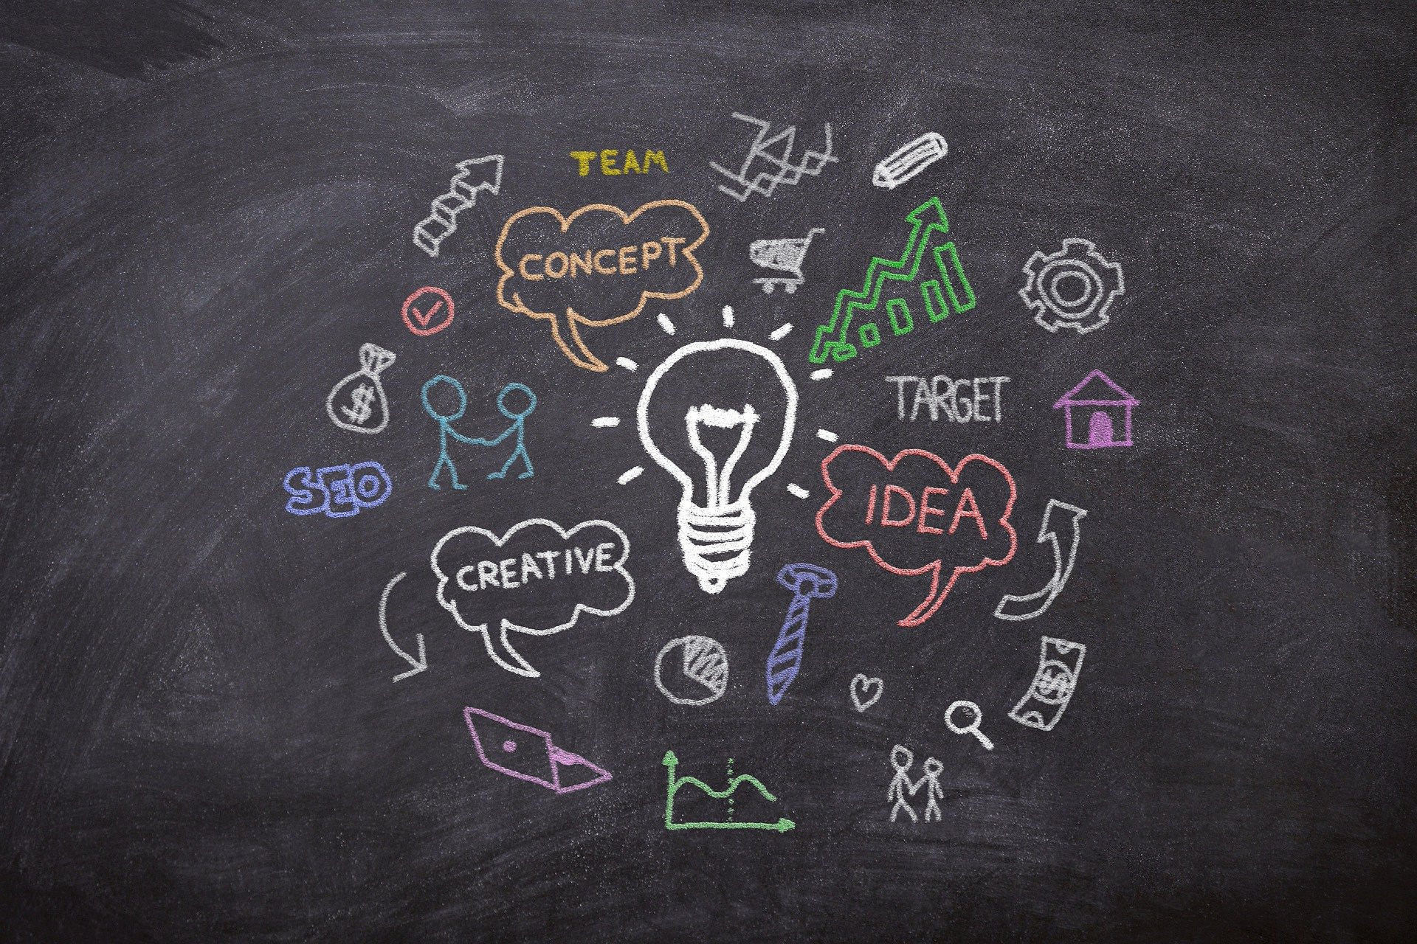
Python Imaging Library
PIL
Shubham Baranwal
https://www.linkedin.com/in/shubham-151015/

Slide 2
PILLOW Module
In today’s digital world, we come across lots of digital images. In case, we are working with Python programming language, it provides lot of image processing libraries to add image processing capabilities to digital images. Some of the most common image processing libraries are: OpenCV, Python Imaging Library (PIL), Scikit-image, Pillow. However, in this tutorial, we are only focusing on Pillow module and will try to explore various capabilities of this module.

Slide 3
What we are going to do today???
Python Pillow — Installing Pillow using pip
Python Pillow — Using Image Module ,Opening, rotating and displaying an image Attributes of Image Module
Python Pillow — Working with Images, Reading an Image and Saving an Image
Python Pillow — Creating Thumbnails
Python Pillow — Merging Images
Python Pillow — Blur an Image ,Simple blur Box blur Gaussian Blur
Python Pillow — Cropping an Image
Python Pillow — Flip and Rotate Images

Slide 4
Python Pillow — Resizing an Image Resize and save the resized image
Python Pillow — Adding Filters to an Image , iiiPython Pillow
Filters
Python img.filter(CONTOUR) method
Python img.filter(DETAIL) method
Python img.filter(EDGE_ENHANCE) method
Python img.filter(EDGE_ENHANCE_MORE) method
Python img.filter(EMBOSS) method
Python img.filter(FIND_EDGES) method
Python img.filter(SMOOTH) method
Python img.filter(SHARPEN) method
Python Pillow — Colors on an Image Color Names
ImageColor.getrgb() Method
ImageColor. getcolor() Method

Slide 5
Python Pillow — ImageDraw Module Canvas Drawing Shapes using ‘ImageDraw’ module
Python Pillow — Writing Text on Image
Selecting the font
Python Pillow — M L with Numpy
Creating image from Numpy Array
Creating greyscale images
Creating numpy array from an Image

