Slide 1
FLYWIRE SUMMER INTERNSHIP 2026 · PROJECT 7
Chokepoint neurons across sensory pathways
progress & framing check
● olfactory ● mechanosensory ● visual
Pranav · August 2026 · FAFB v783 + male CNS v0.9
Chokepoint neurons · 1 / 12

Slide 2
JUNE · THE PROPOSAL
What I set out to find
senses
smell · touch · vision
→
interneurons
the middle of the brain
→
descending neurons
commands to the body
• Hypothesis: some interneurons are bottlenecks — “if you removed them, information could no longer get through.”
• Payoff question: is any neuron a bottleneck for all three senses? That would be a genuinely critical hub of the whole brain.
• Why it matters: in human brain imaging, network hubs are the regions preferentially damaged in Alzheimer's and stroke. The fly is the only complete wiring diagram where the idea can be tested exactly.
Both predictions get tested directly in this talk — and both turn out to be wrong in an interesting way.
Chokepoint neurons · 2 / 12

Slide 3
JUNE – EARLY JULY
Learning the data
• Downloaded edge lists for five connectomes; learned the data by building neuron embeddings and exploring the graph structure.
• Hop-size analysis settled the pathway definition: 1 hop leaves too few real sensory→motor endpoints; 3 hops balloons past what exact path computation can handle. 2 hops each way became the standard.
• First olfactory subgraph running end to end — sensory neurons to descending neurons as one directed graph.
134,181
neurons, FAFB v783
2.7M
connected pairs
3
sensory pathways built
Chokepoint neurons · 3 / 12

Slide 4
MID-JULY · FIRST RESULT, FIRST MISTAKE
DNp32 — a headline that wasn't real
• First full run used unweighted betweenness — every connection counted the same — and produced a headline: DNp32, a bottleneck shared by smell *and* vision.
• The problem: the edge list I had inherited carried no synapse counts. A 5-synapse whisper and a 500-synapse highway looked identical.
• With the real weighted Codex data, DNp32's betweenness is exactly zero in both pathways. It sits on no strong route at all — a pure artifact.
Weighting is not a refinement — it decides the answer.
An ablation isolating the weighting shows it alone changes 23–32 of each top 50. After this, no result in the project went unreported without a control.
Chokepoint neurons · 4 / 12

Slide 5
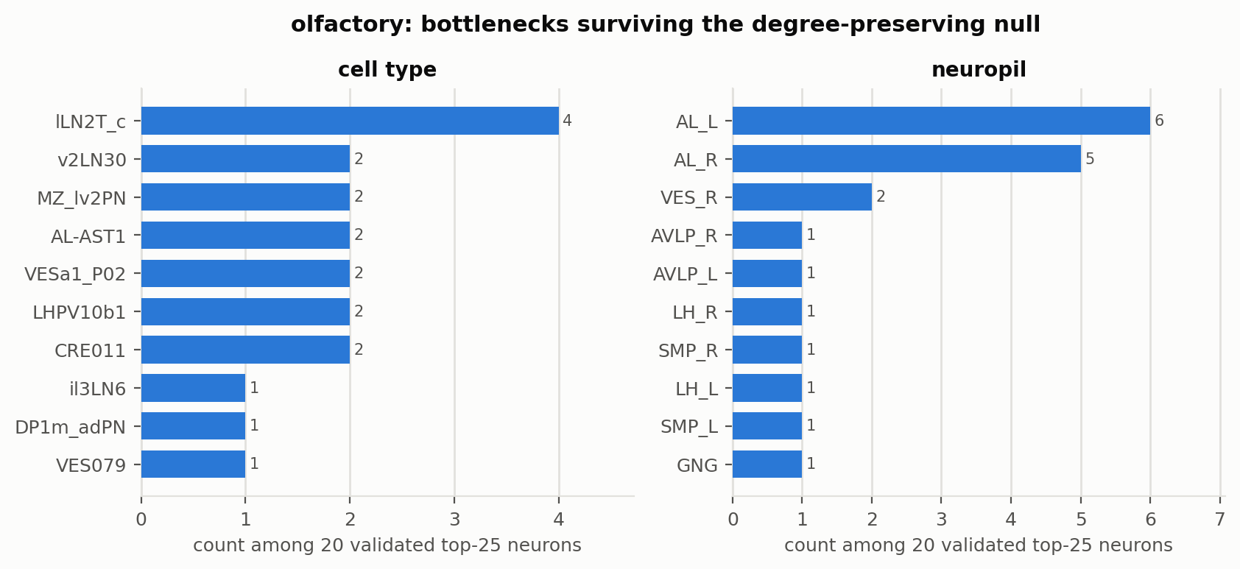
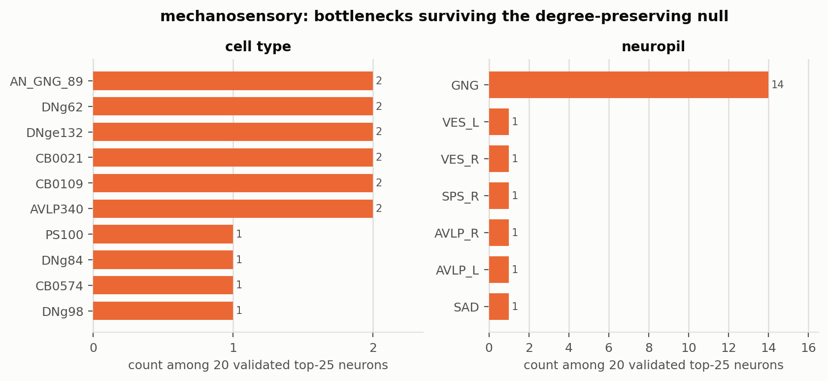
EARLY AUGUST
Rebuilt on weighted data — the anatomy checks out
• From connectivity alone, the ranking recovers textbook anatomy: olfactory bottlenecks concentrate in the antennal lobe, touch bottlenecks in the gnathal ganglion.
• Cross-modal check: 5 neurons appear in two pathways' top 50, none in all three — the first crack in the hypothesis.
Chokepoint neurons · 5 / 12

Slide 6
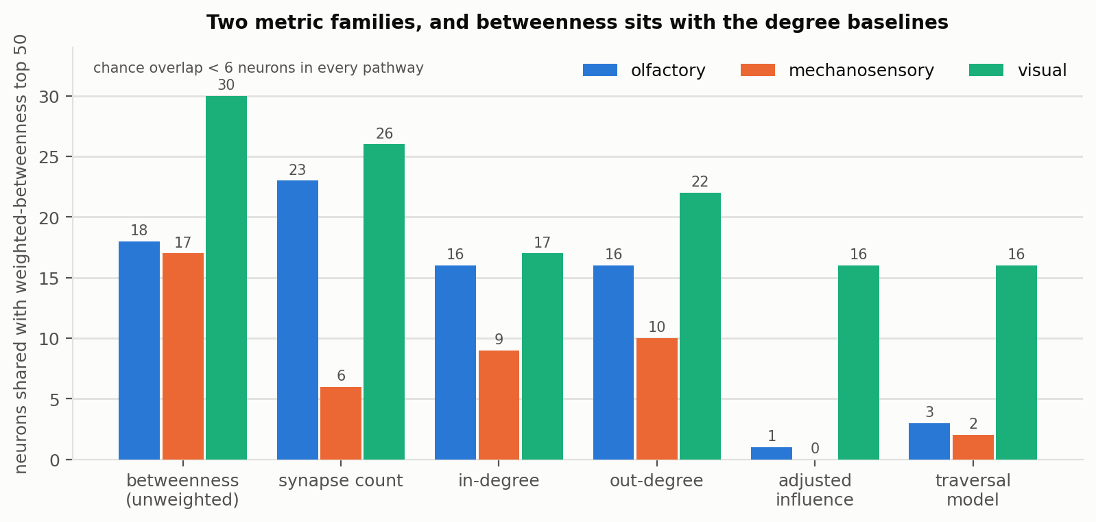
THE WEEK EVERYTHING GOT TESTED
Is “important” even well-defined?
• Different importance metrics pick almost completely different neurons: betweenness vs. the BANC influence metric overlap at 1/50 and 0/50.
• Worse: in two of three pathways, betweenness largely reduces to counting synapses (23/50, 26/50 overlap with raw synapse count).
• Rescue: a null that shuffles the network while preserving every neuron's exact degree — 200 trials, FDR-corrected — 37–45 of 50 survive. The top neurons matter because of *where they sit*, not how many synapses they have.
Chokepoint neurons · 6 / 12

Slide 7
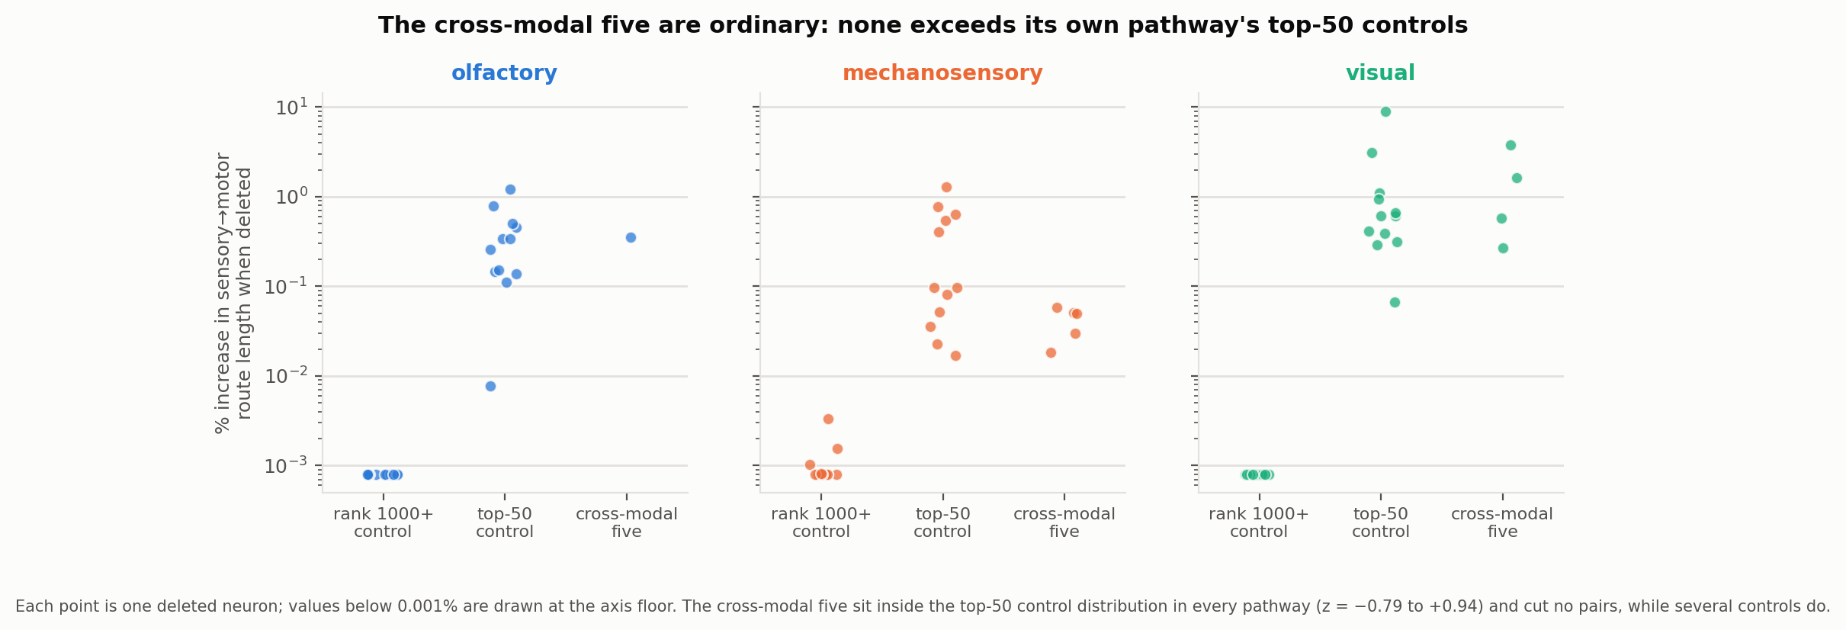
THE DELETION TEST
The hypothesis fails
• Deleted each top neuron and re-solved every sensory→motor route: routes get under 1% longer on average, and zero source→target pairs are ever disconnected.
• The five cross-modal neurons are indistinguishable from ordinary top-50 neurons (z between −0.79 and +0.94).
• Growth note: I also caught my own scoring artifact here — deleting a neuron that is itself an endpoint trivially cuts its own pairs, which had inflated an earlier version of this result.
Chokepoint neurons · 7 / 12

Slide 8
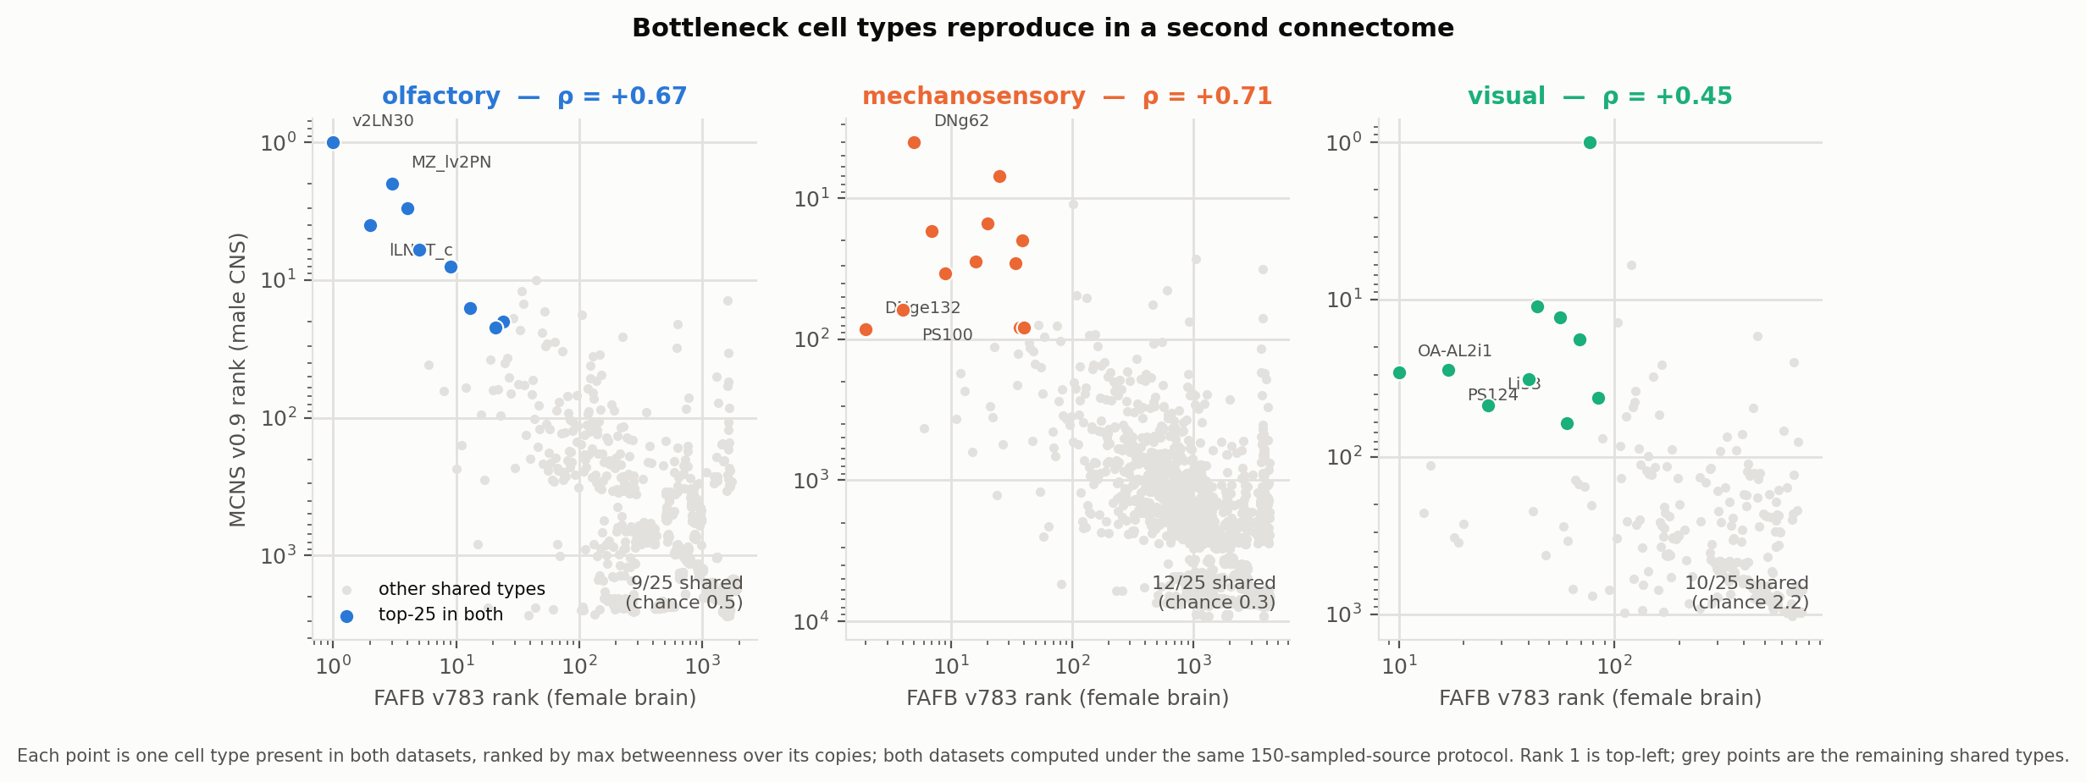
REPLICATION · THE STRONGEST RESULT
It reproduces in a second brain
• Entire pipeline rerun on the Janelia male CNS — different animal, different sex, different reconstruction pipeline.
• Cell-type rankings agree at ρ = 0.45–0.71; top-25 overlaps are 4.5–43× chance. The redundancy result and the degree null replicate too.
• Whatever betweenness measures here, it is a property of *the fly nervous system*, not of one reconstruction.
Chokepoint neurons · 8 / 12

Slide 9
GROUND TRUTH
The physiology agrees — with the negative
 | betweenness rank | experimental result
T4, Mi9 (motion pathway) | ~1000–2000 | blocking → fly is motion-blind
lLN2T_c (my olfactory rank 1) | 1 | silencing → no measurable effect on odor coding
• Pre-registered screen with matched controls: my validated types are not better characterized than mid-ranked neurons (2/24 vs 4/27) — and every necessity-grade result sits in the *control* group.
• Betweenness ranks traffic. Necessity is a property of populations. T4 cells are individually redundant on any single path — exactly what scores low on betweenness and high on necessity when the whole population is blocked.
Chokepoint neurons · 9 / 12

Slide 10
SYNTHESIS
What I think the story is now
structured The junctions are real: they beat degree-preserving nulls and reproduce across two animals.
but redundant No single point of failure anywhere — the pathway routes around every deletion.
and metric-dependent Which neurons get called “critical” depends heavily on the metric you choose.
The proposal's core prediction — remove a bottleneck and information stops — was tested directly and is wrong. I'd rather report that with controls than the reverse without them.
Chokepoint neurons · 10 / 12

Slide 11
LOOKING AHEAD
What's to come
1. Final presentation & poster
Lead with the cross-dataset replication; frame around metric-dependence and structured redundancy. End of August.
2. Third dataset — BANC
Weighted connections are already public; needs a sensory-class label mapping (~2 days). Would make every headline a three-connectome result.
3. Complete the null replication
Male-CNS mechanosensory Null B (~6–8 h unattended) finishes the grid.
4. Release the pipeline
Version-control the 25 scripts with a README — the analysis runs on any pathway subgraph, not just these three.
Chokepoint neurons · 11 / 12

Slide 12
BACKUP
In reserve for questions
• Null A (weight permutation): real weights displace rankings further than permuted ones, z = +2.6 to +4.5, all pathways.
• Cohort sweep: deleting whole cell types is mostly additive (median 1.02–1.14× the sum of single deletions); a small minority (VA2_adPN, 3.9×) are genuinely more than their parts.
• Current-flow betweenness abandoned: 24 h unfinished on the *smallest* graph, and it requires an undirected graph — signal running backwards from motor to eye.
• Motor endpoint (male CNS): at 2 hops only mechanosensory reaches real motor neurons (4,961 sources); olfactory and visual reach essentially none — which retroactively justifies the descending-neuron endpoint.
• Corrected-claims log: DNp32 (unweighted artifact) · “zero pairs cut” (endpoint-scoring artifact) · 11× cohort claim (size vs. coherence confound) — each caught by the next control.
Chokepoint neurons · 12 / 12

