Slide 1
Where does the fly's sensory traffic squeeze through — and does anything break if you cut it?
Chokepoint neurons across sensory pathways in the FlyWire connectome
Question For smell, touch and vision: which neurons carry the strongest routes from sensory input to the descending (motor-command) neurons — are any shared across senses — and is the circuit actually *dependent* on them?
Pranav Voleti · FlyWire Summer Internship 2026 · Project 7 · FAFB v783 (139k neurons, 2.7M weighted connections) + MaleCNS v0.9
Chokepoint neurons across sensory pathways · FlyWire FAFB v783 + MCNS v0.9 · 1/5

Slide 2
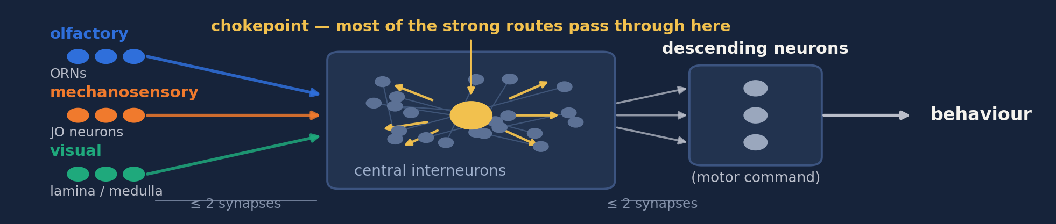
MAIN RESULT
Each sense has its own chokepoints — and no single point of failure
1 · Where anatomy says they should be
2 · Conserved in a 2nd brain
3 · None is required
Smell → antennal-lobe interneurons
Touch → gnathal-ganglion descenders
Vision → lobula-plate wide-field
9 / 12 / 13 of 25 top types recur in the male CNS
…but so does synapse count
Delete any one: routes lengthen 0.3–0.6 %
Nothing disconnects a pair
Structured but redundant — conserved junctions carry the traffic, but every one has a parallel route.
Chokepoint neurons across sensory pathways · FlyWire FAFB v783 + MCNS v0.9 · 2/5

Slide 3
METHOD
Rank the neurons on the strongest routes — then try hard to break the result
1 Build & rank
2 Test it
3 Break it
One graph per sense: every neuron ≤2 synapses from a sensory input and ≤2 from a descending neuron
Rank by synapse-weighted betweenness on sensory→descending paths — high score = sits on the strong routes
Shuffle the wiring but keep every neuron's exact degree: is the rank just connection count?
And control the test itself — run it on a structureless graph to see how many 'survivors' pure selection invents
Delete each bottleneck, re-solve every sensory→motor route: how much longer, how many pairs cut?
Then rebuild the whole study on a second connectome
›
›
4 pathway graphs · ~1,000 betweenness evaluations for the nulls · 2 connectomes · networkx / scipy, reproducible end to end
Chokepoint neurons across sensory pathways · FlyWire FAFB v783 + MCNS v0.9 · 3/5

Slide 4
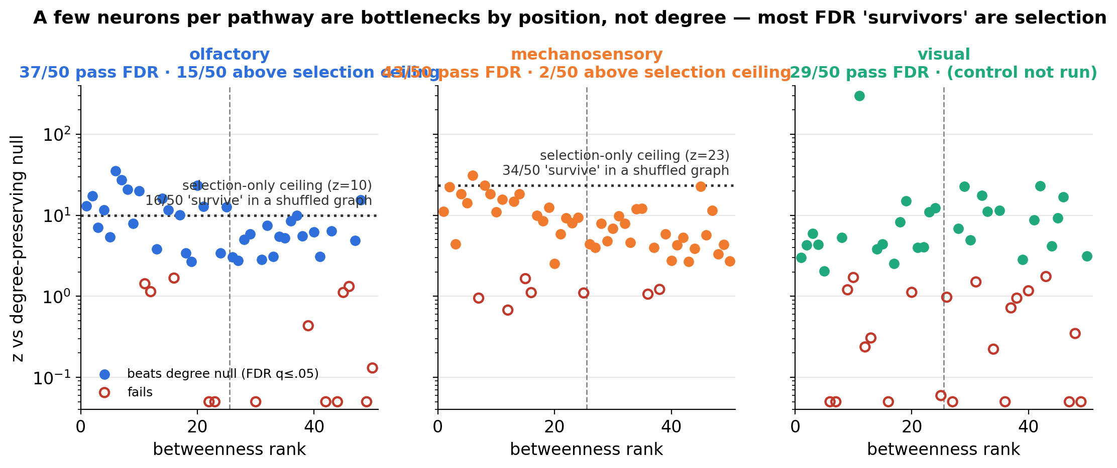
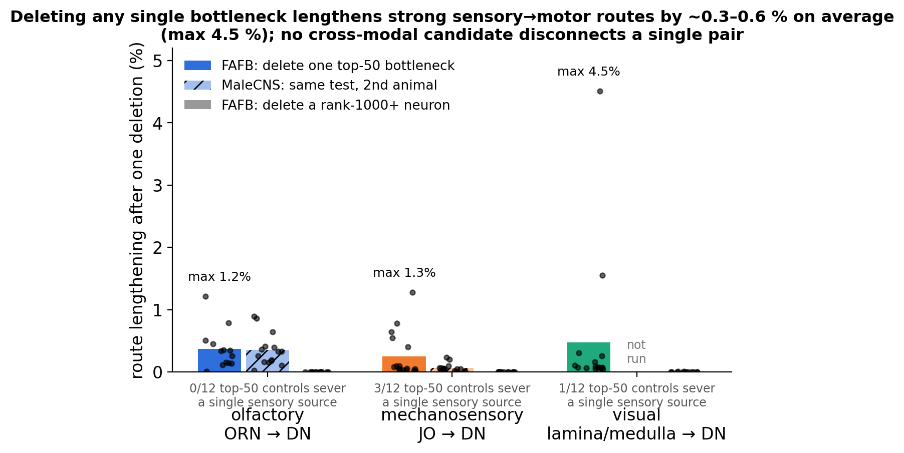
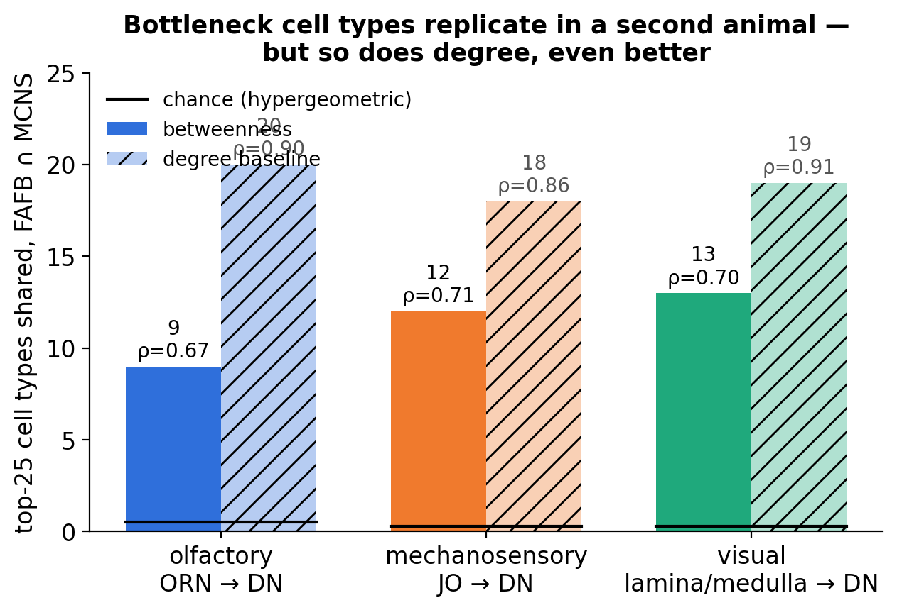
EVIDENCE
Positioned, replicated — but redundant
Dotted line = the highest score pure selection can invent, measured by running the whole test on a structureless graph.
Only neurons above it are positioned beyond doubt: 15 olfactory, 2 mechanosensory.
Chokepoint neurons across sensory pathways · FlyWire FAFB v783 + MCNS v0.9 · 4/5

Slide 5
TAKEAWAY
What to remember
Conserved chokepoints, no single point of failure. Weighted betweenness finds anatomically sensible bottlenecks in each sense that replicate across two animals — and deleting any one barely matters.
“Critical” depends on the question. Traffic (betweenness) ≠ necessity (deletion) ≠ conserved identity (replication). All three are measured here; they disagree in instructive ways.
Two self-corrections along the way: (i) the first “visual” pathway was really the *ocellar* reflex arc — rebuilt with lamina/medulla inputs; (ii) the degree null over-counted survivors by a winner's-curse of 16–34/50 — now controlled.
Next: whole-population deletions (where necessity lives — T4/Mi9 are rank-1000 here yet behaviourally essential), and a third connectome (BANC).
Elevator pitch This project maps where smell, touch and vision funnel toward the fly's motor system in two whole-brain connectomes, and finds conserved chokepoint neurons that carry the traffic but — because every one has a parallel route — none the circuit cannot live without.
Chokepoint neurons across sensory pathways · FlyWire FAFB v783 + MCNS v0.9 · 5/5

Slide 6
BACKUP
Pathway definitions and sizes
• Graph: Codex FAFB v783 connections, ≥5 synapses per pair → 134k neurons, 2.70M edges; MCNS v0.9 → 6.24M edges
• Targets: super_class ∈ {descending, motor}. Sources: olfactory = ORNs (1,765 in graph); mechanosensory = JO/mechanosensory afferents (1,675); visual = Lamina Monopolar + Transmedullary + Medulla Intrinsic families (17,004); ocellar = ocellar photoreceptors (142)
• Subgraph: ≤2 hops from a source AND ≤2 hops to a target. Olf 8.7k nodes/163k edges · Mech 13.6k/373k · Visual 60.5k/1.23M (sampled-source betweenness, 500 seeds) · Ocellar 386/2.1k
• Correction: original “visual” = class == visual (photoreceptors); 142/146 surviving sources were ocellar, and the 24k-node graph hung off 4 compound-eye PRs. Renamed ocellar; spec-compliant visual rebuilt. MCNS has no ocellar PRs, so the earlier visual replication was withdrawn and re-done like-for-like.
• Ocellar on its own: 112 neurons with nonzero betweenness; Null B 13/50 vs a selection floor of 2.8/50; OCG01 cells at z≈0 → degree-driven reflex arc, not a positional-bottleneck pathway.
Backup B1

Slide 7
BACKUP
Null B — degree-preserving null and its selection-bias control
• Directed double-edge swap, 5×|E| attempts, preserves in-degree, out-degree, out-synapse total; 200 trials (olf/mech/ocellar), 30 (visual); 100 sampled sources; BH-FDR on p_z
• FDR survivors (top-50 / top-25): olfactory 37/20 · mechanosensory 43/20 · visual 29/16 · ocellar 13/12
• Control: treat one shuffle as data, take *its* top-50, test vs further shuffles (3 pseudo-real × 50 trials). False-positive floor: olfactory 16.0 ± 0.8, mechanosensory 34.0 ± 2.2, ocellar 2.8 ± 3.4; max z manufactured by selection alone: 9.9 / 23.4 / 3.4
• Above that ceiling: olfactory 15/50 (MZ_lv2PN z=35, VES079 23, AL-AST1 21, lLN2T_c 17, v2LN30 13 …); mechanosensory 2/50 (DNge132 31, CB0021 23); visual control not run (≈6 h) — likely survivors PS124 z=15, AVLP435a 8
• Null A (weight permutation, 50 trials): real weights displace the ranking more than permuted weights in olf/mech/legacy-visual (z 2.6–4.5); fails in ocellar
Backup B2

Slide 8
BACKUP
Deletion test, cell-type cohorts, and the cross-modal six
• Single deletion, 100 sources × all targets, damage scored only over pairs whose own endpoints survive: top-50 mean detour 0.37 % (olf), 0.34 % (mech), visual see talk fig; rank-1000+ ≈ 0.000 %; MCNS 0.35 / 0.06 %. Max single-neuron effect ≈ 4 % (legacy CB3916)
• A few FAFB deletions sever *whole sensory sources* (cut counts = multiples of the target count) — peripheral single-gateway cells, FAFB-only so far (0/45 in MCNS)
• Whole cell types: nearly all superadditive but barely (median 1.02–1.14×); 14/75 beat size- and rank-matched random sets at z>2. Standouts VA2_adPN (3.9×, z=+20), OCG02b, lLN2T_c (1.7×)
• Cross-modal six: PVLP076 (olf+mech), AVLP080 ×2, CB0677, PS124 (mech+vis), CB0676 (mech+ocellar). None in three. Legacy five all failed the deletion test (z −0.8…+0.9 vs ordinary top-50 controls)
Backup B3

Slide 9
BACKUP
Metric dependence and ground truth
• Betweenness vs total synapse count top-50 overlap: olfactory 23/50, legacy-visual 26/50, mechanosensory 6/50 (chance ≈ 0.3) — two pathways are largely degree-recoverable; mechanosensory is the one that needed the metric
• Flow metrics (Bates et al. 2025 influence; probabilistic traversal) agree with each other (ρ 0.77–0.89) and not with betweenness (ρ ≈ 0 – 0.3): *path* vs *flow* definitions of importance pick different neurons
• Current-flow betweenness: infeasible (24 h, no result on the smallest graph) and requires symmetrising the graph — reported as a negative feasibility result
• Pre-registered literature screen (validated types vs rank-1000–2000 controls): 2/24 vs 4/27 named types with functional evidence; all *necessity* evidence (T4, Mi9 → motion-blind) is in the control arm; the one validated type tested by silencing (lLN2T_c / LN2) showed no effect on odour coding — consistent with the deletion result
Backup B4

Slide 10
BACKUP
Replication detail (FAFB vs MaleCNS, 150 sampled sources each, cell-type max)
• Olfactory 9/25 (exp 0.52, p 2e-10), ρ 0.67 all / 0.54 nonzero-in-both (n=157): lLN2T_c, v2LN30, il3LN6, MZ_lv2PN, AL-AST1, DM1_lPN, PLP096, PVLP076, lLN2F_b
• Mechanosensory 12/25 (exp 0.28), ρ 0.71 / 0.56 (639): DNg62, DNge132, DNge027, DNg35, DNg16, DNg100, DNp35, AVLP080, AVLP340, PS100, PS124, PVLP076
• Visual 13/25 (exp 0.27), ρ 0.70 / 0.60 (548): Am1, H2, LPT26, LT11, LT1c, LT62, LT79, Li32, Li33, PVLP011, PVLP061, AVLP080, PS124
• Degree baseline: 20 / 18 / 19 of 25, ρ 0.90 / 0.86 / 0.91 — replication shows the pathway is conserved, not that betweenness adds conserved information
• Only mechanosensory reaches VNC motor neurons within 2+2 hops in MCNS (696 targets); olfactory/visual reach 1 / 0 — justifies the descending endpoint
Backup B5

