Slide 1
FLYWIRE SUMMER INTERNSHIP 2026
Where does the fly's sensory traffic squeeze through — and does anything break if you cut it?
Finding — and stress-testing — the chokepoint neurons between the senses and the motor system
139k
2.7M
3
2
neurons · whole brain
weighted connections
senses: smell · touch · vision
connectomes: FlyWire + male CNS
Pranav Voleti · FlyWire Summer Internship 2026
Chokepoint neurons across sensory pathways · FlyWire FAFB v783 + MCNS v0.9
1 / 5
Notes:
Olfactory, mechanosensory and visual input all have to converge onto the
descending neurons — the one endpoint every modality reaches within two hops.
My question: on the way from the senses to the DNs, **which neurons carry the
traffic — and does the circuit actually depend on them?**
I asked this in two connectomes — FAFB and the male CNS — so nothing counts
unless it recurs in both animals.

Slide 2
THE PROBLEM
We can now see every wire in the brain — but not which ones matter
Every signal from the fly's nose, antennae and eyes must reach ~1,300 descending neurons — the only cells that carry commands to the body.
The connectome gives us the complete wiring diagram. What it doesn't give us: which neurons the traffic actually depends on.
Which neurons?
Shared hubs?
Truly critical?
carry the strongest routes from each sense toward the motor system
are any chokepoints shared between smell, touch and vision — brain-wide critical hubs?
if you removed one, would the circuit actually break — or route around it?
Answered in two independent whole-brain connectomes, so nothing counts unless it appears in both animals.
Chokepoint neurons across sensory pathways · FlyWire FAFB v783 + MCNS v0.9
2 / 5
Notes:
FAFB gives us the complete weighted graph, but not which neurons the
sensory-to-DN traffic depends on. So, three questions. **Which neurons rank
highest by synapse-weighted betweenness on sensory-to-DN paths**, per modality?
**Are any of them shared across modalities** — brain-wide hubs? And are they
**truly critical** — does deleting one lengthen or sever the paths, or does the
graph just route around it?

Slide 3
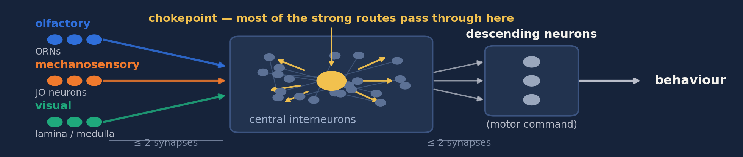
THE SOLUTION
Each sense has its own chokepoints — and no single point of failure
1 · Where anatomy predicts
2 · Conserved in a 2nd brain
3 · None is required
Smell → antennal-lobe interneurons
Touch → gnathal-ganglion descenders
Vision → lobula-plate wide-field cells
9 / 12 / 13 of top-25 types recur
chance expectation: < 1
delete any one → routes lengthen
just ~0.5 % · nothing disconnects
Structured but redundant — conserved junctions carry the traffic, but every one has a parallel route.
Chokepoint neurons across sensory pathways · FlyWire FAFB v783 + MCNS v0.9
3 / 5
Notes:
*(gesture across the schematic)* One pathway graph per modality: sources on the
left, DNs on the right, everything within two hops of both in between. The
yellow cell is what I was hunting — the neuron the strong routes run through. Three findings.
**One: every modality has these chokepoints, and they're the cells you'd
predict** — the antennal-lobe local network for olfaction, lLN2T_c and v2LN30;
gnathal descending neurons for mechanosensation; and for vision the wide-field
lobula-plate cells — LPi, Am1, H2.
**Two: they're conserved.** Rebuild everything in the male CNS — different
animal, different sex, different pipeline — and nine, twelve, and thirteen of
the top twenty-five cell types recur, against a chance expectation below one.
**Three — the headline — not one of them is required.** Delete any single
chokepoint and the strong routes lengthen by about half a percent. Nothing
disconnects. And cross-modal sharing is shallow: six of two hundred top neurons
span two modalities, none spans all three.
So: **structured but redundant** — conserved junctions carry the traffic, but
every one has a parallel route.

Slide 4
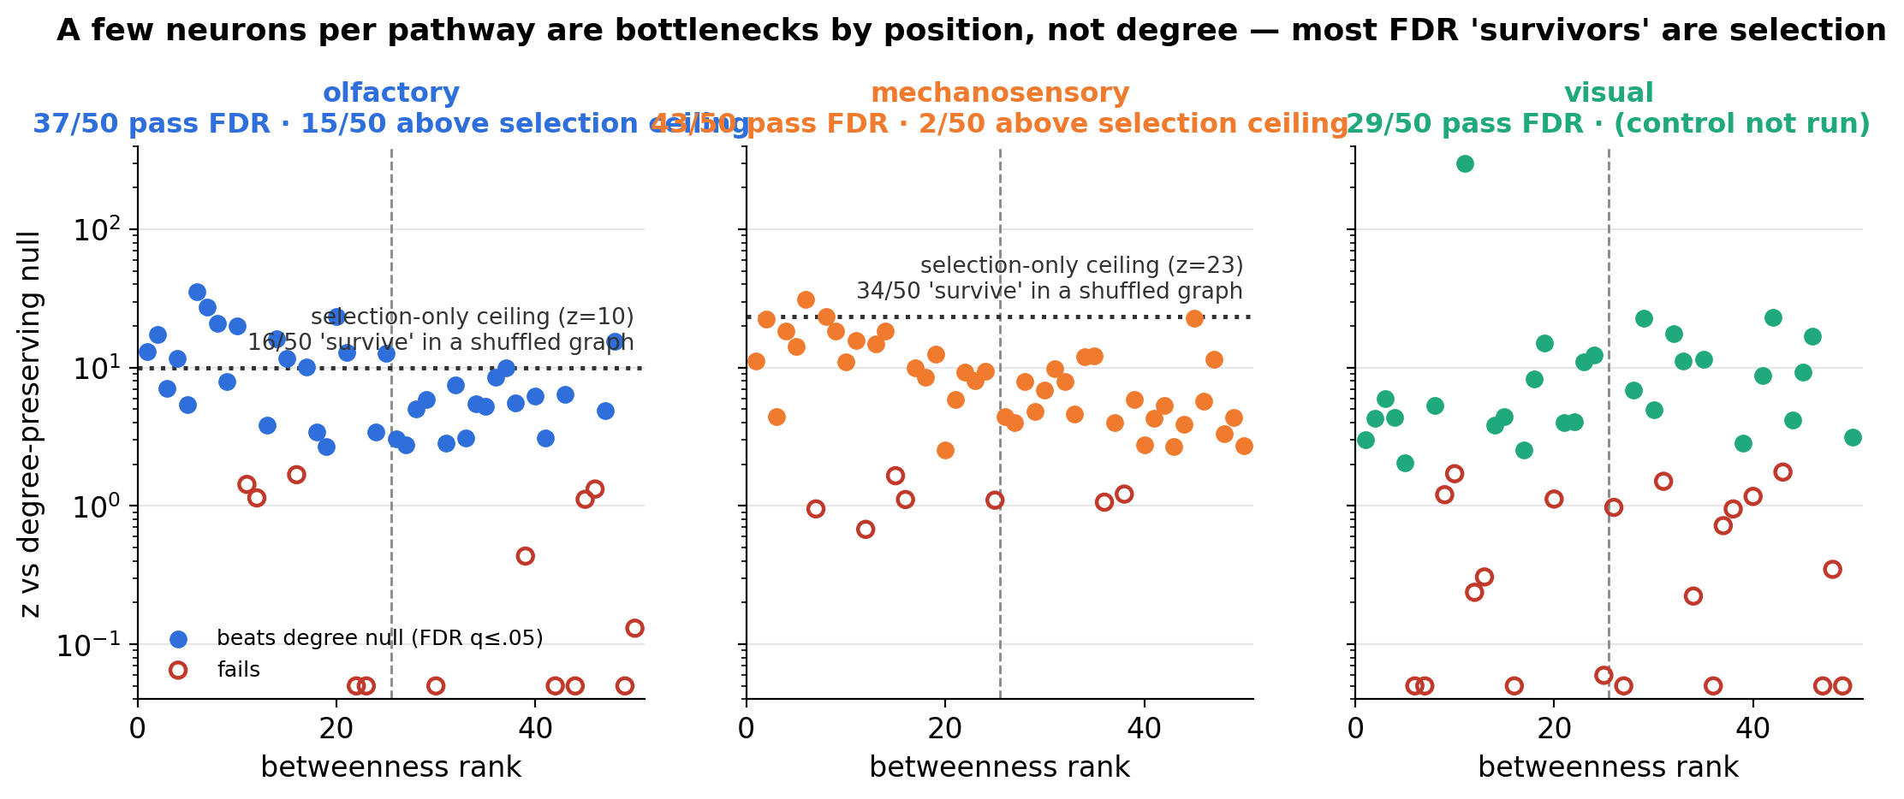
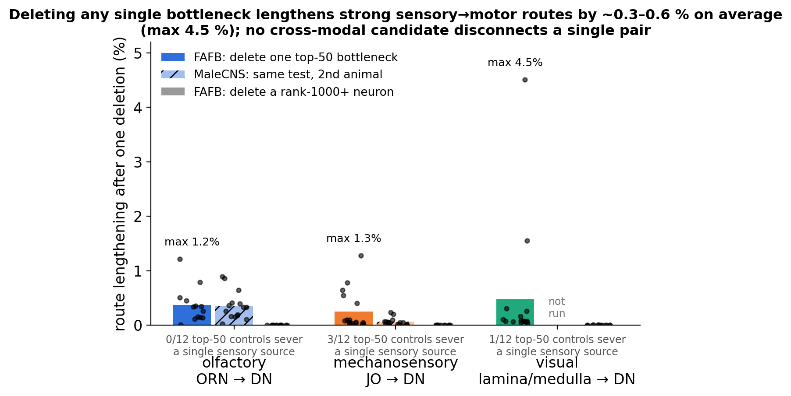
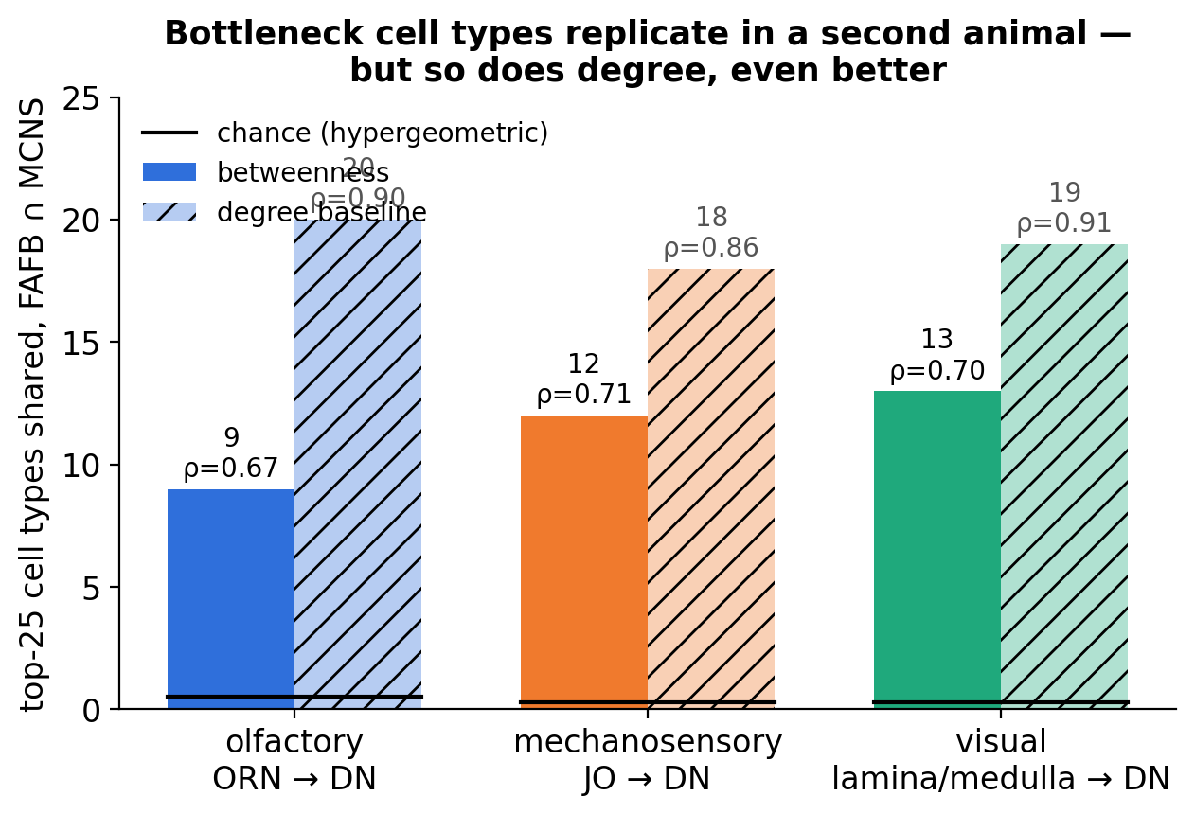
DOES IT HOLD UP?
Positioned beyond chance, replicated — but redundant
Every ranking was attacked with shuffled-wiring nulls — including one where the entire test runs on a structureless graph, so we know exactly how much 'signal' chance alone can fake.
What survives: 15 olfactory and 2 mechanosensory neurons positioned beyond all doubt — and a deletion gradient of 1,000× between top and rank-1000 neurons.
Chokepoint neurons across sensory pathways · FlyWire FAFB v783 + MCNS v0.9
4 / 5
Notes:
The part I want you to trust. Every ranking was tested against
**degree-preserving nulls** at FDR five percent — is this just degree? Mostly
no. But I also ran a **selection-bias control**: the entire pipeline on a
shuffled graph treated as data, where every survivor is a false positive by
construction. That bounds the winner's curse — and it caught real inflation in
my own earlier numbers. Above that ceiling: **fifteen olfactory and two
mechanosensory neurons** positioned beyond any doubt.
And deletion damage spans **three orders of magnitude** — half a percent for a
top-fifty neuron, effectively zero at rank one thousand. The ranking is real;
the stakes are just low. Same answer in the second connectome.

Slide 5
TAKEAWAY
Conserved chokepoints, no single point of failure
9 / 12 / 13
~0.5 %
6 / 200
top-25 cell types conserved across two connectomes (chance < 1)
route lengthening when any single chokepoint is deleted
top neurons shared between two senses; none across all three
• “Critical” depends on the question. Carrying the traffic, being necessary, and being conserved are three different things — and in this brain they disagree.
• Next: population-level deletions — the behaviourally essential cells (T4, Mi9) rank ~1000 here, so necessity lives at the population level, not in single neurons.
The fly brain's sensory-motor chokepoints are real, they're conserved across two connectomes — and you can cut any one of them without breaking anything.
Chokepoint neurons across sensory pathways · FlyWire FAFB v783 + MCNS v0.9
5 / 5
Notes:
So: **conserved chokepoints, no single point of failure.** The broader point —
"critical" depends on which question you ask. Betweenness, deletion damage, and
cross-connectome conservation are three different measurements, and here they
disagree. T4 and Mi9 — behaviourally indispensable — sit at rank one thousand
in betweenness. **Necessity is a population property**, and cohort-level
deletions are exactly where this goes next.
The fly brain's sensory-motor chokepoints are real, they're conserved across
two connectomes — and you can cut any one of them without breaking anything.

Slide 6
Got Questions?
Pranvoleti2009@gmail.com
Chokepoint neurons across sensory pathways · FlyWire FAFB v783 + MCNS v0.9
5 / 5

