Slide 1
FLYWIRE SUMMER INTERNSHIP 2026 · PROJECT 7
Where does the fly's sensory traffic squeeze through — and does anything break if you cut it?
Finding — and stress-testing — the chokepoint neurons between the senses and the motor system
139k
2.7M
3
2
neurons · whole brain
weighted connections
senses: smell · touch · vision
connectomes: FlyWire + male CNS
Pranav Voleti · Princeton Neuroscience Institute symposium · August 2026
Chokepoint neurons across sensory pathways · FlyWire FAFB v783 + MCNS v0.9
1 / 5

Slide 2
THE PROBLEM
We can now see every wire in the brain — but not which ones matter
Olfactory, mechanosensory and visual input must all converge onto the descending neurons — the shared endpoint every modality reaches within two hops.
FAFB gives us the complete weighted graph. What it doesn't give us: which neurons the sensory→DN traffic actually depends on.
Which neurons?
Shared hubs?
Truly critical?
rank highest by synapse-weighted betweenness on sensory→DN paths, per modality
are any high-betweenness neurons shared across modalities — brain-wide hubs?
does single-neuron deletion lengthen or sever sensory→DN paths — or does the graph route around it?
Everything is replicated FAFB v783 → MaleCNS v0.9 at the cell-type level; nothing counts unless it recurs in both.
Chokepoint neurons across sensory pathways · FlyWire FAFB v783 + MCNS v0.9
2 / 5

Slide 3
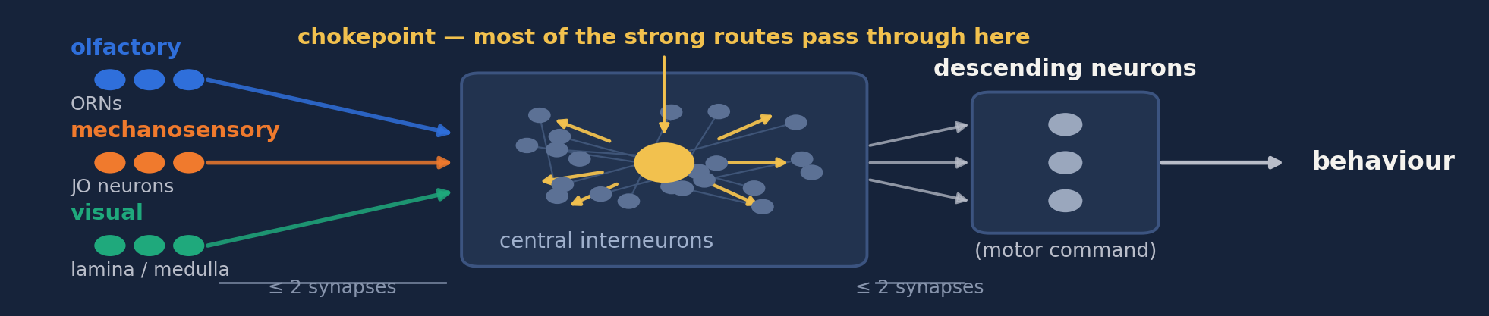
THE SOLUTION
Each sense has its own chokepoints — and no single point of failure
1 · Where anatomy predicts
2 · Conserved in a 2nd brain
3 · None is required
Olf → AL LNs (lLN2T_c, v2LN30, MZ_lv2PN)
Mech → GNG DNs (DNge132, DNg62)
Vis → LPi / Am1 / H2 wide-field cells
9 / 12 / 13 of top-25 types recur
chance expectation: < 1
delete any one → routes lengthen
just ~0.5 % · nothing disconnects
Structured but redundant — conserved junctions carry the traffic, but every one has a parallel route.
Chokepoint neurons across sensory pathways · FlyWire FAFB v783 + MCNS v0.9
3 / 5

Slide 4
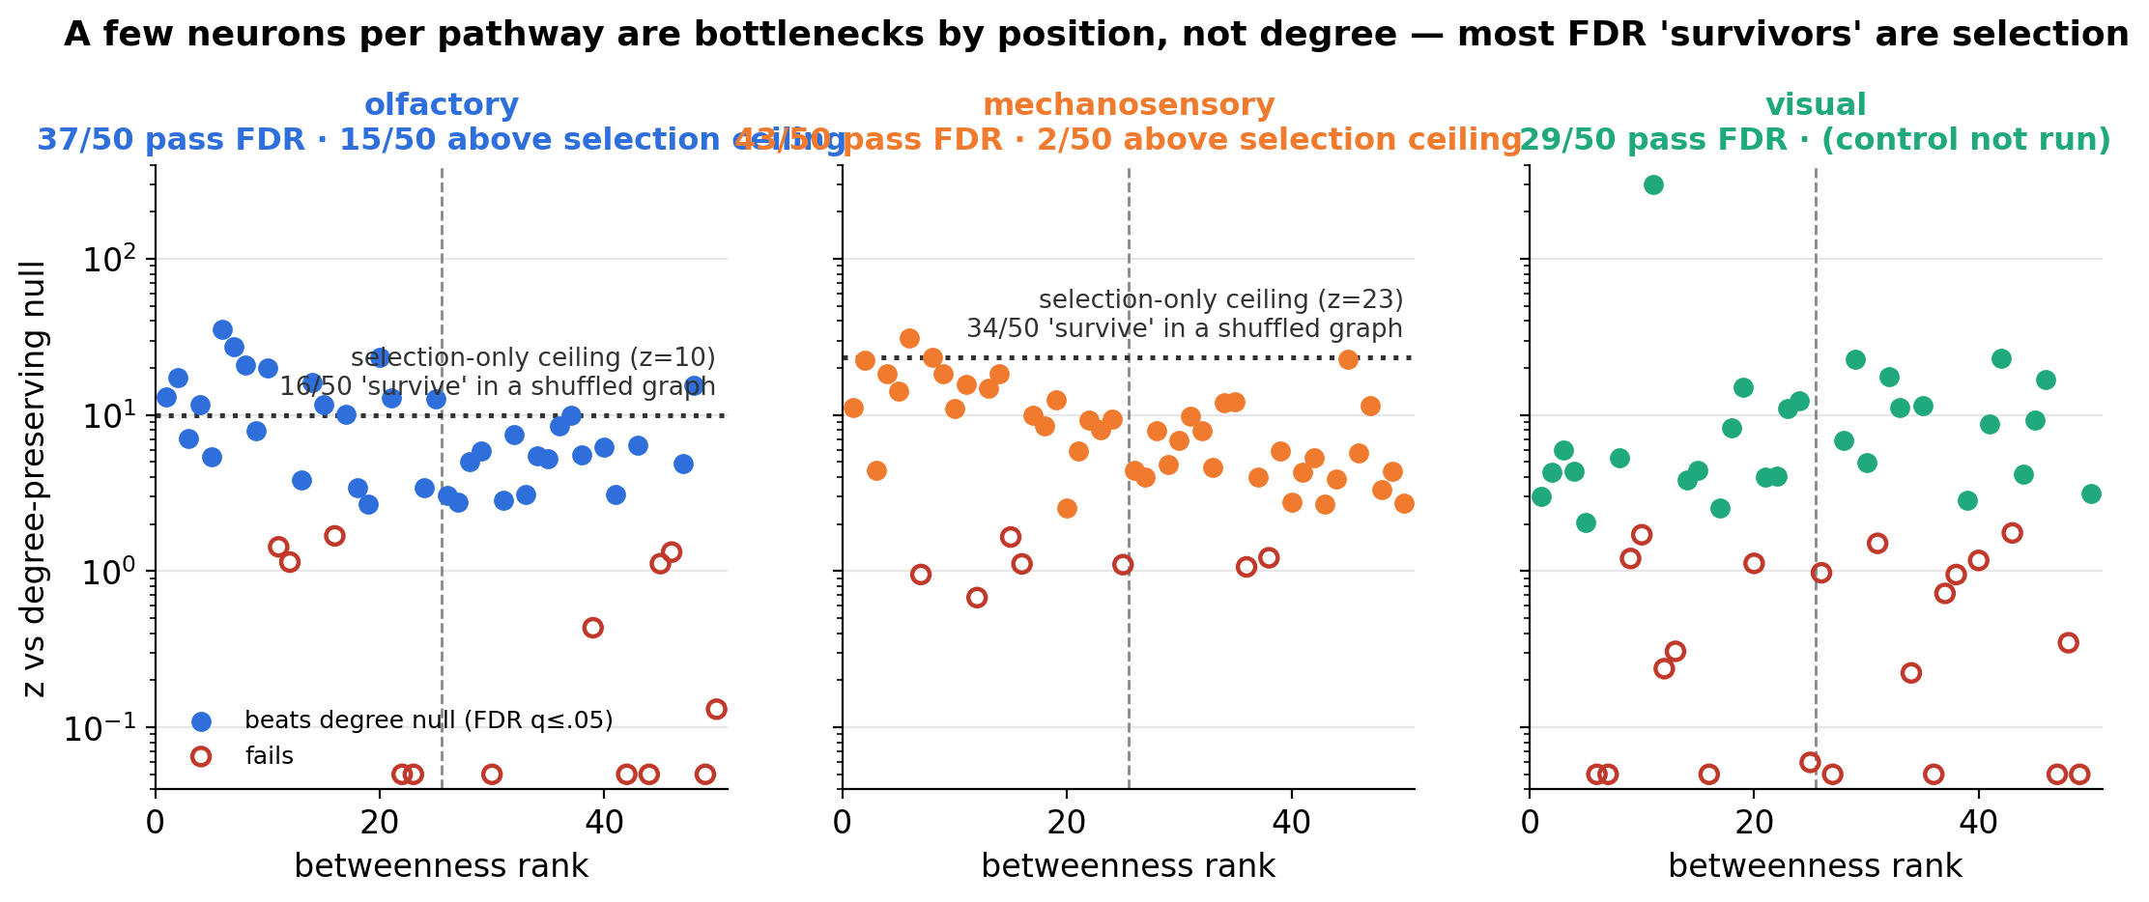
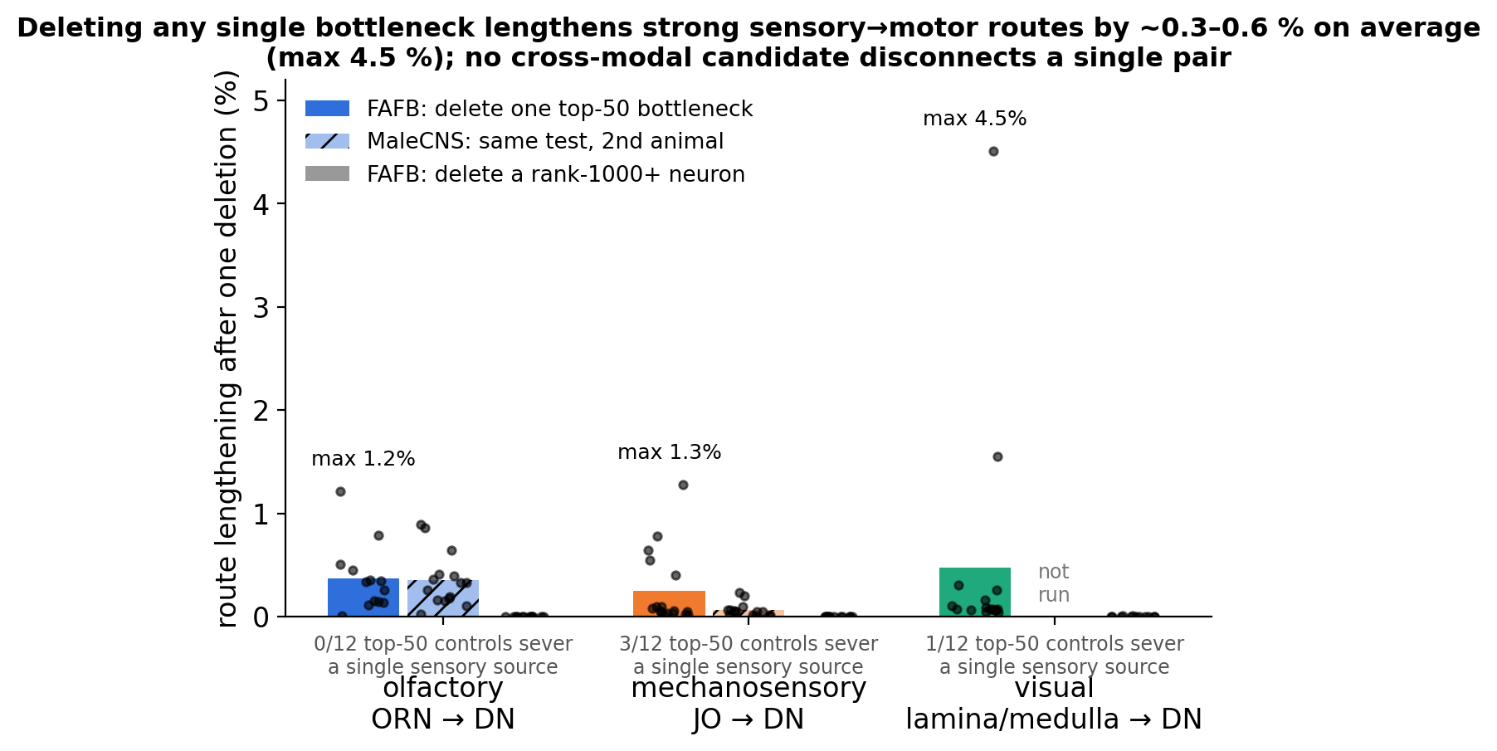
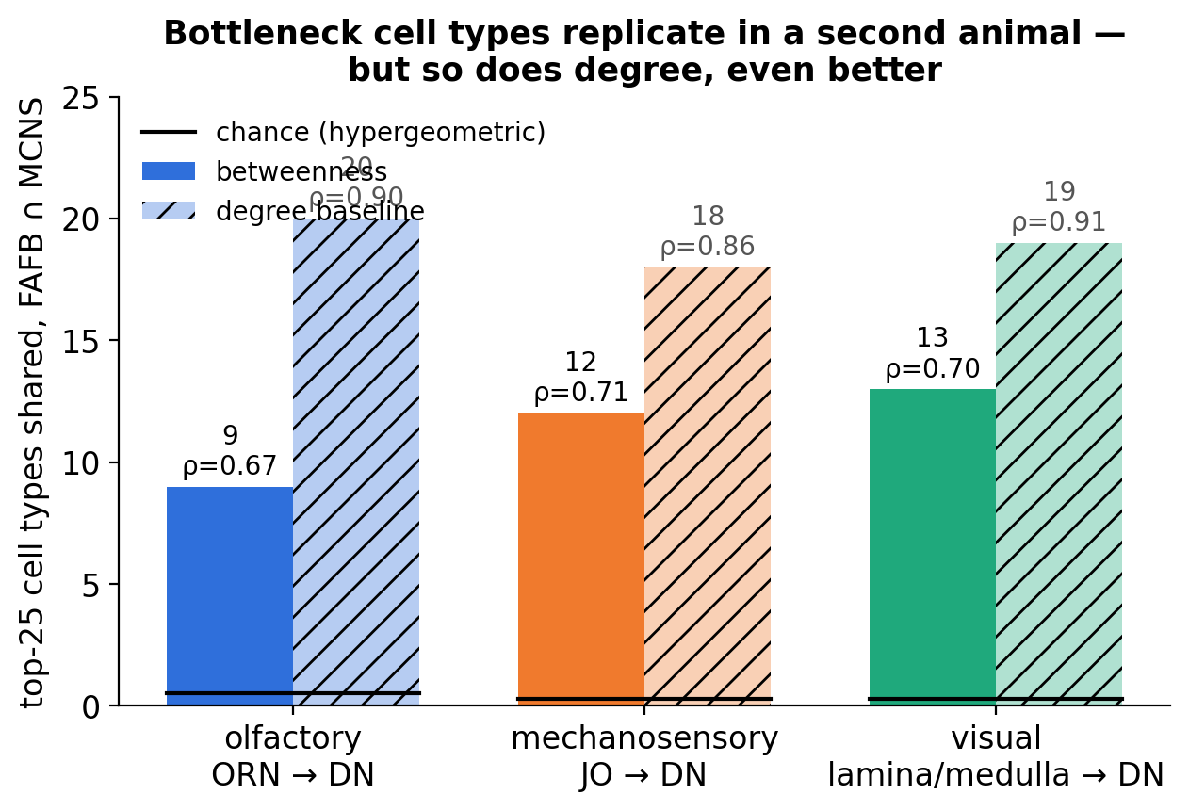
DOES IT HOLD UP?
Positioned beyond chance, replicated — but redundant
Rankings tested against degree-preserving nulls (FDR q≤0.05) plus a selection-bias control: the full pipeline run on a shuffle-as-data graph, bounding the winner's-curse floor.
Above the selection ceiling: 15 olfactory, 2 mechanosensory neurons. Deletion damage spans 3 orders of magnitude from top-50 (~0.5 %) to rank-1000 (~0.000 %).
Chokepoint neurons across sensory pathways · FlyWire FAFB v783 + MCNS v0.9
4 / 5

Slide 5
TAKEAWAY
Conserved chokepoints, no single point of failure
9 / 12 / 13
~0.5 %
6 / 200
top-25 cell types conserved across two connectomes (chance < 1)
route lengthening when any single chokepoint is deleted
top neurons shared between two senses; none across all three
• “Critical” depends on the question. Carrying the traffic, being necessary, and being conserved are three different things — and in this brain they disagree.
• Next: cohort-level deletions — T4/Mi9, behaviourally indispensable, sit at rank ~1000 in betweenness: necessity is a population property.
The fly brain's sensory-motor chokepoints are real, they're conserved across two connectomes — and you can cut any one of them without breaking anything.
Chokepoint neurons across sensory pathways · FlyWire FAFB v783 + MCNS v0.9
5 / 5

