Slide 1
FLYWIRE SUMMER INTERNSHIP 2026 · PROJECT 7
Where does the fly's sensory traffic squeeze through — and does anything break if you cut it?
Chokepoint neurons on the sensory→motor pathways of two whole-brain connectomes
139k
2.7M
3
2
neurons · FAFB v783
weighted connections
senses: smell · touch · vision
connectomes: FlyWire + male CNS
Pranav Voleti · Princeton Neuroscience Institute symposium · August 2026
Chokepoint neurons across sensory pathways · FlyWire FAFB v783 + MCNS v0.9
1 / 5

Slide 2
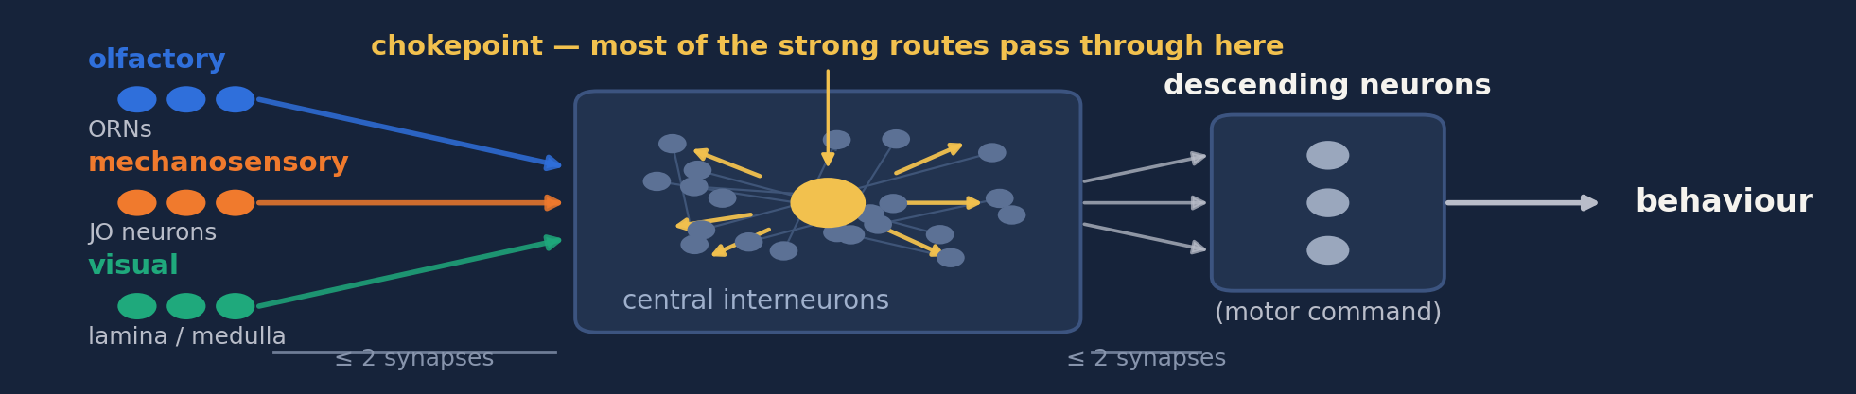
MAIN RESULT
Each sense has its own chokepoints — and no single point of failure
1 · Where anatomy predicts
2 · Conserved in a 2nd brain
3 · None is required
Smell → antennal-lobe interneurons
Touch → gnathal-ganglion descenders
Vision → lobula-plate wide-field cells
9 / 12 / 13 of top-25 types recur
chance expectation: < 1
delete any one → routes lengthen
just ~0.5 % · nothing disconnects
Structured but redundant — conserved junctions carry the traffic, but every one has a parallel route.
Chokepoint neurons across sensory pathways · FlyWire FAFB v783 + MCNS v0.9
2 / 5

Slide 3
METHOD
Rank the neurons on the strongest routes — then try hard to break the result
1 BUILD & RANK
2 TEST IT — TWICE
3 BREAK IT
One graph per sense: every neuron ≤2 synapses from a sensory input *and* ≤2 from a descending neuron
Rank by synapse-weighted betweenness — a neuron scores only if the *strong* routes run through it
Degree-preserving shuffle: is the ranking just connection count?
Control the test itself: run everything on a structureless graph, where every 'hit' is a false positive by construction
Delete each bottleneck; re-solve every sensory→motor route
Rebuild the entire study in a second connectome
›
›
4 pathway graphs · ~1,000 betweenness evaluations for the nulls · 2 connectomes · fully reproducible (networkx / scipy)
Chokepoint neurons across sensory pathways · FlyWire FAFB v783 + MCNS v0.9
3 / 5

Slide 4
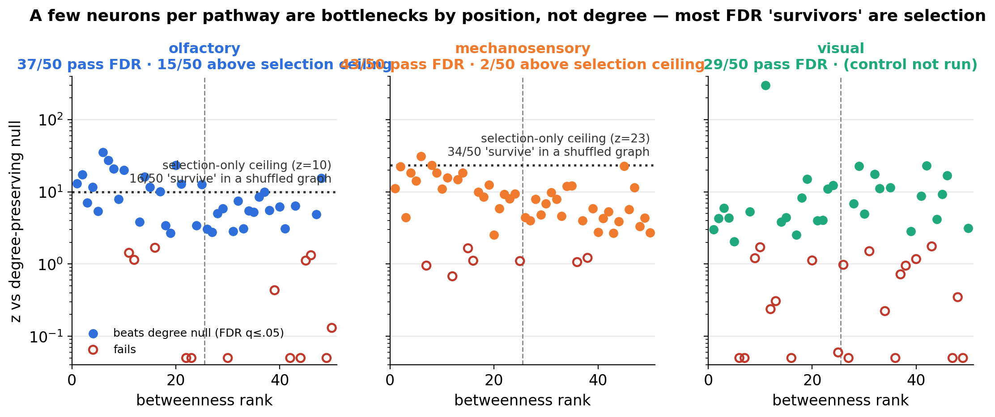
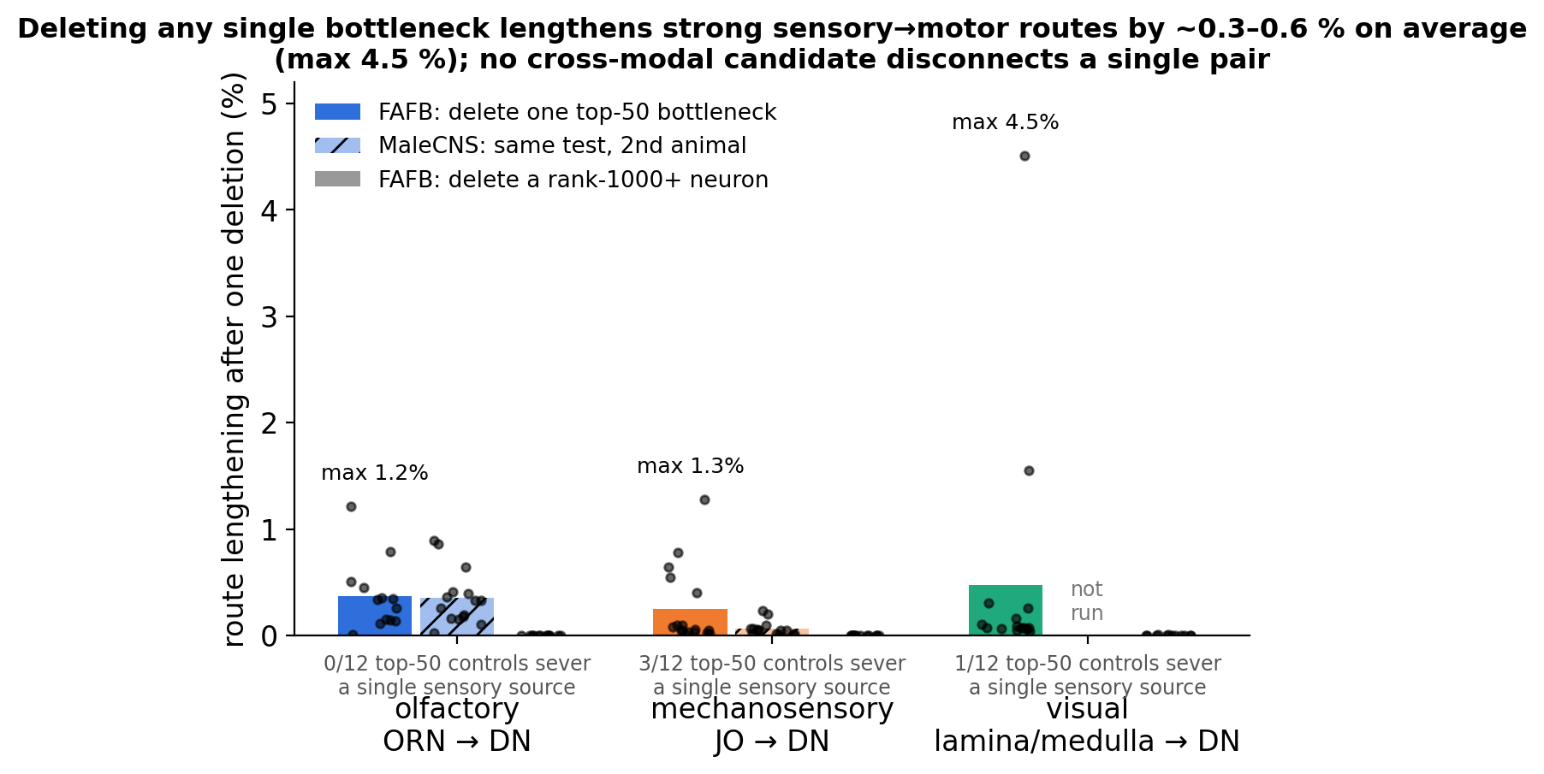
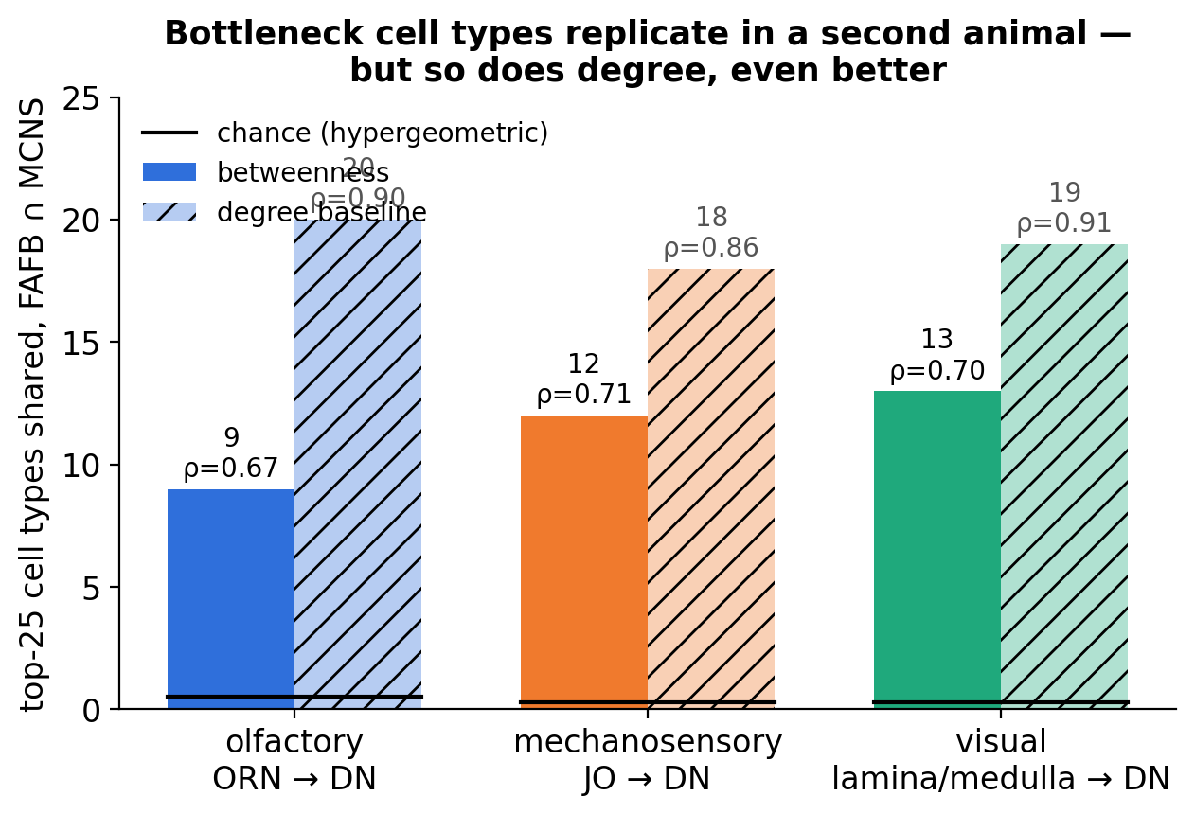
EVIDENCE
Positioned, replicated — but redundant
Dotted line = the best score pure selection can invent (whole test run on a structureless graph).
Only neurons above it are positioned beyond doubt: 15 olfactory · 2 mechanosensory.
Chokepoint neurons across sensory pathways · FlyWire FAFB v783 + MCNS v0.9
4 / 5

Slide 5
TAKEAWAY
Conserved chokepoints, no single point of failure
9 / 12 / 13
~0.5 %
6 / 200
top-25 cell types conserved across two connectomes (chance < 1)
route lengthening when any single chokepoint is deleted
top neurons shared between two senses; none across all three
“Critical” depends on the question. Traffic (betweenness) ≠ necessity (deletion) ≠ conserved identity (replication) — measured here, and they disagree.
Two self-corrections: the first “visual” pathway was really the ocellar reflex arc; a selection-bias control caught inflation in the degree null.
Next: population-level deletions — behaviourally essential cells (T4, Mi9) sit at rank ~1000 here, so necessity lives at the population level.
The fly brain's sensory-motor chokepoints are real, they're conserved across two connectomes — and you can cut any one of them without breaking anything.
Chokepoint neurons across sensory pathways · FlyWire FAFB v783 + MCNS v0.9
5 / 5

Slide 6
BACKUP
Pathway definitions and sizes
• Graph: Codex FAFB v783 connections, ≥5 synapses per pair → 134k neurons, 2.70M edges; MCNS v0.9 → 6.24M edges
• Targets: super_class ∈ {descending, motor}. Sources: olfactory = ORNs (1,765); mechanosensory = JO/mech afferents (1,675); visual = Lamina Monopolar + Tm + Mi families (17,004); ocellar = ocellar PRs (142)
• Subgraph ≤2 hops each side. Olf 8.7k/163k · Mech 13.6k/373k · Visual 60.5k/1.23M (sampled-source, 500 seeds) · Ocellar 386/2.1k
• Correction: original “visual” was 142 ocellar + 4 compound-eye PRs → renamed ocellar; spec-compliant visual rebuilt; MCNS visual replication withdrawn and redone like-for-like
• Ocellar alone: Null B 13/50 vs selection floor 2.8/50; OCG01 at z≈0 → degree-driven reflex arc, not positional
Backup B1
B1

Slide 7
BACKUP
Null B — degree-preserving null and its selection-bias control
• Directed double-edge swap, 5×|E| attempts, preserves in/out-degree and out-synapse total; 200 trials (olf/mech/ocellar), 30 (visual); BH-FDR on p_z
• FDR survivors (top-50 / top-25): olfactory 37/20 · mechanosensory 43/20 · visual 29/16 · ocellar 13/12
• Control: treat one shuffle as data, run the whole pipeline on it. False-positive floor: olf 16.0 ± 0.8, mech 34.0 ± 2.2, ocellar 2.8; max z from selection alone: 9.9 / 23.4 / 3.4
• Above the ceiling: olfactory 15/50 (MZ_lv2PN z=35, VES079 23, AL-AST1 21, lLN2T_c 17); mechanosensory 2/50 (DNge132 31, CB0021 23)
• Null A (weight permutation): real weights displace rankings more than permuted (z 2.6–4.5); fails in ocellar
Backup B2
B2

Slide 8
BACKUP
Deletion test, cell-type cohorts, and the cross-modal six
• Single deletion, 100 sources × all targets: top-50 mean detour 0.37 % (olf), 0.34 % (mech); rank-1000+ ≈ 0.000 %; MCNS 0.35 / 0.06 %; max single-neuron effect ≈ 4 %
• A few FAFB deletions sever whole sensory sources — peripheral single-gateway cells, FAFB-only (0/45 in MCNS)
• Whole cell types: nearly all superadditive but barely (median 1.02–1.14×); 14/75 beat matched random sets at z>2 (VA2_adPN 3.9×, z=+20)
• Cross-modal six: PVLP076, AVLP080 ×2, CB0677, PS124, CB0676. None in all three senses
Backup B3
B3

Slide 9
BACKUP
Metric dependence and ground truth
• Betweenness vs synapse-count top-50 overlap: olf 23/50, legacy-visual 26/50, mechanosensory 6/50 (chance ≈ 0.3) — mech is the pathway that needed the metric
• Flow metrics (Bates 2025 influence; probabilistic traversal) agree with each other (ρ 0.77–0.89), not with betweenness (ρ ≈ 0–0.3)
• Current-flow betweenness infeasible (>24 h on smallest graph) — reported as a negative feasibility result
• Literature screen: all *necessity* evidence (T4, Mi9 → motion-blind) is in the control arm; lLN2T_c silencing showed no odour-coding effect — consistent with the deletion result
Backup B4
B4

Slide 10
BACKUP
Replication detail (FAFB vs MaleCNS, 150 sampled sources, cell-type max)
• Olfactory 9/25 (exp 0.52, p 2e-10), ρ 0.67: lLN2T_c, v2LN30, il3LN6, MZ_lv2PN, AL-AST1, DM1_lPN …
• Mechanosensory 12/25 (exp 0.28), ρ 0.71: DNg62, DNge132, DNge027, DNg35, PS124, PVLP076 …
• Visual 13/25 (exp 0.27), ρ 0.70: Am1, H2, LPT26, LT62, LT79, PVLP011, PS124 …
• Degree baseline: 20/18/19 of 25, ρ ≈ 0.9 — the *pathway* is conserved, not extra betweenness information
• Only mechanosensory reaches VNC motor neurons within 2+2 hops in MCNS — justifies the descending endpoint
Backup B5
B5

