Slide 1
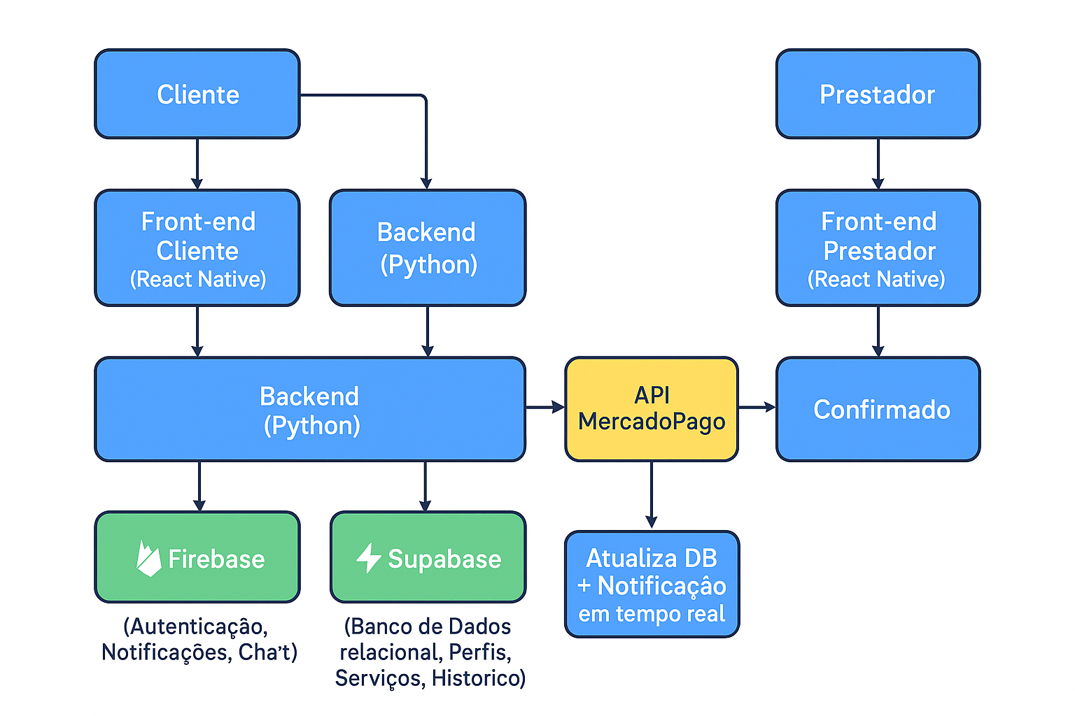

Slide 2

Usuário
Prestador
Front-end
React Native
Back-end
Python
Front-end
React Native
FAST API
Flask
FireBase
SupaBase
API Mercado Pago

