Slide 1
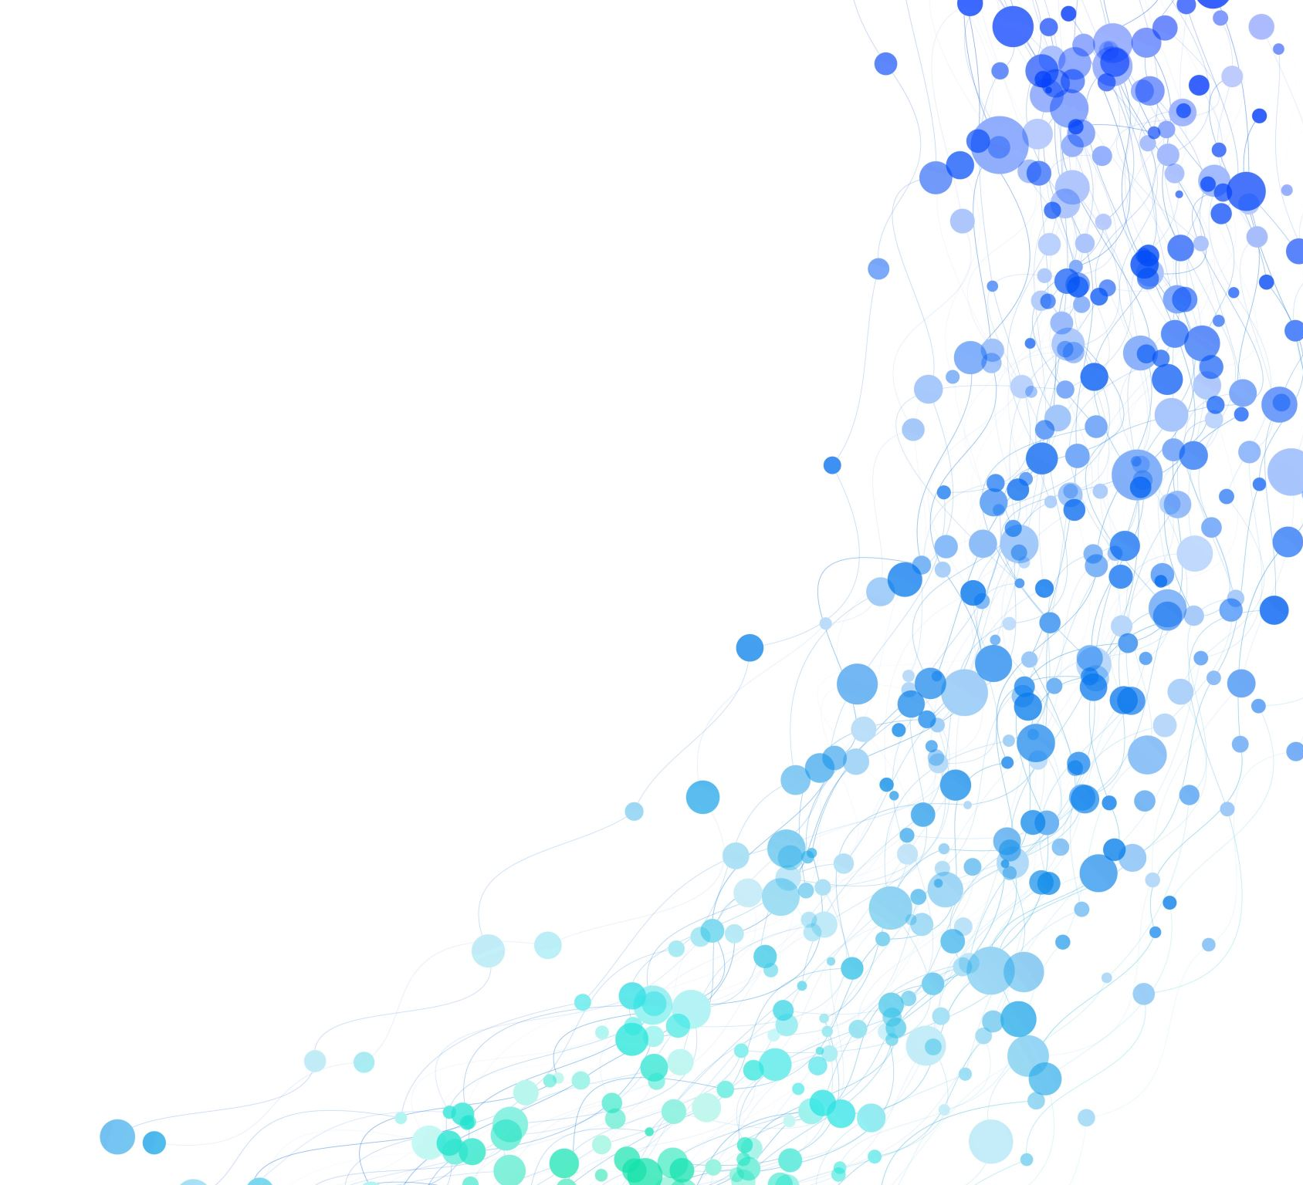
Deep Reinforcement Learning for mobile robot navigation
RBE595 Final Project – Varun gampa, rohin siddhartha

Slide 2

abstract
This project presents an approach for goal-driven exploration of unknown environments through deep reinforcement learning.
An optimal waypoint is selected from the Points of Interest (POI) for possible navigation directions.
Motion Policy for local navigation is learned through a Deep Reinforcement Learning framework in simulation.
Aims at fully autonomous navigation being performed without any prior knowledge while simultaneously the map is recorded as the robot moves through the environment.
The proposed method does not rely on a map or prior information in complex static as well as dynamic environments

Slide 3
introduction
Typically, in SLAM, a person operates a measuring device and the map is generated from the location and environment landmarks.
However, this introduces high cost of labor, physical constraints, environmental dangers etc.
Using Deep Reinforcement Learning, we can make precise decisions for autonomous agents.
Waypoints guide the DRL-based policy to the global goal, hence solving the local optimum problem.

Slide 4
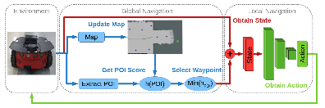
Method

Slide 5
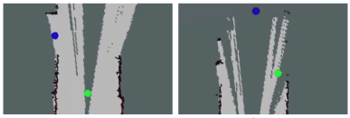
Global and local navigation
Global Navigation – Optimal Waypoint Selection from evaluation criteria.
Local Navigation – Using Deep Reinforcement Learning
Waypoint is given to Neural Network in polar coordinate format, action is calculated based on sensor data and executed towards waypoint.
Mapping is performed while moving towards waypoints towards the global goal.

Slide 6
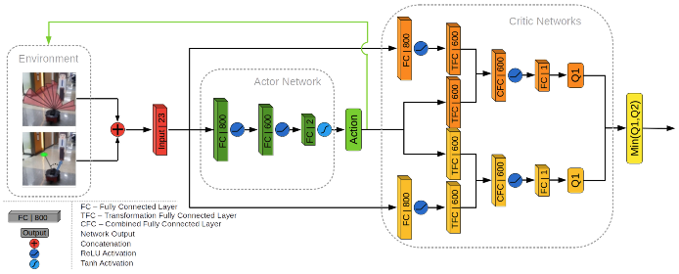
TD3 Network architecture

Slide 7
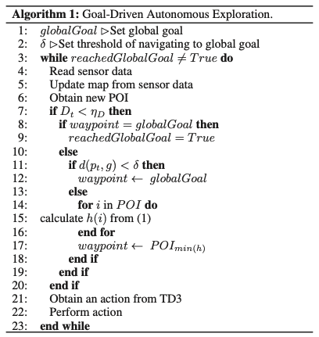
Goal driven autonomous exploration

Slide 8
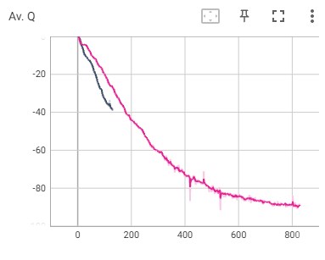
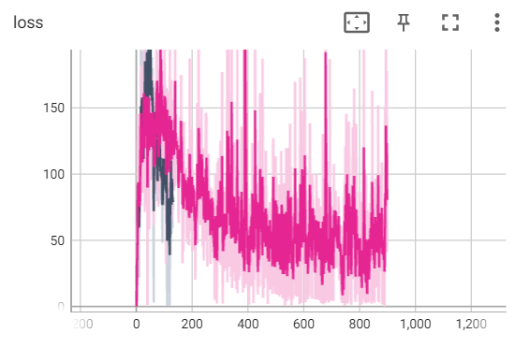
Results obtained

Slide 9
Project Working video

Slide 10
Conclusion and future works
This project aimed at introducing a goal driven autonomous exploration system for mobile robots.

