Slide 1

Inferring Cow Phenotypes Based on Sensor Data
Peter von Rohr and Jessica Gearning

Slide 2
Content
What are the data
What can we do with this data
Introduction to statistical learning (machine learning)
Everyday use cases of statistical learning
Statistical learning in agriculture
SESAM - second level algorithm
Conclusions

Slide 3
Data
Output of first level classification
For every cow over time the basic behavior
Basic behavior can be one of
Eating
Laying
Standing
Walking
Ruminating

Slide 4
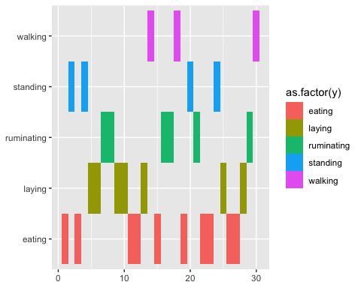
Basic Behavior over Time

Slide 5
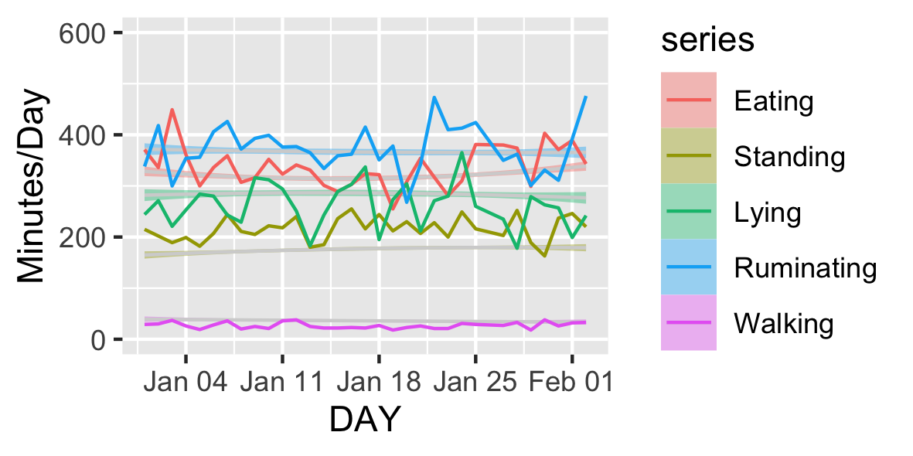
Data Aggregation Over Time
Summarize duration of behaviors over one day
Yields Average time for a certain behavior per day
Defines graphical representation of behavior pattern diagram

Slide 6
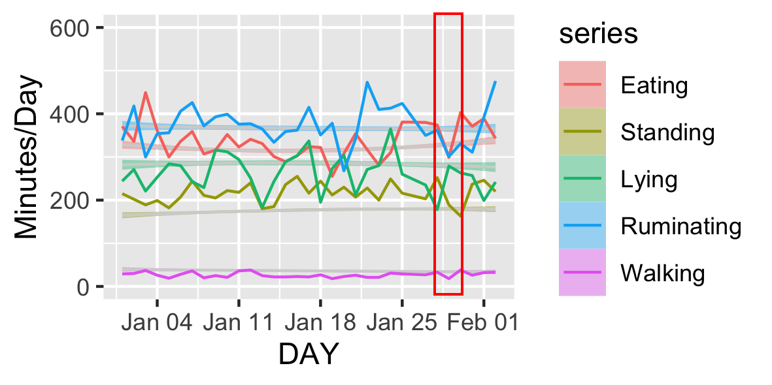
Overlay Phenotypes of Interest
Phenotypes of interest
Heat
Lameness
Calving
Mastitis
Ketosis
…
Pooled as events where farmer must be alerted
Overlay events in behavior pattern diagrams
Associate events with behavior pattern diagrams

Slide 7
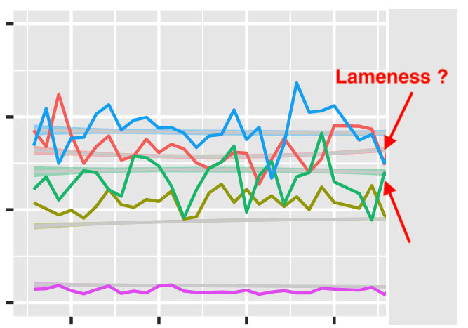
Aim: Prediction of Events
Given association of events and cow behavior
Aim: Predict future events based on cow behavior pattern
Solution
Understand combined data consisting of cow behavior and events as training dataset for a machine learning problem
Use statistical learning model to predict future events

Slide 8
Machine/Statistical Learning
Two categories that are important for us
Supervised
Unsupervised

Slide 9
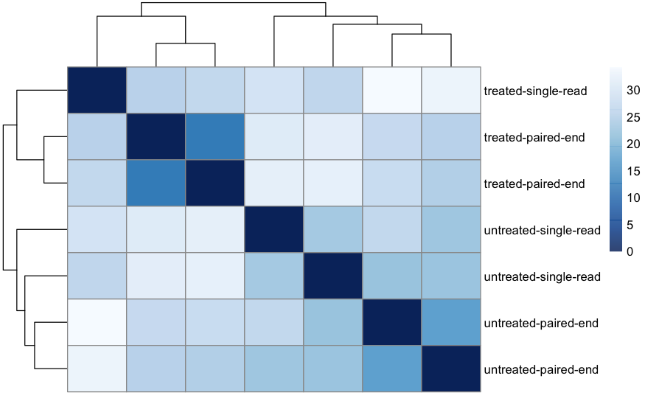
Unsupervised Learning
In unsupervised learning, data consists of a set of variables describing the objects / subjects of interest
Aim: Find relationships between variables
Methods used in unsupervised learning are
Principal Components Analysis (PCA)
Cluster analysis
Neural Networks

Slide 10
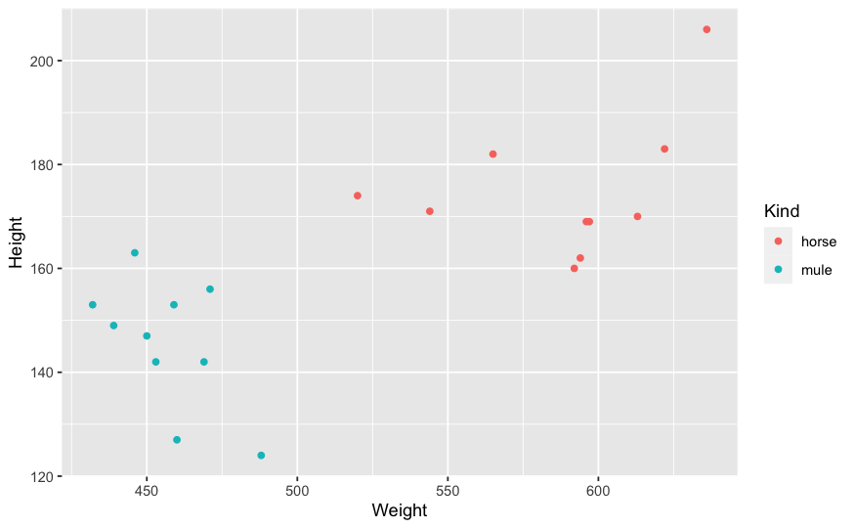
Supervised Learning
In supervised learning
statistical model is used to understand the relationship between a number of predictor variables (input) and a response variable (output)
statistical model can be used to predict future values of the response given new predictor variables
Methods are
Regression analysis
Linear Discriminant analysis
Tree-Based Methods (Random Forest, …)
Support Vector Machine (SVM)

Slide 11
Statistical Learning in Everyday Life
Face recognition based on pictures
Faces on pictures
Recognize persons according to their faces
Driving assistance system
Autonomous driving

Slide 12
Statistical Learning in Agriculture
Mobile applications for recognizing plants: e.g. PictureThis
Take a picture of a plant
App searches for name of plant
Weed recognition robots
Robot differentiates between weeds and crops
Weeds are removed

Slide 13
Second Level Algorithm in SESAM
Use overlay dataset of cow behavior and events as training sets to predict the relationship between behavior and the events
Given new behavior data of cows, new events can be predicted
Based on predicted events, alerts can be defined

Slide 14
Details of Second Level Algorithm
Take an event of interest (heat, calving, mastitis) on a given day
Separate the cows in two groups
cows for which event can be observed
cows for which event cannot be observed
Check differences between cows of two groups in behavior pattern
Ideally behavior patterns show differences between cows of two groups

Slide 15
Results of Second Level Algorithm
How can differences in behavior patterns be found in a systematic way
Use Support Vector Machine to find optimal border between behavior patterns of two groups
Use border to predict future occurrences of events based on observed behavior pattern

Slide 16
Conclusions
Start with prototype-system of inference of phenotypic events based on behavior data
Data quality and density of collected phenotypic events is critical
Time resolution for different events must be adjusted
Further research is needed to address open questions

Slide 17
Thank you
Questions ?

